Slide 1

Custly CRM
Calm CRM for SMEs with templates + privacy-first deployment.
Applicant: Johnson Gao
Company: Kainuo Innovision Tech Co., Limited
Program: HKSTP Ideation Application
Date: 2026-01-29

Slide 2
Project Summary
Custly is a calm, modern CRM for SMEs that centralizes customer data, manages deals and tasks, and offers industry templates with EN/简
体/繁體 support-enabling enabling privacy-first deployments and fast onboarding from lead to revenue.

Slide 3








The Problem & Market Need
Current Pain
Market Desire
Scattered Context:
Customer data is lost
Velocity:
Fast setup without long
across chat, email, and spreadsheets.
implementation cycles.
Barrier to Entry:
Traditional CRMs
ROI: Affordable pricing structures suited
for SMEs.
(Salesforce/HubSpot) are expensive, heavy,
and slow to adopt.
Localization Gap:
Local teams lack bilingual
Localization:
Native support for EN/简体
workflows and industry-specific presets.
|
繁體.
Data Sovereignty:
Privacy concerns limit
Flexibility:
Options for hosted or
the adoption of cloud-only SaaS solutions.
self-hosted data (privacy-first).

Slide 4




Solution Overview: The Core Workflow
Capture
Qualify
Convert
Retain
Leads
Import/Create
Notes + Activity
Deal Pipeline +
Follow-ups, Tags,
Reporting
Timeline
Task Management
Contacts
Template-first
Privacy-first Backend
Calm UI
Pre-built presets for
E-commerce and Counseling.
Built on PocketBase for data
security.
Designed for daily focus and
minimal noise.

Slide 5
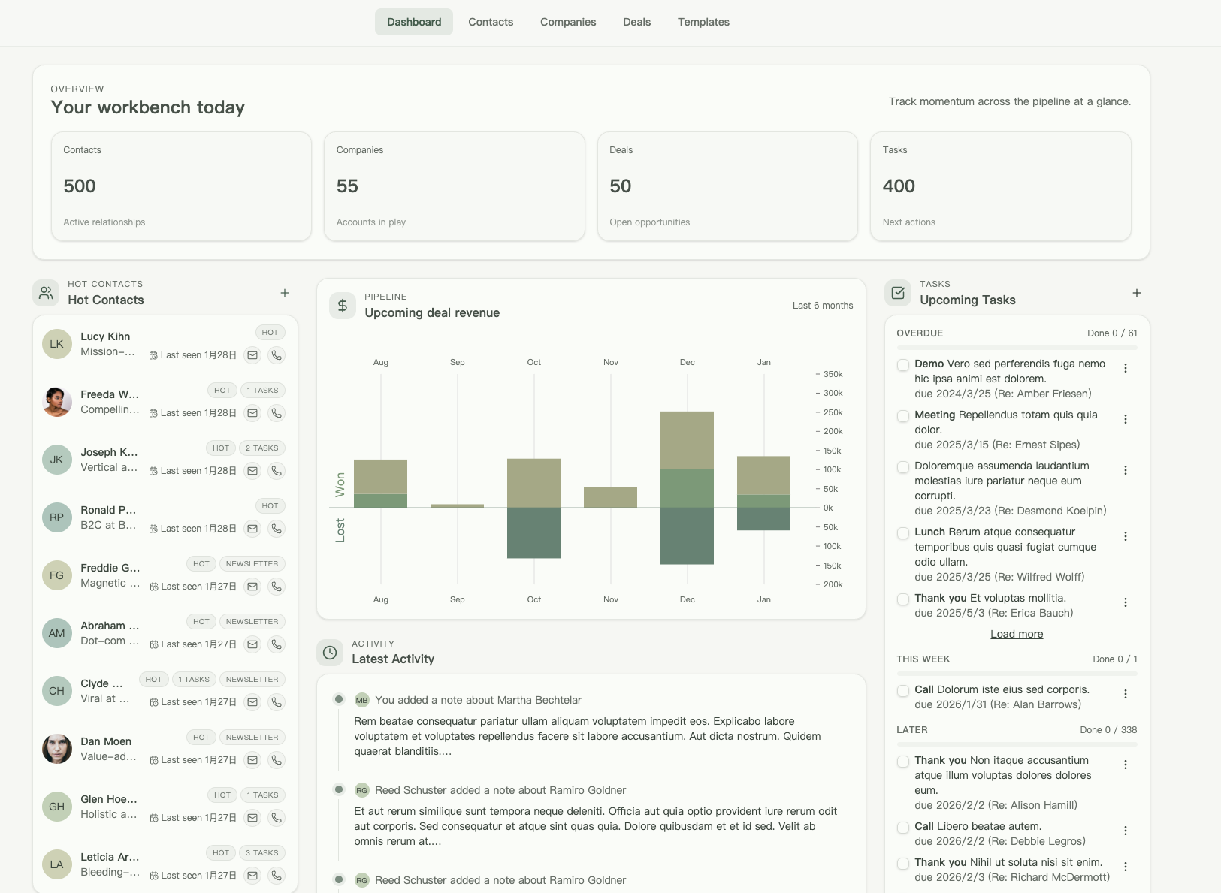
A Calm, Unified Workspace
Pipeline Snapshot
Hot Contacts
Task Management
Activity Feed

Slide 6

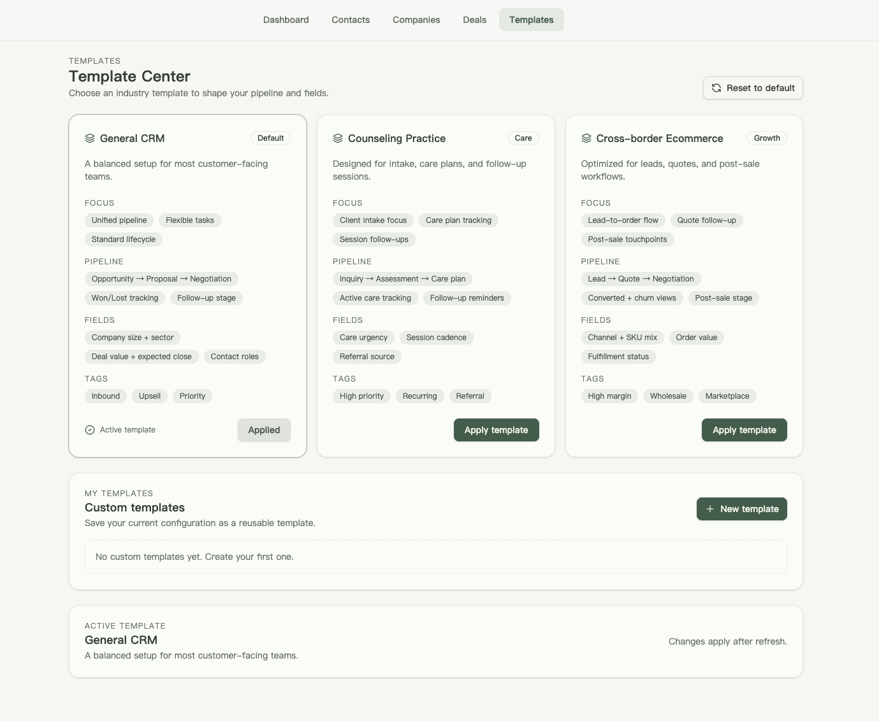
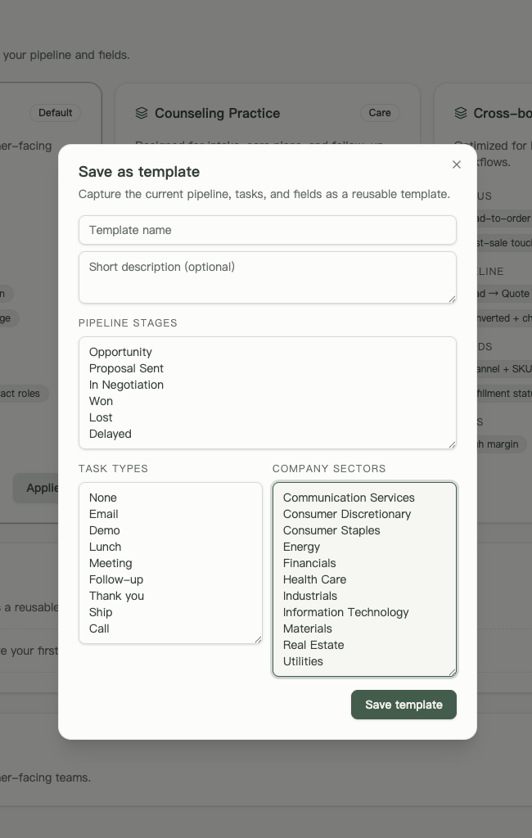
Innovation: The Template Center
Key Features
Industry Presets:
General CRM: Standard
lifecycle (Opportunity
Won).
Counseling Practice: Care-
focused (Inquiry
Assessment → Care plan).
Cross-border E-commerce:
Transactional (Lead Quote
Order).
Customization:
Users can save current configurations as reusable templates.
Reset Capability:
One-click reset to default industry standards.

Slide 7
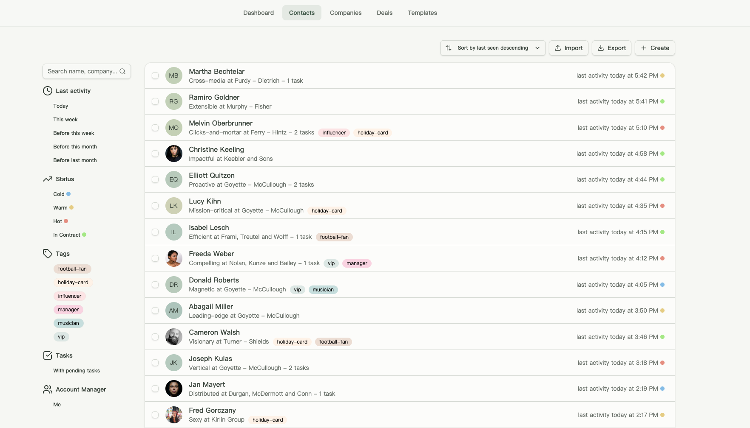
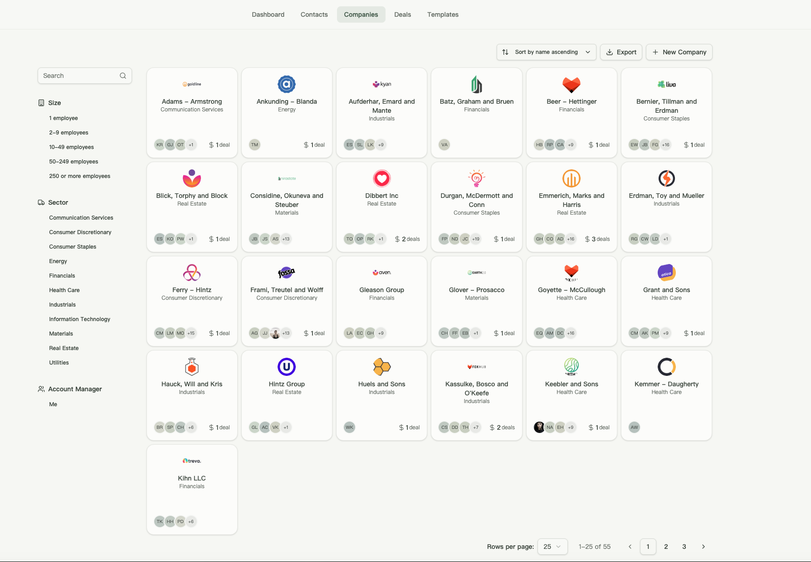
Core Product Modules & Technology
Feature Set
Data Management (Contacts, Deals Tasks),
Organization (Tags, Filters),
Security (OAuth, Password Reset).
Tech Stack
Backend: PocketBase (Golang) for performance/portability.
Frontend: Modern reactive web framework
Localization: Full EN/繁體/简体 support

Slide 8



Market Size & Opportunity
Target Market (Hong Kong)
Global CRM Market Size (USD Billions)
350k+ SMEs (98% of enterprises)
~1.2M jobs (43% of employment)
2024
101.4B
Global CRM Market Growth
2025
114.2B
CAGR:~12.6%(2024-2032)
2032 (Proj.)
262.7B

Slide 9




Target Customers & Use Cases
Paying Customers
End Users
Primary Use Cases
SMEs, Digital Agencies,
Private Clinics, Cross-border
E-commerce teams.
Founders, Sales Managers,
Account Executives,
Customer Support teams.
Client Onboarding & Intake
Deal Tracking & Pipeline
Management
Retention & Follow-up
scheduling

Slide 10


Competitive Positioning
High
Salesforce/HubSpot
Custly
Heavy & Costly
Fast onboarding +
Templates + Calm UX
Workflow Depth /Customization
Open Source
Zoho/Pipedrive
High Setup Effort
Weaker Templates
Ease of Setup / Onboarding
High

Slide 11





Business Model & Go-tO-Market Strategy
Freemium
Pro
Team
Enterprise
Limited seats +
demo data.
Full CRM +
Template Center.
Shared pipelines
+ Permissions.
Custom SLA/
On-premise.
Distribution Channels
Content SEO
Partnerships
(Incubators)
Outbound
(Agencies/Clinics)
PLG (Instant
(Template intent)
Demo Access)

Slide 12

R&D Progress & Technology Roadmap
Status: Delivered (Current State)
Roadmap: Next 12 Months
PocketBase collections &
Authentication flow complete.
Q1:
OAuth hardening, QA testing,
Performance optimization.
Template Center & Custom
Templates engine operational.
Q2:
Template Engine v2 + Sharing
capabilities.
Full multi-language coverage
(EN/简体/繁體).
Q3:
Al Suggestions (Pilot
implementation).
Landing page & Legal compliance
pages active.
Q4:
Audit logs + Advanced
Permissions system.

Slide 13

12-Month Execution Schedule
Phase
Business Dev
Finance
Technology
OAuth hardening, localization QA
Month 1-3
SME Validation
Grant setup
Month 4-6
Pilot customers
Pricing tests
Template v2, analytics
Month 7-9
Partnerships
Revenue tracking
Al pilot, automation
Month 10-12
Scale sales
Investor readiness
Enterprise features

Slide 14


Management & R&D Team
Johnson Gao
Founder
(Johnson Gao)
Founder
Technology
Business
Frontend Engineer
(Hire)
Business Development
Manager (Hire)
Founder, Kainuo Innovision Tech Co., Limited
Leading a Software & Website Development firm specializing in digital transformation solutions. Spearheading the R&D and commercialization of the flagship AI CRM product for local SMEs.
MSc Program & Project Management (University of Warwick)
Specialized in Agile Software Development, Product Management, and strategic delivery. Focused on rapid iteration and tech lifecycle management.
R&D Project Experience (COCHE - InnoHK Centre)
Former Project Assistant (AI Team) at the Centre for Cerebro-cardiovascular Health Engineering. Gained hands-on experience in AI project lifecycles, data compliance, and cross-functional team coordination within the HKSTP ecosystem.
Education (HKMU)
Business Management & Applied Psychology – Combining business strategy with user behavior insights to drive product-market fit.
Backend Engineer
(Hire)
Product/UX Designer
(Hire)

Slide 15
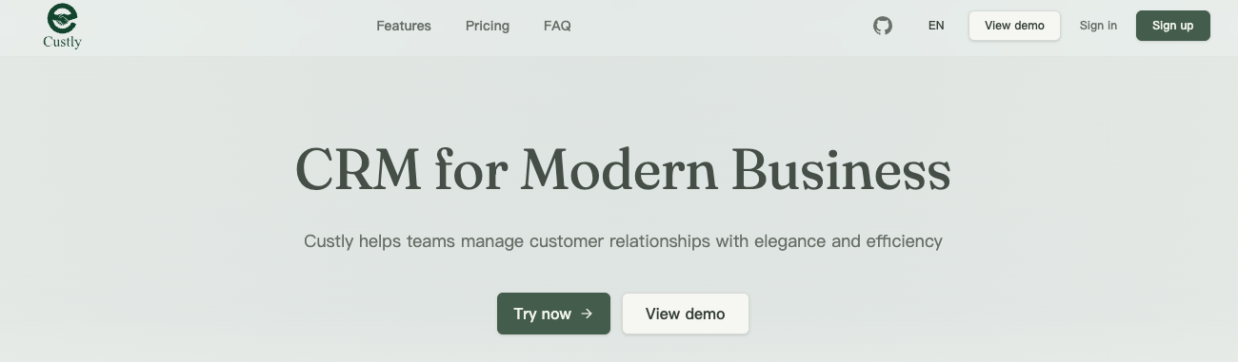
Conclusion & Compliance
Contact Us
Technical Architecture & Strategy
📧 Email: contact@kainuotech.com 📱 WhatsApp / Mobile: +852 9341 2653 🔗 LinkedIn: linkedin.com/company/kainuo-tech/ 🌐 Product Demo URL: www.custly-crm.kainuotech.com/demo
🏢 Company Website: www.kainuotech.com
Built on a robust Open-Source Foundation (MIT Licensed) to ensure core stability, while we focus 100% on Proprietary Localization & Vertical Features.
Use Custly to understand your customers better, so that you can grow your business faster!

