Slide 1


INFO6105 19024 Data Sci Eng Methods SEC 30 Fall 2024
Final Presentation
--Unsupervised Learning for Diabetes and Marketing Campaign Success Analysis
By Chi-Yao Hsiao

Slide 2
CONTENTS
Introduction
Data Preprocessing
Feature Engineering
Model Training
Evaluation and Results

Slide 3
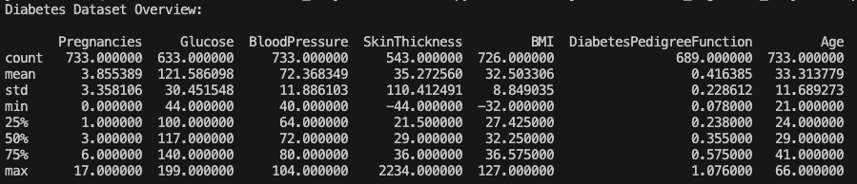
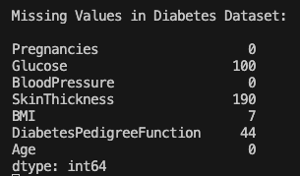
Introduction
----Dataset Overview

Slide 4
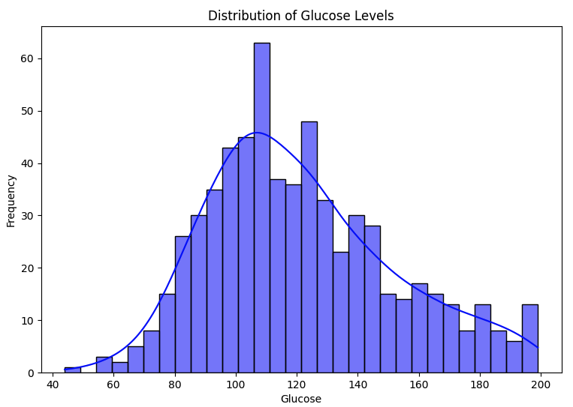
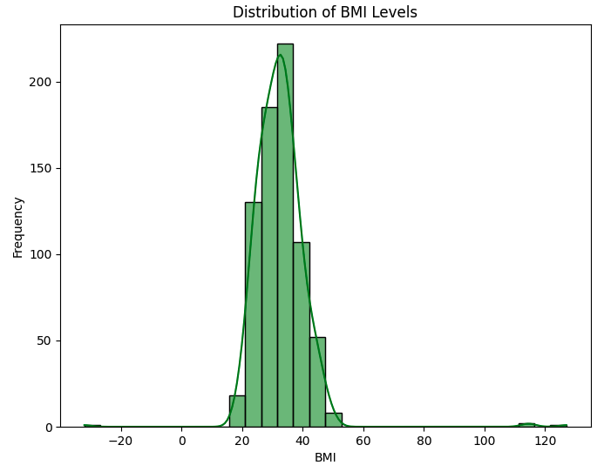
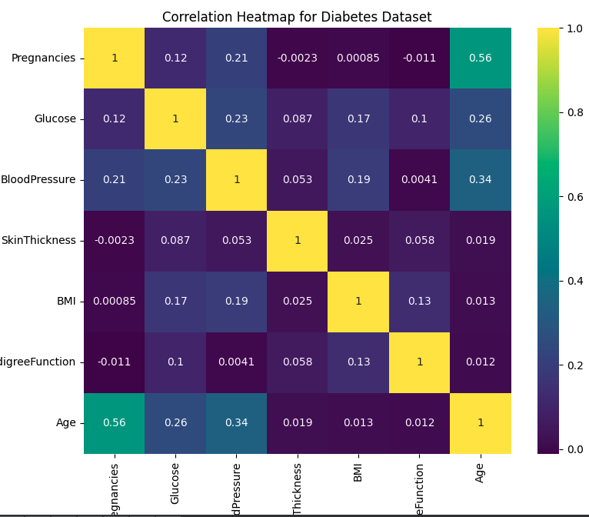
Introduction
----Dataset Overview
Glucose and BMI levels show significant variance.
The correlation heatmap reveals that Glucose and BMI have a positive correlation with the Outcome.

Slide 5
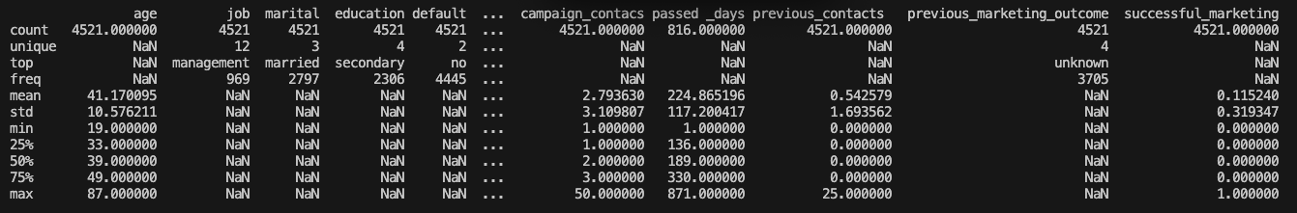
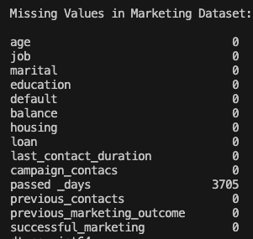
Introduction
----Dataset Overview

Slide 6
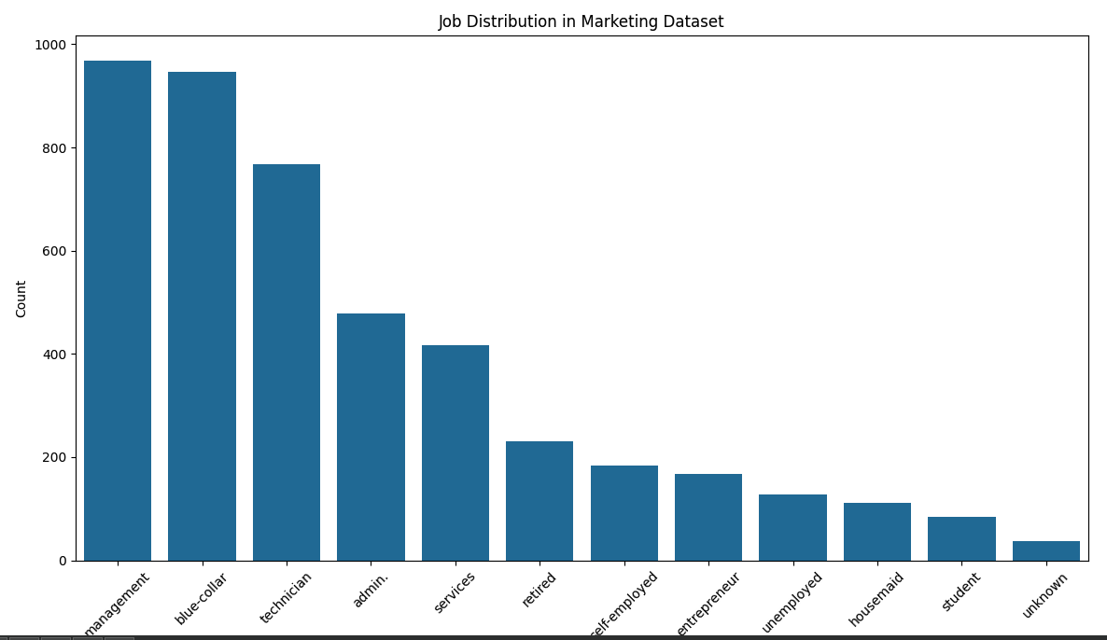
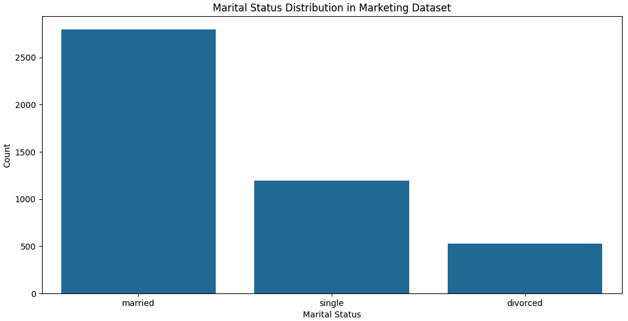
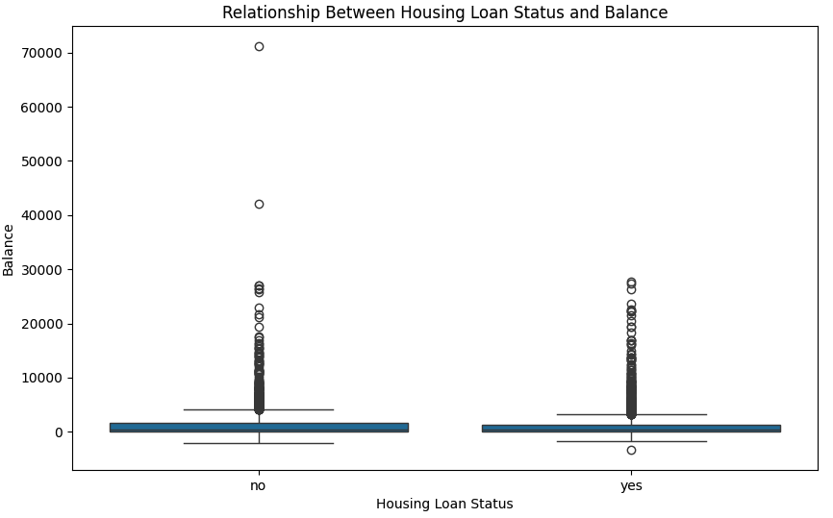
Introduction
----Dataset Overview
Certain jobs (e.g., management) are overrepresented. Housing loan status seems to be linked with balance levels.

Slide 7
Data Preprocessing
1. Removing the outiers with Interquartile Range method
2. impute missing values using SimpleImputer sklearn package
3. Normalize all columns using MinMaxScaler
4. Handling categorical variables using OneHotEncoder
Data preprocessing is essential to ensure that the dataset is clean, consistent, and suitable for modeling, which ultimately leads to more accurate and reliable predictions.

Slide 8
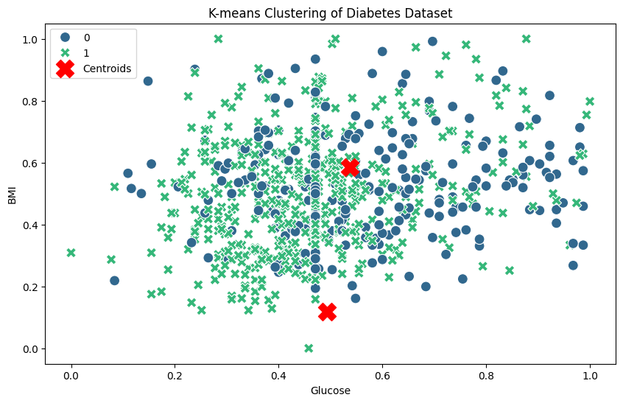
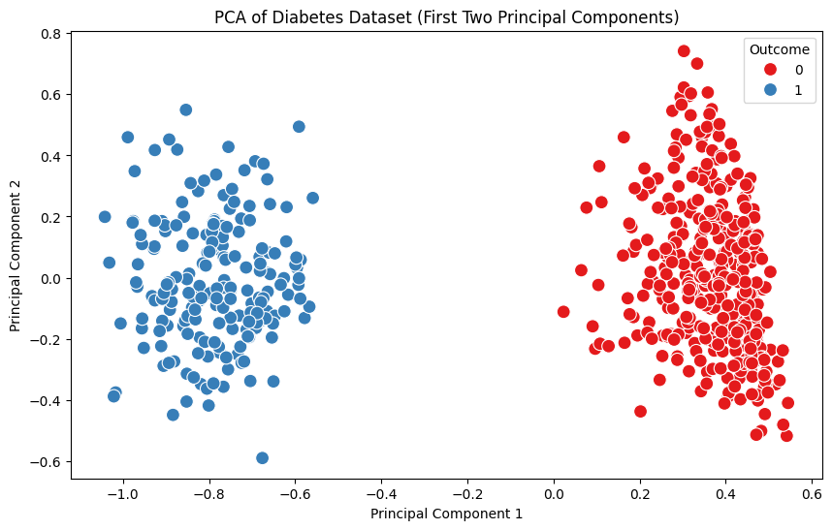
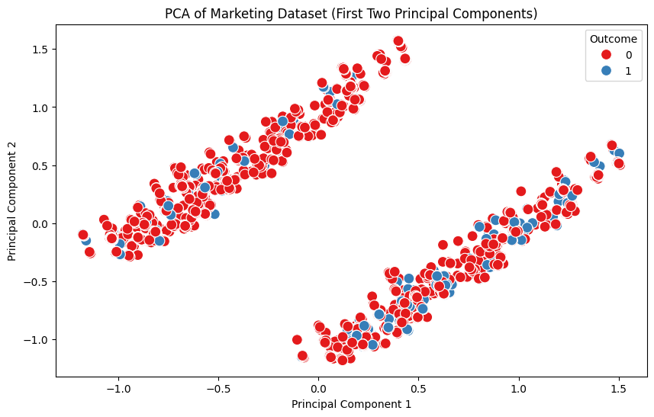
Feature Engineering
1. Kmeans for clustering the outcome prediciton
2. Apply PCA on the training data to create new components
PCA is not well-suited for this marketing dataset because it cannot capture the complex non-linear relationships and categorical interactions effectively, leading to poor separation between classes.

Slide 9
Model Training
1. Classification using a super learner: Naïve Bayes, Neural Network, and KNN
2. Train meta learner on outputs of three base classifiers using 5-fold CV.
3. Find hyperparameters for all these models which provide the best accuracy rate
Best Hyperparameters: {'final_estimator__criterion': 'gini', 'final_estimator__max_depth': 3, 'final_estimator__min_samples_leaf': 1, 'final_estimator__min_samples_split': 2} Test Accuracy: 0.8979591836734694
Best Hyperparameters:
{'final_estimator__criterion': 'gini', 'final_estimator__max_depth': 3, 'final_estimator__min_samples_leaf': 1, 'final_estimator__min_samples_split': 20}
Test Accuracy: 0.8773480662983425

Slide 10
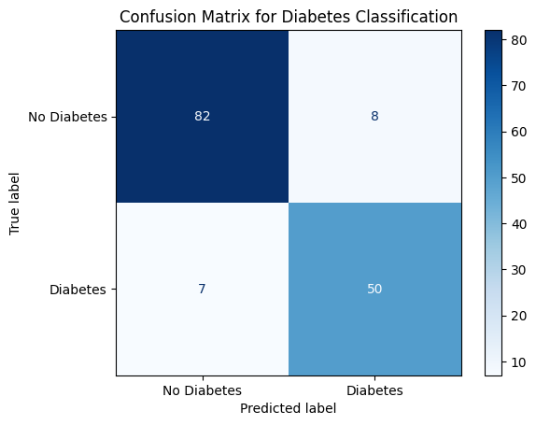
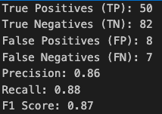
Evaluation and Results
In this scenario, the model is performing well!!!
It correctly identifies most of the positive diabetes cases (high recall) and has a low rate of false positives (high precision).
Depending on the problem, we can decide whether it's more important to avoid false negatives (missing diabetes cases) or false positives (misclassifying non-diabetic patients). This analysis could guide further improvements to the model.

Slide 11
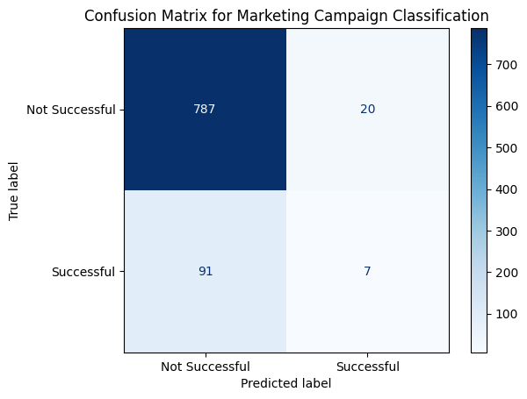
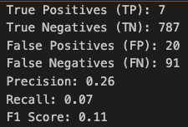
Evaluation and Results
Despite the high overall accuracy (87.73%), the confusion matrix reveals significant imbalances in the model's performance.
Specifically, the model has a very low recall (0.07) and precision is also low (0.26), this might suggests that this kind of model might be biased towards predicting unsuccessful campaigns due to the class imbalance.
Possible to-do: resampling (rebalance the data), modifying the decision threshold, or using different evaluation metrics

Slide 12
THANKS
Chi-Yao Hsiao

