Slide 1
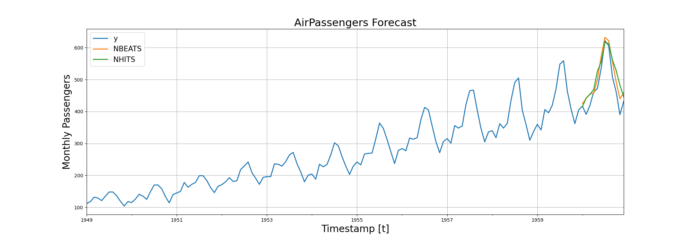

Slide 2
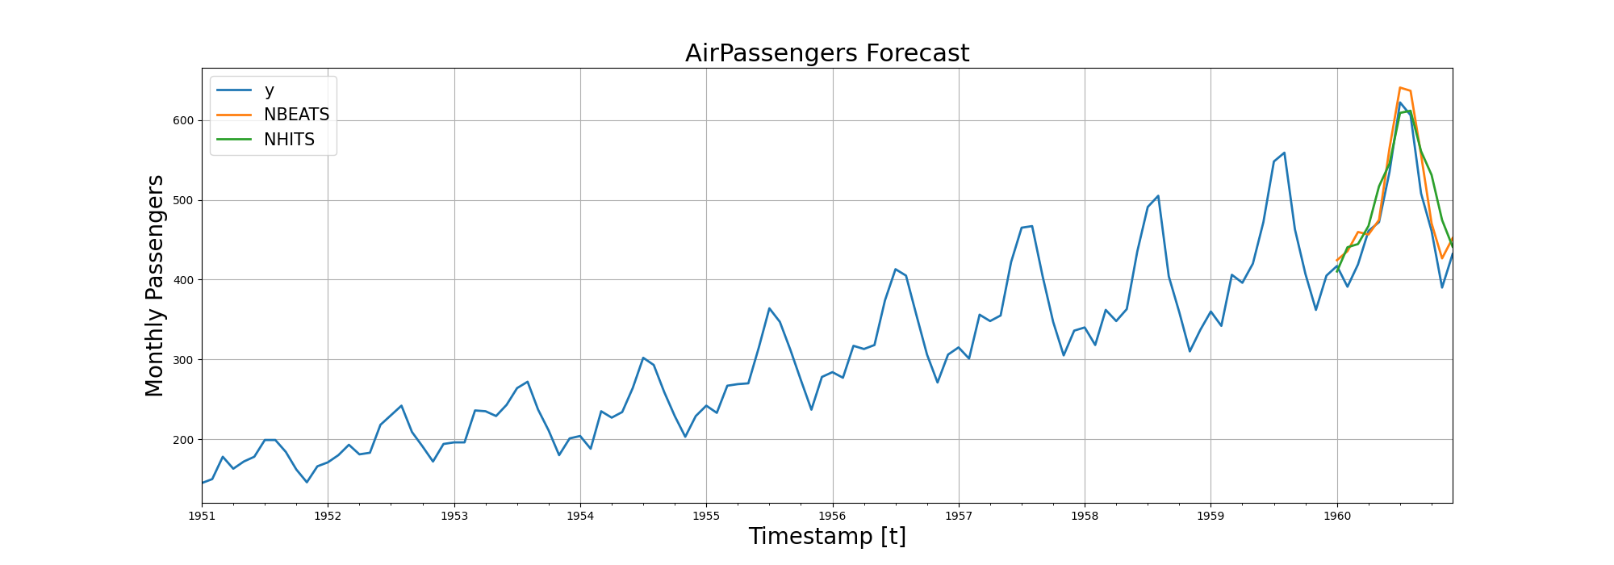
N-BEATS RMSE: 28.960128784179688
N-HITS RMSE: 41.29133224487305

Slide 3
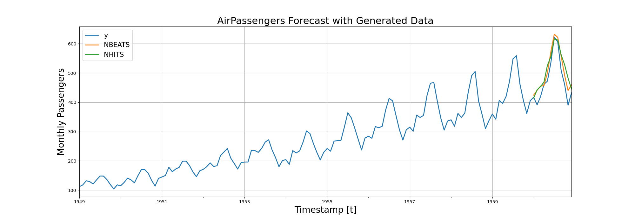
N-BEATS RMSE: 32.769859313964844
N-HITS RMSE: 44.134361267089844

Slide 4

N-BEATS RMSE: 32.67506790161133
N-HITS RMSE: 46.136436462402344

Slide 5

N-BEATS RMSE: 31.229761123657227
N-HITS RMSE: 45.31382369995117

Slide 6
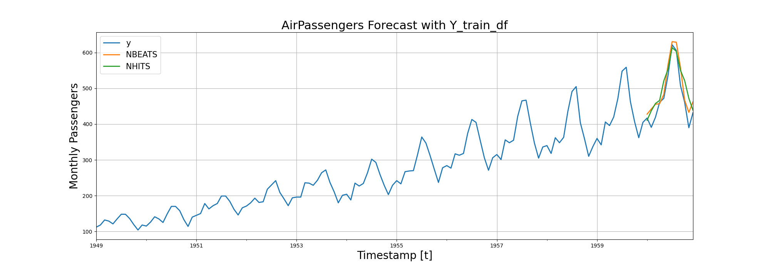
N-BEATS RMSE: 30.31711769104004
N-HITS RMSE: 39.560123443603516

Slide 7
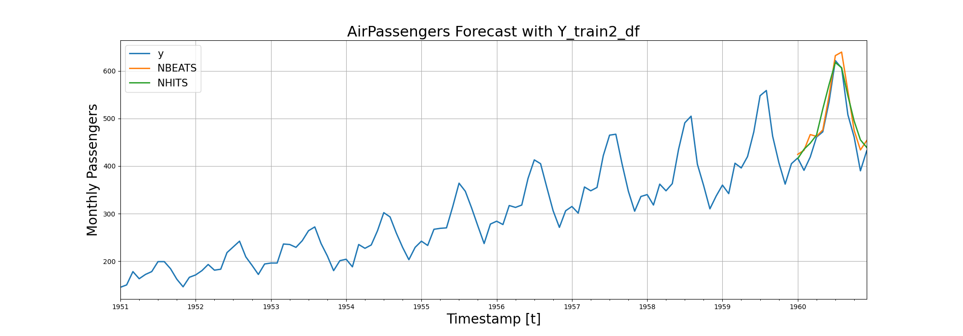
N-BEATS RMSE: 29.680870056152344
N-HITS RMSE: 33.61145782470703

Slide 8

N-BEATS RMSE: 30.444734573364258
N-HITS RMSE: 44.447471618652344

Slide 9
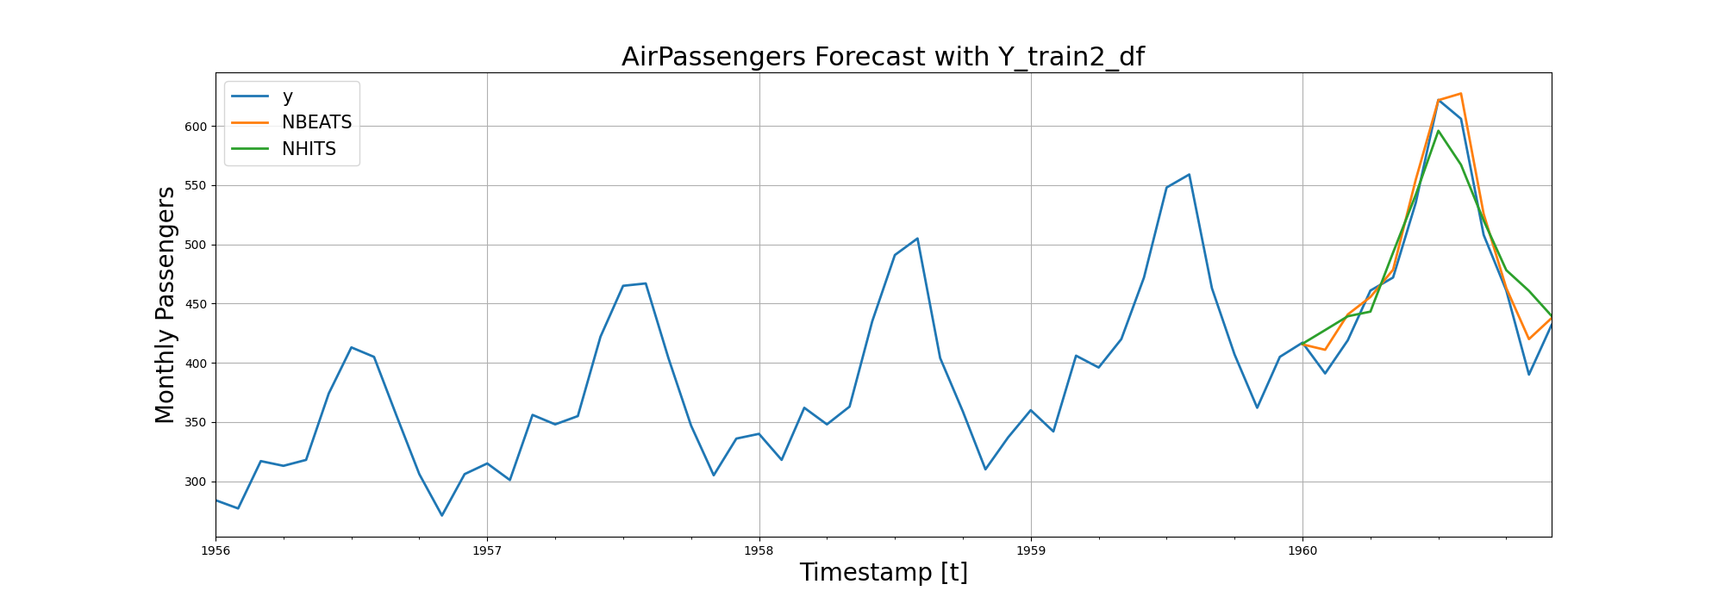
N-BEATS RMSE: 15.909482955932617
N-HITS RMSE: 29.225482940673828

Slide 10
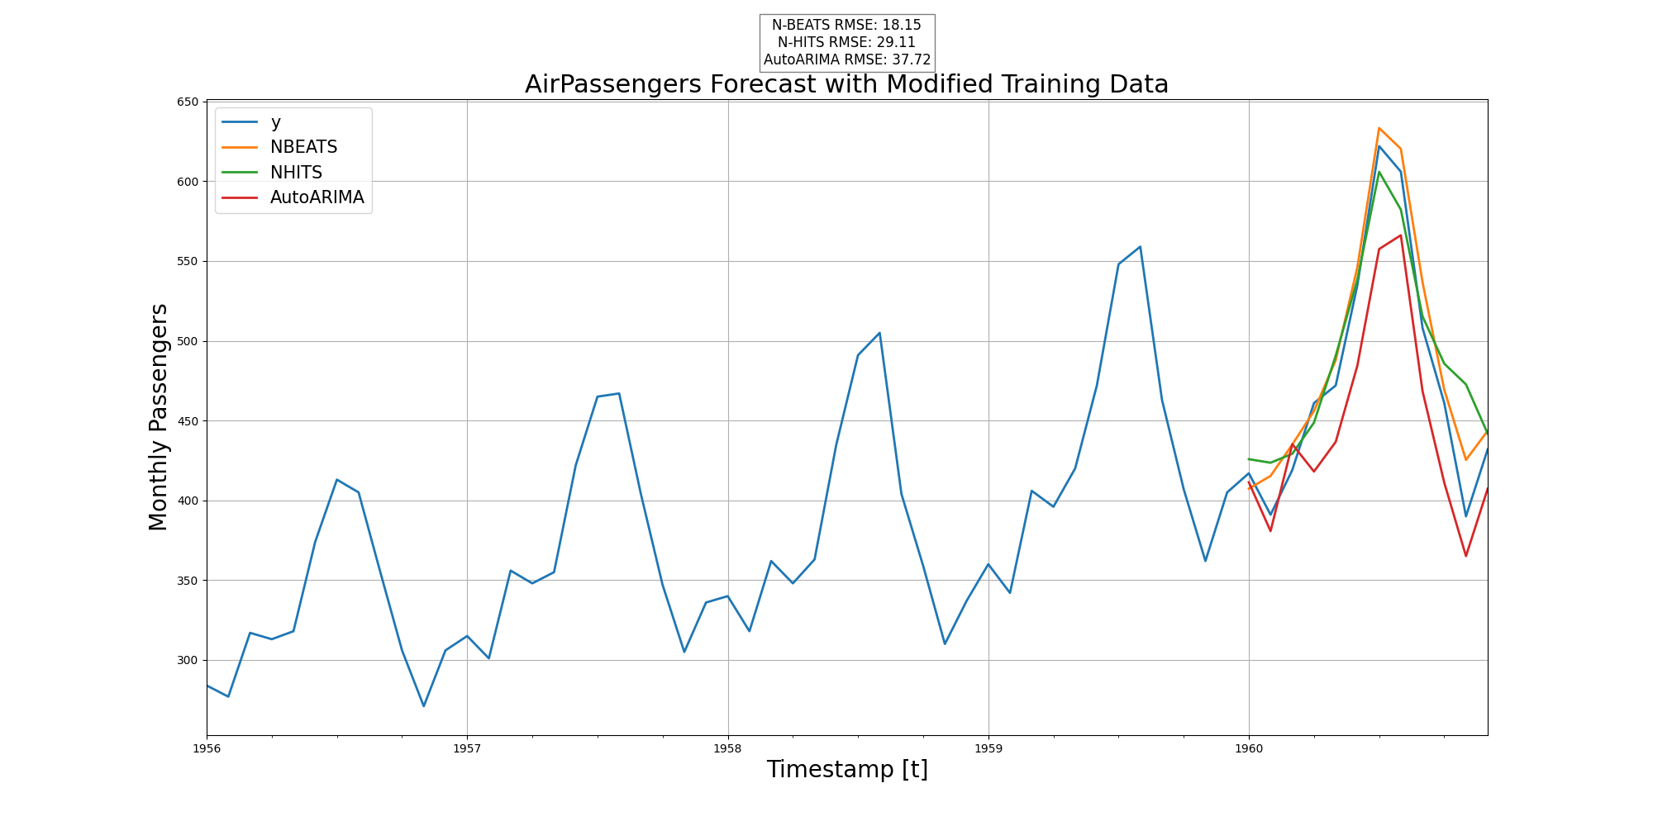

Slide 11
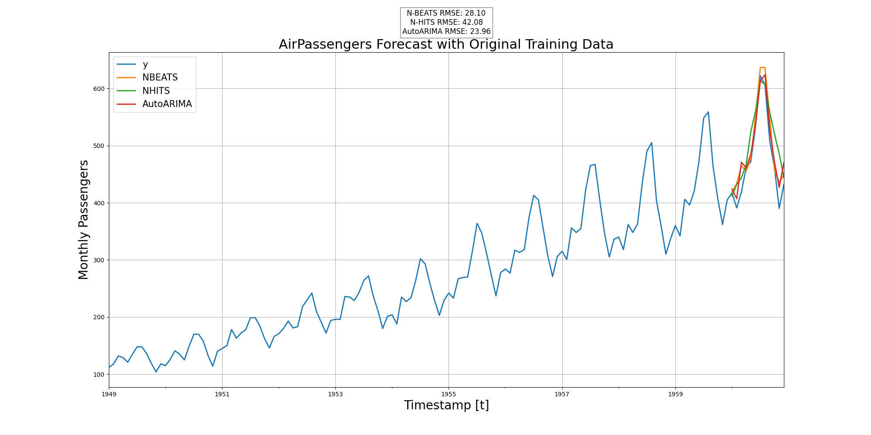

Slide 12
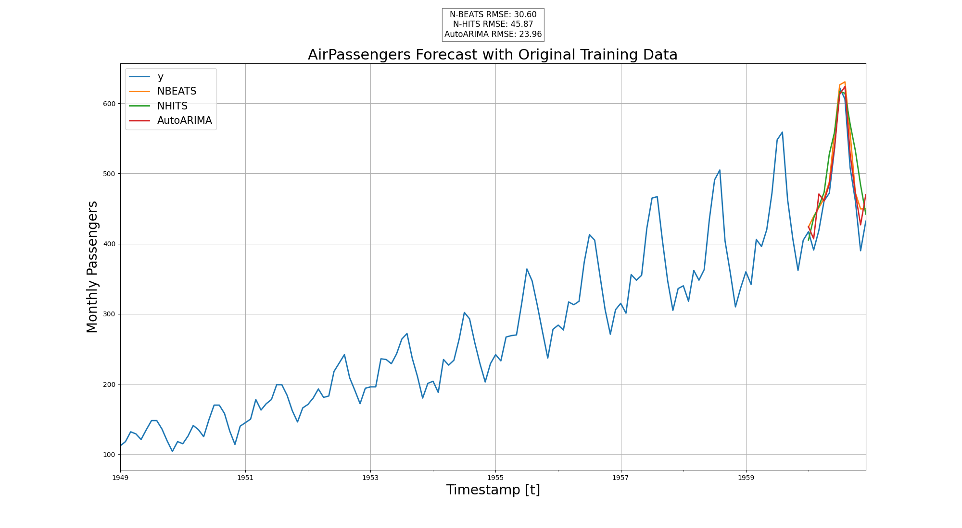

Slide 13
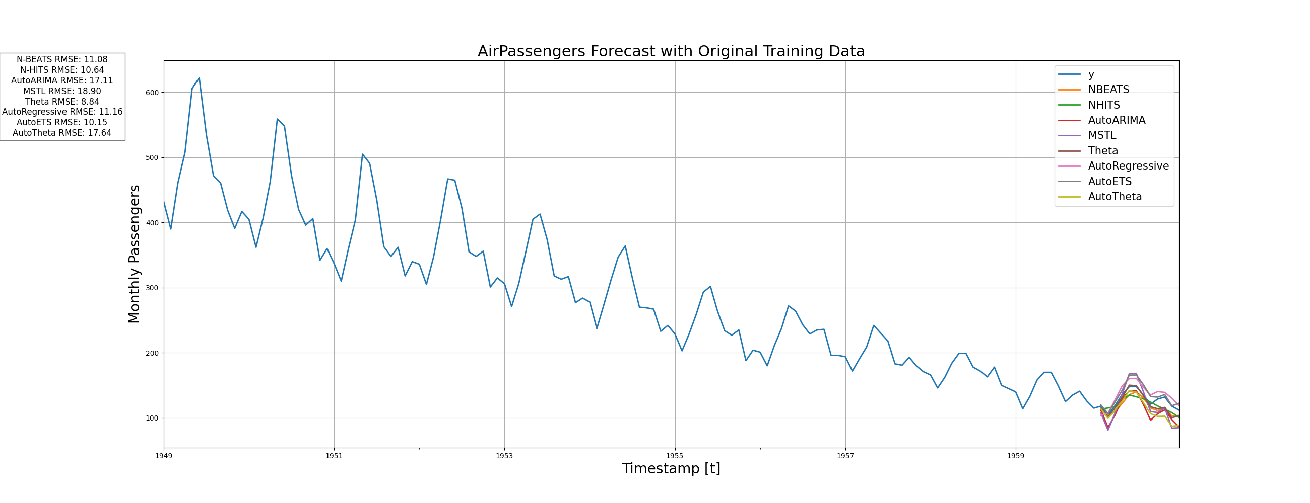
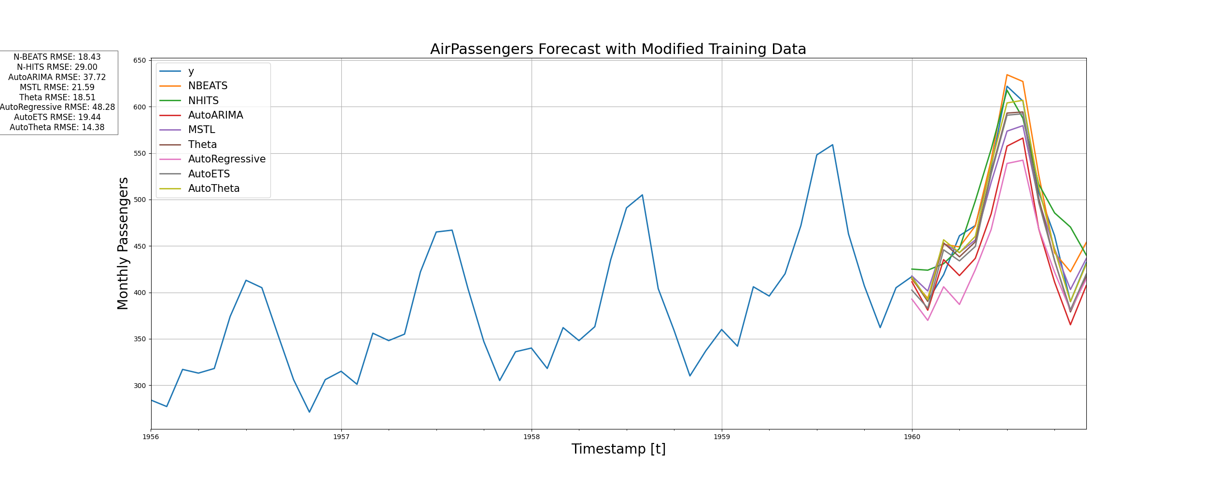

Slide 14
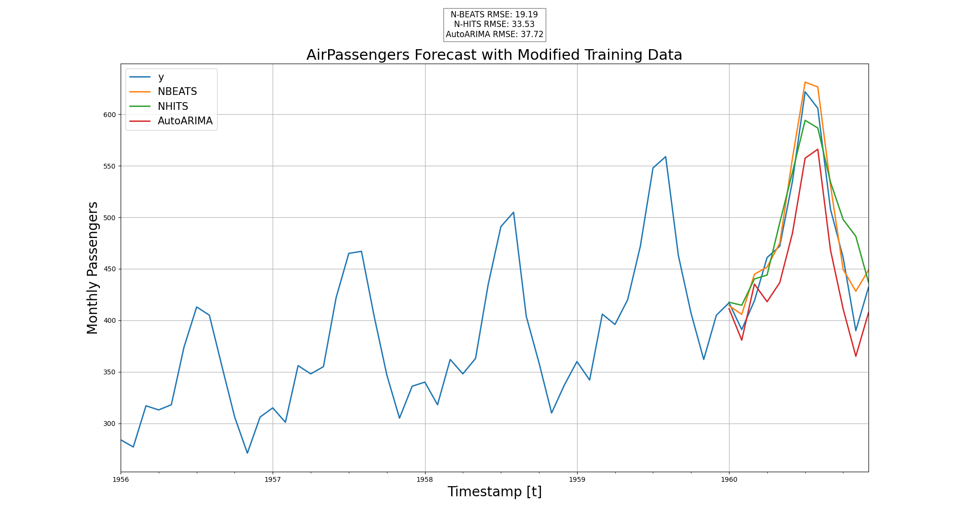

Slide 15
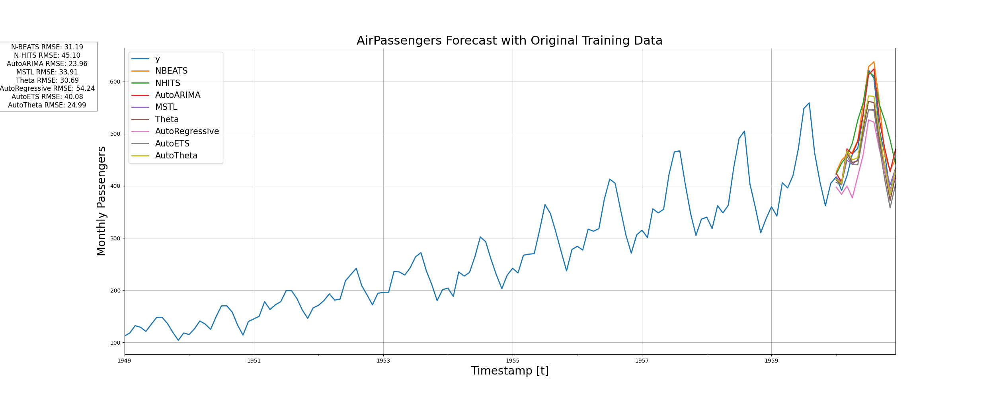

Slide 16
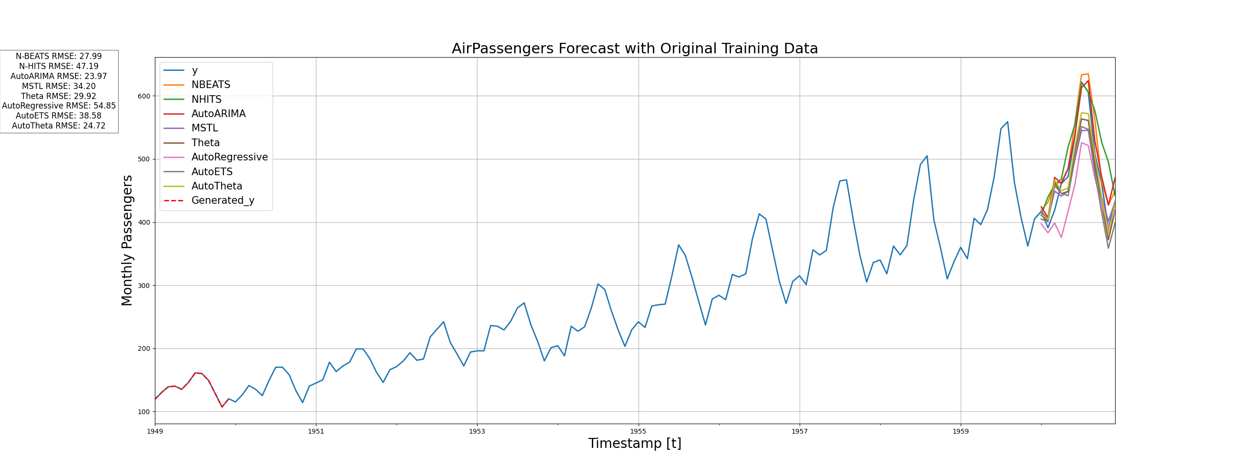

Slide 17
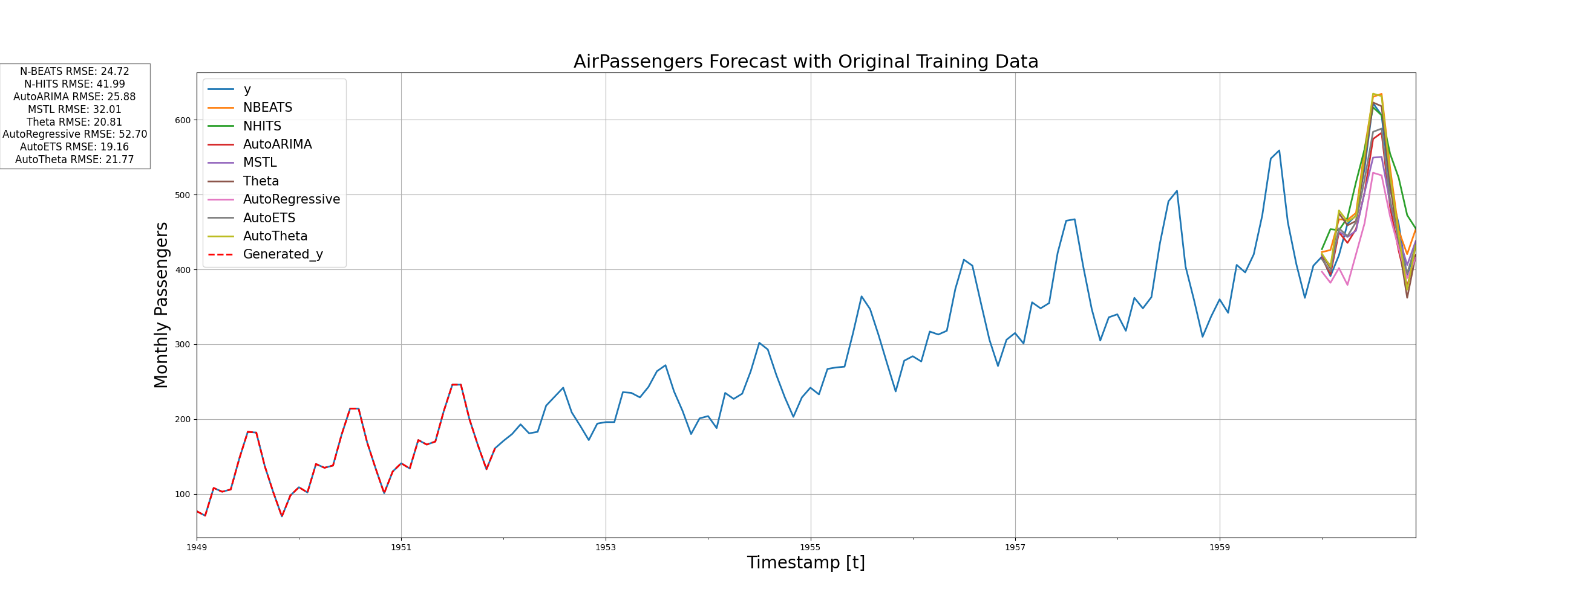
GPT 3.5

Slide 18
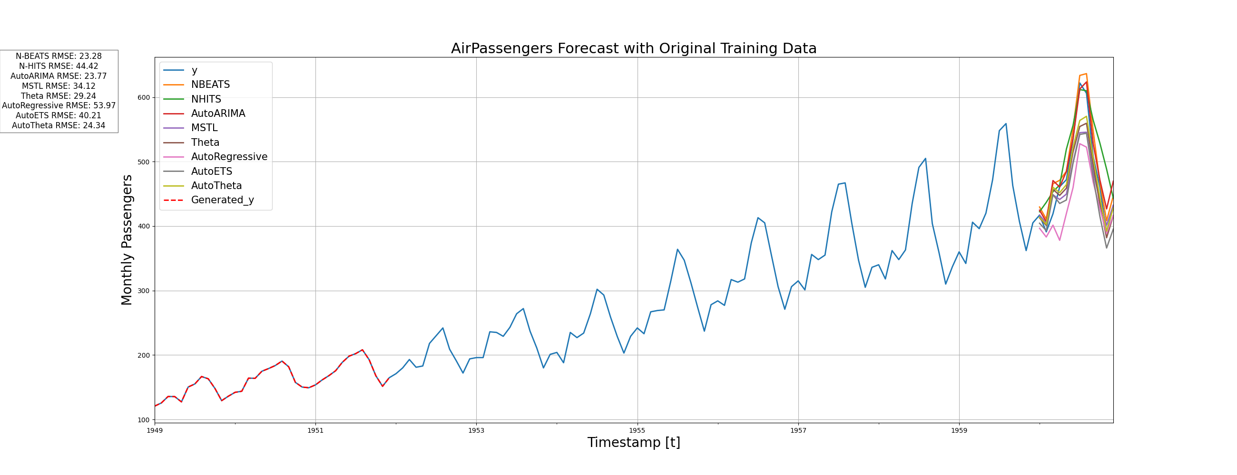
GPT 4 - 0125

Slide 19
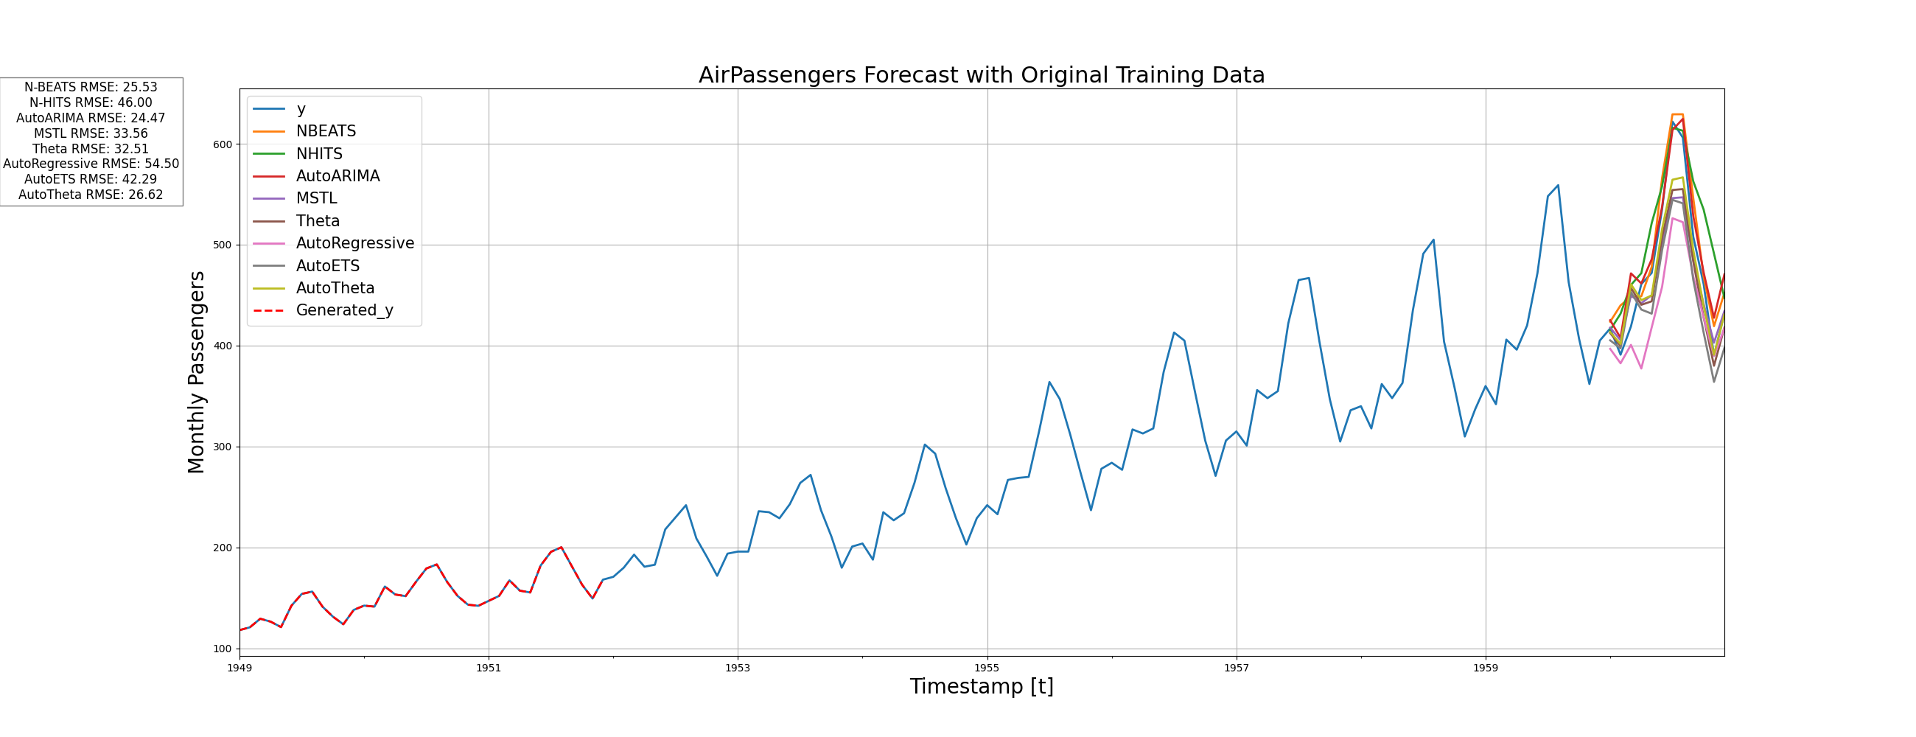
GPT 4 - 0125

Slide 20
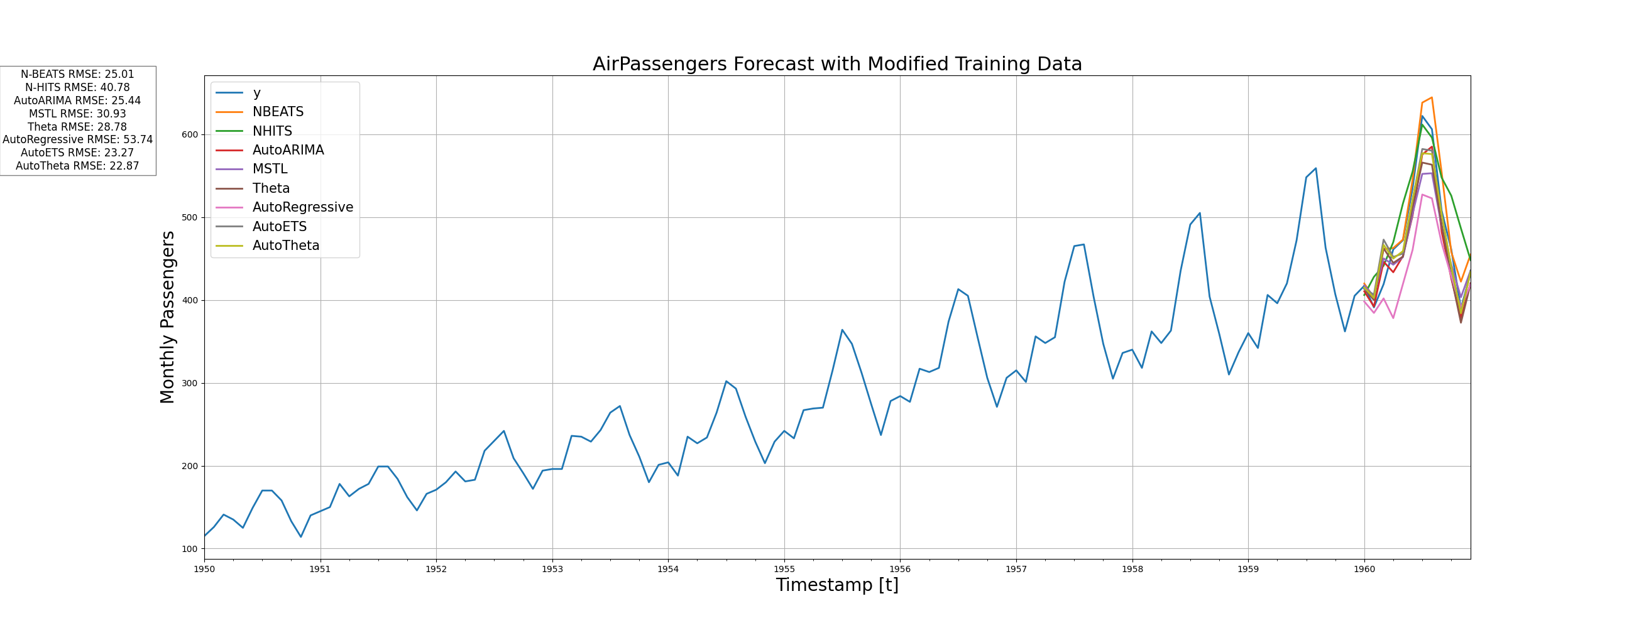

Slide 21
