Slide 1
Customer Churn Early-Warning Dashboard
26.5%
of customers churned
Predict who will leave, explain why, and tell the agent what to say
BA6003 Database & Programming | Final Project
Notes:
Open with the problem: more than a quarter of the customers in this telecom dataset churned. Our product warns the retention team before that happens, explains why each customer is at risk, and drafts a verified call script. The workflow follows the brief: data, SQL database, Python, dashboard, business insight, with a GenAI feature on top.

Slide 2



Customers leave before we can react
7,043
26.5%
USD 139k
customers analysed
churned (1,869 customers)
monthly revenue lost to churn
Today the team reacts after the cancellation. Replacing a lost customer costs more than keeping one, so the value lies in warning early and knowing what to say.
Notes:
Data: Telco Customer Churn, 7,043 customers. 1,869 churned, which is 26.5%, and together they paid USD 139,131 a month. The business problem is that the company can only react after the fact.

Slide 3



Built for the retention team
Who uses it
Decision it supports
What they get
Customer-success teams
Call-centre agents
Marketing staff
Who to contact this week
With which approved offer
Whether the campaign pays back
Ranked call list with reasons
A verified, editable call script
An ROI simulator
Use case from the brief: Churn Risk - which groups have higher cancellation risk?
Notes:
Target users are customer-success teams, call-centre agents and marketing staff. The decision: who to contact, with what offer, and whether it pays back. We use telecom data as the proof case; a bank or insurer with contract, tenure and payment data would follow the same workflow but needs its own calibration.

Slide 4





From data to retention action in five steps
Step 1
Step 2
Step 3
Step 4
Step 5
Data
SQL
Python
Dashboard
GenAI
Telco CSV: 7,043 customers, 21 fields
4 tables + 1 view, 11 queries, constraints
Churn model, risk tiers, plain-language reasons
Streamlit: filters, call list, ROI simulator
Call scripts, checked by rules before use
Insight: contract type, tenure and payment friction drive churn. Every step is tested, and AI output is verified before an agent sees it.
Notes:
This is the required stack: SQL tables, queries, joins and aggregations in the back end; Python for wrangling and the model; a Streamlit dashboard as the front end; a GenAI feature that helps the user decide; and a GitHub-ready repository with a README. One command, run_pipeline.py, rebuilds everything.

Slide 5
A clean, constrained SQL database
Data checks before loading
customers
services
demographics, tenure, churn label
phone, internet and six add-ons
11 blank TotalCharges, all new customers (tenure 0): stored as NULL, not guessed
No duplicate customer IDs
Every table reconciles to 7,043 rows
CHECK, key and index constraints on every table
billing
churn_scores
contract, payment method, charges
model probability, tier, reasons
SQL skills shown
JOIN, WHERE, GROUP BY, HAVING, CASE, CTE and RANK() window function
View v_customer_360 joins all four tables for every query and the dashboard.
Notes:
The schema separates who the customer is, what they subscribe to, how they pay, and the model's scores. The 11 blank TotalCharges values are all new customers who have not been billed yet, so they are NULL rather than zero or an average. The ETL asserts that each table holds exactly 7,043 rows. The eleven named queries cover joins, filters, group-bys, HAVING, a CTE and a window function.

Slide 6
Contract type is the biggest churn lever
88.6%
of all churners are on month-to-month contracts (1,655 of 1,869)
47.4%
churn in the first 12 months, against 9.5% after 48 months
Churn rate by contract type
Notes:
Month-to-month customers churn at 42.7%, one-year at 11.3%, two-year at 2.8%. This comes from the churn_by_contract query. Risk is also front-loaded: 47.4% churn in the first year of tenure.

Slide 7
The riskiest segment: monthly fiber customers in year one
 | 0-12 months | 13-24 months | 25-48 months | 49+ months
Month-to-month | 51.4% n=1,994 | 37.7% n=737 | 32.9% n=802 | 26.0% n=342
One year | 10.5% n=124 | 8.1% n=197 | 10.6% n=518 | 12.9% n=634
Two year | 0.0% n=68 | 0.0% n=90 | 2.2% n=274 | 3.3% n=1,263
41.9%
fiber optic churn, against 19.0% for DSL
45.3%
electronic-check payers, against 15-19% for other methods
9.0%
with Online Security and Tech Support, against 49.0% with neither
Churn rate by contract and tenure band (n = customers in cell)
70.2% churn: month-to-month + fiber + first year (916 customers, USD 75k a month)
Add-on comparison covers internet customers only.
Notes:
The heatmap combines two of the biggest drivers. The two-year first-year cells show 0.0% but rest on small groups (68 and 90 customers), so read them as very low. The worst cell is month-to-month, first year, and the query high_risk_segments shows that fiber customers in that cell churn at 70.2%. The add-on comparison covers customers with internet service only.

Slide 8
The model ranks risk and explains it
0.845
ROC-AUC on 1,761 held-out customers
2.8x
lift: customers in the top 10% of scores churn 2.8 times as often as average
0.844
gradient boosting challenger: no better, so we keep the explainable model
What drives churn risk (log-odds; red raises risk, green lowers it)
Notes:
Logistic regression and gradient boosting score the same on the hold-out set, so we keep the model whose predictions can be broken into reasons an agent can read. Gender and TotalCharges are not used. TotalCharges is roughly tenure times monthly charge, which made the coefficients misleading; removing it changed AUC by less than 0.002. Longer tenure and two-year contracts lower risk; month-to-month, higher bills, fiber and electronic check raise it.

Slide 9
Risk tiers match what really happened
22.0%
of customers flagged High or Critical (1,552)
54.3%
of all churners captured in that group
65.4%
of flagged customers really churned
Actual churn rate by model risk tier (scores are out-of-fold)
Notes:
Tiers cut the predicted probability at 25%, 50% and 75%. Every customer is scored by a model that never saw them (5-fold out-of-fold scores), so this back-test is honest. Flagging the High and Critical tiers means calling 22% of customers while reaching 54% of the churners, and about two in three flagged customers really left.

Slide 10
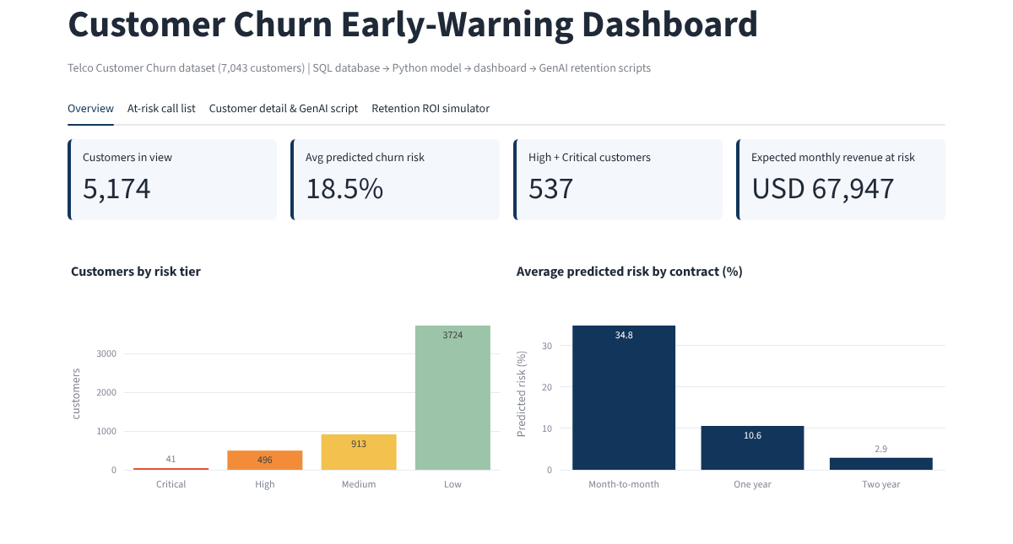




A dashboard the retention team can act on
Overview
KPIs, risk tiers, highest-risk segments
Call list
Ranked by expected monthly loss, CSV export
Customer detail
Why flagged, plus a GenAI call script
ROI simulator
Overview tab: KPI tiles and risk-tier charts for the 5,174 active customers
Threshold, save rate and cost sliders
Notes:
Four tabs. The sidebar filters by contract, internet service and tenure band and switches between active customers (the call-list view) and all customers (the back-test). In the default view there are 5,174 active customers, 537 of them High or Critical. We ran the app headless: every tab opens, filters toggle and the script button works without errors.

Slide 11
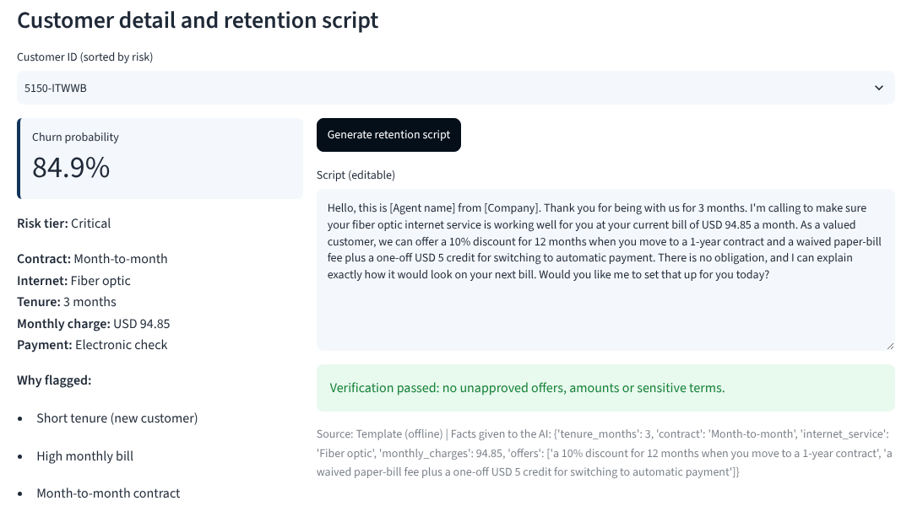
GenAI drafts the script, rules verify it
1
Approved facts and offers
Tenure, contract, bill; offers chosen by rules
2
LLM or offline template
Claude via API when a key is set
3
Rule-based verifier
Amounts, %, durations, banned terms, length
4
Agent reviews and edits
The AI only words facts and offers the business already approved.
Shown as Verified or Needs review
Evidence: 7 automated tests pass; all 7,043 template scripts pass the verifier; test scripts with a 50% discount or a "senior customer" mention are rejected.
Notes:
The AI never decides the offer or a price. Offers are selected by rules from the customer's real situation; the model only words them. Every script then passes a verifier that checks every amount, percentage and duration against the customer's real data and the approved offers, rejects sensitive or forbidden wording, and checks length and a closing question. If an LLM output fails, it is replaced by the template and labelled. The live LLM call is optional and was not exercised in our test run, which had no API key; the template path, verifier and fallback were tested.

Slide 12
Calling High and Critical customers pays back
537
active High and Critical customers to call
USD 84k
expected net benefit
596%
ROI; still 333% if only 10% are saved
Expected net benefit by risk tier, active customers only
Call Critical and High first, add Medium as capacity allows; serve Low with cheap automated messages.
Illustrative assumptions: USD 8 per contact, 30% save rate, 12 months of revenue kept, discount costs 10% of it.
Notes:
Assumptions are illustrative and editable in the dashboard: USD 8 per contact, 30% of would-be churners saved, saved customers keep 12 months of revenue, and the retention discount costs 10% of that revenue. Only active customers count, because a customer who has already left cannot be saved. At the High plus Critical operating point the expected net benefit is about USD 84 thousand with a ROI near 596 percent; at a 10 percent save rate it is still 333 percent. The Low tier returns only 75 percent, so it is not worth calling. The save rate is an assumption, not a measurement, so we recommend an A/B test.

Slide 13


How we verified the work, and its limits
Verified
Limitations
Row counts reconciled at every load step
Scores are out-of-fold: no customer is scored by a model that saw them
AI scripts checked by rules; 7 automated tests pass
Dashboard run headless: every tab, filter and button
Report and slide numbers taken from pipeline outputs
One snapshot without dates: scores show relative risk, ROI is a simulation
Save rate and costs are assumptions, not measurements
Telecom data is a proxy for banks and insurers
Live LLM call not exercised without an API key; template path tested
Notes:
This slide answers the brief's last prompt: keep the project simple but complete, with verification of AI outputs. Left: what we checked. Right: what to keep in mind. The data is a single snapshot, so the dashboard shows relative risk and the ROI tab is decision support, not a forecast.

Slide 14
Recommendation and next steps
Recommendation
Next steps
Start with the 537 active High and Critical customers
Offer month-to-month fiber customers a discounted one-year contract
Move electronic-check payers to automatic payment
Bundle Online Security and Tech Support for customers without them
1
Time-stamped data to predict churn in the next 30 days
2
A/B test scripts against a control group to measure the real save rate
3
Uplift model: target who is persuadable, not only at risk
4
Connect to the CRM so the call list refreshes nightly
GitHub repository: README, SQL, Python, dashboard and tests. Run: python run_pipeline.py, then streamlit run app/dashboard.py
Notes:
Recommendation: start with the High and Critical active customers and use the approved offers that match their situation: a discounted one-year contract for monthly fiber customers, automatic payment for electronic-check payers, and security or tech-support bundles for customers without them. Next steps: time-stamped data, an A/B test to measure the real save rate, an uplift model, and CRM integration.

