Slide 1
Aveomachine 4 – The Cave
Walkthrough

Slide 2
Walkthrough
This walkthrough should be used only if the player gets stuck!

Slide 3
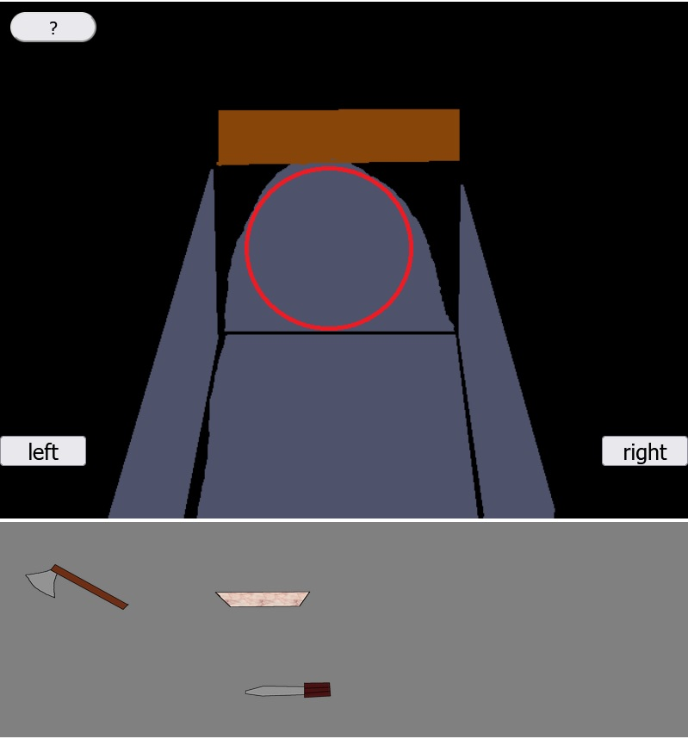
1. step
Click on the circled area to get out of the tunnel of the weekend house, which leads to the cave!

Slide 4
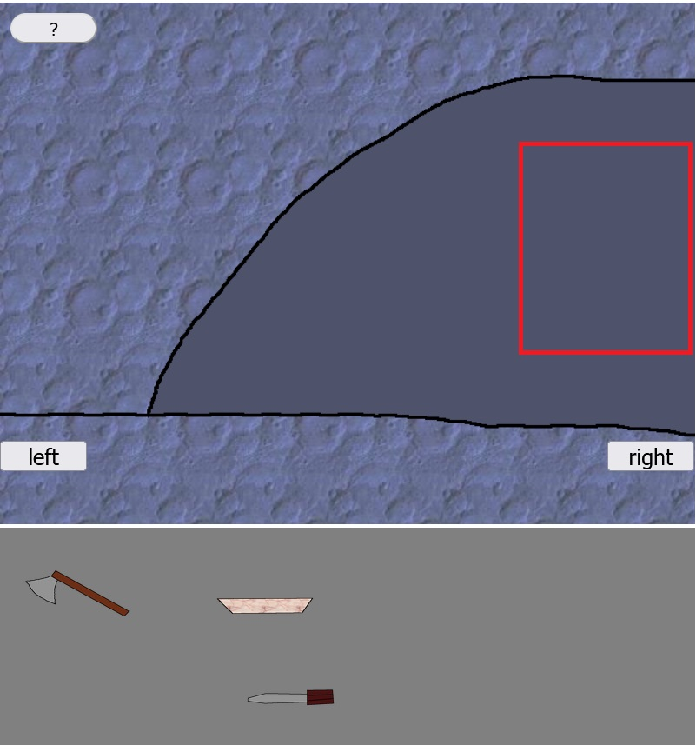
2. step
Click on the red rectangled area to move deeper into the cave!

Slide 5
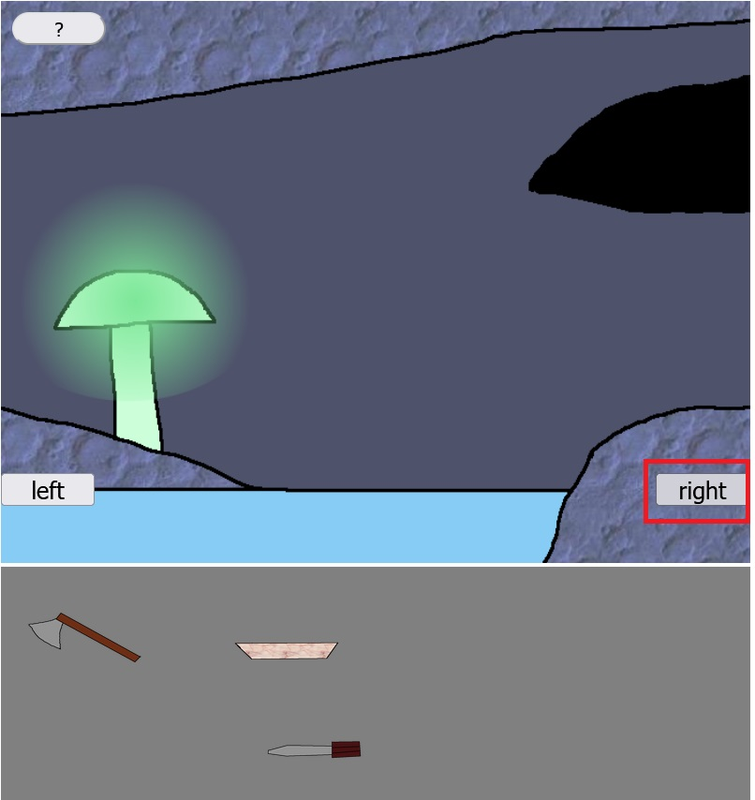
3. step
Click on the right button!

Slide 6
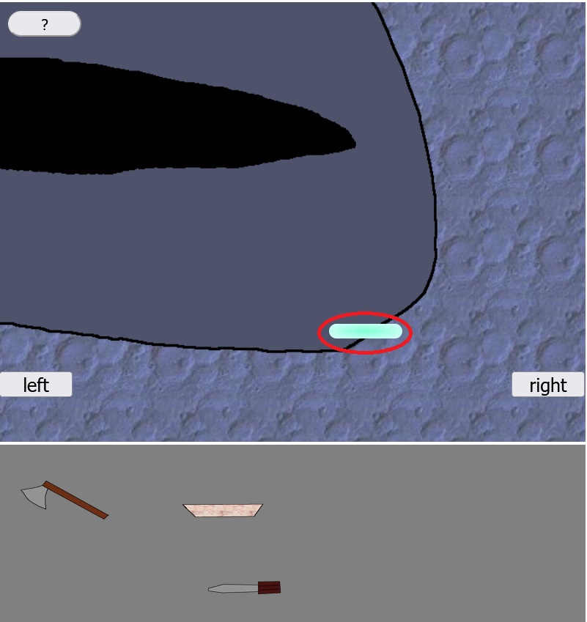
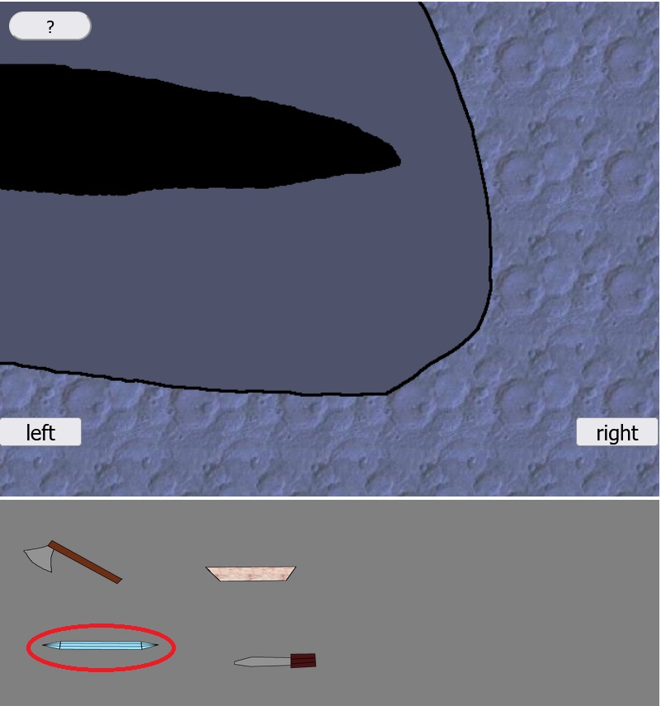
4. step
Click on the oval light blue object, which is in the wall of the cave! A crystal item gets received.

Slide 7
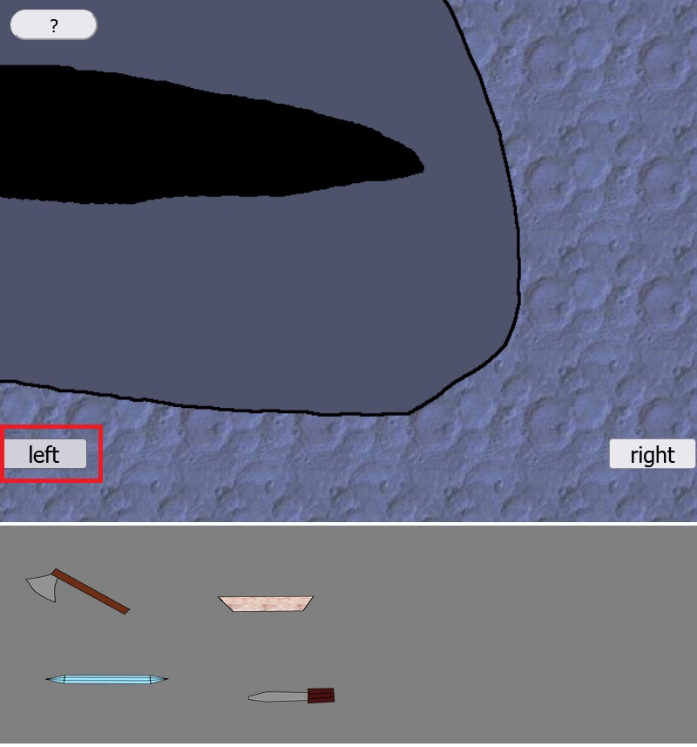
5. step
Click on the left button to get back to the lake of the cave!

Slide 8
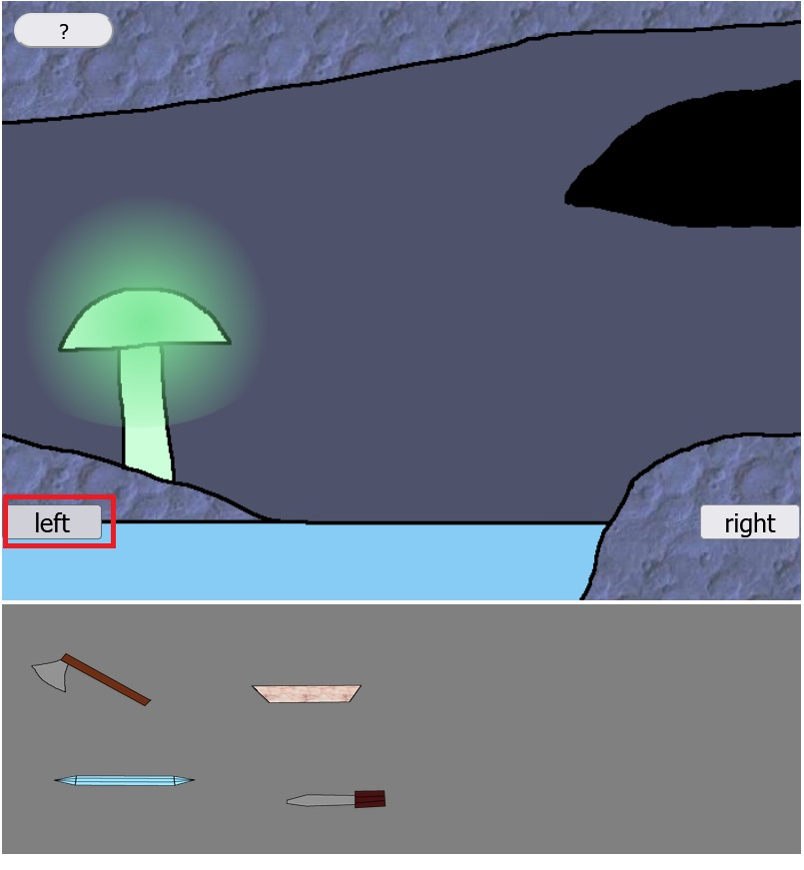
6. step
Click on the left button to get to the mushroom way!

Slide 9
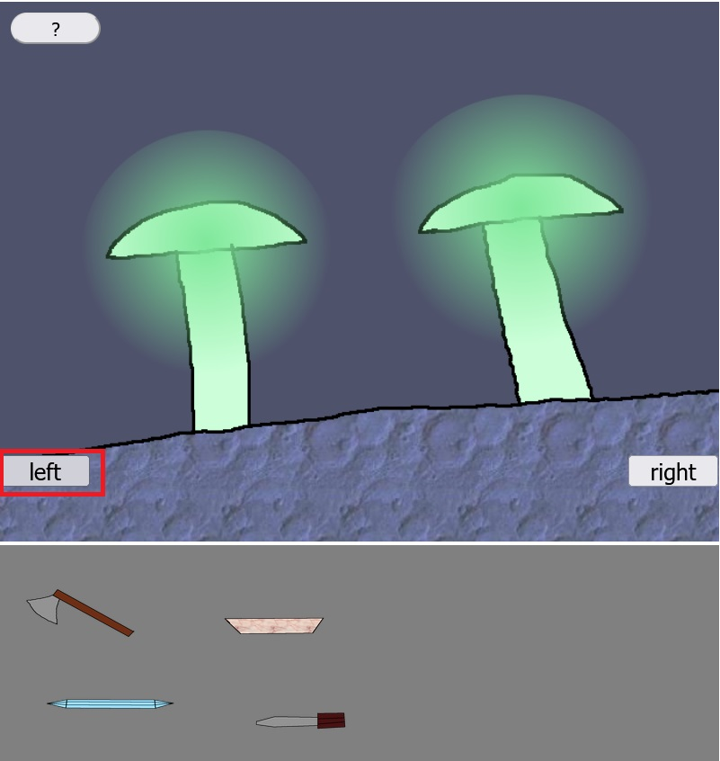
7. step
Click on the left button to get to the crystal gate!

Slide 10
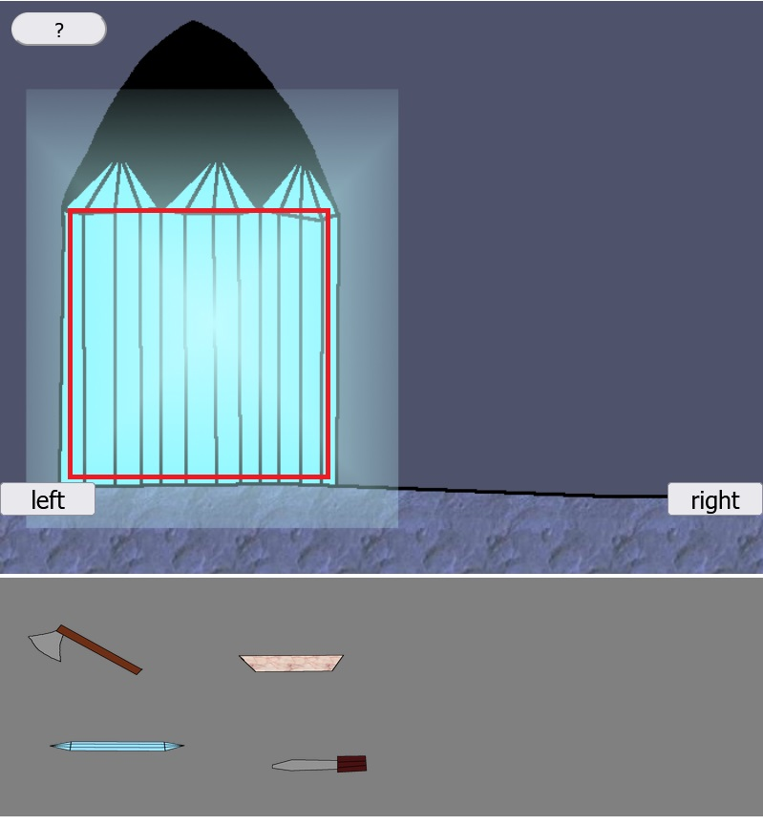
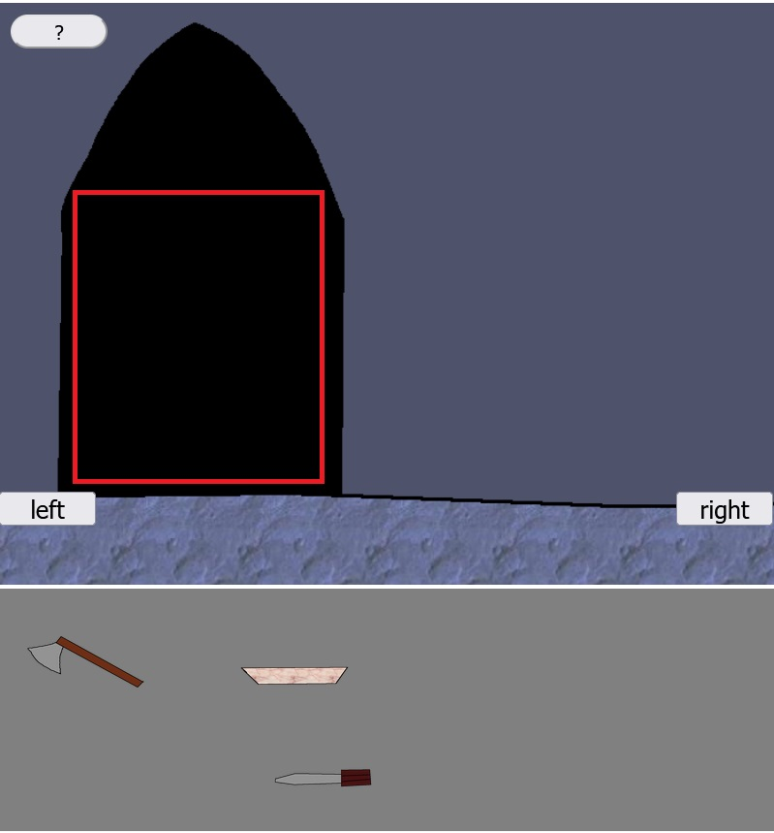
8. step
Click on the crystal gate to break it with the crystal item from the inventory! Then click on the cleared way!

Slide 11
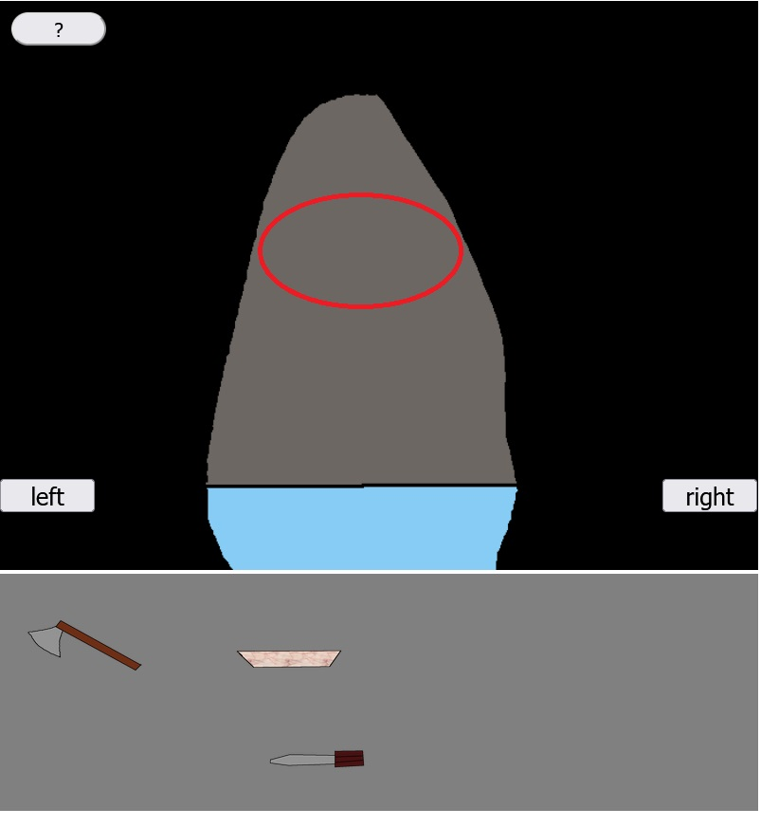
9. step
Click on the red circled area to pass through the tunnel to the door of the lab!

Slide 12
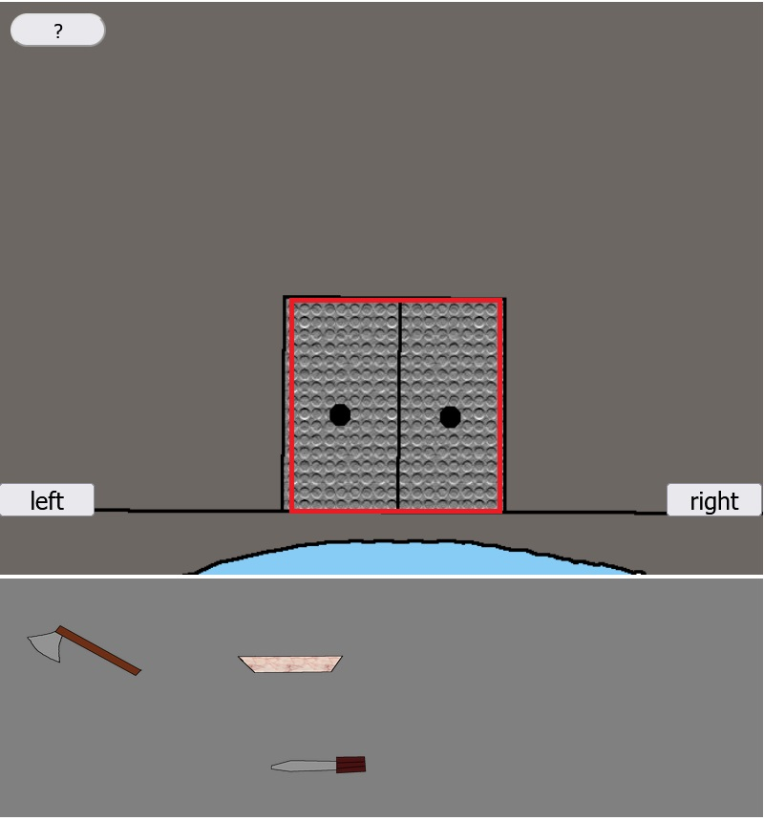
10. step
Click on the door of the lab to enter!

Slide 13
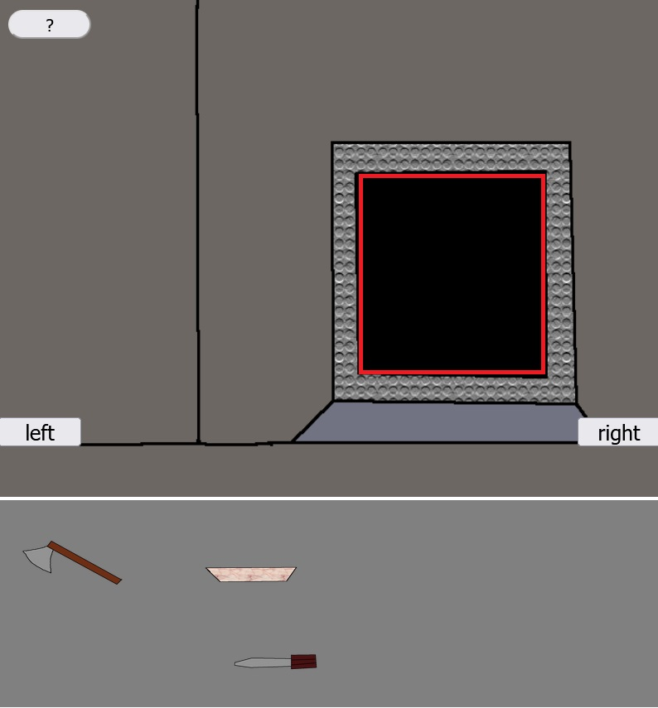
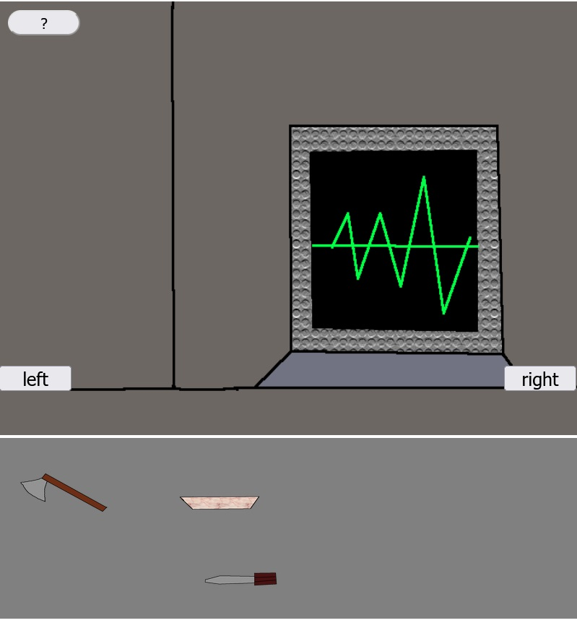
11. step
Click on the black screen of the lab’s computer! A sound gets played.

Slide 14
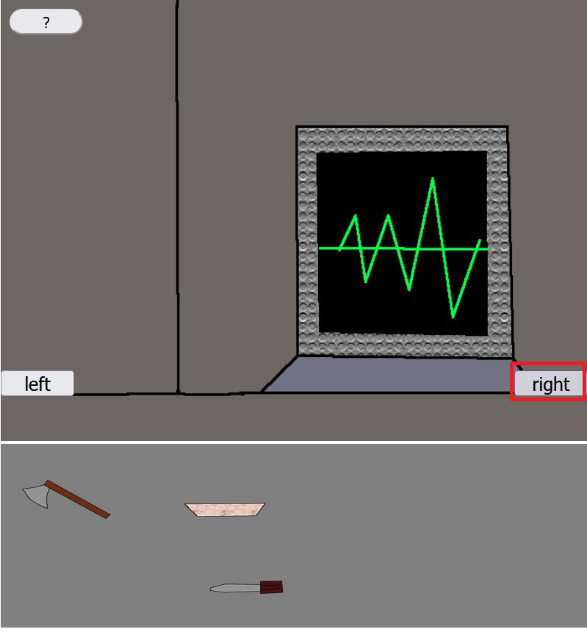
12. step
Click on the right button to get to the other section of the lab!

Slide 15
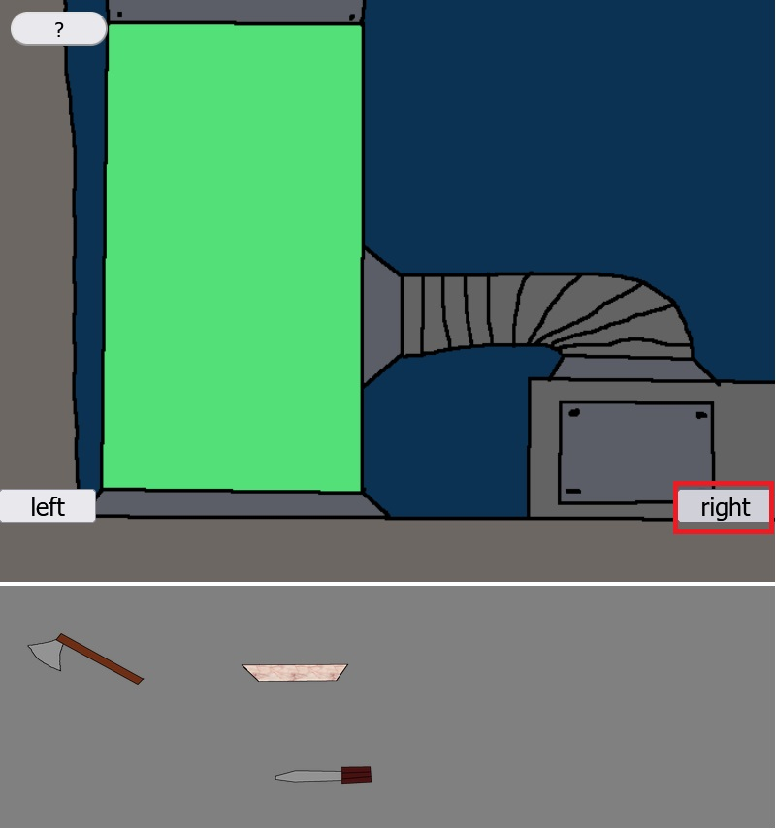
13. step
Click on the right button to get to the cook section of the lab!

Slide 16
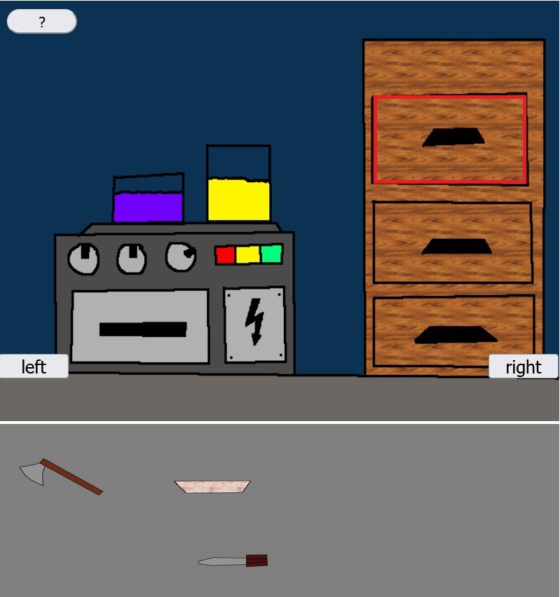
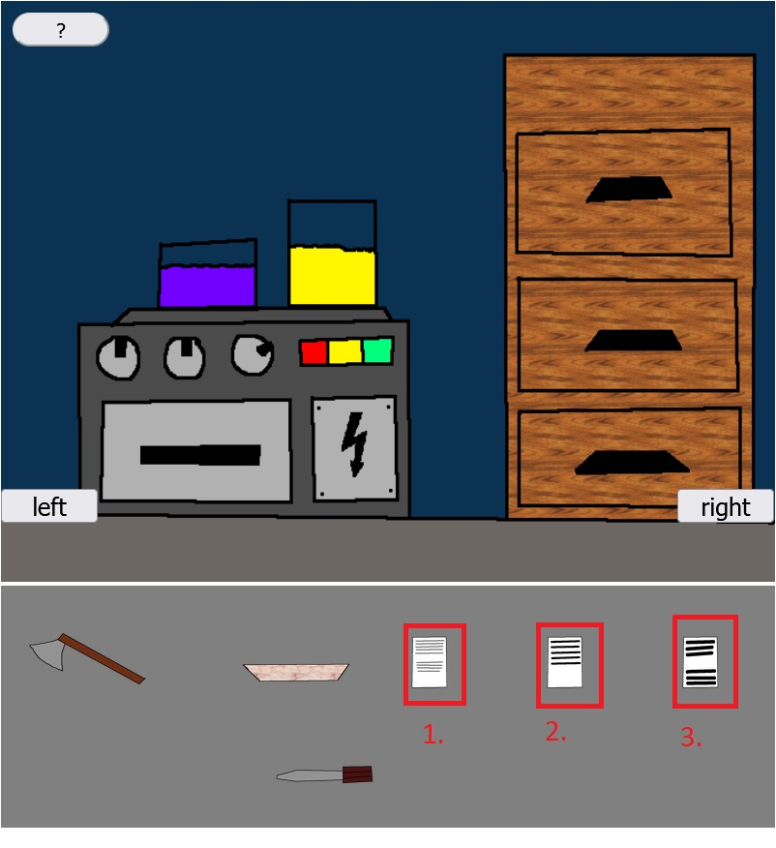
14. step
Click on the drawer! Notes will get received.
Click on the notes to read them!

Slide 17
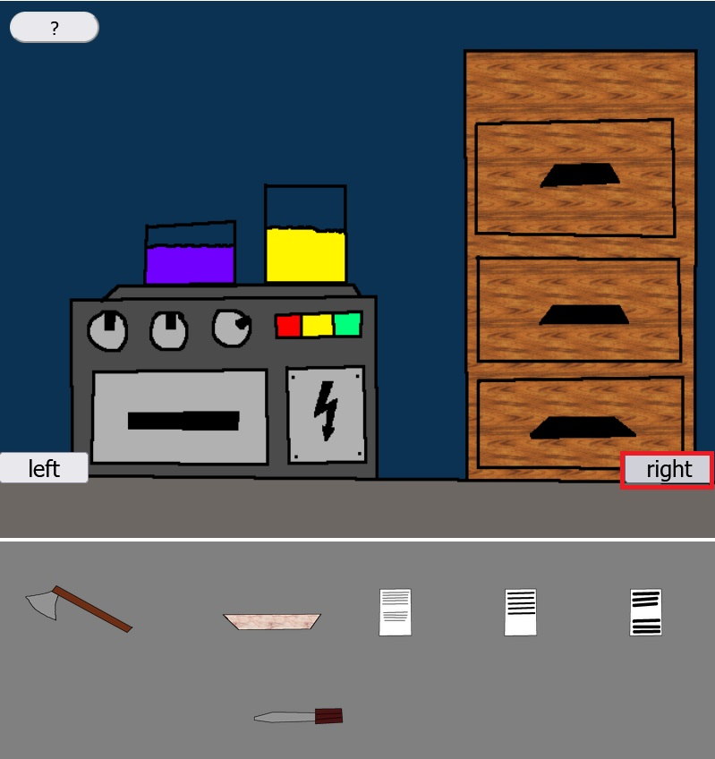
15. step
Click on the right button to get to the door of the portal room!

Slide 18
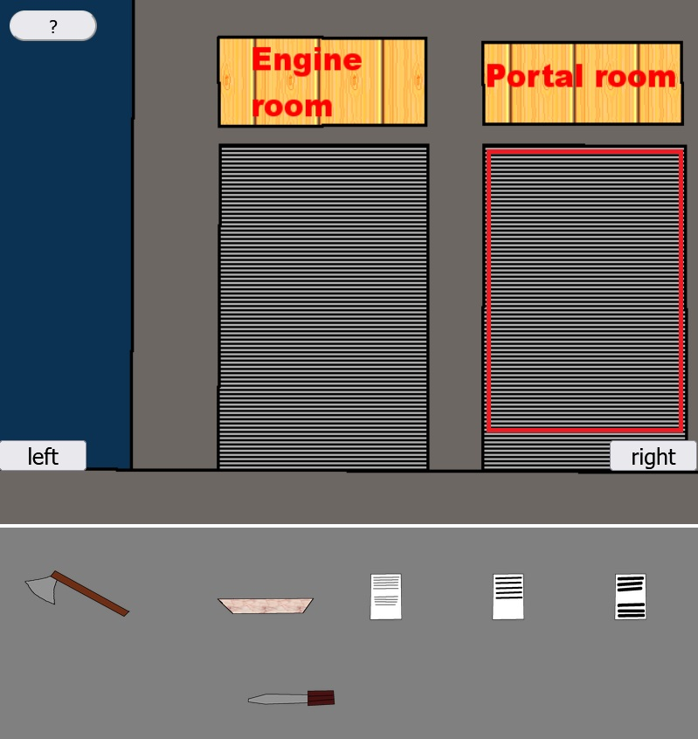
16. step
Click on the portal room to enter!

Slide 19
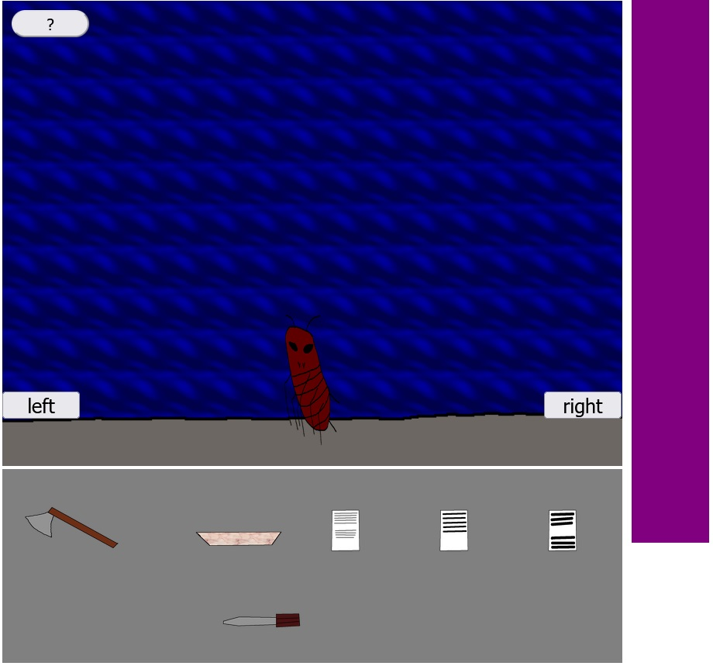
17. step
A boss will appear, which has to be defeated! The purple bar represents its actual health point value.

Slide 20
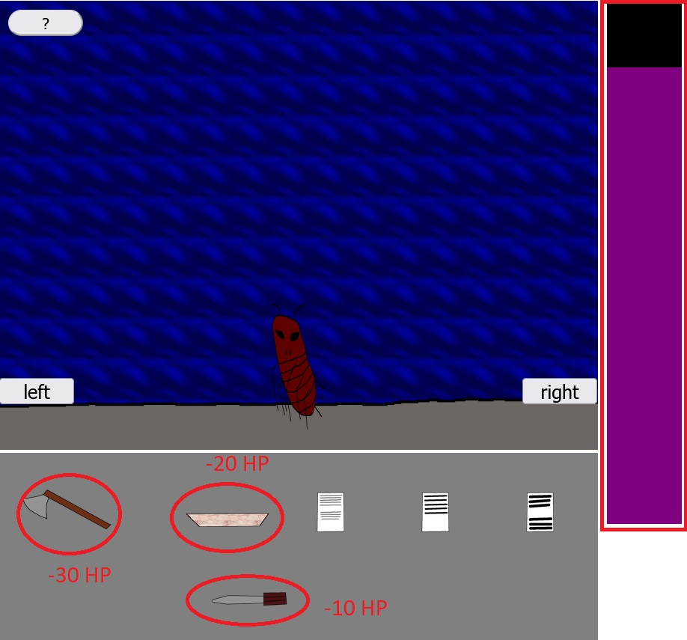
18. step
Keep clicking on the axe, or the bowl, or the screwdriver, until the actual health point value representer purple bar disappears!

Slide 21
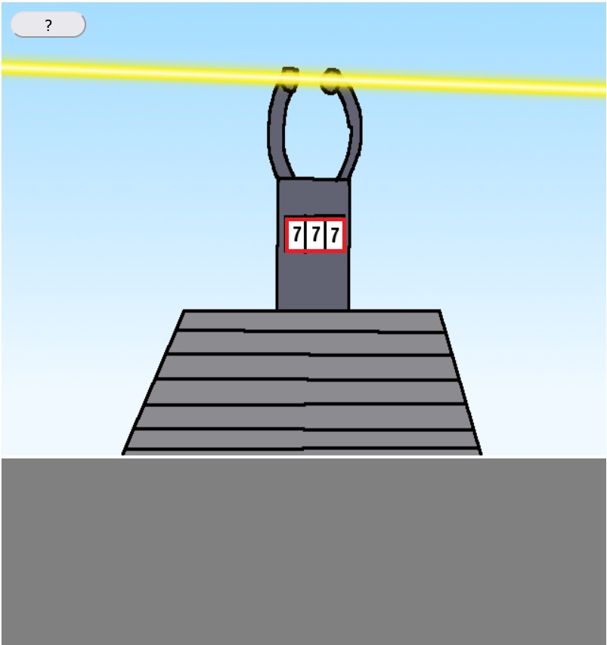
19. step
As the boss gets defeated, the way to the portal will get clear.
Click on the number section of the portal machine!

Slide 22

Congratulations! You have won the game!

