Slide 1
Aveomachine 2 – The Ship
Walkthrough

Slide 2
Walkthrough
This walkthrough should be used only if the player gets stuck!

Slide 3
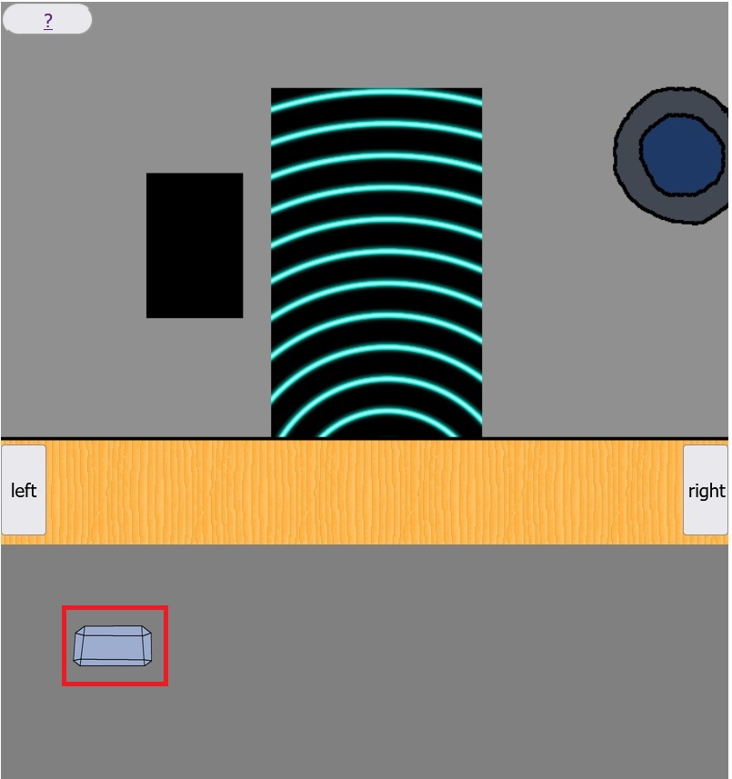
Step 1.
Click on the crystal to deactivate the safety laser!

Slide 4
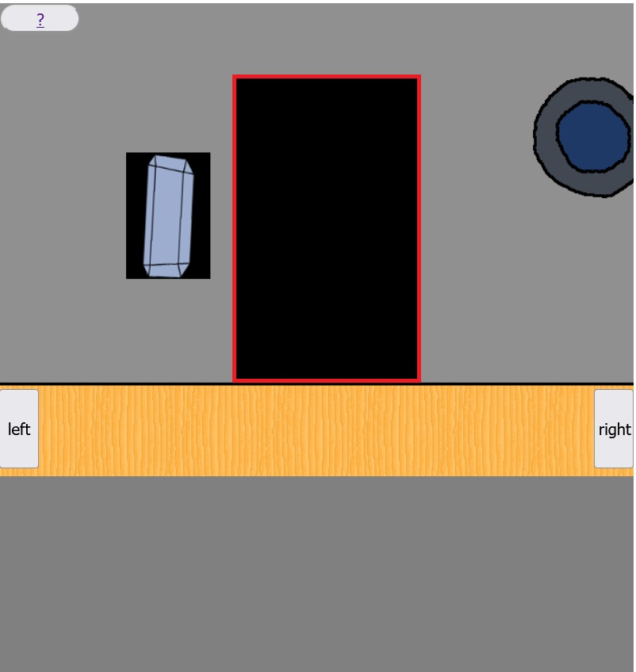
Step 2.
Click on the door to enter the ship!

Slide 5
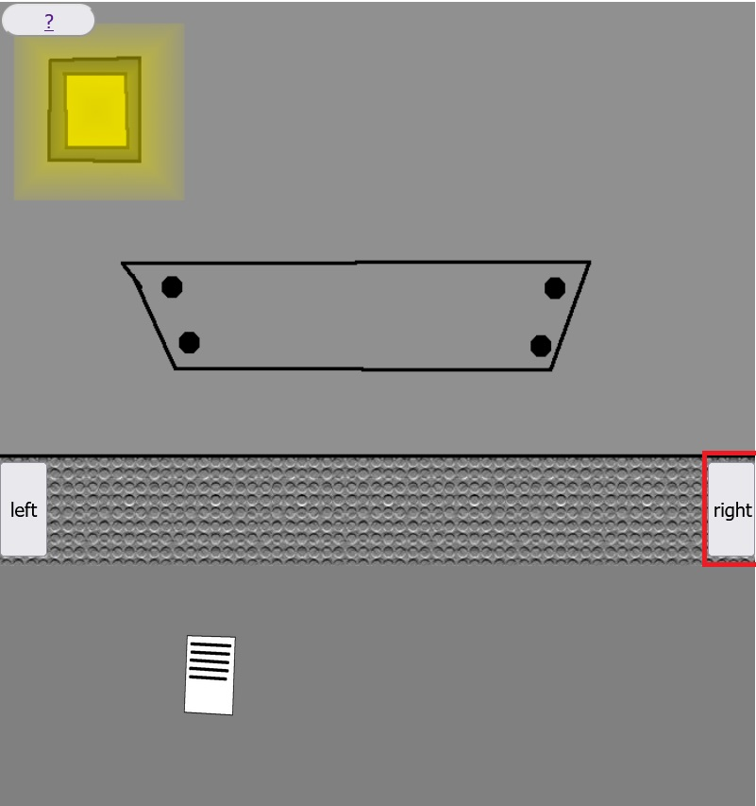
Step 3.
Click on the right button!

Slide 6
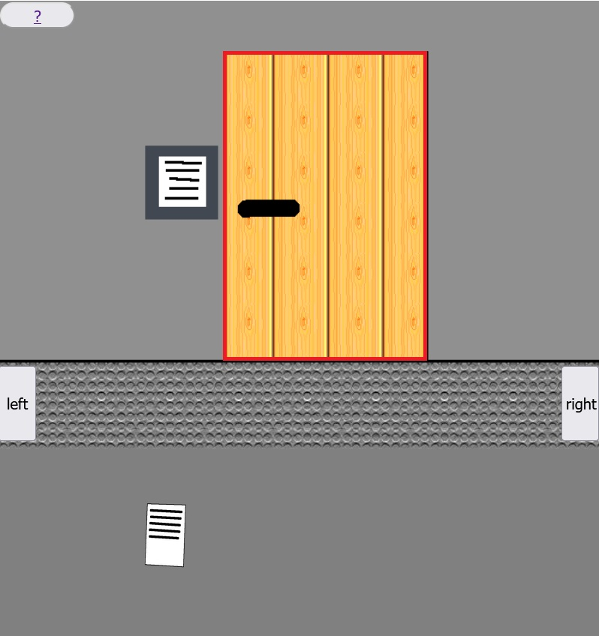
Step 4.
Click on the door of the crew room!

Slide 7
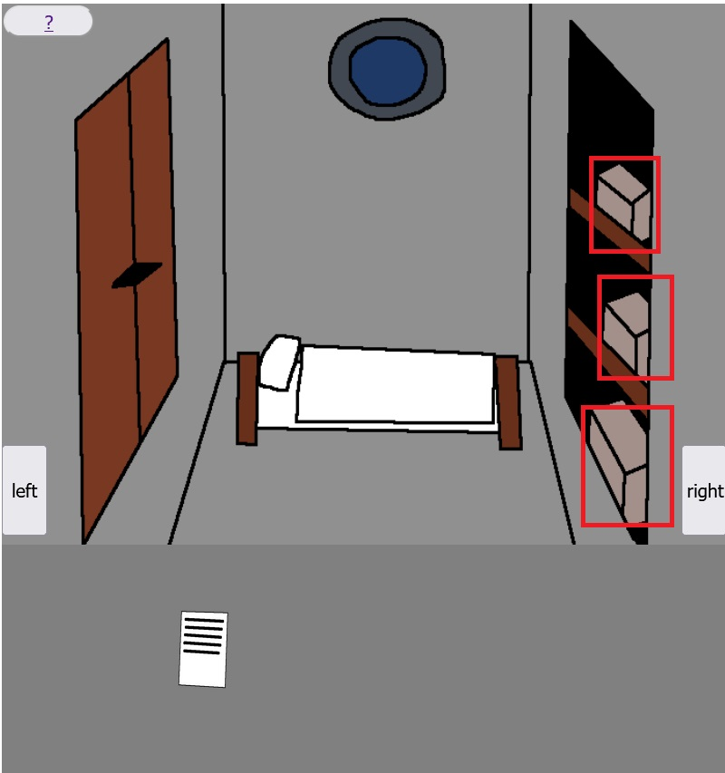
Step 5.
Click on the boxes to gather resources!

Slide 8
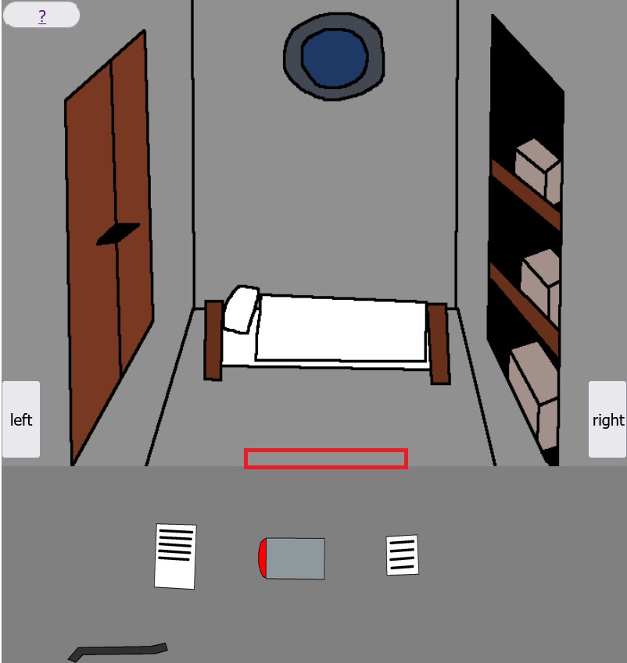
Step 6.
Click on the red rectangle area to leave the crew room!

Slide 9
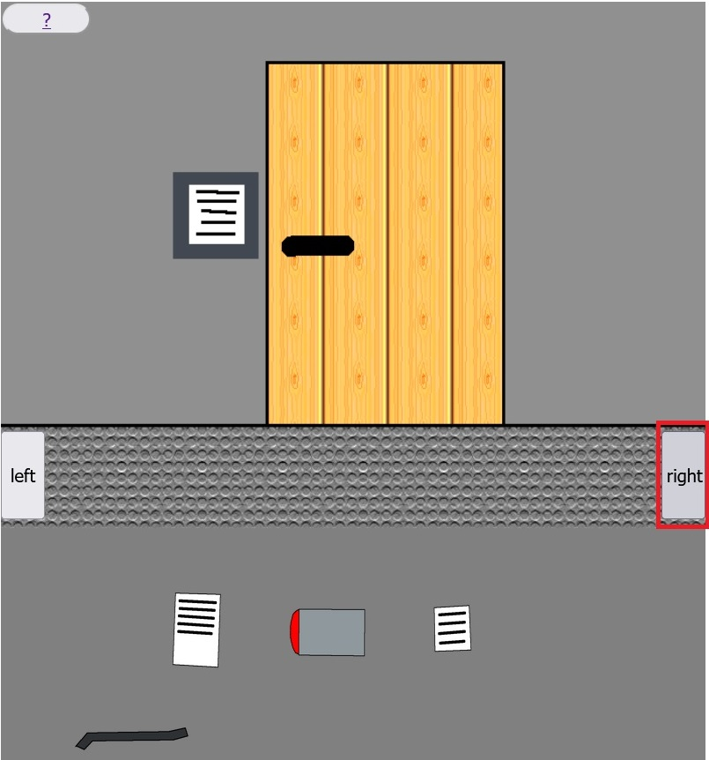
Step 7.
Click on the right button!

Slide 10
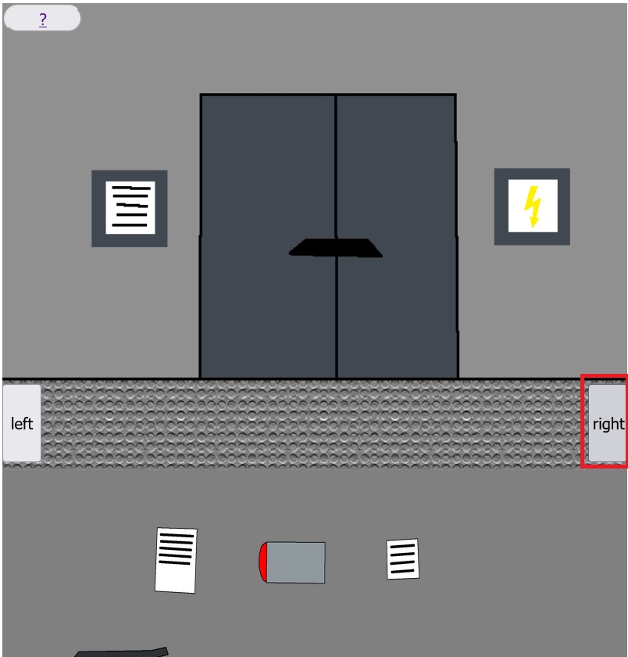
Step 8.
Click on the right button!

Slide 11
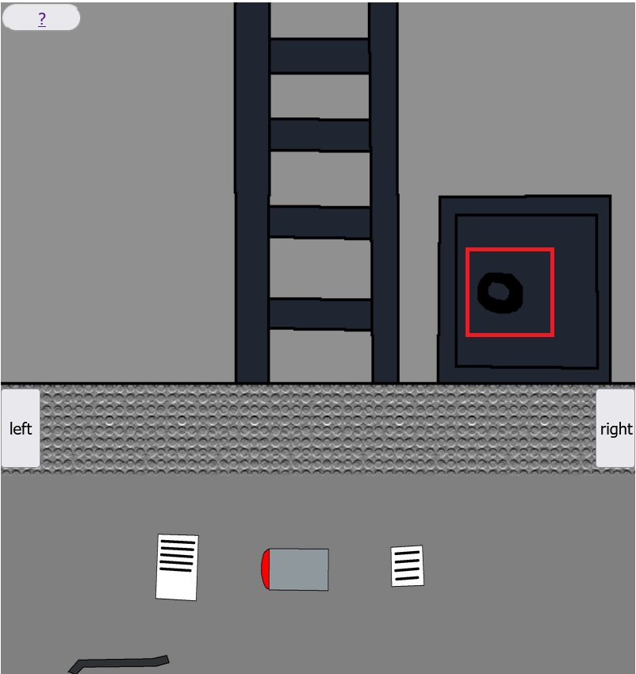
Step 9.
Click on the safe to get resources!

Slide 12
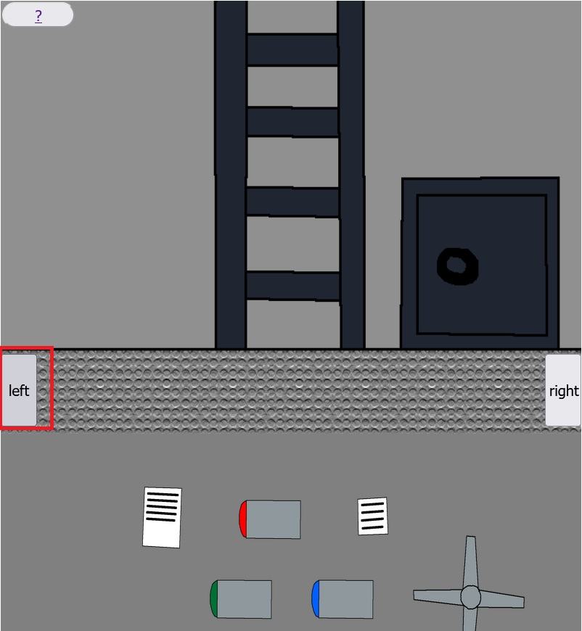
Step 10.
Click on the left button!

Slide 13
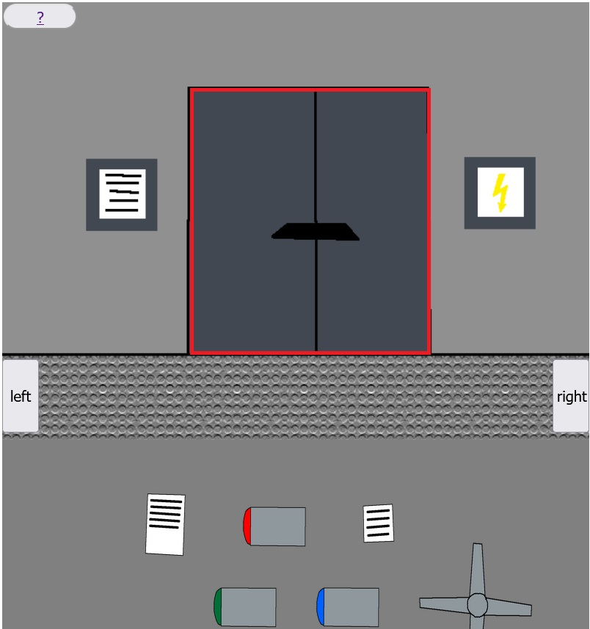
Step 11.
Click on the door of the engine room!

Slide 14
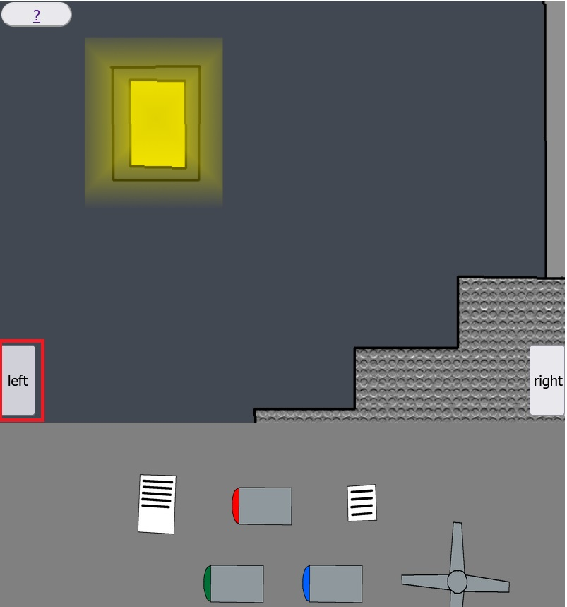
Step 12.
Click on the left button!

Slide 15
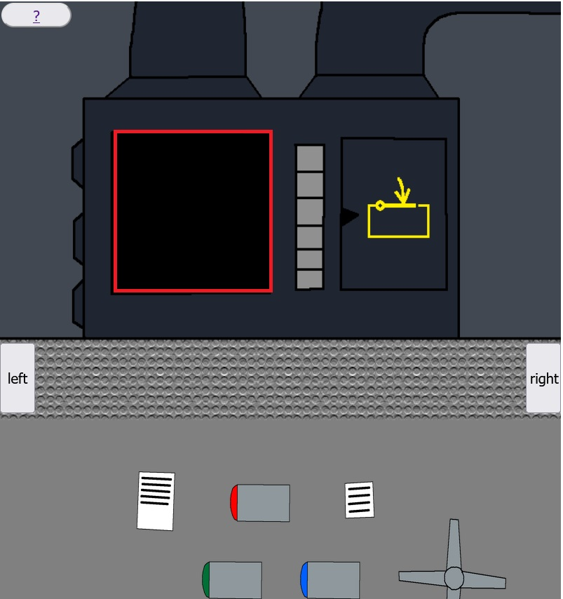
Step 13.
Click in the black area to place the fan into the engine!

Slide 16
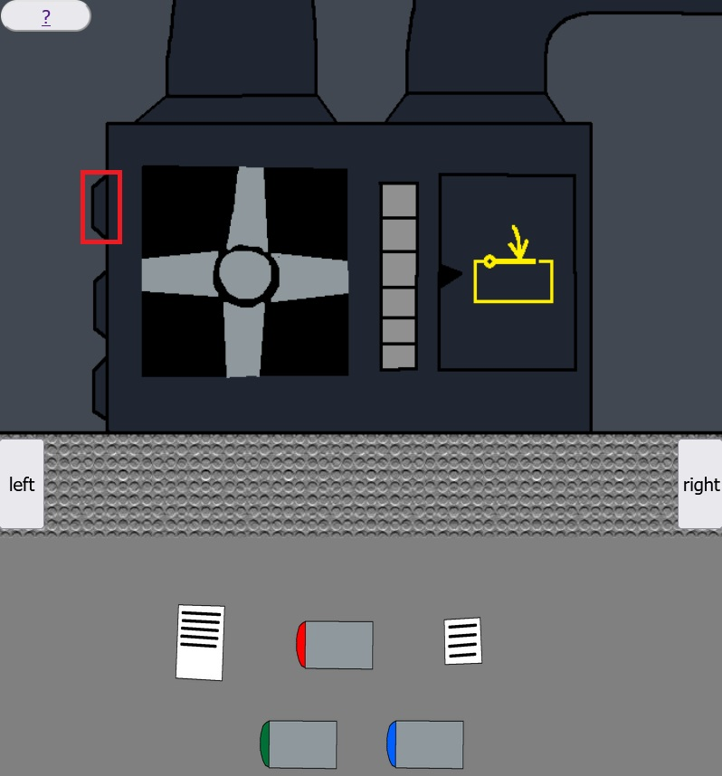
Step 14.
Click on the top fuse holder to place the red fuse into the engine!

Slide 17
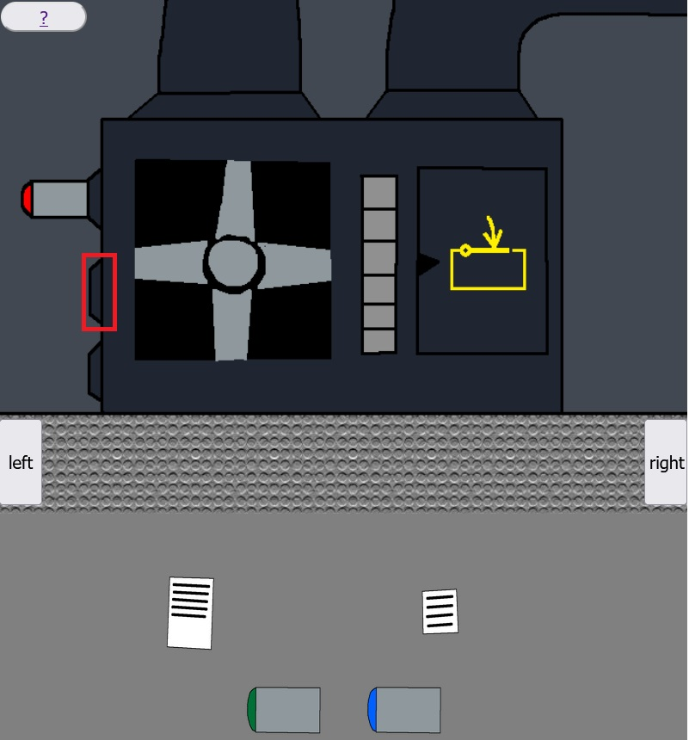
Step 15.
Click on the middle fuse holder to place the blue fuse into the engine!

Slide 18
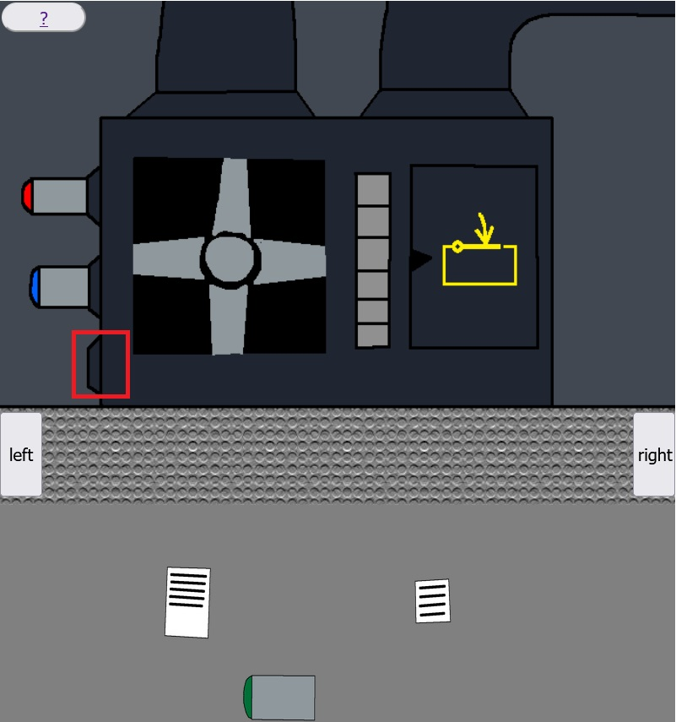
Step 16.
Click on the bottom fuse holder to place the green fuse into the engine!

Slide 19
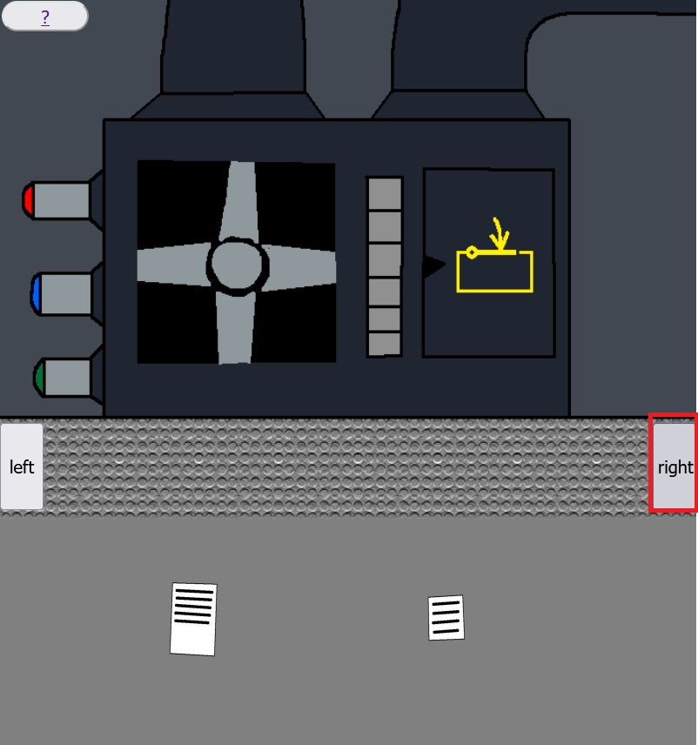
Step 17.
Click on the right button!

Slide 20
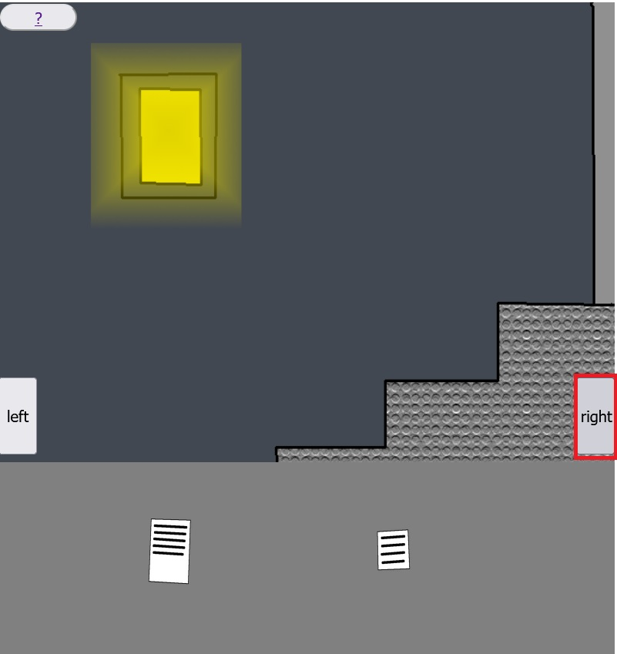
Step 18.
Click on the right button!

Slide 21
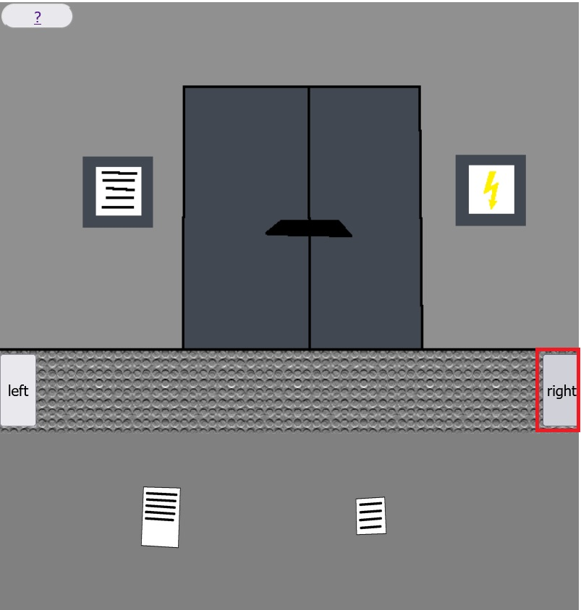
Step 19.
Click on the right button!

Slide 22
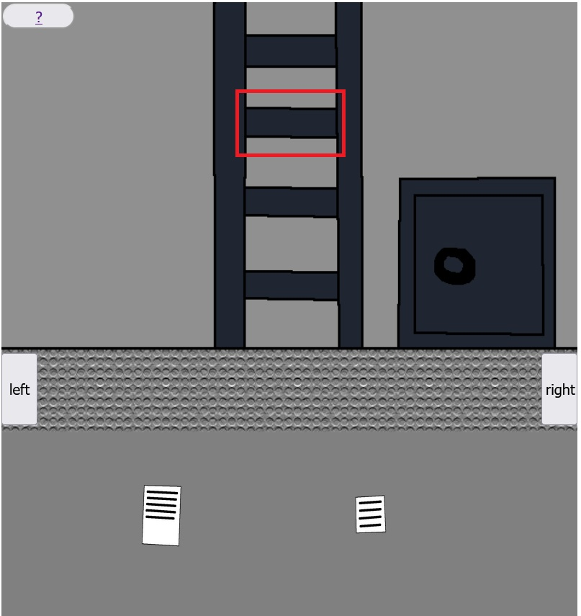
Step 20.
Click on red rectangle marked rung of the ladder!

Slide 23
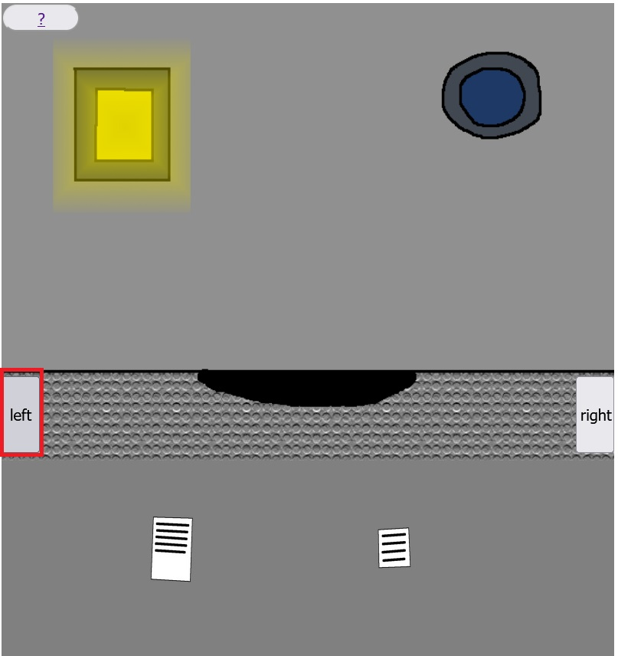
Step 21.
Click on the left button!

Slide 24
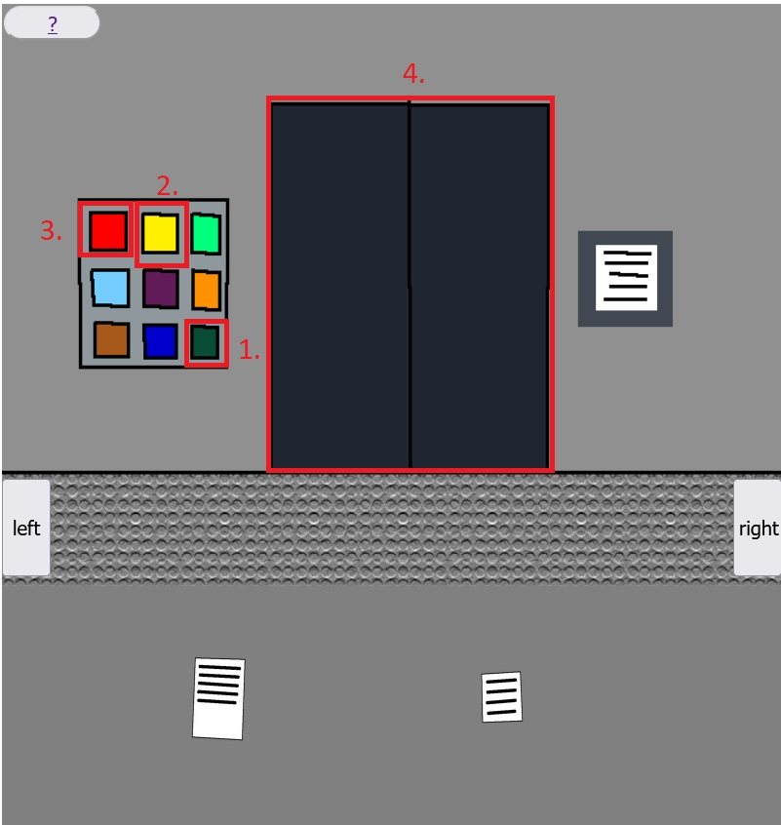
Step 22.
Click on the buttons in the shown order, and then on the door!

Slide 25
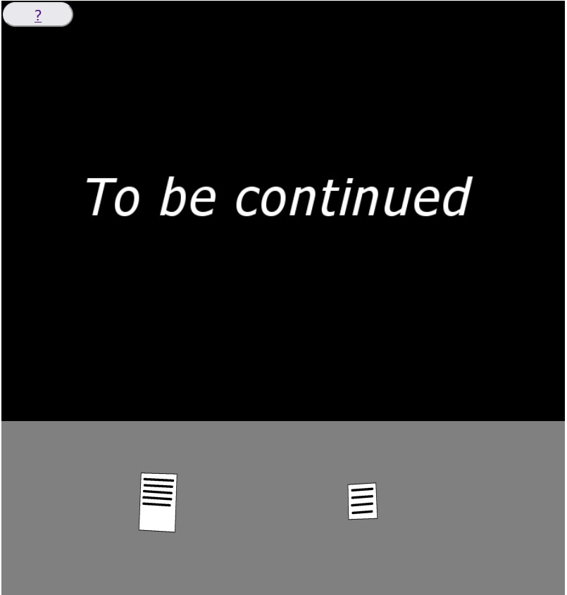
Congratulations! You have won the game!

