Slide 1
Aveomachine 1 – The Pantry
Walkthrough

Slide 2
Walkthrough
This walkthrough should be used only if the player gets stuck!

Slide 3
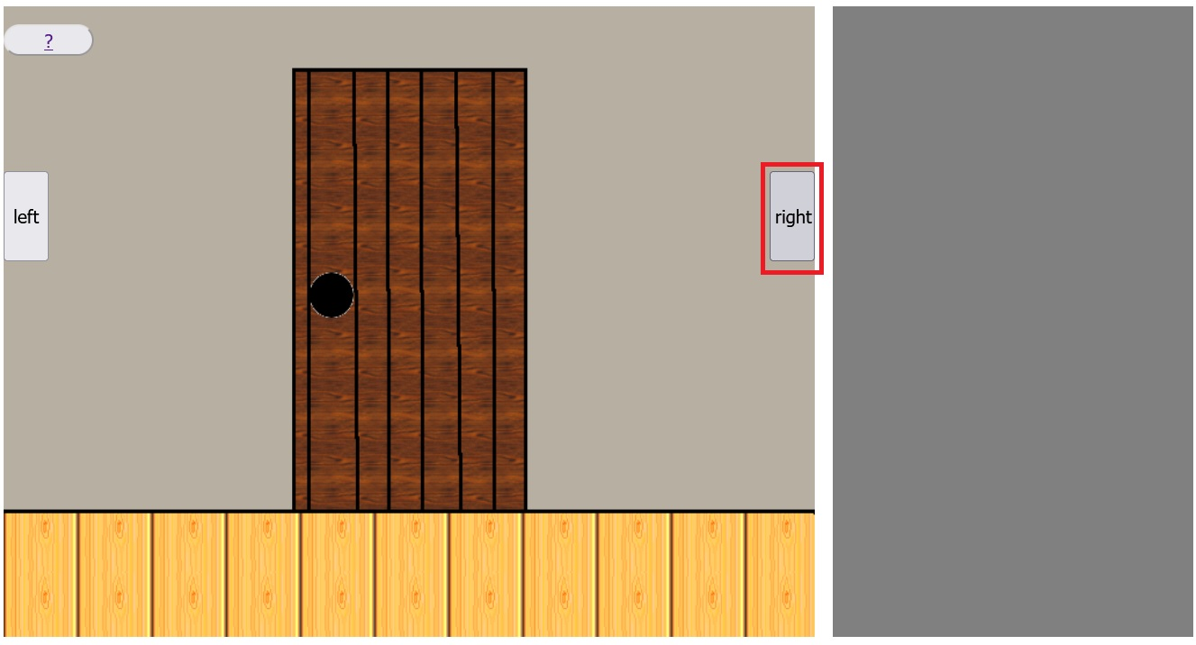
1. step
Click on the right button!

Slide 4
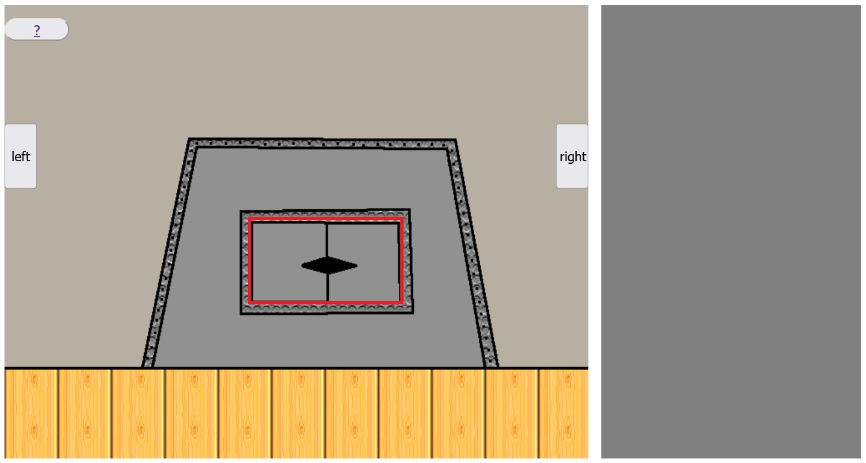
2. step
Click on the door of the metal container!

Slide 5
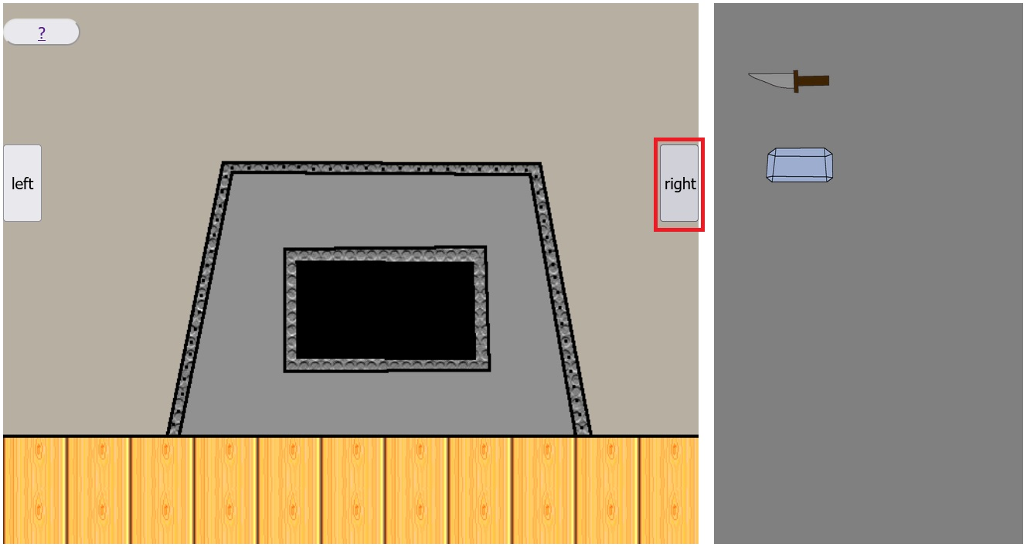
3. step
Click on the right button!

Slide 6
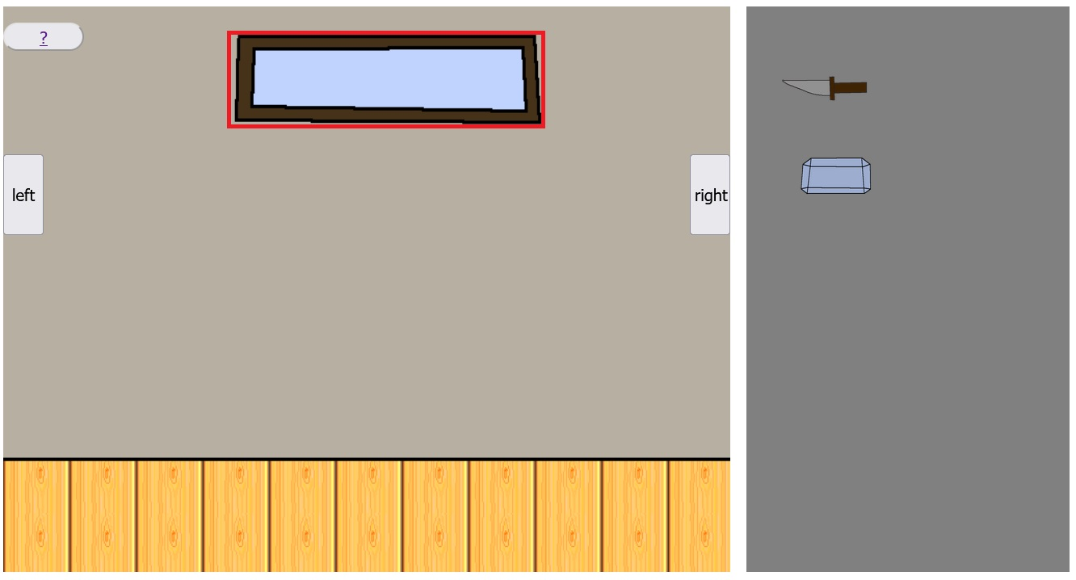
4. step
Click on the window!

Slide 7
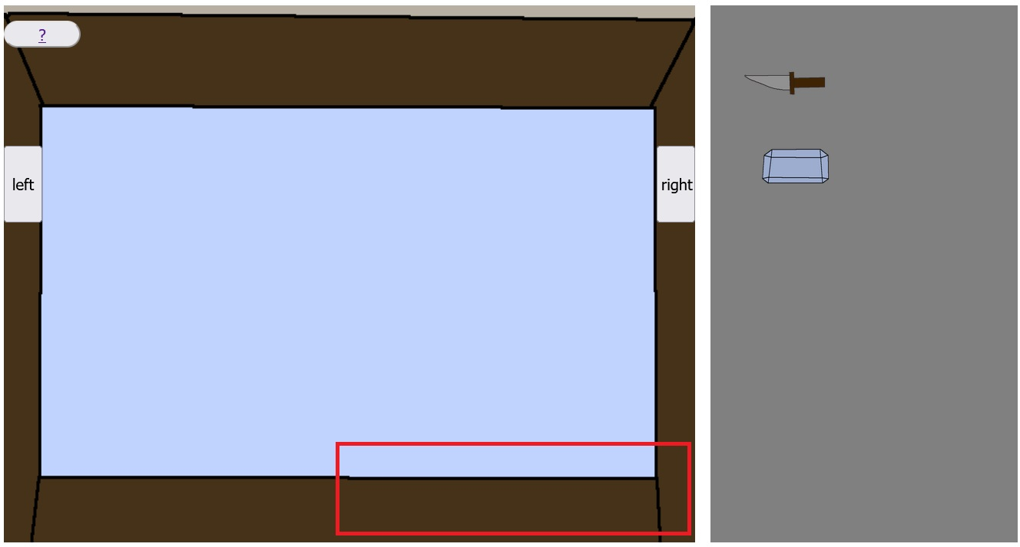
5. step
Click on the selected red rectangle area to get the key!

Slide 8
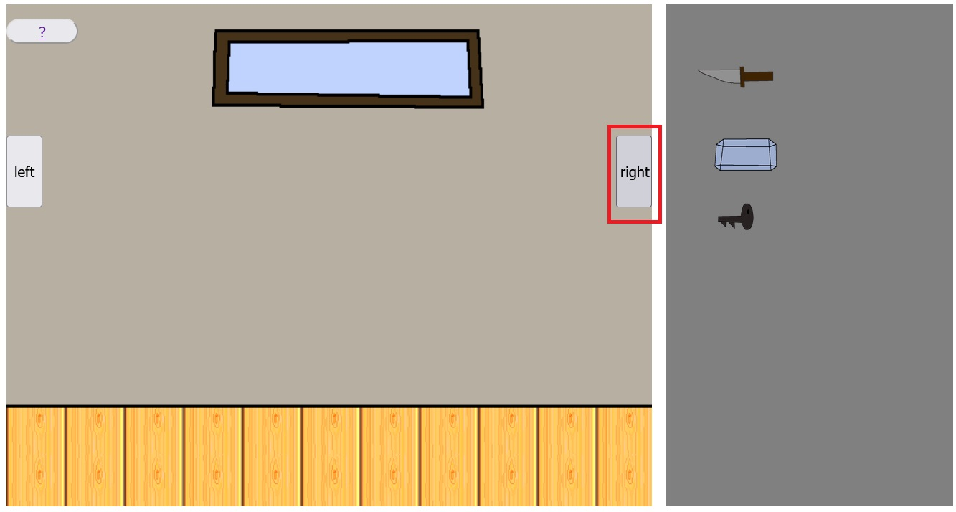
6. step
Click on the right button!

Slide 9
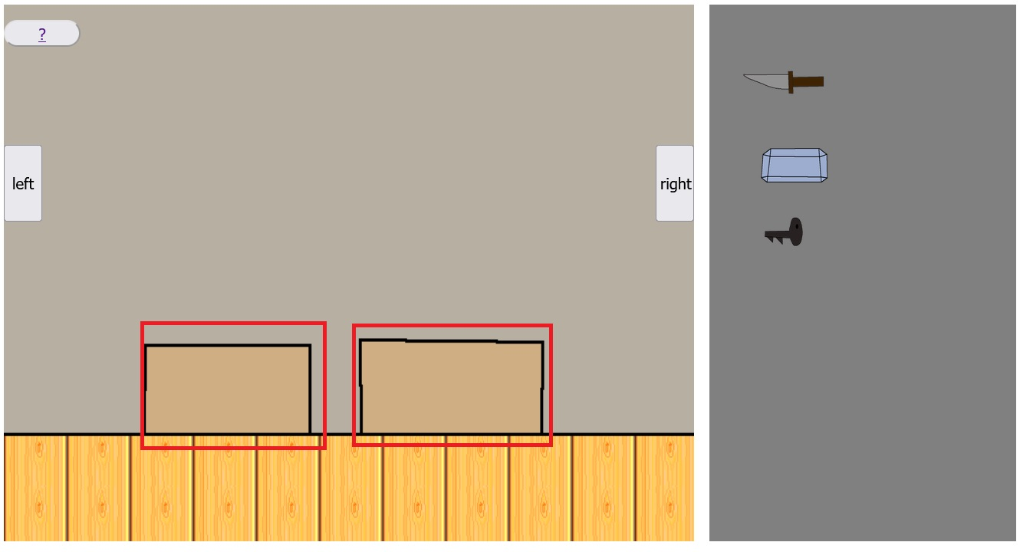
7. step
Click on any of the boxes to get items!

Slide 10
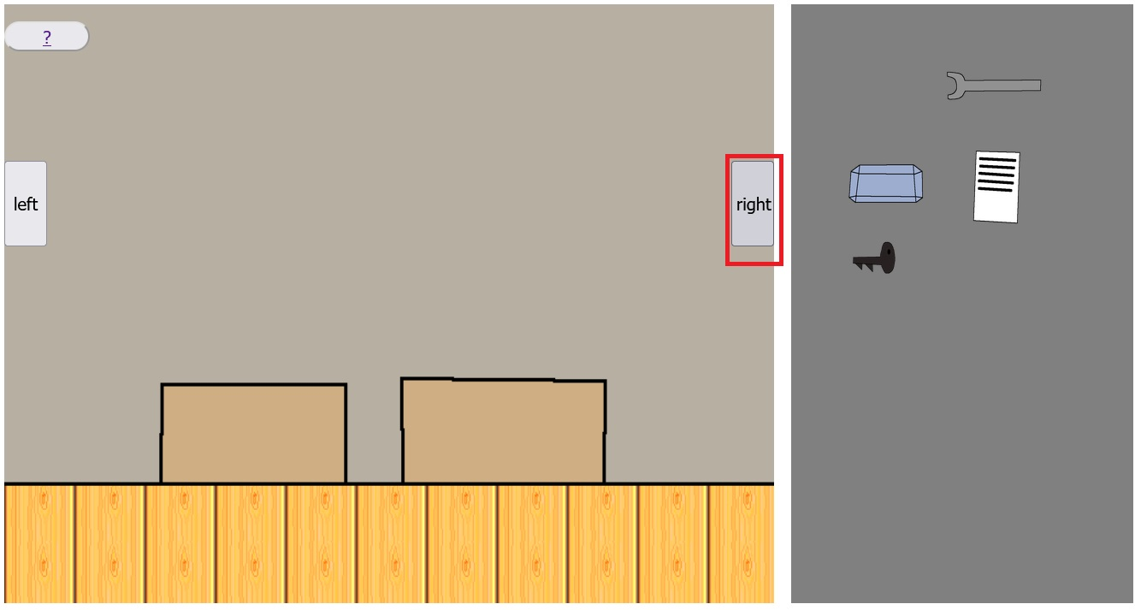
8. step
Click on the right button!

Slide 11
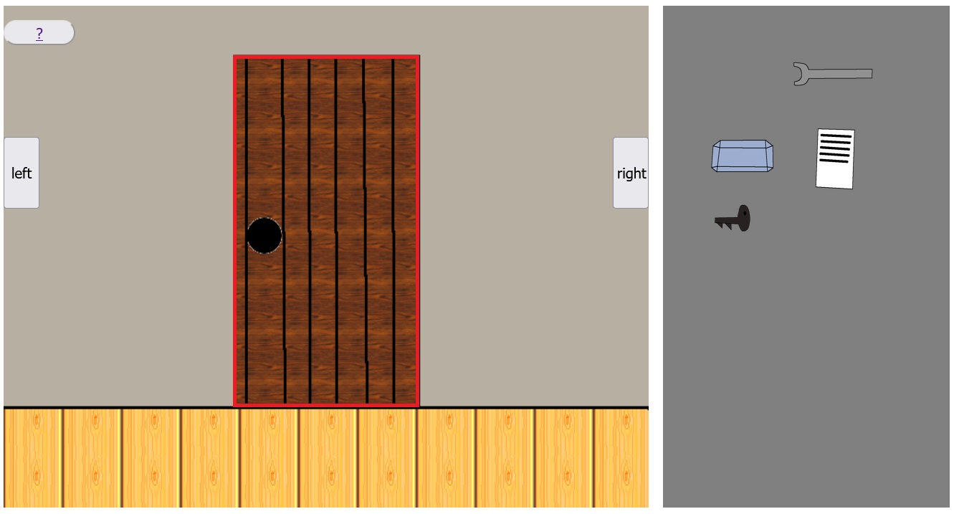
9. step
Click on the door!

Slide 12
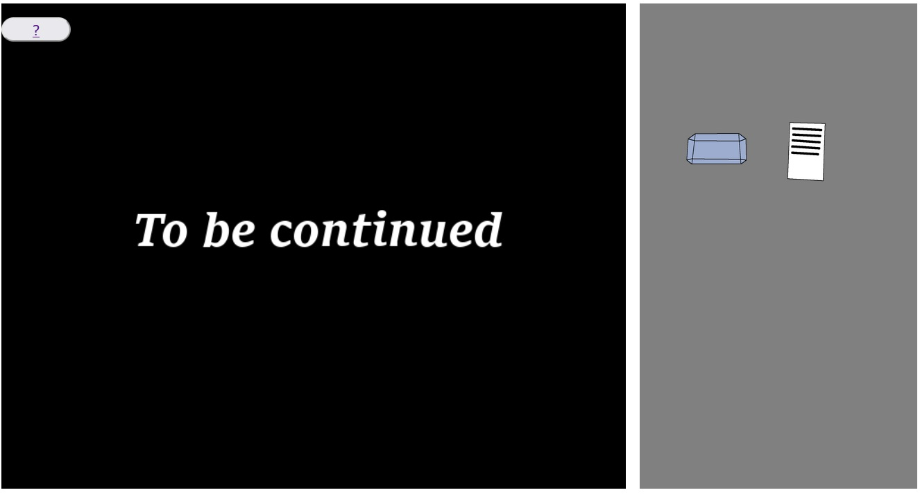
Congratulations! You have won the game!

