Slide 1
Aveomachine 3 – The Weekend House
Walkthrough

Slide 2
Walkthrough
This walkthrough should be used only if the player gets stuck!

Slide 3
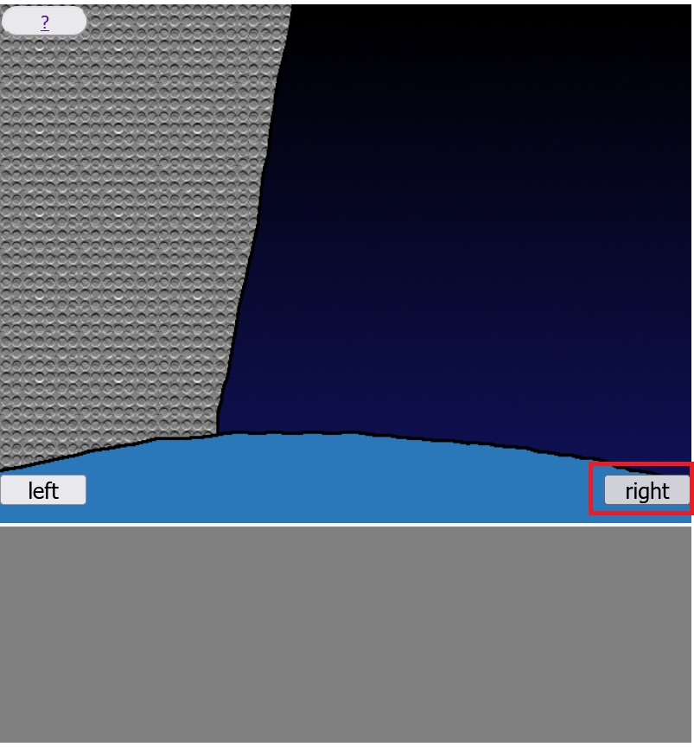
Step 1.
Click on the right button!

Slide 4
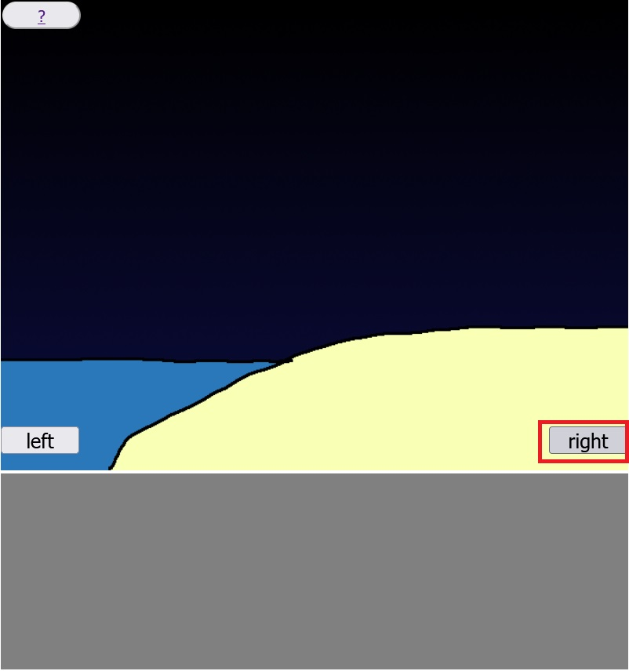
Step 2.
Click on the right button!

Slide 5
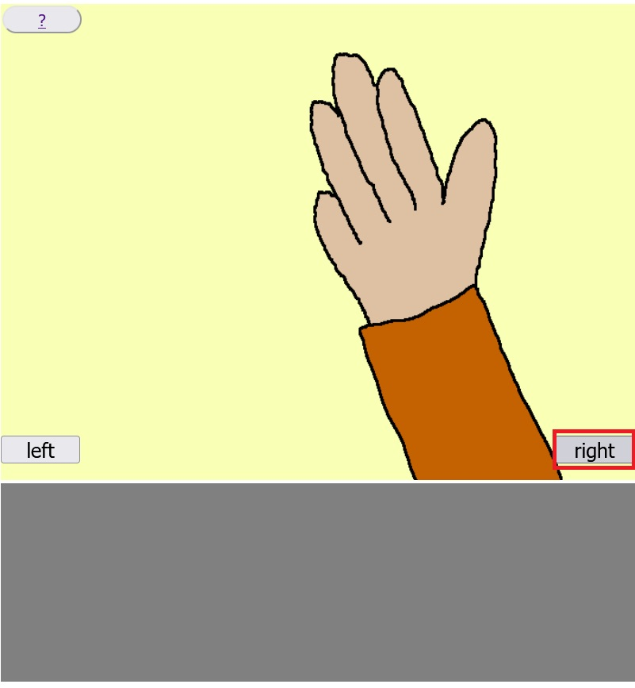
Step 3.
Click on the right button!

Slide 6
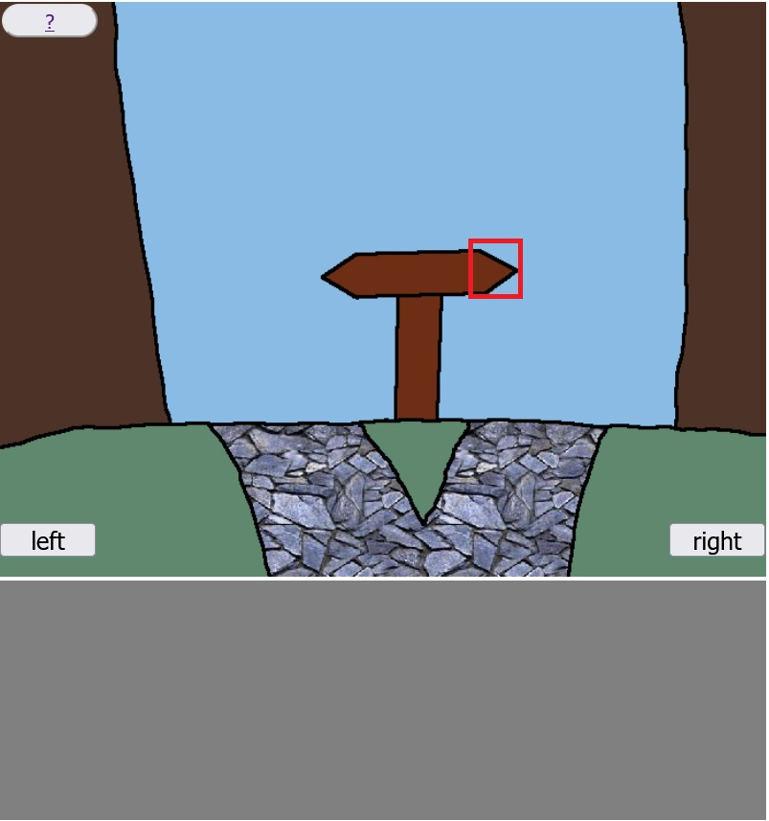
Step 4.
Click on the right side of the road sign!

Slide 7
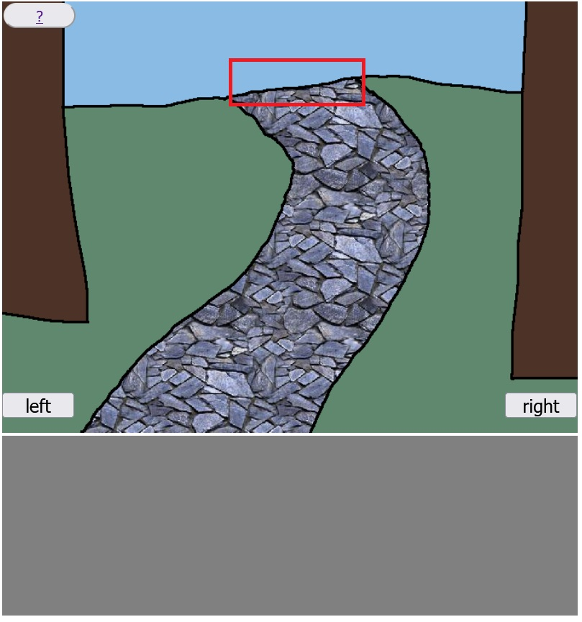
Step 5.
Click in the area marked with red rectangle!

Slide 8
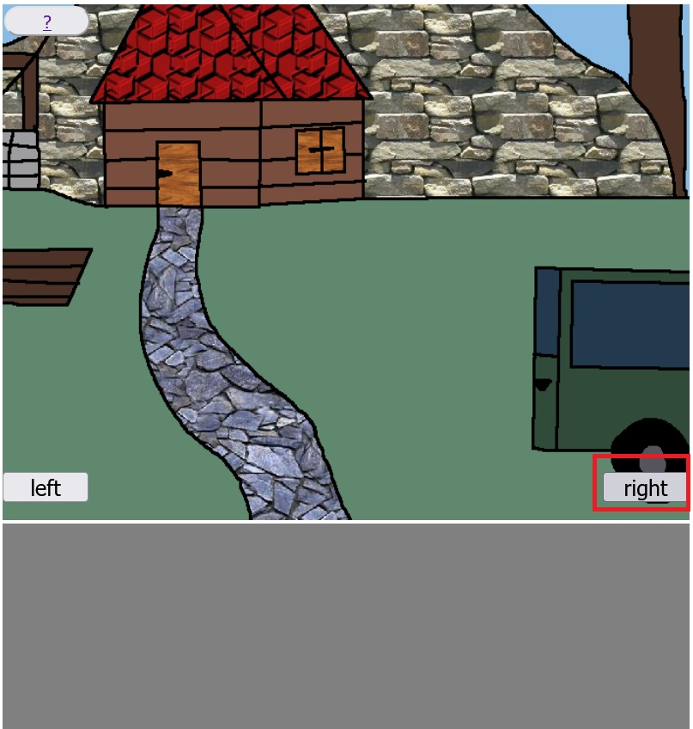
Step 6.
Click on the right button!

Slide 9
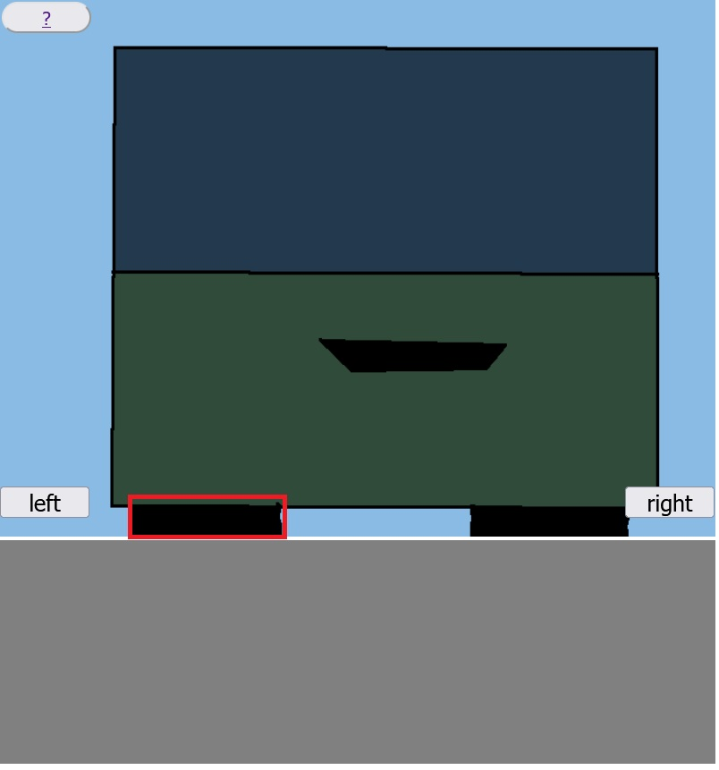
Step 7.
Click on the left tyre!

Slide 10
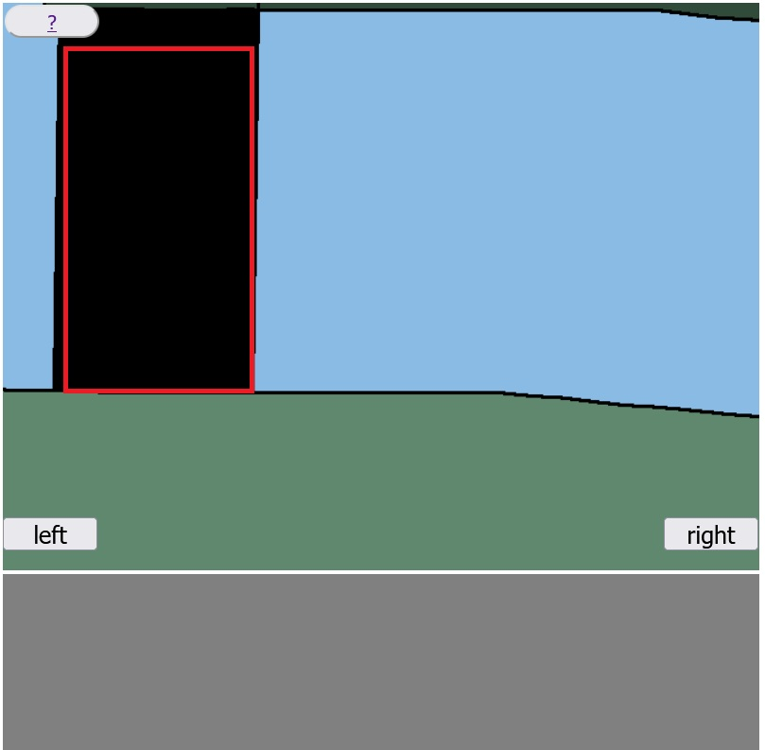
Step 8.
Click on the left tyre!

Slide 11
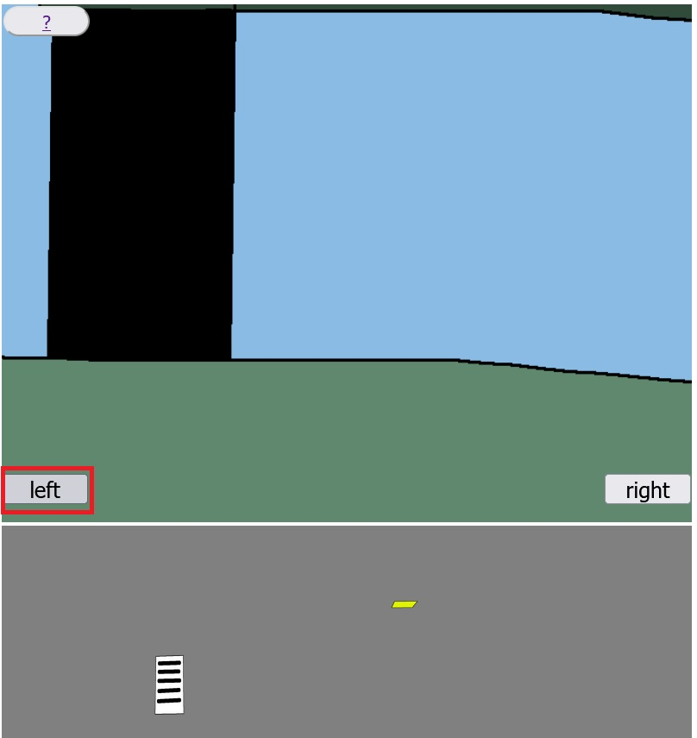
Step 9.
Click on the left button!

Slide 12
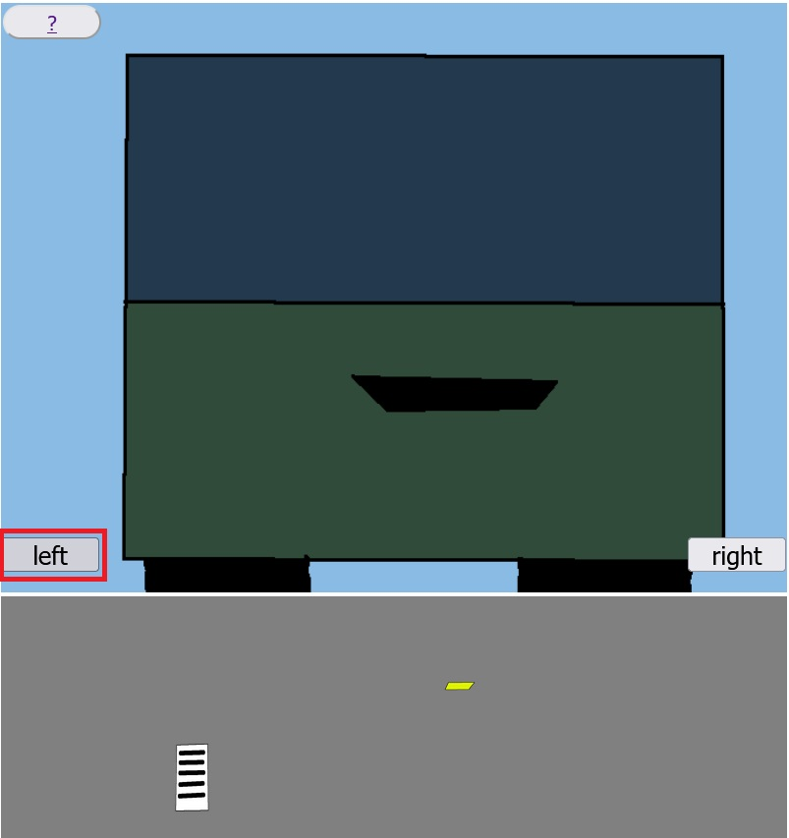
Step 10.
Click on the left button!

Slide 13
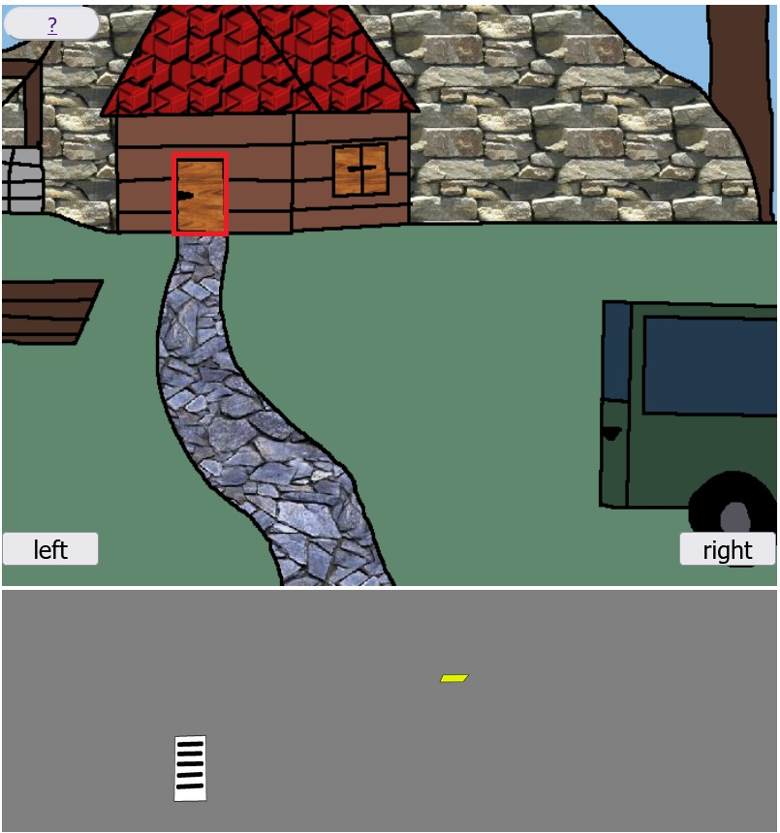
Step 11.
Click on the door of the weekend house!

Slide 14
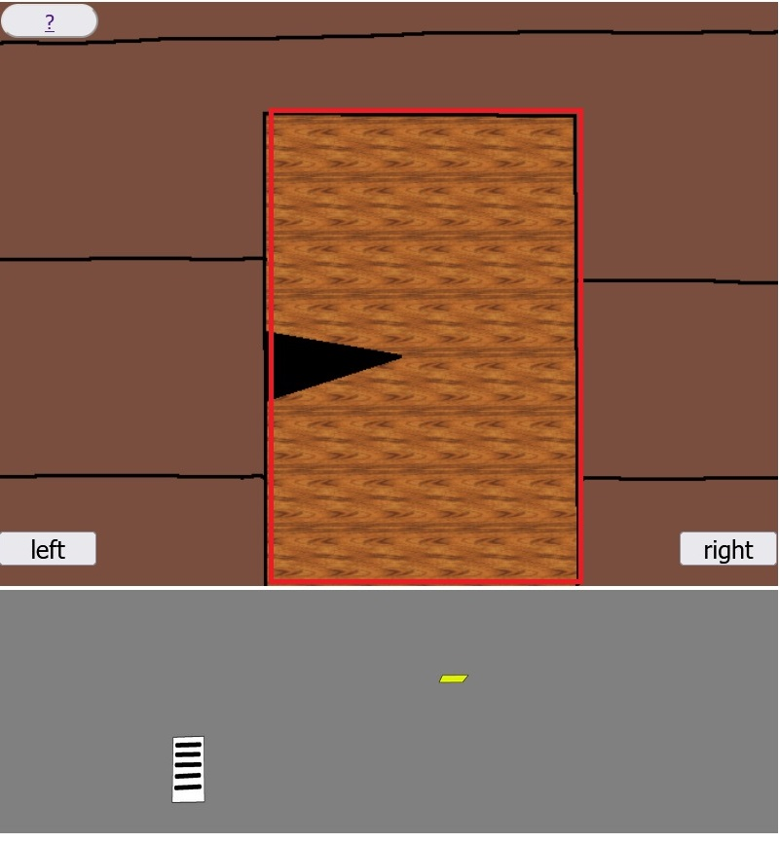
Step 12.
Click on the door of the weekend house!

Slide 15
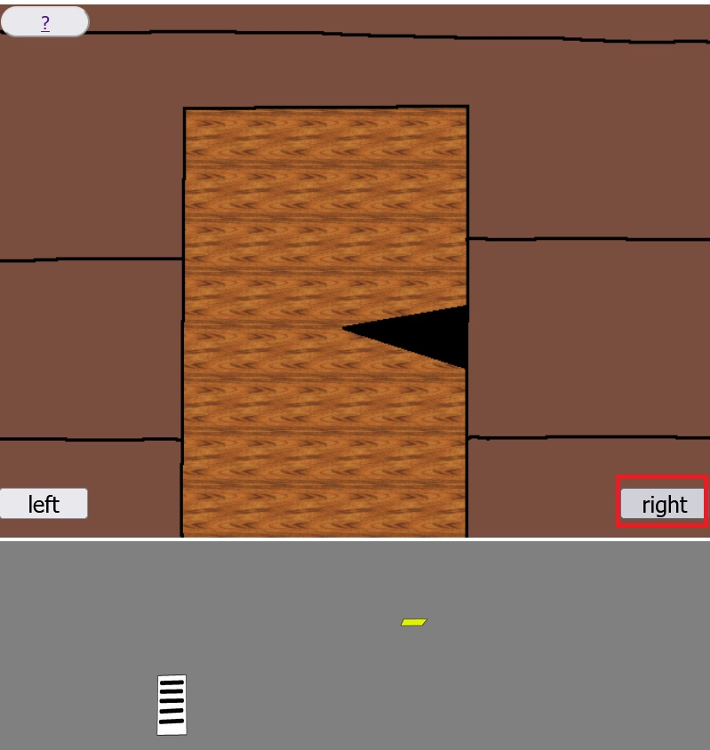
Step 13.
Click on the right button!

Slide 16
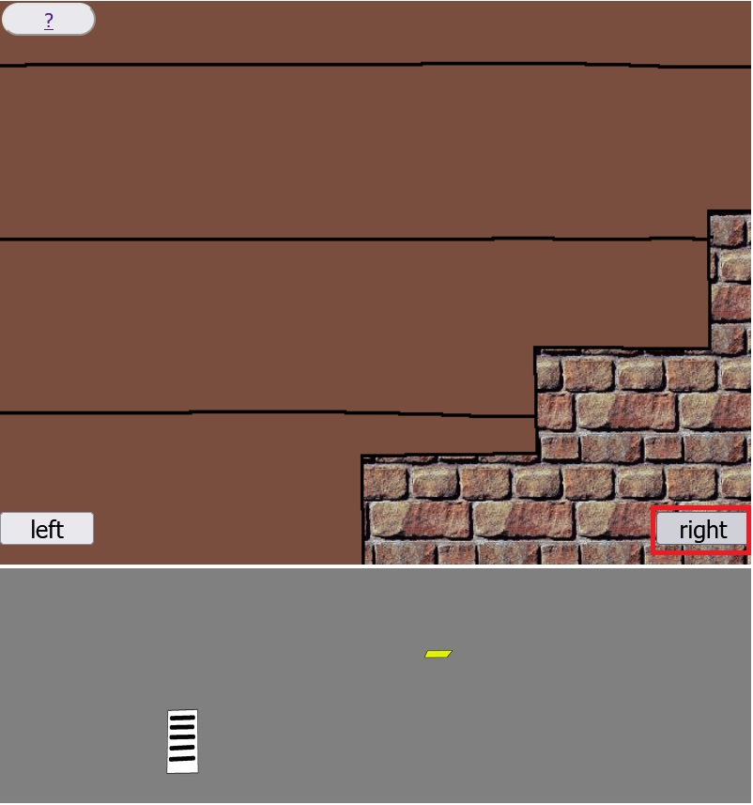
Step 14.
Click on the right button!

Slide 17
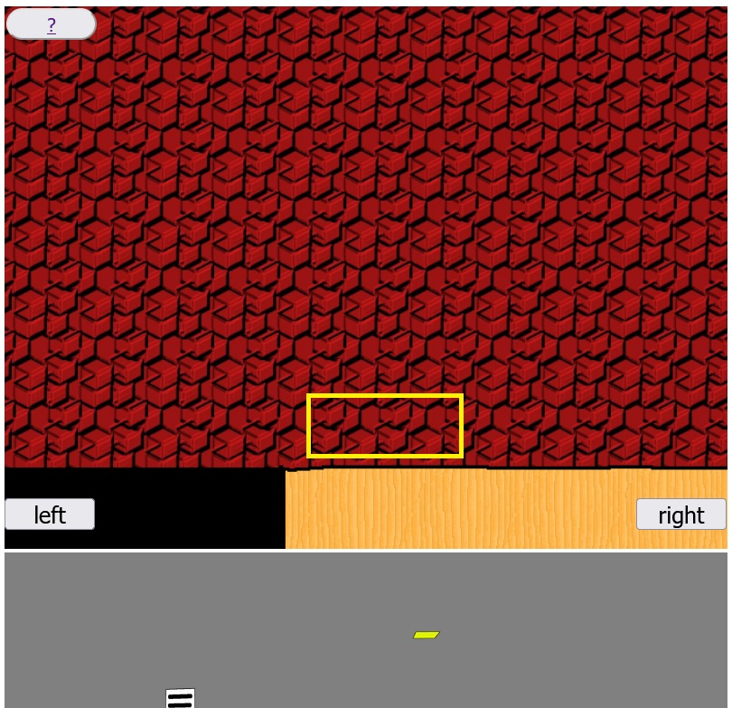
Step 15.
Click in the yellow rectangle marked area to get the bowl!

Slide 18
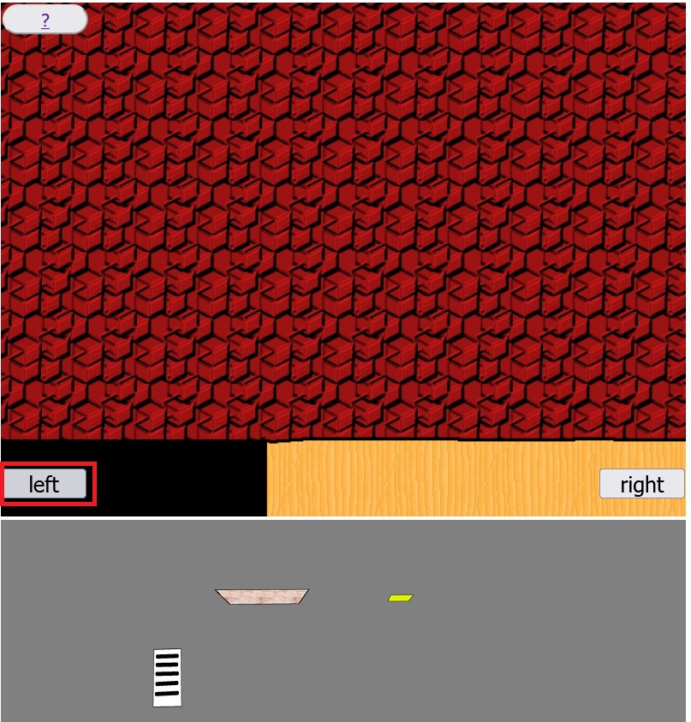
Step 16.
Click on the left button!

Slide 19
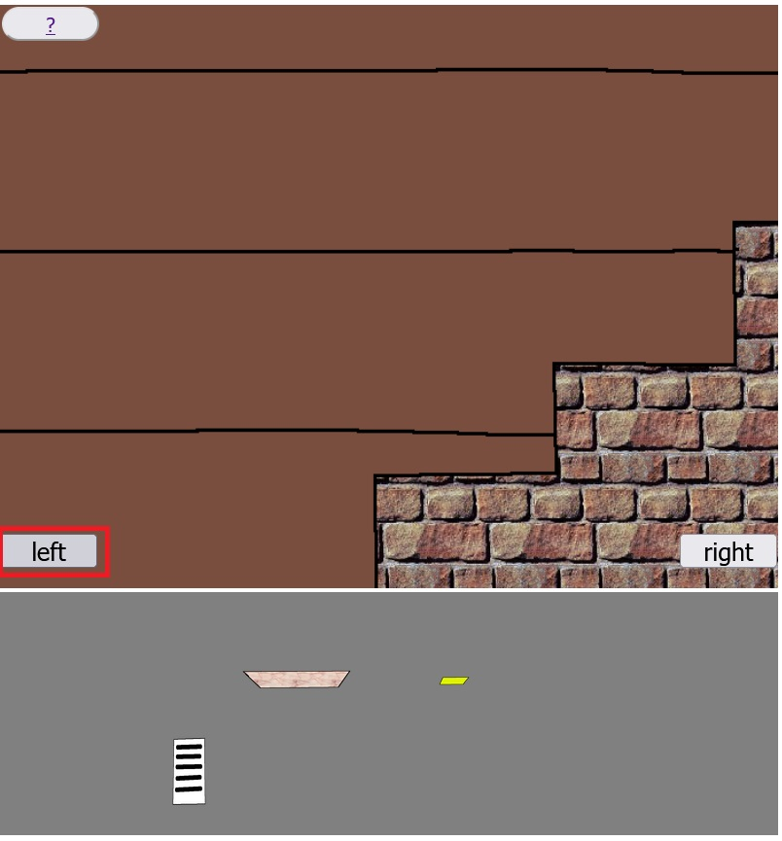
Step 17.
Click on the left button!

Slide 20
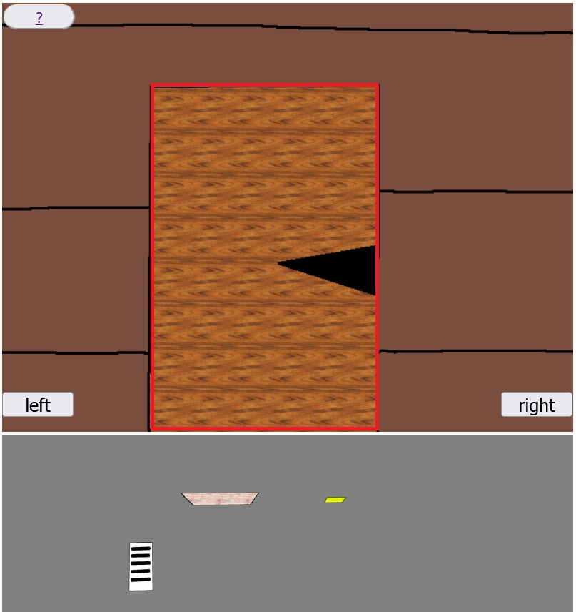
Step 18.
Click on the door of the weekend house!

Slide 21
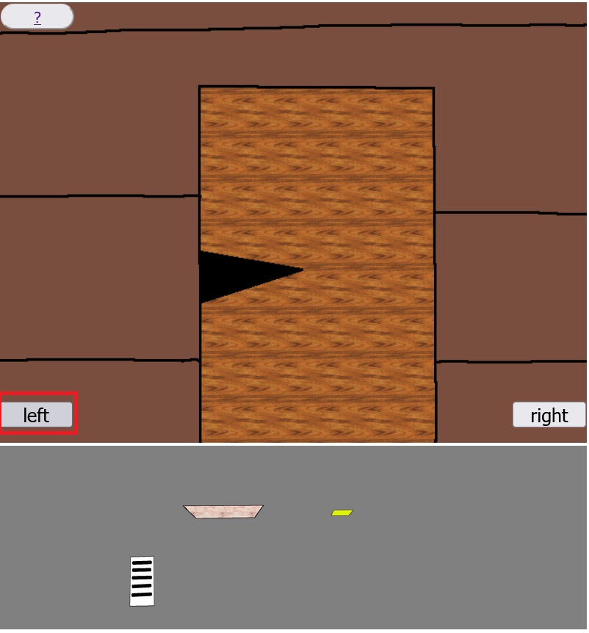
Step 19.
Click on the left button!

Slide 22
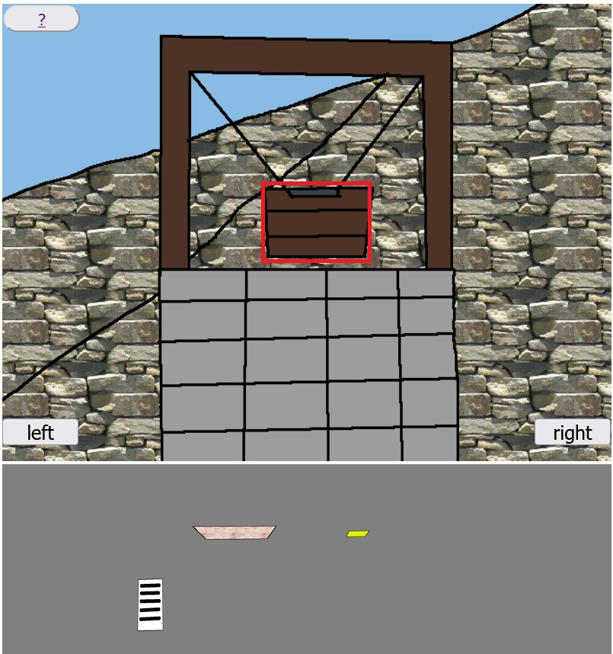
Step 20.
Click on the bucket of the well to fill the bowl with water!

Slide 23
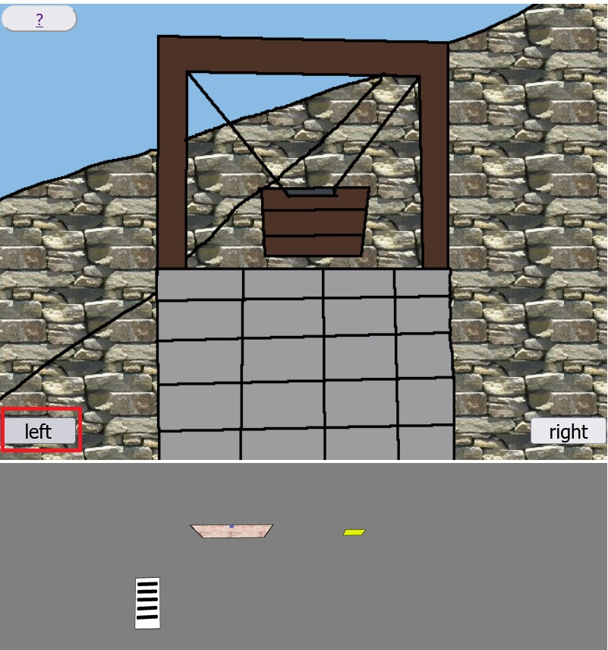
Step 21.
Click on the left button!

Slide 24
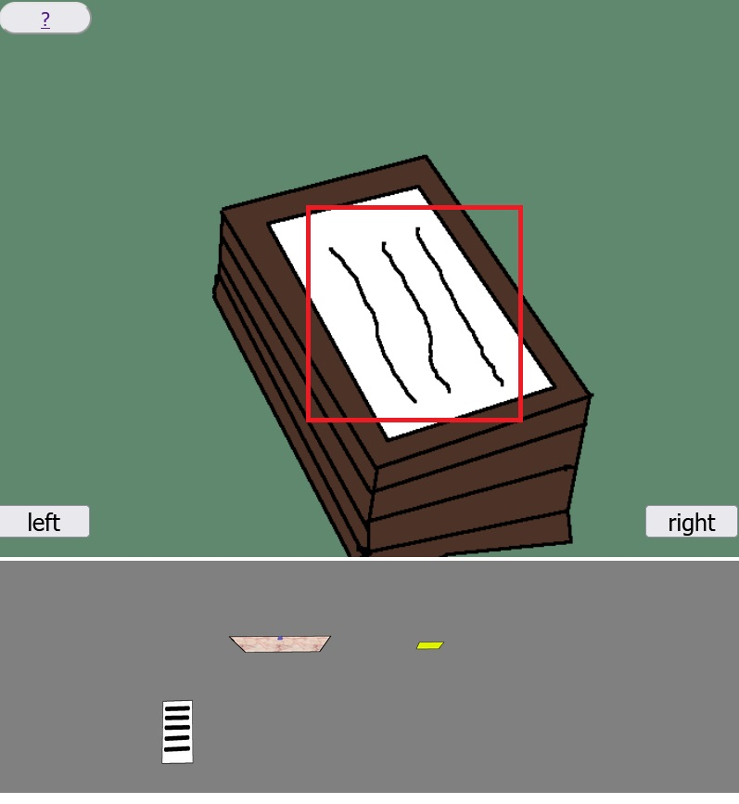
Step 22.
Click on the blanket to get the axe!

Slide 25
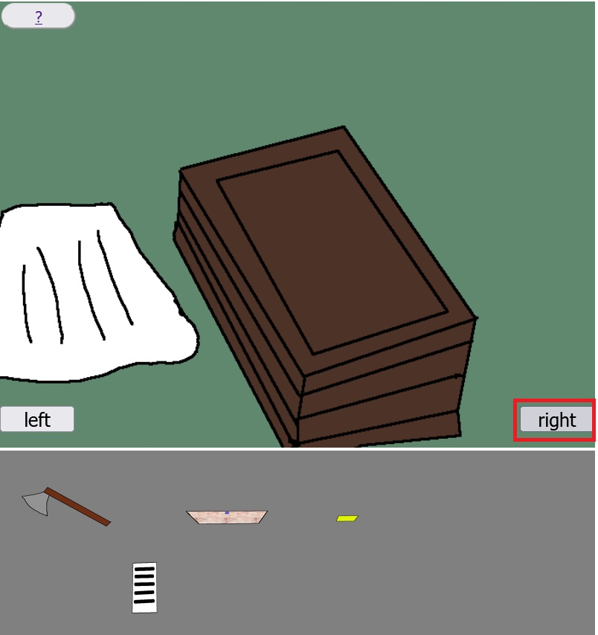
Step 23.
Click on the right button!

Slide 26
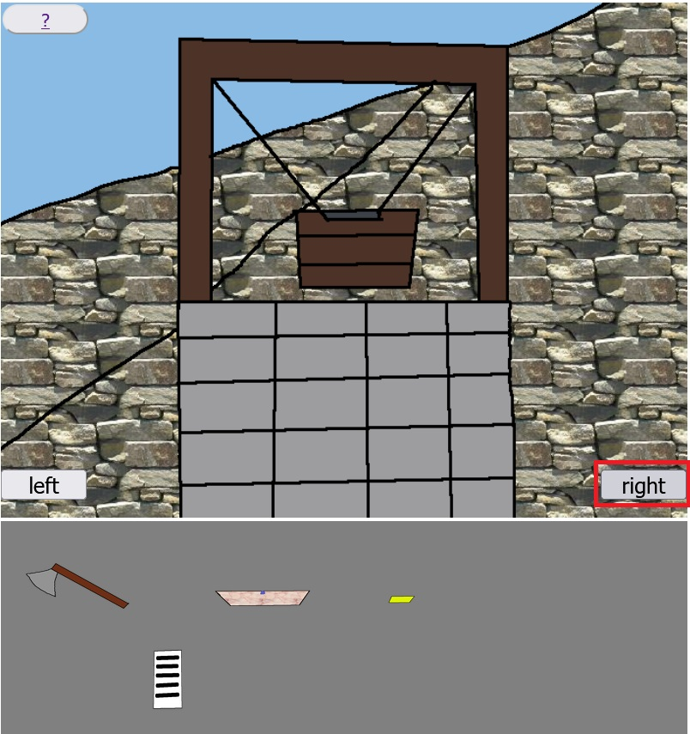
Step 24.
Click on the right button!

Slide 27
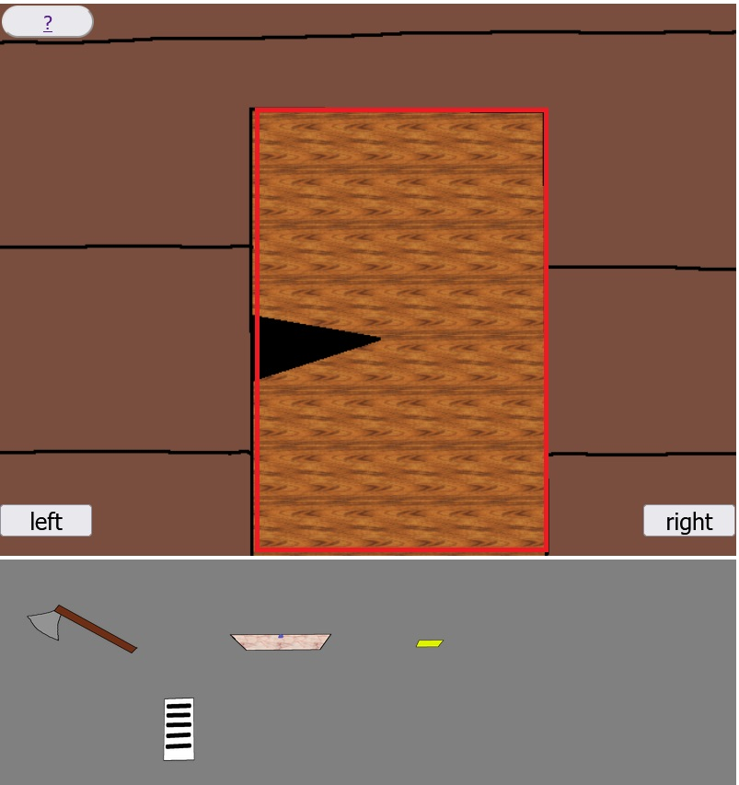
Step 25.
Click on the door of the weekend house!

Slide 28
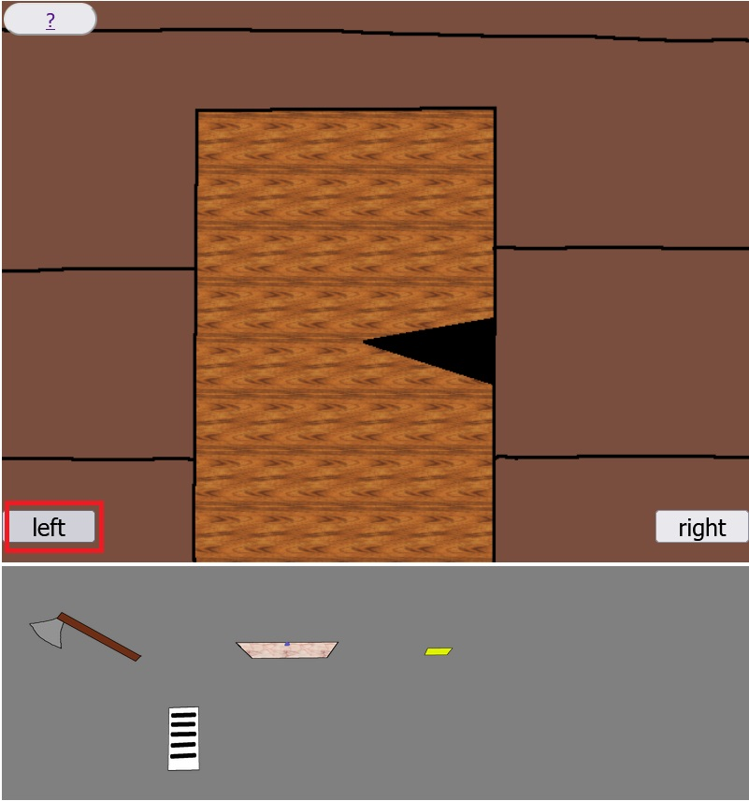
Step 26.
Click on the left button!

Slide 29
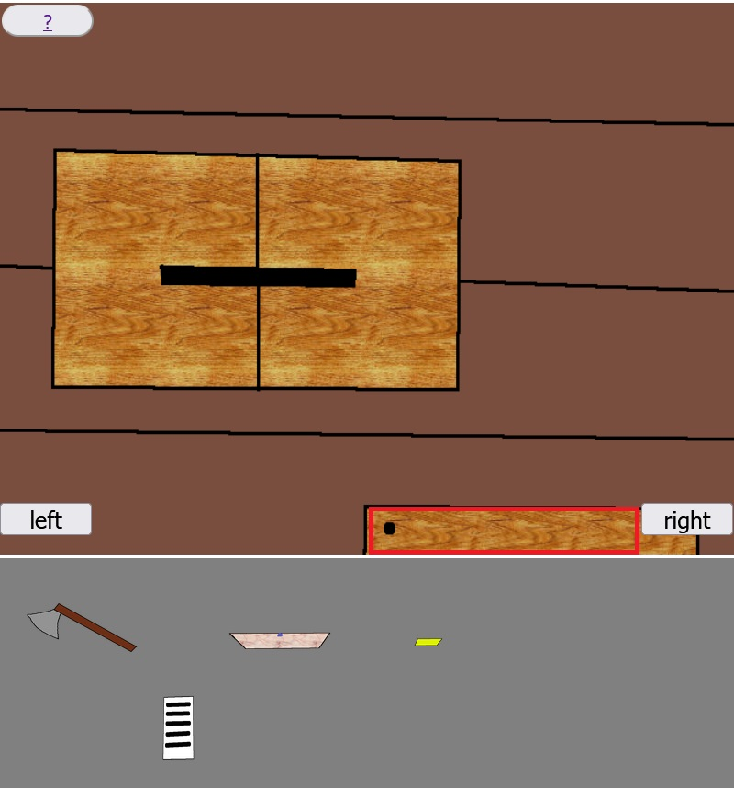
Step 27.
Click on the wooden box to get resources with the axe!

Slide 30
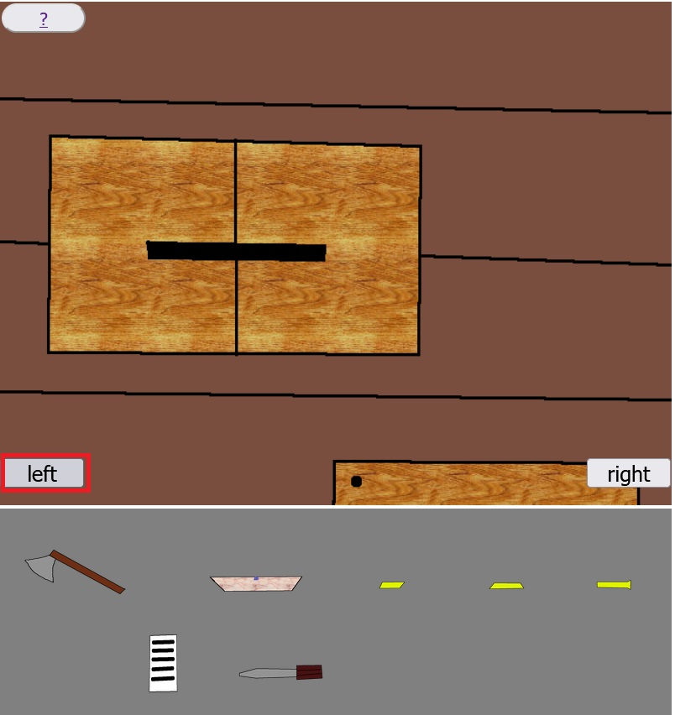
Step 28.
Click on the left button!

Slide 31
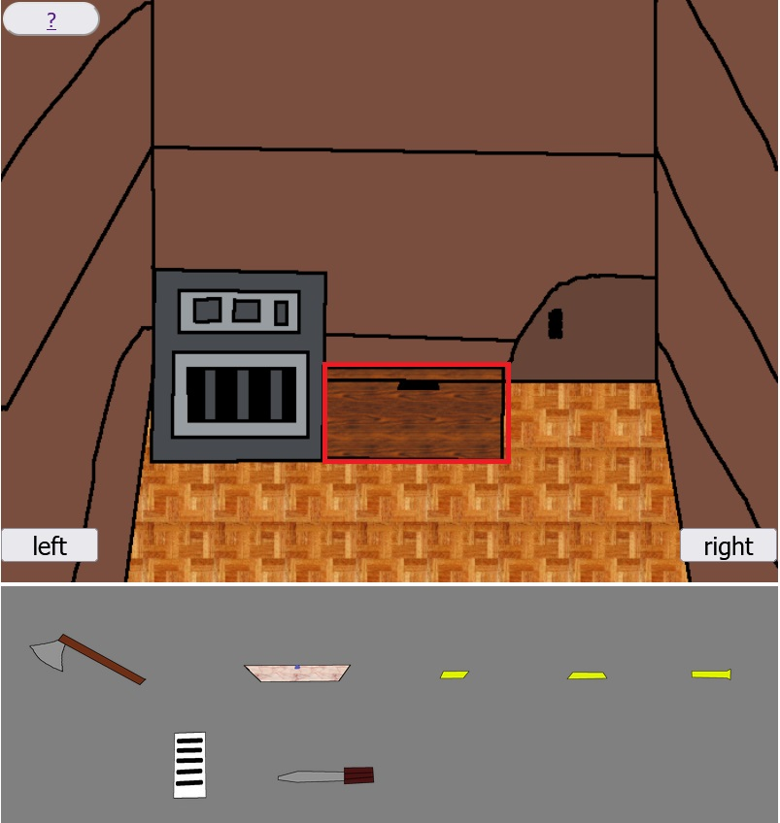
Step 29.
Click on the wooden box to deactivate the bomb!

Slide 32
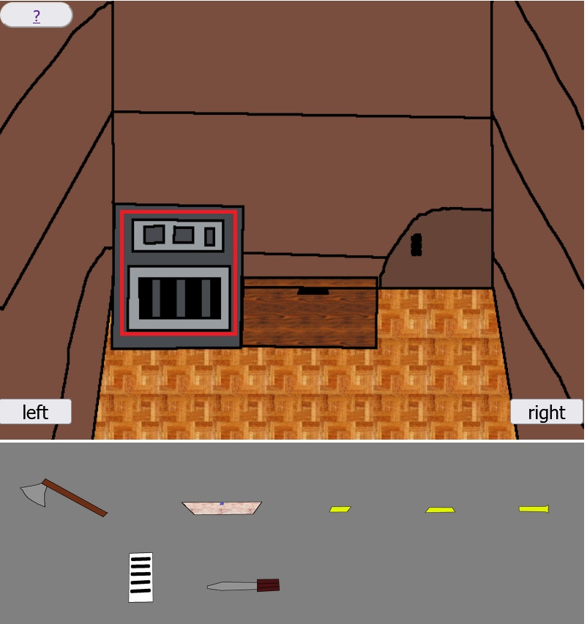
Step 30.
Click on the furnace to create key!

Slide 33

Step 31.
Click on the keyhole of the tunnel door!

Slide 34
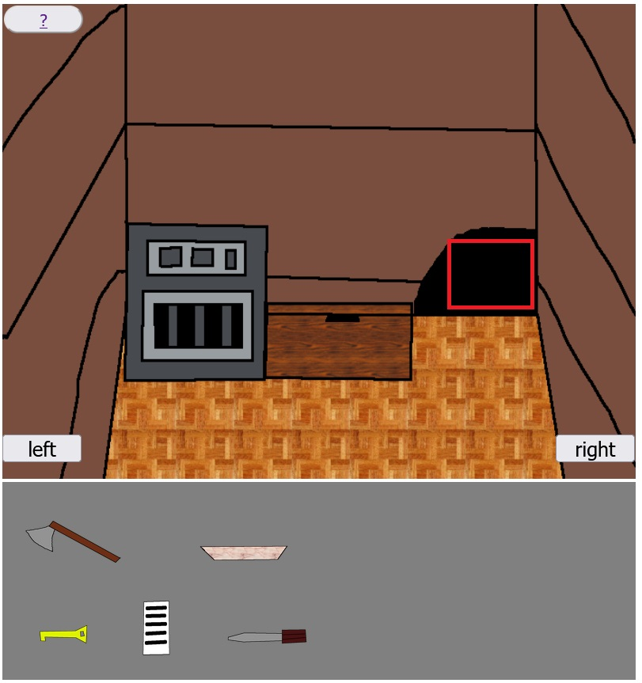
Step 32.
Click on the tunnel!

Slide 35
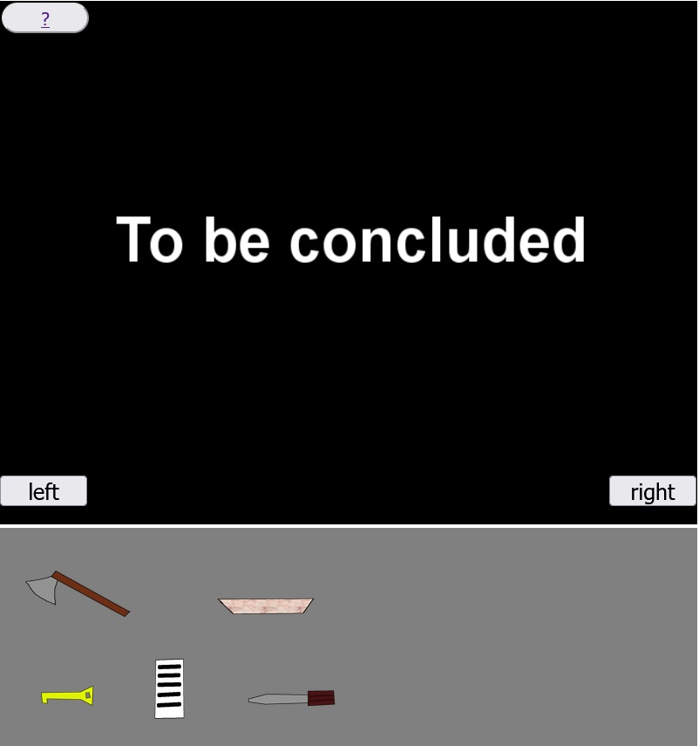
Congratulations! You have won the game!

