Slide 1
Deep Reinforcement Learning for Atari Games
Liyang Xie, Xiao Zeng, Kaixiang Lin
Notes:
12mins + 3mins Q&A

Slide 2
Outline
Introduction
Deep reinforcement learning.
Method & Algorithms
Policy Gradient, Deep Q-learning, A3C
Experimental Results
Notes:
10s

Slide 3
Introduction
Notes:
10s

Slide 4
Policy Gradient
Notes:
10s

Slide 5
Policy Gradient
Notes:
10s

Slide 6
Policy Gradient
Notes:
10s

Slide 7
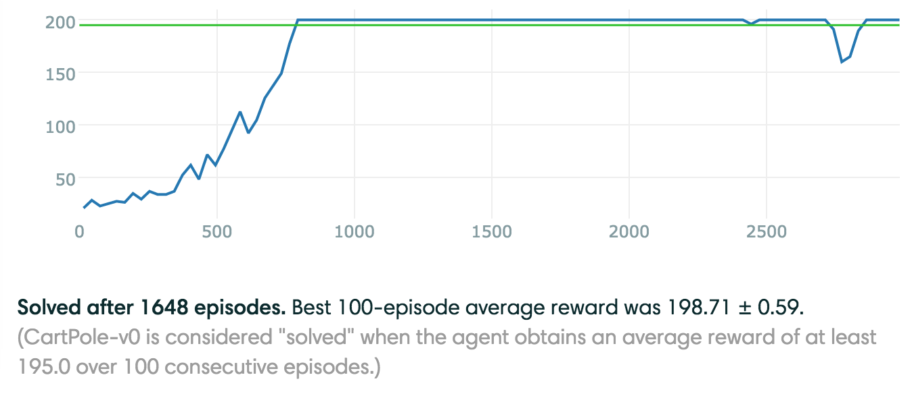
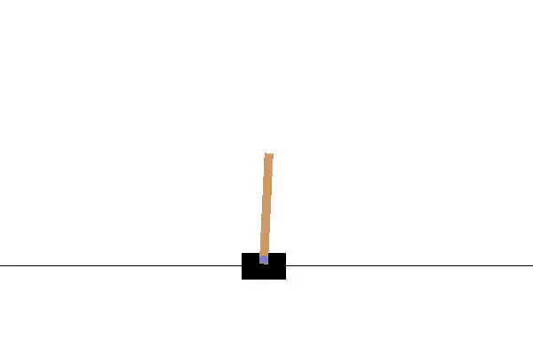
Policy Gradient- Cartpole
Notes:
10s

Slide 8
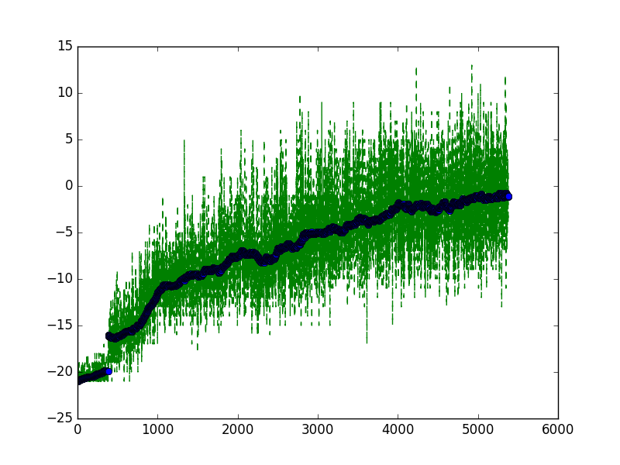
Policy Gradient - Pong
Notes:
10s

Slide 9
Q & A
Email: {xieliyan, zengxia6, linkaixi}@msu.edu
Notes:
Put email at the end

Slide 10
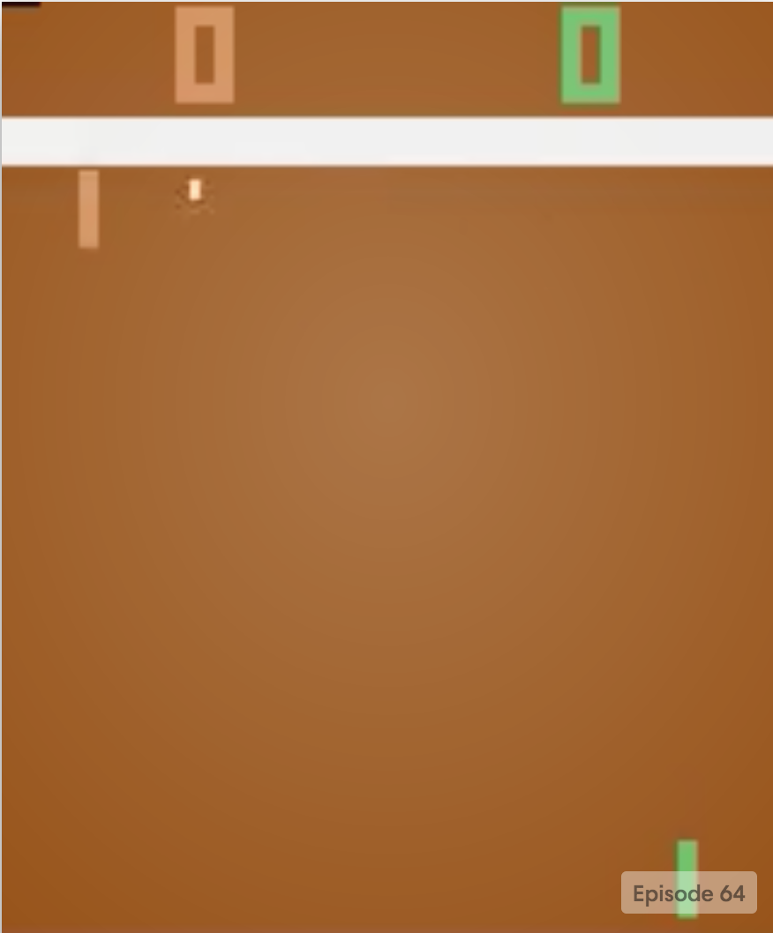
Moving up
preprocessing
Probability of actions
…..
Softmax
Moving down
State
L1: Input layer
L2: Several fully connected layers
L3:Output layer

