Slide 2
Content

Slide 3
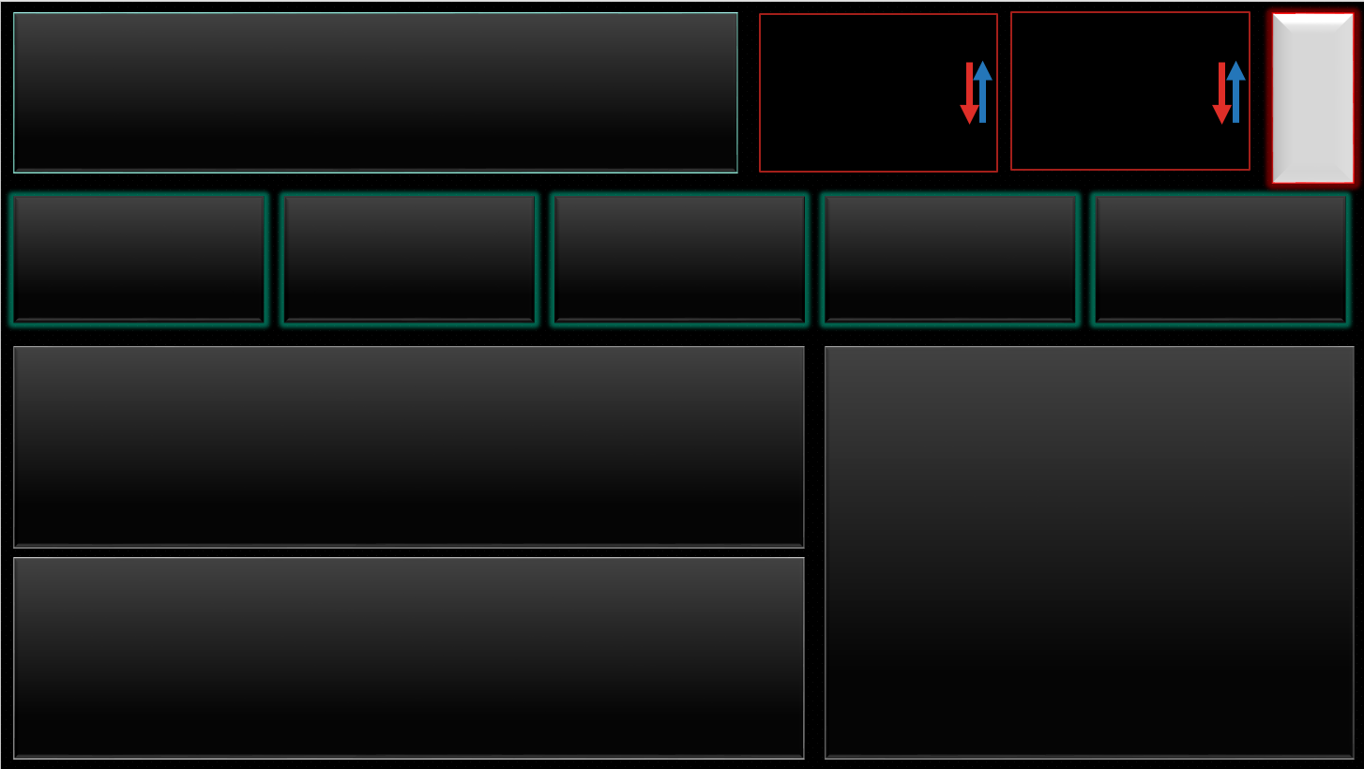

Slide 4


