Slide 1
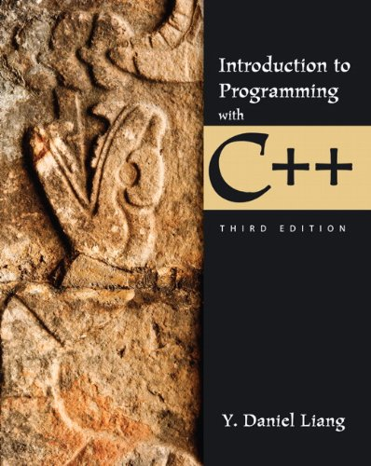
Welcome to
EGR 125
Introduction to Engineering Methods (C++ Programming for Engineers)
Reading Assignment:
Chapter 1 (read lightly) in Introduction to Programming with C++, 3rd Edition by Y. Daniel Liang

Slide 2
Where is C++ used in an engineering curriculum?
From the TCC Student Handbook for Engineering:
Technical Flowchart for Mechanical, Civil, and Environmental Engineering
EGR 110
EGR Graphics
(includes MatLab)
MatLab
EGR 120
Intro to EGR
MTH 173
Calculus I
EGR 125
Intro to Engr. Methods
C++
PHY 241
Univ. Physics I
MTH 174
Calculus II
EGR 140
Statics
PHY 242
Univ. Physics II
MTH 279
Diff. Equations
EGR 245
Dynamics
EGR 246
Mechanics
Of Materials
EGR 246
Mech. Of Materials Lab
MTH 277
Multivariable Calculus
MatLab
C++
TCC
CEE 305
C & E
Engineering Computations
ME 3405
Computational Methods in
ME
ODU
(Civil & Environmental)
(Mechanical)

Slide 3
Where is C++ used in an engineering curriculum?
From the TCC Student Handbook for Engineering:
Technical Flowchart for Electrical and Computer Engineering
EGR 120
Intro to EGR
MTH 173
Calculus I
EGR 110
EGR Graphics
(Includes MatLab)
MatLab
EGR 125
Intro. To Engr. Methods
Or CSC 201
Computer Science I
PHY 241
Univ. Physics I
MTH 174
Calculus II
EGR 140
Statics
(not req. for CpE at ODU)
C++
PHY 242
Univ. Physics II
MTH 279
Differential Equations
EGR 271
Circuit Theory I
EGR 270
Fundamentals of Computer Engineering
CSC 210
Programming in C++
(for CpE only)
C++
MTH 277
Multivariable Calculus (not required for Computer Engineering at ODU)
EGR 272
Circuit Theory II
EGR 262
Fundamental Circuits Lab
MatLab
C++
TCC
C++ and MatLab used in numerous junior and senior level electrical and computer engineering courses
ODU

Slide 4
Chapter 1: Introduction to Computers, Programs, and C++ Programming Languages
Assembly language
One level above machine language
Specific to a given type of microprocessor or computer
High-level language
Designed to simplify writing programs
Can be used on any type of computer
Four types
Procedural (imperative) – PBASIC, MatLab, C, etc
Functional
Declarative
Object oriented – C++, Java, C#

Slide 5
Software
Set of instructions read into computer’s memory and later executed on demand
Two types
System Software
Operating systems
Utility programs
Language translators
Application Software
Examples include games, word processing, database management, graphics, and much more
Programs solve practical problems or perform specific tasks
We will write programs of this type

Slide 6
Language Translators
Convert programmer-made instructions (source code) into machine-language instructions (object code)
Three types
Assemblers: Convert assembly language programs to object code
Interpreters: Converts an instruction to object code then executes it
Compilers: Converts entire program to object code to create an executable program that can be launched.

Slide 7
Integrated Development Environment (IDE)
Full package
Compiler
Text editor
Debugging tools
Allows creation, repeated execution and modification of a program
Helps find violations of language rules
Examples:
Microsoft Visual C++ (MSVC)
Bloodshed Dev C++
Eclipse CDT Project (C/C++ Development Tools)
We will use Dev C++ (free!)

Slide 8
Development of C++ Language
Middle 1980s at Bell Laboratories
Developed by Bjarne Stroustrup
Improvement upon C language
Standardized in 1997
American National Standards Institute (ANSI)
International Standards Organization (ISO)
The standard for C++ is continually being updated. The current standard is C++11 which was approved by the ISO in 2011.
C++ is object-oriented (uses classes). We will see what this means later in the course.

Slide 9
Structure of a C++ Program
The main() function
Overall structure of a C++ program contains one function named main(), called the driver function
All other functions are invoked from main()‏
Each statement inside the function must be terminated with a semicolon.
return: A keyword causing the appropriate value to be returned from the function
The statement return 0 in the main() function causes the program to end

Slide 10
Simple C++ Program – Example 1
#include <iostream>
using namespace std;
int main( )
{
statement1;
statement2;
return 0;
}
Header file (library)
Use the standard (std) namespace
The main function
Each statement ends with a semicolon (;)
Causes program to end (return is followed by an integer since main has a return type of int)
Body of the program inside braces { }

Slide 11
Simple C++ Program – Example 2
// - Indicates comment
// EGR 125 – Program to find square root of a number
#include <iostream> // header containing cin, cout
#include <cmath> // header containing sqrt( )
using namespace std; // use standard (std) namespace
int main( ) // main function
{
double x,y; // declare x and y as real numbers
cout << “Please enter x: “; // send prompt to screen
cin >> x; // read input from keyboard
y = sqrt(x); // calculate y
cout << “y = “ << y; // display result
return 0; //end program and return 0
}

Slide 12
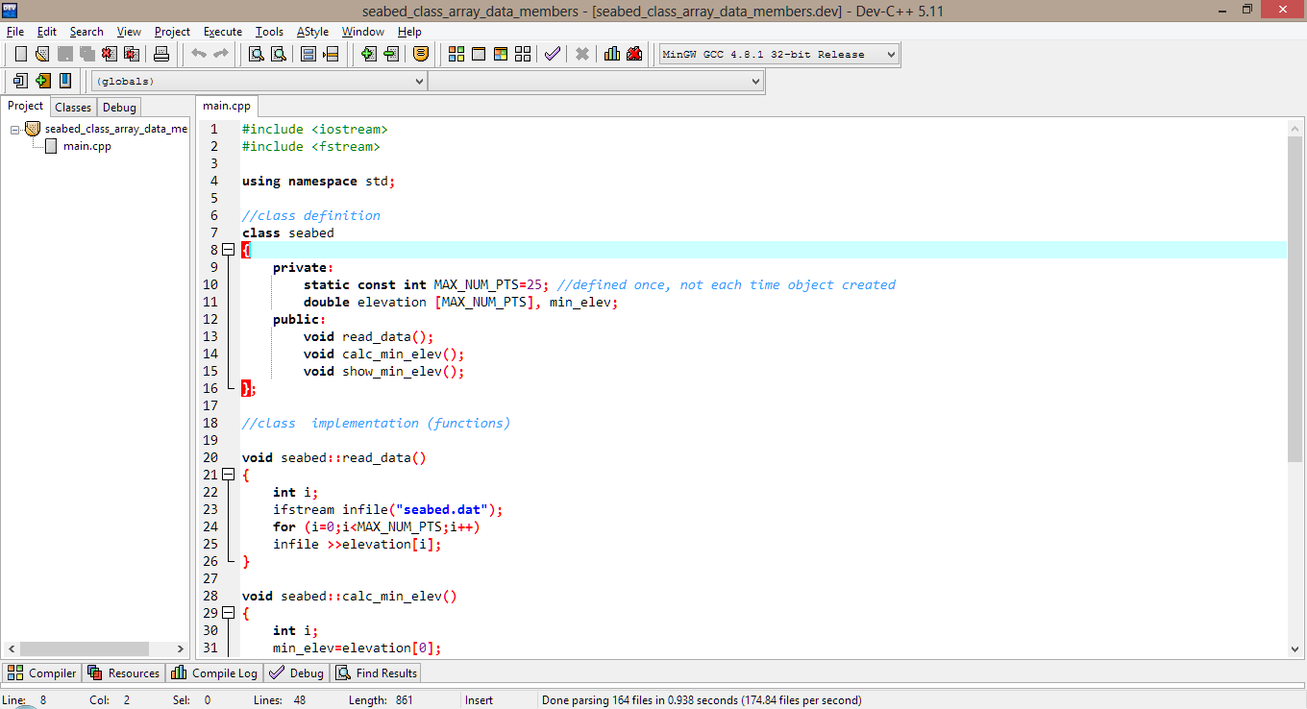
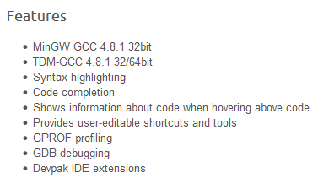
Bloodshed Dev C++ The latest version of Dev C++ can be downloaded from the course Blackboard site
Note: The installation of DevC++ should be easy. Instructions for installing and configuring are provided on the Bb site

Slide 13
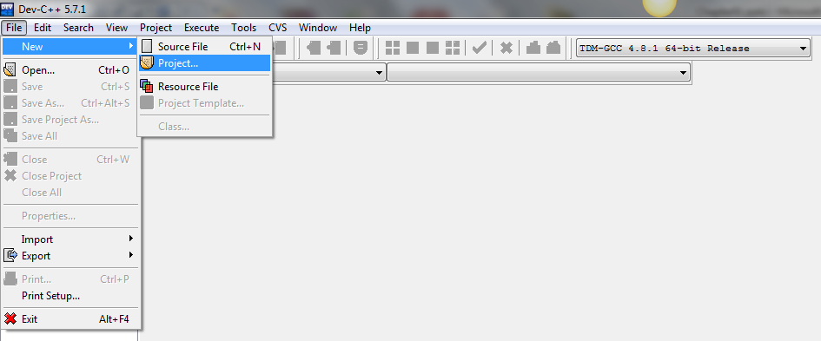
Creating A Project in C++ We will typically create a project in Dev C++. The project can contain various files, but our initial projects will contain only one file: main.cpp
Launch DevC++: Use the shortcut on the desktop or use Start – All Programs – Bloodshed DevC++ - DevC++
Create a project: File – New - Project

Slide 14
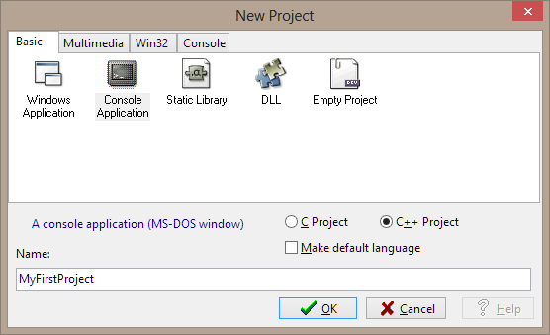
Select the project type and name the project:
Select Console Application
Make sure the C++ Project radio button is selected
Enter a name: MyFirstProject
Select OK

Slide 15
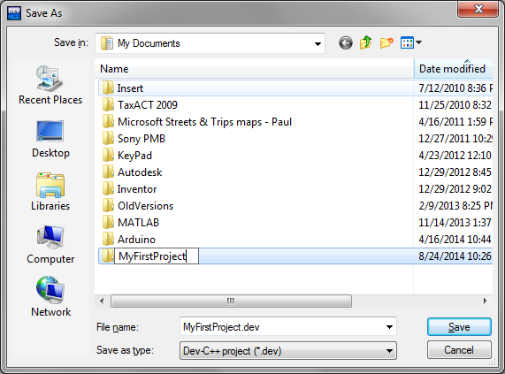
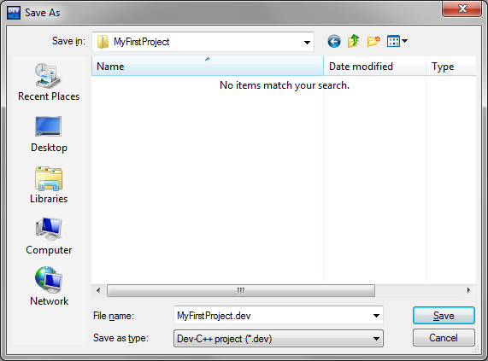
Save the project in a new folder (with the same name):
Select Create New Folder
Enter a name for the folder: MyFirstProject
Double-click the new folder to open it
Save the project : MyFirstProject.dev

Slide 16
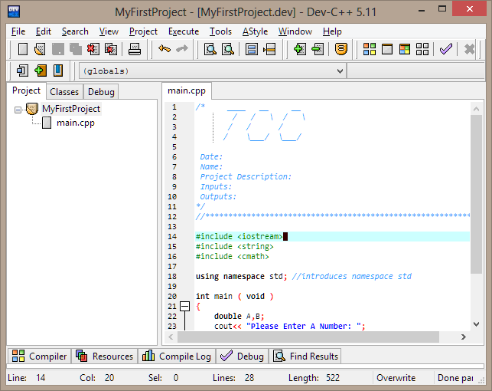
Enter the source code (your C++program):
The TCC template should populate the source file
Enter your source code between the braces

Slide 17
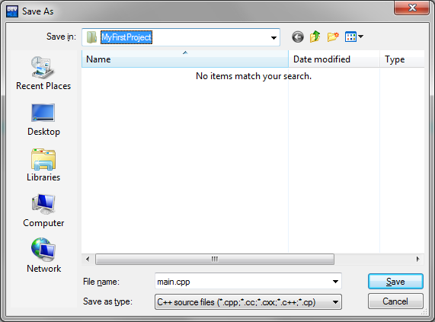
Save the file:
It is common to save the file as main.cpp (default setting)
Make sure you save the source file in your project folder (default setting)

Slide 18
Note the structure:
Note that if you expand (+) the project, you will see that the project contains one file: main.cpp
This will be a typical structure for early projects.

Slide 19
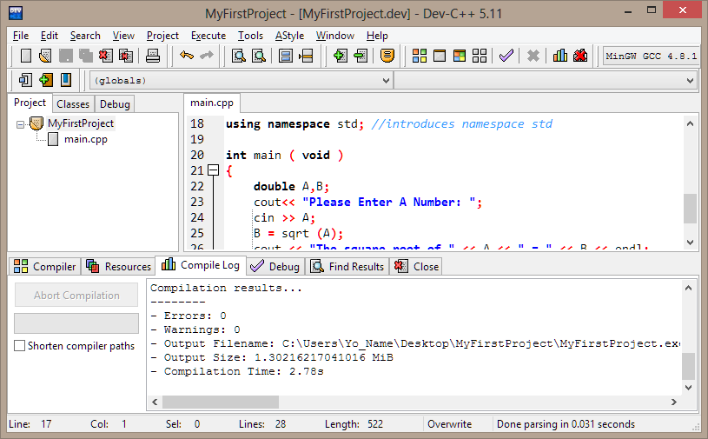
Compile the project:
Select the Compile Button (or use F9).
A successful results is indicated by: 0 Errors and 0 Warnings
You can also use the Compile and Run Button (F11)

Slide 20
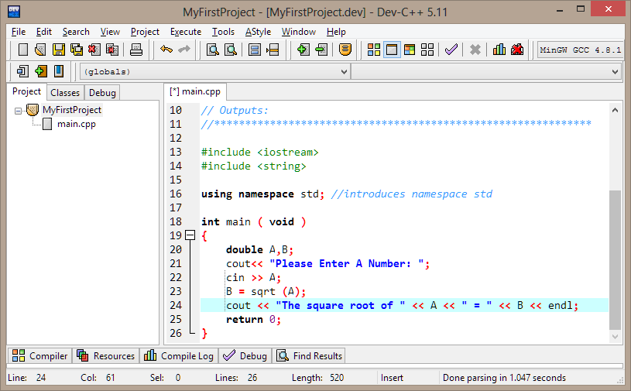
Run the project:
Select the Run Button (or use F10).
You can also use the Compile and Run Button (F11)

Slide 21
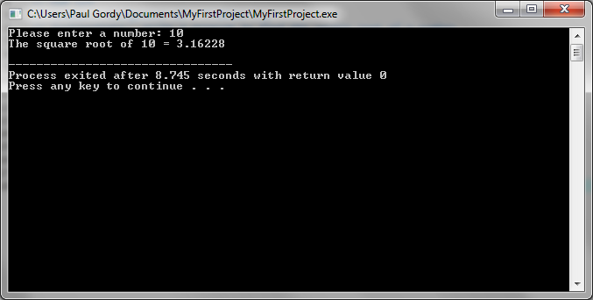
Enter inputs and check your results:
An output window will appear when the program runs.
Enter the desired inputs.
Check the outputs to be sure that they are correct.

Slide 22
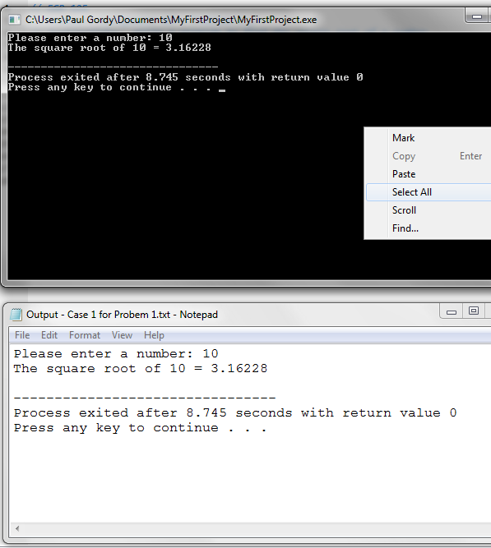
Printing your results:
There is no print option for the output window.
To print the results, right click and pick Select All. This puts the entire output in the clipboard.
Open Notepad, Word, etc., and Paste the output.
Print it from Notepad, Word, etc.
You can also use PrintScreen, but it wastes ink and is harder to read.

Slide 23
Types of Programming Errors
There are three types of programming errors:
Syntax Errors – Errors where the program will not compile correctly due to incorrect usage of C++ commands.
Logical Errors – Errors where the user didn’t correctly solve the problem. The program compiles correctly, but the answers are incorrect.
Runtime Errors – Errors where the program will not run or crashes due to errors such as overflow, underflow, improper memory allocation, etc. Example: A program might divide by N, but if N = 0 the program crashes.

Slide 24
Example – The three types of programming errors are illustrated in examples below.
These examples can be compiled and run from this presentation. (Syntax errors, of course, can’t be run.)
The results are also shown on the following three slides.
ShowSyntaxErrors
ShowRuntimeErrors
Run
ShowLogicErrors
Run

Slide 25
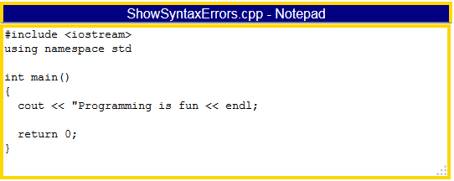
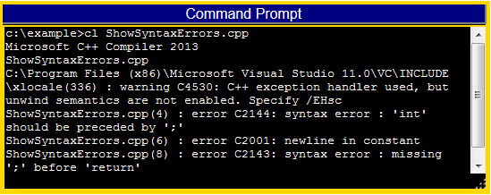
What was the problem?

Slide 26
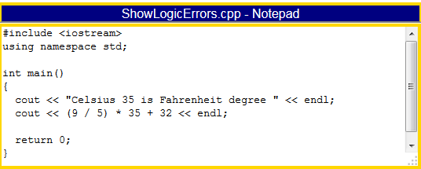
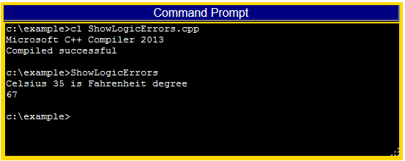
What was the problem?

Slide 27
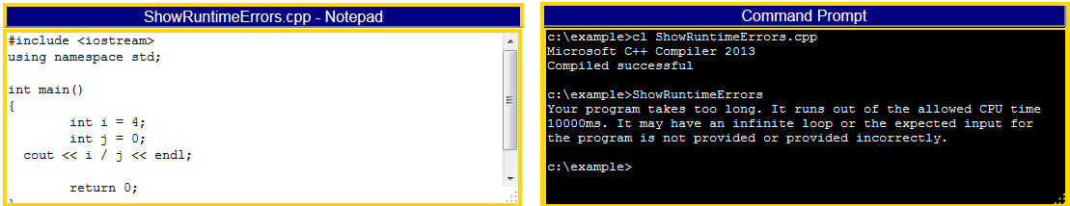
What was the problem?

