Slide 1
Chapter 3 – Selection Structures
It is often necessary in programming to make decisions, where the
program will perform different tasks based on the results of some test.
So far, all of our C++ programs have consisted of straight line control, or a series of commands executed in order with no branches.
In this chapter selection structures (also called decision structures or branching structures) are introduced.
Two types of selection structures will be introduced:
if structures
switch structures

Slide 2
Flowcharts for straight line and selection control structures
Command
Command
Command
False
Test
True
Command
Commands
to execute
if False
Commands
to execute
if True
Command
Command
Command
Straight Line Control
Example Selection Structure
(decision structure)
Notes:
2

Slide 3
Simple if Control Structures
Used to make decisions
Relational expression evaluated
Evaluated as true or false
Block of statements only executed if true
statement
relational
expression
True
Form:
if (relational expression)
{
statement(s);
}
statements
to execute
if True
False
statement
Block of statements (compound statement) to be executed if the relational expression is true or skipped if false.
Flowchart

Slide 4
Examples:
if (Price > 100.00)
{
cout << “Shipping charge is 2%”;
charge = 0.02*cost;
}
if (Age < 0) cout << “Error. Age cannot be negative.”;
Note: Braces are only needed for 2 or more statements.
if (Angle = = 90)
{
cout << “Right triangle”;
H = pow(pow(A,2)+pow(B,2),1.0/2);
}

Slide 5
Relational Expressions
Type of logical expression
Produces result of true or false
Compares values of two arithmetic expressions
Form: left_operand relational_operator right_operand
Example: if (x + y < 6 - z)
Relational Operator | Operation | Example
= = | Equal to | Row == 6
!= | Not equal to | Time != 100
> | Greater than | Max_Value > 12.5
>= | Greater than or equal to | Age >= 21
< | Less than | A - B < 0.001
<= | Less than or equal to | pow(b,2) <= 4*a*c

Slide 6
Examples: Relational Expressions For each case below, assume that: A = -1, B = 3, C = 0, and D = 4; Arithmetic operations are evaluated before logical operations (more on this later)
Relational Expressions | true or false?
( B – D < A)
(A - B == C - D)
(B – D – A <= 0)
(pow(B,2) > B*D-2*A)
(1/B >= 1/D)
(A != -1)

Slide 7
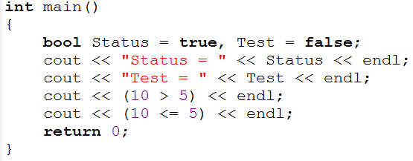
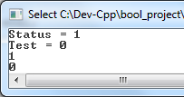
The bool data type
So far we have used the data types int, float, short, double, char, etc.
The bool data type is often used with relational expressions.
Variables of type bool can be either true or false.
Example:
int j = 2;
double x = 3.75;
bool Result1 = true, Result2 = false ;
C++ uses 1 to represent true and 0 to represent false.
If you display a bool variable, 0 or 1 will be displayed.
Example: Discuss the results below.
true = 1
false = 0

Slide 8
The bool data type (continued)
You can assign any numeric value to a bool variable.
Any non-zero value is true. Zero is false.
Examples:
bool b1 = -1.5; // same as bool b1 = true;
bool b2 = 0; // same as bool b2 = false;
bool b3 = 1.5; // same as bool b3 = true;
Non-zero value = true
Zero value = false

Slide 9
Comparing Characters and Strings
Comparing letters is essential in alphabetizing names or in using characters to make decisions in selection structures.
Single characters are treated as integers and are compared based on their ASCII value (see table in Appendix of the textbook), so
‘A’ < ‘B’ (since using their ASCII values, 65 < 66)
‘A’ < ‘a’ (65 < 97)
‘1’ < ‘2’ (49 < 50)
Strings of characters are compared one character at a time. If the first character in each string is the same, then move on and compare the second character, etc. They are essentially ordered as they might be in a dictionary, so
“sent” < “sentence” < “sentences”

Slide 10
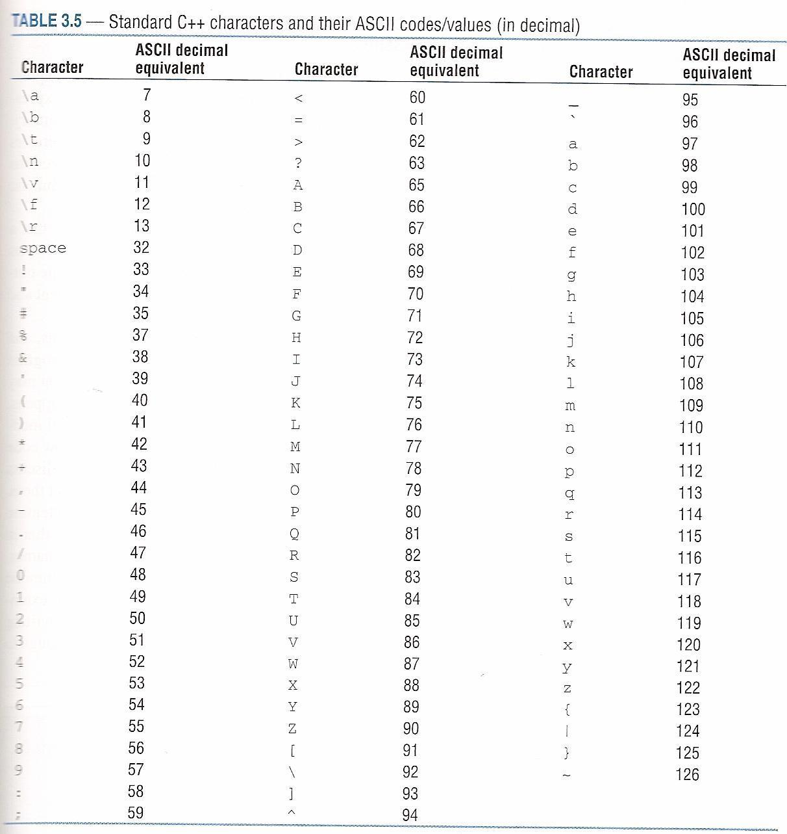
ASCII Codes
Exercise: Determine whether each expression below is true or false:
Expression | T/F?
‘x’ < ‘y’
‘a’ < ‘B’
“pen” < “pencil”
“3” < “4”
“35” < “315”
‘*’ < ‘?’

Slide 11
Logical Operators
Sometimes logical operators are used for more complicated logical tests for branching.
For example, instead of executing a block of statements if x > 2, we might want to execute them if x > 2 and if x < 7.
The logical operators are commonly used:
AND (&&)
OR (||)
NOT (!)

Slide 12
Logical AND Operator
The symbol && represents the logical function AND
Combines two relational expressions
Combined expression true only if BOTH expressions are true
The AND function is defined as follows:
L1 | L2 | L1 && L2
false | false | false
false | true | false
true | false | false
true | true | true
Example:
double Age = 12;
if (Age > 12 && Age < 20)
{
cout << “You are a teenager”;
}
True or false?

Slide 13
Logical OR Operator
The symbol || represents the logical function OR
Combines two relational expressions
Combined expression false only if BOTH expressions are false
The OR function is defined as follows:
L1 | L2 | L1 || L2
false | false | false
false | true | true
true | false | true
true | true | true
Example:
double x = 2, y = 3;
if (x > = 3 || y != 2)
{
statement(s);
}
True or false?

Slide 14
Logical NOT Operator
The symbol ! represents the logical NOT function
Reverses result of a relational expression
The NOT function is defined as follows:
Example: ! (x == y)
L1 | !L1
false | true
true | false
Example:
double x = 2, y = 3;
if (!(x = = y))
{
statement(s);
}
True or false?

Slide 15
Precedence of Operators
Operator Symbol | Operator Name | Direction | Precedence (1 = highest)
( ) | Parentheses | L to R | 1
++, -- | Post-increment | L to R | 2
++, -- | Pre-increment | R to L | 3
! | Logical NOT | L to R | 3
+, - | Positive, negative | L to R | 3
*, /, % | Multiplication, division | L to R | 4
+, - | Addition, subtraction | L to R | 5
<=, >=, >, < | Relational operator | L to R | 6
= =, != | Relational operator | L to R | 7
&& | Logical AND | L to R | 8
|| | Logical OR | L to R | 9
+=, -+, *=, /=, %= | Compound assignment | R to L | 10
= | Assignment | R to L | 10

Slide 16
Example:
int a = 4, b = -2, c = 0;
if (a > b || b > c && a != b)
{
statement(s);
}
True or false?
Example:
int a = 4, b = -2, c = 7;
if (pow(a,2) > a*c+b || 17-c > c-17 && a/2 != -b)
{
statement(s);
}
True or false?

Slide 17
Simple if/else control structures
One block of statements is executed if the expression is true and another block if the expression is false.
Braces are optional if there is only one statement in the block.
Form:
if (relational expression)
{
statement1a;
statement1b;
…
}
else
{
statement2a;
statement2b;
…
}
Block of statements (compound statement) to be executed if the relational expression is true
Block of statements (compound statement) to be executed if the relational expression is false

Slide 18
Flowchart for if/else control structures
statement
Form:
if (relational expression)
{
statement1a;
statement1b;
…
}
else
{
statement2a;
statement2b;
…
}
False
Relational
expression
True
statement 2a
statement 1a
statement 2b
statement 1b
statement

Slide 19
Examples
if (x < 12)
cout << “smaller than twelve”;
else
cout << “twelve or larger”;
Note: No braces are needed since each block contains only one statement.
if (Hours > 40)
{
cout << “You worked overtime”;
Pay = 40*Base_Rate + (Hours – 40)*Overtime_Rate;
}
else
{
cout << “No overtime worked”;
Pay = Hours*Base_Rate;
}

Slide 20
Class Examples – If structures
Try one or more examples in class if time allows
Prompt the user to enter a valid grade.
If the grade is from 0 to 100, display “valid grade”
Otherwise display “invalid grade”
Calculate the cost to order a certain quantity of items based on the table below.
Prompt the user to enter the quantity desired
Display the unit cost and the total cost.
Display an error message if a negative quantity is entered.
Quantity | Unit Cost
0 – 24 | $1.50
25 - 99 | $1.25
100 or more | $1.10

Slide 21
Nested if Statements
Nested if statements are very common in programming
A nested if statement is an if statement that is the target of another if or else statement.
Proper indentation helps us to understand the structure (although the compiler doesn’t care).
Example form:
if (outer)
{ …
if (inner)
{ … }
else
{ … }
}
else
{ … }
Inner block only executed if outer if statement was true

Slide 22
//Example – Nested if statements
int x, y, z, result;
cout << “Enter values for x, y, and z”;
cin >> x >> y >> z;
if (x > y)
{
if (x > z)
{ result = pow(x,2);}
else
{ result = pow(y,2);}
}
else
{ result = pow(z,2);}
Try it for a few cases:
x | y | z | result
1 | 2 | 3
1 | 3 | 2
2 | 1 | 3
2 | 3 | 1
3 | 1 | 2
3 | 2 | 1

Slide 23
if-else-if structures
Shifts program control, step by step, through series of statement blocks
Control stops at relational expression that tests true
Some programming languages have an “elseif” command. In C++, using
else if(relational expression)
simply implies that the if statement represents that block of instructions to be represented when the else condition is true.
Proper indentation is important for readability.
In general, an else statement always refers to the nearest if statement that is within the same block as the else and not already associated with another else.

Slide 24
Format: if-else-if structure
if (relational_expression_1)
{
statement_block_1
}
else if (relational_expression_2)
{
statement_block_2
}
.
.
.
else if (relational_expression_n-1)
{
statement_block_n-1
}
else
{
statement_block_n
}

Slide 25
Class Example: if-else-if structure Write C++ instructions to find y(x) after the user enters a value for x.

Slide 26
int X, Y = 9;
cout << "\n Please enter a value for X: ";
cin >> X;
if (X > 2 && X <= 25)
if (X > 10)
{ Y = 1;
if (X > 20)
Y = 2;
}
else
Y = 3;
else if (X <= 0 || X > 50)
if (X > -10 && X < 75)
Y = 4;
else
Y = 5;
else if (X > 25)
{ if (X > 35)
Y = 6;
else if (X < 32)
Y = 7;
}
else
Y = 8;
cout << "\n Y = " << Y;
return 0;
}
Example: Determine y for each value of x
X | Y
-15
-5
1
3
10
15
22
28
32
40
60
80

Slide 27
int X, Y = 9;
cout << "\n Please enter a value for X: ";
cin >> X;
if (X > 2 && X <= 25)
if (X > 10)
{Y = 1;
if (X > 20)
Y = 2;
}
else
Y = 3;
else if (X <= 0 || X > 50)
if (X > -10 && X < 75)
Y = 4;
else
Y = 5;
else if (X > 25)
{if (X > 35)
Y = 6;
else if (X < 32)
Y = 7;
}
else
Y = 8;
cout << "\n Y = " << Y;
return 0;
}
Example: The last example is repeated without indentation. Note how difficult it is to follow.
Always indent if structures!

Slide 28
Testing for multiples
The modulus (%) function works well for testing for multiples.
For example, A%3 = 0 if integer A is a multiple of 3.
Example:
int main ( )
{ int N;
cout << “Enter an integer N: “;
cin >> N;
if (N%3 == 0)
cout << “N is a multiple of 3”;
else
cout << “N is not a multiple of 3”;
Class Example: Write a program to determine if N is:
1) a multiple of both 3 and 5
2) a multiple of 3, but not 5
3) a multiple of 5, but not 3
4) a multiple of neither 3 nor 5

Slide 29
Values of Relational Expressions
It is helpful to understand how C++ handles relational expressions. For example, accidentally using if (x = 2) instead of if (x = = 2) may yield unexpected results.
Result of relational expression
False, C++ compiler gives zero
True, C++ compiler gives one
Value of relational expression
Zero, result is false
Nonzero, result is true
Tricky Examples: If x = 10, is each expression below true or false, or is a compiler error generated?
if (x = 5) T F Error if (x = 0) T F Error
if (x) T F Error if (!x) T F Error
if (x = 10 == 1) T F Error if (x = 10 == 10) T F Error
if (5 == x) T F Error if (5 = x) T F Error
if (!(x == 2)) T F Error if(!x == 2) T F Error
0 = False
Non-zero value = True

Slide 30
Example: Testing for zero
Using the ideas just presented, we see that the following sections of code are equivalent:
if (x != 0)
cout << “true” << endl;
else
cout << “false” << endl;
if (x)
cout << “true” << endl;
else
cout << “false” << endl;

Slide 31
Comparing for Equality
Comparing real numbers for equality in computer programs can yield unexpected results since the numbers are stored in binary form.
For example, the decimal number 0.1 forms a repeating number in base 2:
Rule: Avoid testing two values for equality with single-precision (float) and double-precision (double) variables. It is better to compare for an acceptable difference between their values.
Instead of comparing
for equality:
if (x == y)
Test for an acceptable
small difference:
if (abs(x-y) < 1E-6)

Slide 32
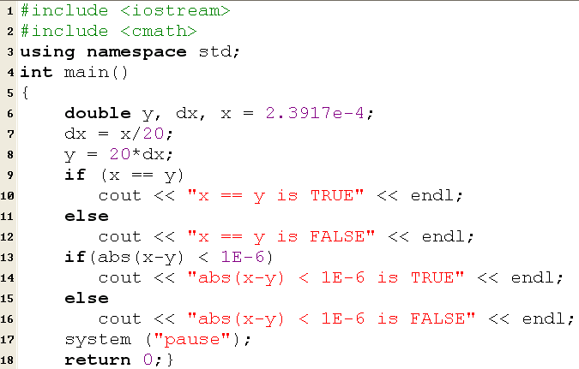
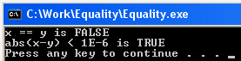
Comparing for Equality - Example
Mathematically we would expect x == y to be true, but due to round off errors it is false. However, it is very close (within one millionth)!

Slide 33
Common Errors in Selection Statements
Common Error 1: Forgetting Necessary Braces

Slide 34
Common Errors in Selection Statements
Common Error 2: Wrong Semicolon at the if Line

Slide 35
Common Errors in Selection Statements
Common Error 3: Mistakenly Using = for ==
if (count = 1)
cout << "count is zero" << endl;
else
cout << "count is not zero" << endl;

Slide 36
Common Errors in Selection Statements
Common Error 4: Redundant Testing of Boolean Values

Slide 37
Conditional Expressions (Ternary Operator)
Conditional expressions use the ternary operator to assign either of two expressions to an identifier based on the result of a relational test.
Form: expression1 ? expression2 : expression3
Example: x = (y < z) ? y : z ;
The following sections of code perform the same function.
if (x < 0)
y = 5;
else
y = 3*pow(x,2);
y = (x < 0) ? 5:3*pow(x,2);

Slide 38
switch Control Structure
Form:
Control jumps to this point if expression = constant1
(must be an integer).
switch (expression)
{case constant1:
statement1a;
statement1b;
break;
…
case constant2:
statement2a;
statement2b;
…
…
default:
statements;
}
Case sections often end with a break statement. Break transfers control to the end of the structure (closing brace). If break is omitted, next case is executed also!
If expression was not equal to any of the constants listed, control jumps to this point (default section optional).

Slide 39
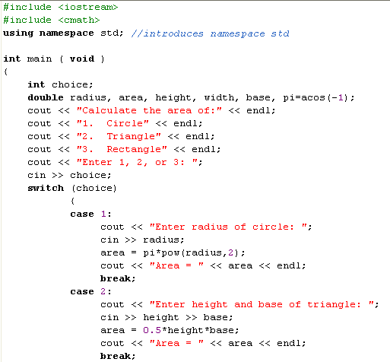
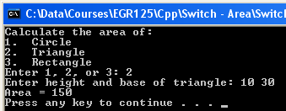
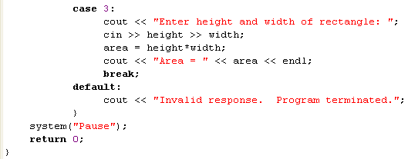
Example 1: Switch structure

Slide 40
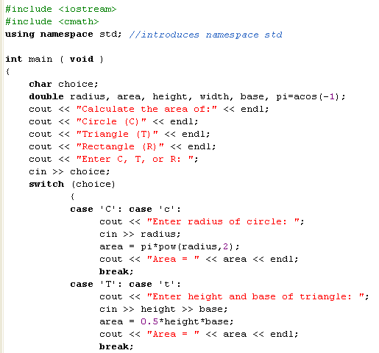
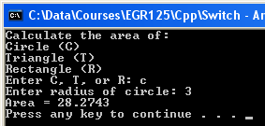
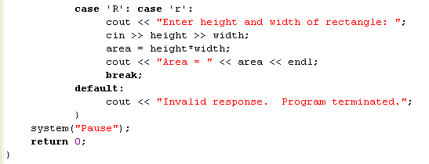
Example 2: Switch structure
Recall that characters are treated as integers (ASCII value)
Allow for both upper and lower case inputs

Slide 41
Class Examples – Switch structures
Try one or more examples in class if time allows
A) Create a simple menu to convert a distance in feet to:
inches
centimeters
meters
miles
B) Calculate the cost to order a certain quantity of items. Hint: Use integer division within the switch statement to reduce the number of cases..
Quantity | Unit Cost
0-24 | $1.50
25-99 | $1.25
100 or more | $1.10

