Slide 1
Chapter 5 – Repetition Structures (Looping Structures)
Repetition structures (or iterative structures or looping structures) are used in programming to repeat sections of code. Examples where iteration is important:
Calculating f(x) for 100 values of x
Computing a result iteratively until a certain accuracy is reached, such as in evaluating a series like sin(x) = x – x³/3! + x⁵/5! – x⁷/7! + ….
Printing a table of results
Allowing the user to correct input values or to rerun a program
Reading large quantities of data from a data file
Working with arrays
Etc
There are three basic types of control structures:
Sequential structures (or straight-line structures)
Decision structures (or selection structures or branching structures)
Iterative structures (or looping structures)
These structures are illustrated on the following page:
1
Notes:
1

Slide 2
Flowcharts for sequential, selection, and iterative control structures
Command
Command
Command
Command
False
Test
True
Setup
Done
Command
Commands
to execute
if False
Commands
to execute
if True
Commands
Command
Command
Command
Command
Sequential Structure
(straight-line structure)
Example Selection Structure
(decision or branching structure)
Iterative Structure
(looping structure)
2
Notes:
2

Slide 3
Iterative Structures in C++
There are three types of iterative structures in C++:
while loop
Continue looping while a condition is true
Pre-test on the condition, so loop is executed 0 or more times
do-while loop
Continue looping while a condition is true
Post-test on the condition, so loop is executed 1 or more times
for loop
Loop for a specific number of iterations based on an index variable

Slide 4
while loop
Key features:
A pre-test is used at the beginning of the loop
The loop is executed 0 or more times (until the condition is false)
The test condition must be initialized before the loop
Form:
Example 1: while loop
while (condition)
{
statement(s)
}
int i = 1;
while (i <= 5)
{
cout << “Loop #” << i << endl;
i++;
}
Note: braces optional if only one statement.

Slide 5
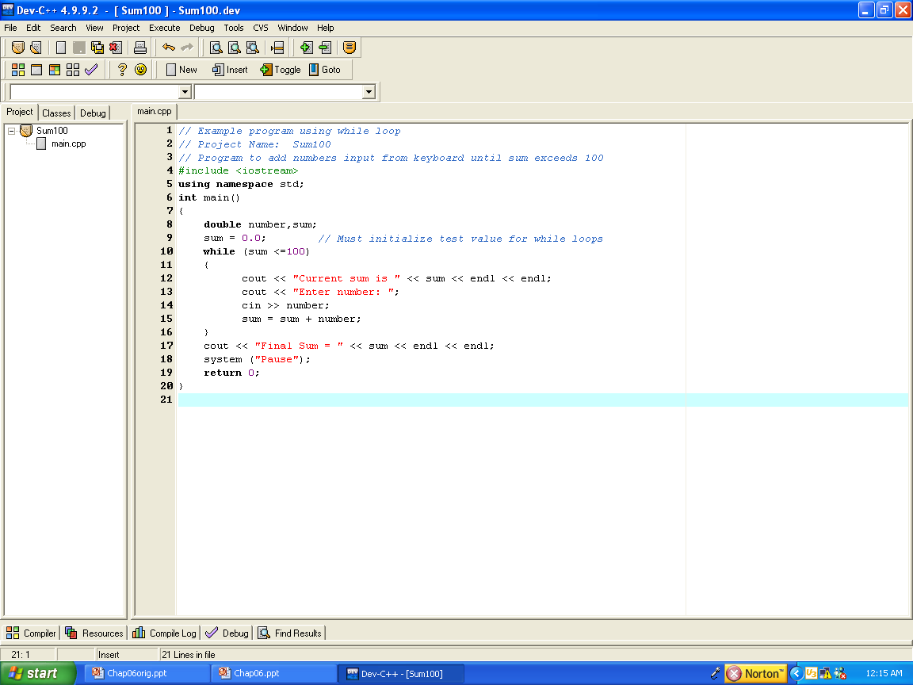
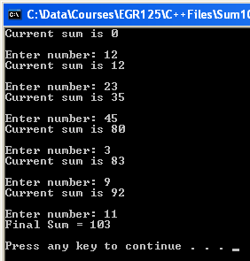
Example 2: while loop

Slide 6
Example 3: while loop (using a sentinel) Write a C++ program to calculate the average of an unknown number of grades as follows:
Sentinel A sentinel (or a flag) is a data value used to signal the start or the end of a data series. The value of a sentinel must be chosen so that it cannot be confused with a legitimate data value. Examples:
Positive entries are valid so use -1 as a sentinel
Letters A-F are valid (as in a menu structure), so use any other input as a sentinel
Prompt the user to enter a grade each time through the loop
Update the sum and number of grades
Prompt the user to enter a negative grade (as a sentinel) after the
last valid grade
Continue looping while the input grade is not negative

Slide 7
Example 4: while loop Write a C++ program to evaluate e (the base of the natural log) to 5 digits after the decimal point using the following series: e = 1/0! + 1/1! + 1/2! + 1/3! + ….. Display the final value of e (it should be 2.71828).

Slide 8
do while loop
Key features:
A post-test is used at the end of the loop
The loop is executed 1 or more times (until the condition is false)
The loop must be executed at least once!
It is not necessary to initialize a test condition before the loop
Unlike the while loop, there is a semicolon after the condition.
Form:
do
{
statement(s)
}
while (condition);
Note: braces optional if only one statement.

Slide 9
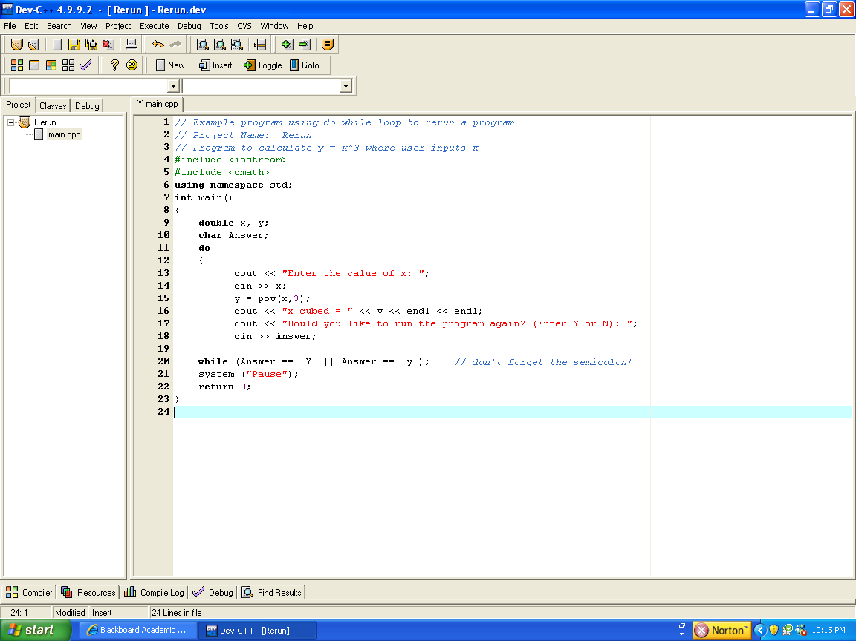
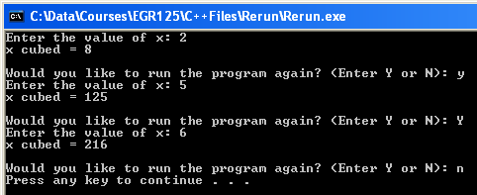
Example 1: do while loop – re-running a program

Slide 10
Example 2: do while loop
Write a C++ program that uses a do while loop to determine the largest integer N such that
N³ – 2N² < 100,000
Display the result.
Also display the value of N and the value of N³ – 2N² after each pass through the loop.

Slide 11
Example 3: do while loop – correcting erroneous inputs
A do while loop is often used to correct erroneous inputs.
Write a C++ program to find acos(x) where -1 < x < +1 as follows:
Prompt the user to enter the value of x.
If x is invalid, display an error message and prompt the user to re-enter x.
If x is valid, calculate acos(x) and display the result (in degrees).

Slide 12
for loop
The for loop is often the best loop structure when you know how many times the instructions in the loop are to be executed.
The for loop has three parts:
Initialization expression – a loop control variable is assigned an initial value
Conditional statement – the loop is repeated as long as this is true
Step – specifies how to modify the loop variable after each pass thru the loop
Form:
for (initialization expression; conditional statement; step)
{
statement(s)
}
Note: braces optional if only one statement.
For loop – Example 1:
for (i = 1; i <= 10; i++)
{
cout << “Hello!” << endl;
}
Result: “Hello!” is displayed ten times.

Slide 13
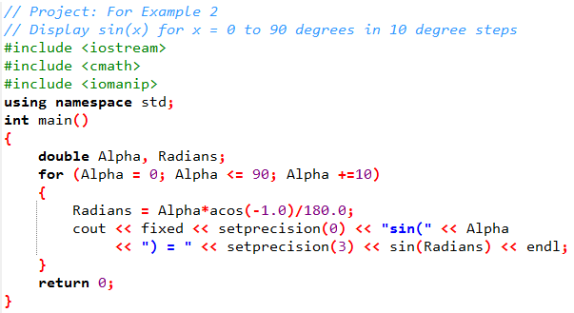
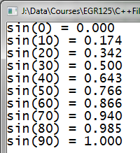
for loop – Example 2
Display sin(α) for α = 0 to 90° to 10° steps.

Slide 14
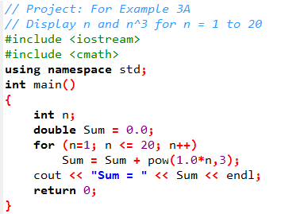
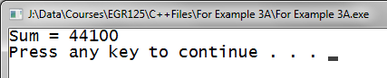
for loop – Example 3
Display the result of the following summation:

Slide 15
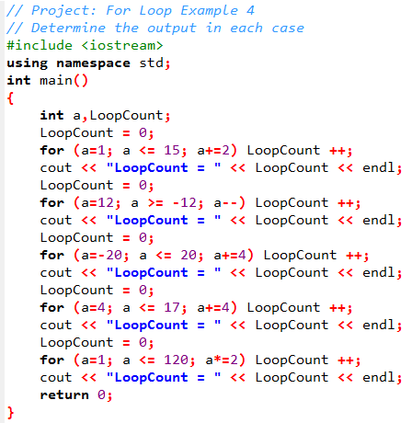
for loop – Example 4
Determine the output in each case below:
LoopCount = _______
LoopCount = _______
LoopCount = _______
LoopCount = _______
LoopCount = _______

Slide 16
for loop – Example 5
Write a program that uses a for loop to create a nicely formatted table showing the values of radius, surface area, and volume of a sphere.
Let the radius, R, varies from 0 to 9.5 in increments of 0.5
Use setw( ) to control the width of each column
Include a table heading with units

Slide 17
Nested for loops
There are many cases where it is useful to form nested loops, or loops inside or other loops. An example is illustrated below:
for (int i = 1; i < = 4; i++)
{
statement(s)
for (int j = 1; j <= 3; j++)
{
statement(s)
}
statement(s)
}
Outer loop
Inner loop

Slide 18
Tracing through nested for loops
It is often necessary to trace through a nested loop structure to determine the resulting calculations, displayed values, etc. Using a table can be helpful.
Example: Trace through the nested loop shown below:
i | j | k
for (int i = 1; i < = 4; i++)
{
for (int j = 1; j <= 3; j++)
{
k = i + j;
}
}

Slide 19
Nested for loops – Example 1
Determine the output for each part below.
int Count = 0;
for (int i = 1; i < = 5; i++)
for (int j = 1; j <= 4; j++)
for (int k = 1; k <= 3; k++)
Count++;
cout << “Count = “ << Count;
Count = __________
int Count1 = 0, Count2 = 0, Count3 = 0;
for (int i = 10; i > = 0; i-=2)
{
Count1++;
for (int j = 3; j <= 24; j+=3)
{
Count2++;
for (int k = -20; k <= 20; k+=5)
Count3++;
}
}
cout << “Count1 = “ << Count1 << endl;
cout << “Count1 = “ << Count1 << endl;
cout << “Count1 = “ << Count1 << endl;
Count1 = __________
Count2 = __________
Count3 = __________

Slide 20
Nested for loops – Example 2
Determine the output for the instructions shown below.
for (int i = 1; i < = 2; i++)
for (int j = i; j <= 3; j++)
for (int k = j; k <= 4; k++)
cout << i << j << k << endl;
Output:

Slide 21
Infinite loops (forever loops)
It is sometimes useful to construct a loop which will execute forever. Such loops are sometimes called infinite loops or forever loops.
Examples:
Monitor an alarm system 24 hours per day and sound an alarm when appropriate
Run the display on a gas pump and display advertising until a user presses a button to indicate that they want to pump gas.
Notes:
An infinite loop may be exited at any point using a break statement.
You can generally stop an infinite loop from the keyboard by pressing Ctrl+C.

Slide 22
Infinite loops (forever loops)
Infinite loops can be created easily using any of the three types of loop structures introduced:
Infinite while loop:
while (1)
{
statement(s)
}
Infinite do while loop:
do
{
statement(s)
}
while (1);
Infinite for loop:
for(;;)
{
statement(s)
}

Slide 23
Infinite loops - examples
//clock program
while (1)
{
statements to display time
}
// alarm program
do
{
statements to sound alarm if certain inputs occur
}
while (1);
// vending machine
for(;;)
{
statements to wait for inputs
statements to release product statements to dispense change
}

Slide 24
Structures with an indeterminate number of loops
For loops with an indeterminate number of iterations, we can use:
While loop – exit at the top of the loop
Do while loop – exit at the bottom of the loop
Forever loop – exit in the middle of the loop using a break statement
while (x < 2)
{
statement(s)
}
do
{
statement(s)
}
while (x < 2);
for(;;)
{
statement(s)
if (!(x<2)) break;
statement(s)
}
Exit from top of loop once x<2 is false
Exit from bottom of loop once x<2 is false
Exit from middle of loop once x<2 is false
Note: Any number of exit points could be provided in any of the loop structures above using break statements.

Slide 25
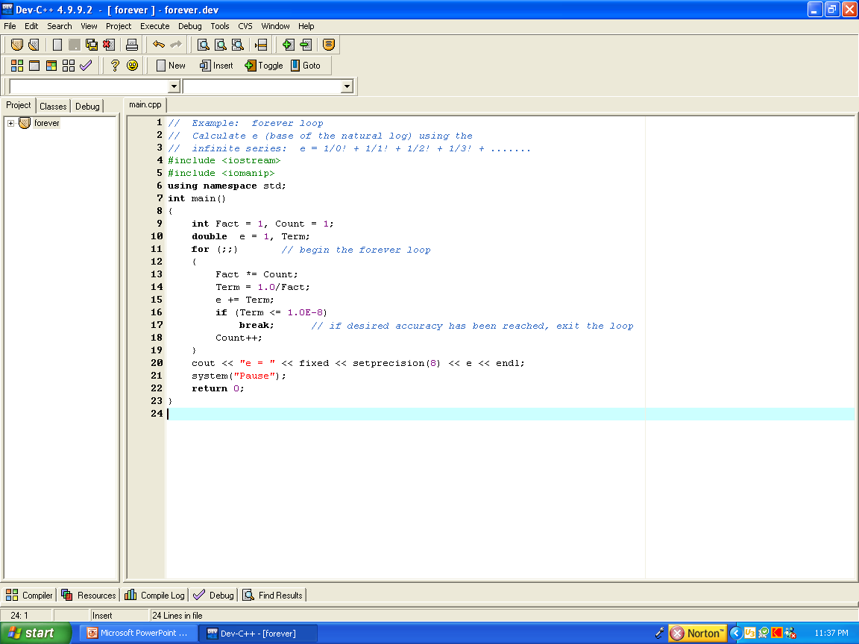
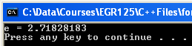
Forever loop - Example
Write a C++ program to evaluate e (the base of the natural log) using the infinite series e = 1/0! + 1/1! + 1/2! + 1/3! + ….. accurate to 8 digits after the decimal point using a forever loop with a break statement.

Slide 26
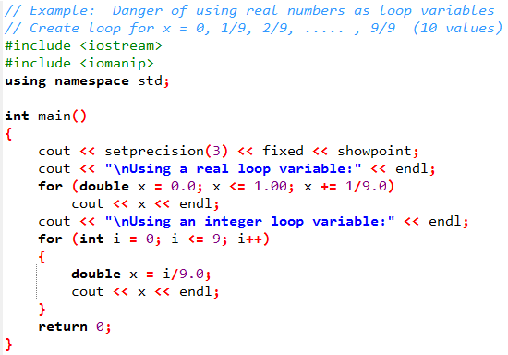
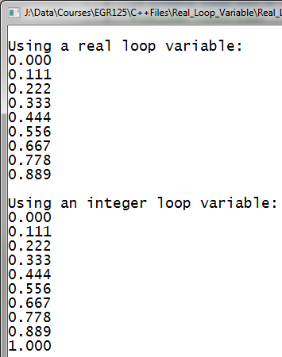
Avoiding real numbers as loop variables
It is good practice to avoid using real numbers (float, double, etc) as loop variables due to round off errors.
Example: Create a loop for form x = 0, 1/9, 2/9, …, 9/9 (10 total values)
Last value in loop is missing (only 9 values, not 10)

