Slide 1
Chapter 6 – Functions
Function – a subprogram “called” or used by the main function or some other function. Each function is designed to complete some task and has certain specified inputs and outputs.
Why use functions?
There are several reasons for using functions, including:
Reusability of code
For reuse in the same program – for example, you might write a function named fact(x) to calculate x! It might be called many times in your program.
For reuse in other programs – for example, you might write a function to find an inverse matrix. You might only need the function once in your current program, but the function may be useful in later programs as well.
Top-down design – It is common to break a large task into smaller tasks that are more manageable. Functions help to do this. A program with thousands of lines is much easier to follow if it is broken into logical subtasks using functions.
1
1
Notes:
1

Slide 2
Top-Down Design Example: Program to control a robot
main
Propulsion
function
Steering
function
Robot arm
function
Power
Control
function
Speed
Control
function
Start/
Stop
function
Sensors
function
Logic
function
Initialize
function
Joint 1
function
Joint 2
function
Gripper
function
f1
f2
f3
f4
f5
Note: Additional branches (functions) could be added
2
2
Notes:
2

Slide 3
Types of functions
Functions can be broken into two groups:
Library functions
Programmer-defined (or user-defined) functions
Library functions
We have used many library functions so far, such as sin(x), log(x), exp(x), setw(n), setprecision(n), etc.
Many C++ libraries are available and we typically include only those that we need.
Example:
#include <cmath> // include library of math functions
int main()
{
double Area, pi, Radius = 4.4;
pi = acos(-1.0); // use acos(x) function from cmath library
Area = pi*pow(Radius,2); // use pow(x,n) function from cmath library

Slide 4
Programmer-defined (or user-defined) functions
There are three categories of user defined functions:
Functions that return no value
The function performs a task, but returns no value.
Examples:
Function TCClogo() might display the TCC logo
Function PrintErrorMessage(N) might display one of several messages
Functions that return one value
The function performs a task or calculation and returns the result.
Examples:
Function fact(N) might calculate N! and return the result
Function Area(b,h) might calculate the area of a triangle and return the result
Functions that “pass by reference” – typically used when two or more outputs are returned
The function performs a task or calculation and typically returns two or more.
Examples:
Function roots(A,B,C,root1,root2) might return the values of the two roots of the quadratic equation Ax² + Bx + C.
Function Triangle(Base, Height, Area, Perimeter) might return the values of the area and the perimeter of a triangle given the base and the height.

Slide 5
General form for functions:
Three things are needed to make use of a function in a program:
Function Declaration (or prototype)
Function Call
Function Definition
These items are described on the next three slides.

Slide 6
Function Declaration (or prototype)
Similar to declaring a variable
Specifies the function name and the types for the inputs and outputs
Form:
return_type FunctionName (type for each argument)
Examples:
void SkipLine(void);
double log2(double);
int Fact(int);
double AverageGrade(double, double, double, double);
int main(); // look familiar?
int main(void); // equivalent to the line above

Slide 7
Function Call
Similar to calling or using a library function
Argument may be a value, variable, or expression.
Example (not a complete program):
double x, y, Avg, T1 = 80, T2 = 88, FE = 77, HW = 94;
int A, B=6;
y = acos(x); // call cmath library function
A = Fact(B); // call user function to find 6!
TCCLogo(); // call user function to display TCC logo
Avg = AverageGrade(T1,T2,FE,HW); // call user function
// to calculate average grade
cout << setprecision(4) << y; // call iomanip library function
How many inputs and outputs does each function used above have?
Function | # inputs | # outputs
acos
Fact
TCCLogo
AverageGrade
setprecision

Slide 8
Function Definition
Consists of a header and the body of the function (enclosed in braces.
The form for the header looks similar to the prototype, but also includes variable names for all arguments
Form for definition:
return_type FunctionName (type and name for each argument)
{
statement(s) to perform function task;
}

Slide 9
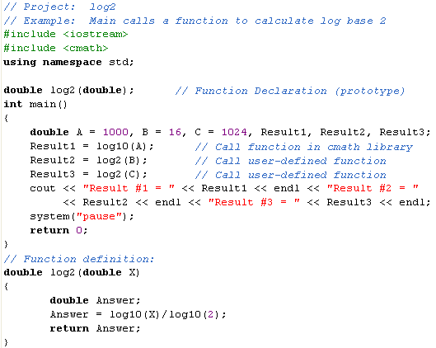
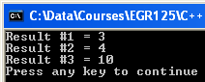
Function – Example 1 (one input, one output)
Write a function to calculate log₂(X) and use the function in the main program.
Recall that each function has three key elements.
1. Function Declaration
2. Function Call
3. Function Definition

Slide 10
Value Parameters
The argument names used for variables in functions need not be the same names used in the main program (but they can be the same).
The arguments in functions are sometimes called dummy arguments.
The arguments used in examples so far are called value parameters or input parameters or copy parameters. Different memory locations are used to store arguments in the calling function than to store the variable in the function being called. When the function is called, the value is copied to the new memory location.
#include <cmath>
int main( )
{
double A = 1.5, B;
B = exp(A);
}
Variable Name | Value in memory
A | 1.5
x | 1.5
A is substituted for x. x is a “dummy argument.”
Value copied to new memory location when function called.
Library cmath contains the function
exp(x)

Slide 11
Value Parameters
Let’s see how value parameters (or copy parameters ) were used in Example 1.
Answer is copied to Result2.
B is copied to X.

Slide 12
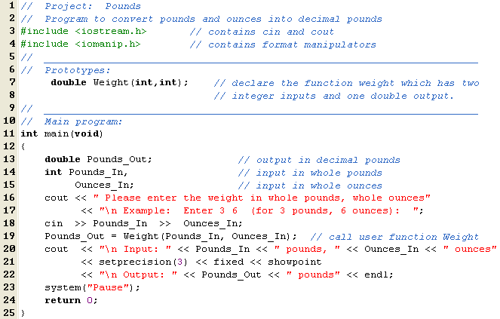
Function – Example 2 (two inputs, one output)
Write a function to convert weight from pounds and ounces to decimal pounds.
For example, it would convert 2 lb, 4 oz to 2.25 lb Recall that there are 16 oz in one pound (lb).
(continued on next slide)

Slide 13
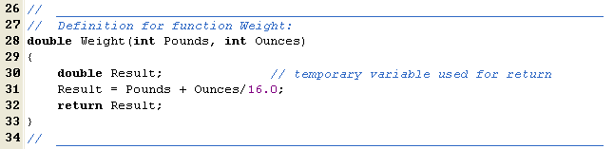
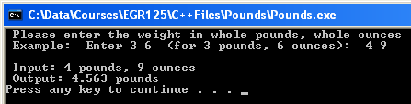
(continued from previous slide)

Slide 14
Notes on functions
Previous examples illustrate common function usage, but other
variations are possible.
We will typically show function definitions after the main program, but they could be shown before.
We will typically show function declarations (prototypes) outside the body of all other functions. A declaration could be inside the body of a function (such as main), but then the function could only be called by that function.
A function can have multiple return statements (exit points).
Arguments in functions may be values, variables, or expressions. For example, the earlier log2(x) function might be called using:
A1 = log2(16);
A2 = log2(Z);
A3 = log2(4*B + pow(Z,2));

Slide 15
Class Examples:
Develop one or more of the following programs in class
Write a function to convert an angle from degrees to radians and write a main program that uses the function.
Write a function to calculate N! and write a main program that uses the function.
Write a function to display the TCC logo and a main program that uses the function.
Write a function to convert time in hours, minutes, and seconds to seconds and a main program that uses the function.

Slide 16
Reference Parameters
Previous examples illustrate functions with zero or one outputs and value parameters were used for arguments.
In order to specify functions with two or more outputs, we need to use reference parameters as arguments (there may also be some arguments that are value parameters).
Reference parameters are indicated by placing an ampersand (&) after the type in both the function declaration (prototype) and function definition, but not in the function call.
Reference parameters variables in the calling function and the function being called share the same memory location, so they can be used for inputs or outputs. They can have the same name or different names (they are aliases).

Slide 17
Reference Parameters
Sample function declaration:
void FName(double, double, double&, double&); \\ prototype
Value
Parameter
Reference
Parameter
Value
Parameter
Reference
Parameter
Sample function definition:
void FName(double In1, double In2, double& Out1, double& Out2)
{
statement(s)
}
Value
Parameter
Reference
Parameter
Value
Parameter
Reference
Parameter

Slide 18
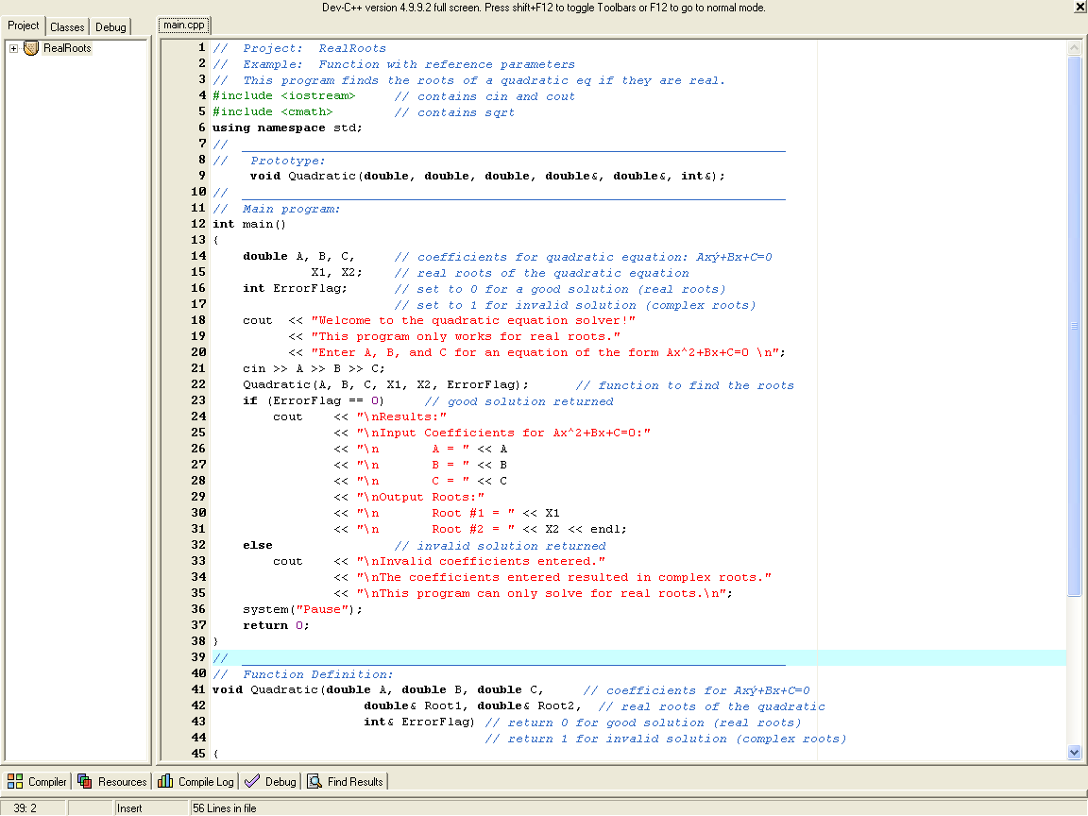
Function
Example 3:
(3 inputs,
3 outputs)

Slide 19
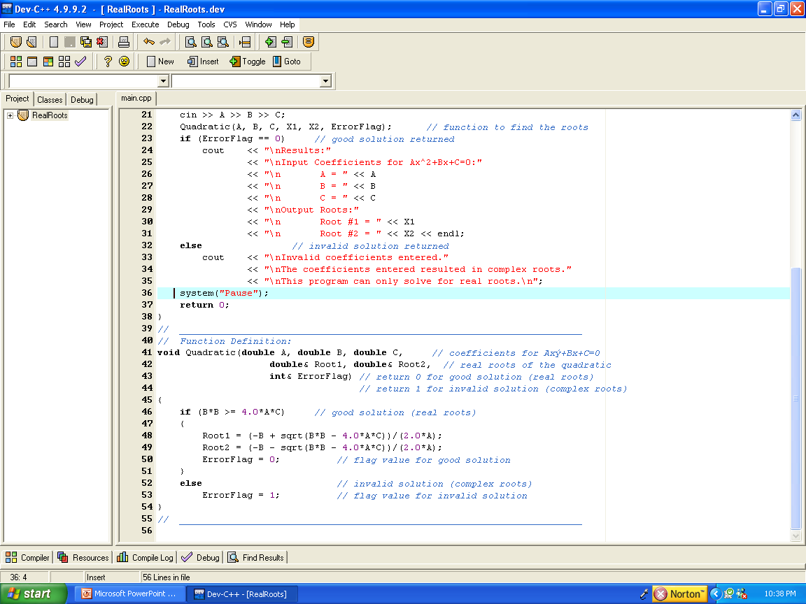
Function Example 3: (3 inputs, 3 outputs)

Slide 20
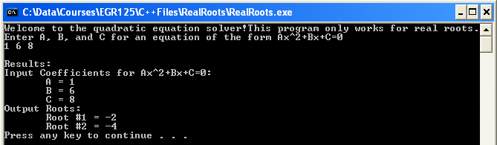
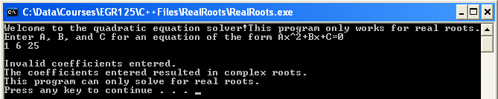
Function Example 3: (3 inputs, 3 outputs)

Slide 21
Function Example 3: (3 inputs, 3 outputs)
Memory usage for value parameters and copy parameters
Name | Value |  | Name | Value
A |  |  | A
B |  |  | B
C |  |  | C
Value parameters are copied from the calling function to the function being called.
copy
copy
copy
Name | Value | Alias Name
X1 |  | Root1
X2 |  | Root2
ErrorFlag |  | ErrorFlag
Reference parameters use a shared memory location so any change in one function affects the other.

Slide 22
Class Example:
Write a main program and a function SOLVE2 to solve two
simultaneous equations.
The main program should:
Prompt the user for the inputs (A,B,C,D,E,F)
Call function SOLVE2 (6 inputs, 2 outputs) to find x and y
Display the results

Slide 23
Class Example:
Write a main program and a function TIME2 to convert time in
seconds to time in hours, minutes, and seconds.
The main program should:
Prompt the user for the input time in seconds
Call function TIME2 to convert the time to hours, minutes, and seconds
Display the results

Slide 24
Scope
As we have seen, two functions may use the same name for unrelated variables, so it is important to know where a variable is valid, or to know its scope.
In C++ there are three kinds of scope:
Block – a variable may be declared and used within a set of braces. It is not defined outside of the braces
Function – a variable may be declared and used within a function. This is sometimes called a local variable. It is not defined outside of the function.
File – a variable may be declared outside and before the body of any function and then can be used in all functions in the file. This is sometimes called a global variable.
Note: We could use global variables to avoid passing information between functions using reference parameters, but this is generally considered to be poor programming style. In EGR 125 do not use global variables except for defining useful constants.

Slide 25
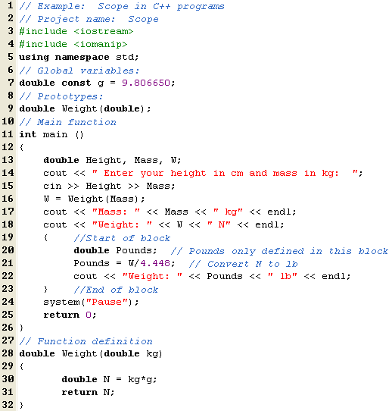
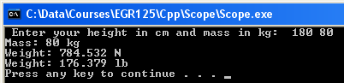
Scope - Example
File scope
(Global variable)
g is defined in all functions
Function scope
(Local variable)
Height, Mass, W only defined in function main
Block scope
Pounds only defined within braces
Function scope
(Local variable)
N only defined in function Weight

Slide 26
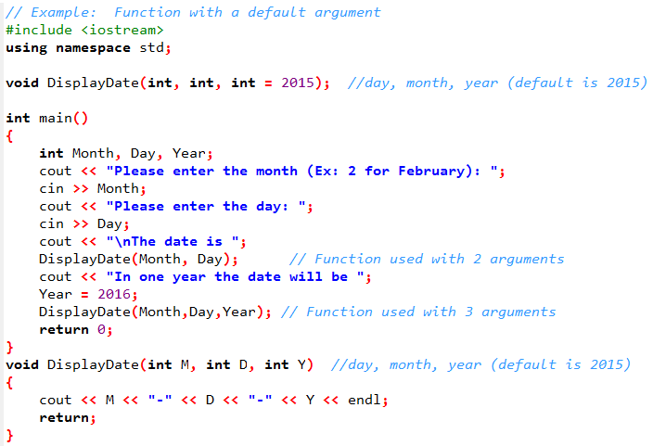
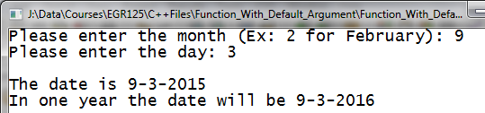
Functions with default arguments
In general, the number, order, and type of arguments in function calls, declarations, and definitions should match. An exception is made when 1 or more of the arguments are assigned default values in the function declaration (prototype). Another exception is
when functions are overloaded (to be presented shortly.)
default value for argument
Example: Use a function to display the date with the year provided or with the default (current) year.
Note that the default value for the argument only appears in the prototype.

Slide 27
Functions with default arguments - Example
The distance D between two points in an xy plane (2D) can be calculated using:
Similarly, the distance D between two points in an xyz plane (3D) can be calculated using:
Class Example: Write a C++ program that uses a function DIST(x1,x2,y1,y2,z1,z2) to find the distance between two points.
Find the distance between the points (1,2,3) and (4,6,15) by calling
DIST(1,4,2,6,3,15) // use function with 6 arguments
Find the distance between the points (30,-15) and (60,25) by calling
DIST(30,60,-15,25) // use function with 4 arguments

Slide 28
Function Overloading
Function overloading is a term that means to define two or more functions with the same name.
Why overload functions?
To allow for different numbers of arguments
To allow for different types of arguments
To overload functions we need to:
Include a prototype for each version of the function
Include a definition for each version of the function
When the function is used, C++ counts the number of arguments and looks at the types of the arguments in order to use the correct function definition.
Operator Overloading: We will later discuss overloading operators in C++. Note that C++ does different operations for 1/3 and 1.0/3. How does it know? It looks at the types of the arguments and uses the appropriate operator (integer division or real division).

Slide 29
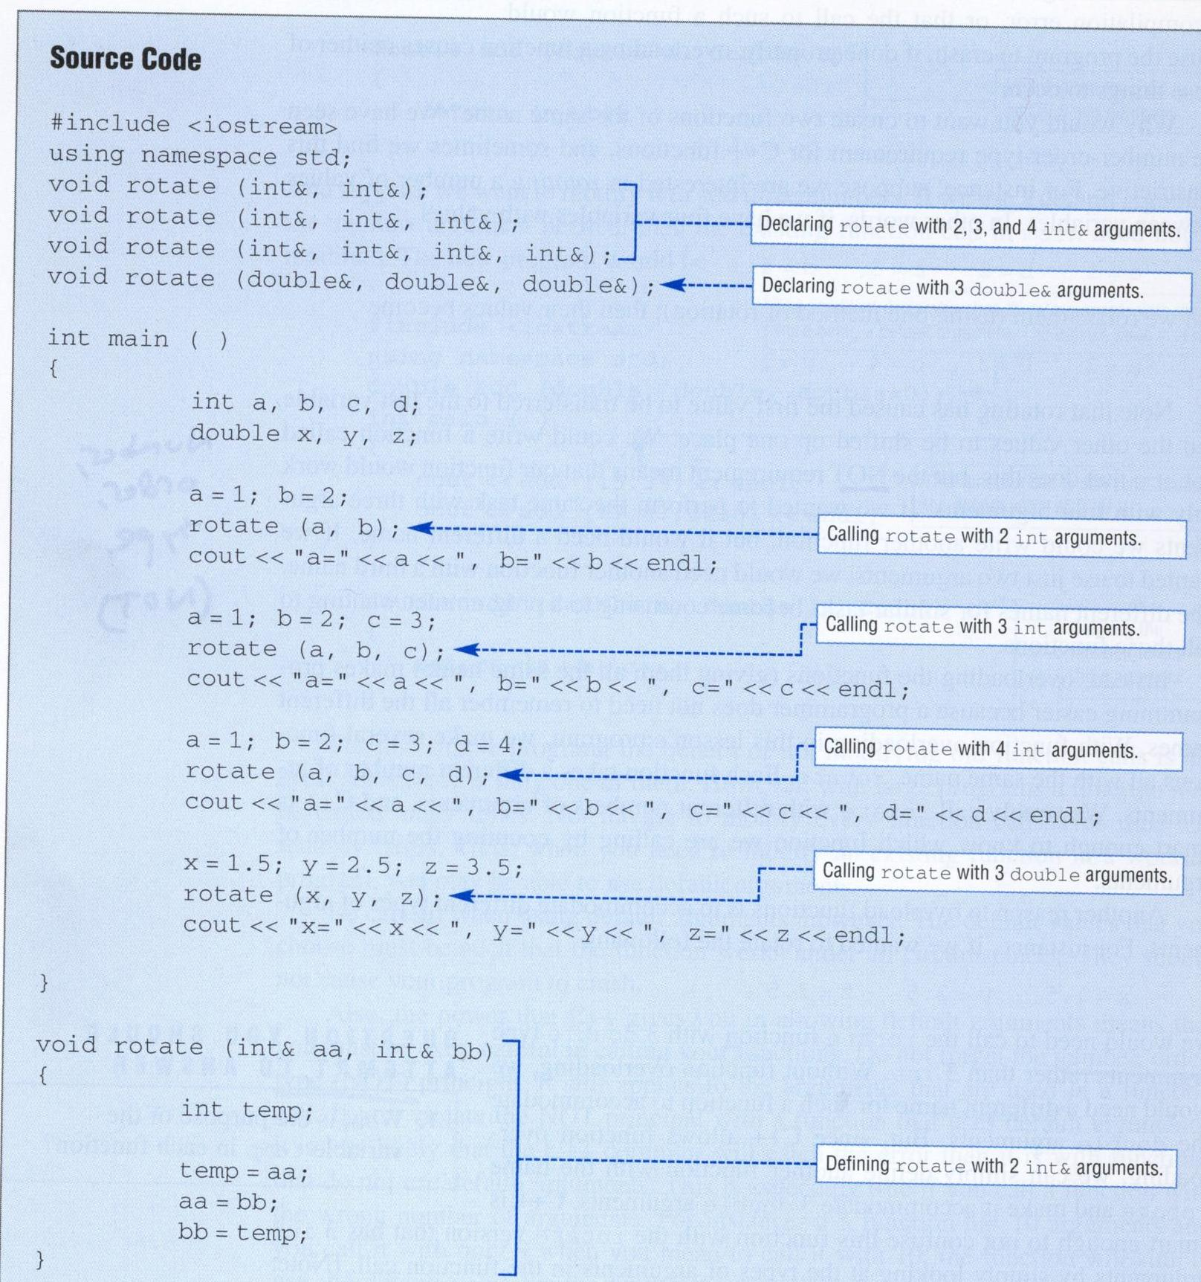
Function Overloading Example
(Reference: Programming in C++ by D’Orazzio, pp 324-325)
Page 1 of 2

Slide 30
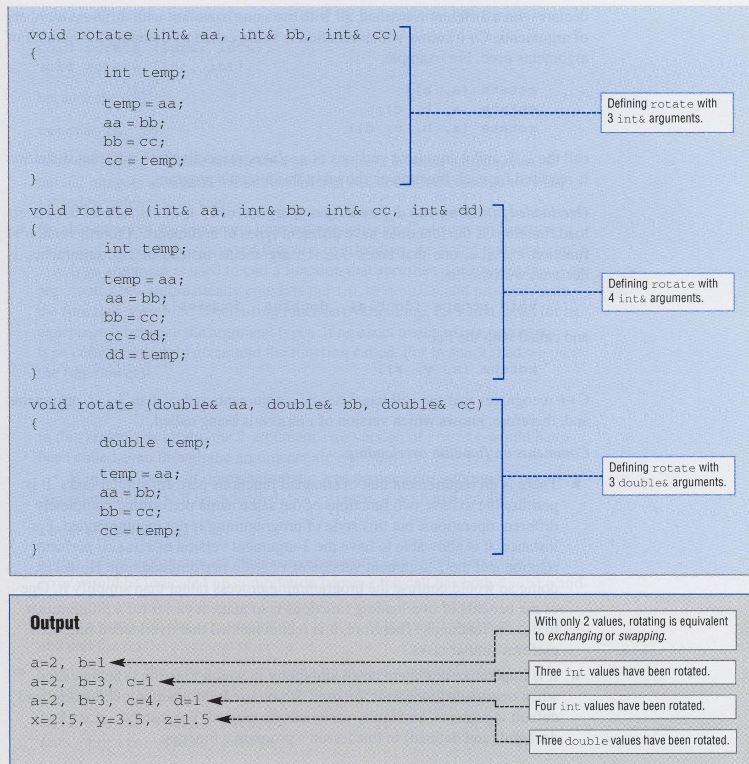
Function Overloading Example
(Reference: Programming in C++ by D’Orazzio, pp 324-325)
Page 2 of 2

Slide 31
Creating Libraries of Functions
As you write more and more functions, you will eventually have a collection of useful functions. It is convenient to put these in a library for easy access in other programs. You can then “include” the library in projects and will not have to list function declarations (prototypes) or definitions in the main file.
Steps to creating a library of functions:
Create a single file containing the function definitions (and any libraries they might use (for example #include <cmath> ). Save the file with a cpp extension, such as EGR125.cpp
Create another file containing the prototype for each function in the previous file just created. Save this file with an h extension (header file), such as EGR125.h
Add both files above to any project which will use the functions.
Add “include EGR125.h” to the main.cpp file

Slide 32
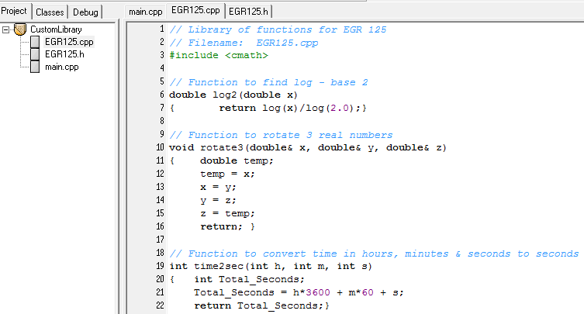
Example - Creating a Custom Library
Step 1) Create a library of functions: EGR125.cpp

Slide 33
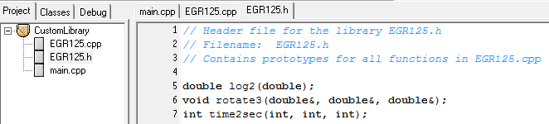
Example - Creating a Custom Library
Step 2) Create a header file: EGR125.h
Step 3) Add EGR125.cpp and EGR125.h to the project

Slide 34
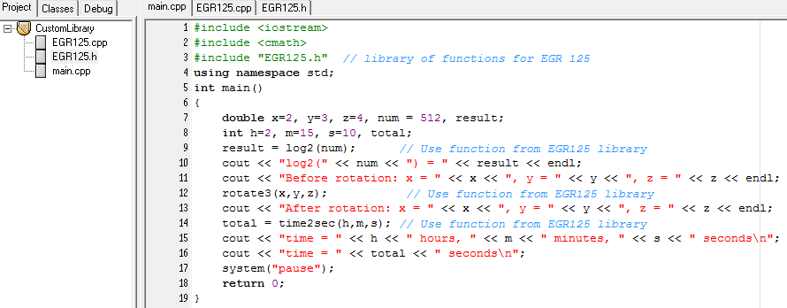
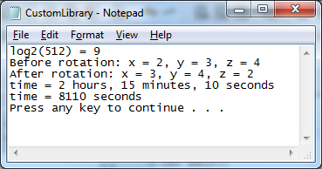
Example - Creating a Custom Library
Step 4) Add “include EGR125.h” to main.cpp
Output:

