Slide 1
Chapter 7 – Single-Dimensional Arrays
Reading Assignment: Chapter 8 – Multidimensional Arrays in Introduction to Programming with C++, 3rd Edition, by Liang.
array x
Array (subscripted variable, indexed variable) An array is a data structure in C++ that consists of a group of like-type data where each element in the array is easily referred to by an index.
Example:
int main()
{
const int N = 10; //10 elements in the array
double x[N],y[N]; //define arrays x and y
x[0] = 10; //assign value to x[0]
x[1] = 20;
y[0] = 33;
y[1] = 43;
….
array y
x | y
10 | 33
20 | 43
x[0]
y[0]
x[1]
y[1]
x[9]
1
y[9]
1
Notes:
1

Slide 2
Declaring arrays
Arrays are declared like other variables, except that the identifier is followed by brackets containing a value specifying the size of the array.
Form:
type ArrayName[ArraySize];
ArrayName – any valid identifier
ArraySize – a constant variable, expression, or literal
Examples:
const int N = 30;
int A[N], B[2*N], C;
double Grades[100], Monthly_Sales[12], Total;
char Initials[3];
Notes:
Nvv

Slide 3
Working with arrays elements
Elements in an array are easily referred to using the subscript (or index).
The index for the first element is 0. If an array has size N, then the indices run from 0 to N-1. A[2] refers the third element in array A and may be treated as any other variable.
Example:
const int N = 4; // specify the array size *
int A[N]; // declare the array
A[0]=10; // assigning a value to A[0]
A[1]=20;
A[2] = A[0] + A[1]; // array elements used in expressions
A[N-1] = A[N-2]; // array indices can be expressions
cout << A[2]; // printing one value of the array
// *Note: It is good practice to use variables for array sizes
Notes:
Nvv

Slide 4
Initializing arrays
Elements in array may be initialized in two ways:
Explicitly (using an assignment statement for each element)
Using a list. A list is denoted using braces, with element in the list separated by a comma.
Initializing arrays explicitly Easily accomplished using a for loop.
Example: Explicitly initialize all elements in an array to 5
const int Asize = 100;
int A[Asize];
for (int i = 0; i < Asize; i++) A[i] = 5;
Notes:
Nvv

Slide 5
Example: - Initializing arrays explicitly. Determine the contents of each array below after the following instructions.
const int Size = 8;
int A[Size], B[Size], C[Size], D[Size], E[Size];
for (int i = 0; i < Size; i++) A[i] = 10 + i%2*10;
for (int j = Size-1; j >=0; j--) B[j] = j*j;
for (int k = 0; k < Size; k++)
{ C[Size-1-k] = 5*k – A[k];
if(A[k] > B[k])
D[k] = A[k];
else
D[k] = B[k];
}
for (int m = 0; m < Size/2; m++)
{ E[m] = m;
E[Size-1-m] = m;
}
A | B | C | D | E
Notes:
Nvv

Slide 6
Initializing arrays using a list
Elements in array may be initialized using a list of values in braces.
If the number of values listed is less than the size of the array, the remaining elements are initialized to zero (treated as null characters ‘\0’ in char arrays).
If the array size is omitted when using a list, then the array size is set to the number of elements in the list.
Example:
double X[4] = {1.1, 2.2, 3.3, 4.4}; // initialize array X with a list
Using the list above is equivalent to:
double X[4];
X[0] = 1.1;
X[1] = 2.2;
X[2] = 3.3;
X[3] = 4.4;
Notes:
Nvv

Slide 7
Example: - Initializing arrays using a list
int A[5] = {11,22}; // initializes array values to 11,22,0,0,0
double Sum[7] = {0.0}; // initializes all 7 sums to 0.0
int B[ ] = {2,4,6,8}; // array B is assigned an array size of 4
char Vowels[8] = “aeiou”; // Vowels[0] = ‘a’, Vowels[1] = ‘e’, etc.
Array A
11
22
0
0
0
Array Sum
0
0
0
0
0
0
0
Array B
2
4
6
8
Array Vowels
a
e
i
o
u
\0
\0
\0
\0 is the “null character”
Notes:
Nvv

Slide 8
Printing arrays
Arrays are easily printed using for loops. However, formatting the output may require some thought. Determine the output in each case shown below.
Example 1:
int Grades[12]={78,80,82,84,86,88,90,92,94,96,98,100};
for (int j = 0; j < 12; j++)
cout << Grades[ j ] << endl;
Example 2:
int Grades[12]={78,80,82,84,86,88,90,92,94,96,98,100};
for (int j = 0; j < 12; j+=3)
cout << Grades[ j ] << Grades[j+1] << Grades[j+2] << endl;
Notes:
Nvv

Slide 9
Example 3:
int Grades[12]={78,80,82,84,86,88,90,92,94,96,98,100};
for (int Row = 0; Row <= 2; Row++)
for (int Col = 0; Col <=3; Col++)
cout << Grades[ 4*Row+Col ] << endl;
Example 4:
int Grades[12]={78,80,82,84,86,88,90,92,94,96,98,100};
for (int Row = 0; Row <= 2; Row++)
{
for (int Col = 0; Col <=3; Col++)
cout << Grades[ 4*Row+Col ];
cout << endl;
}
Notes:
Nvv

Slide 10
Functions and Arrays
Arrays may be passed as arguments of functions, but some important
notes should be made:
Function declaration - include the data type and empty brackets
Function call – include the array name with no brackets
Function header – include the data type, name, and empty brackets
Reference parameters – Arrays are always treated as reference parameters, but no ampersand (&) is required. Since reference parameters can be used for input or output, making an array a constant will protect it from being changed by the function (i.e., it will be treated as an input only).
Dimensioning arrays - Arrays are typically dimensioned in the main calling function, not in the function to which the array is passed. The array size is often passed to the function along with the array. This keeps functions general in nature so that they can work with any size array.
Notes:
Nvv

Slide 11
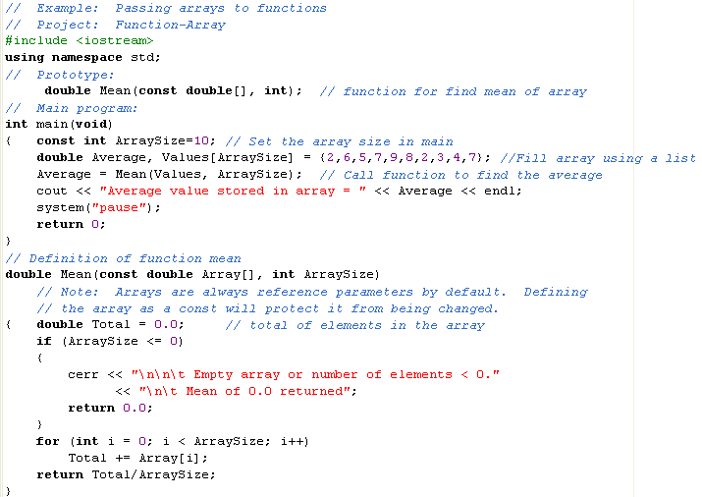
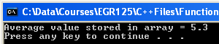
Example – Passing an array to a function
Comments on highlighted sections:
Notes:
Nvv

Slide 12
Examples:
Write functions for one or more of the following examples
(along with a main program to call them) in class:
Find the max value in an array
Add two arrays
Find the average value in an array and then form another array containing the difference between each element and the average.
Find the standard deviation of the elements in an array as defined below:
Notes:
Nvv

