Slide 1
Chapter 8 - Multi-Dimensional Arrays
Reading Assignment: Chapter 8 – Multidimensional Arrays in Introduction to Programming with C++, 3rd Edition, by Liang.
So far we have used one-dimensional (1D) arrays, but we can also use arrays with 2 or more dimensions. 2D arrays essentially correspond to matrices.
Example:
int A; // single variable
int B[6]; // 1D array
int C[3][4]; // 2D array (matrix)
int D[3][4][5]; // 3D array
int E[3][4][5][3]; // 4D array
//etc
How many variables are stored in each case?
Array | Number of variables
B
C
D
E
Notes:
1

Slide 2
Multi-dimensional Arrays
One subscript for each dimension
Use square brackets for each subscript
Each subscript begins with 0
A 2D array is typically represented as a matrix
Example:
int A[3][4]; // 2D array (matrix) with 3 rows and 4 columns
Col
0
Col
1
Col
2
Col
3
A[0][0]
Row 0
A[1][2]
Row 1
A[2][3]
Row 2
Notes:
2
2

Slide 3
Specifying values in arrays
As with 1D arrays, values can be loaded into multidimensional arrays:
explicitly (referring to each element by its indices) or
using a list
Example: Loading values into a matrix explicitly
int A[2][3]; // 2D array (matrix) with 2 rows and 3 columns
A[0][0] = 1;
A[0][1] = 2;
A[0][2] = 3;
A[1][0] = 4;
A[1][1] = 5;
A[1][2] = 6;
Results for matrix A:
1 | 2 | 3
4 | 5 | 6
Notes:
3
3

Slide 4
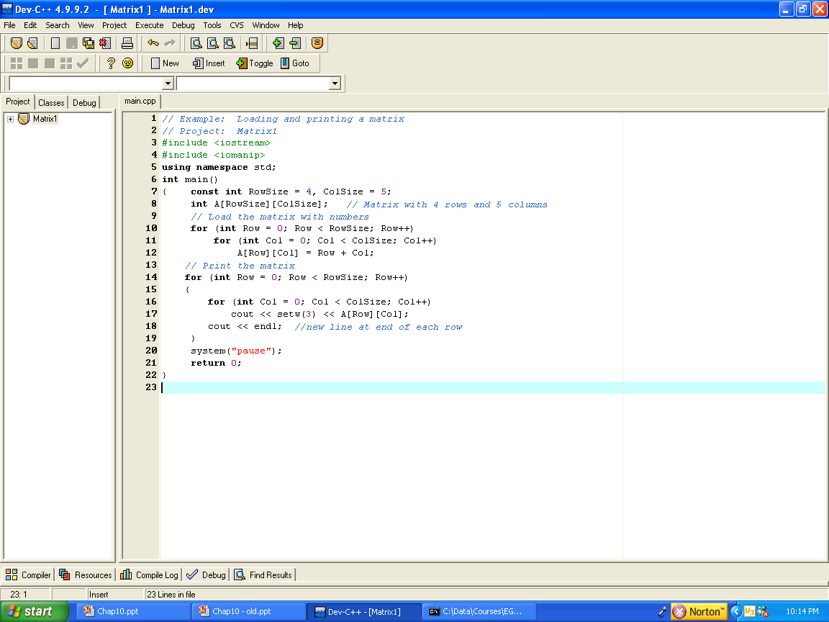
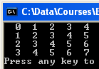
Example: Values can be loaded into an array efficiently using for loops.
The array can also be displayed using for loops.
Notes:
4
4

Slide 5
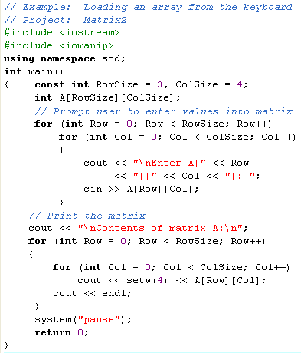
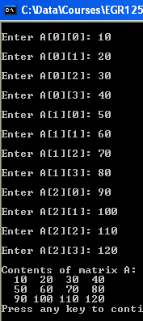
Example: Loading values into a matrix from the keyboard and displaying the results.
Notes:
5
5

Slide 6
Loading values into a matrix using a list
Example: Fill out the matrices indicated below.
int A[2][3] = {3,6,9,12,15,18}, B[2][3] = {7,8,9},
C[][2] = {2,4,6,8,10,12,14,16} ;
Notes:
If the leftmost index is omitted, the array is sized according to the number of list elements.
Recall from 1D arrays the effect of listing fewer values than the size of the array (the remaining values are 0 for numeric arrays).
Matrix A:
Matrix B:
Matrix C:
Notes:
6
6

Slide 7
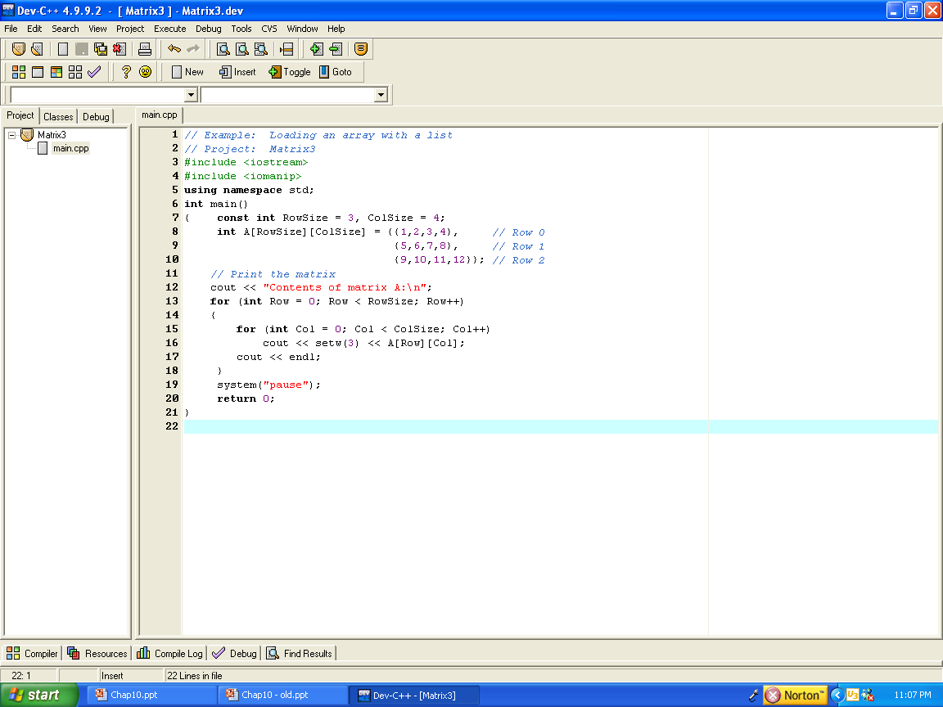
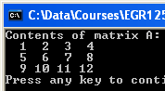
Loading values into a matrix using a list
Example: Lists can also be grouped (i.e., a list of lists) to make it easier to read the row and column values for a matrix.
Notes:
7
7

Slide 8
Visualizing multi-dimensional arrays
We often use sketches to help us visualize arrays, such as:
1D array - single row or column
2D array – matrix
3D array – cube of cells
4D array – row or column of cubes?
Example:
int A, B1[6], B2[6], C[3][4], D[3][4][5], E[3][4][5][3];
E
A
B1
C
D
B2
Notes:
8
8

Slide 9
Visualizing multi-dimensional arrays
D[0][0][0]
D[0][0][1]
D[0][0][2]
D[0][0][3]
D[0][1][0]
D[0][1][1]
D[0][1][2]
D[0][1][3]
D[0][2][0]
D[0][2][1]
D[0][2][2]
D[0][2][3]
D[1][0][0]
D[1][0][1]
D[1][0][2]
D[1][0][3]
D[1][1][0]
D[1][1][1]
D[1][1][2]
D[1][1][3]
D[1][2][0]
D[1][2][1]
D[1][2][2]
D[1][2][3]
Although we might find the visualizations on the previous slide to be useful, note that C++ stores the variables linearly, with the last index varied first (then the second index from the last, etc). This is important when loading an array with a list.
Example: int C[3][4], D[2][3][4];
C[0][0]
C[0][1]
C[0][2]
C[0][3]
C[1][0]
C[1][1]
C[1][2]
C[1][3]
C[2][0]
C[2][1]
C[2][2]
C[2][3]
D
C
Note that matrices are filled in by row when using a list.
Note that the indices increase numerically for any array. In this case: (..,111,112,113,120,..)
Notes:
9
9

Slide 10
Multi-dimensional Arrays and Functions
The material covered for using 1D arrays with functions also applies
for multi-dimensional arrays with one important difference. Only
the first set of brackets in the function declaration and function
definition can be empty. To summarize some key points:
Include empty brackets for the leftmost index, but use specific dimensions for all other indices (along with the type) for all arrays in the function declaration (prototype). Example:
void MFunction(int[][10], int);
The function definition is similar to the prototype, but must also include variable names. Example:
void MFunction(int A[][10], int Asize)
{ statement(s); // body of the function }
No brackets are needed in the function call statement. Example:
MFunction(A,Size);
Arrays are always reference parameters, so they can be inputs or outputs.
Input arrays can be protected by making them constants.
const int CMax = 4; // global variable
void MFunction(const int A[][CMax], int); // Example prototype
// protecting contents of matrix A
Notes:
10
10

Slide 11
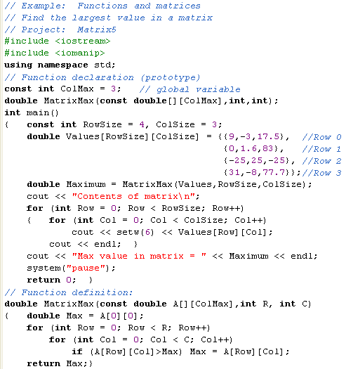
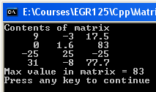
Example: Passing a matrix to a function
Notes:
11
11

Slide 12
Arrays with 3 or more dimensions
Using 1D and 2D arrays is common and somewhat natural. Applications using 3 or more dimensions are harder to find.
Example: Suppose that an array is used to record daily rainfall over a 10-year period.
Using a 1D array is awkward as there are 10*365 = 3650 days (not counting leap years). Using the following declaration:
double Rain[3650]; // declare 1D array
Rain[2125] = 0.25; // it is hard to tell what date this is!
Using a 3D array is clearer, where the 3 indices correspond to the year, month, and day.
const int Year = 11, Month = 13, Day = 32;
double Rain[Year][Month][Day]; // declare 3D array
Rain[1][4][25] = 0.25; // 1/4 “ of rain on April 25 in
// Year 1 of the study
Why use 11 years, 13 months and 32 days above? Discuss in class.
Notes:
12
12

Slide 13
Matrix Examples
Try one or more of the following examples in class:
Load values into matrices A and B with a list and then form matrix C = A + B (A, B, and C must have the same dimensions)
Read matrix A from the keyboard and call one or more functions to find the max, min, and average of the elements in matrix A. Display the matrices and the results from the functions. For example, the function calls might be:
Avg = MatrixAverage(A,Size);
Max = MatrixMax(A,Size);
Min = MatrixMin(A,Size);
Notes:
13
13

