Slide 1
Chapter 12 – Standard Template Library
Reading Assignment: Chapter 12.6 – Vector Class in Introduction to Programming with C++, 3rd Edition, by Liang.
Chapter 12 covers Templates, Vectors, and Stacks. We will only cover section 6 on the vector class. The vector class is part of the Standard Template Library (STL). The vector class allows you to easily form vectors that could be used in place of arrays (covered in Ch 7-8). Why use the Vector Class?
Size: A vector’s size is more flexible than the size of an array and can be easily changed during the program.
Functions: The vector class has useful libraries of functions for working with vectors.
Notes:
1

Slide 2
Expanding and Contracting Lists of Data
We have seen so far that we must specify the size of an array at the beginning of the program.
If we are not sure of the number of elements to be loaded into an array we could declare a large size for the worst case scenario, but this would waste memory. For example, we could list the number of students as 500 for an unknown class size, but this is wasteful for a class size of 20.
Two other ways to handle this are listed below. Both involve dynamic memory allocation.
Dynamically create new arrays and delete arrays as needed using the new and delete operators. We will see how to do this in a later chapter once pointers are introduced.
Use the vector class in the Standard Template Library (STL). C++ includes a useful set of classes in the STL that allow the programmer to easily modify, expand, and contract structures. Additionally, functions are included in the STL for sorting and searching lists of data.
Notes:
2
2

Slide 3
The Standard Template Library
Standard Template Library (STL): Generic set of data structures that can be modified, expanded, and contracted
Each STL class is coded as a template to permit the construction of a container
Container: A generic data structure, referring to a set of data items that form a natural group
Also called list or collection
Containers include vectors, deques, lists, sets, multisets, maps, and multimaps. Here we will only look at vectors.
Vector: Similar to an array
Uses a zero-relative index, but automatically expands as needed

Slide 4
The Standard Template Library (continued)
STL Vector class provides many useful methods (functions) for vector manipulation:
insert(pos, elem); // inserts elem at position pos
name.push_back(elem); //append elem at the end of the vector
name.size(); //return the size of the vector
STL also provides generic functions called algorithms
sort(name.begin(), name.end()); //sort the vector in ascending order
reverse(name.begin(), name.end()); //reverse the order of the elements in the vector
accumulate(name.begin(), name.end()); //sum the elements in the vector
max_element(name.begin(), name.end()); //returns the position (iterator) of the max value in the vector – see note in Example 2.

Slide 5
The Standard Template Library (continued)
Must include the header files:
#include <vector> // required to use vector<T> class
#include <algorithm> // needed for some algorithms or functions //such as reverse( ), replace( ), etc.
#include <numeric> // needed for some algorithms or functions // such as accumulate( )
Create and initialize a vector:
Form: vector<dataType> vectorName(size, initial_value);
Examples:
vector<int> X; // vector of unspecified size
vector<double> Y(50); // vector with 50 elements (indices 0 to 49)
vector<double> Z(N,0); // vector of size N (perhaps after the user
//enters a value for N) with elements set to 0

Slide 6
The Standard Template Library (continued)
Syntax:
To modify a specific element (similar to using an array):
vectorName[index] = newValue;
To insert a new element:
vectorName.insert(index, newValue);
Note: index is an iterator. To insert a value into position N in the array, you might use:
vectorName.insert(vectorName.begin( ) + N, newValue);
STL provides other containers, algorithms, and iterators

Slide 7
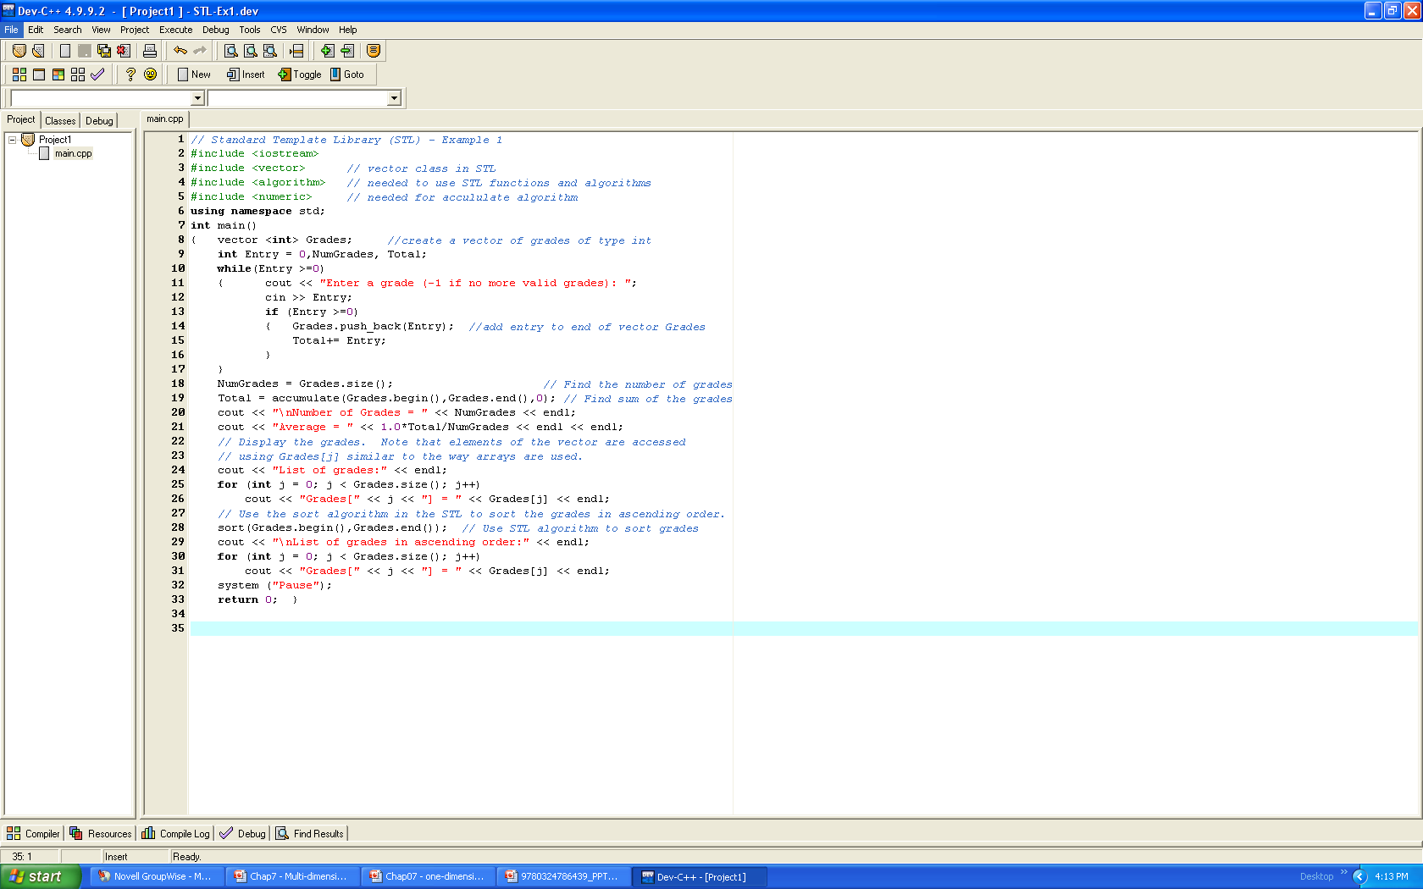
STL Example 1: Use the vector <T> class in the STL to read in an unknown number of grades and sort the grades.
(continued on next slide)

Slide 8
STL Example 1: (continued)

Slide 9
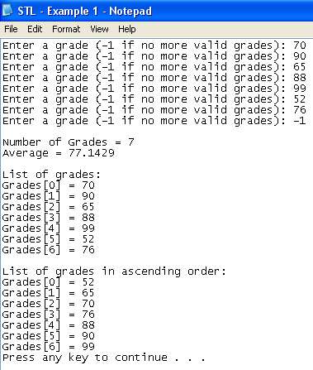
Output for STL Example 1 on previous page.

Slide 10
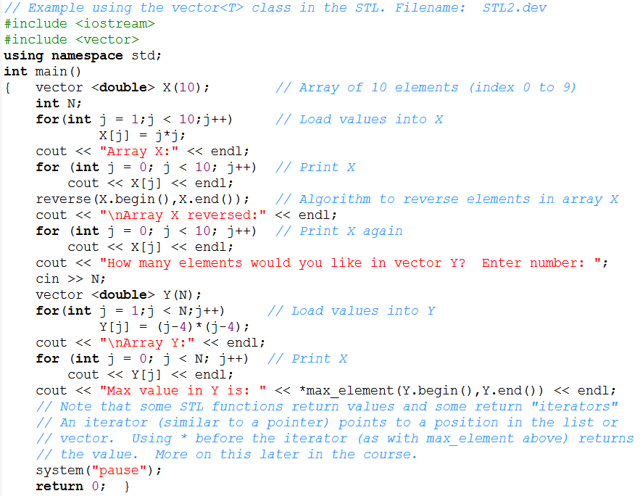
STL Example 2: Use the vector <T> class in the STL to create a fixed size vector and to create a second vector of size N to be specified by the user.

Slide 11
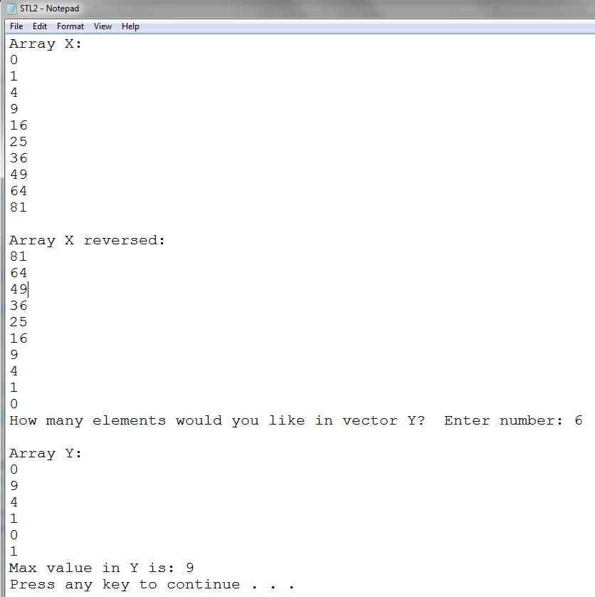
Output for STL Example 2:

Slide 12
Class Example: - Create a vector of 10 doubles using the vector class. - Prompt the user to enter 10 values. - Insert a new value in the middle of the vector using insert( ) - Remove the last value from the vector using pop_back( ) - Add two new values to the end of the vector using push_back( ) - Find the average and maximum value in the list using accumulate( ), size( ), and max_element( ).

