Slide 1
Chapter 13 – Data Files
Reading Assignment: Chapter 13, Sections 1-4, 6 in Introduction to Programming with C++, 3rd Edition, by Liang.
We have already seen how to read inputs from the keyboard and to output values to the computer screen.
Now we will see how to read from and write to files (also called input files, output files, text files, or data files)
C++ Program
12.5 15.2
16.7 22.1
18.6 19.4
….
Max = 22.1
Min = 12.5
Avg = 17.4
….
Input file
Output file

Slide 2
File (data file, text file, output file, input file) – a computer file used for input to or output from a program.
Why use a file?
There are many uses for files, including:
To provide permanent storage of data, such as:
Inventories
Bank accounts
Log sheets
Lab data
Results of your C++ programs
Etc
To avoid entering large quantities of data from the keyboard
To provide a copy or record of the output
To store data where it can then be accessed by other programs, such as MATLAB or Excel

Slide 3
Interactive programs
Our C++ programs so far have been interactive as they:
Prompt the user on the screen to enter inputs
Read inputs from the keyboard
Display outputs on the screen
Non-interactive programs might read inputs from a data file, process the data, and write the results to another data file.

Slide 4
Input and Output Streams
Streams are series of bytes in a sequence that flow from device to device
Objects are regions of storage in memory
The object used determines the device stream that the data comes from or goes to
cin and cout are identifiers for objects defined by iostream (cin representing the keyboard and cout representing the screen)
fstream is a class that allows us to define other objects (example identifiers outfile and infile) establishing connections between our C++ program and files.
>> is called the extraction operator
<< is called the insertion operator
Examples of input and output streams
cin >> x; // extract data from cin into x (identifier for the keyboard)
cout << y; // insert data from y to cout (identifier for the screen)
infile >> x; // extract data from infile into x(ex identifier for a data file)
outfile << y; // insert data from y to outfile(ex identifier for a data file)

Slide 5
Class fstream
fstream is a class that allows us to define objects establishing connections between a C++ program and files. Several useful operators and functions are part of the class.
Header – be sure to include the following header
#include <fstream> // header for working with files
Opening output files:
Form: ofstream fileidentifier(“filename”);
Example: ofstream outfile(“F:Lab1output.dat”);
Example: ofstream output(“C:\\DevC++\\EGR125.out”);
(Note that “\\” is necessary for a single slash in a character string.)
Opening input files:
Form: ifstream fileidentifier(“filename”);
Example: ifstream infile(“F:Lab1input.dat”);
Example: ifstream input(“C:\\DevC++\\EGR125.in”);

Slide 6
Two approaches for opening files
A file can be opened using either of the following approaches:
ifstream infile(“Lab1input.dat”); // declare object and open file
OR
ifstream Infile; // declare object
Infile.open(“Lab1input.dat”); // open file
(The second option is better if you will be opening and closing the file more than one time.)
Default file path
If the full path to a file is not specified, the compiler will assume that the file is in the same folder as the project. Examples:
ofstream output(“C:\\DevC++\\EGR125.out”); // Full path specified
ofstream outfile(“Lab1output.dat”); // File in project folder

Slide 7
fstream (continued)
Insertion operator (>>):
Example: ifstream infile(“Lab1input.dat”);
cin >> x; // read x from keyboard
infile >> y; // read y from the input file
Extraction operator (<<):
Example: ofstream outfile(“Lab1output.dat”);
cout << x; // send x to the screen
outfile << y; // send y to the output file
Closing files:
Closing files is generally not necessary unless you want to open another file using the same identifier, but it might be good practice.
Form: fileidentifier.close();
Example: ofstream outdata(“E:\\EGR125\\mystuff.out”);
outdata << x << y << z; // send data to file
outdata.close( ); // close the file

Slide 8
Writing to an output file – basic steps
Open the file (select an identifier and file name)
Example: ofstream outfile(“E:Lab1output.dat”);
Send outputs to the file using the ofstream object like you would use cout
Example: outfile << “x = “ << x;
(similar to cout << “x = “ << x;)
Close the file
Example: outfile.close( );
To view the results, open the newly formed output file with Notepad, Word, DevC++, etc.
By default, if you run the program again the old output file will be replaced by the new output file. This is usually convenient. Each time you run your program the output file is updated.
See sample program on the next page

Slide 9
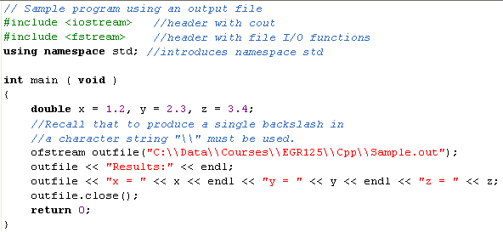
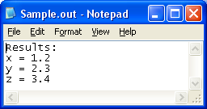

Slide 10
Creating an input file
In order to use a C++ program to read an input data file, we must first create the data file.
Create the input file using Notepad, Word (save in text or rtf format, not as a Word document), DevC++, etc. Use a meaningful file name. The extension isn’t important, but an extension like .dat or .in is recommended.
Numeric values are typically separated by white spaces (space, tab, or newline (\n) )
There is an invisible end-of-file marker ◊ at the end of each file so the program knows when the end has been reached.
C++ would read the following numeric values from the following data files in the same way:
White space = space, tab (\t), or newline (\n)

Slide 11
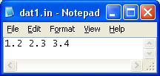
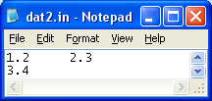
Reading input files
C++ would read the following numeric values from the following data files in the same way since it makes no distinction between white spaces. The sequence of characters seen in each case is shown.
ifstream infile(“A:dat1.in”);
infile >> x >> y >> z;
1 | . | 2 |  | 2 | . | 3 |  | 3 | . | 4 | ◊
ifstream infile(“A:dat2.in”);
infile >> x >> y >> z;
1 | . | 2 | \t | 2 | . | 3 | \n | 3 | . | 4 | ◊

Slide 12
Reading from an input file – basic steps
Create the input file using Notepad, Word (save in text or rtf format, not as a Word document), DevC++, etc.
Open the file (select an identifier and file name)
Example: ifstream infile(“E:Lab1input.dat”);
Read inputs from the file using the ifstream object like you would use cin
Example: infile >> x;
(similar to cin >> x;)
Beware of how C++ handles white spaces and how real numbers and integers are read from files.
Close the file
Example: infile.close( );
The output of the program could be sent to the screen or to an output data file.
See sample program on the next page

Slide 13
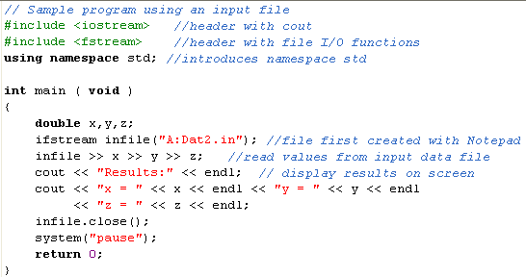
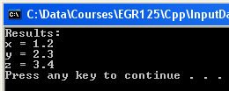

Slide 14
Reading different data types from files
When reading numeric data from a file, care must be taken when working with integers and real numbers.
Reading an integer, such as 2, as a real causes no problem. The integer value is promoted to a real value (2.0).
Reading a fixed point number, such as 2.5, as an integer will result in reading just the digits up to the decimal point (2).
Reading a fixed point number that begins with a decimal point, such as .500, as an integer will result in a file read error or unpredictable results.
See the following three examples:

Slide 15
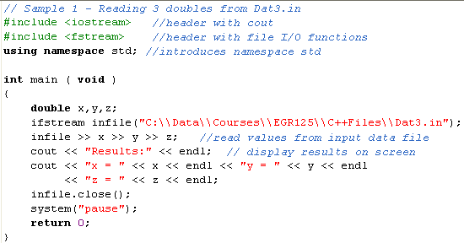
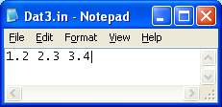
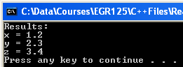
Sample 1: Reading double, double, double from Dat3.in
Note
15

Slide 16
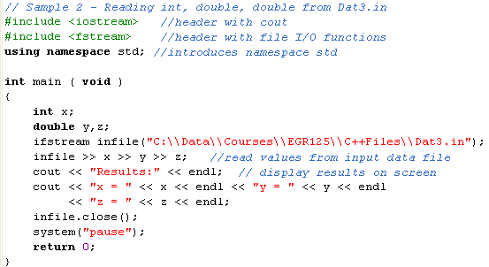

Sample 2: Reading int, double, double from Dat3.in
Note
16

Slide 17

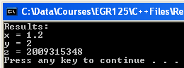
Sample 3: Reading double, int, int from Dat3.in
Note
17

Slide 18
Reading Character Data
To read the next three characters typed at the keyboard:
cin >> c1 >> c2 >> c3;
To read the next three characters in the data file defined below:
ifstream infile(“A:Mydata.in”);
infile >> c1 >> c2 >> c3;
Whitespaces are NOT needed for separating character data
if used, whitespaces are ignored

Slide 19
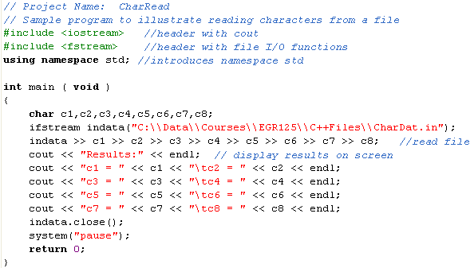
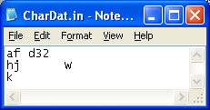

Note that the white spaces were ignored

Slide 20
Input Buffer
Perhaps you have used some program on your computer where you held down a key and, even after you released the key, the program still responded to the input. The keystrokes were stored in a buffer in your computer. Additionally, you may have held down a key until the keyboard began beeping, indicating that the buffer was full.
A buffer is a region of memory used for temporary storage of information being transferred between devices
Keystrokes stored in the buffer are accessed sequentially (i.e., in the same order that they were entered.)
The computer has a position indicator to keep track of which information has been read.
Why is this important in C++ programming? Suppose you request a single character input (Y or N, for example), but the user accidentally hits the key twice. The second character is still in the buffer and will be read at the next input!

Slide 21
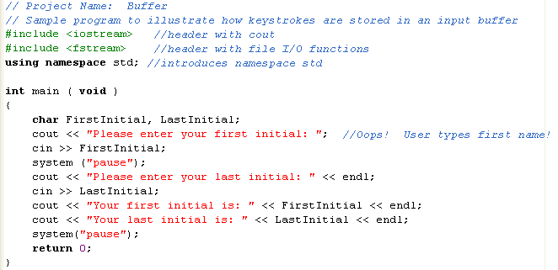
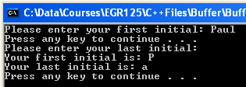
Input Buffer - Example
21

Slide 22
Variable file names
We can easily use a use a string to store the file name as in the example below. The user could also enter the file name from the keyboard.
# include <fstream>
# include <string>
using namespace std;
int main()
{ string File1 = “E:Number.dat";
double number;
ifstream Infile(File1);
22
Problem with some C++ compilers – (Not a problem with DevC++)
Some compilers may not support the use of strings for filenames when using fstream. They may require the use of a C-style character array instead of a string. If this problem occurs, there are two choices:
Use a C-style character array
Use a string and convert it to a C-style character array using the function c_str(). See the following two slides for examples.
Notes:
22
22

Slide 23
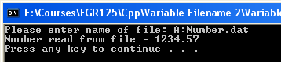
Variable file names - If your compiler doesn’t support the use of strings for filenames with fstream, one solution is:
Use C-style strings (possibly dangerous since a long filename & path could exceed the string size and crash the computer).
#include <iostream>
#include <fstream>
#include <cstring> //C-style character arrays
using namespace std;
int main()
{ char File1[100]; // set max file name length
cout << "Please enter name of file: " ;
cin >> File1;
double number;
ifstream Infile(File1);
Infile >> number;
cout << "Number read from file = " << number << endl;
system("pause");
return 0; }
Using C-style character arrays isn’t necessary with DevC++
23
Notes:
23
23

Slide 24
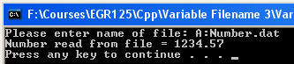
Variable file names - If your compiler doesn’t support the use of strings for filenames with fstream, a second solution is:
Convert the C++ string to a C-style string using the member function c_str(). This approach is recommended and is shown below.
#include <iostream>
#include <fstream>
#include <string> //C++ string
using namespace std;
int main()
{ string File1;
cout << "Please enter name of file: " ;
cin >> File1;
double number;
ifstream Infile(File1.c_str()); // convert to C-string
Infile >> number;
cout << "Number read from file = " << number << endl;
system("pause");
return 0; }
Using c_str() isn’t necessary with DevC++, but it may be shown in text examples
24
Notes:
24
24

Slide 25
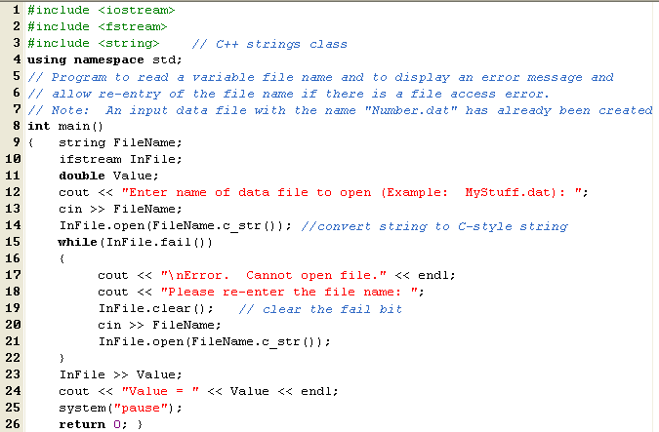
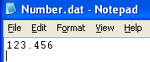
Testing for file access errors
The function fail() can be used to verify that a file opens properly.
fail() = 1 (true) if the file failed to open
fail() = 0 (False) if the file open successfully
Notes:
Nvv

Slide 26
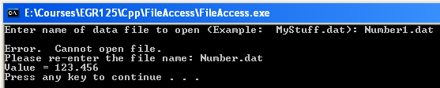
Testing for file access errors - continued
Results from the previous program are shown below. The file Number.dat was created using Notepad prior to running the program.
Note that initially an incorrect filename was entered (Number1.dat)
Then the correct filename was entered (Number.dat) and the value in the data file was successfully read.
Notes:
Nvv

Slide 27
Input/Output Files
Example:
ifstream InputA; // input file only
InputA.open(“MyInputs.txt”);
ofstream OutputB; // output file only
OutputB.open(“MyOutputs.txt”);
fstream InOutC; // input file or output file
InOutC.open(“MyData.txt”, ios::in);
InOutC >> x; // read from the file
…
InOutC.close(); // close the input file
// and reopen as an output file
InOutC.open(“MyData.txt”, ios::out);
InOutC << “Results:”; // write to the file
…
InOutC.close();
Previous examples have used
ifstream for input files and
ofstream for output files.
Another option is to use fstream where the file could be used for input or output by specifying the file mode. This is useful when updating information in a file, such as a bank account or an inventory.
Notes:
Nvv

Slide 28
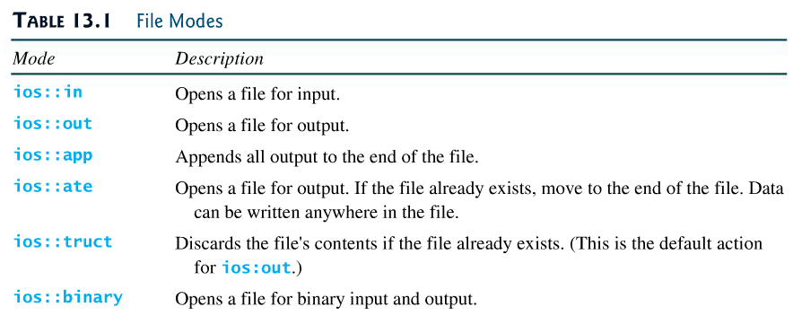
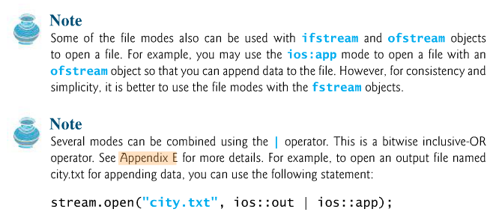
Other file modes
The file modes ios::in and ios::out were used in the previous example to specify files as input files or output files. Other file modes are also available. See Table 13.1 below. An example is shown on the next slide.
Notes:
Nvv

Slide 29
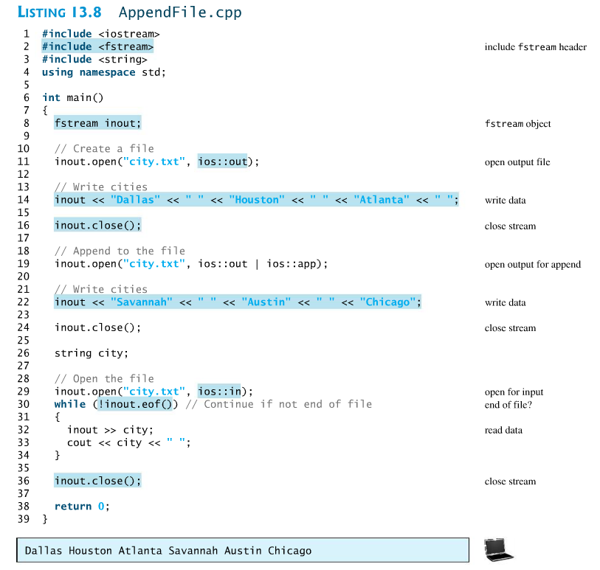
Example: Using a file for both input and output
Notes:
Nvv

Slide 30
Useful functions for reading from and writing to files
There is a problem when reading from files using the extraction (>>) operator: data is delimited by white spaces. This can be a problem when white spaces are part of a string (such as spaces in a name).
Some useful functions:
getline( ) – useful for reading until a specified delimiter is read (\n is the default)
Note: getline( ) was also covered earlier in Chapter 4
Form: getline(ifstream& input, int string s, char delimitChar)
Example: getline(cin, CompleteName); \\ read from the keyboard into a string named CompleteName until a newline is entered
Example: getline(Input, Address, ‘\n’) \\ read from an input data file named Input into a string named Address until a newline is entered
Notes:
Nvv

Slide 31
get( ) – useful for reading one char at a time (including white spaces)
Form: char get( ) // no inputs, returns one character
Example: Symbol = cin.get( ) \\ read one character from the keyboard (including white spaces) into a char variable named Symbol
Example: Symbol = Input.get( ) \\ read one character from an input data file named Input (including white spaces) into a char variable named Symbol
put( ) – useful for writing one char at a time (including white spaces)
Form: void put(char ch) // no outputs, one character input
Example: cout.put(Symbol) \\ writes the value of the char variable Symbol to the computer screen (including white spaces)
Example: Output.put(Symbol ) \\ writes the value of the char variable Symbol to a data file named Output (including white spaces)
Summary: When reading from a data file named Input, use:
Input >> charVar; // read one char at a time (skips white spaces)
charVar = Input.get( ); // read one char at a time (incl. white spaces)
Input >> strVar; // read one string at a time (until white space)
getlline(Input, strVar); // read the entire line as a string
Notes:
Nvv

Slide 32

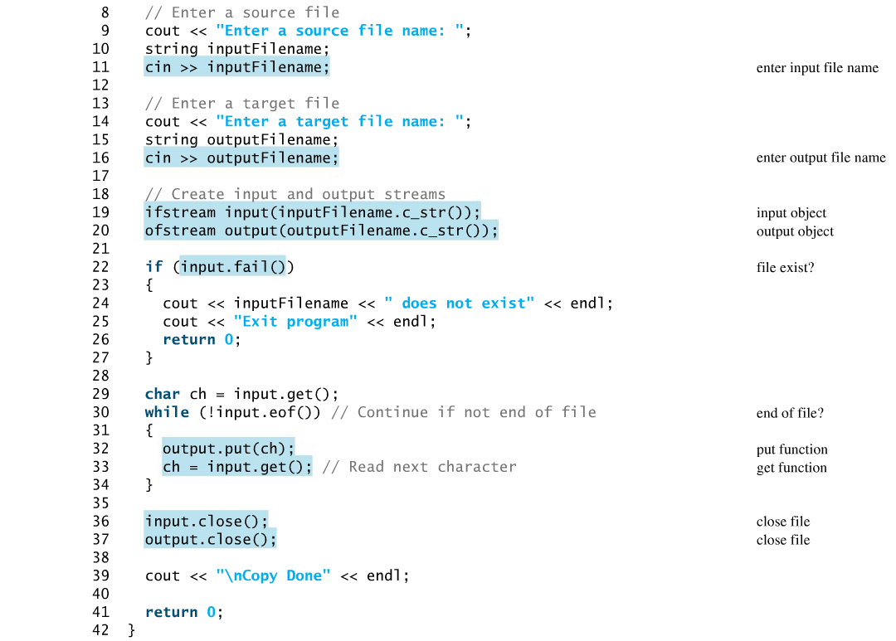
Example from the textbook:
Use get( ) and put( ) to copy a data file
Notes:
Nvv

Slide 33
Class example:
Create the data file named sides.txt using NotePad with the values below (base and height for 5 right triangles).
Write a C++ program to read the input file, calculate the hypotenuse for each triangle, and write the results to a new data file named hypotenuse.txt.
Contents of hypotenuse.txt:
Contents of sides.txt:
Base Height Hypotenuse
3 4 5
5 12 13
10 10 14.14
1 2 2.24
9 12 15
3 4
5 12
10 10
1 2
9 12
Modify the program above to work for an undetermined number of right triangles by searching for the eof marker.
Modify the program above to print an error message if it is unable to open sides.txt
Modify the program above to allow the user to enter the name of the output data file.
Notes:
Nvv

Slide 34
Data Files and Arrays
Arrays are very useful for storing and processing information read from data files. Two cases will be considered:
1) The number of items in the file is known.
2) The number of items in the file is NOT known.
1) The number of items in the file is known.
Example: Read 100 (x,y) point from a data file
named A:dataxy.in.
const int Size = 100;
double x[Size], y[Size];
ifstream InData(“A:dataxy.in”);
for (int j = 0; j < Size; j++)
InData >> x[j] >> y[j];
Contents of dataxy.in:
10 220
12 230
14 240
16 252
18 269
…..
Notes:
Nvv

Slide 35
Data Files and Arrays
2) The number of items in the file is NOT known.
Recall that every data file ends with an invisible end-of-file (EOF) marker. The function eof( ) in fstream returns a value of 1 when eof is encountered and a value of 0 otherwise. Because eof( ) is a member function in the class ifstream, it must be used along with the file object identifier and dot notation. For example:
ifstream InFile(“C:\\MyStuff.dat”)
InFile >> x;
if (InFile.eof( )) cout << “ End of file has been reached”;
Object
Member function
Dot notation
Example:
A data file named A:Grades.dat contains an unknown number of grades. Determine the number of grades, the average grade, and maximum grade, and the minimum grade. Assume that all grades are between 0 and 100. See next slide.

Slide 36
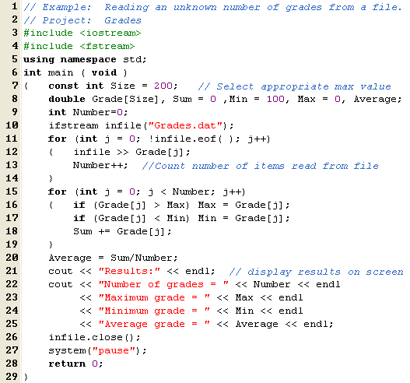
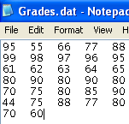
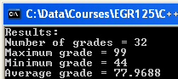
Note: Be sure that there are no extra white spaces in the data file after the last grade or else Number will be 33 (incorrect) instead of 32.
Notes:
Nvv

Slide 37
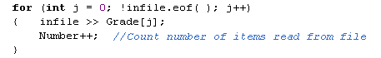
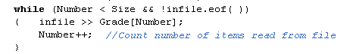
Note that a while loop could have been used in the last example to read the unknown number of grades from the data file as shown below. An additional test was added to ensure that the maximum array size was not exceeded.
Notes:
Nvv

Slide 38
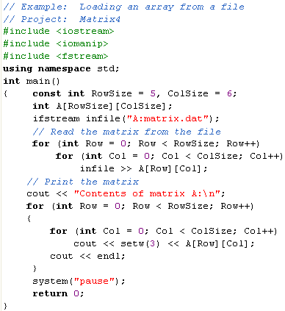
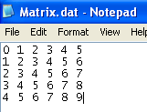
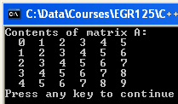

Reading matrix values from a data file
Reading values from a data file into a matrix is relatively easy. Values are read sequentially from the data file, so they need not be arranged in the form of a matrix. The output is the same for either Matrix.dat below.
Notes:
38
38

Slide 39
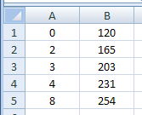
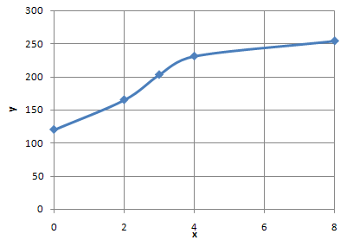
Formatting a data file so that it can be opened in Excel
Writing a C++ program to graph data would be very challenging. It would be especially difficult to write a program with extensive graphing options such as those found in Excel.
A better option is to send your data to a data file and then open the file in Excel.
Separating your data into columns in Excel is easily done by separating the values with delimiters. A comma is often used as a delimiter, although spaces and tabs can be used as well.
A data file that uses commas to separate the data is called a commas-delimited file. Excel can easily open this type of file.
C++ Program
Data File
Excel File
Excel Graph
Program performs calculations and writes data to file with commas
to separate values
0,120
2,165
4,203
6,231
8,254
commas used as delimiters
Notes:
39
39

Slide 40
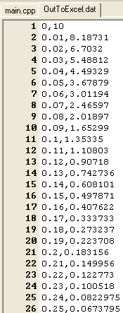
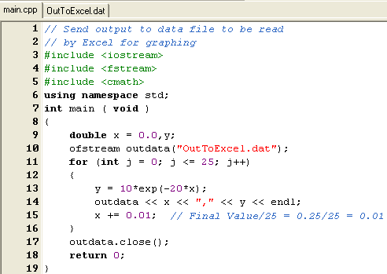
Example:
Data File:
Writing a C++ program to:
Calculate y = 10e^{-20x} for x = 0 to 0.25 (using 26 values)
Send the x,y values to a commas-delimited file
Open the file in Excel
Graph the data
C++ Program:
Notes:
40
40

Slide 41
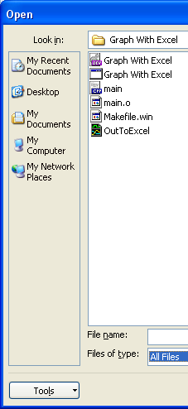
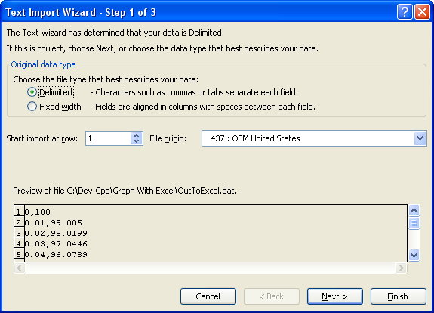
Open the file in Excel.
Select Delimited file type.
Notes:
41
41

Slide 42
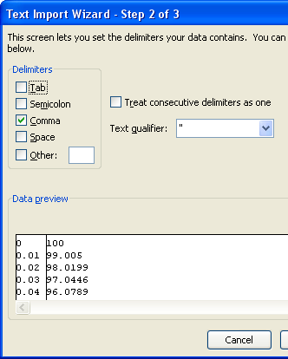
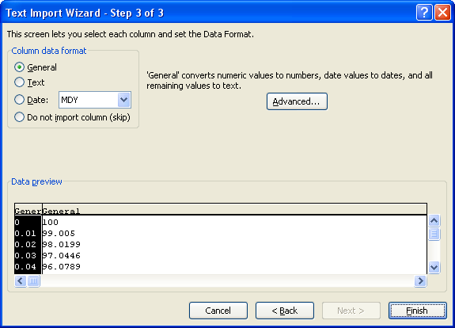
Select Comma as the delimiter.
Select General data format.
Note: You can also create an output file with a csv (comma separated values) extension and Excel will skip steps 1-3 above and open the file right away. Example filename: MyData.csv
Notes:
42
42

Slide 43
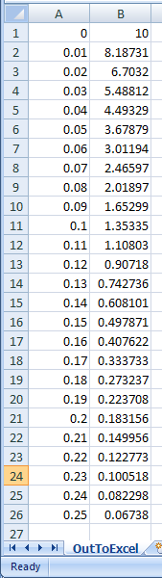
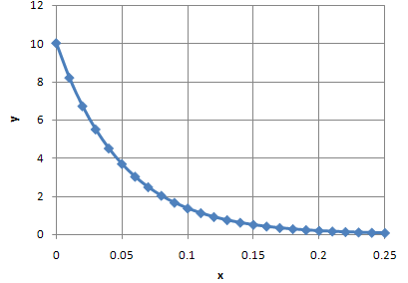
The data should now appear in Excel in two columns.
Graph the data in Excel using an x-y scatter chart.
Of course, you can add additional formatting in Excel (title, axis labels, gridlines, etc).
Notes:
43
43

Slide 44
Class example:
Write a C++ program to calculate the area of a circle as the radius varies from 0 to 5 in increments of 0.25. Send the results to a commas delimited data file as illustrated below. Use 2 digits after the decimal point and show trailing zeros.
Contents of Circle.txt:
0.00,0.00
0.25,0.20
0.50,0.79
5.00,78.54
Open Circle.txt with Excel and graph the results using an xy (scatter) plot. Label the axes, add a title, and add gridlines.
Notes:
Nvv

