Slide 1


Google App Engine Developer Workshop
April 21, 2013

Slide 2
Workshop Goals
Overview of Cloud Computing
What is Google App Engine?
Setup your Google App Engine account
Code Lab Sessions
Cover various App Engine APIs / Services.
Help you to take your next leap into writing Cloud Applications running on Google App Engine infrastructure.

Slide 3

Prerequisites
A laptop and Internet connection
Mobile Phone with a working phone number
Basics of Java / JSP / Servlets

Slide 4
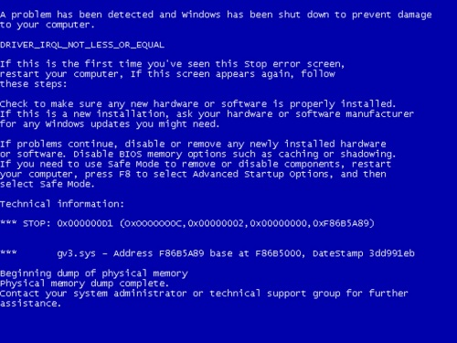
Course Requirements
Basic working knowledge of HTML, JavaScript and CSS
Use a Text Editor or any other IDE of your preference to write all code samples
We shall run all examples on various browsers

Slide 5

Session 1 – Cloud Computing Overview

Slide 6
Cloud Computing
6
Cloud Computing is a pay-per-use model for enabling available, convenient, on-demand network access to a shared pool of configurable computing resources (e.g., networks, servers, storage, applications, services) that can be rapidly provisioned and released with minimal management effort or service provider interaction.
Credit : http://csrc.nist.gov/publications/nistpubs/800-145/SP800-145.pdf

Slide 7

The 5-3-4 formula
7
Cloud Computing comprises of
5 key characteristics
3 delivery models
4 deployment models.

Slide 8

5 Key Characteristics
8
On Demand Self Service
Ubiquitous network access
Location independent Resource Pooling
Rapid Elasticity
Pay Per Use

Slide 9
3 Delivery Models
9
Software as a Service (SaaS)
Gmail, SalesForce.com, Google Apps, Office Live
Platform as a Service (PaaS)
Google App Engine
Windows Azure
Heroku
CloudFoundry
Force.com
Infrastructure as a Service (IaaS)
Amazon Web Services (AWS), Google, Microsoft, IBM, EMC

Slide 10
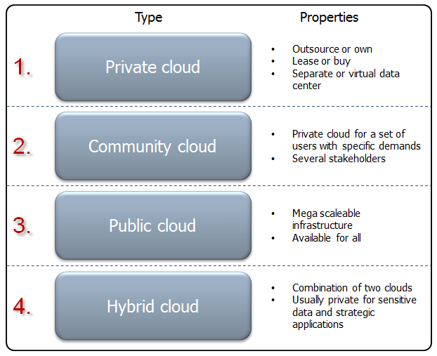
4 Deployment Models
10

Slide 11
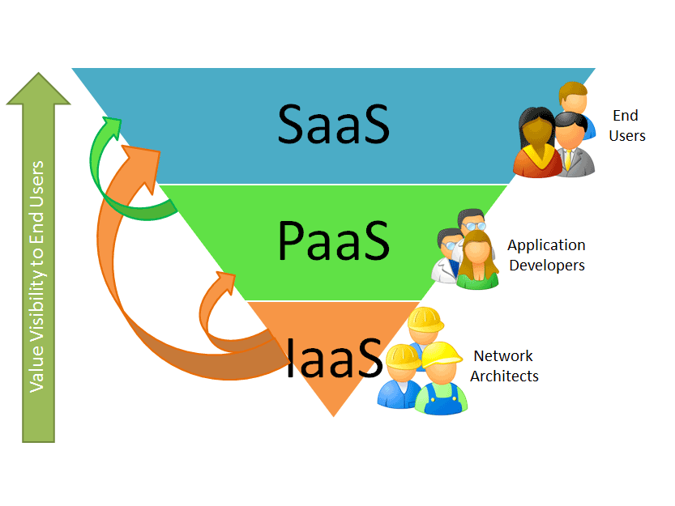
Target Customers
11
Image Credit: http://www.saasblogs.com/saas/demystifying-the-cloud-where-do-saas-paas-and-other-acronyms-fit-in/

Slide 12


Session 2 – App Engine Overview

Slide 13



What is common between these companies?

Slide 14
What is Google App Engine?
Application Hosting and Development Platform
Host your application on Google’s infrastructure
3 runtimes supported : Java, Python and Go
Variety of Services to boost developer productivity
Free Quota and then Pay per use
http://cloud.google.com/appengine

Slide 15
App Engine – History
April 7, 2008 : First Release (Python)
2009 : Support for Java
2011 : Go Language support
Current Version : 1.7.7 – April 9, 2013
Since 2012 - monthly release cycle

Slide 16
What does it provide?
Run time infrastructure
Use Google Infrastructure
Python, Java or Go Applications
One Google Account – 10 Applications with Free Quota
Administrative Console
Developer Tools
App Engine SDK (Java, Python, Go)
Local Development Server
Eclipse Plug-in to develop applications and 1-click deploy to Cloud

Slide 17
App Engine Advantages
Leading PaaS
Google Infrastructure
Generous Free Quota
Pay per use
Quick to start
99.95 SLA
Paid support offered as part of Premier Accounts
Global Data Locations
Easy to Manage / Run

Slide 18
App Engine Services
Support for Java Web Applications.
Java version 6 / 7
Files API & integration with Google Cloud Storage (GCS)
XMPP API
Channel API
Memcache API
Users API
Task Queues & Crons
URL Fetch API

Slide 19
App Engine Services
High Availability NoSQL and SQL Service
Blobstore API
Search API
App Engine Map Reduce
Logs API
SSL Support
Pagespeed service
Google Cloud Endpoints

Slide 20
Usage Quotas
Requires Google Account
An Account can register up to 10 Applications.
Free Quota is available for each application.
Beyond that a pay per use policy applies
https://developers.google.com/appengine/docs/quotas

Slide 21
Usage – Free Quota
Quota | Limit (per day)
Instance-hours | 28 hours
Emails | 100 (5000 admin emails)
Bandwidth in | Unlimited
Bandwidth out | 1 GB
Datastore | 1 GB
Blobstore Data | 5GB
Datastore Operations | 50k operations
App Size | 10K files, 32MB/file, 1GB App Size
XMPP API | 10k stanzas
URLFetch API calls per day | 657,000
Log Data | 1 GB
The power comes with certain restrictions like HTTP Request 60 second limit and more.

Slide 22
App Engine - Competition
Amazon Web Services
VMWare
Heroku
CloudFoundry
OpenShift
Force.com
Rackspace
Windows Azure
GoGrid

Slide 23
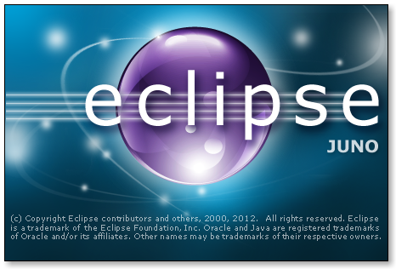

Session 3 – App Engine Setup

Slide 24
App Engine - Setup
What you need
Java SDK ( 1.6 or 1.7 )
App Engine SDK (Latest version is 1.7.7.1)
Eclipse (Take the latest version – Eclipse Juno)
Google Eclipse Plugin for Eclipse Juno
Note: 1.7.7 has a bug in uploading the application, hence you may need to download 1.7.7.1 (http://googleappengine.googlecode.com/files/appengine-java-sdk-1.7.7.1.zip)

Slide 25

App Engine - Setup
25
Did you setup your environment ?
Setup Instructions :
Follow Google App Engine Development Environment Setup.docx.

Slide 26

Hands On Exercise
Our goal here is to setup your Development Environment.
Follow Google App Engine Development Environment Setup.docx

Slide 27

Session 4 – Hello World

Slide 28
App Engine – Hello World
Get our App Engine Account Setup and create an Application.
Develop the default App Engine application using Google Eclipse Plugin Project Wizard.
Deploy our Application to App Engine cloud
See it live !
While the application does not do much, it will demonstrate your development / deploy workflow.

Slide 29
App Engine – Account Setup
Go to http://appengine.google.com
Sign in with your Google Account.
When you create Applications for the first time, it will ask for Mobile Number and Google will send you a verification code via SMS.
Complete the validation process with the code.
Each Google Account gives you 10 Applications
A Mobile number can be verified only once ;-)

Slide 30
App Engine – Create App
We do not want to stray from tradition, so let us create a Hello World application.
Use Eclipse and Google Eclipse plugin to generate default Application Template.
Test it out locally.
Demo : Develop Hello World Locally

Slide 31
App Engine – Deploy App
31
Final Step is to deploy the App to the Cloud.
Step 1 : Create an Application that will host your application. This is a unique Application Id. This is done from http://appengine.google.com. Login and go to My Applications and then Create Application.
Step 2 : Use the Google one-click Deploy option in Eclipse to deploy your application directly under that Application Id.
The app on successful deployment will be available at http://<APPID>.appspot.com

Slide 32
Hands On Exercise
Go to /hands-on-exercises/HelloWorld.docx
Follow the document and deploy your First Google App Engine application.

Slide 33





Session 5 – Exam Results App

Slide 34
ExamResults App
Web Application
Lookup Exam Results
Web Interface to enter your Seat Number and it gives back results.
Accepts request over Google Chat and responds with Chat message.
Accepts request over Email and responds with Email.

Slide 35

Demos
Exam Results App – In Action
http://exam-results.appspot.com

Slide 36

Session 6 – Code Lab
Web Interface

Slide 37
Web Interface
We will start off with building a Web Interface as demonstrated in the demo
Make use of Servlets and JSP
App Engine supports Java Servlet 2.5 specification
If you are familiar with developing basic Java Servlet / JSP applications, you are all set.

Slide 38
Web Interface – The Flow
38
The flow is simple:
Home page (index.html) that has a form that accepts a Seat Number of the student who took the exam
This is submitted to a Servlet, which builds a dummy result
The Servlet forwards control to a JSP page that will display the Exam result
If there are any errors, an error JSP page that is configured will display the error

Slide 39
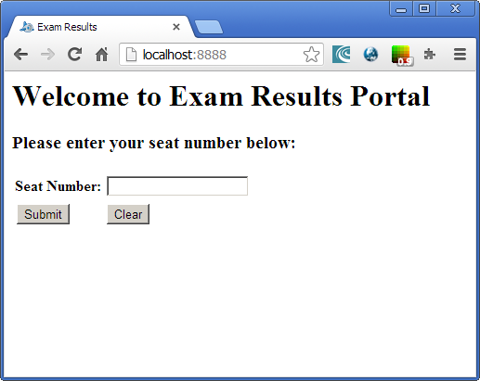
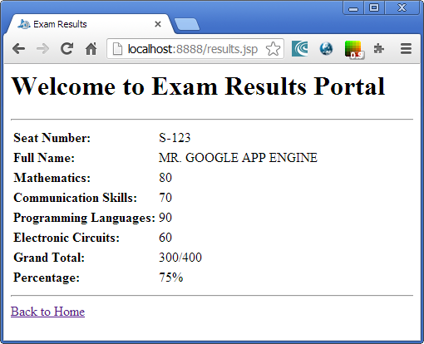
Web Interface – Visual Flow
39
ExamResultsServlet.java
Java Servlet
index.html
results.jsp

Slide 40
Hands On Exercise
Step by Step instructions to create the Exam Results Application and the Web Interface. It contains:
Go to /hands-on-exercises/ExamResults-Step2-WebInterface.docx
Step 1 just contains an empty template app so do not use that but you can use that as a starter project for any App Engine app.

Slide 41

Session 7 – Code Lab
Datastore Service

Slide 42
App Engine Datastore
App Engine provides a highly scalable option for persisting your data
App Engine provides NoSQL schemaless object store.
It is called the Datastore. The Datastore API is used to persist and retrieve data.
The Datastore API uses Google BigTable.
JDO, JPA and other 3rd party libraries (Objectify)

Slide 43
Modelling an Entity
Every data object is known as Entity
Entities do not have columns, they have one or more properties
A property can be one of several types: String, Integer, etc.
Each entity is identified by its Kind & Key
Kind : Categorization
Key : Unique value

Slide 44
Exam Result Entity
Entity
Kind = ExamResult
Key = SeatNumber
Properties
Student Name
Marks_Math
Marks_CommSkills
Marks_Total
Marks_Percentage
…..

Slide 45
Add an Entity
//Entity (Type, Key)
Entity examresult = new Entity("ExamResult", seatnumber);
//Set the Properties (Remember there is no schema, just properties)
examresult.setProperty("studentName", studentName);
examresult.setProperty("marks_Math", marks_Math);
examresult.setProperty("marks_CommSkills", marks_CommSkills);
examresult.setProperty("marks_Programming", marks_Programming);
examresult.setProperty("marks_ElectronicCircuits", marks_ElectronicCircuits);
examresult.setProperty("marks_Total", marks_Total);
examresult.setProperty("marks_Percentage", marks_Percentage);
//Get the Datastore Service
DatastoreService datastore = DatastoreServiceFactory.getDatastoreService();
//Call put method
datastore.put(examresult);

Slide 46
Hands On Exercise
Step by Step instructions to create the Datastore Layer for the application.
We will build a persistable Entity named ExamResult and use the JDO API to write and search for the records. It will our Data Access Object (DAO).
Additionally, we will integrate it with the ExamResultsServlet code so that actual data is returned.
Go to /hands-on-exercises/ ExamResults-Step3-Datastore.docx

Slide 47
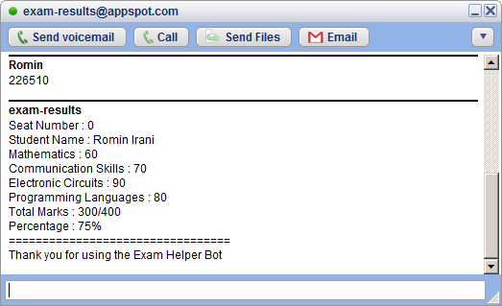
Session 8 – Code Lab
XMPP Service

Slide 48
App Engine – XMPP Service
Instant Messages or Chat.
App Engine Application can talk to any XMPP-compatible Chat Service such as Google Talk or Jabber.
Useful for creating interactive Chat based applications that a user can add to Google Talk and communicate via a subset of commands.
For e.g. A Weather XMPP Bot which when provided a city name, gives its current weather conditions.

Slide 49
App Engine – XMPP Service
XMPP Service support includes
Sending XMPP Messages
Receiving XMPP Messages
Sending Invitations
Managing Presence
https://developers.google.com/appengine/docs/java/xmpp/

Slide 50
App Engine – XMPP Service
Sending XMPP message is as simple as invoking the similar to invoking any HTTP request, simply invoke the XMPP API to send the message. Optionally, you can monitor for errors.
Receiving XMPP is similar to receiving HTTP requests. App Engine wraps the message and invokes standard Request Handlers for XMPP in your application.
The message is put in the HTTP Request payload and you can parse it out.

Slide 51
App Engine – XMPP JID
Each participant in an XMPP Application is identified by a Jabber ID (JID)
Jabber ID : username @ domain / resource
To send a XMPP Message, you send the message to your own server, which delivers it to the other server and if the user is online, the message is delivered to the client application e.g. Google Talk.
For XMPP Chat, your App Engine application can receive messages at app-id@appspot.com or anything@app-id.appspotchat.com

Slide 52
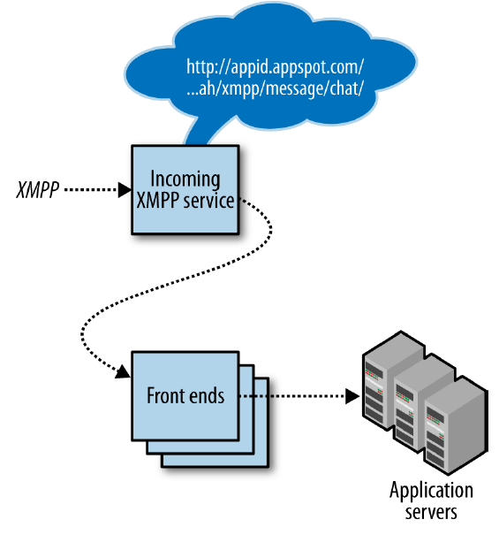
App Engine – XMPP Service

Slide 53
App Engine – Receiving XMPP Messages
To receive XMPP Message in your application, first enable the feature in the application configuration.
Go to appengine-web.xml in /WEB-INF folder and add the following entry:
<inbound-services>
<service> xmpp_message </service>
</inbound-services>

Slide 54
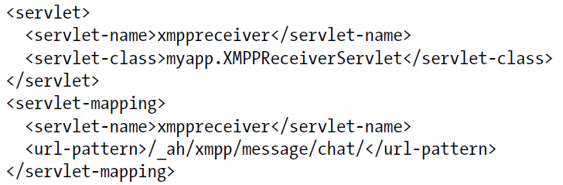
App Engine – Receiving XMPP Messages
Add the incoming XMPP Message URL Path to a Servlet
web.xml description
In the Servlet, handle the POST method to extract out the XMPP message payload

Slide 55
App Engine – Receiving XMPP Message
public class XMPPReceiverServlet extends HttpServlet {
public void doPost(HttpServletRequest req, HttpServletResponse resp)
throws IOException {
XMPPService xmpp = XMPPServiceFactory.getXMPPService();
Message message = xmpp.parseMessage(req);
// ... Use methods like
// message.getFromJid();
// message.getBody();
}
}

Slide 56
App Engine – Sending XMPP Message
XMPPService xmpp = XMPPServiceFactory.getXMPPService();
JID recipient = new JID(“romin.k.irani@gmail.com");
Message message = new MessageBuilder()
.withRecipientJids(recipient)
.withBody(“Welcome to App Engine!")
.build();
SendResponse success = xmpp.sendMessage(message);
if (success.getStatusMap().get(recipient) !=endResponse.Status.SUCCESS) {
// ...
}

Slide 57
Hands On Exercise
Allow for anyone to request their exam result via XMPP Chat
Write incoming XMPP handler to receive and parse request
Send out the response via XMPP itself
Flow is: User logs to Google Talk, adds the Application Chat Id to his/her friends list and interacts with the XMPP Chat Application
Go to /hands-on-exercises/ExamResults-Step4-XMPP.docx

Slide 58
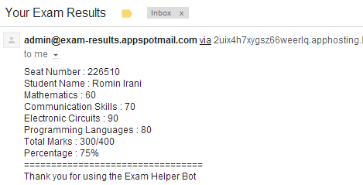
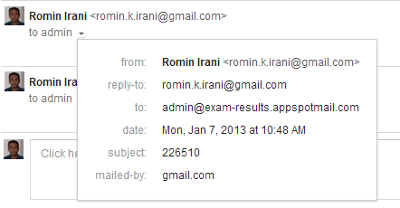
Session 9 – Code Lab
Email Service

Slide 59
App Engine – Mail Service
App Engine provides the Mail Service API
Used for sending and receiving email
Sending Email is similar to invoking any HTTP request, simply invoke the Mail API to send email.
Receiving Email is similar to receiving HTTP requests. App Engine wraps the message and invokes standard Request Handlers for Mail in your application
The message is put in the HTTP Request payload
https://developers.google.com/appengine/docs/java/mail/

Slide 60
App Engine – Mail Service
Each app has its own set of incoming email addresses, based on its application ID.
For email, the app can receive messages at following address:
anything@app-id.appspotmail.com
Free Quota : 100 per day external, 5000 per day (Administrator)
Dev Server supports API but does not send out actual email. It just shows it in the Log.

Slide 61
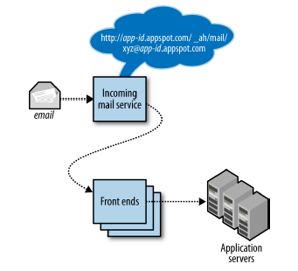
App Engine – Mail Service

Slide 62
App Engine – Receiving Email
To receive email in your application, first enabled the feature in the application configuration
Go to appengine-web.xml in /WEB-INF folder and add the following entry:
<inbound-services>
<service>mail</service>
</inbound-services>

Slide 63
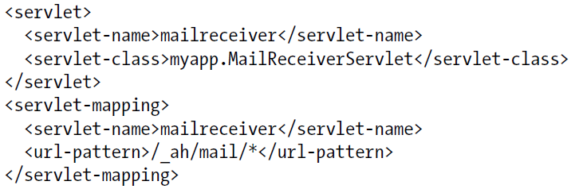
App Engine – Receiving Email
Add the incoming email URL Path to a Servlet
web.xml description
In the Servlet, handle the POST method to extract out the Email message payload

Slide 64
App Engine – Receiving Email
public void doPost(HttpServletRequest req, HttpServletResponse resp) throws IOException {
Properties props = new Properties();
Session session = Session.getDefaultInstance(props, null);
try {
MimeMessage message = new MimeMessage(session, req.getInputStream());
String contentType = message.getContentType();
Object content = message.getContent();
if (content instanceof String) {
// A plain text body.
}
else if (content instanceof Multipart) {}
}
catch (MessagingException e) {
//..
}
}

Slide 65
App Engine – Sending Email
To send Email, call the API of the Mail Service
Fill out From, To, CC, BCC, Subject, Message, Attachments.
Valid From Address
The Google Account address of one of the application administrators
The address of the user currently signed in to the app
A valid incoming email address for the application

Slide 66
App Engine – Sending Email
String recipientAddress = <email address>;
Properties props = new Properties();
Session session = Session.getDefaultInstance(props, null);
String messageBody =“Hi”;
try {
Message message = new MimeMessage(session);
message.setFrom(new InternetAddress(“test@test.com"));
message.addRecipient(Message.RecipientType.TO, new InternetAddress(recipientAddress));
message.setSubject("Welcome to App Engine Workshop!");
message.setText(messageBody);
Transport.send(message);
} catch (Exception e) {
}

Slide 67
Hands On Exercise
Allow for anyone to request their exam result via Email
Write incoming email handler to receive and parse request
Send out the response via email (Ideally this should be send out asynchronously via Task Queue API)
Go to /hands-on-exercises/ExamResults-Step5-Email.docx

Slide 68

Session 10 – Code Lab
Cron Service

Slide 69
App Engine – Cron Service
Ability to run tasks at regular intervals
Schedule one or more repetitive tasks to run at different intervals
Ability to specify Time Zones also
Examples
Fetch the latest news every 1 hour
Update App statistics every 6 hours
Check system to send any email reminders every 12 hours
Take a backup every week on Wednesday at 12:00 AM
https://developers.google.com/appengine/docs/java/config/cron

Slide 70
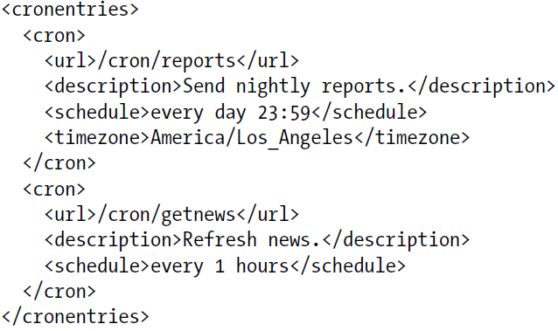
App Engine – Cron Service
Cron Schedules are specified in a cron.xml file that is placed in the /WEB-INF directory

Slide 71
App Engine – Cron Service
Each Cron Entry specifies the following:
description : A description of the task
url : the URL path of the Request handler to invoke. This will map to the Servlet that you will configure in the web.xml file
schedule: the Cron expression that specifies the schedule on which to execute the task
timezone: Optional. The Zone Info descriptor for the timezone e.g. America/Los Angeles. If omitted it is UTC
target: Optional. ID of the App version to use for the task.

Slide 72
Cron Service - Schedules
A Cron Expression for the schedule is a simplified English-like format that describes the recurrence of the task
every 1 minutes
every 10 hours
every day 11:00
every wednesday 15:00
2nd sunday
every 30 mins from 9:00 to 12:00

Slide 73
Hands On Exercise
Write out a Cron Job that executes every 2 or 1 hour and prints out a dummy string or Twitter Search.
First configure your cron.xml file with the cron entry and place it in /WEB-INF folder
Map the Cron Job Request Handler to Servlet and code the Servlet
Deploy the application on App Engine and observe the results
Go to /hands-on-exercises/ExamResults-Step6-CronJob.docx

Slide 74
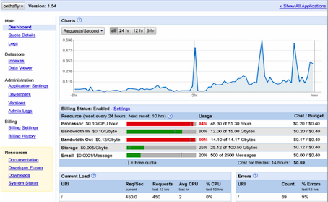
Session 11 – Code Lab
Administrative Console

Slide 75
Administrative Console
Login at http://appengine.google.com
Visit your list of applications
Click on a particular application to view the Administrative Console

Slide 76
Administrative Console
Dashboard shows current usage / quota limits
View Logs
View Datastore
Versions
Enable/Disable Application
and more …

Slide 77
Hands On Exercise
For one of your App Engine applications, login with your account credentials at http://appengine.google.com
Visit the Dashboard and visit the different links
Most important ones:
Current usage
Logs
Datastore viewer

Slide 78
More Services
We have only seen a few of the App Engine Services
Investigate and learn about these additional ones
Blobstore – for storing large amounts of data
Memory Cache – store and retrieve data from memory
Task Queues – Create asynchronous tasks that are executed by App Engine automatically
And more …
Visit : https://developers.google.com/appengine/docs/java/

Slide 79
Important URLs
Official Site : https://cloud.google.com/products/
AppEngine Console: http://appengine.google.com
Java Documentation: https://developers.google.com/appengine/docs/java/overview
AppEngine Code Lab: http://googcloudlabs.appspot.com

Slide 80
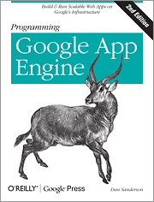
Books
80
Excellent in-depth book on Google App Engine covering both Python and Java
Code snippets in this presentation taken from book for demonstration purpose only
Programming Google App Engine, 2nd Edition
By Dan Sanderson
Publisher: O'Reilly Media
Released: October 2012
Pages: 538
http://shop.oreilly.com/product/0636920017547.do

Slide 81

App Engine for Startups
81
$1,000 of credit to build Apps on GAE
http://cloud.google.com/startups
Verification Code : DR-03
Application deadline is April 30, 2013

Slide 82
Thank You
Q & A
Blog : w w w . r o m i n i r a n i . c o m
Website : http://www.mindstormsoftware.com
Email : romin.irani@mindstormsoftware.com
Twitter : @iRomin

