Slide 1
Project presentation
AH2179 - Applied Artificial Intelligence in Transportation
Johanna Schaefer

Slide 2
Research question
How well can missing sensors be compensated by using data from other sensors in the same portal or from neighboring?
→regression problem
Hypothesis: Sensors in the same portal are better at forecasting than sensors in a different portal.
Practical relevance: Sensor failures are common in real-world traffic systems.

Slide 3
Descriptive Analysis

Slide 4
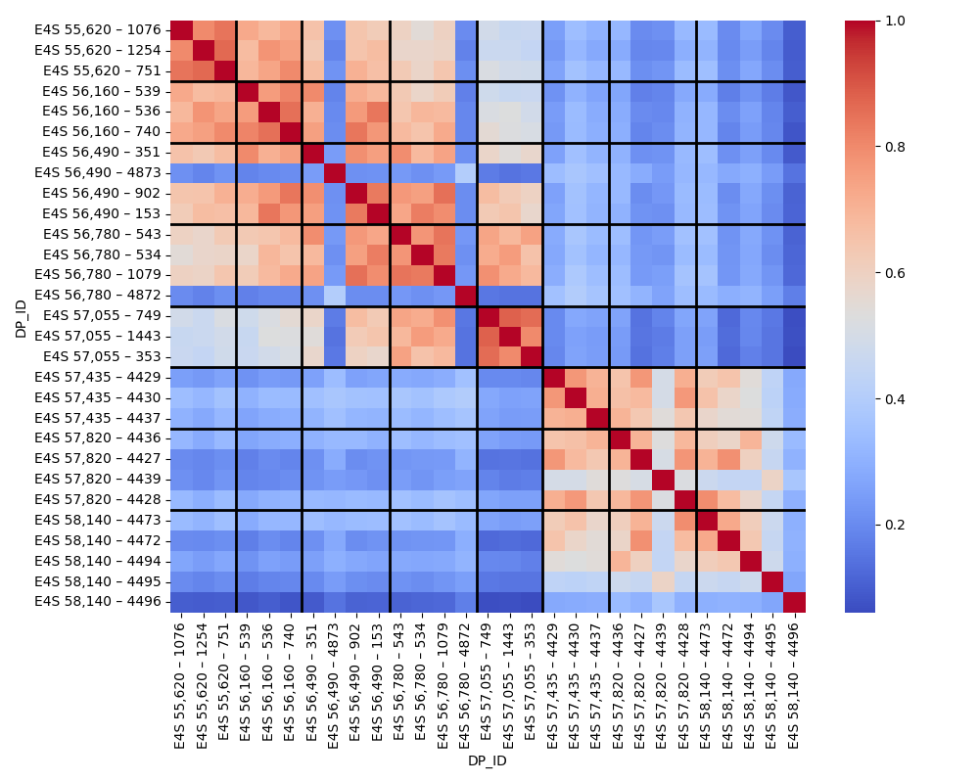
Correlation between sensors
Speed:
Two groups of portals
High correlation within same portal

Slide 5
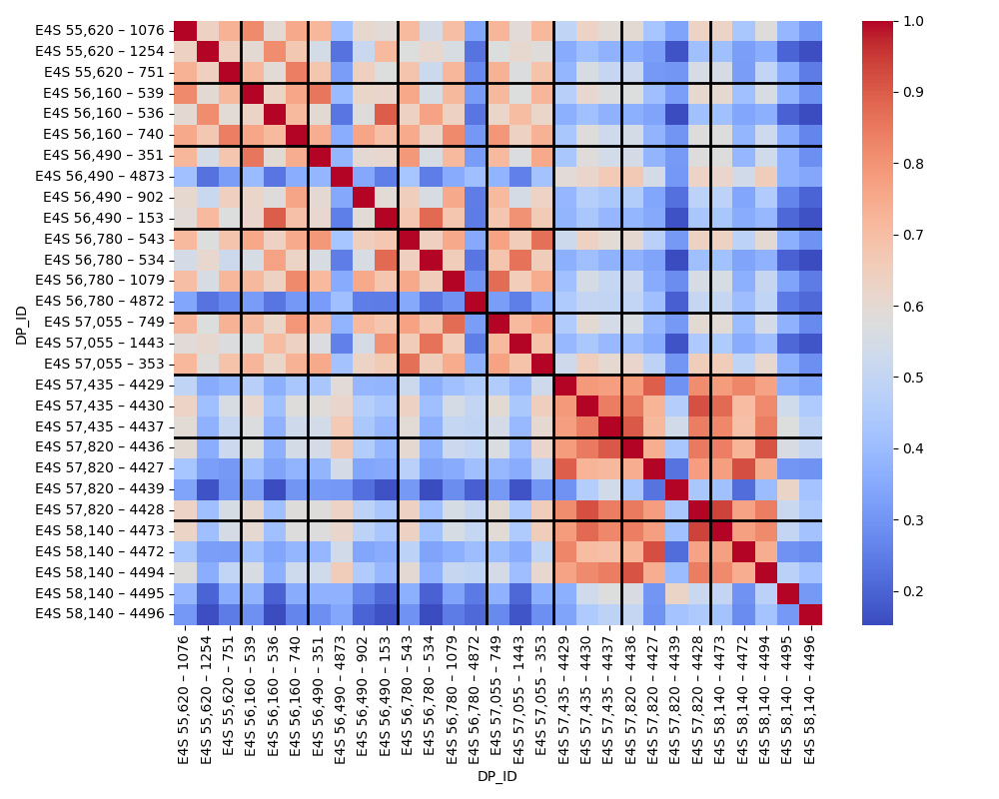
Correlation between sensors
Flow:
Two groups of portals
Partially higher correlation with sensors of different portals

Slide 6
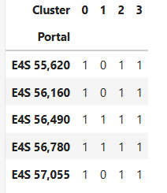
Clustering of the lanes –Speed and Flow :
Kmeans- Clustering
Only for the 5 portals that seems showing a similar behaviour
N_clusters= 4

Slide 7
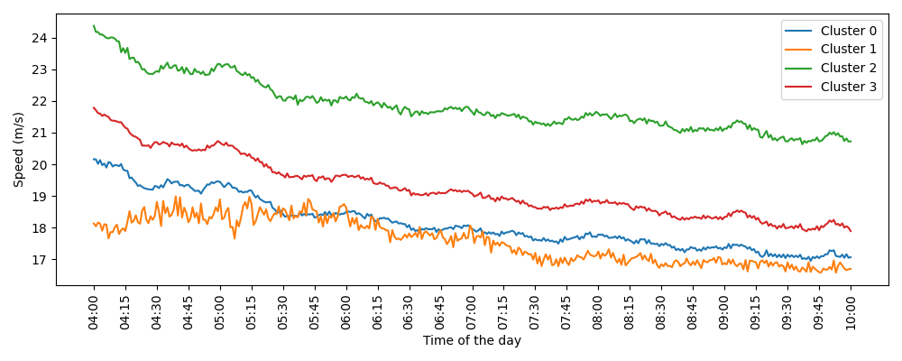
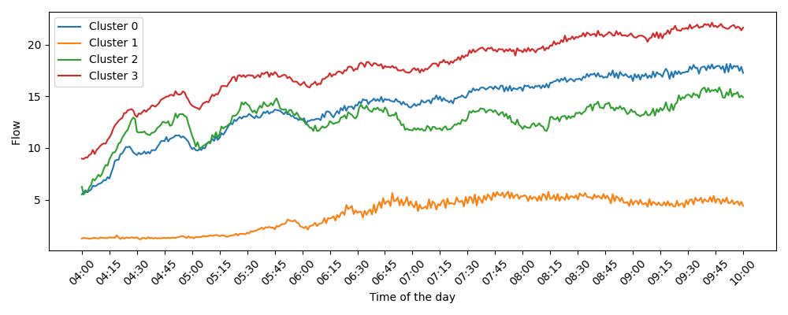
Clustering of the lanes –Speed and Flow :
4 lanes can be identified:
Cluster 0: right lane
Cluster 1: up and down lane
Cluster 2: left lane
Cluster 3: middle lane

Slide 8
Methodology
Predict speed and flow for sensor 1076 (in portal 55620)
with the other sensors in the same portal (55620): 751 and 1254
the sensors in the portal upstream (56160): 536, 539,740
Take lag features (speed / flow) to predict the upcoming 15 minutes
Summed flow
Average speed

Slide 9
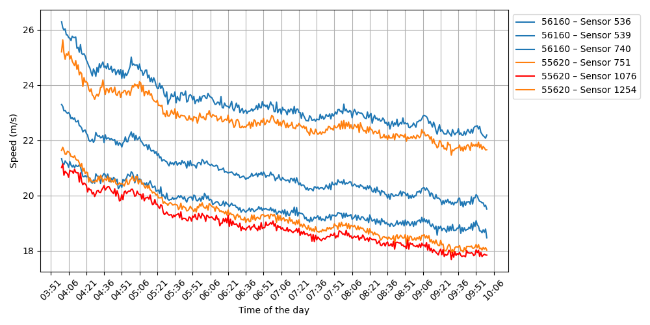
Portal 55620 and 56160

Slide 10
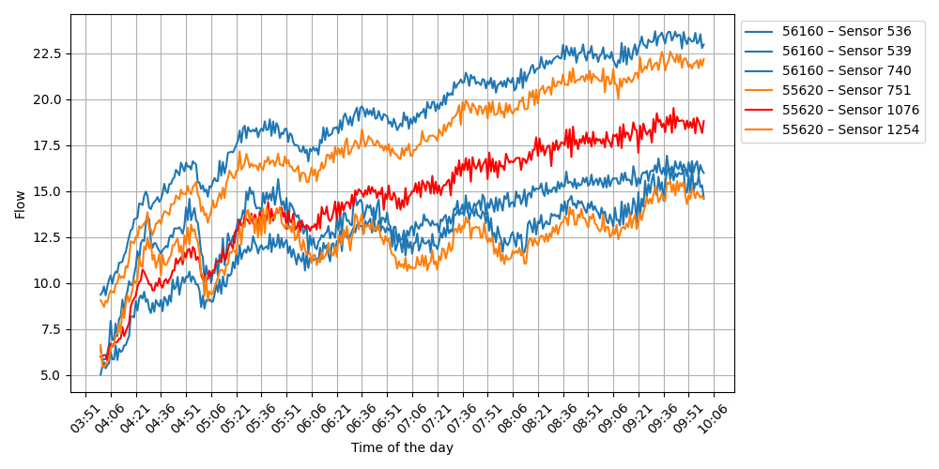
Portal 55620 and 56160

Slide 11
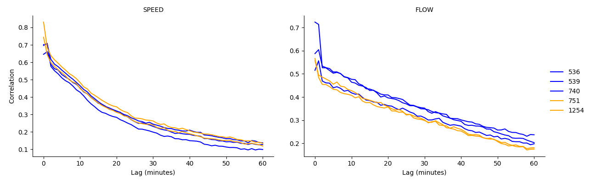
Determine the number of lag-features

Slide 12
Models trained
Linear Regression
XGB-Boost
Feedforward Neural Network (FNN)
Long Short-Term Memory Network (LSTM)

Slide 13
Results on Testset –Flow 04:15-10:00
MAE:
→neighbour portal is better for prediction
→XGBoost gives best result
 | Linear Regression | Xgboost | Xgboost-randomSearch | NN | NN-grid search
Same Portal | 23,809 | 20,634 | 20,321 | 20,952 | 20,481
Neighbour Portal | 23,297 | 17,192 | 17,026 | 17,504 | 17,286

Slide 14
Results on Testset -Speed 04:15-10:00
MAE:
→same portal sensor are better for prediction
→XGBoost gives best results
 | Linear Regression | XGBoost | XGBoost-randomSearch | NN | NN-gridsearch
Same portal | 0,462 | 0,401 | 0,398 | 0,42 | 0,419
Neighbour portal | 0,399 | 0,424 | 0,42 | 0,444 | 0,437

Slide 15
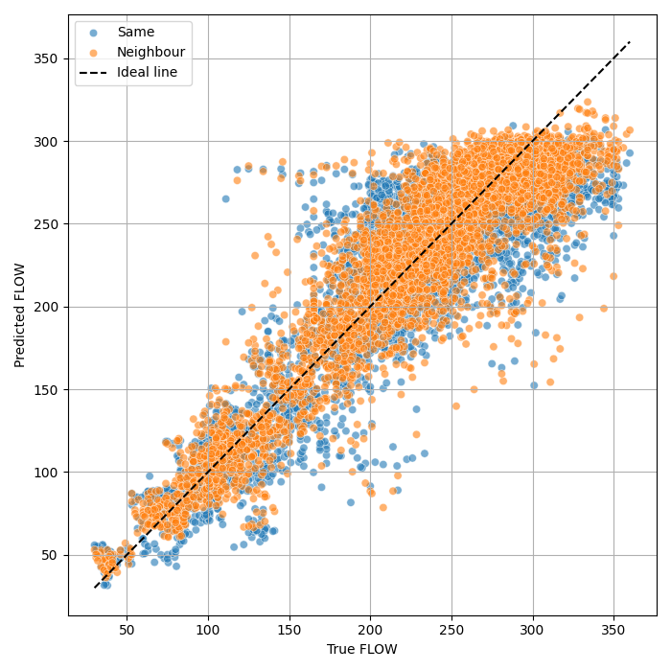
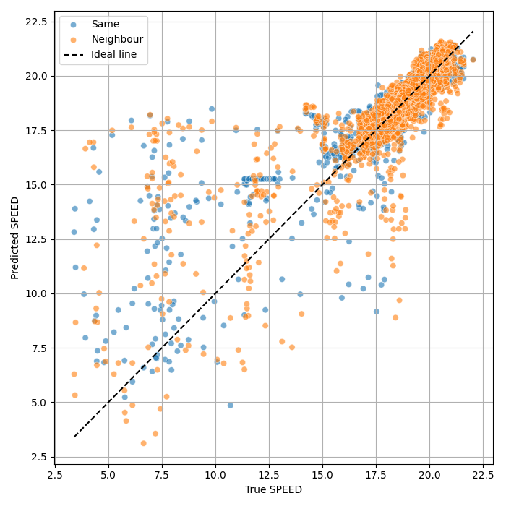
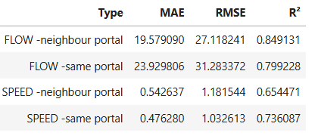
Evaluation on evaluation set 07:30-08:30
Flow: prediction of neighbouring sensors is better
Speed: prediction of same portal sensors is better

Slide 16
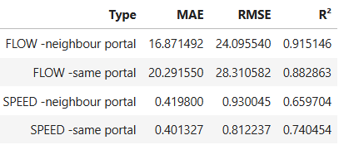
Evaluation vs Testset:
No significant drop between the test and evaluation set
Performance on Testset from Train/test random split
Performance on new unseen data

Slide 17
Final conclusions
Speed can be better predicted with the use of the other sensors in the same portal
Flow can be better predicted with the use of the sensors in the neighbouring portal
Further research: the influence of the distance of the neighbouring portal is assumed to have a big influence on the predicting accuracy

