Slide 1
KINEMATICS
(hfren)

Slide 2
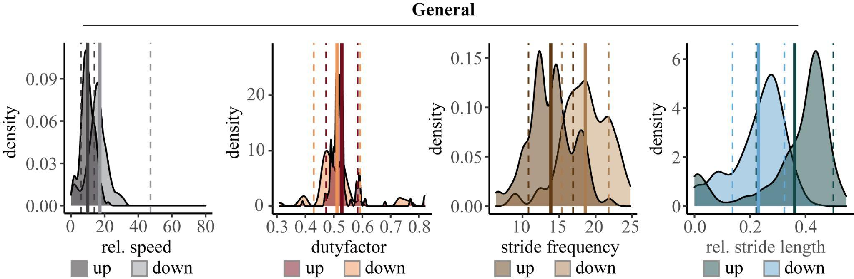
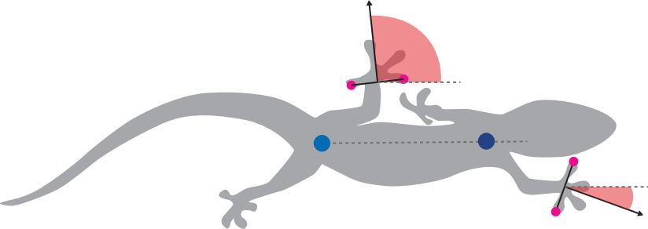
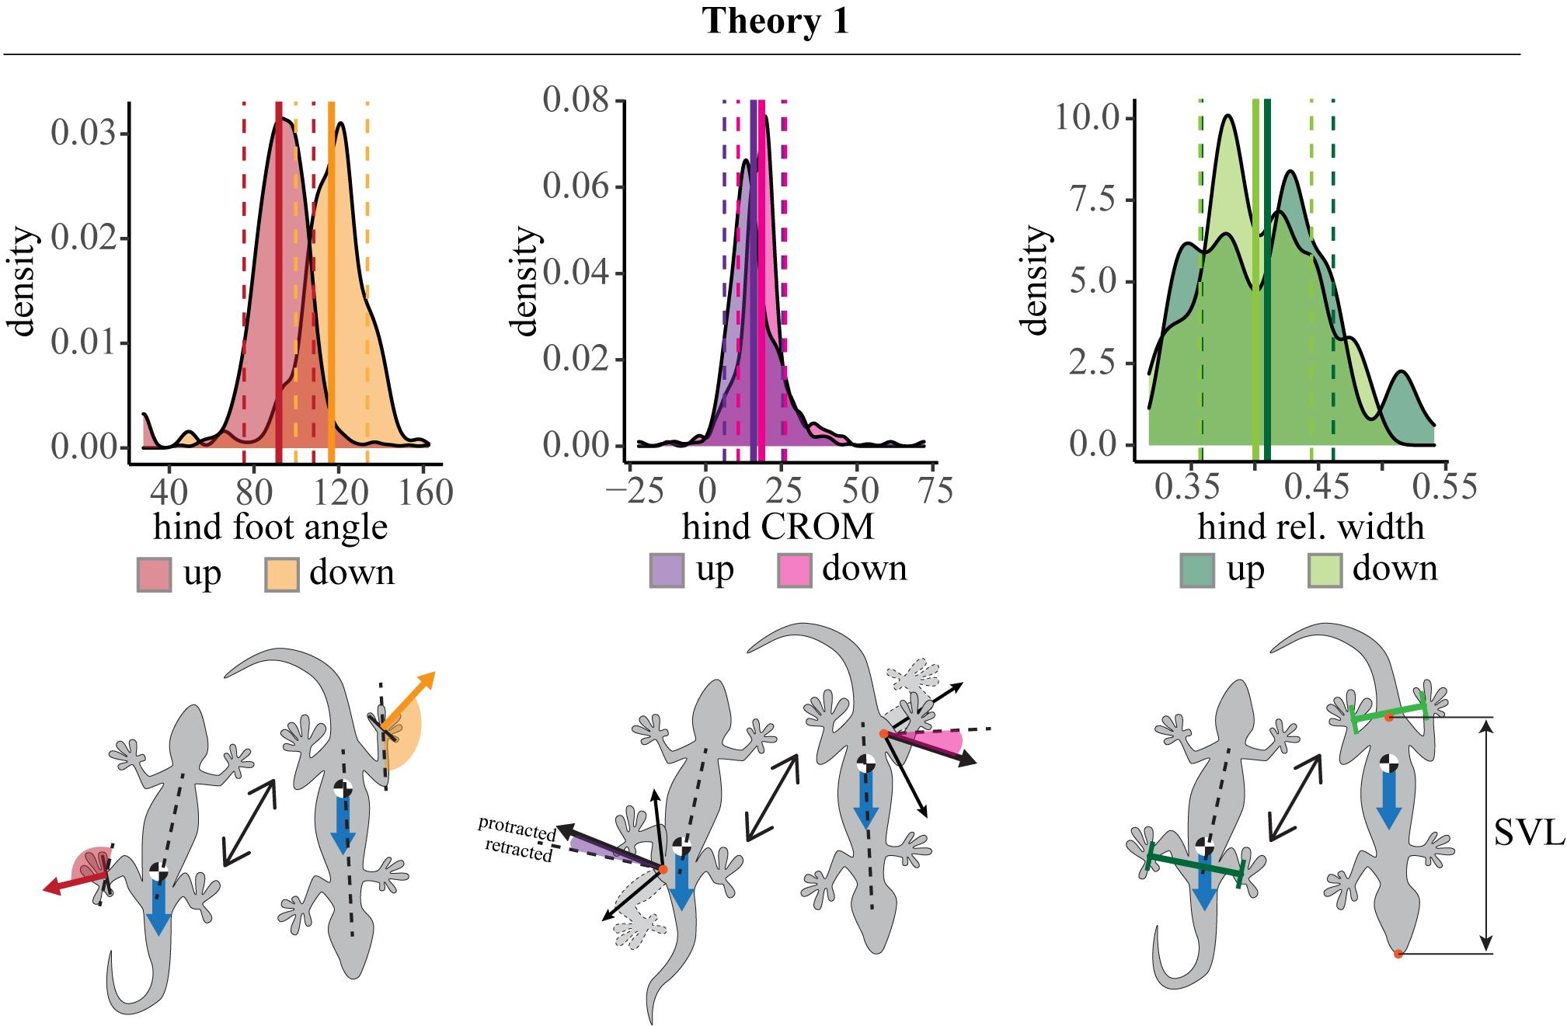
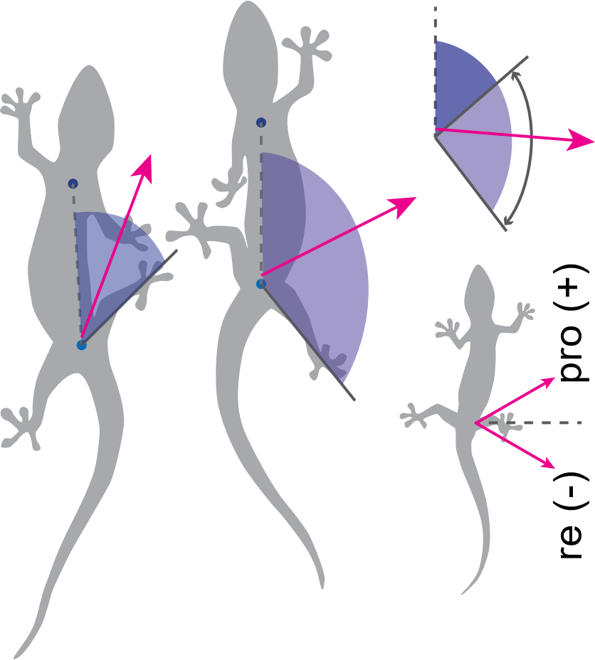
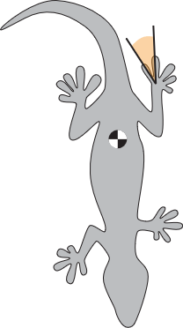
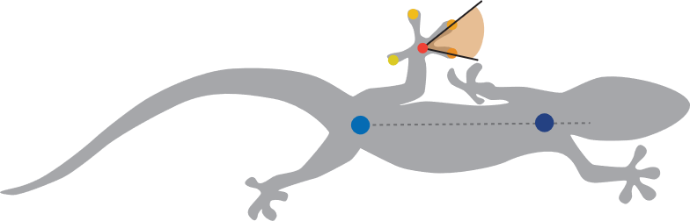
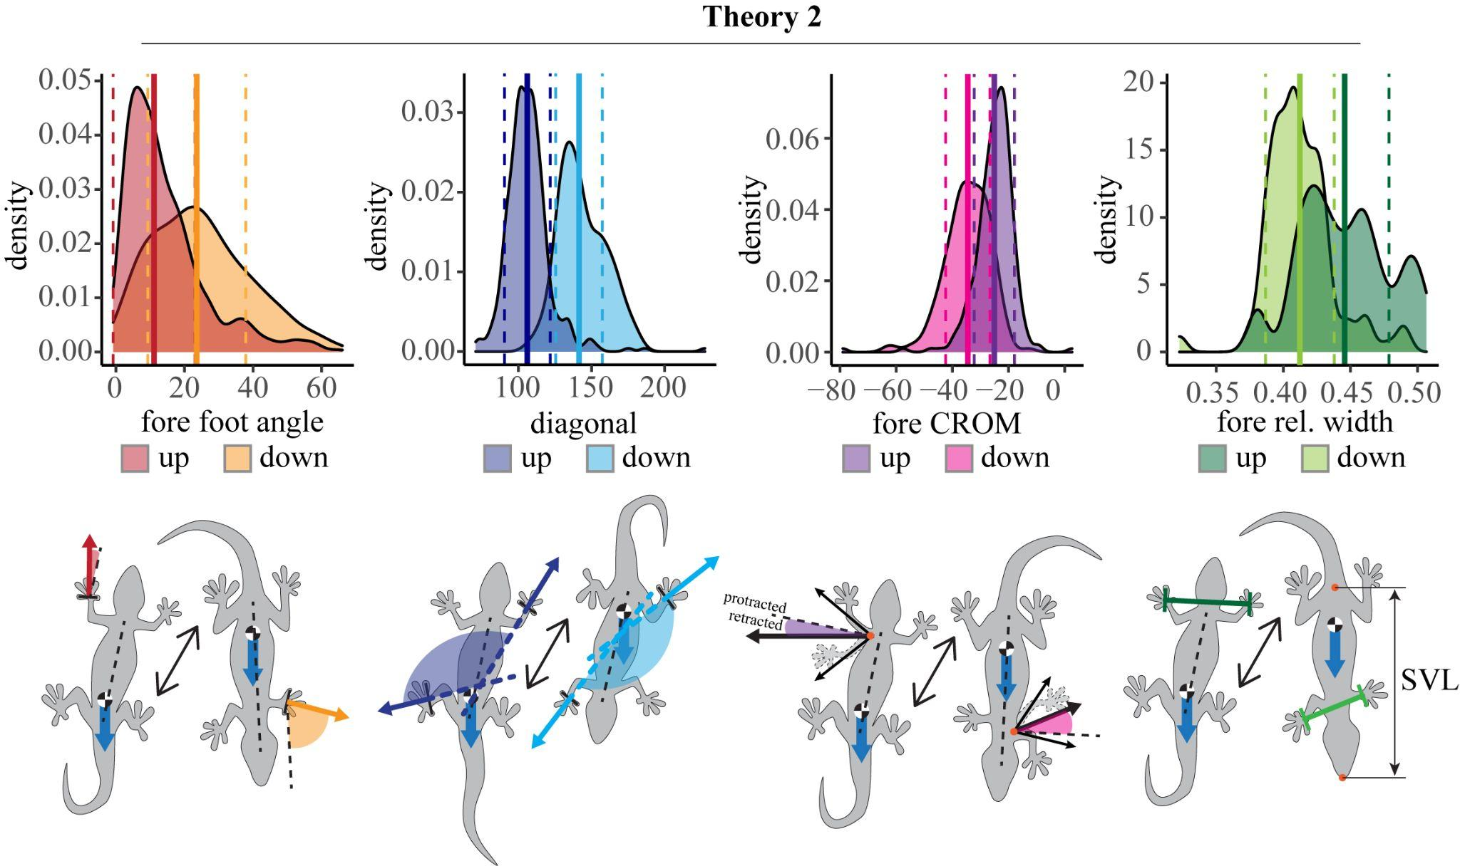
Duty factor decreases slightly (sign.),
rel. speed increases for down,
with frequency increasing and stride length decreasing
Hind foot angle increases for down from 90° to 115°,
CROM hind protracts even further for down from 15° to 19°,
Rel. width between the hind feet decreases for down
Mean toe spreading angle: - fore feet:
51 (up) to 57 (down)
Hind feet:
54 (up) to 40 (down)
Fore foot angle increases for down from 15 to 25,
The diagonal (foot angle fore+hind) increases for down from 107 to 145
CROM fore retracts even further for down from -25 to -35,
Rel. width between the fore feet decreases for down

Slide 3
DYNAMICS

Slide 4
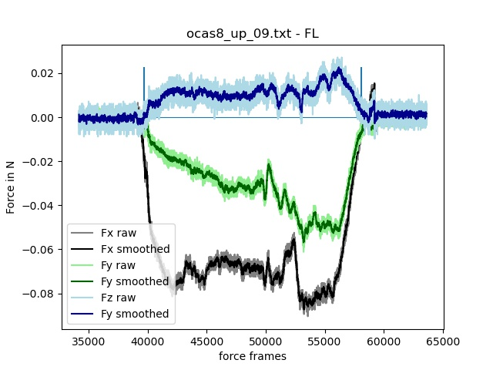
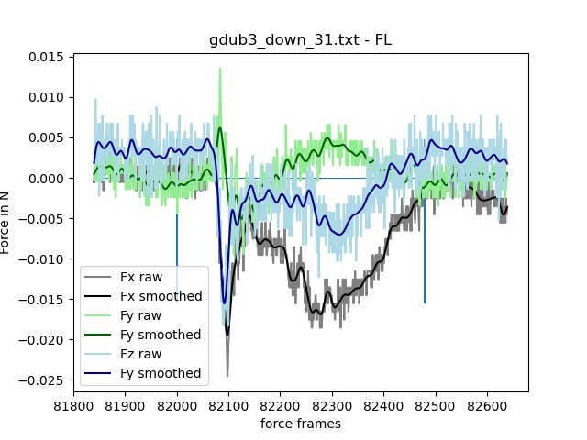
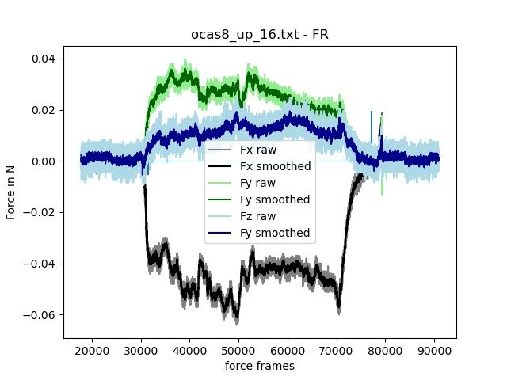
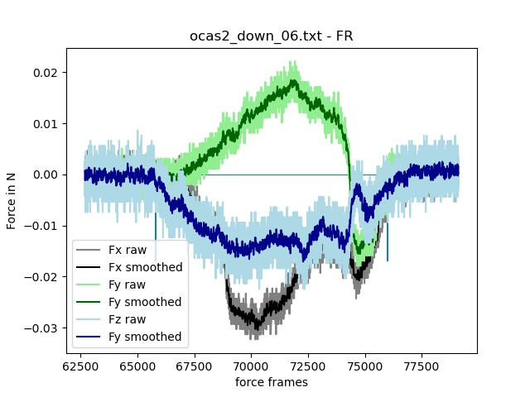
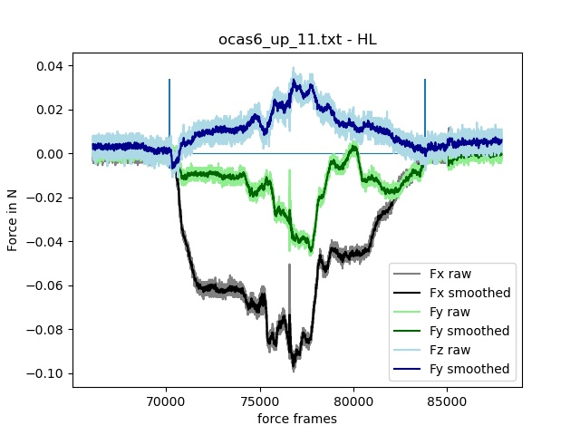
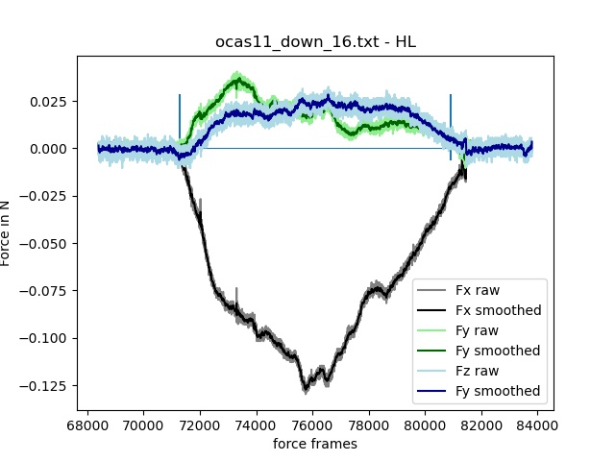
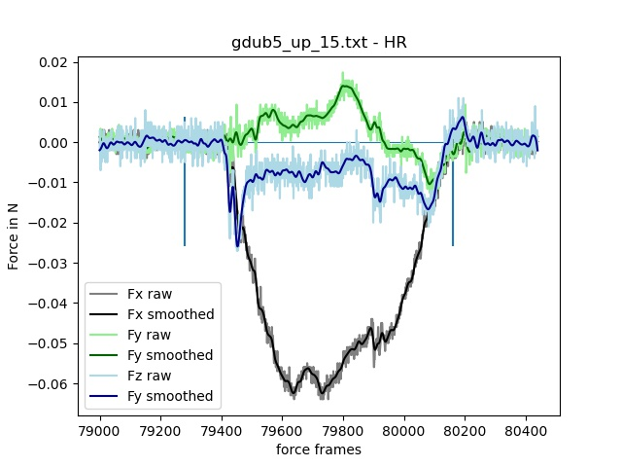
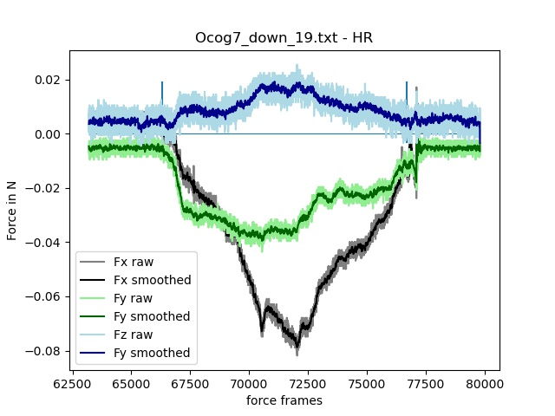
Exemplary force plots of footfalls
UP
DOWN
Fx
Fy
Fz

Slide 5
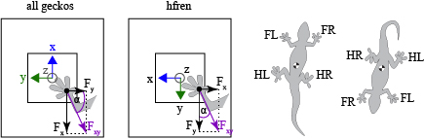
UP
DOWN

Slide 6
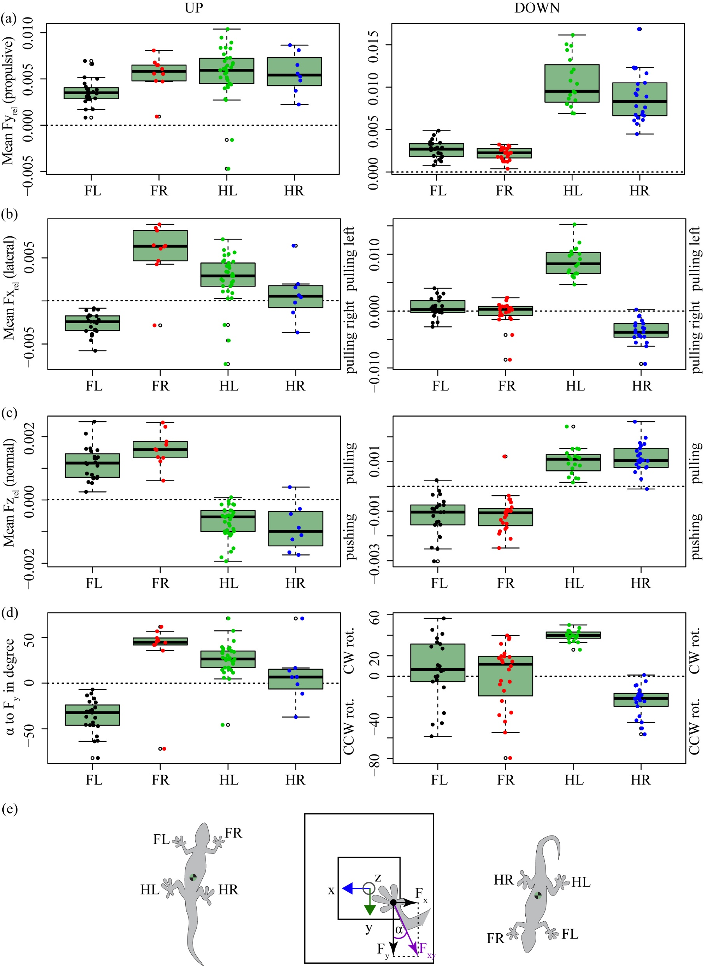
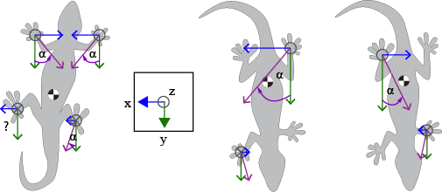
Up: all feet generate propulsive forces
Down: hind feet generate more, forefeet maintain magnitude
→ hind feet brake
Up: left feet pull right, right feet pull left, not sure what’s wrong with HL…, fore feet pull more than hind feet
Down: pattern inverted, hind feet now pull more than forefeet, basically no lateral forces for forefeet
Up: forefeet pull, hind feet push Down: Inverse

Slide 7
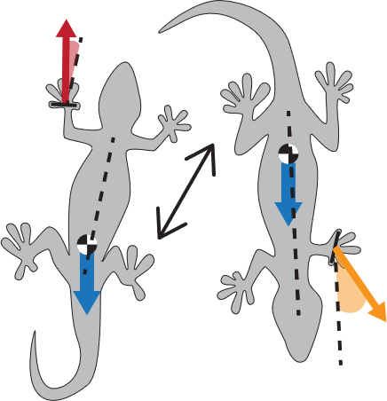
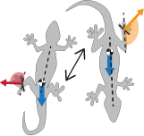
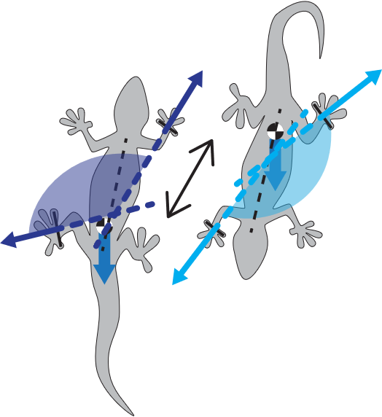
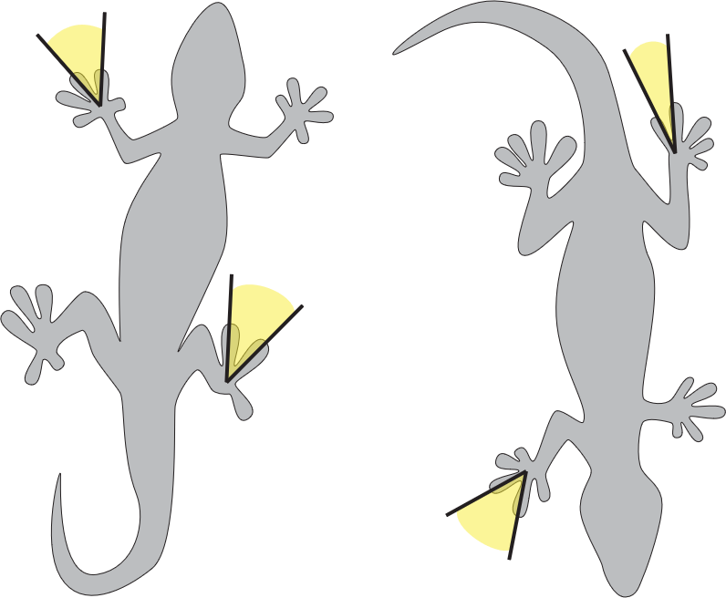
14
115
Foot angles
90
25
diagonal
107
145
51
40
Mean toe spreading
54
57
forces

Slide 8
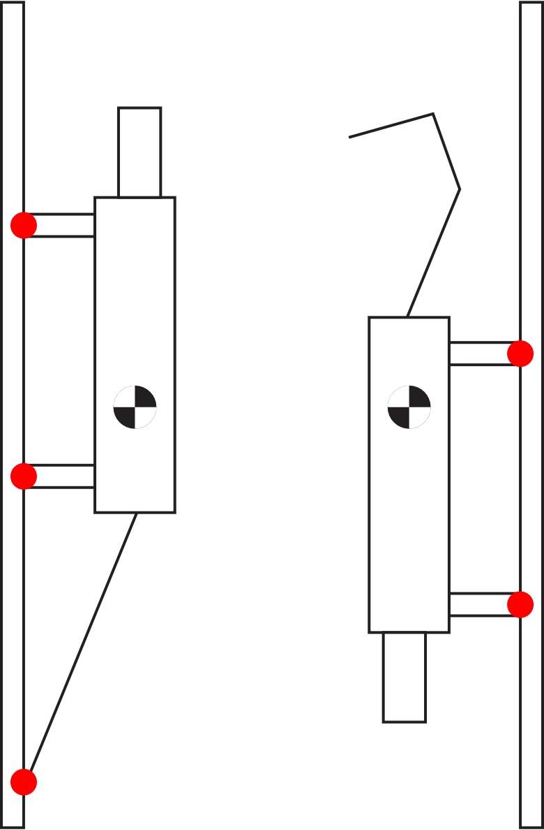
Modelling questions:
Geckos have 3 points of contact when climbing head up, but only 2 when climbing head down. (also see Jusufi et al., 2008)
Overturning moment larger when climbing head-down?
Incorporate the morphology of the geckos to calculate the overturning moment.
How to include lateral forces, how to explain the disconnect between the angle of the “wrists” and the angle of the Fxy forces?
→ Why spread the feet to the sides for head-down climbing, when no lateral forces are produced??
3D model possibility??

