Slide 1
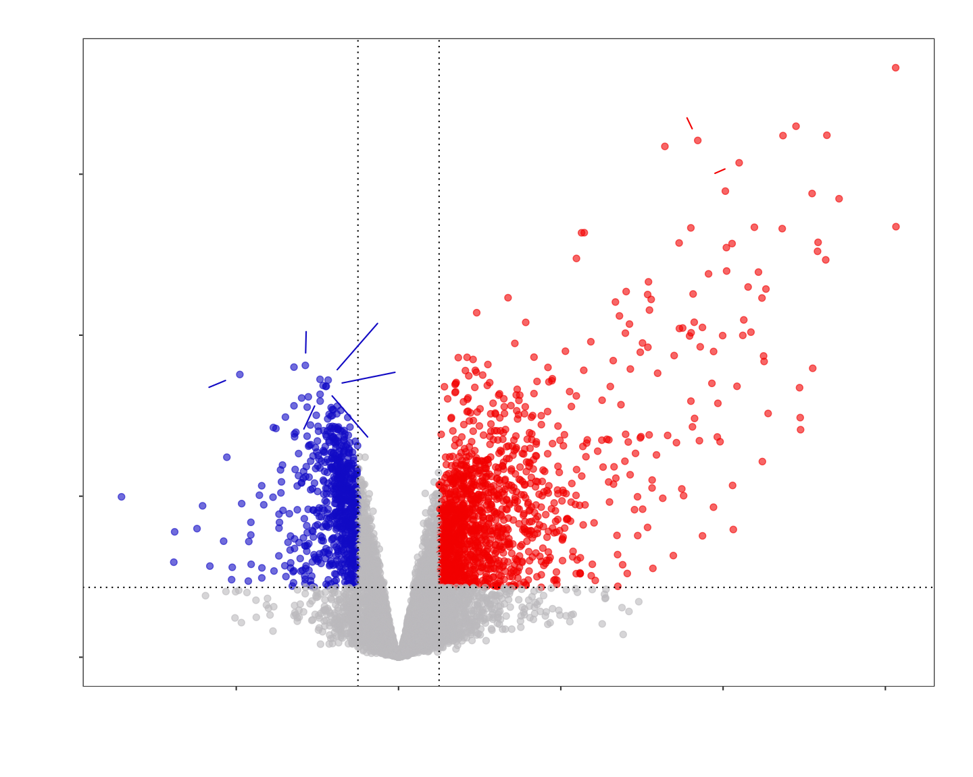
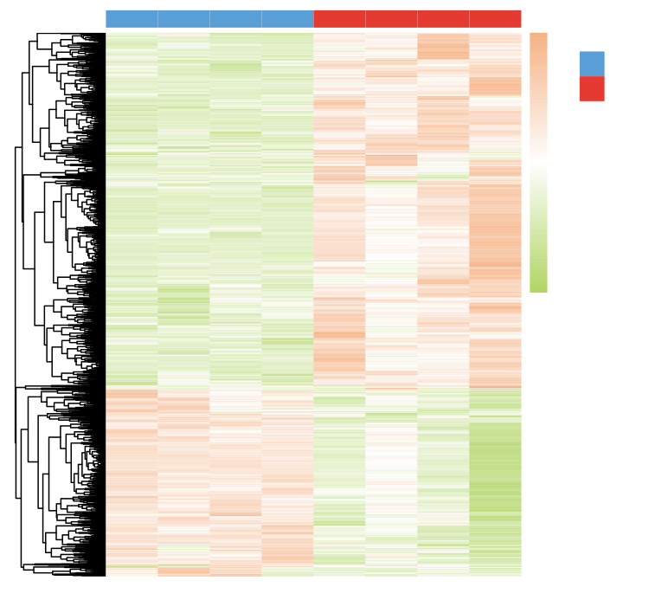
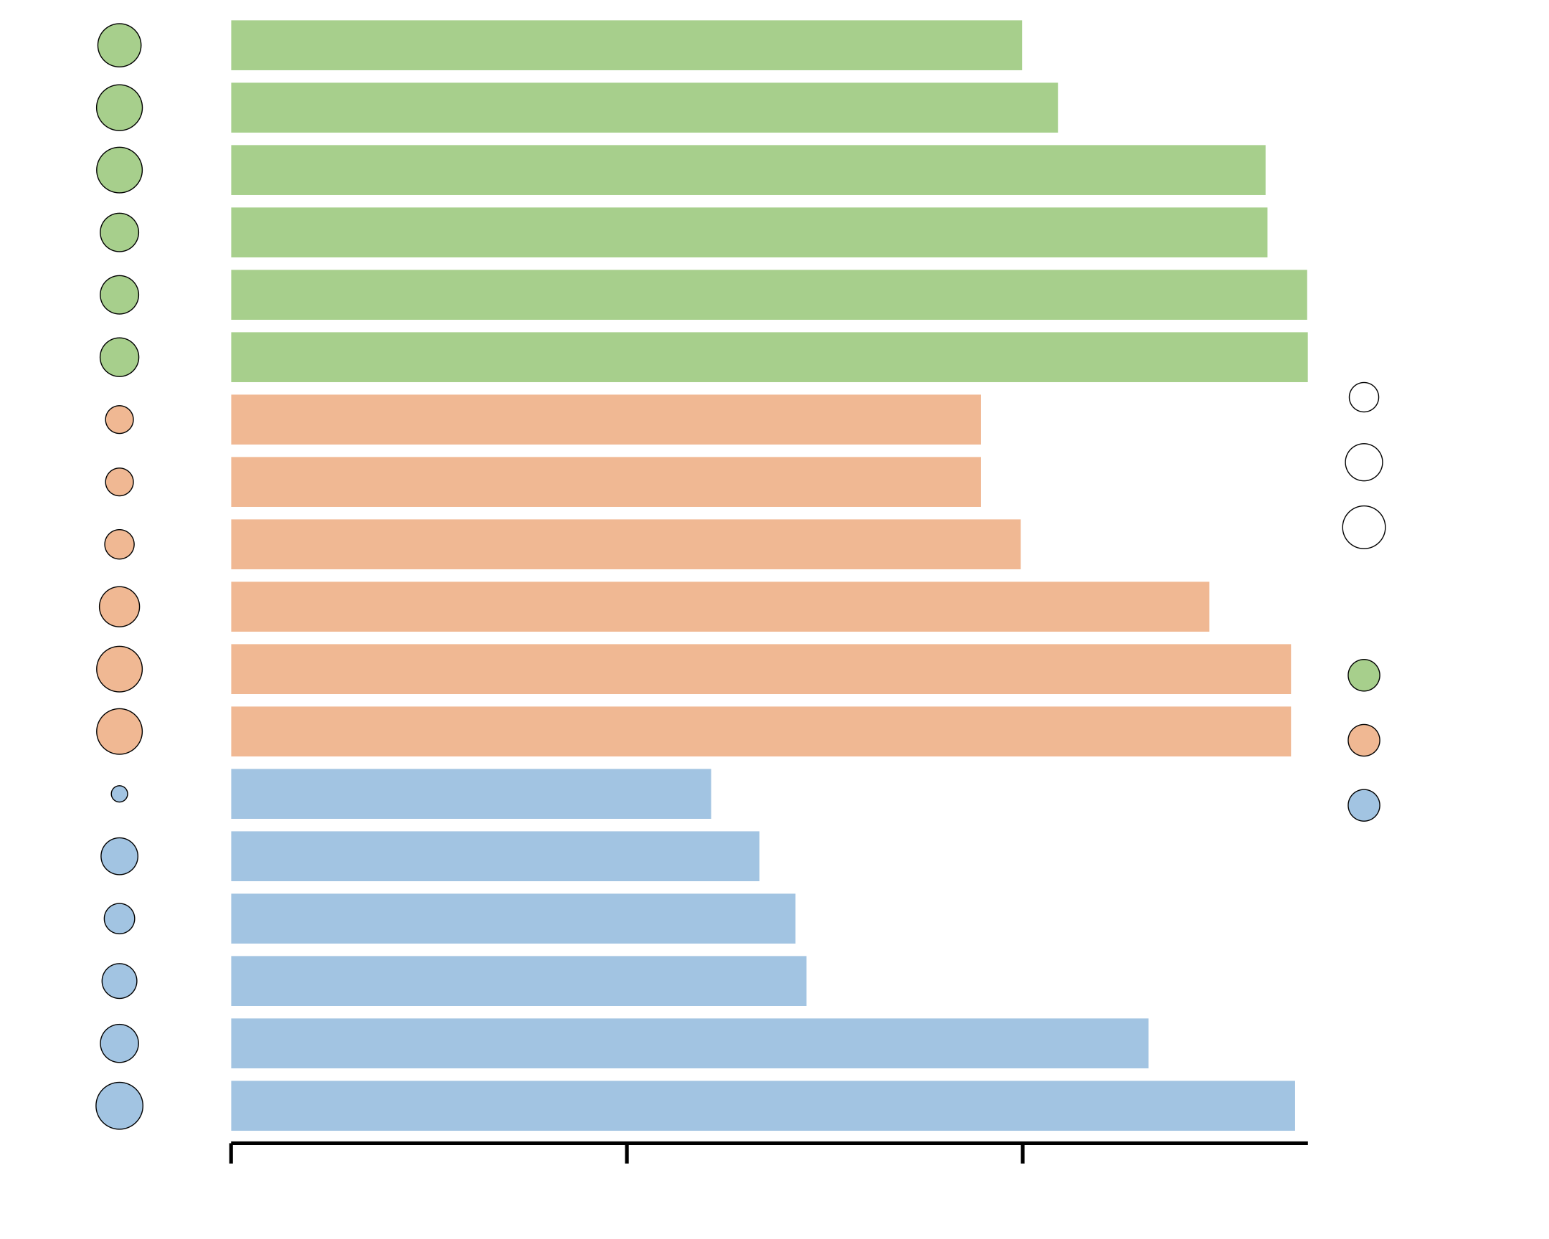
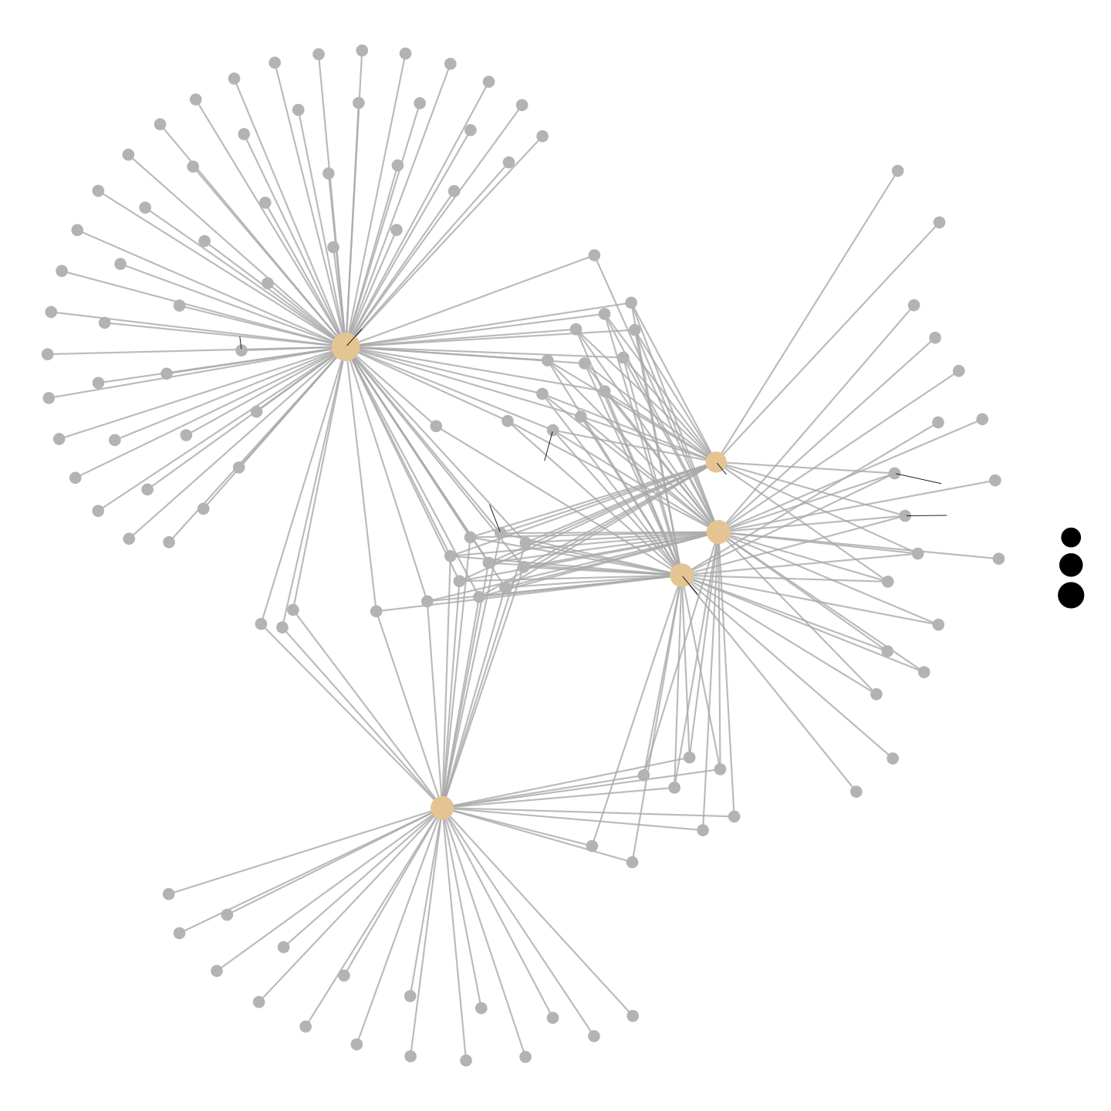
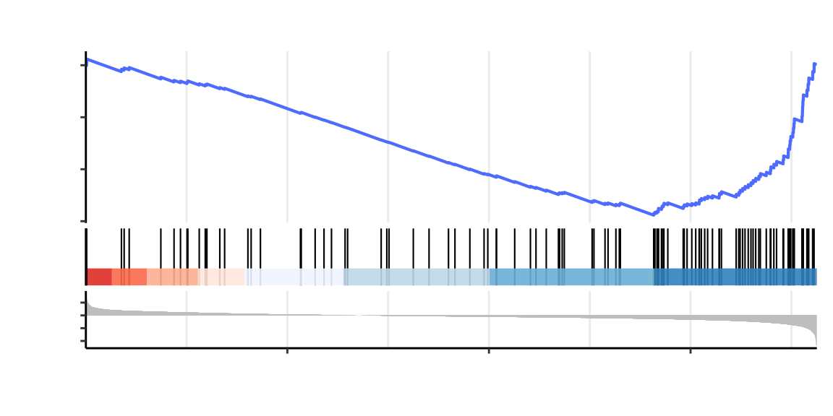
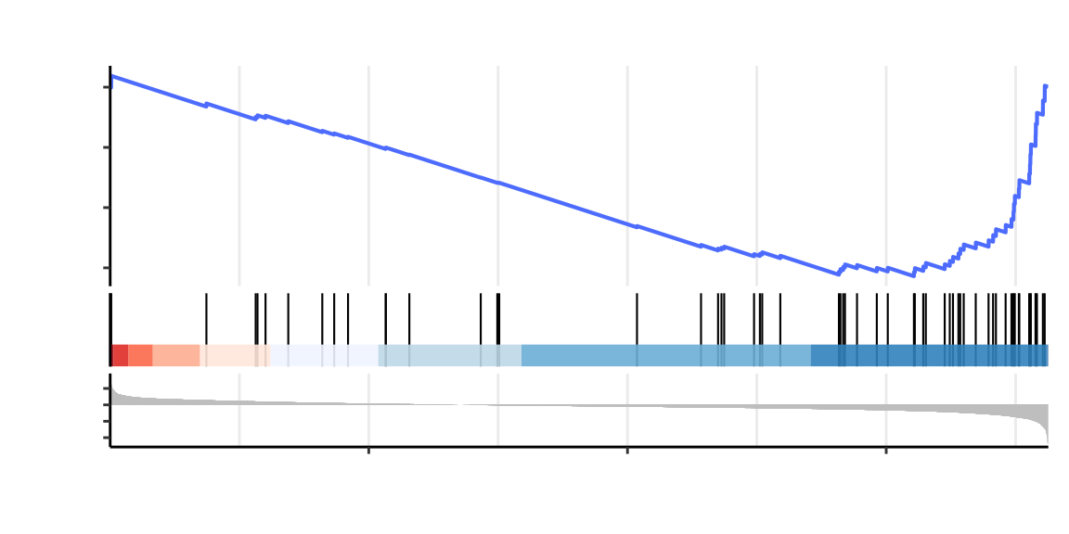
A
B
Done: 716
Up: 1377
Group
F1LN61
2
Group
A0A8I5ZV61
C
A0A8I6ALW9
F1M5J8
F1LYU3
A0A8I5Y662
1
M
9
F1LTN6
A0A8I6A4U0
0
A0A8I6AP25
A0A8I6ARR5
−1
6
G3V648
A0A8I5Y1E6
P52504
−2
−log10 p−value
P06686
D3ZA93
F1LXA0
P35571
A6ZIQ8
A6I691
B5DFN3
3
0
−2
0
2
4
6
C
log2 Fold Change
E
N2
N3
N4
N5
M1
M2
M4
M5
RNA: Up in Model
n = 158
Protein: Up in Model
regulation of body fluid levels
actin filament organization
wound healing
coagulation
blood coagulation
hemostasis
stress fiber
contractile actin filament bundle
actin filament bundle
collagen-containing extracellular matrix
external encapsulating structure
extracellular matrix
collagen binding
cell adhesion molecule binding
integrin binding
glycosaminoglycan binding
actin filament binding
actin binding
82
Hbb/Thbs1/Akap11/Ano6/Inpp5k...
Pdlim3/Fhod1/Sptbn1/Lcp1/Lmod1...
Hbb/Thbs1/Yap1/Ano6/F11/Myof/Slc4a1/Papss2...
Hbb/Thbs1/Ano6/F11/Slc4a1/Papss2/Kng2/Dmtn...
Hbb/Thbs1/Ano6/F11/Slc4a1/Papss2/Kng2...
Hbb/Thbs1/Ano6/F11/Slc4a1/Papss2/Kng2/Anxa7...
Pdlim3/Flnb/Fhod1/Lcp1/Ppp1r12c/Actn4/Tpm3...
Pdlim3/Flnb/Fhod1/Lcp1...
Pdlim3/Flnb/Fhod1/Lcp1/Ppp1r12c/Actn4...
Gpc6/Thbs1/Ltbp4...
Gpc6/Thbs1/Ltbp4/Postn...
Gpc6/Thbs1/Ltbp4/Postn/Mfap5/Ogn/Igfals...
Crtap/Thbs1/Itgav/Abi3bp/Vwf/Tnxb...
Thbs1/Itgav/Lcp1/Postn/Itga8...
Thbs1/Itgav/Lcp1/Itga8/Itgb5/Anxa7/Actn1...
Thbs1/Thbs3/Mpo/Ltbp2/Itgam/Postn...
Flnb/Fmnl1/Sptbn1/Lcp1/Actn4/Tpm3...
Pdlim3/Flnb/Fmnl1/Sptbn1/Lcp1/Lmod1/Epb41l2
'Praf2''Thbs1''Anpep‘
'Thbs3''Lmod1''Sncg''Ltbp2''Serpine2’
'Postn''Myof''Thbs4''Cp''Mfap5''Dock6’
'Pi16''Mnda''Itga8''Stab1''Efemp2’
'Ncam1’'Plac9''Myh11''Vwf''Itih3''Cd68’
'Hmcn2''Lsp1''Tpm2''Actn1''Tsc22d1’
'Gm2a''Fn1''Ahnak2''Albfm1''Vwf’
'Serpinf2''C3''Ltbp3''Matn4''Lsp1’
'Itga2b''Zyx''Col18a1''C2’
‘Serpinf1’‘P3h3‘...
93
92
BP
64
64
Count
65
40
37
60
D
37
CC
80
n = 145
40
ONTOLOGY
RNA: Down in Model
Protein: Down in Model
70
BP
'Ldb3''Ckm''Ndrg2’
'Gpam''Pdha1''Ldb3''Ldb3''Them7’
'Ank2''Osbpl6''Agtpbp1''Acss3’
'Rap1gap2''Scrn3''Acacb''Ldhd’
'Slc25a15''Vwa8''Mipep''Pfkm’
'Cacna1c''Acadm''Slc27a1''Ank1’
'Prdx3''Mrps27''Ank1''Hspa9''Acsl6’
'Frmd5''Dglucy''Suclg2''Acox1''Retsat’
'L2hgdh''Timm23''Pygm’
'Phospho1''Tecr’...
92
92
CC
27
MF
59
42
MF
53
63
98
0
10
20
F
G
−Log10(Pvalue)
Sun2
Fhl1
Sptbn1
0.0
Integrin signaling − Rattus norvegicus (rat)
Csrp3
Xirp2
Xirp1
Myot
Myl4
Myh7
−0.2
Col3a1
Emd
Dcn
Vim
Pdlim1
Nrap
Running Enrichment Score
Csrp2
Pdlim5
Ttn
Tmod3
Sun1
Sntb2
Lmod1
Eno2
Tpm2
Fbln2
Gp5
Cd44
−0.4
Col5a1
Ankrd1
Tpm3
Fbn1
−0.6
Lmna
Fbn2
Flnc
Myh8
Col4a2
Lmnb2
Tpm4
Col6a6
02
Cytoskeleton in muscle cells − Rattus norvegicus (rat)
Icam1
Eln
Pdlim7
Bgn
Col6a2
Col9a1
Col6a3
Ranked List Metric
Tnni1
Fermt3
−2
Col5a2
Tpm1
Col6a1
Col1a1
Thbs3
C3
Fgb
−4
C
2000
4000
6000
M
Fmnl1
Fbln1
Thbs4
Rank in Ordered Dataset
Tmem43
Sgce
Zyx
Tln1
Thbs1
Prkca
Dsp
Pdlim3
Col1a2
Vwf
Fgg
Myl1
Itga1
ECM−receptor interaction − Rattus norvegicus (rat)
size
ECM−receptor interaction − Rattus norvegicus (rat)
Tcap
Vcan
Itgb4
Itgb5
Itga8
Integrin signaling − Rattus norvegicus (rat)
Lama5
20
Pdlim2
Csrp1
Itga3
Itga2b
Itgav
Vtn
Fga
40
0.0
Myh9
Itgb3
Spp1
60
Myh11
Myl9
Actb
Fn1
Focal adhesion − Rattus norvegicus (rat)
Flnb
−0.2
Myh10
Flna
Running Enrichment Score
Igf1
Ctnnb1
−0.4
Pdgfrb
Rac2
Actn1
Prkcb
−0.6
Regulation of actin cytoskeleton − Rattus norvegicus (rat)
Actn4
Arhgef6
Rap1b
02
Ppp1r12c
Itgam
Ranked List Metric
−2
Actr2
C5
Mylk
−4
C
2000
4000
6000
M
F2
C9
Wasf2
C8g
Gsn
Rank in Ordered Dataset
C8a
Kng1
Pfn2
C8b
Enah
Kng1
Arpc1b
C6
Arpc5
Kng2
Iqgap1

Slide 2
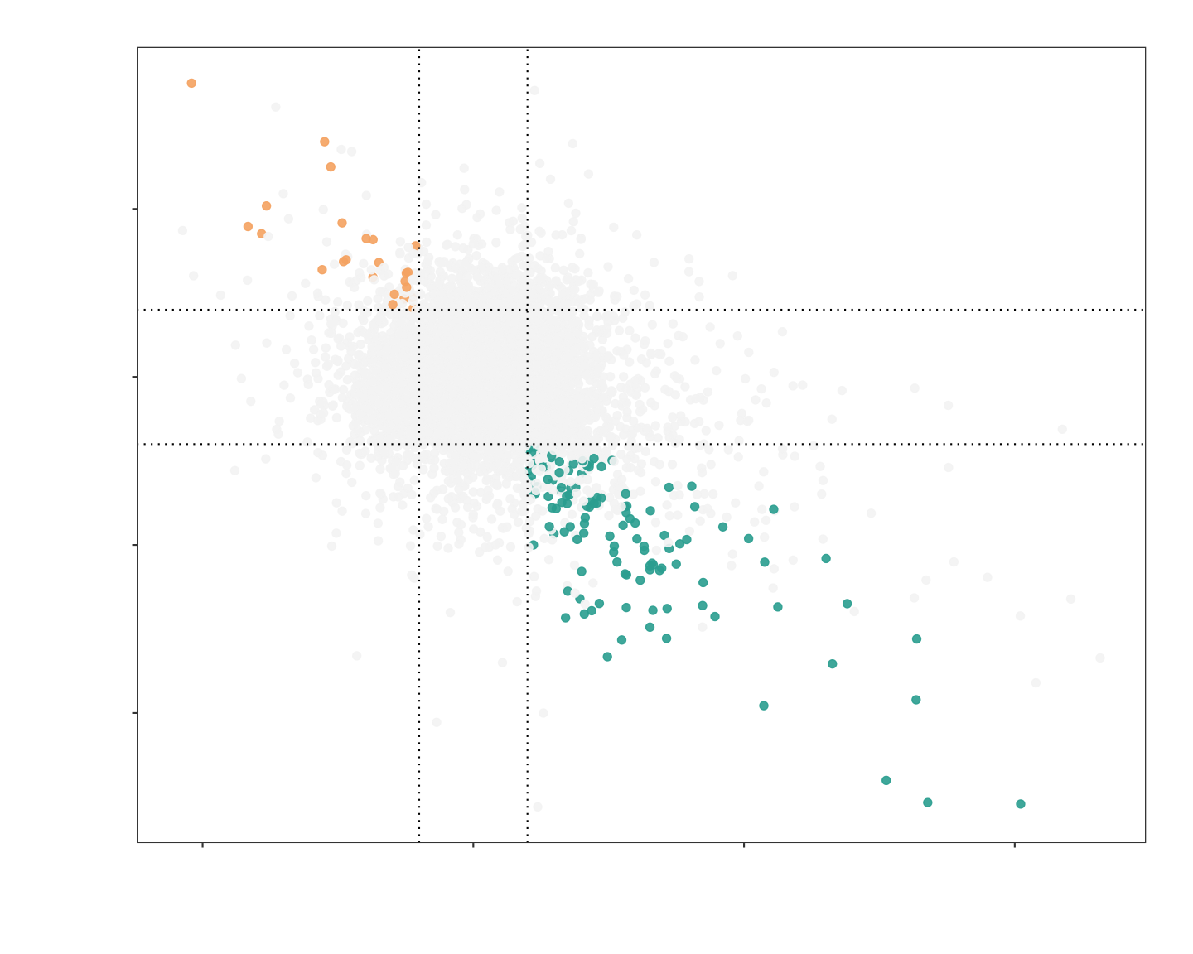
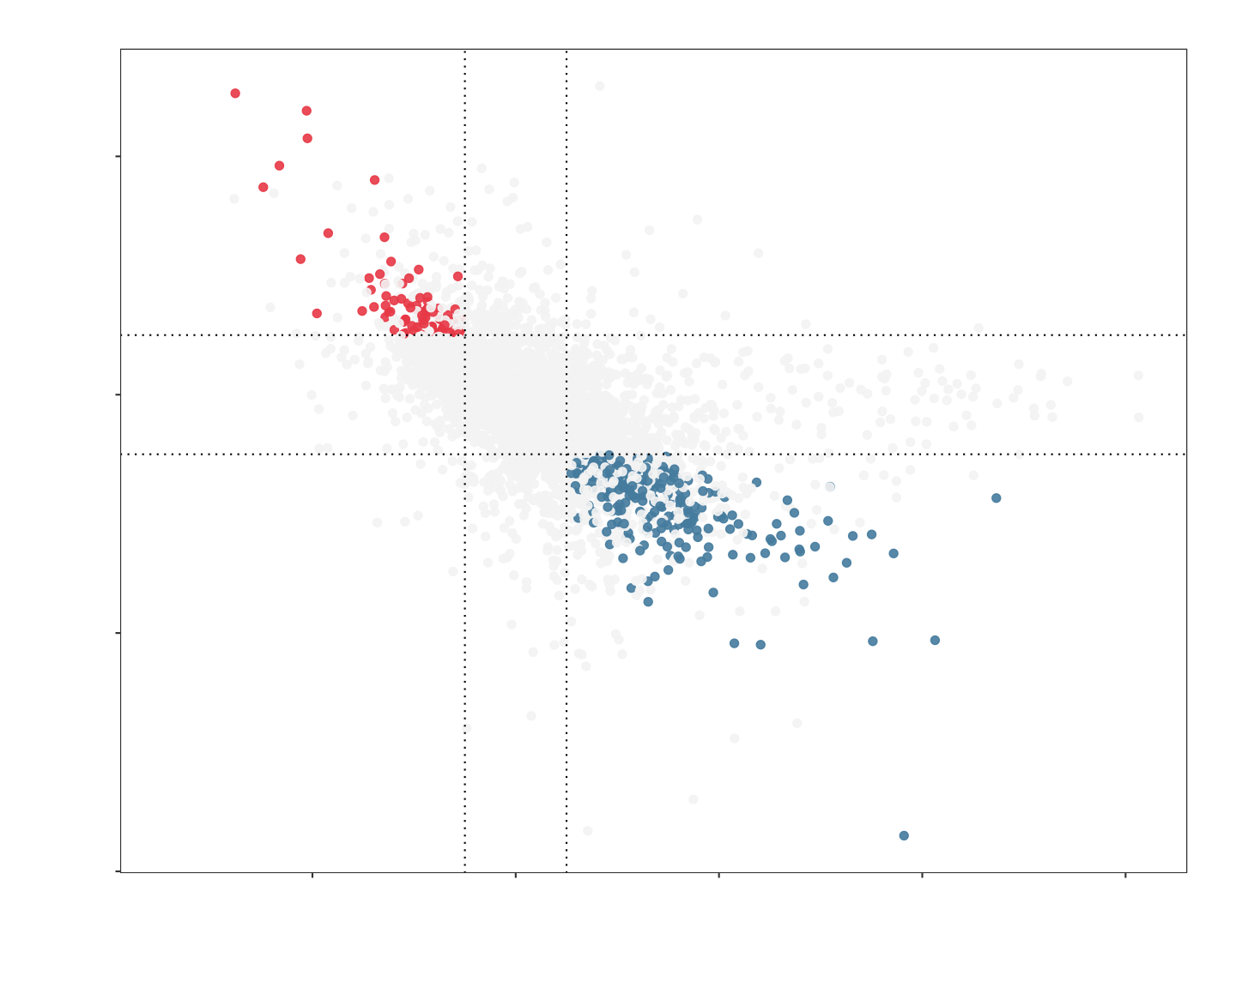
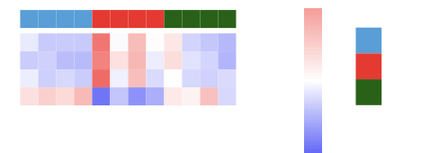
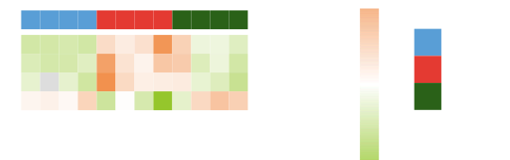
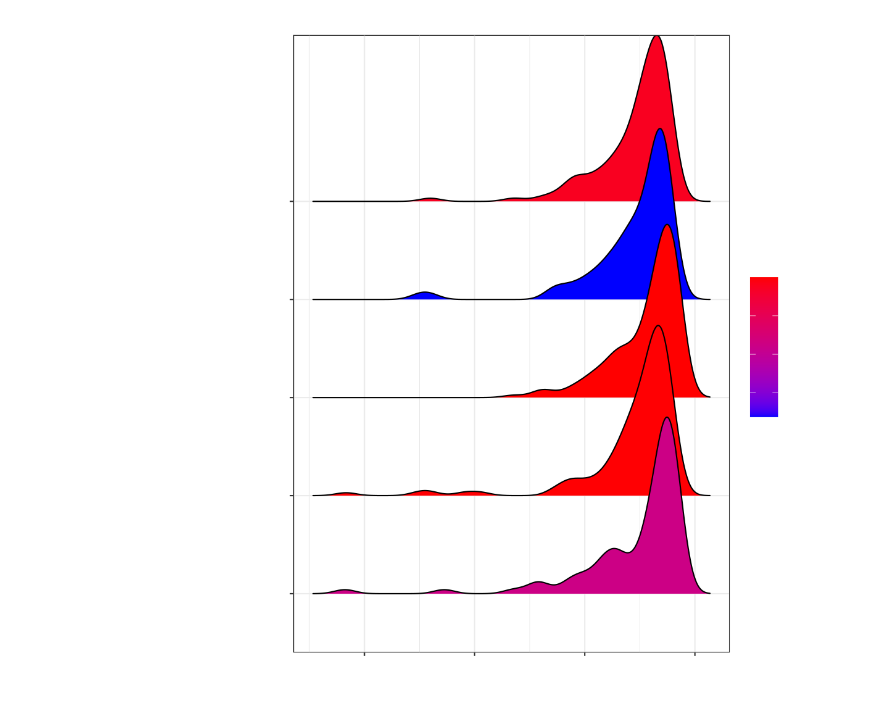
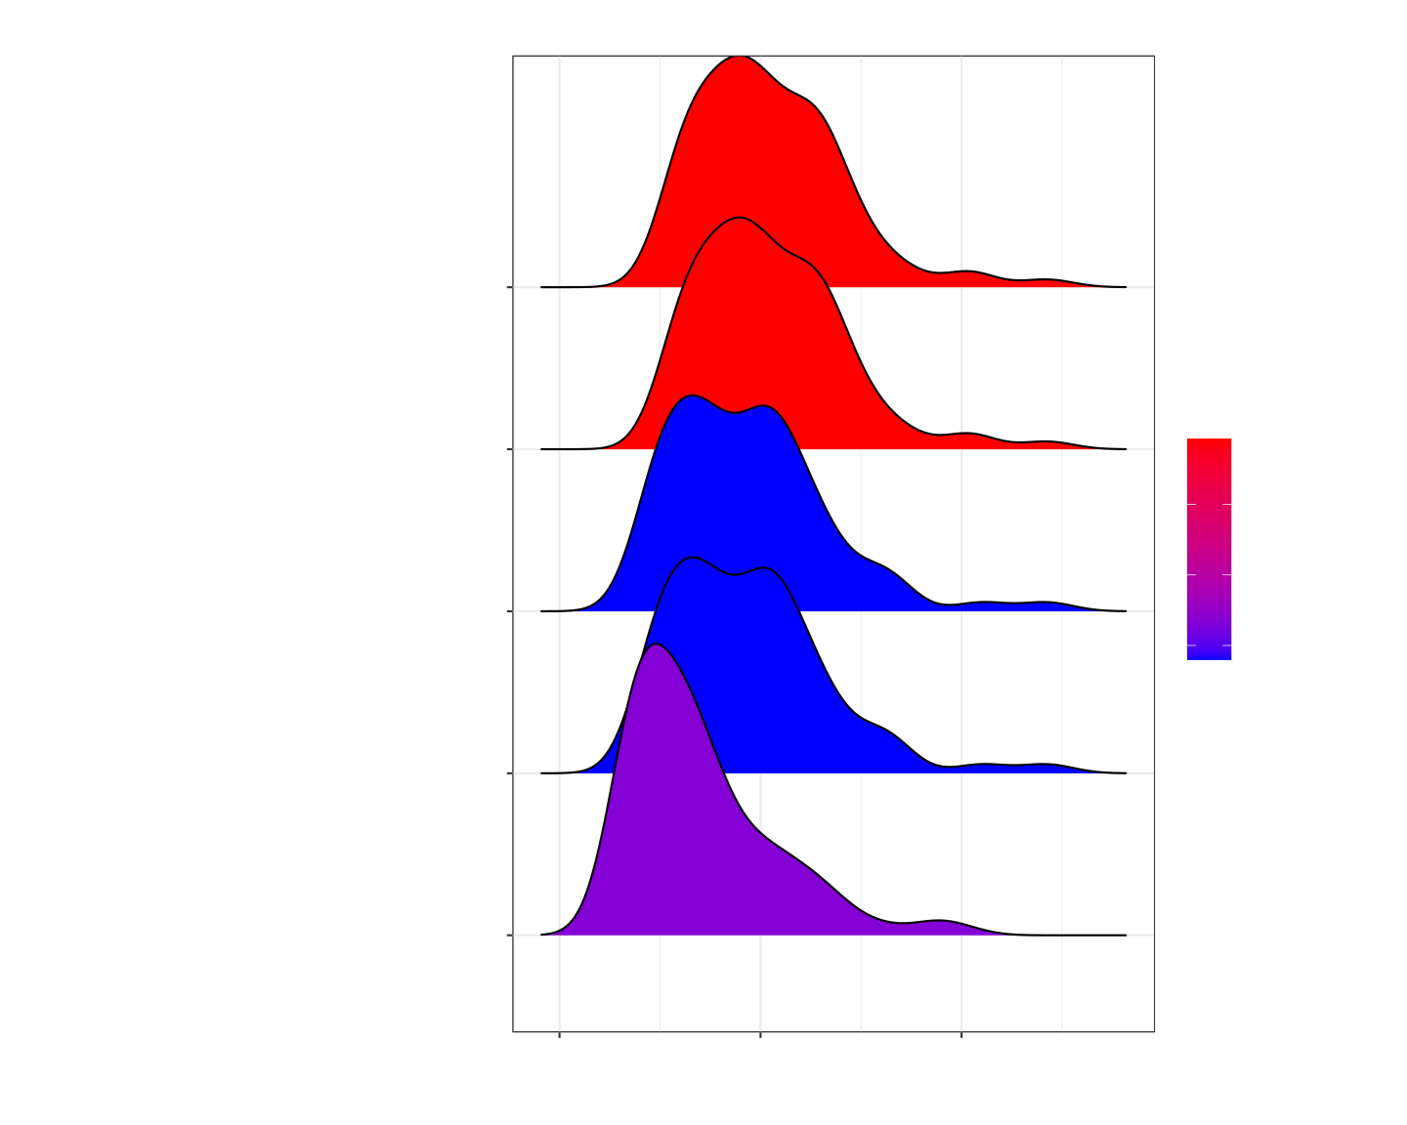
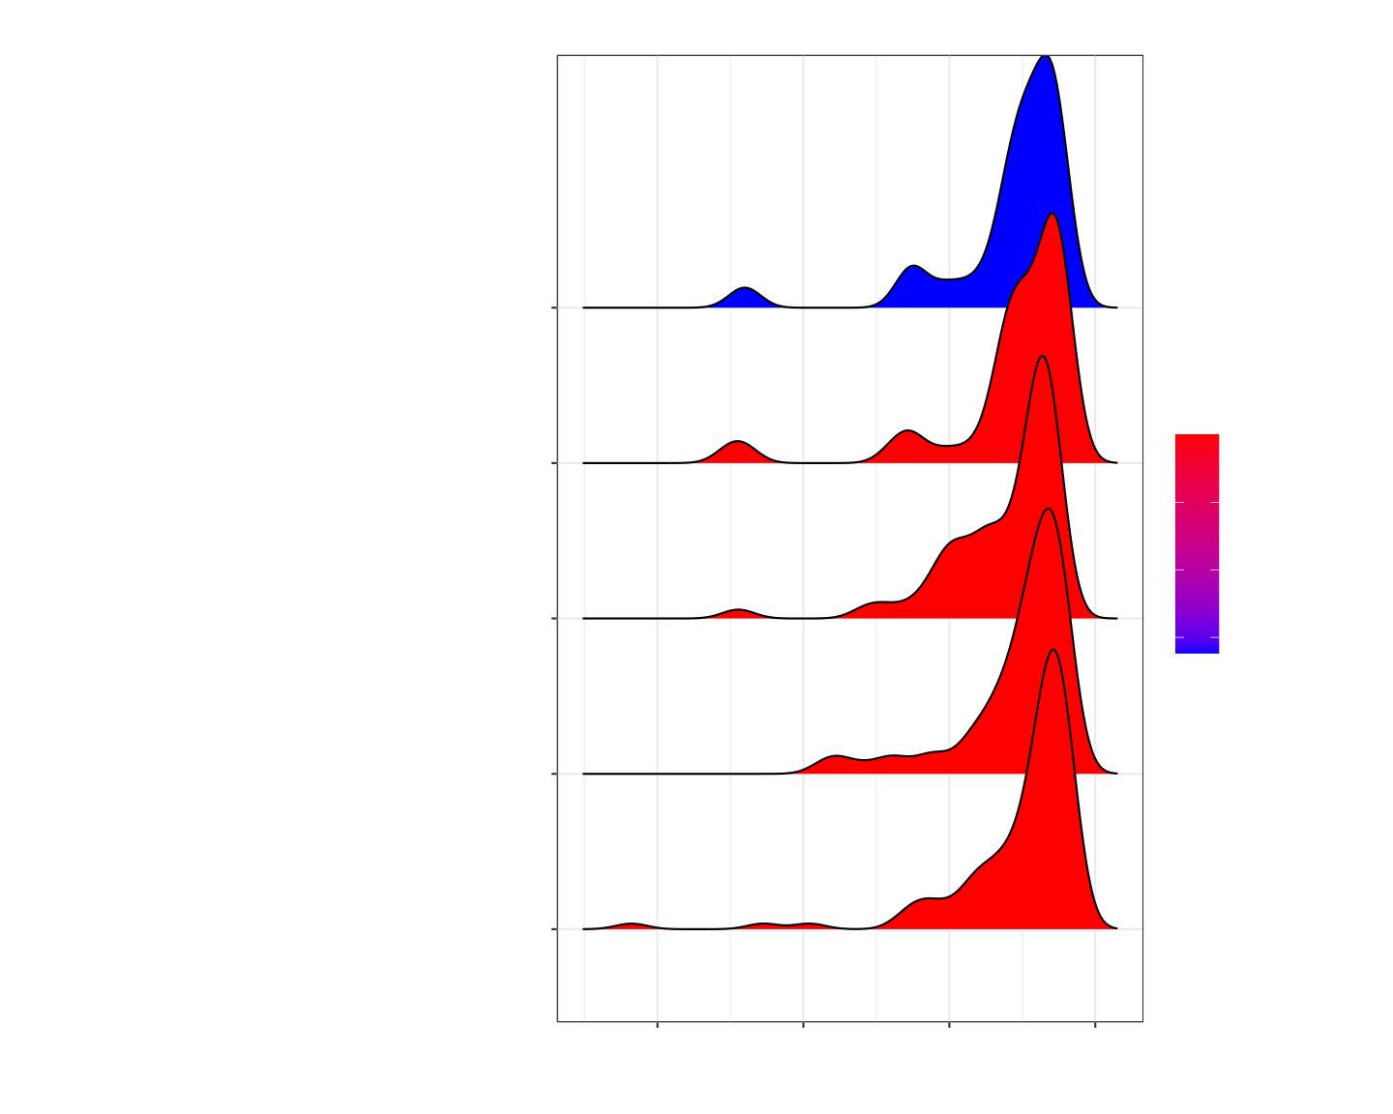
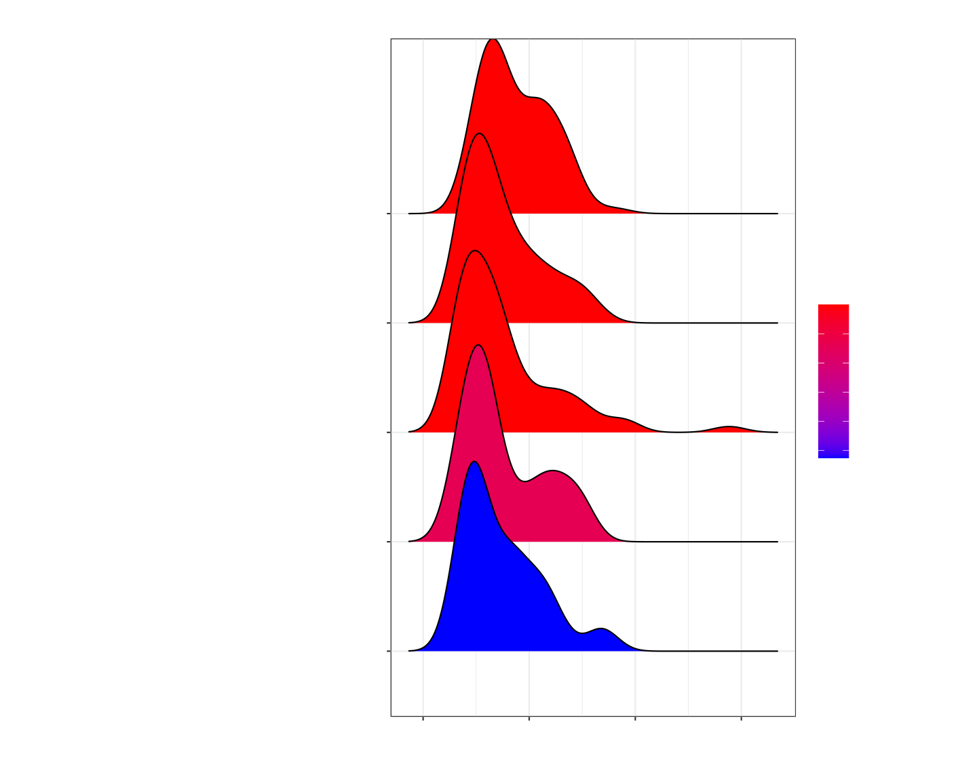
A
B
n = 24
n = 95
2.5
2
SM vs M
0.0
SM vs M
0
−2.5
−2
−5.0
n = 128
n = 381
−5
0
M vs C
5
10
−4
−2
0
M vs C
2
4
6
C
D
E
Group
2
Group
Up to Down
Down to Up
Fbn1
1
C
Thy1
0
M
Eln
SM
RNA
Fbn1
Thy1
Eln
PRO
RNA
Acacb
PRO
C2
C3
C4
C5
M1
M2
M4
M5
SM1
SM3
SM4
SM5
Acacb
−1
F
−2
Group
2
Group
G3V9M6
1
C
P01830
0
M
Q99372
SM
N2
N3
N4
N5
M1
M2
M4
M5
SM1
SM3
SM4
SM5
A0A0G2K1F2
−1
I
−2
G
muscle tissue development
extracellular matrix
cell adhesion molecule binding
2e−11
external encapsulating structure
1e−12
4e−11
2e−12
muscle cell differentiation
6e−11
extracellular structure organization
3e−12
extracellular matrix
extracellular matrix organization
H
myofibril
−6
−4
−2
0
J
actin binding
0
1
2
ECM−receptor interaction
Cytoskeleton in muscle cells
Integrin signaling
2e−04
Integrin signaling
0.0025
0.0050
4e−04
0.0075
Cytokine−cytokine receptor interaction
6e−04
Focal adhesion
0.0100
0.0125
Cadherin signaling
ECM−receptor interaction
Cytoskeleton in muscle cells
Cytokine−cytokine receptor interaction
−6
−4
−2
0
0
1
2
3

