Slide 1
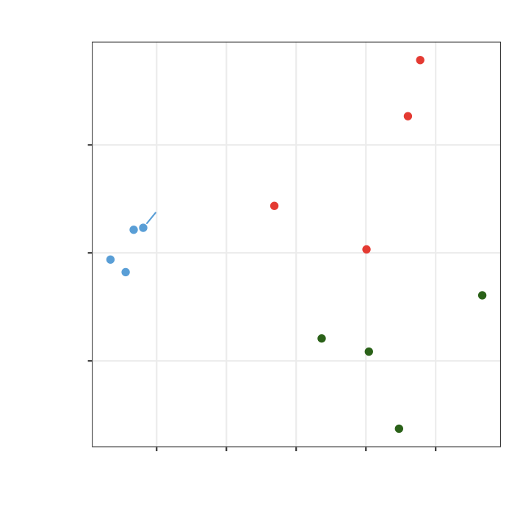
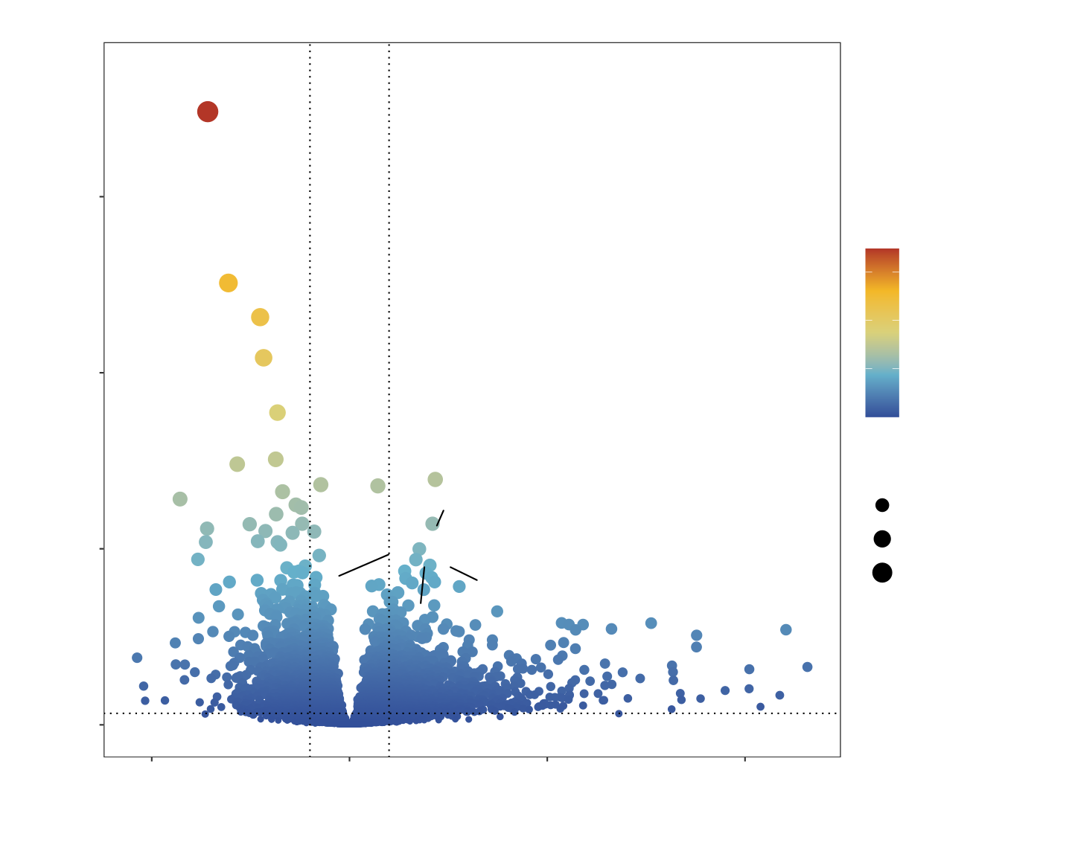
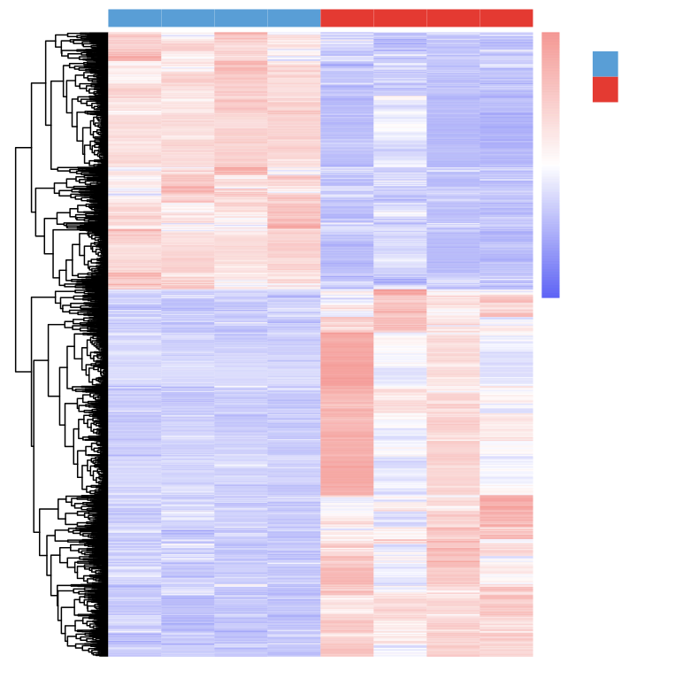
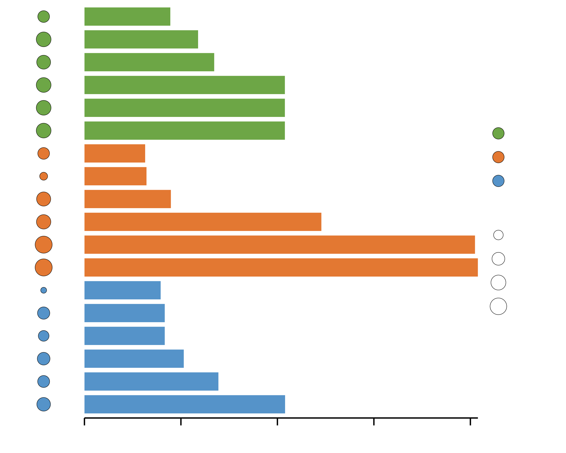
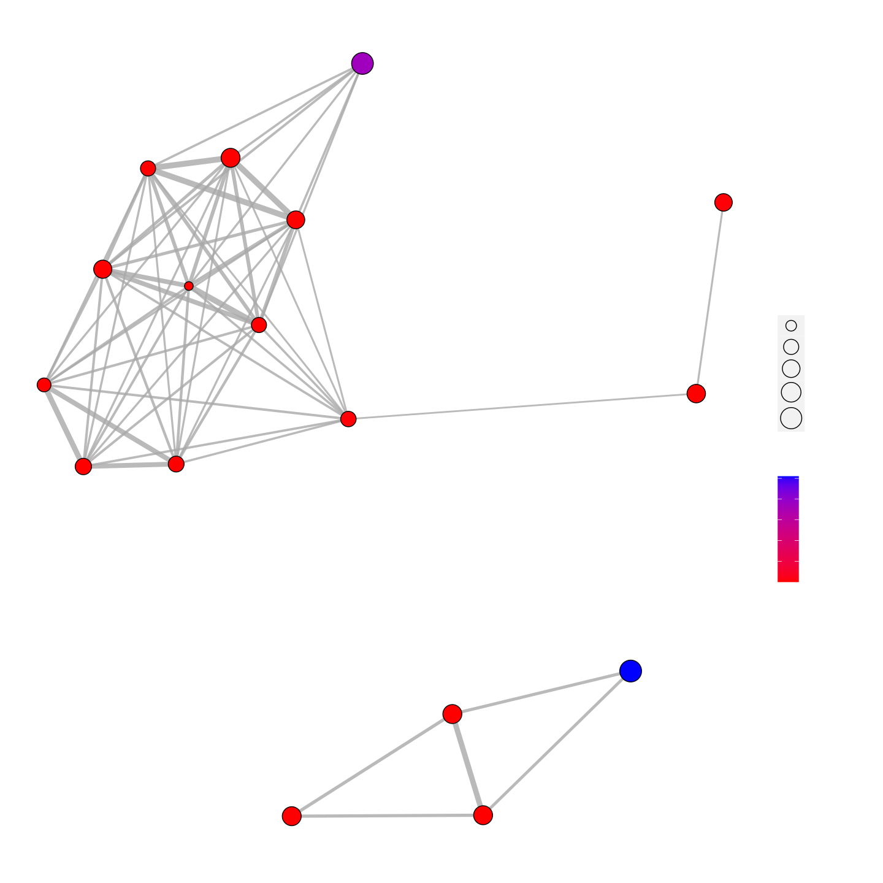
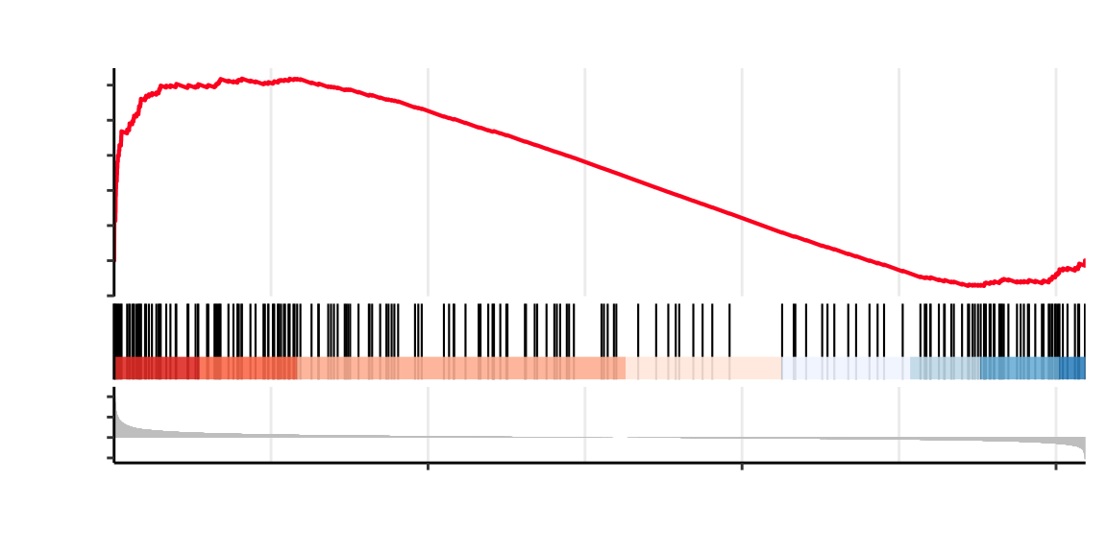
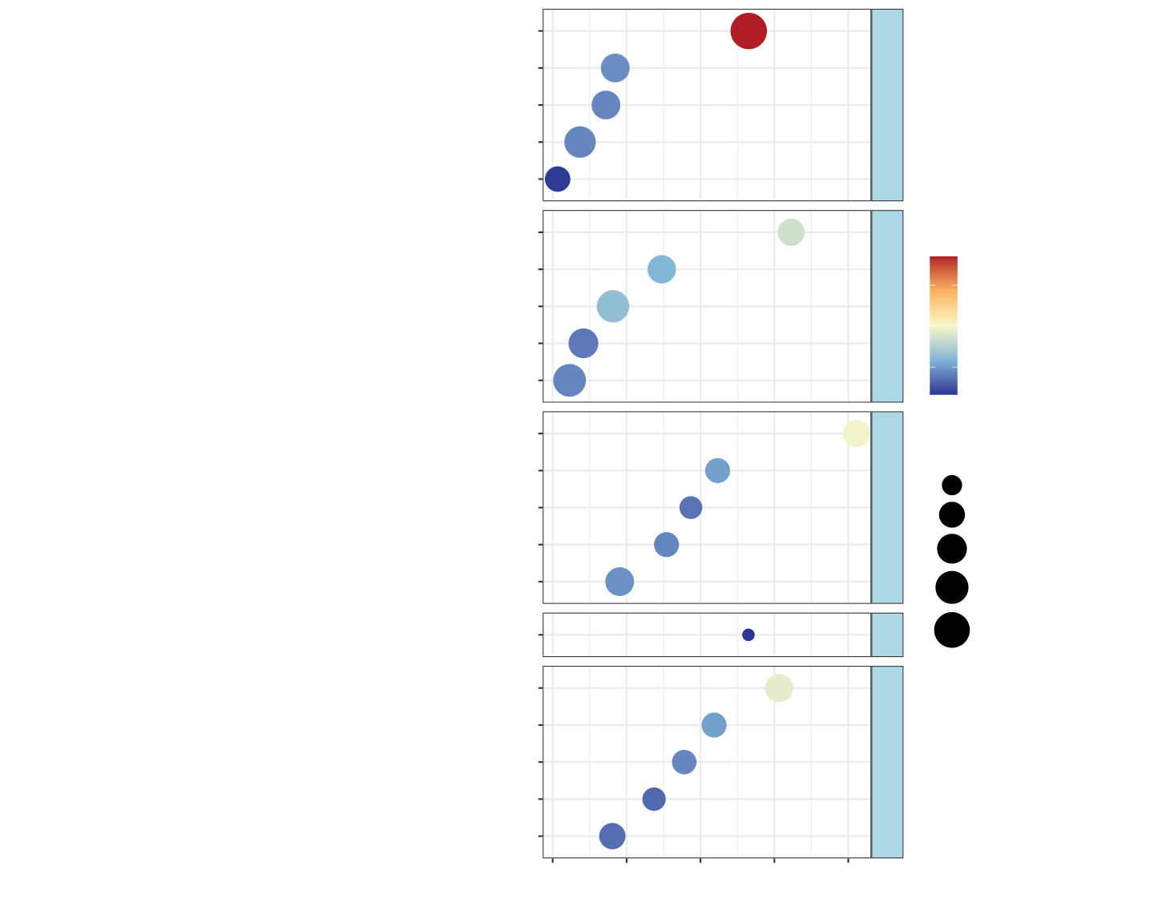
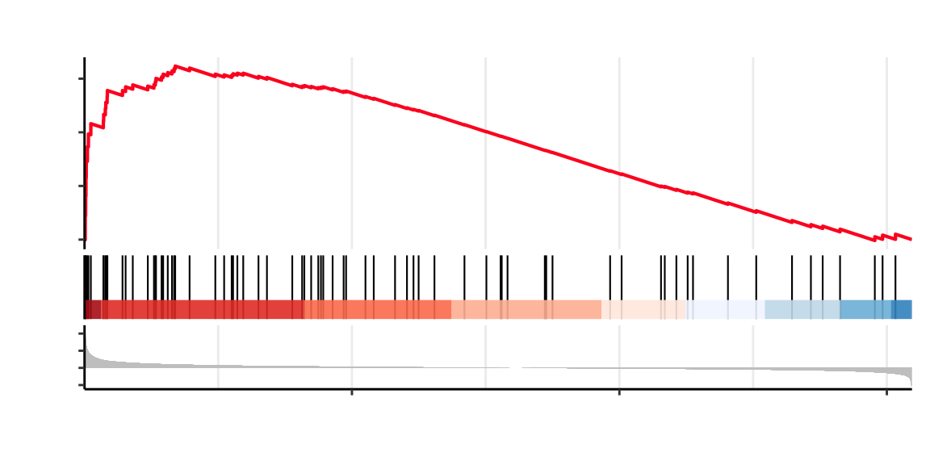
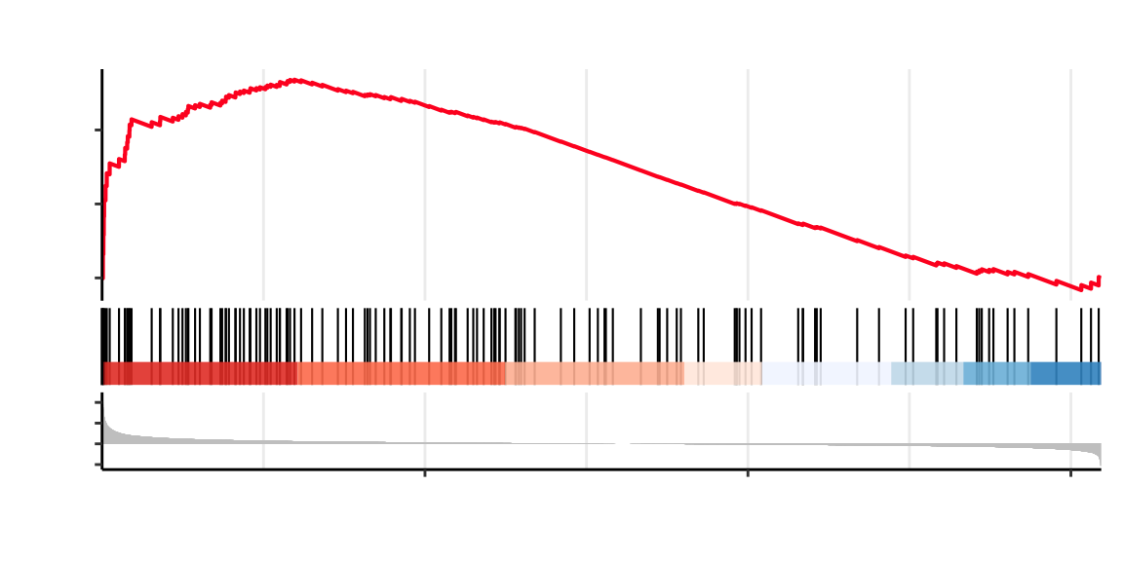
A
B
Done: 968
Up: 1383
C
M1
Group
Group
Prox1
2
C
M3
60
1
M
10
Hipk2
−log10(p.adj)
0
C1
Gpd1l1
Acadsb
60
−1
C2
M2
M4
FAM120C
40
−2
PC2: 14.8% variance
C4
40
20
0
C3
SM1
−log10 p−value
Fbxo32
Herc3
Gnl3l
Map3k6
−log10(p.adj)
SM2
Gprin3
Tnik
F2rl1
Sned1
20
Acer2
Ifitm10
40
−10
SM3
20
Slc35e4
Ptgs1
Akip1
Kcnj14
60
SM4
Slc10a6
−20
−10
0
10
20
0
−5
0
5
10
PC1: 64.1% variance
log2 Fold Change
D
E
regulation of tube diameter
muscle system process
muscle contraction
extracellular structure organization
external encapsulating structure organization
extracellular matrix organization
contractile fiber
collagen trimer
external side of plasma membrane
collagen-containing extracellular matrix
extracellular matrix
external encapsulating structure
extracellular matrix structural constituent con...
carbohydrate binding
integrin binding
sulfur compound binding
heparin binding
glycosaminoglycan binding
40
Ace/Acta1/Acta2/Actg2/Adra2a...
Acta1/Acta2/Actg2/Actn3/Adra2a...
Acta1/Acta2/Actg2/Actn3/Adra2a...
Adamts15/Adamts16/Adamts17...
Adamts15/Adamts16...
Adamts15/Adamts16/Adamts17...
Acta1/Acta2/Actg2/Actn1/Actn3...
Adipoq/C1qtnf5/Col11a1/Col11a2/Col12a1...
Abcb1b/Abcg2/Ace/Ackr2/Anpep...
Acta2/Adamts10/Adamts15...
Acta2/Adamts10/Adamts15/Adamts16/Adamts17...
Acta2/Adamts10/Adamts15/Adamts16...
Col11a1/Col11a2...
Asgr2/Bcan/C4b/Cd33/Cemip...
Actn1/Ccn2/Ccn3/Ccn4/Ccn5...
Adamts15/Alk/Aplp1/Apoe/Atp1a3...
Adamts15/Alk/Aplp1/Apoe/Ccl2...
Adamts15/Alk/Aplp1/Apoe/Bcan...
73
BP
62
collagen trimer
73
ONTOLOGY
external encapsulating structure organization
73
extracellular matrix organization
extracellular structure organization
carbohydrate binding
73
BP
collagen−containing extracellular matrix
40
CC
extracellular matrix
external encapsulating structure
number of genes
20
18
MF
40
heparin binding
external side of plasma membrane
60
65
CC
80
68
Count
glycosaminoglycan binding
integrin binding
p.adjust
100
25
sulfur compound binding
5e−07
4e−07
107
3e−07
50
2e−07
108
75
1e−07
15
100
muscle contraction
contractile fiber
45
32
MF
regulation of tube diameter
muscle system process
49
42
59
0
10
20
30
40
F
−Log10(Pvalue)
G
Cytoskeleton in muscle cells − Rattus norvegicus (rat)
0.5
0.4
0.3
Running Enrichment Score
0.2
0.1
Cytoskeleton in muscle cells
0.0
Motor proteins
−0.1
Focal adhesion
Cellular Processes
10
Phagocytosis
5
Ranked List Metric
0
Cellular senescence
−5
M
5000
10000
C
ECM−receptor interaction
−log10(p.adjust)
Rank in Ordered Dataset
15000
Integrin signaling
15
0.6
ECM−receptor interaction − Rattus norvegicus (rat)
Cytokine−cytokine receptor interaction
EIP
10
Calcium signaling pathway
0.4
PI3K−Akt signaling pathway
5
Running Enrichment Score
Malaria
0.2
Rheumatoid arthritis
Count
0.0
Leishmaniasis
10
10
Human Diseases
20
5
Ranked List Metric
Staphylococcus aureus infection
30
0
−5
M
5000
10000
C
Tuberculosis
40
Rank in Ordered Dataset
15000
Taurine and hypotaurine metabolism
M
50
Integrin signaling − Rattus norvegicus (rat)
Protein digestion and absorption
0.4
Complement and coagulation cascades
Running Enrichment Score
Hematopoietic cell lineage
Organismal Systems
0.2
IL−17 signaling pathway
0.0
Adrenergic signaling in cardiomyocytes
2
3
4
5
6
10
5
Ranked List Metric
0
−5
M
5000
10000
C
Rank in Ordered Dataset
15000

