Slide 1
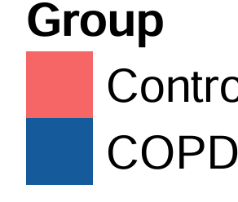
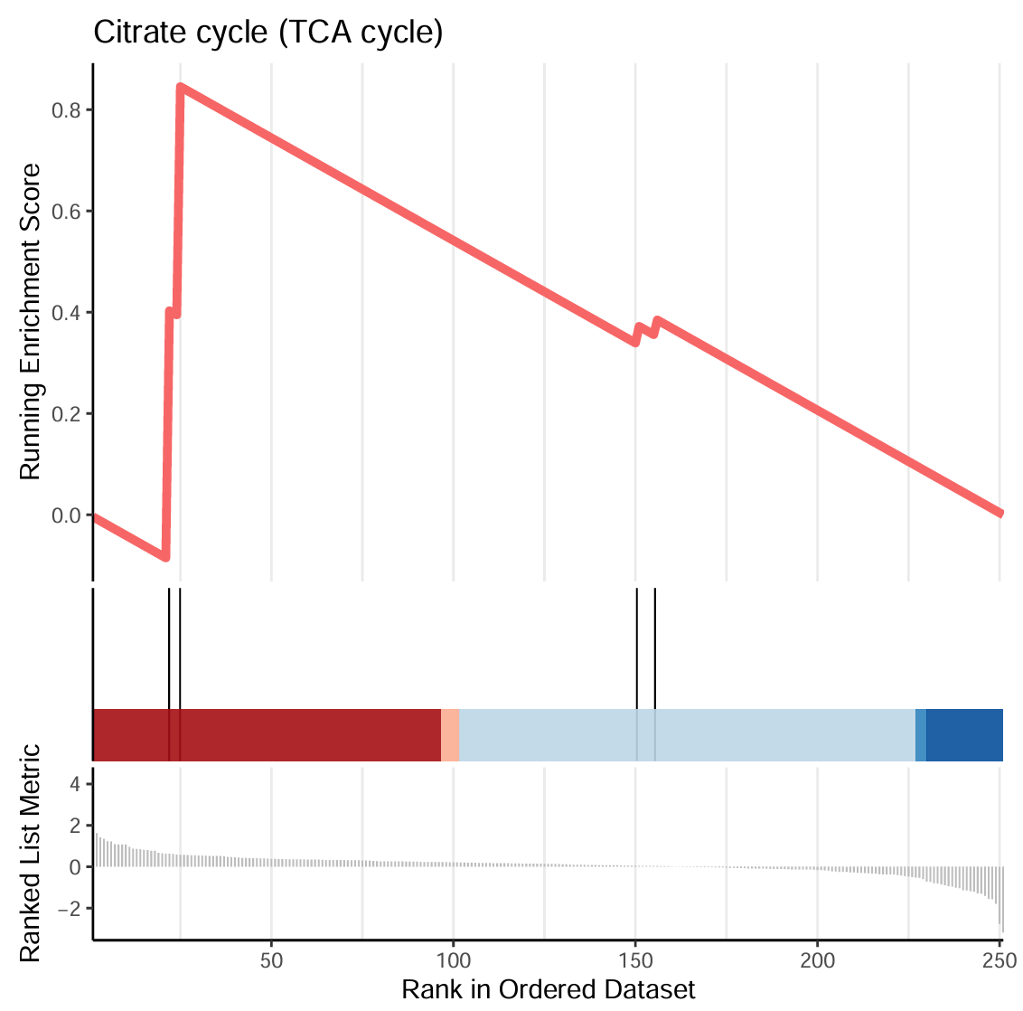
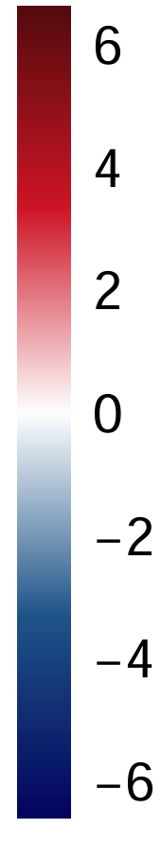
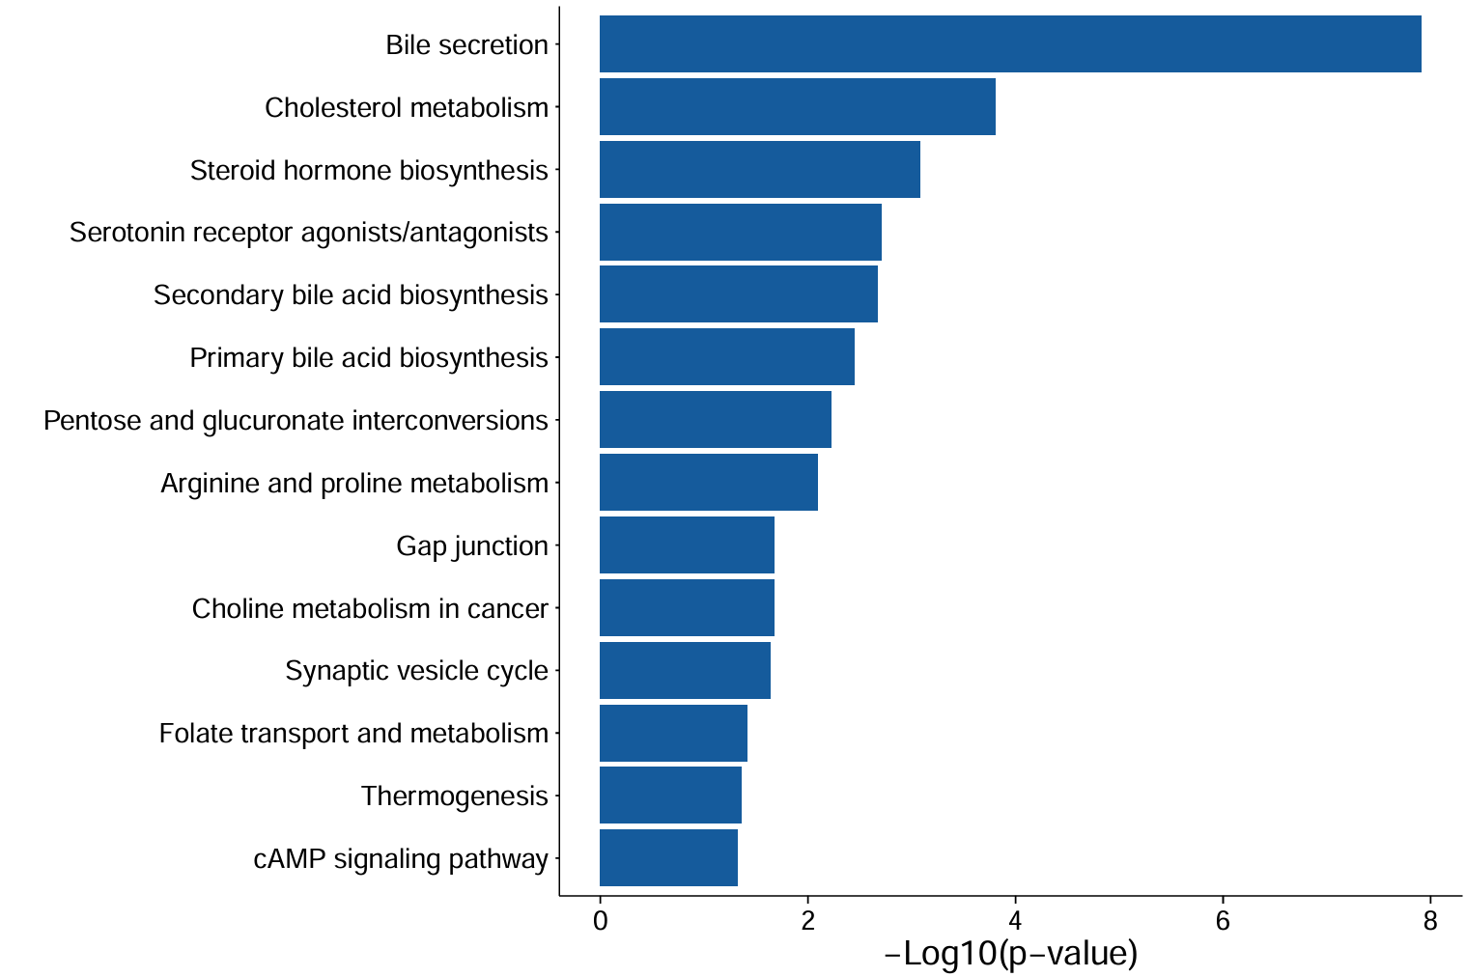
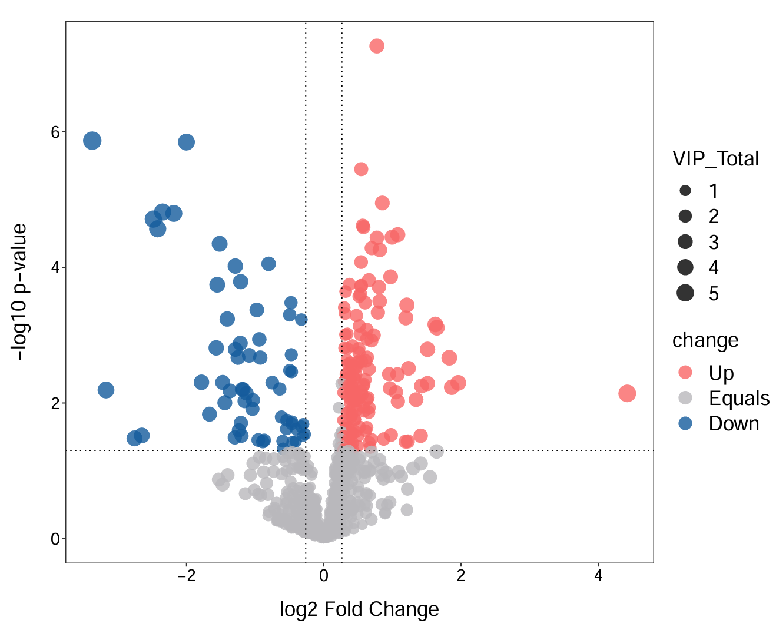
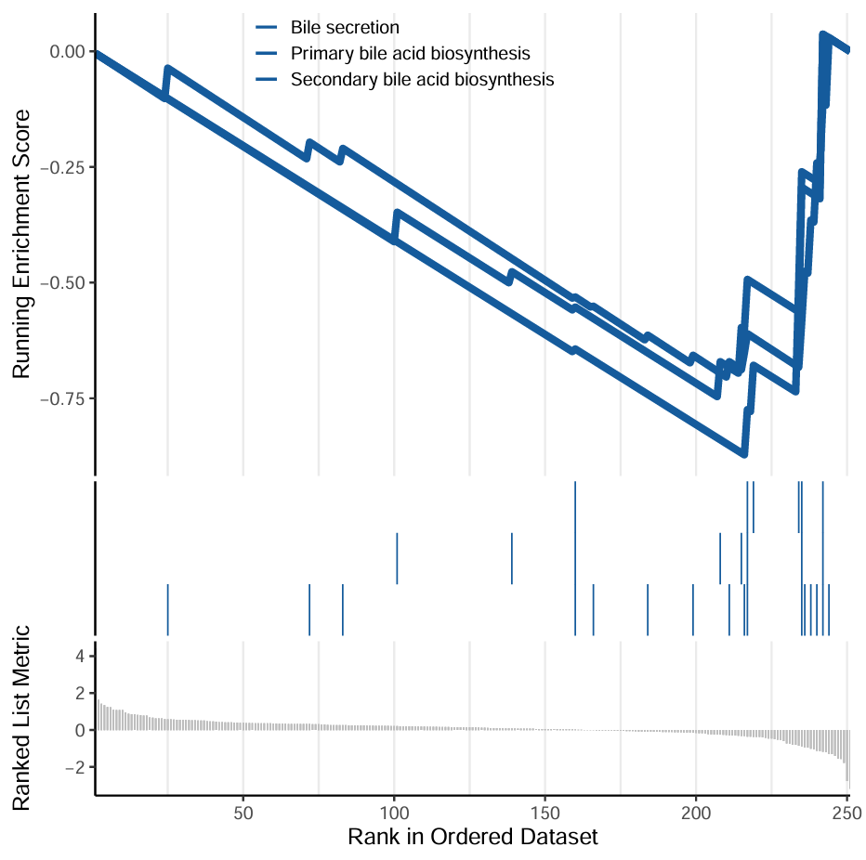
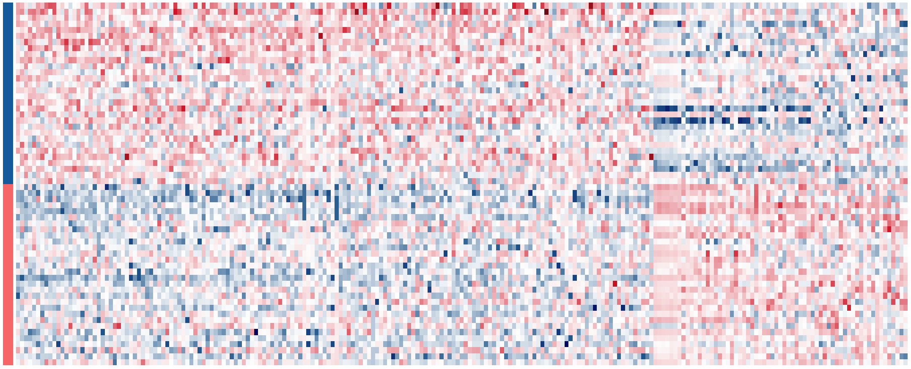
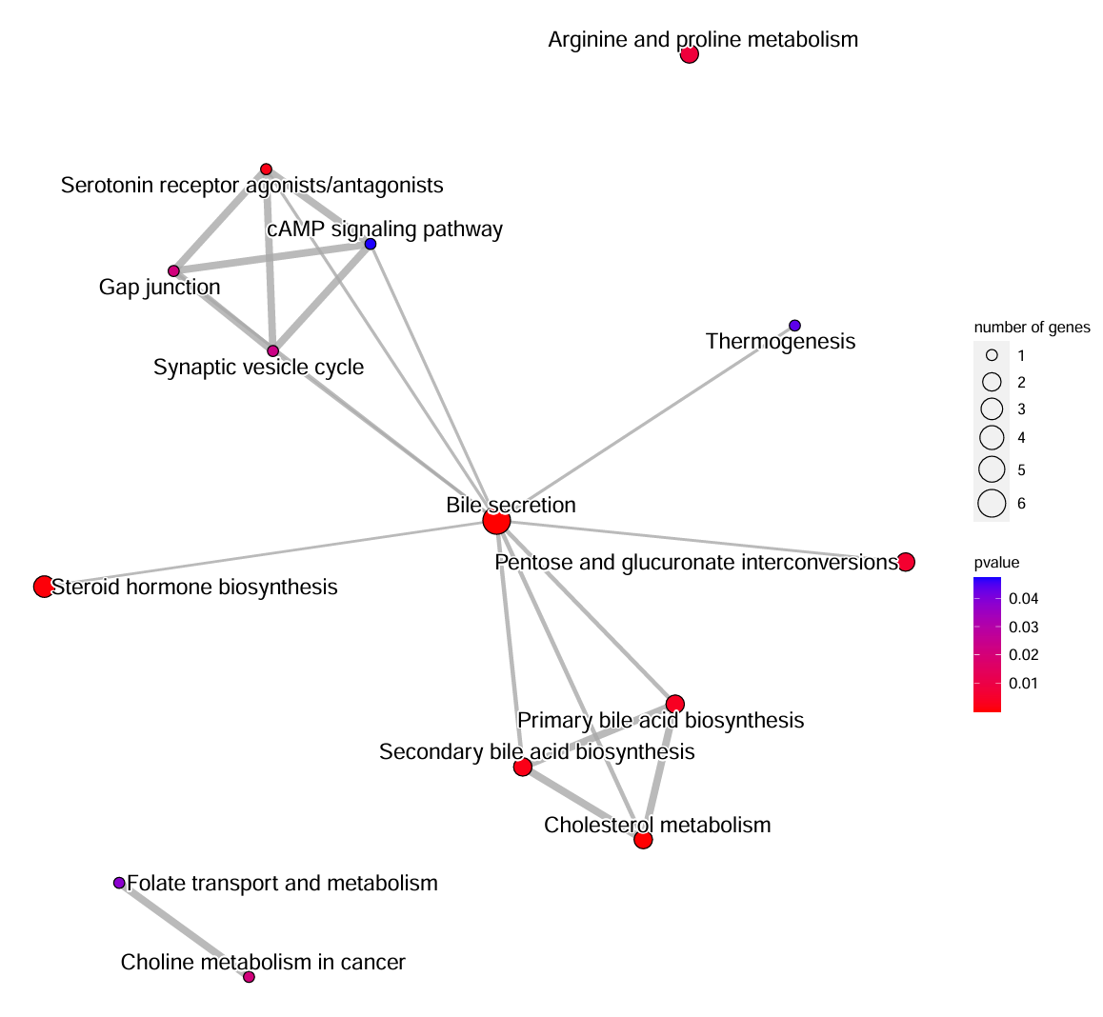
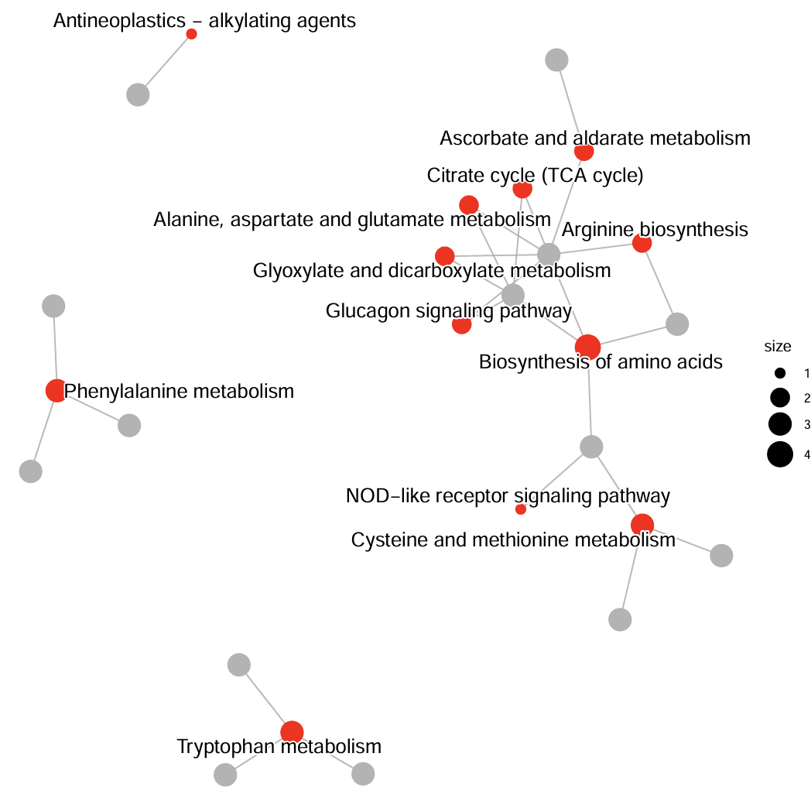
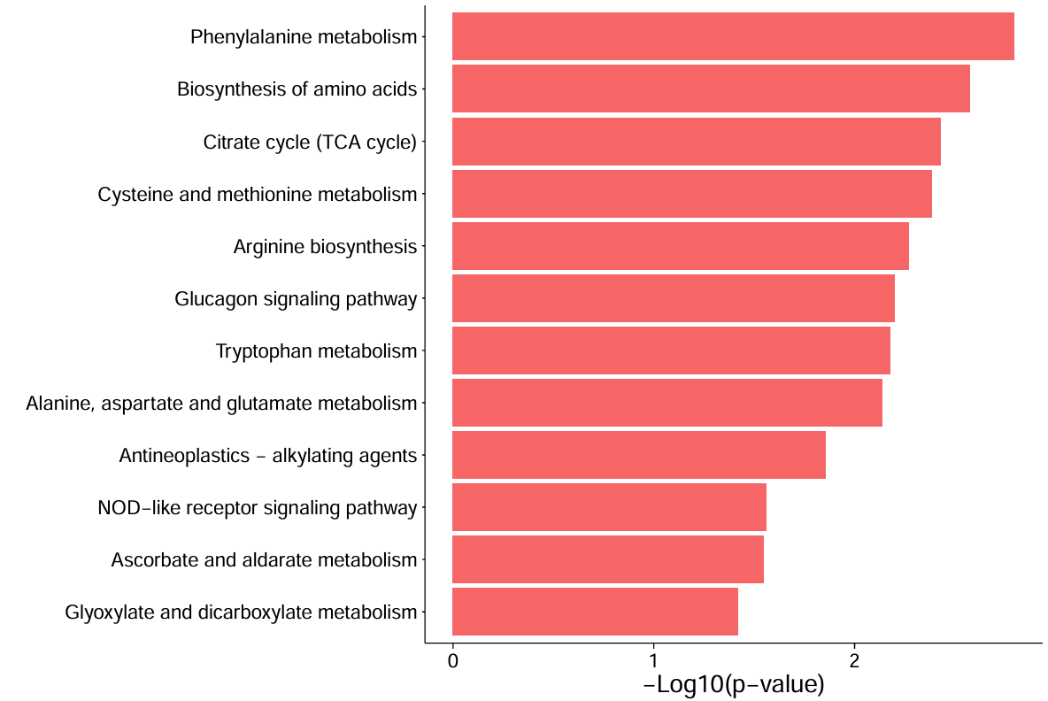
Antineoplastics – alkylating agents
0.8
Citrate cycle (TCA cycle)
Ascorbate and aldarate metabolism
Citrate cycle (TCA cycle)
0.6
Alanine, aspartate and glutamate metabolism
Arginine biosynthesis
size
0.4
Glyoxylate and dicarboxylate metabolism
1
Running Enrichment Score
Glucagon signaling pathway
2
Biosynthesis of amino acids
3
0.2
Phenylalanine metabolism
4
0.0
NOD-like receptor signaling pathway
Cysteine and methionine metabolism
4
2
Ranked List Metric
Tryptophan metabolism
0
-2
50
100
150
200
250
Rank in Ordered Dataset
Bile secretion
Cholesterol metabolism
Steroid hormone biosynthesis
Serotonin receptor agonists/antagonists
Secondary bile acid biosynthesis
Primary bile acid biosynthesis
Pentose and glucuronate interconversions
Arginine and proline metabolism
Gap junction
Choline metabolism in cancer
Synaptic vesicle cycle
Folate transport and metabolism
Thermogenesis
cAMP signaling pathway
0
2
4
6
8
−Log10(p-value)

