Slide 1
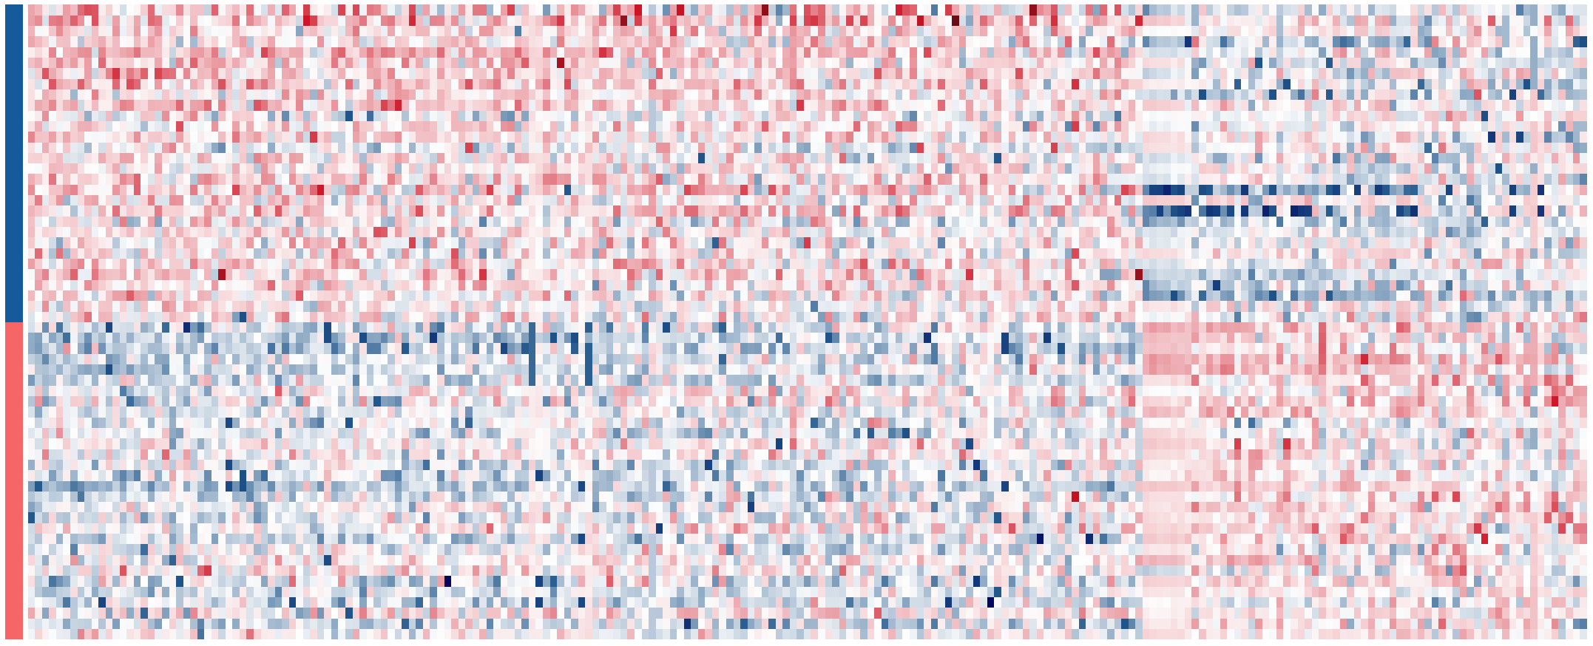
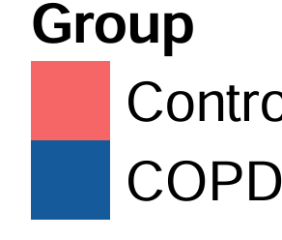
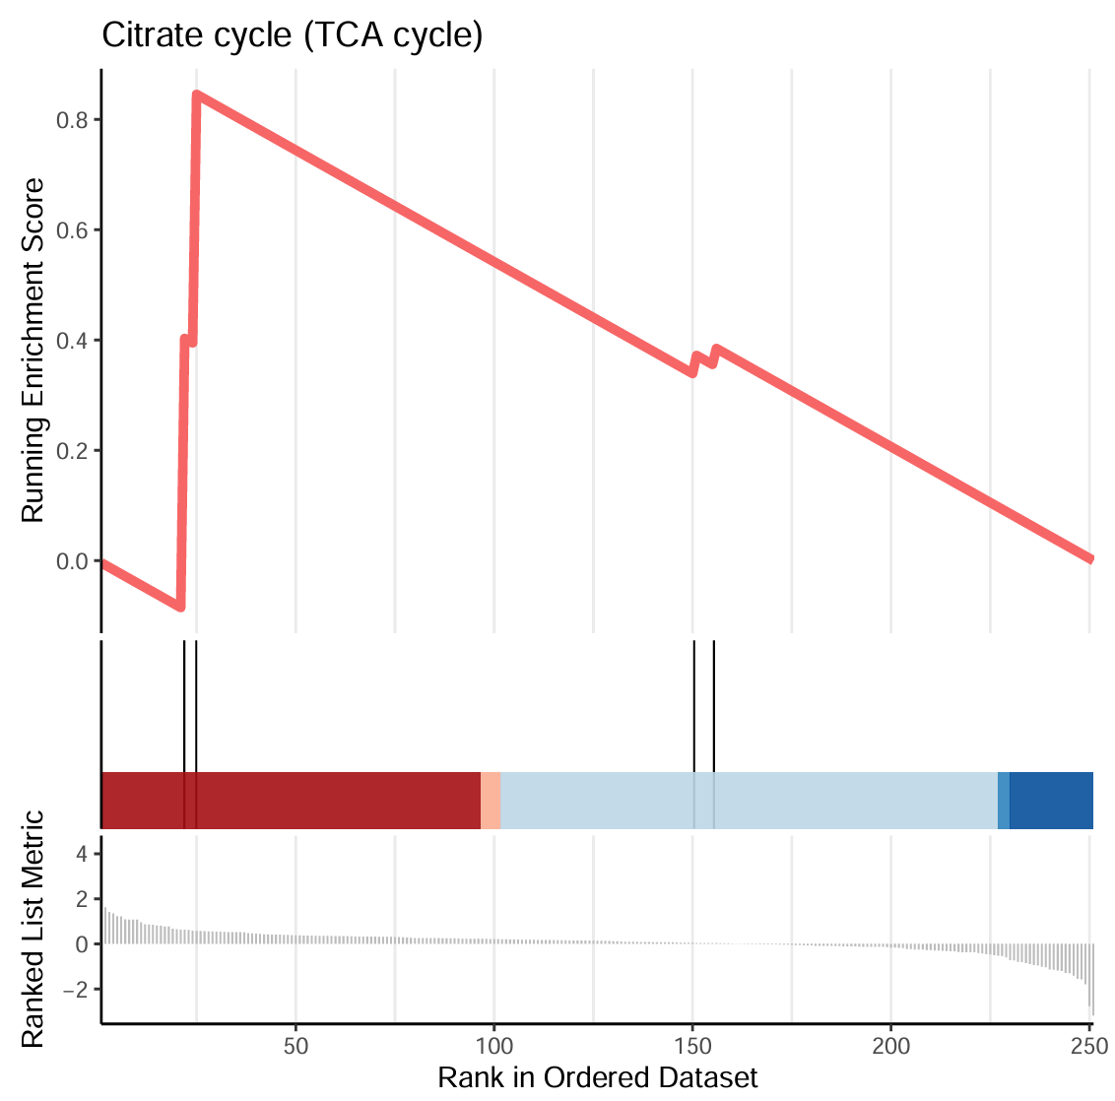
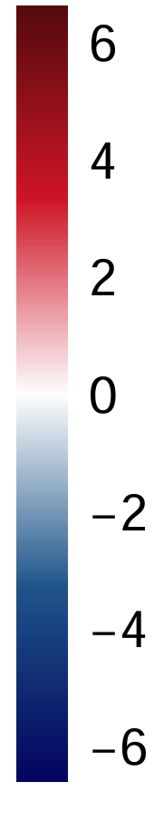
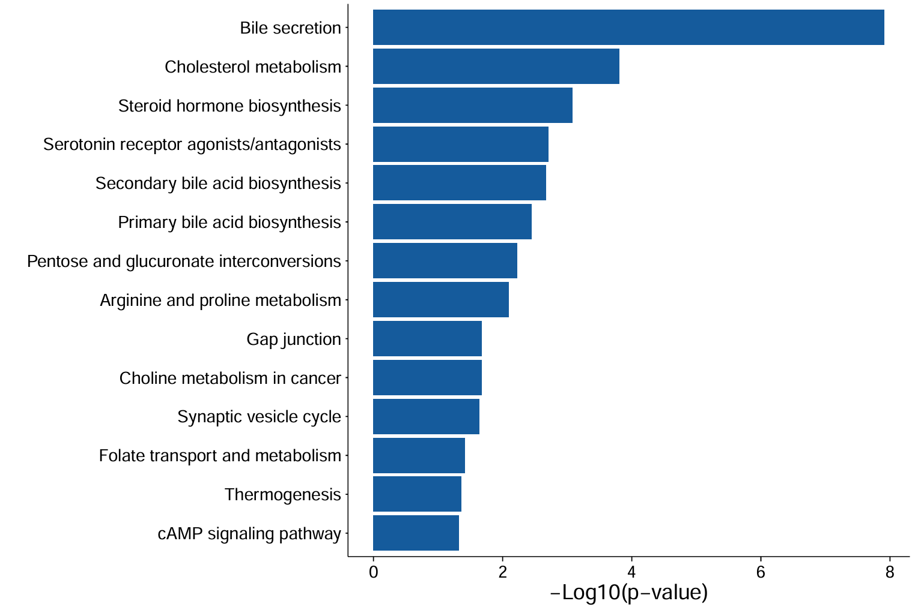
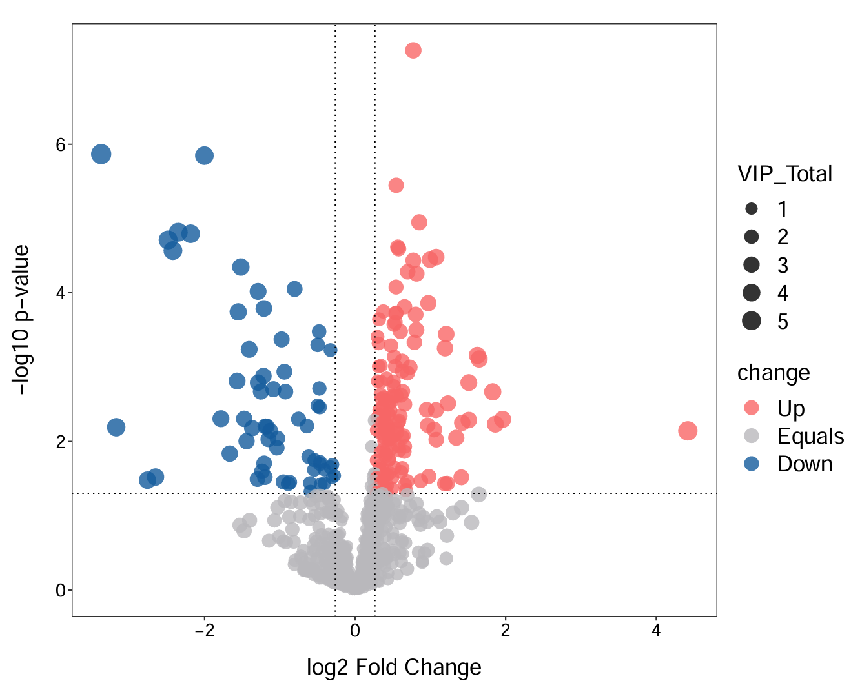
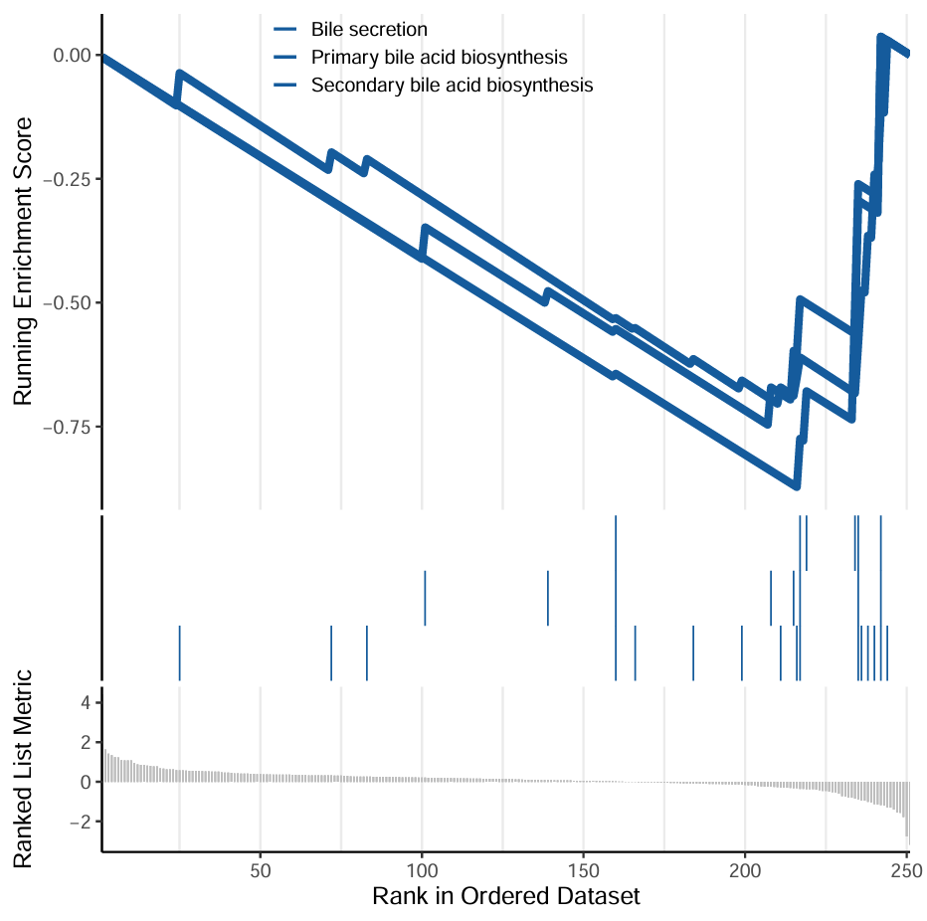
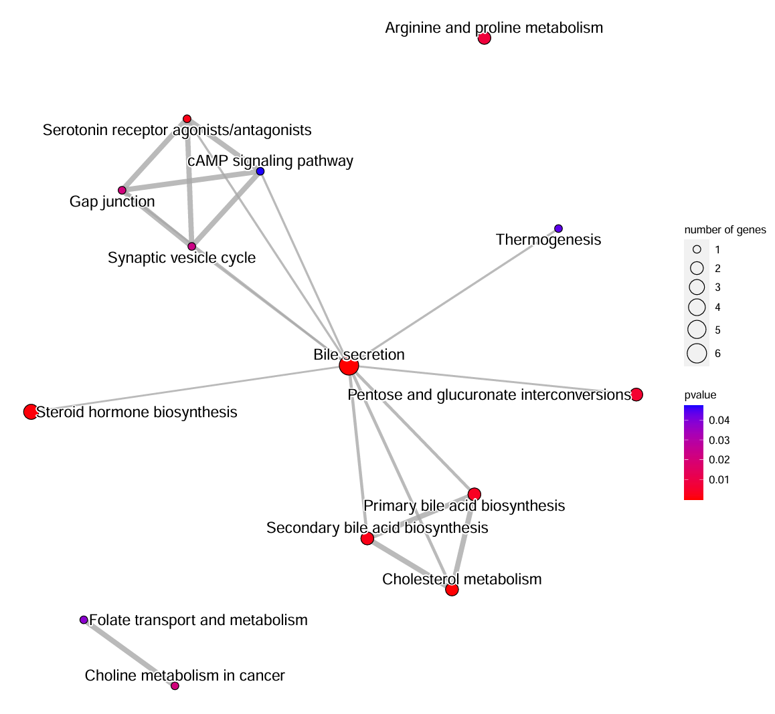
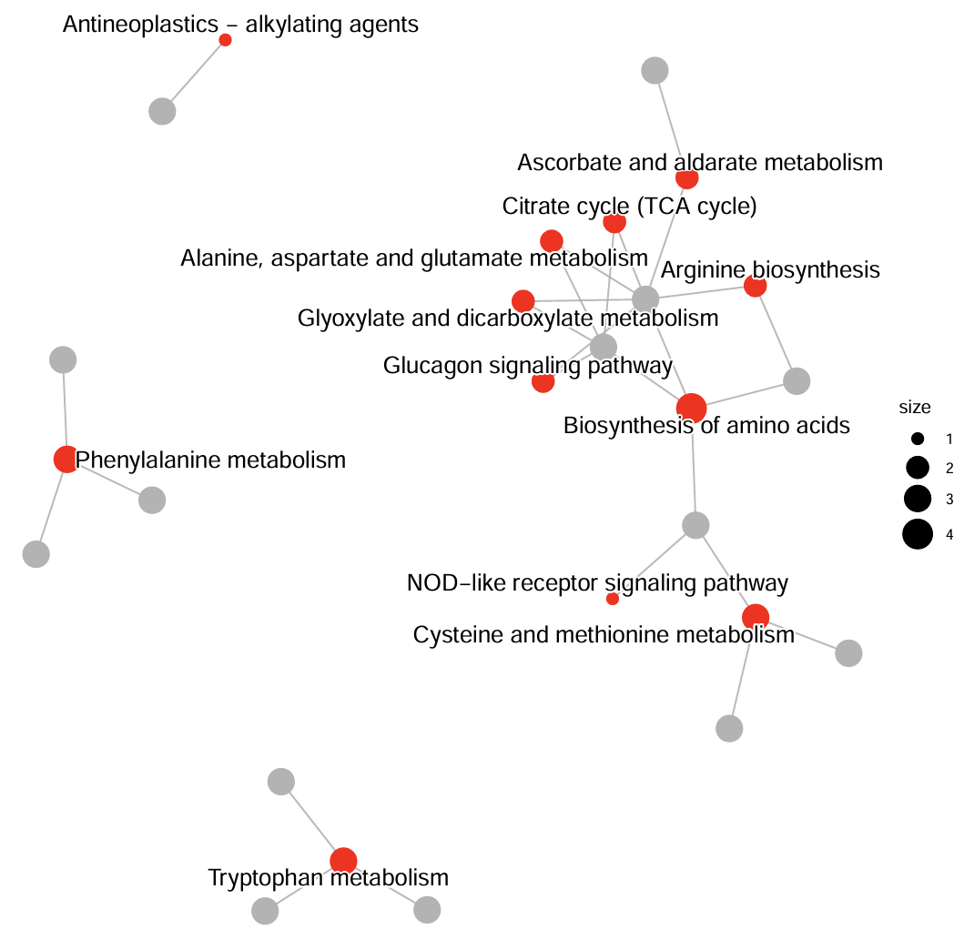
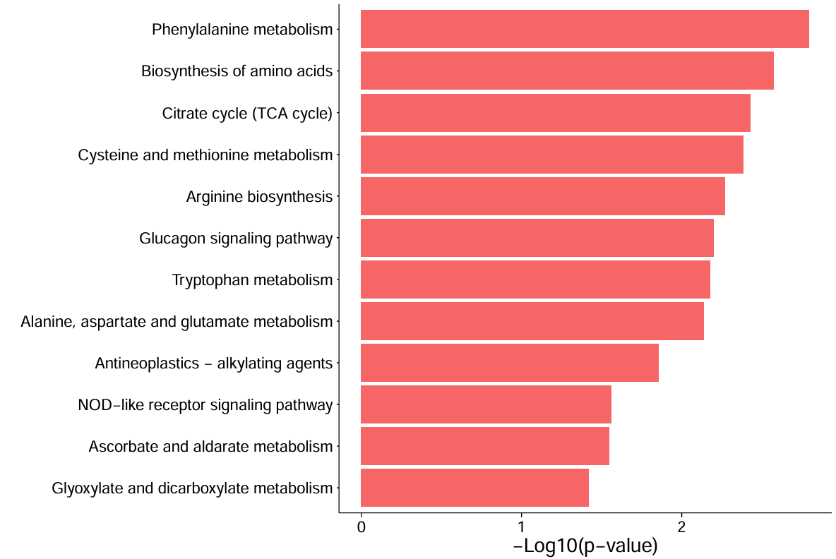
A
COPD-PD vs Control
B
Up: 158
Down: 63
Ketophenylbutazone
L-Cystine
6
Group
5-Hydroxy-L-tryptophan
Control
COPD-PH
Prasterone-3-sulfate
N-Acetyl-L-methionine
4
Contro
6
COPD
Sphaerosinin
Antheraxanthin
VIP_Total
1
2
2
3
4
4
0
−log10 p-value
5
change
-2
Up
2
Equals
Down
-4
0
-2
0
2
4
-6
C
log2 Fold Change
D
E
Phenylalanine metabolism
Antineoplastics – alkylating agents
0.8
Citrate cycle (TCA cycle)
Biosynthesis of amino acids
Ascorbate and aldarate metabolism
Citrate cycle (TCA cycle)
Citrate cycle (TCA cycle)
0.6
Cysteine and methionine metabolism
Alanine, aspartate and glutamate metabolism
Arginine biosynthesis
size
0.4
Arginine biosynthesis
Glyoxylate and dicarboxylate metabolism
1
Running Enrichment Score
Glucagon signaling pathway
2
Glucagon signaling pathway
Biosynthesis of amino acids
3
0.2
Tryptophan metabolism
Phenylalanine metabolism
4
0.0
Alanine, aspartate and glutamate metabolism
NOD-like receptor signaling pathway
Antineoplastics – alkylating agents
Cysteine and methionine metabolism
NOD-like receptor signaling pathway
Ascorbate and aldarate metabolism
4
Glyoxylate and dicarboxylate metabolism
2
0
1
2
Ranked List Metric
−Log10(p-value)
Tryptophan metabolism
0
-2
50
100
150
200
250
F
G
H
Rank in Ordered Dataset
Arginine and proline metabolism
0.00
Bile secretion
Bile secretion
Primary bile acid biosynthesis
Cholesterol metabolism
Serotonin receptor agonists/antagonists
-0.25
Secondary bile acid biosynthesis
Steroid hormone biosynthesis
Gap junction
cAMP signaling pathway
Serotonin receptor agonists/antagonists
Thermogenesis
number of genes
Running Enrichment Score
Secondary bile acid biosynthesis
Synaptic vesicle cycle
1
-0.50
2
Primary bile acid biosynthesis
3
Pentose and glucuronate interconversions
4
Bile secretion
5
Arginine and proline metabolism
Steroid hormone biosynthesis
Pentose and glucuronate interconversions
pvalue
6
-0.75
Gap junction
0.04
Choline metabolism in cancer
0.03
0.02
Synaptic vesicle cycle
Primary bile acid biosynthesis
0.01
Folate transport and metabolism
Secondary bile acid biosynthesis
Thermogenesis
Folate transport and metabolism
Cholesterol metabolism
4
cAMP signaling pathway
2
Ranked List Metric
0
2
4
6
8
Choline metabolism in cancer
0
−Log10(p-value)
-2
50
100
150
200
250
Rank in Ordered Dataset

