Slide 2

What we already have
A mathematic model predicting different parameters assuming several hypothesis (Juliette, Paul)
A complex simulation of digital organisms (Aevol)
→ M(µi, zc, znc, g, Ne, lm)
→ B=

Slide 3
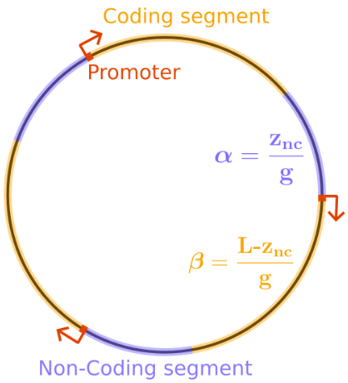
The assumptions
→ Homogeneous and single-directionnal genome
→ Genes are coding sequence and do not overlap
→ Mutation affecting genotype are lethal
→ Population effective size Ne is constant
→ Mutation rates µi are uniform and constant
Figure 1: Schematic representation of a genome (Paul Banse, Guillaume Beslon, Juliette Liuselli).

Slide 4





What the model predicts
There is a bias to genome size increase.
As znc increase, the probability to mutate and the probability to be neutral does not grow at the same speed.
  A force (selection) favors small genomes as they have a lower probability of mutating and be affected by a deleterious mutations.
There is an equilibrium where these two forces balance

Slide 6
The issues
The model relies on strong assumptions that we know they are false.
Aevol is a rich but complex simulation. An Aevol simulation cannot be initialized and run while aligning with these assumptions.

Slide 7
The solution (aim of the internship)
Implement a simpler simulation where hypothesis can either be respected or not.
Then, compare several simulations.
→ What are the hypothesis that bring a notable difference with reality?

Slide 8
Two simulations
Some hypothesis cannot be respected outside of mathematic field: the math model predicts the equilibrium but not the dynamics.
One simulation is applying the model iteratively from an arbitrary starting point (called Iterative Model) (like a implicit sequence and finding a fixed point)
The other is a Wright-Fisher simulation (called Simulation)

Slide 9
Iterative Model
M(µi, zc, g, Ne, lm)
znc, µi, zc, g, Ne, lm
Δznc · t
znc = znc + Δznc,
[Ne = R(µi, zc, znc, g, Ne, lm)]
t is a “time factor” to accelerate the convergence.
t “real” generations happens at each iteration (Euler approach).

Slide 10
Simulation
Generation i
Generation i+1
DEAD
DEAD
Neutral mutant
Ne, i
Neutral mutant
Ne, i+1
µ process
Pfix(Ne, i, ...)
Pfix(Ne, i+1, ...)
N
N

