Slide 1
FUTREENG
Crain & Wooley
Intake Engine → SaaS Opportunity
A working product. A real client. A category-sized opening.
PREPARED BY Joseph Panetta
FOR Haron "Q" Wilson — FutreEng
DATE May 17, 2026

Slide 2
FUTREENG
01 / THE PATTERN WE FOUND
02
A small firm trying to grow with the same intake process they had at 10 leads a month
"We have 3 intake staff for less than 100 consults per month. WE HAVE GOT TO REALIZE SOME EFFICIENCIES WITH TECHNOLOGY."
— Crain & Wooley · April 30, 2026
His existing flow: lead → human responds → human qualifies → human schedules → human follows up → human chases. Five manual touches per lead, three salaried staff to deliver them, and the firm still loses leads in the cracks.
CONSULTS / MONTH
MANUAL TOUCHES / LEAD
CONSULT FEE
<100
5+
$300
Today, with 3 intake staff
Every one of them automatable
Cash on the table per booking
WHAT THIS FIRM IS ALREADY PAYING FOR
CRAIN & WOOLEY · SAAS OPPORTUNITY · MAY 2026

Slide 3
FUTREENG
02 / WHAT WE BUILT
03
Four engines. One pipeline. Zero human touches between submit and onboard.
INTAKE GATE
PAYMENT BRIDGE
Qualification before payment
$300 Stripe gate
Four-step form with conditional logic. Auto-disqualifies bad-fit leads before they hit the firm. Estate-planning specific.
No calendar slot without the consultation fee paid. Webhook validates, status flips, scheduling unlocks.
GHOST ASSISTANT
ONBOARDING ACCELERATOR
4-day SMS + email nurture
Clio Manage matter creation
Day 0 confirmation, Day 1/4 SMS nudges, Day 2 email. Auto-cancels on pay, schedule, opt-out, or LOST.
On HIRED, fires Contact → Matter → Task list inside Clio. Client onboarded inside an hour, paralegal-free.
BUILT END-TO-END · RUNNING AGAINST STAGING DATA TODAY
CRAIN & WOOLEY · SAAS OPPORTUNITY · MAY 2026

Slide 4
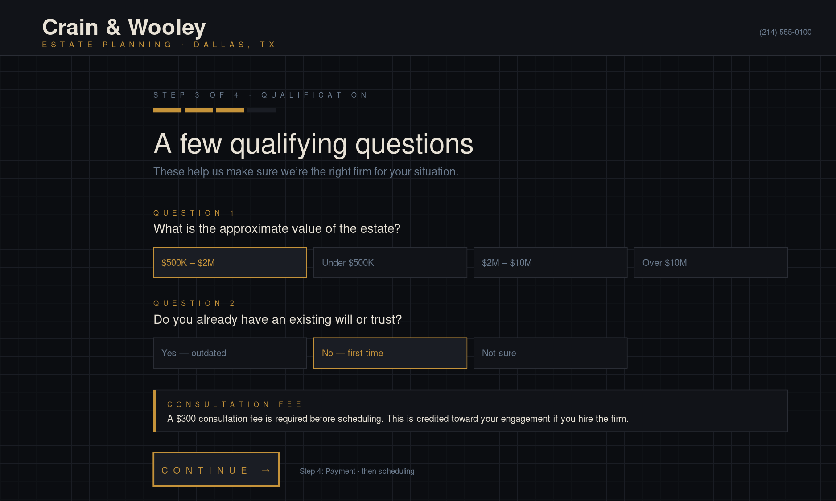
FUTREENG
02 / WHAT WE BUILT — INTAKE
04
Public intake. Qualifies, prices, gates the calendar.
FORM LOGIC
Four-step form
Conditional qualification
Auto-disqualify bad fit
$300 fee disclosed
Pushes lead to Clio Grow
Mobile-first responsive
STEP 3 OF 4 — QUALIFICATION
CRAIN & WOOLEY · SAAS OPPORTUNITY · MAY 2026

Slide 5
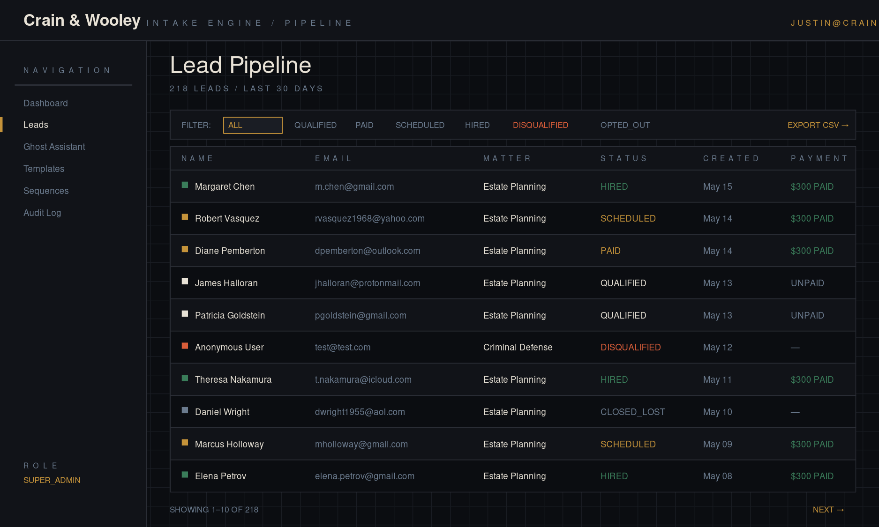
FUTREENG
02 / WHAT WE BUILT — ADMIN
05
Every lead, every status, one view. CSV export one click.
ADMIN POWERS
Role-based access
Pipeline filtering
Lead detail drawer
CSV lead + audit export
Mark HIRED → fires Clio
Opt-out badge inline
PRODUCTION-READY ADMIN UI
CRAIN & WOOLEY · SAAS OPPORTUNITY · MAY 2026

Slide 6
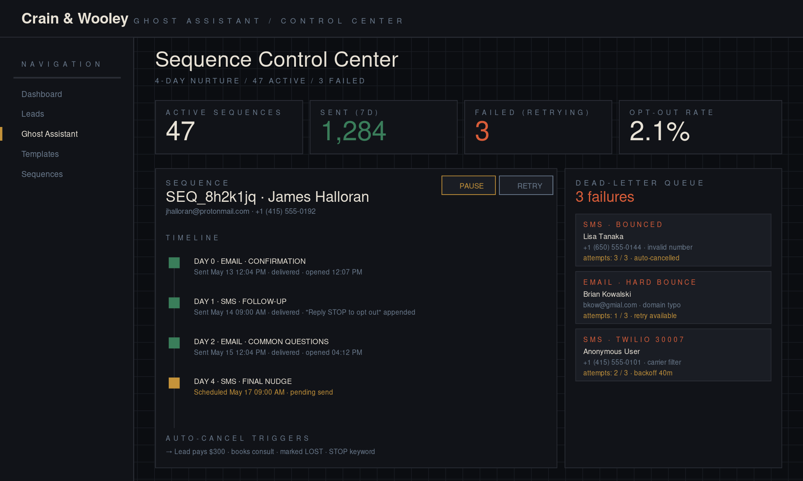
FUTREENG
02 / WHAT WE BUILT — NURTURE
06
Sequence Control Center. Durable. TCPA-compliant. Dead-letter handled.
RELIABILITY
Exponential backoff
Idempotency keys
Dead-letter threshold
STOP / START handler
Editable templates
Full audit trail
4-DAY NURTURE · AUTO-CANCEL ON PAY / SCHEDULE / OPT-OUT
CRAIN & WOOLEY · SAAS OPPORTUNITY · MAY 2026

Slide 7
FUTREENG
03 / WHERE IT STANDS
07
Code complete. Blocked on access, not engineering.
SHIPPED
BLOCKED ON ACCESS
Multi-step intake + qualification
$300 Stripe payment gate
4-day Ghost Assistant nurture
Durable retries, dead-letter, idempotency
TCPA opt-out (STOP/START + unsubscribe)
Admin auth with 3-tier RBAC
Sequence Control Center + templates editor
CSV exports + audit trail
Vault-dark design system end to end
Stripe account + API keys (firm)
Clio Developer App (firm admin)
Onboarding task checklist (paralegal)
"Hired" trigger definition
DNS access for crainwooley.com
Twilio area-code preference
Now self-served via the new Clio Grow login: practice areas, scheduler event types, pipeline stages, Inbox URL.
EVERY ITEM IS ACCESS, NOT ARCHITECTURE
CRAIN & WOOLEY · SAAS OPPORTUNITY · MAY 2026

Slide 8
FUTREENG
04 / THE BIGGER PLAY
08
C&W is not the deliverable. C&W is the design partner.
What we built for Crain & Wooley is product. Estate-planning intake is one vertical of a category that already pays $200-800/mo per firm to companies like Lawmatics, Lead Docket, and Captorra. There are 150,000 Clio customers in the US small/solo segment. Most of them suffer the exact problem the firm described — manual intake, lost leads, no payment gate, no follow-up cadence.
THE MARKET
THE PRICE BAND
THE EXIT
~440K firms
$399–699/mo
5–10× ARR
US small/solo law firms
~150K already on Clio
Established by competitors
70–80% gross margin
Vertical SaaS multiples
$25–150M at $5–10M ARR
WE HAVE THE PRODUCT. THE CATEGORY IS WAITING.
CRAIN & WOOLEY · SAAS OPPORTUNITY · MAY 2026

Slide 9
FUTREENG
05 / WHO IS ALREADY HERE
09
Established competitors, established price points.
COMPANY
PRICE
TRACTION
POSITION
Lawmatics
$300–500/mo
Raised $10M Series A (2022)
Practice management + intake
Lead Docket
$200/user/mo
Acquired by ClickCease (2023)
Personal injury focus
Captorra
$200–400/mo
Private, ~$10–20M revenue est.
Mass tort + class action
Smith.ai
$300–1,000/mo
Virtual receptionist tier
People-driven w/ tech wrap
Clio Grow
$49/user/mo
Native Clio product
Intake CRM only — no automation
FutreEng (us)
$499/mo + rev share
Built. One firm live. Multi-tenant pending.
Vertical-specific, payment-native
WE ARE NOT INVENTING THE CATEGORY — WE ARE ENTERING IT WITH AN ADVANTAGE
CRAIN & WOOLEY · SAAS OPPORTUNITY · MAY 2026

Slide 10
FUTREENG
06 / UNIT ECONOMICS
10
Vertical SaaS economics, with a built-in payments multiplier.
PER FIRM, PER MONTH
THE MARGIN STORY
SaaS subscription
$499.00
75%+
Infra cost (hosting / SMS)
($120.00)
Stripe processing on $30K
($870.00)
Payments rev share (5%)
+$1,500.00
Gross margin at the subscription line. The payments rev share runs at ~95% margin on top of that — it is pure platform yield on dollars already moving through Stripe.
Net per firm
~$1,009
Assumes 100 consults/mo at $300, comparable to C&W target
NOT THE NUMBERS OF A CONSULTANCY — THE NUMBERS OF A SOFTWARE BUSINESS
CRAIN & WOOLEY · SAAS OPPORTUNITY · MAY 2026

Slide 11
FUTREENG
07 / THE HIDDEN LEVER
11
Most legal SaaS doesn't touch the payment flow. We're built around it.
Crain & Wooley runs $30,000 per month in consult fees through Stripe. At 250 firms doing the same thing, that is $7.5M in monthly payment volume crossing our infrastructure. Stripe Connect destination charges let us take 5-10% of every transaction as a platform fee, on top of the subscription. This is the difference between a $1.5M ARR business and a $4–6M ARR business with the same customer count.
10 FIRMS
100 FIRMS
500 FIRMS
$3.6M
$36M
$180M
annualized payment volume
annualized payment volume
annualized payment volume
EVERY $1M IN PAYMENT VOLUME = $50K–100K IN PLATFORM REVENUE
CRAIN & WOOLEY · SAAS OPPORTUNITY · MAY 2026

Slide 12
FUTREENG
08 / 3-YEAR TRAJECTORY
12
Conservative path to $5M ARR. Real, not aspirational.
READING THE CURVE
Year 1
10 → 30 firms
$60K–180K ARR
Year 2
100 firms
$600K–2.4M ARR
Year 3
300 firms
$1.8M–7.2M ARR
Ceiling
1,000 firms
$6M–24M ARR
PROJECTIONS · ASSUMES 5% PAYMENT REV SHARE + $499 SUBSCRIPTION
CRAIN & WOOLEY · SAAS OPPORTUNITY · MAY 2026

Slide 13
FUTREENG
09 / WHAT COULD KILL THIS
13
The risks I would name before someone else does.
Clio builds it themselves
Multi-tenant refactor
They have Clio Grow. They could ship automation natively for free. Hedge: be practice-area specific and TCPA-deep in ways they will not.
Current build is single-tenant. Six months of engineering to safely onboard customer #2 without exposing customer #1's data.
Sales cycle is slow
Practice-area sprawl
Law firms are conservative buyers. 30–90 days, CAC $1.5–5K. Need a wedge: partnership, content, or a community of Clio Certified Consultants.
Estate planning ≠ PI ≠ family law ≠ immigration. Each new vertical is 2–4 weeks of templates and qualification logic. Don't promise five.
NONE OF THESE ARE FATAL. ALL OF THEM NEED A PLAN.
CRAIN & WOOLEY · SAAS OPPORTUNITY · MAY 2026

Slide 14
FUTREENG
10 / THE PLAY
14
Sell installs. Refactor multi-tenant. Decide at firm 10.
01
02
03
NOW — 3 MONTHS
3 — 9 MONTHS
9 — 18 MONTHS
Land C&W. Banner case study.
Sell 5–10 bespoke installs.
Ship multi-tenant. Self-serve. Decide.
Finish the Clio integration once the firm's creds arrive. Go live. Document the 1-month conversion lift, time-to-onboard, $300-fee capture rate. C&W becomes the design partner reference call we lean on for every subsequent sale.
$7.5K setup + $999/mo per firm to similar estate-planning practices, sourced through Crain & Wooley's network and ours. This funds the multi-tenant refactor in parallel and validates pricing before we commit to self-serve.
Self-serve onboarding, in-app Clio OAuth, Stripe Connect for the rev share. At 10 paying firms running clean, decide: (a) ride it to $1–2M ARR with two of us and high margins, or (b) raise $1–3M, hire a sales lead, push for $10M ARR.
NO BIG BET BEFORE THE PRODUCT IS PROVEN ON 10 FIRMS
CRAIN & WOOLEY · SAAS OPPORTUNITY · MAY 2026

Slide 15
THE ASK
Two decisions.
One timeline.
DECISION 1
DECISION 2
Do we treat C&W as the case-study moment?
Do we start the multi-tenant refactor now or after firm 5?
Means: get the metrics, get the testimonial, get permission to use the firm name. We use it as the cold-outreach reference for the next 30 conversations.
Means: do we burn 6 months of engineering before we know pricing sticks, or sell 5 bespoke installs first and start the rebuild with paying customers in hand?
— Joe

