Slide 1

Linux

Slide 2
What’s the plan?
What is Linux?
Operating system
Unix
Kernel
Open-Source
Major distros
  Debian/Ubuntu
  RedHat/Fedora
  Arch
Conclusion

Slide 3
What is Linux?
Linux is a collection of open source unix-like operating systems based on the Linux kernel.

Slide 4
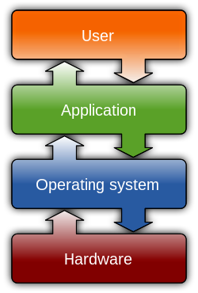
Operating System
Three main purposes:
  Managing hardware resources
  Providing a user interface
  Running applications

Slide 5
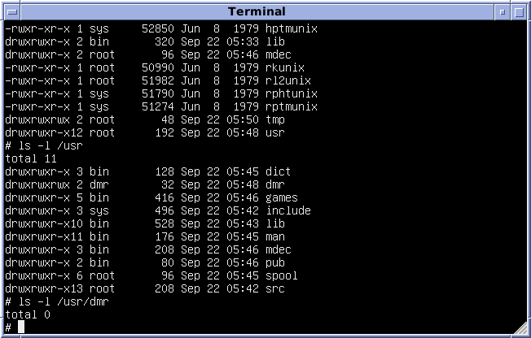
Unix
Created in the 70s by AT&T for the Bell System
Defining characterisitics :
  Plain text to store data
  Hierarchical file system
  Small specialised programs working
  together instead of a big one
Creation of the “Unix philosophy”

Slide 6
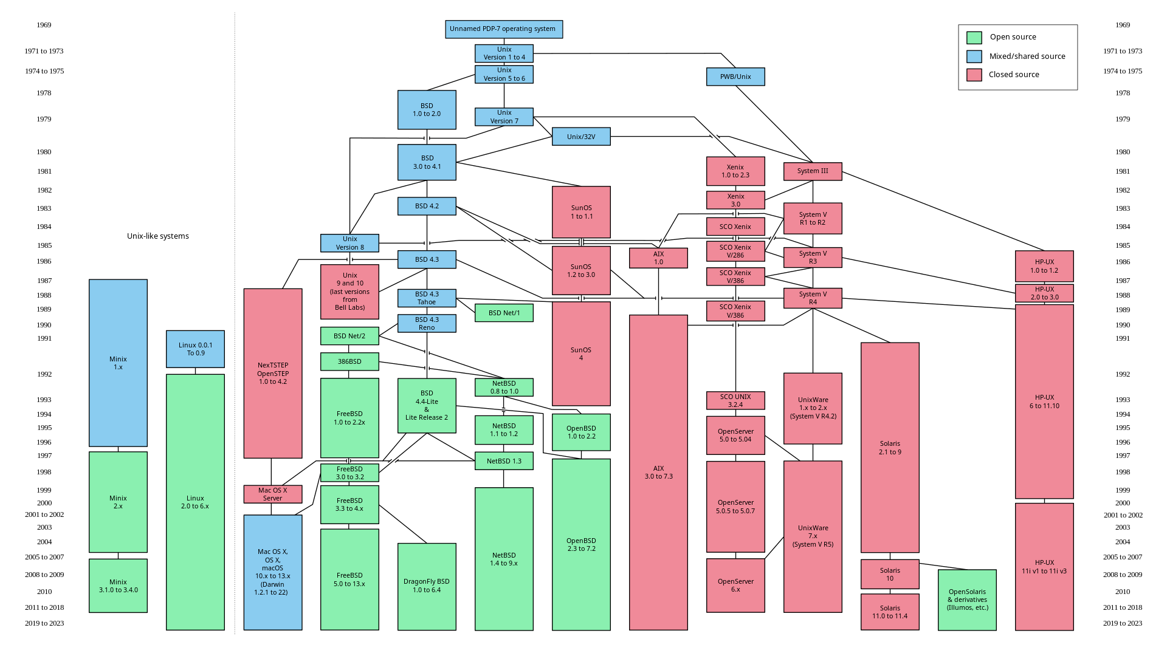
Unix

Slide 7
Kernel

Slide 8
Kernel

Slide 9
Sources
Wikipedia :
  https://en.wikipedia.org/wiki/Unix_philosophy
  https://en.wikipedia.org/wiki/Unix
  https://en.wikipedia.org/wiki/Unix-like
  https://en.wikipedia.org/wiki/Linux_kernel
  https://en.wikipedia.org/wiki/Operating_system
  https://en.wikipedia.org/wiki/Linux
Youtube :
  https://www.youtube.com/watch?v=t9e3NvTnCOA

