Slide 1

Team JR

Slide 2
Function
To discover the funniest jokes as rated and uploaded by users by directly comparing jokes to one another

Slide 3
Specification List
Must: Create a collection of the most popular jokes as rated by users
Must: Users should be able to upload jokes and rate other people’s
Must: Jokes will be rated by directly comparing two jokes against each other
Should: Jokes will be sorted and rated by category
Should: Users can find the highest rated jokes in each category

Slide 4
Specification list continued
Should: Users will not need to log in to rate jokes
Could: Allow users to have a profile page which will display their personal jokes
Could: Handle static media jokes
Could: Allow users to report offensive jokes
Wont: Allow users to rate a particular joke directly
Wont: Allow users to comment on a joke directly

Slide 5

User Persona 1 - Viewer
Basic Details:
Name: Tim
Age: 32
Education: MA Business and Economics
Location: New York, USA
Occupation: Business Manager
Traits: smart, light-hearted, quick-thinking
Further Details:
Tim has half an hour to fill while waiting for a train and is looking for a quick laugh.
Tim wants to view and rate jokes but doesn’t have the intention to upload his own jokes
Tim doesn’t want to log in or create an account to view some jokes
Tim wants to select the category of jokes he is interested in (e.g. Knock knock jokes)
Tim wants to be able to view the newest and highest rated jokes in a category
Tim wants to then be presented with two jokes, and select the one he thinks is funnier

Slide 6

User Persona 2 - Uploader
Basic Details:
Name: Claire
Age: 24
Education: Graduate English Literature
Location: Glasgow, UK
Occupation: Journalist
Traits: witty, clever, creative
Further Details:
Claire has a talent for clever puns and is looking to share her creativity with other people
Claire wants to be able to create a user profile through which she can upload her jokes
She wants to have a profile page where she can view her most recent and highest rated jokes
She wants to view all the jokes she has uploaded, and be able to sort them in a meaningful manner (eg. Date uploaded)
When she wants to upload her new pun, she simply writes it up and selects an appropriate category (eg. Puns)

Slide 7
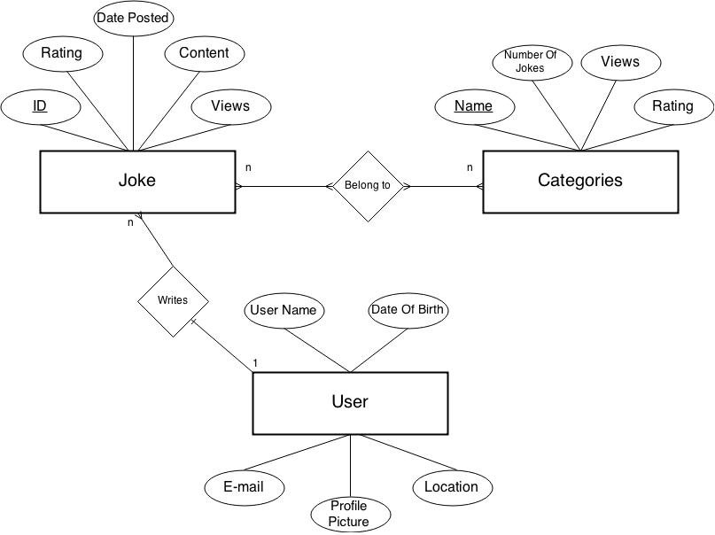

Slide 8
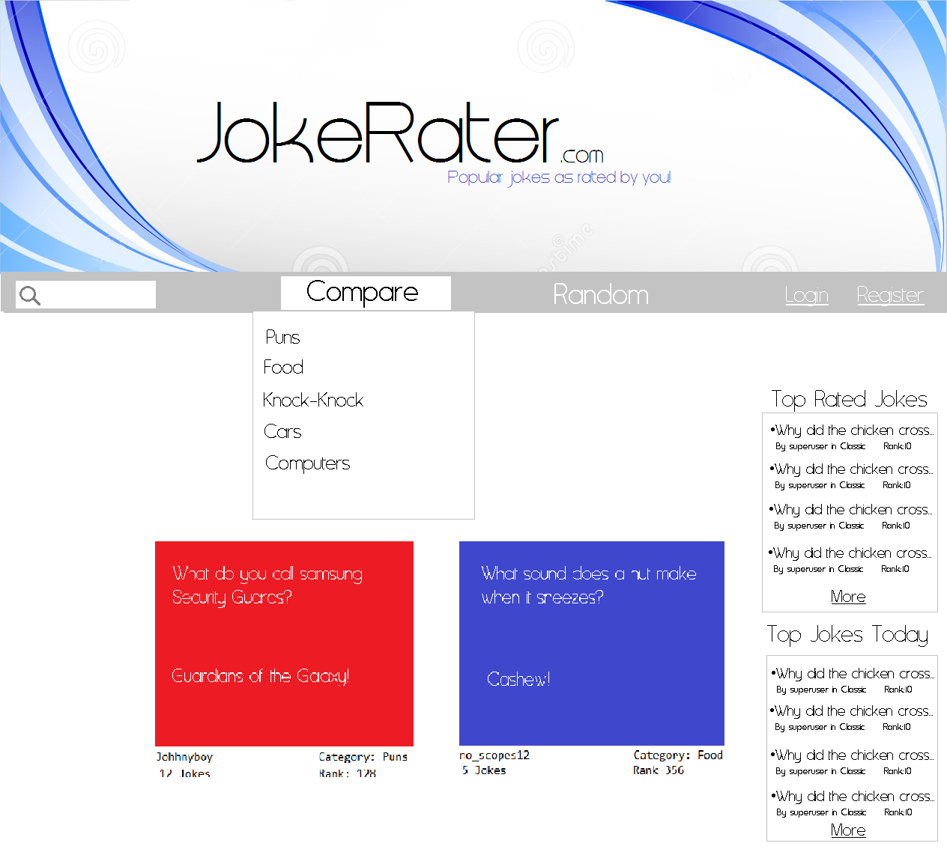
Main Page

Slide 9
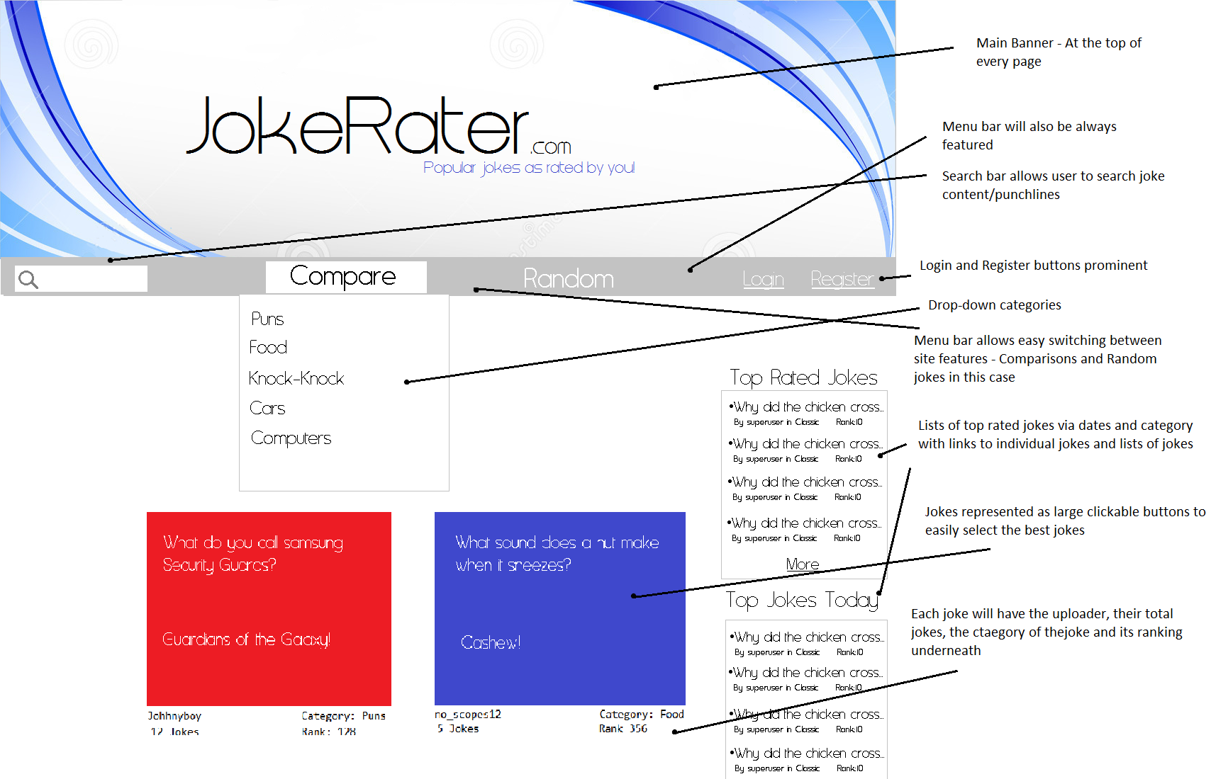

Slide 10
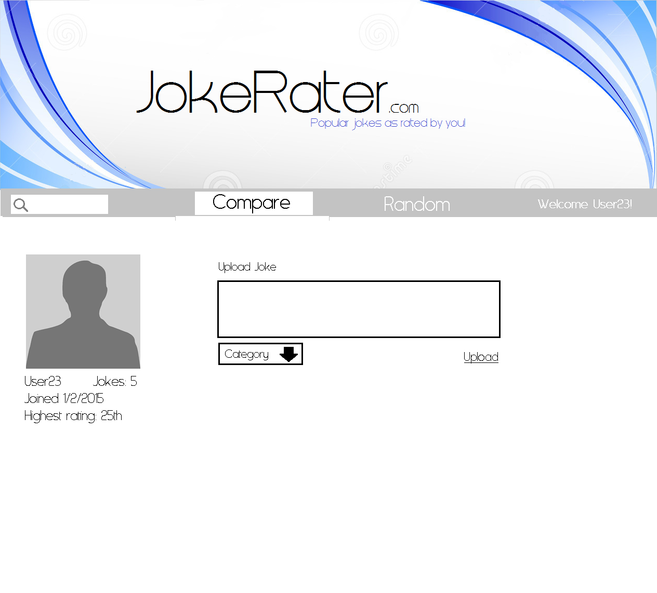

Slide 11
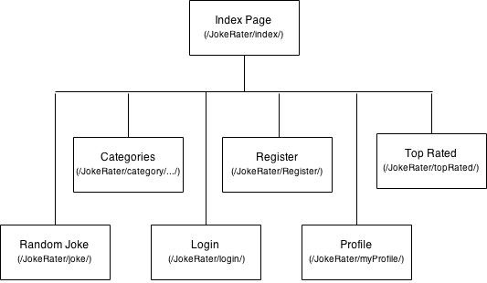
Site Map

Slide 12
URL Mapping (1)
/JokeRater/main
The first page the user sees showing two jokes from a random category to be compared together
/JokeRater/joke
Accessed when viewing a joke directly or have selected random joke
/JokeRater/category/...........
Similar to the main page but guarantees the jokes will be from a given category
/JokeRater/topRated
Allows the user to view the top 20 jokes in a given category, for a given time period

Slide 13
URL Mapping (2)
/JokeRater/login
Login page
/JokeRater/register
Allows first time users to register with the site such that they are able to upload jokes
/JokeRater/myProfile
Users can upload jokes as well as viewing the statistics of the jokes they have previously uploaded

