Slide 1

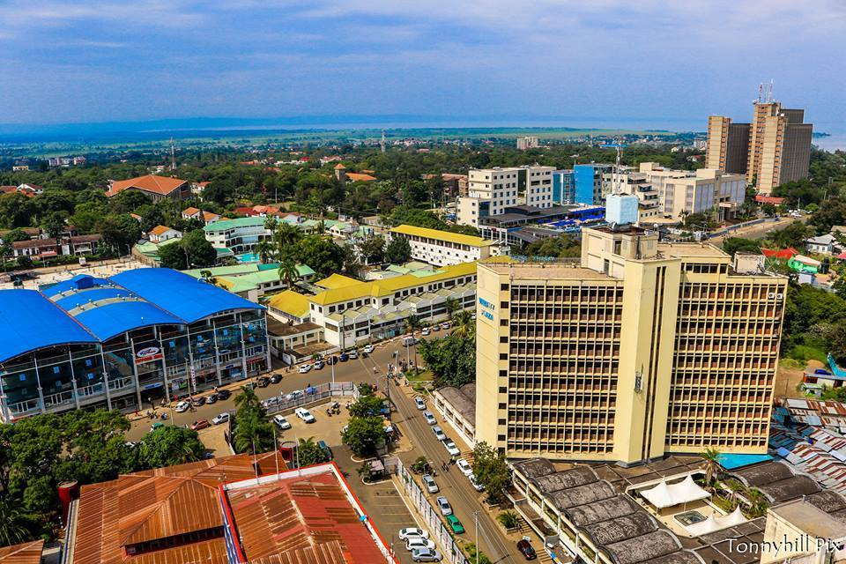


Slide 2
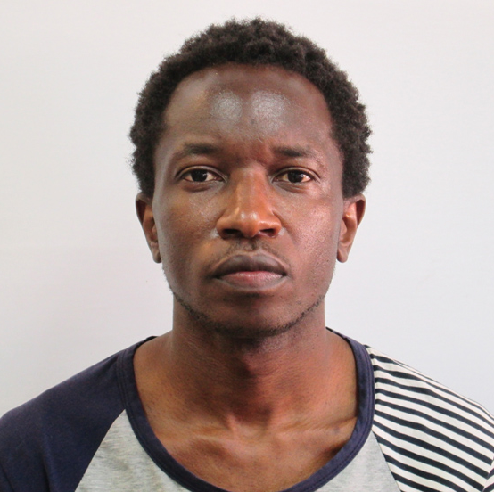







Education & Career
MSc. Bioinfo.
PhD. Med. Virol.
BSc. Biochem.

Slide 3
INTRODUCTION TO BIONFORMATICS
by
DR. HARRIS ONYWERA
AFRICA CDC
Tue., 14th February 2023

Slide 4

What is bioinformatics?
search
Sep 2002
Sep 2003
Oct 2013
Jun 2014
Feb 2023
158,000
531,000
3,990,000
8,180,000
164,000,000
Proteomics
606,000
1,490,000
11,100,000
20,200,000
661,000,000
Genomics
837,000
1,870,000
14,900,000
24,500,000
258,000,000
Bioinformatics
1,601,000
3,891,000
29,990,000
52,880,000
1,083,880,000
Michael Jackson
643,000,000
620,000,000
Jesus Christ
279,000,000
459,000,000

Slide 5
Genomics & Proteomics
Genomics: study of an organism's genome and the use of the genes.
Proteomics: large-scale study of structure and function of proteins.
Proteomics is more complicated than genomics:
  Genome is a rather constant entity.
  Proteome differs from cell-to-cell and is constantly changing via its biochemical interactions with the genome and the environment.

Slide 6
Bioinformatics: a field of science in which biology, computer science and information technology merge into a single discipline.
Biologists
Collect molecular data:
DNA & protein sequences,
gene expression, etc.
Bioinformaticians
Study biological questions by analyzing biological data.
Deal with storage, retrieval, analysis, and interpretation of data using computer-based software and tools.
Computer scientists
(+Mathematicians, Statisticians, etc)
Develop tools, software, algorithms
to store & analyze the data.

Slide 7
Objectives of Bioinformatics
To develop new algorithms and statistics for assessing the relationships among large sets of data.
To use computer-based software and tools to analyze and interpret various data.
To develop database for an efficient storage, access, retrieval, and management of information.

Slide 8
Components of Bioinformatics
Data
Database (DB)
DB Mining Tools

Slide 9
Data
Nucleic acids sequences
Protein sequences
Protein structures
Metabolic pathways

Slide 10
Databases
Are integral components of bioinformatics.
Are vast collection of data on specific topic, e.g., nucleotide sequence, etc., in an electronic environment.
  DB types: Sequence db, structural db, micro-array db, pathway db, enzyme db, etc.
Are computerized storehouse of data (records).
  Data stored in standardized formats.
Allows data mining.

Slide 11
Nucleotide Sequence DB
National Center for Biotechnology Information (NCBI) – GenBank: www.ncbi.nlm.nih.gov/GenBank
European Molecular Biology Laboratory (EMBL): www.ebi.ac.uk/embl
  Maintained by European Bioinformatics Institute (EBI).
DNA Database of GenomNet, Japan (DDBJ): www.ddbj.nig.ac.jp
  Developed in 1986 as a collaboration with EMBL and GenBank.
  Produced, maintained and distributed by the National Institute of Genetics, Japan.

Slide 12
Nucleotide Sequence Databases
NCBI, EMBL, and DDBJ are updated and exchanged on a daily basis and the accession numbers are consistent.
No legal restriction associated with the usage of these 3 db.
  However, there are some patented sequences in the db.
Other db - Expressed Sequence Tags (EST) – dbEST (http://www.ncbi.nlm.nih.gov/dbEST), Single Nucleotide Polymorphisms (SNPs) – dbSNP (http://www.ncbi.nlm.nih.gov/SNP/).

Slide 13
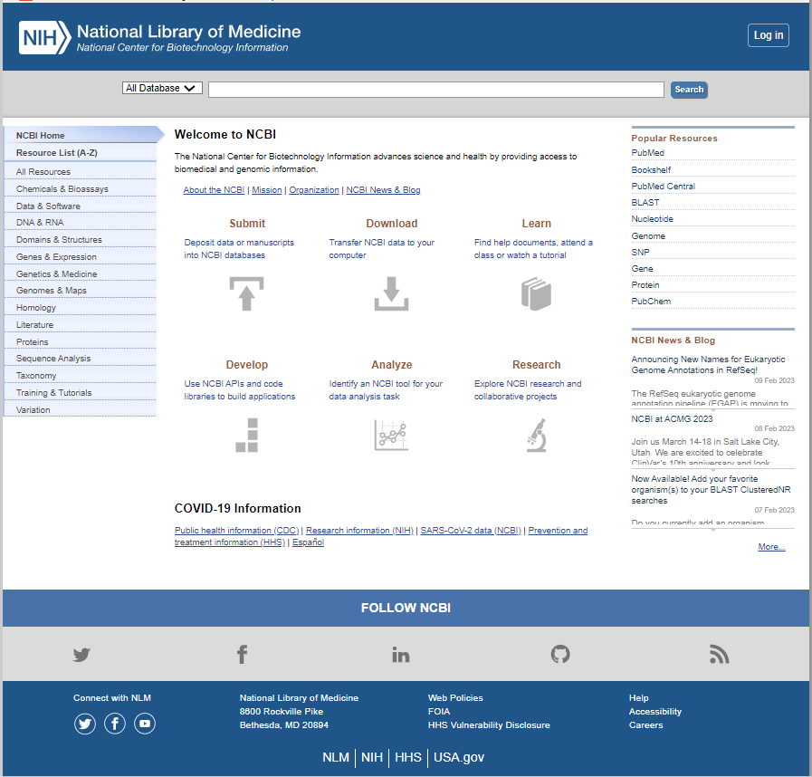

Slide 14
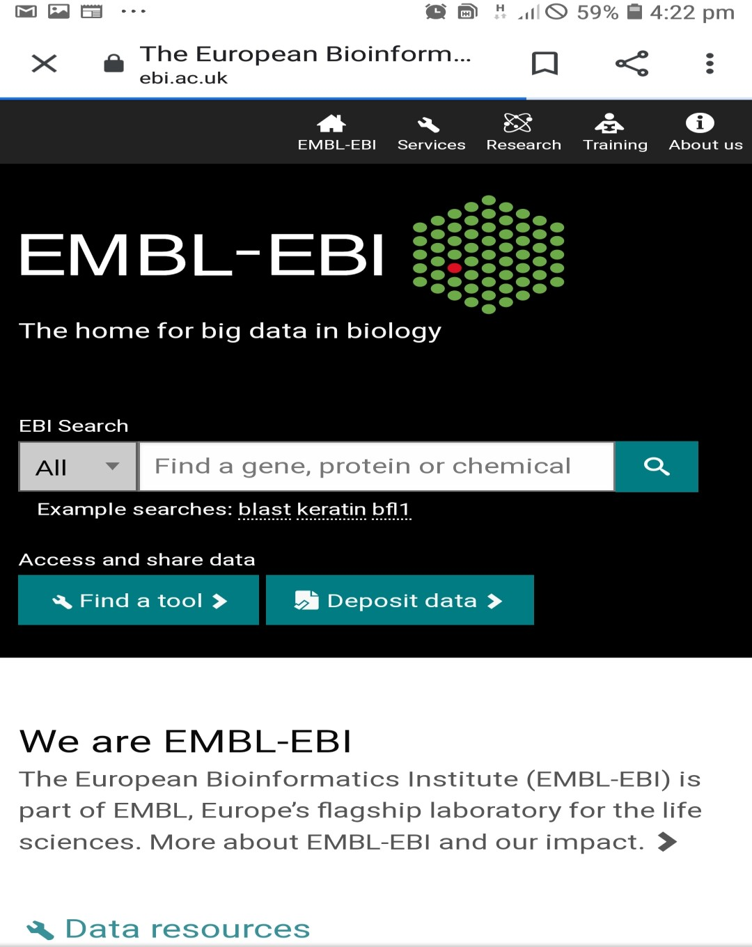

Slide 15
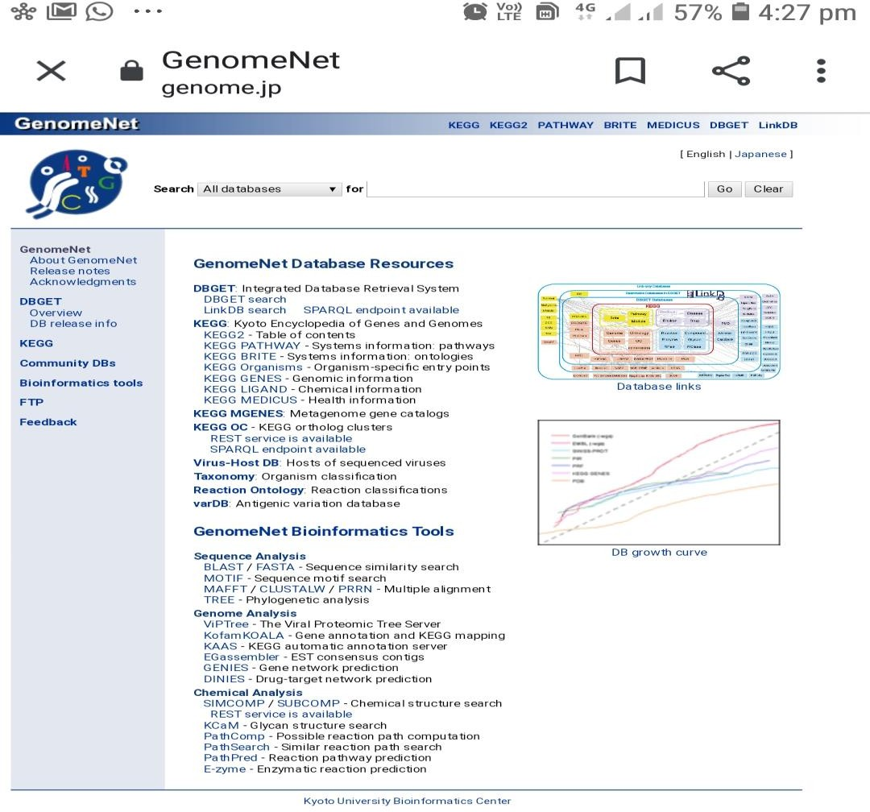

Slide 16
Protein DB
Protein sequence db
  Functions as repository of raw data: two types (primary and secondary).
  Secondary db compile and filter sequence data from different primary db.
  Secondary db contain information derived from protein sequences and help the user determine whether a new sequence belong to a known protein family.
Protein structure db
  3D structural data of large biological molecules, such as proteins and nucleic acids.

Slide 17
Examples of Primary DB
SWISS-PROT: Groups at Swiss Institute of Bioinformatics (SIB):
  Provides high-level sequence annotation.
  Describe protein functions.
  Minimum level of redundancy.
  High level of integration with other db.
TrEMBL: Computer-annotated supplements of SWISS-PROT that contains all the translations of EMBL nucleotide entries not yet integrated in SWISS-PROT.
Protein Information Resource (PIR): Does sequence similarity.

Slide 18


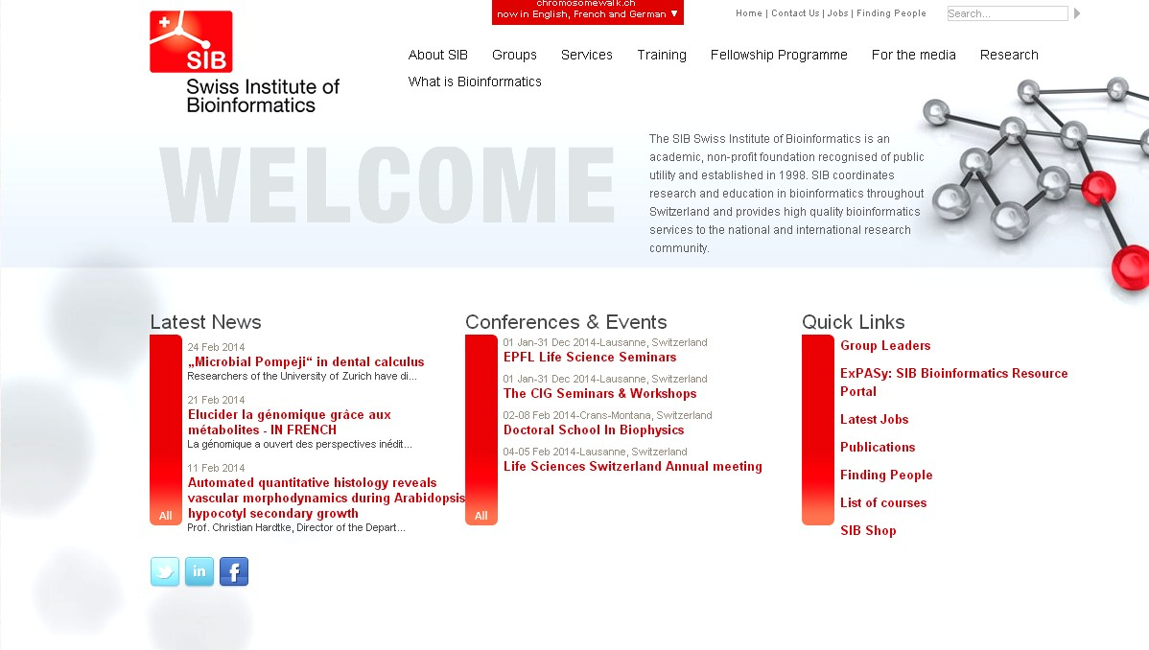

Slide 19
Secondary DB
PROSITE: db of short protein sequence patterns and profiles that characterize biologically significant sites in proteins.
  Part of SWISS-PROT.
PRINTS: Provides a compendium of protein fingerprints (groups of conserved motifs that characterize a protein family).
Pfam: db of protein families defined as domains
BLOCKS

Slide 20
Protein Structural db
Protein Data Bank (PDB): db of 3D structures of biological macromolecules (determined by X-ray crystallography and NMR).
  Entries contain atomic coordinates, and some structural parameters connected with the atoms.
Structural Classification of Proteins (SCOP): Classifies protein 3D structures in a hierarchical scheme of structural classes (folds, super-families, and families).
Class, architecture, topology, homologous (CATH) super-family: Performs perform hierarchical classification of protein domain structures.

Slide 21
DB Mining (Analysis) Tools
Are search engine tools that facilitate utilization of db.
Analysis Tool | Function
BLAST, e.g., BLASTn, BLASTp (NCBI, USA) | Used to analyse sequence information and detect homologous sequences
ENTREZ (NCBI, USA) | Used to access literature (abstracts), sequence and structure db
DNAPLOT (EBI, UK) | Sequence alignment tool
LOCUS LINK (NCBI, USA) | Assessing information on homologous genes
LIGAND (GenomNet, Japan) | A chemical db, allows search for a combination of enzymes and links to all publically accessible db.
BRITE (GenomNet, Japan) | Biomolecular relations information transmission and expression db; links to all publically accessible db.
TAXONOMY BROWSER (NCBI, USA) | Taxonomic classification of various species as well as genetic information
STRUCTURE | Support Molecular Modelling Database (MMDB) and software tool for structural analysis

Slide 22
Sequence Alignment
Bioinformatics compares sequences to deduce whether the sequences are related to each other.
Through this type of comparative analysis:
  Detect homology.
  Structural and functional analysis of newly determined sequences.
Sequence alignment is the process by which sequences are compared by searching for common character patterns and establishing residue-residue correspondence among related sequences.
  Pairwise sequence alignment.
  Multiple sequence alignment.

Slide 23
Sequence Alignment
Sequence similarity: % of aligned residues that are similar in physicochemical properties such as size, charge and hydrophobicity.
If the sequence similarity is high enough, common evolutionary relationship can be deduced!
Sequence homology: When two sequences have descended from a common evolutionary origin, they are said to have a homologous relationship or share homology.
Sequence similarity vs sequence homology: QUANTITATIVE vs QUALITATIVE:
  40% similarity.
  40% homology (Wrong).

Slide 24
Sequence Alignment
Sequence identity:
  Nucleotide sequence: Identity and similarity are synonymous.
  Protein sequence: % of matches of the same amino acid residues between two aligned sequences.
Remember: Similarity is the percentage of aligned residues that have similar physicochemical characteristics.
% identity is obtained by dividing the number of identical matches by the total length of the aligned region and multiply by 100.

Slide 25
Pairwise Sequence Alignment
Pairwise sequence alignment is the process of lining up two sequences to achieve maximal levels of identity. It is the basis of database similarity searching and multiple sequence alignment!
T H I S S E Q U E N CE
| | | | | | | | | | T H A T S E Q U E N C E
The length of the sequence matters!
  A 30% identity over a long alignment is less likely to have arisen by chance than a 30% identity over a very short alignment.

Slide 26
T H A T S E Q U E N C E
T H I | S | I | S A S E Q U E N C E
| | |  |  | | |
T H I S I S A S E Q U E N C E
| | | | | | | | | | T H A T - - - S E Q U E N C E
T H I S I S A - S E Q U E N C E
| | | | | | | | | | | T H - - - - A T S E Q U E N C E
There is never just one possible alignment between two sequences and the best one is not always obvious!
Sequences can always be aligned – lots of possible alignments.

Slide 27
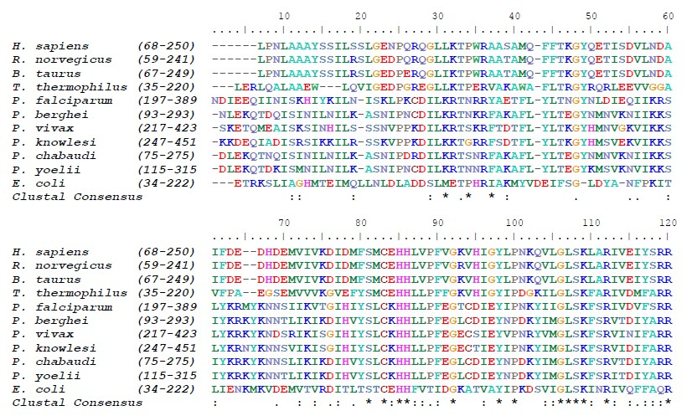
Multiple Sequence Alignment (MSA)
Alignment of more than two sequences.

Slide 28
MSA
Improves the accuracy of alignment between the sequence pairs.
Reveals patterns of conserved residues that are not obvious when only two sequences are studied.
Important for predicting the secondary structure, identification of residues important for specificity etc.
Essential prerequisite to carry out phylogenetic analysis of sequence families.

Slide 29
Some MSA Programs
ClustalW
T-Coffee (Tree-based Consistency Objective Function for Alignment Evaluation)
MUSCLE (MUltiple Sequence Comparison by Log-Expectation)
MAFFT (Multiple Alignment using Fast Fourier Transform)
PROMALS3D
DIALING2
KALIGN
CLC & GCG WorkBench

Slide 30
Global vs Local Sequence Alignment
Global sequence alignment:
  Best alignment of two sequences across their entire length.
  Most applicable to highly similar sequences.
  Creates an end-to-end alignment (Needleman and Wunsch).
Local sequence alignment:
  Finds the most similar regions in the two sequences being aligned rather than finding the best way to align the entire length of the two sequences being compared.
  For sequences of different length.
  Finds the best local alignment (Smith – Waterman).

Slide 31

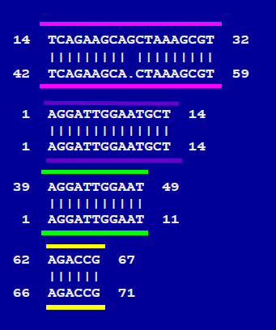
Global vs Local Sequence Alignment

Slide 32
T H A T S E Q U E N C E
T H I | S | I | S A S E Q U E N C E
| | |  |  | | |
T H I S I S A S E Q U E N C E
| | | | | | | | | | T H A T - - - S E Q U E N C E
T H I S I S A - S E Q U E N C E
| | | | | | | | | | | T H - - - - A T S E Q U E N C E
There is never just one possible alignment between two sequences and the best one is not always obvious!
Sequences can always be aligned – lots of possible alignments.

Slide 33
Why Gap Penalties?
The optimal alignment of two similar sequences is usually that which:
  Maximizes the number of matches
  Minimizes the number of gaps.
Permitting the insertion of arbitrarily many gaps can lead to high scoring alignments of non-homologous sequences.
Penalizing gaps forces alignments to have relatively few gaps.

Slide 34
Gaps & Gap Penalties
Gap penalty: each time a gap is introduced a penalty is subtracted from the score, decreasing the overall score of the alignment.
Gap extension penalty: extending an existing gap.
  Gap extensions are less expensive than gap penalties.
If gap penalty is set high -> ?
  Fewer gaps will be inserted into the alignment, as their inclusion will radically decrease the maximum match value.
If gap penalty is set low -> ?
  More and larger gaps will be inserted.

Slide 35
Some Visualization Programs
Bioedit
Cinema
Jalview

Slide 36
Relevance of Alignment
Analysis of a single gene (protein) sequence:
  Evolutionary relationships.
  Sequence features (physical properties, binding sites, modification sites)
  Prediction of protein secondary and tertiary structures
Analysis of whole genomes:
  Location of specific genes on chromosomes.
  Presence or absence of biochemical pathways.
Analysis of genes and genomes with respect to function (functional annotation).

Slide 37
Phylogenetics
Phylogenetic tree (phylogeny) is a diagram that depicts the lines of evolutionary descent of different species, organisms, or genes from a common ancestor.
Nucleic acid and protein sequences are used to infer phylogenetic relationships.
Tools for phylogenetic analysis – MEGA, PHYLIP, PAUP, BEAST, Treeview, ODEN, PHYLOWIN, TREECON, DENDRON, etc.

Slide 38
An Examples of Application of Bioinformatics – Precision Medicine

Slide 39
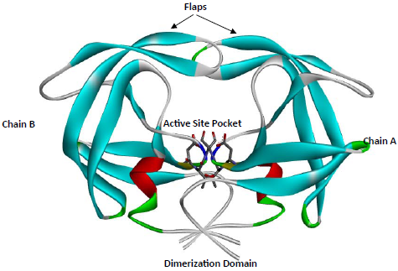
HIV-1 Protease Structure
Aspartyl protease: -Asp²⁵-Thr²⁶-Gly²⁷- (Conserved triad)
Homodimer: 99 amino acids/chain
Cleavage: 9 Polyproteins
Conformation: Open, Semi-Open, Closed
Notes:
The access of the substrate to the active site of PR is regulated by two mobile flaps that shift from an open to a closed conformation to bind and cleave the substrate. Protease inhibitors (PI) were developed to inhibit cleavage function of HIV-1 protease by mimicking the reaction intermediates that arises during the hydrolysis of the substrate, disabling the enzyme. The current success of PIs is frequently limited by the emergence of protease gene mutations that confer resistance to this drug class. By changing the structure of the substrate-binding cavity, mutations directly or indirectly interfere with the binding of inhibitors, resulting in viral resistance to PIs.

Slide 40
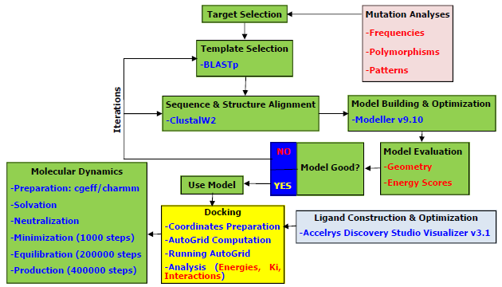
Notes:
Homology modeling by restraints satisfaction extracted from the alignment. Overall stereochemical quality of the residues within the acceptable limit. Protein stable if the energy distribution/fluctuations are below the zero flagging value.
Rigid Docking: Staring coordinates of NFV were used for redocking with wild-type and cross docking with all generated ligands. Docking calculations done 20 times and best conformation selected via an automated script. These conformations were used for MD.
MD: To mimic the in vivo aqueous environment, firstly periodic boundary conditions were set for the complexed protease based on the shape of ligand-receptor complex from gas-phase. Water molecules were added, while others within a certain distance deleted, leaving each system fully solvated. Chloride ions (or potassium ions) used as counter ions to neutralize any charges. To compute the long-range Coulombic (electrostatic) interactions, the Particle Mesh Ewald (PME) summation algorithm used.

Slide 41
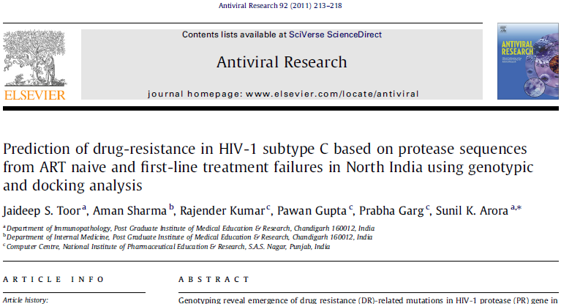
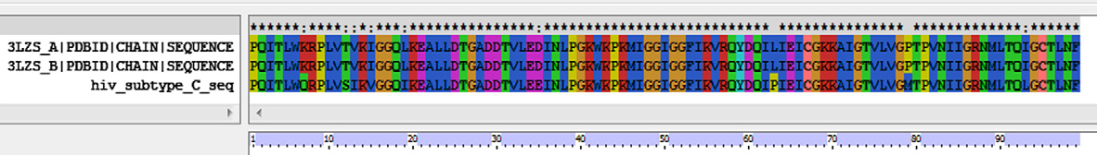
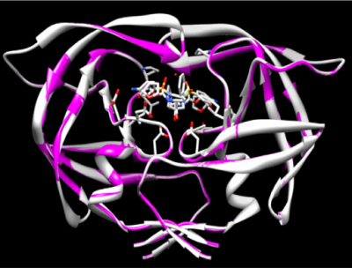
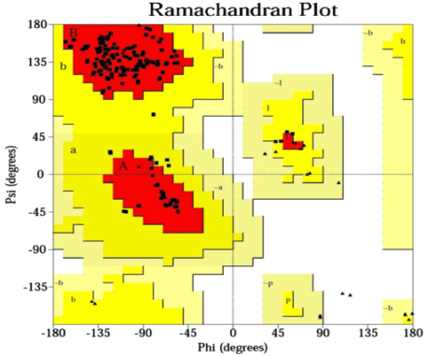
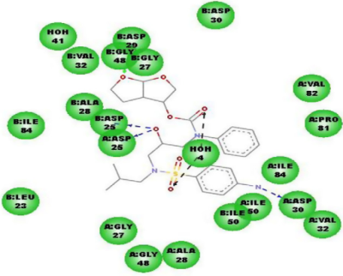
In silico alternative to genotyping DRT.
Mutations: L33F, I47T, M46G & G48E.
Stanford HIVdb (Resistance), Docking (Susceptible): Susceptible to LPV.
Patient finally responded to 2nd-line ART (3TC, AZT & LPV) with significant viral suppression.
Notes:
Elevated cost & Extensive time.
Impractical to use conventional methods to study new mutations.
Docking analysis could be a cheaper alternative to genotyping DRT. Most findings overlapped with Stanford HIVdb interpretation but few discrepancies due to subtype differences. Stanford HIVdb and PIs constructed within the framework of subtype B, which is the commonest in Europe. Subtype C is the commonest circulating strain in India. Stanford’s report showed that one particular female with major and minor mutations could not utilize LPV, yet docking indicated the converse. Patient was placed on second-line regimen containing LPV. She finally with significant viral suppression.

Slide 42
Thank You!

