Slide 1
Genome Assembly
Javan Okendo, PhD

Slide 2
Overview
Sequencing technologies
Steps in a standard genome assembly
Assembly quality assessment
Planning an assembly project
Genome graphs
Genome annotation

Slide 3
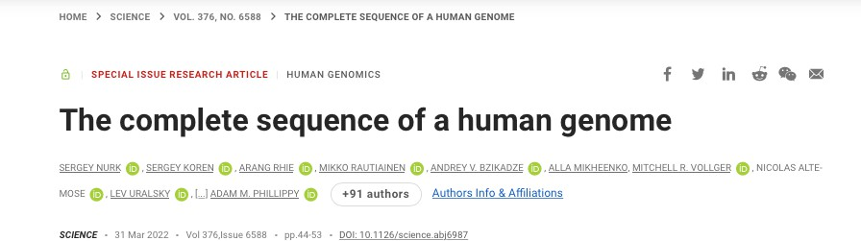
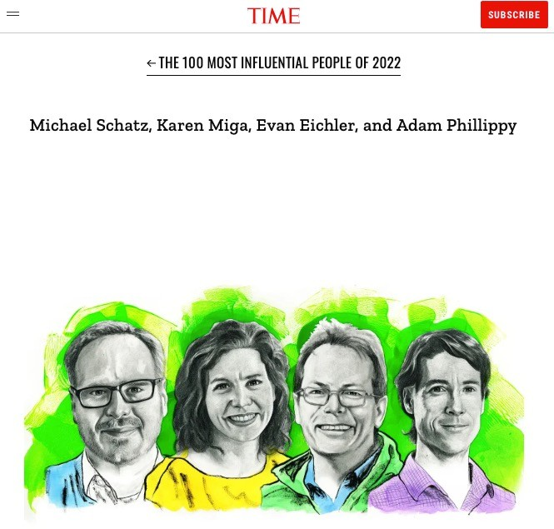
Ideal World!
We may not be too far from this now.
Science, March 2022
Time, May 2022
4

Slide 4


Announced 2018,
started early 2022
Nature, May 2023
Ideal World!
Earth Biogenome Project Pangenomics
EBP website
HPRC Nature issue

Slide 5
Current Sequencing Technologies

Slide 6
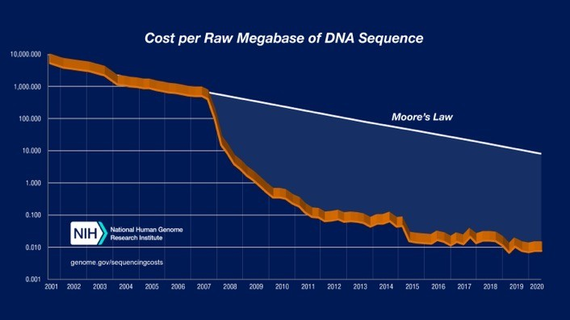
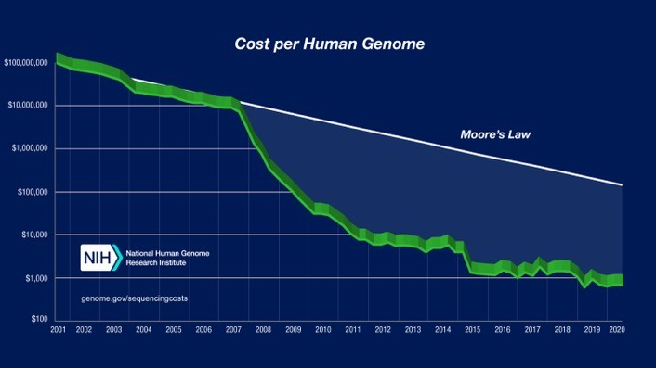
Illumina
Millions to billions of short but highly accurate reads (>99.9%) Can be paired-end (sequence ends of fragments)
Advantages
Highly accurate (~99.9%)
Relatively even coverage of the genome
Well-vetted technology
Most cost-effective, as low as $10 per billion bases
(Generally) robust to sample issues
Disadvantages
Requires high depth for many applications (50x + for assembly)
Sequence length (100-150nt reads) problematic for repeats
Maximum fragment length (<800bp) is an issue
https://www.genome.gov/about-genomics/fact-sheets/DNA-Sequencing-Costs-Data

Slide 7
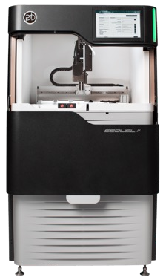
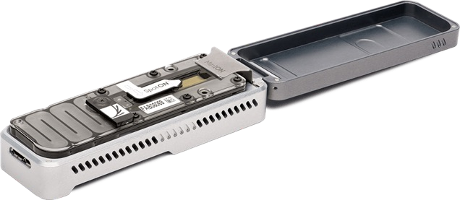
‘Long reads’
Pacific Biosciences (PacBio)
Oxford Nanopore (ONT)
MinION
Pacific Biosciences
Oxford Nanopore
8

Slide 8
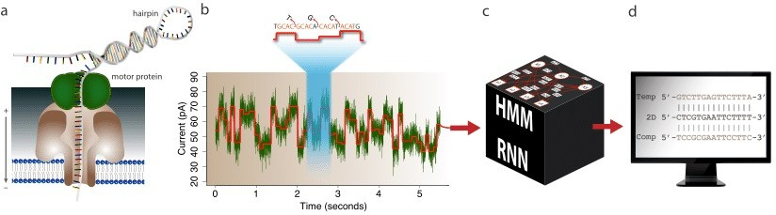
Alberto Magi et al, Briefings in Bioinformatics, Volume 19, Issue 6, November 2018
Oxford Nanopore
9

Slide 9
‘Long Reads’
Advantages
Reads can be very long (1kb – 100kb)
Relatively even coverage of the genome
PacBio HiFi, ONT using latest release - Highly accurate (99%)
PacBio HiFi, ONT - DNA modifications (RNA mods for ONT)
ONT - real-time sequencing, portable, direct RNA
Disadvantages
Expensive compared to Illumina short reads
Need very high quality, high MW DNA samples
Least expensive options are error-prone
Depending on technology, can have systematic errors (homopolymer issues), but getting better

Slide 10
Genome assembly steps

Slide 11
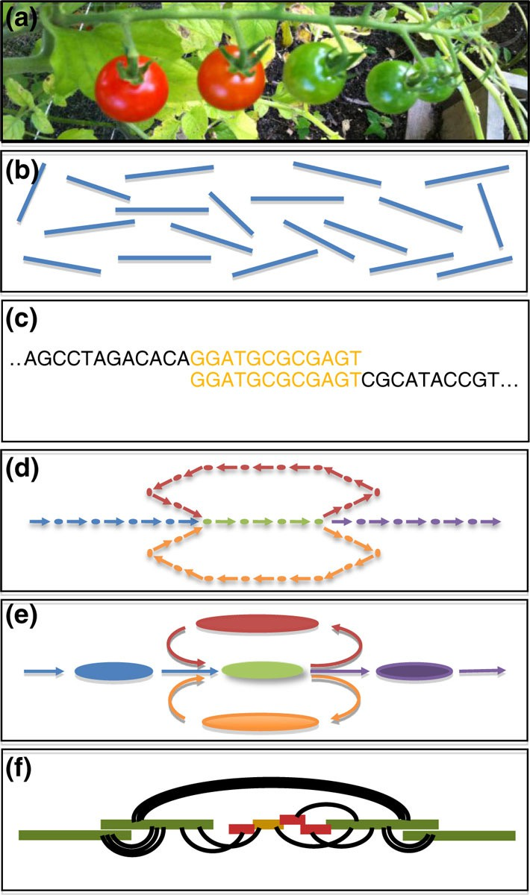
(a) Collect DNA – samples are fragmented and sequenced.
Sequence - many millions/billions of (possibly short) unordered DNA fragments from random positions in the genome.
Compare – how do sequence fragments connect with one another
Graph – capture relationships in a large assembly graph
Simplify- The assembly graph is refined to correct errors and simplify
Scaffold – Use long reads, mates, markers, other long-range information to order/orient assembly (contigs) into large scaffolds
Clean – resolve artifacts, remove contaminants, check gene completeness, contiguity, etc
Annotate – Add features to the genome. Don’t forget RNA if you want to predict genes, preferably from a broad range of tissues/conditions
Schatz et al. Genome Biology 2012 13:243

Slide 12
Let’s Do a Genome Assembly!

Slide 13
The way it used to be… aka ‘the short read days’
You spent your entire grant on getting sequence data and buy a monster multi- core high-memory server
You assemble your genome with your favorite genome assembly tool
You waited a week to a month and you now have results!
Wait, why do I have a million scaffolds? And why is my server on fire?!?
Biology

Slide 14
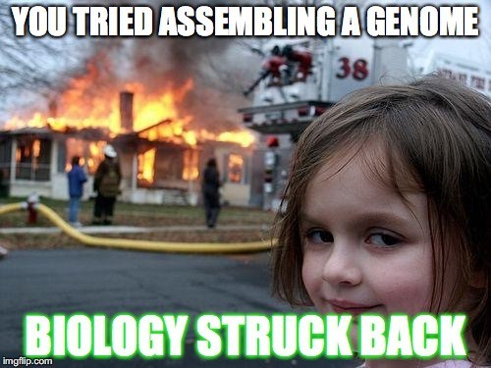

Slide 15
Steps
Basic DNA sequence cleanup and evaluation (pre-assembly)
Contig building
Scaffolding
Post-assembly processing and analyses

Slide 16
Basic cleanup and evaluation
Is the DNA sequence high quality?
Does it need to be trimmed?
Evaluate libraries for read ‘coverage’
Any additional sequence preparation steps

Slide 17
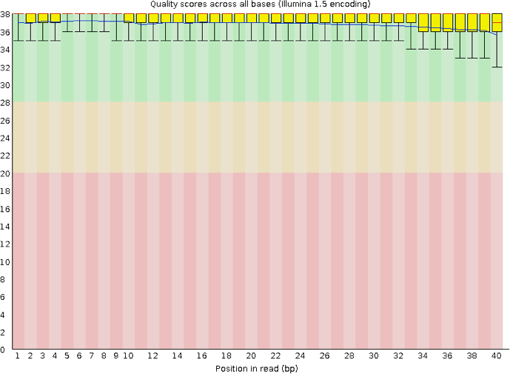
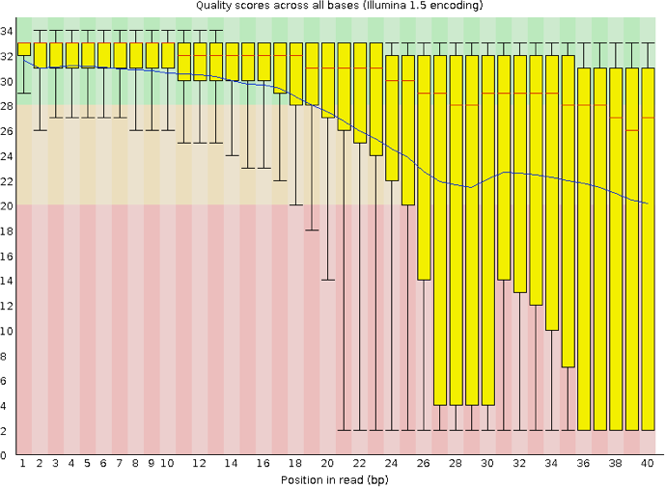
DNA Quality (FASTQC)
Illumina Data
Bad, need to
Trim heavily
Good!
https://www.bioinformatics.babraham.ac.uk/projects/fastqc/

Slide 18
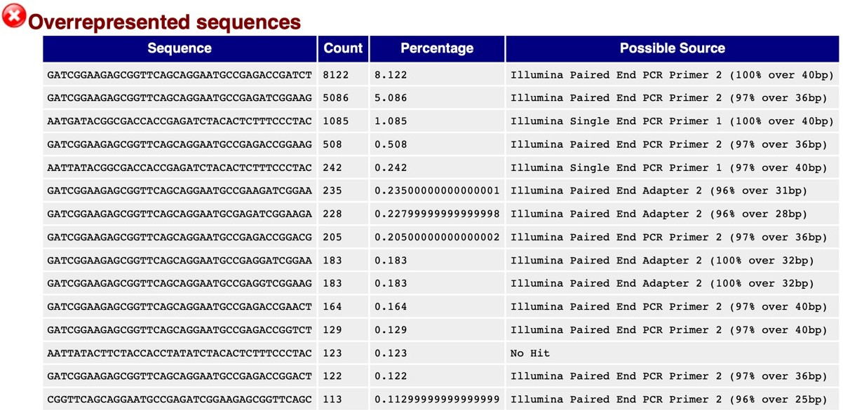
Adapters
https://www.bioinformatics.babraham.ac.uk/projects/fastqc/

Slide 19
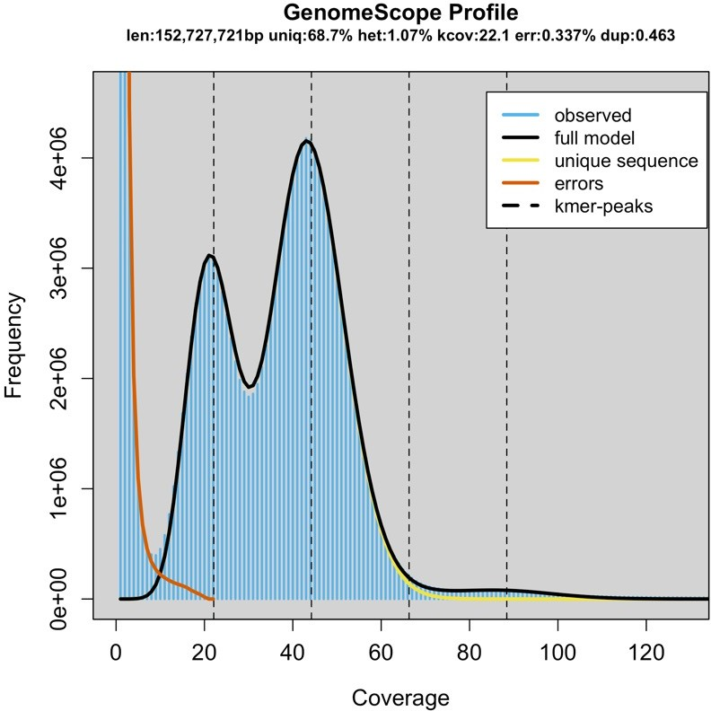
Arabidopsis F1 cross
Coverage
Requires highly accurate reads
Illumina
PacBio HiFi
Kmer read distribution
Genomescope
Rannallo T, Jaron K, Schatz M, Nature Comm, 1432(2020)

Slide 20
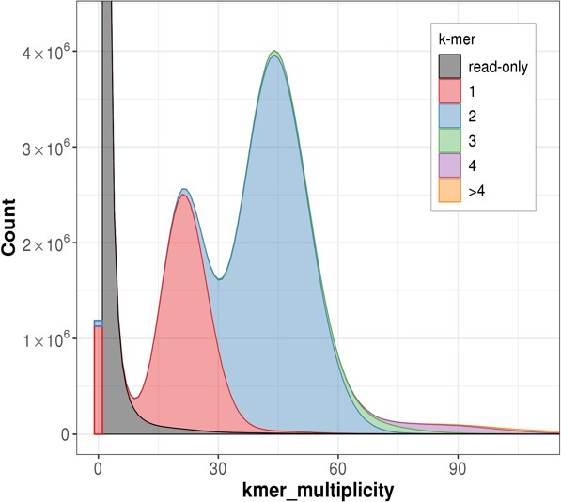
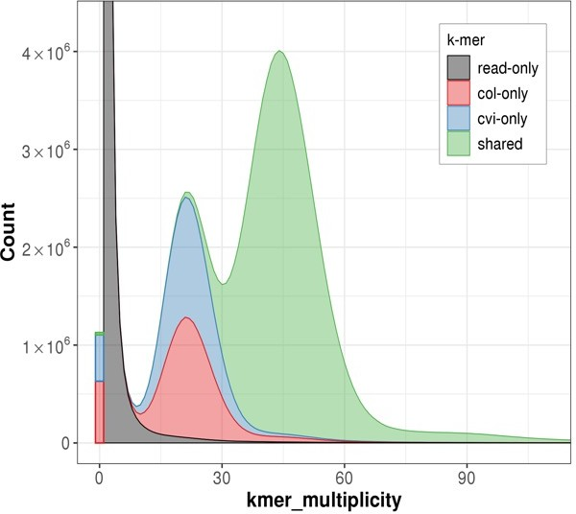
Arabidopsis trio-binning assembly
Coverage
Requires highly accurate reads
Illumina
PacBio HiFi
Kmer read distribution
Merqury
Rhie, Walenz, Koren, Phillipy, Genome Biology (2020)

Slide 21
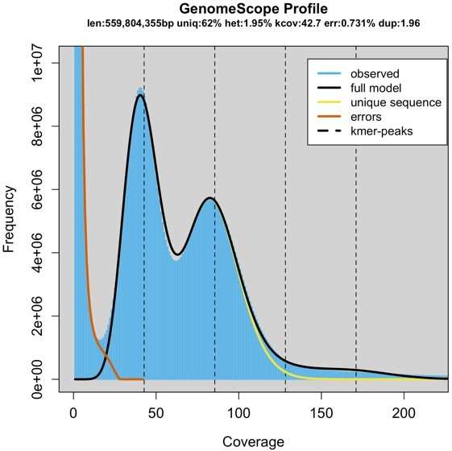
Other pre-assembly steps
Depending on the assembler and technology you use, you may want to:
Assess reads for contaminants
Join paired-end reads into longer reads
Error correction of reads (e.g. fix sequencing errors)

Slide 22
Starting the assembly

Slide 23
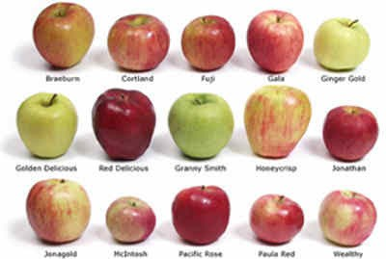
Contig building
Greedy assembly Seed and extend Overlap graph de Bruijn graphs String graphs
..etc etc
… all essentially doing similar things, but taking different ‘shortcuts’ based on needs
T. Seemann

Slide 24
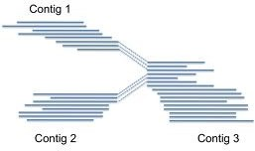
Contigs
Contiguous, unambiguous stretches of assembled DNA sequence
Contigs ends correspond to
Real ends (for linear DNA molecules)
Dead ends (missing sequence)
Decision points (forks in the road)
T. Seemann

Slide 25
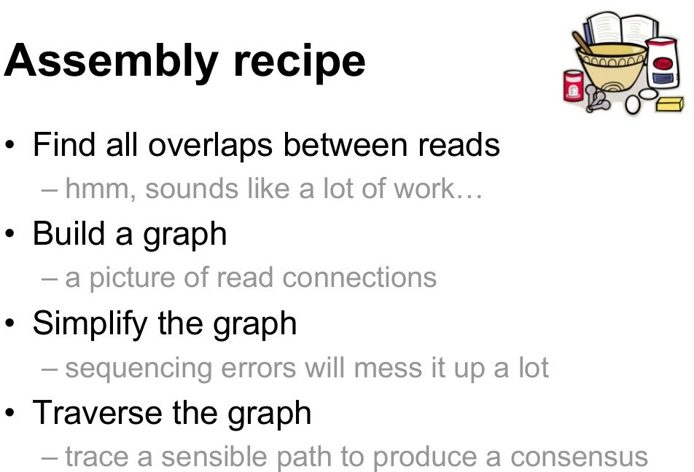
T. Seemann

Slide 26
Graph
Review: A structure where objects are related to one another somehow Nodes/Vertices = objects (sequence)
Edges = relationship (overlap)
a b
A
CGTGCAA
ATGGCGT GGCGTGC
CGTGCAA TGCAATG
CAATGGC ATGGCGT
A
T
3
C
G
TGCAATG
2
ATGGCGT
G
G
Short-read sequencing
4
1
T
C
5
G
GGCGTGC
CAATGGC
Genome: ATGGCGTGCAATGGCGT
Compeau et al, Nature Biotech, 29(11), 2011; https://en.wikipedia.org/wiki/Graph_(discrete_mathematics)

Slide 27
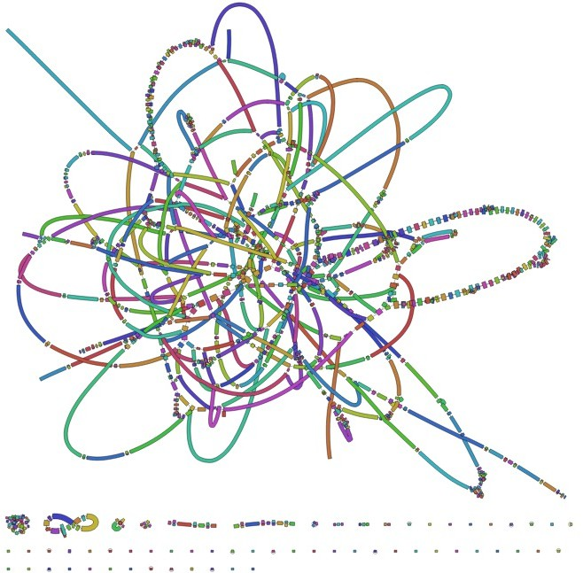
Simple?
https://github.com/rrwick/Bandage/wiki/Effect-of-kmer-size

Slide 28
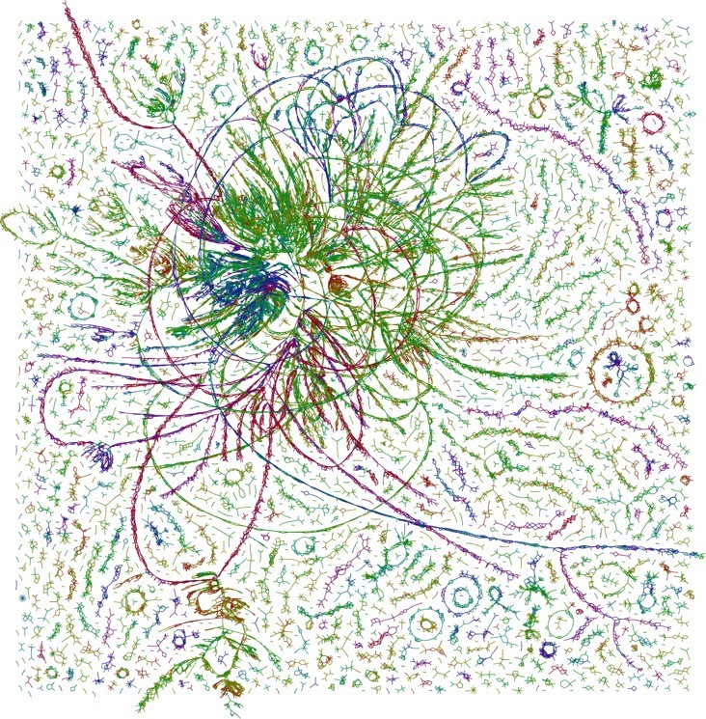
Erm…
http://armbrustlab.ocean.washington.edu/seastar

Slide 29
In essence…
For each unconnected graph:
Find a path which visits each node once
This is referred to as a
Hamiltonian path/cycle
Form consensus sequences from paths
use all the overlap alignments
each of these collapsed paths is a contig
HPCBio data
37

Slide 30
Scaffolding
Now, you have a huge pile of contigs but you want to make them larger. How?
Add context!
Link together contigs using other genomic information
Infer contigs position on the genome relative to one another
50

Slide 31
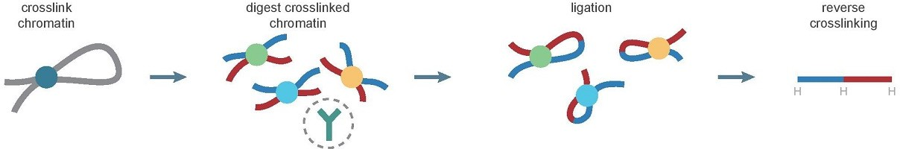
Linking Contigs via DNA Seq
HiC (Chromosome Conformation Capture)
Wikipedia
PacBio/ONT long-reads
10-100 kb+
Illumina sequencing
Paired-end reads
<500bp fragment
>5kb fragment
Mate pair reads
>50kb fragments
Linked reads

Slide 32
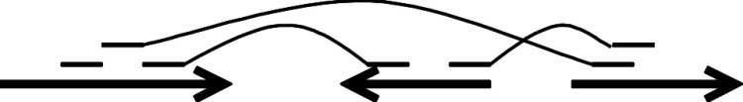
Contigs to scaffolds
Mate-pair read
Paired-end read
Contigs
Scaffold
Gap
Gap
T. Seemann

Slide 33
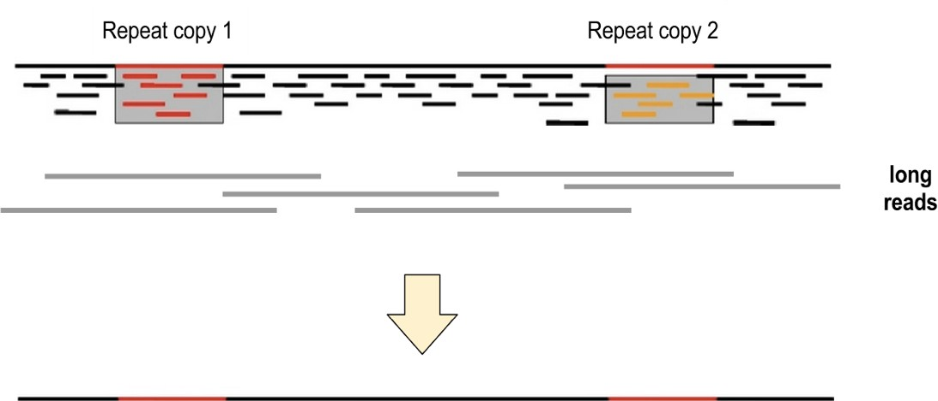
Long reads
T. Seemann

Slide 34
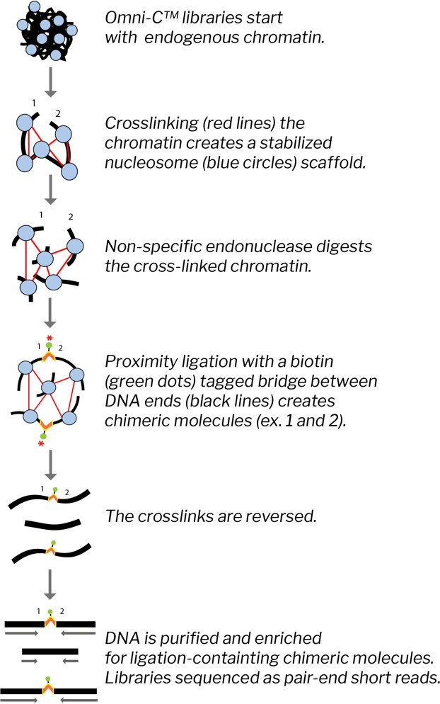
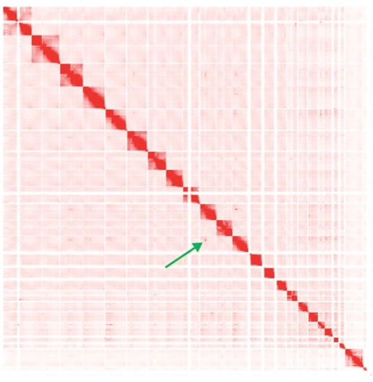
HiC
Chromosome Conformation Technology
Wikipedia
Dovetail Genomics
54

Slide 35
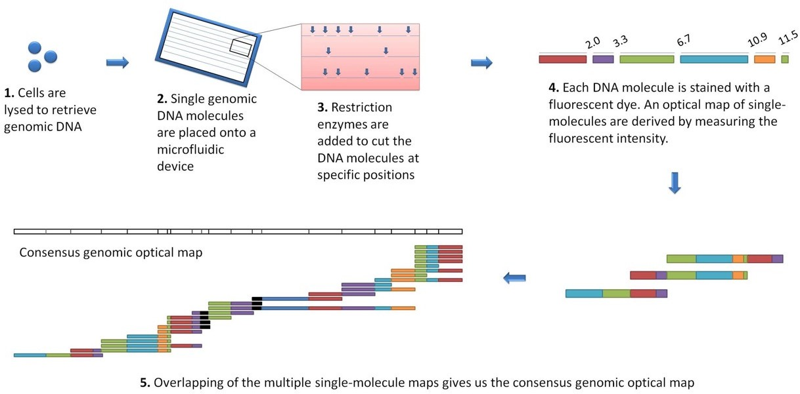
Optical Mapping
Using high resolution single-molecule restriction mapping combined with fluorescent dyes and fluorescence microscopy to produce a genomic map

Slide 36
Starting a new assembly project

Slide 37
Planning a genome sequencing project?
BUDGET!!!
Technological costs
Computational costs
Person costs (time)!
Biology!
Size: how large and/or complex is my genome?
Ploidy: number of sets of chromosomes of the genome?
Multinucleated: can cells have more than one nucleus?
Repetitive: How much of the genome is repetitive? Repeat size distribution?
Heterozygosity: Is my genome highly heterozygous? Inbred (homozygous)?
Public data: Is a good quality genome of a related species available?

Slide 38

How do you start (2023)?
Short reads (billions of reads)
Sequencing costs - $$
Compute costs - $$$$$$$$
Results – fragmented, requires significant ‘cleanup’
Long error-prone reads
Sequencing costs - $$$$
Compute costs - $$$$$
Results –better quality, but requires polishing, can’t easily phase
Long accurate reads
Sequencing costs - $$$$$$
Compute costs - $$$
Results – best (partly) phased diploid assembly***
*** - doesn’t help much if you have higher ploidy! (though this will likely change)

Slide 39

How large is my genome?
The size and complexity of the genome can be estimated from the ploidy of the organism and the DNA content per cell
This will affect:
How many reads will be required to attain sufficient coverage (typically 10x to 100x, depending on read length)
What sequencing technology to use (short vs. long reads)
What computational resources will be needed (generally amount of memory needed and length of time resources will be used)
Oyster (GenomeScope)

Slide 40
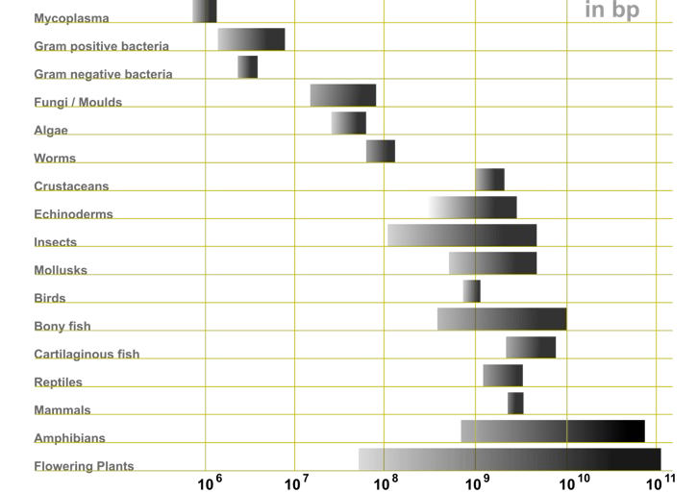
Genome size/complexity
By Abizar at English Wikipedia, CC BY-SA 3.0, https://commons.wikimedia.org/w/index.php?curid=19537795

Slide 41
Heterozygosity
Heterozygous – Locus-specific; diploid organism has two different alleles at the same locus.
Heterozygosity is a metric used to denote the probability an individual will be heterozygous at a given allele.
Higher heterozygosity == more diverse == harder to assemble
Unfortunately, assemblies are represented (for now) as haploid. So this is a major problem!
Oyster: http://qb.cshl.edu/genomescope/genomescope2.0/
62

Slide 42
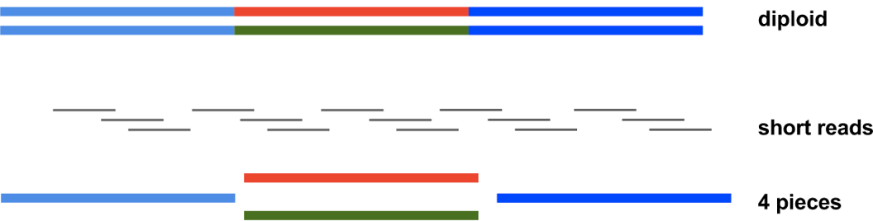
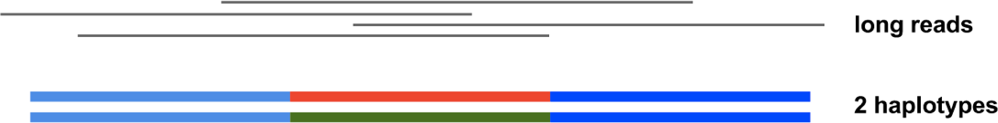
Heterozygosity
Short reads - initial assembly has mix of homozygous and heterozygous regions
Long reads – can get partial to fully phased diploid assemblies
May need multiple technologies to do this
Unphased haploid assembly Haplotypes are separate contigs (haplotigs)
Phased diploid assembly
T. Seemann
63

Slide 43
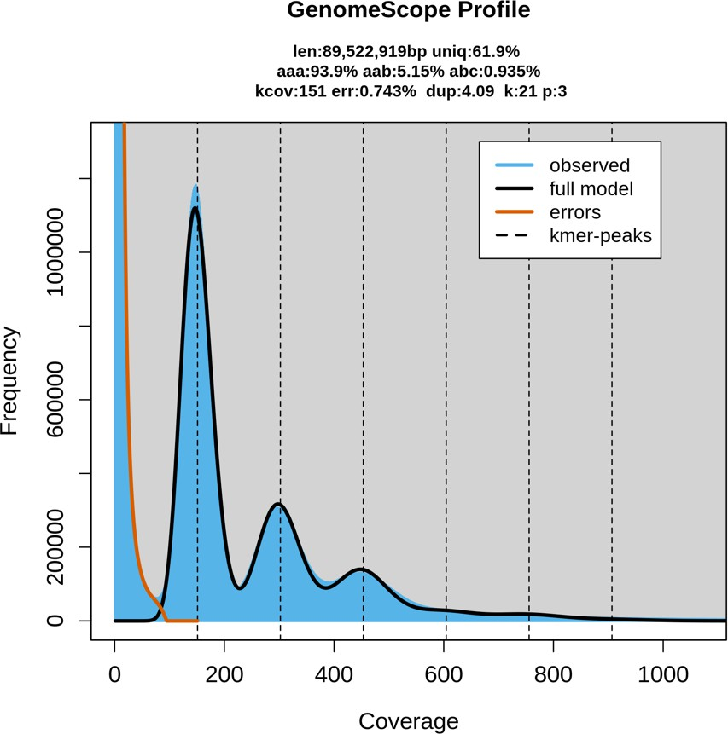
Ploidy
Number of sets of chromosomes in a cell (N)
Bacteria – 1N
Vertebrates – 2N (human, mouse, rat)
Amphibians – 2N to 12N
Plants – 2N to ??? (wheat is 6N)
Root knot nematode (GenomeScope)

Slide 44
Repetitive sequences
Most common source of assembly errors
If sequencing technology produces reads > repeat size, impact is much smaller
Most common solution: generate reads or mate pairs with spacing > largest known repeat
Root knot nematode (GenomeScope)

Slide 45
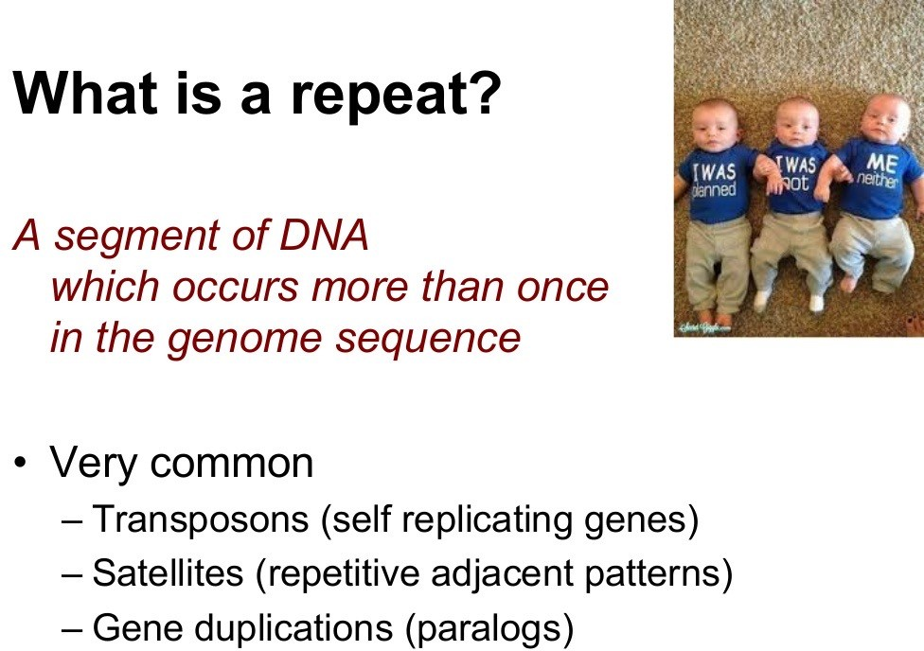
T. Seemann
66

Slide 46
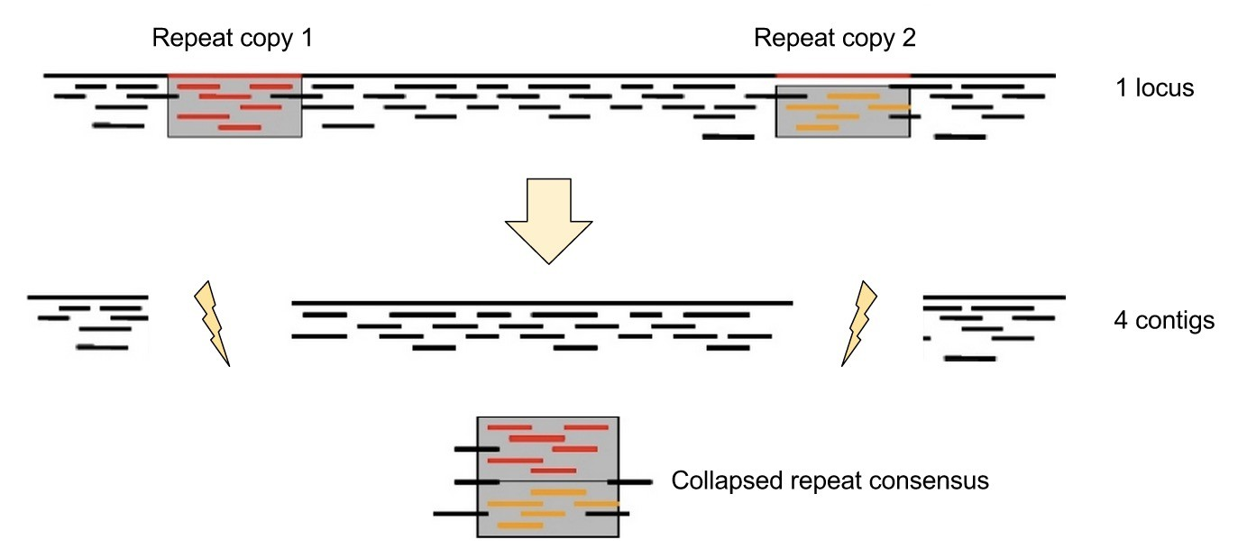
Assembling repeats
T. Seemann

Slide 47
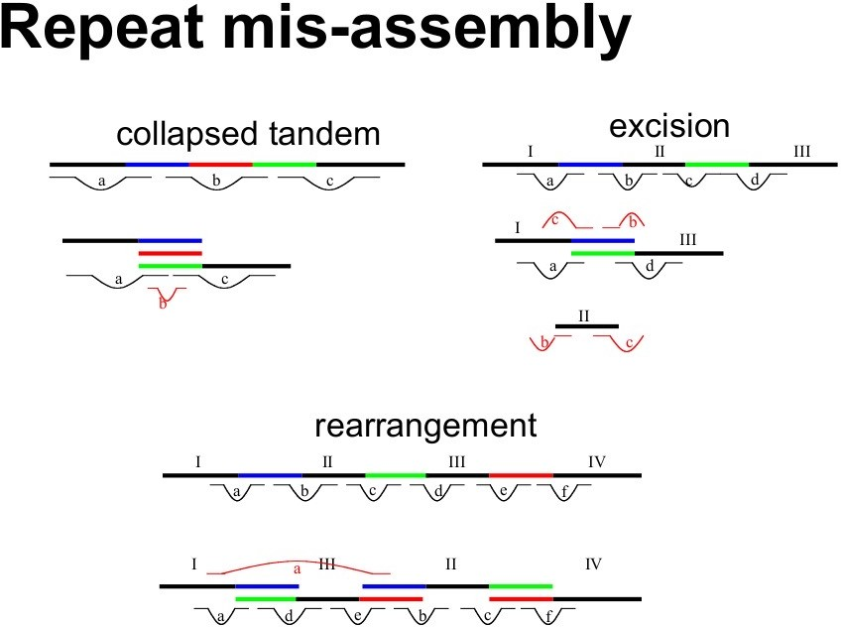
T. Seemann

Slide 48
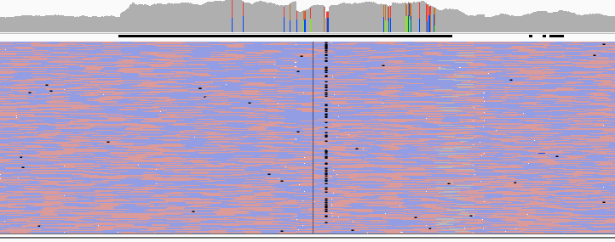
HPCBio data
69

Slide 49
Long reads
T. Seemann
70

Slide 50
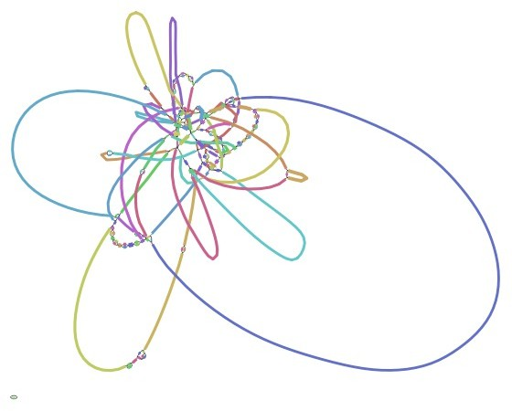
HPCBio data

Slide 51
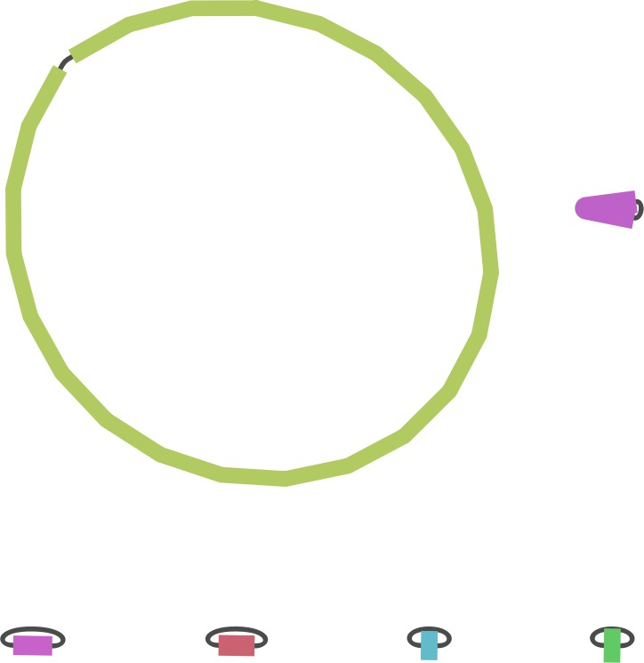
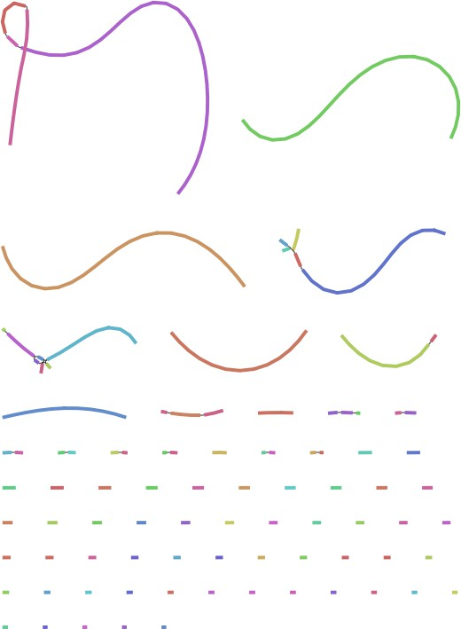
HPCBio data

Slide 52
Genome(s) from related species
Preferably of good quality, with large reliable scaffolds Help verifying the completeness of the assembly
Can themselves be improved in some cases Help guiding the assembly of the target species
But to be used with caution – can cause errors when genome architecture is different!
Large-scale genomic rearrangement in particular is a problem

Slide 53
Typical sequencing strategies
Small genomes (bacteria, fungal)
If you can can get HMW DNA!
PacBio HiFi
Oxford Nanopore sequences at 40-50x coverage, 'polish’ with hybrid correction (using Illumina data) and assembly using Unicycler, Canu, Flye
This may be changing with newer flow cells (R10.4.1 + ’kit14’, as of May 2022)
2 x 300bp overlapping paired-end reads from Illumina MiSeq works okay but will get fragments
Larger genomes
If you can afford it and can get HMW DNA
PacBio HiFi
HiC for scaffolding
ONT (ultralong prep)

Slide 54
T2T strategy
Science, March 2022
Human assemblies
HMW DNA preps
50x PacBio HiFi reads or higher
15-30x Oxford ultralong reads (>100kb)
This is also in flux!
$$$$$$$$$$
Time, May 2022

Slide 55
Assembly strategies and algorithms
For long reads (>500 nt), Overlap/Layout/Consensus (OLC) algorithms work best.
Examples: hifiasm (PacBio HiFi only), Canu, Redbean, Flye, Shasta
Hifiasm is generally recommended for PacBio HiFi data
For short reads, De Bruijn graph-based assemblers are most widely used
Examples: MEGAHIT, SPAdes
Key points:
There is no simple solution, best to try different assemblers and strategies
Use simple metrics to gauge quality of assembly
The field is rapidly evolving, like the sequencing technology
NEXT YEAR THIS PRESENTATION WILL CHANGE AGAIN!

Slide 56
Assessing your assembly

Slide 57
How good is my assembly?
How much total sequence is in the assembly relative to estimated genome size? How many pieces, and what is their size distribution?
Are the contigs assembled correctly?
Are the scaffolds connected in the right order / orientation? How were the repeats handled?
Are all the genes I expected in the assembly?

Slide 58
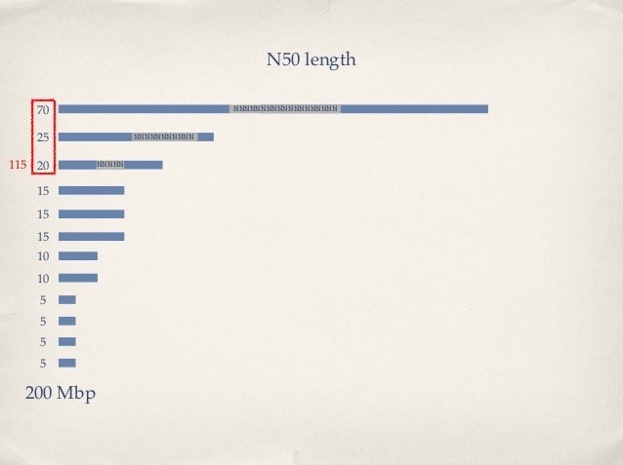
N50: the most common measure of assembly quality
N50 = length of the shortest contig in a set making up 50% of the total assembly length (Larger is better)
NG50 = length of the shortest contig in a set making up 50% of the estimated genome size
NG50 is generally better

Slide 59
Comparative analysis
Compare against
A close reference genome
Results from another assembler
Self-comparison
Versions of the same assembly
Whole genome alignment
MUMmer
Lastz
Generates an alignment and a dot plot

Slide 60
Dot Plot
How can we visualize whole genome alignments?
With an alignment dot plot
N x M matrix
Let i = position in genome A
Let j = position in genome B
Fill cell (i,j) if A_{i} shows similarity to B_{j}
T
G
C
A
A C C T
– A perfect alignment between A and B would completely fill the positive diagonal
From M. Schatz and A. Phillipy : Alignment and Assembly Lecture

Slide 61
B
Translocation
Inversion
Insertion
A
B
A
http://mummer.sourceforge.net/manual/AlignmentTypes.pdf
From M. Schatz and A. Phillipy : Alignment and Assembly Lecture

Slide 62
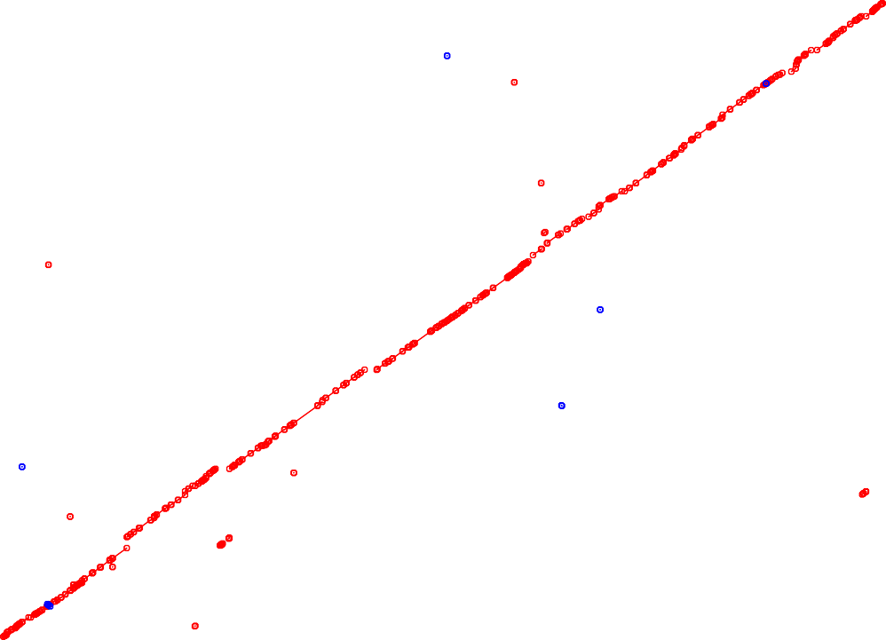

2500000
2000000
Assembly
1500000
1000000
500000
0
0
500000
1000000
1500000
2000000
2500000
3000000
Reference

Slide 63
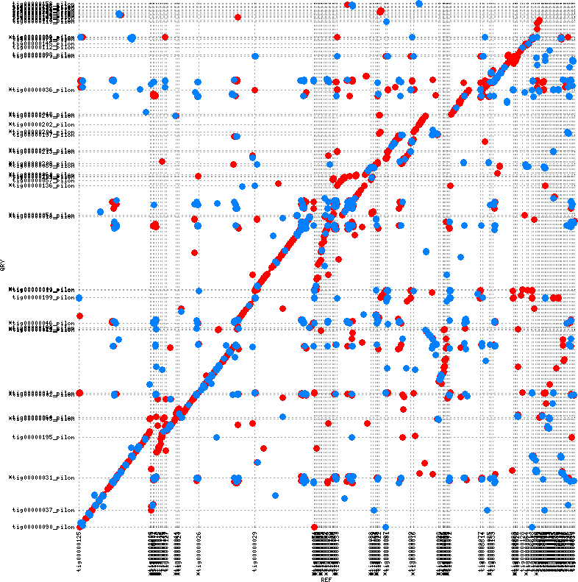
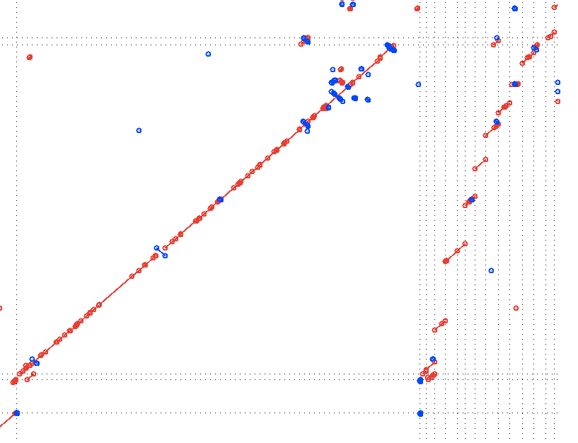

Slide 64
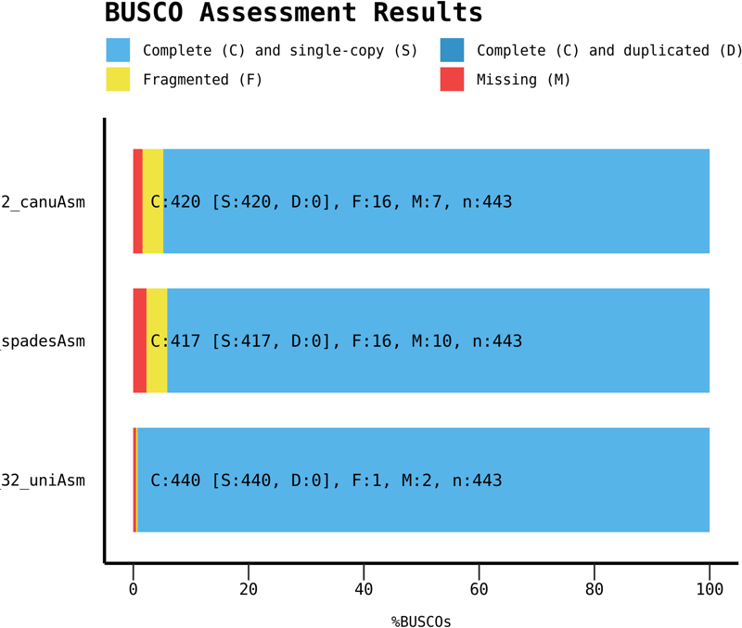
BUSCO: conserved gene sets
BUSCO: From Evgeny Zdobnov’s group, University of Geneva
Coverage is indicative of quality and completeness of assembly
HPCBio data
86

Slide 65
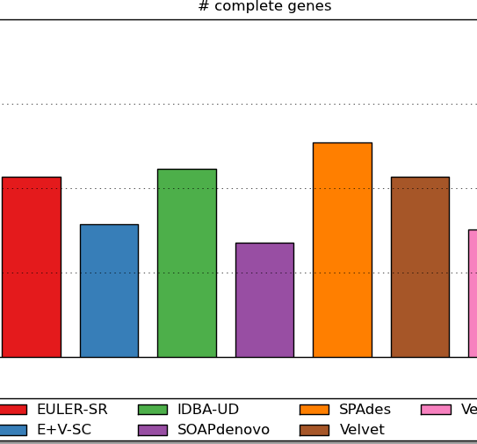
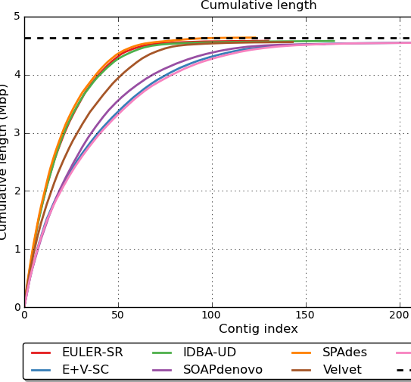
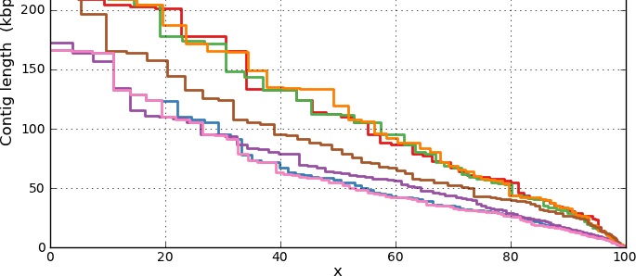
QUAST
QUality ASsessment Tool
Small (bacterial, fungal) and large
(eukaryotic) genomes
Metagenomes
Icarus for contig alignment
visualization
Can compare multiple assemblies against one another
Compare against a known (or close) reference
Optional: Predict genes or include
annotations (checks for odd issues
like frameshifts)
Generates a summary HTML report
87

Slide 66
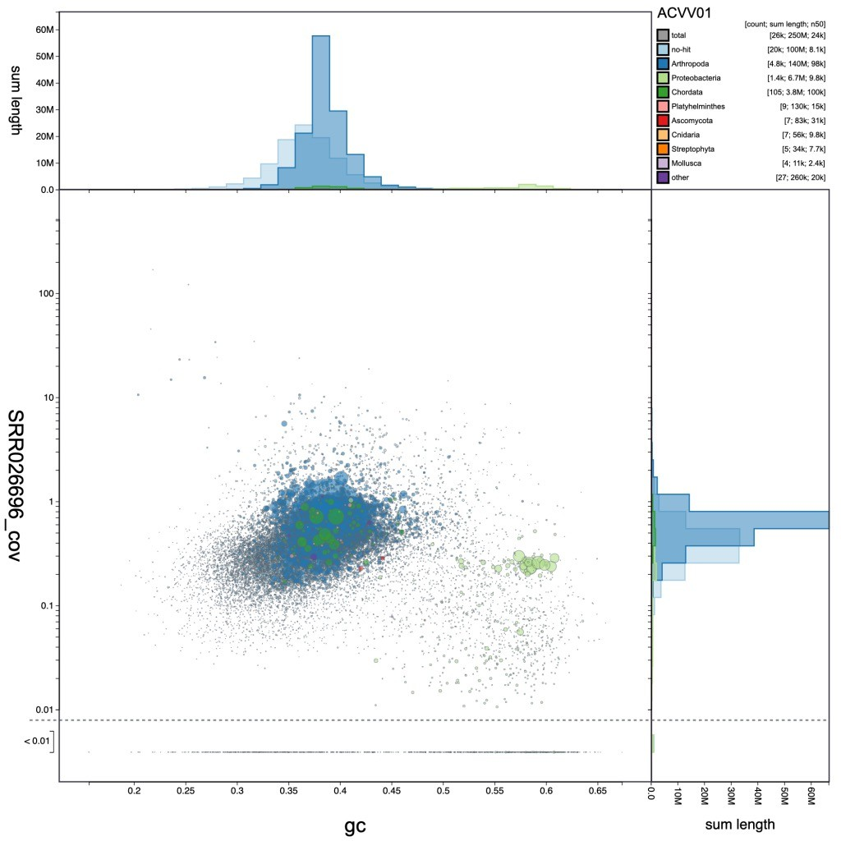
Blob plots
Analyses checking for contaminants, endosymbionts, etc.
Interactive version: BlobToolKit
88

Slide 67
Genome graphs
89

Slide 68
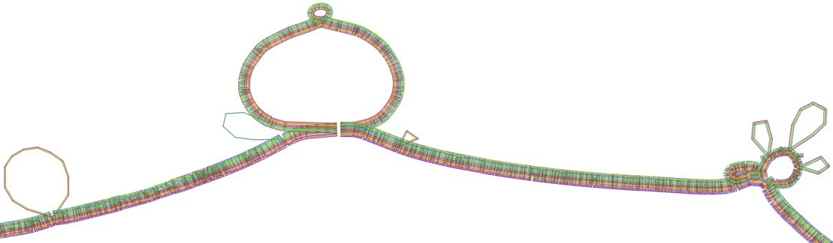
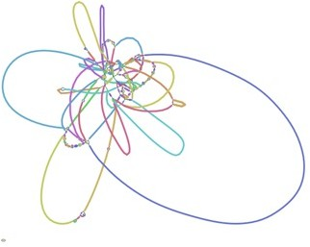
Assembly, variant, and pangenome graphs
With the release of the latest human genome reference, there is more pressure to represent more data with a genome.
Current representations are mainly haploid (one copy)
Assembly graphs can retain haplotype information or raw assembly connectivity
Variant graphs can be generated from a reference genome and a variant file from other samples
Pangenome graphs capture information across populations of samples from the same species
Novak et al, bioRxiv: https://doi.org/10.1101/101378
10x Genomics
90

Slide 69
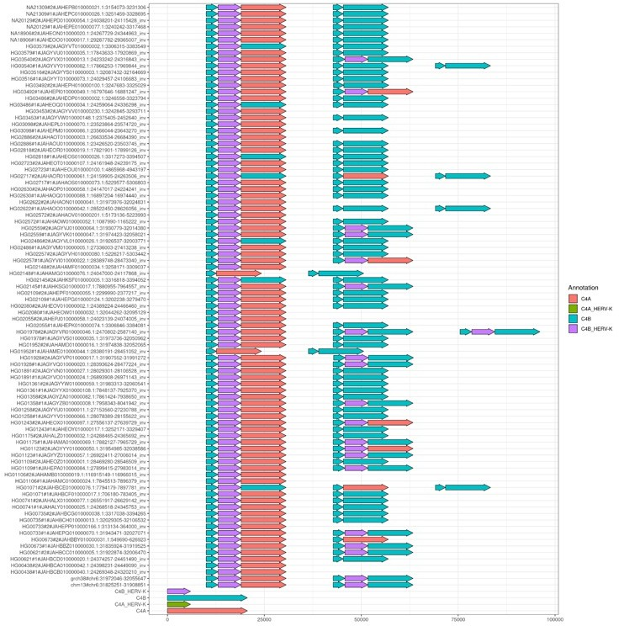

Pangenome graphs
New tools are available and actively being developed to generate and compare multiple high quality genome assemblies
Structural variants, including complex regions
Population genomics
Pangenome graph of the C4 locus with 90 haplotypes (44 diploid de novo assemblies
plus the GRCh38 and
CHM13 reference genomes).
Andrea Guarracino, MemPanG23 workshop/conference, May 2023
HPRC Main Paper
Acrocentric chromosomes

Slide 70

Pangenome graphs
New tools are available and actively being developed to generate and compare multiple high quality genome assemblies
Structural variants, including complex regions
Population genomics
HPRC Main Paper
Acrocentric chromosomes

Slide 71
Acknowledgements
Materials from this slide deck include figures and slides from many publications, Web pages and presentations by:
Carver Biotechnology Center (HPCBio, DNA Sequencing Core)
M. Schatz, A. Phillipy, T. Seemann, S. Salzberg, K. Bradnam, D. Zerbino, M. Pop,
G. Sutton, Nick Loman, Carson Holt, Ryan Wick.
I highly recommend Ben Langmead’s teaching materials; he has a ton fabulous (and much more in-depth) notes on his lab page: http://www.langmead- lab.org/teaching-materials/
Thank you!

