Slide 1
Identification of non-peptide Molecules and non-human peptides in Human BALF reveals potential TB biomarkers

Slide 2
Introduction
Shotgun proteomics widely used approach in the study of proteins
> 75% of acquired MS/MS spectra remain unidentified (Tabb et al 2007)
Unidentified spectra were of high quality and originated from the MS1 features (Griss et al 2016)
Non-tryptic peptides, single amino acid variants, PTMs, and low-quality spectra has been linked to the low peptide ID rate

Slide 3
Motivation
Omics: Consists of genomics, Tx, Px,metabolomics etc
They may contain hundreds or even thousands of variables
What are the other content of ~75% unidentified spectra? Lipids? , Metabolites?, non-human proteins?

Slide 4
Methodology
Remove non-informative spectra- pClean package
Filtering unidentified spectra – Spectra package
Identify human protein – MQ run Uniprot DB
Identify non-human Proteins- MetaNovo
Metabolite & lipid identification- XCMS-CAMERA & XCMS
MetaboSearch v 1.2 – putative metabolite ID
LipidFinder – putative lipid ID

Slide 5
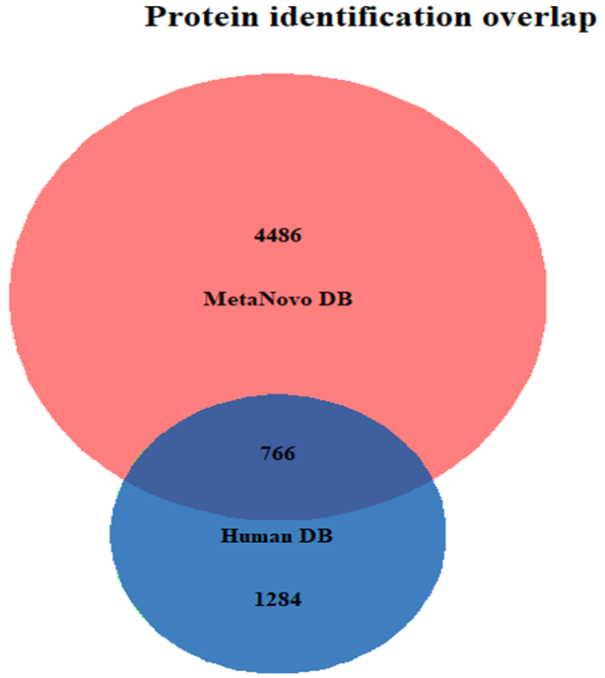
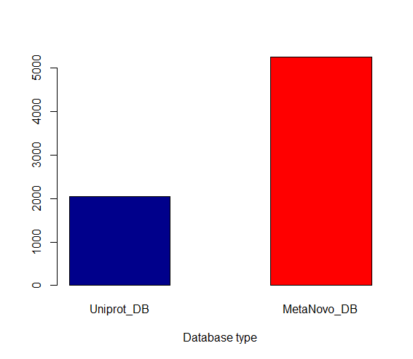
Human & non-human proteins
Figure 1 A: A Venn diagram showing the protein identification overlap between MetaNovo generated database and the Uniprot database. Unique proteins identified from the MetaNovo database were 4486 (68.46%) and 1284 (19.65%) from the Uniprot protein sequence database. There were 766 (11.72%) overlap proteins.
5253
Figure 1 B: # of protein IDs from Uniprot and MetaNovo constructed DB
2051

Slide 6
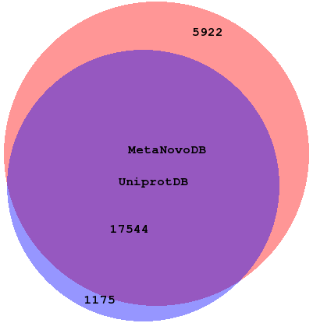
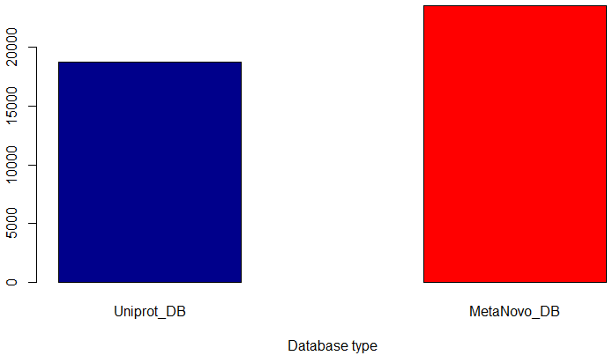
Human & non-human peptides
Figure 1 A: A Venn diagram showing the peptide identification overlap between MetaNovo generated database and the human Uniprot database. Unique peptides identified from the MetaNovo database were 5922 (24.03%) and 1175(4.77%) from the Uniprot protein sequence database. There were 17544 (71.2 %) overlap peptides.
23467
Figure 1 B: # of peptide IDs from Uniprot and MetaNovo constructed DB. There was no significant difference between human Uniprot IDs and MetaNovo protenot statistical significance p-value = 0.07133
18720

Slide 7
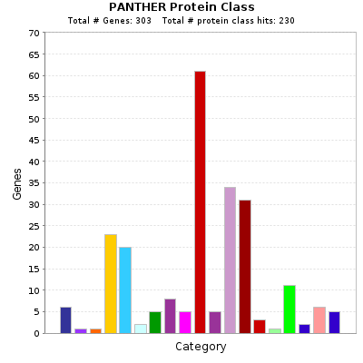
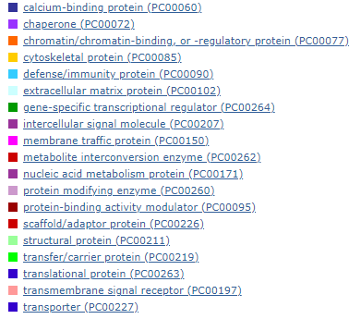
Non-human protein class
Figure 2: Bar graph showing the protein class of non-human proteins identified from the human BALF.

Slide 8
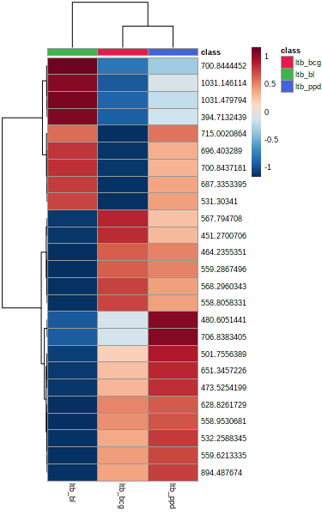
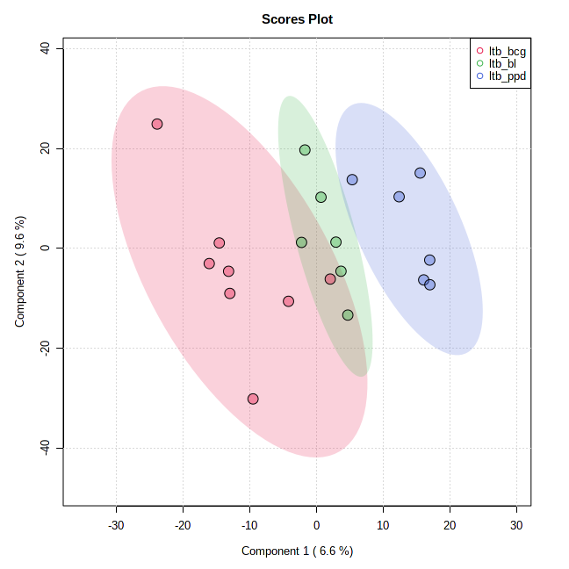
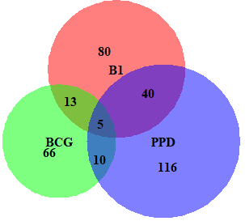
Sample clustering analysis: LTB
A
B
Figure 5: LTB patient cohorts cluster distinctly following BCG and PPD challenge
Biomarker:
Glycerol (B1 & PPD)
Cadaverine (BCG)
hexacosanoic acid (B1)
(5Z,8Z,11Z,13E,17Z)-icosapentaenoic acid (PPD)
C

Slide 9
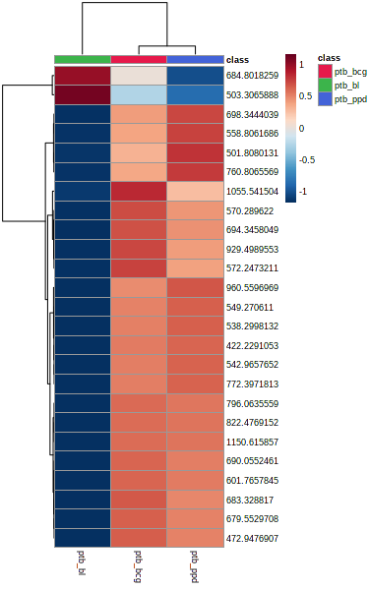
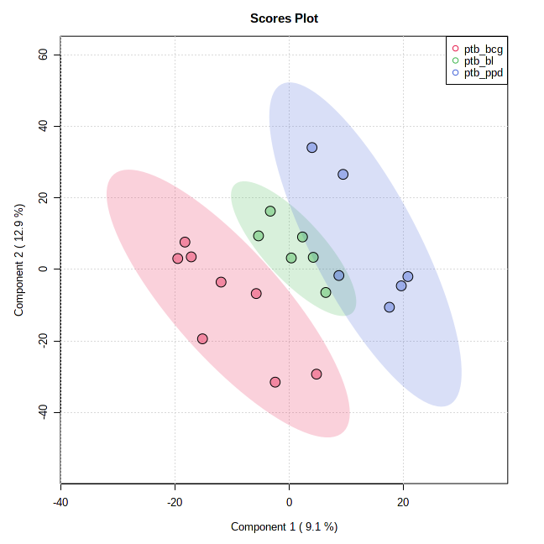
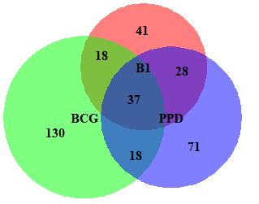
PTB
A
B
C
Figure 6: putative metabolic feature PPD & BCG cohort
BCG challenge have more unique putative metabolites

Slide 10
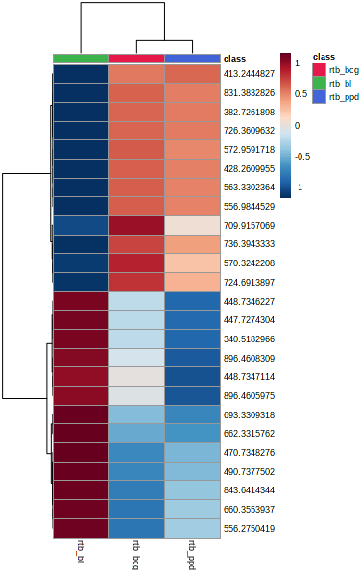
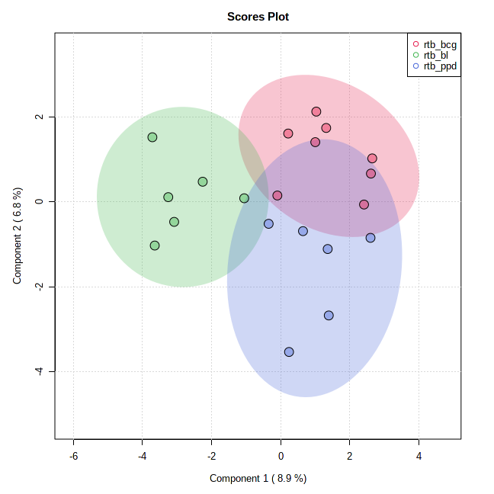
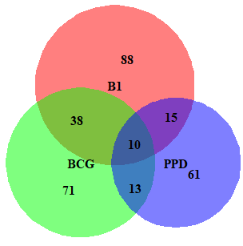
RTB
A
B
Figure 7: There was no clear separation samples. B1 has the majority putative metabolic features
Biomarkers:
3-methyl-butanal
9-octadecenoic
C

Slide 11
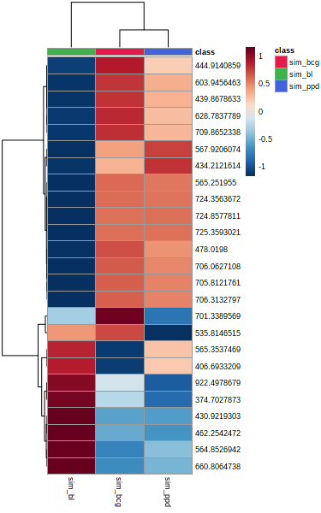
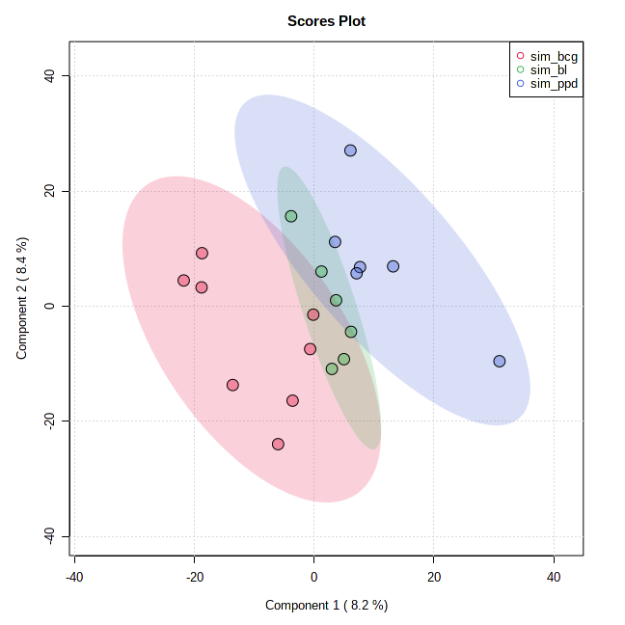
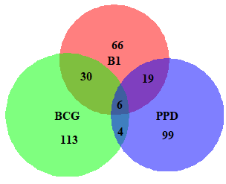
SIM
A
B
C

Slide 12
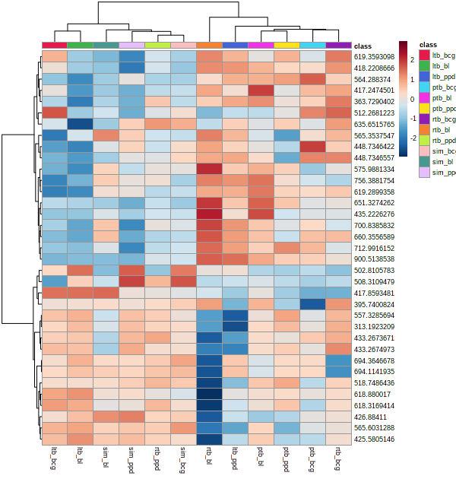
Metabolite features sample clustering
Figure 3: Heatmap showing putative metabolite m/z features clustering showing an overlap between protective and susceptible TB phenotypes

Slide 13
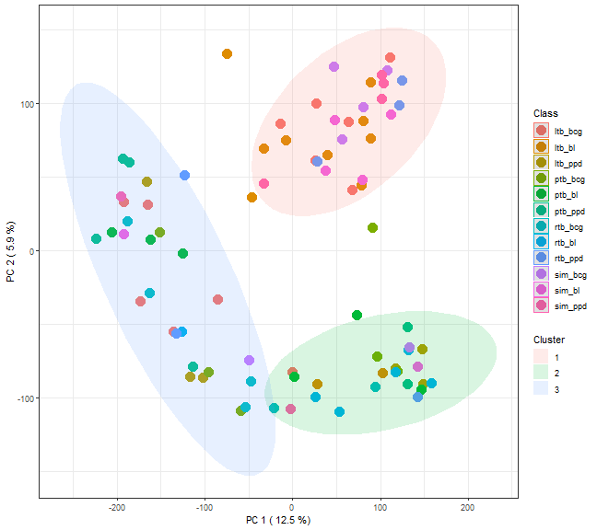
K-mean clustering
Figure 4: The putative metabolite features overlap. K-mean clustering built on entire dataset and color coded by patient challenge groups.

Slide 14
Lipids
Cell envelope lipids constitute ∼40% of the cell dry mass in M.tb (Jackson et al 2014)
Host-pathogen interaction-lipids
Lipids such as lipoarabinomannan, PI produced by mycobacterial species
The biosynthesis of some of these lipids is the site of action of anti-TB drugs such as isoniazid & ethionamide (ETH)
Pathogenesis: acyltrehaloses and long-chain diols

Slide 15
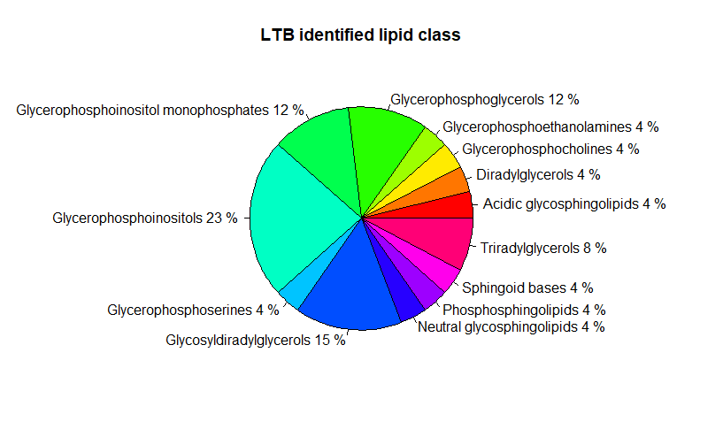
Lipids
XCMS: Bioconductor package used in processing of the MS1 raw files
Perform MS Search on the peak list filtered by Lipid Finder; This was done against computationally generated database composed of over 30,000 bulk (isobaric) species covering the major lipid classes
Glycerophospholipids: are the major lipid constituents of the plasma membrane of Mtb
Extractable lipids
Notes:
phosphatidylinositol [PI], phosphatidylglycerol, phosphatidylserine [PS], phosphatidylethanolamine [PE], cardiolipin [CL]), and mannosylated forms of PI are te major lipid constituents of the plasma membrane of Mtb

Slide 16
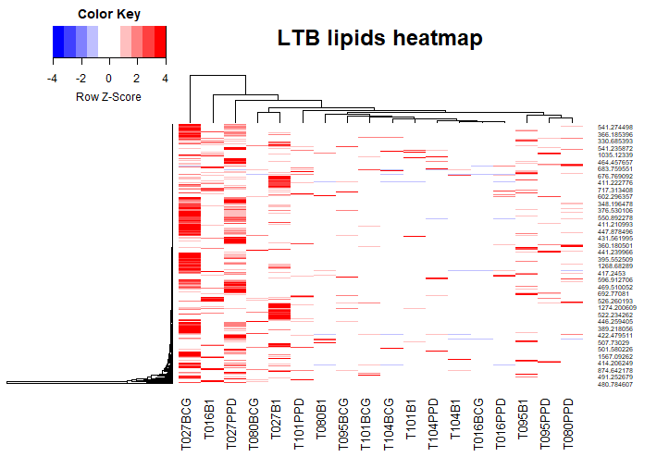

Slide 17
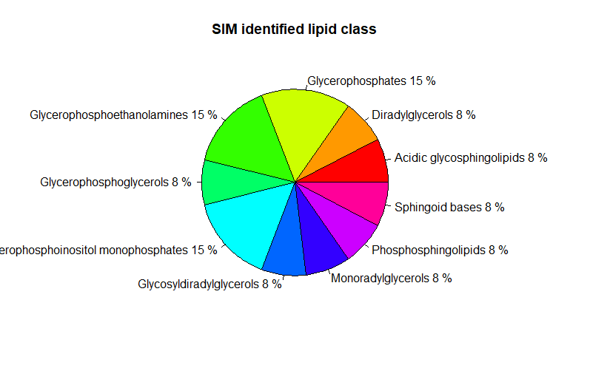
SIM

Slide 18
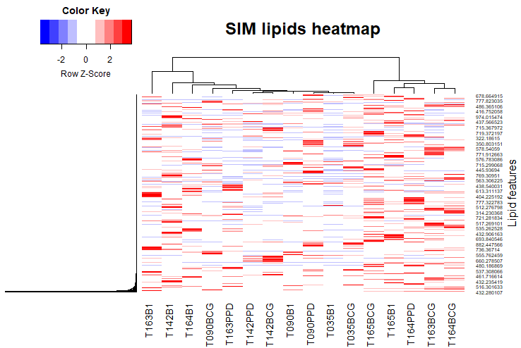

Slide 19
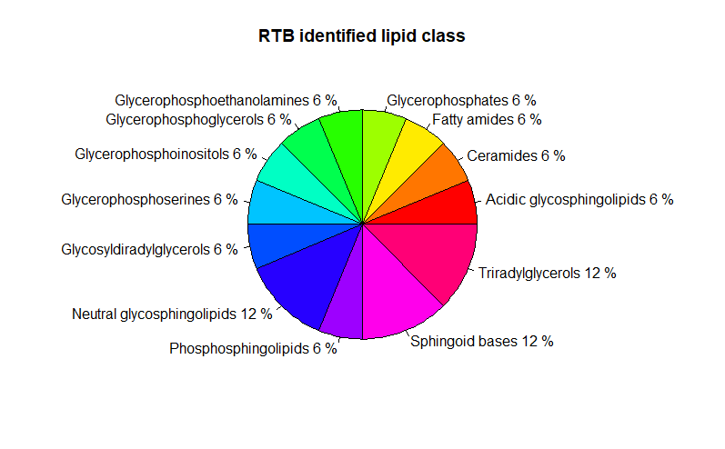
RTB

Slide 20
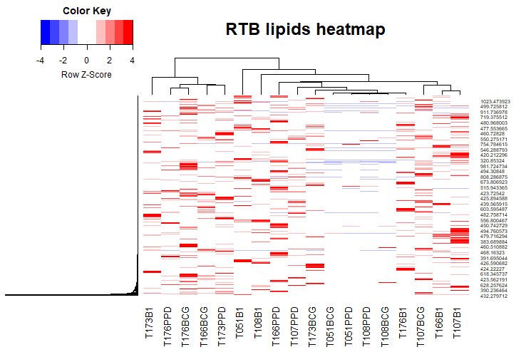

Slide 21
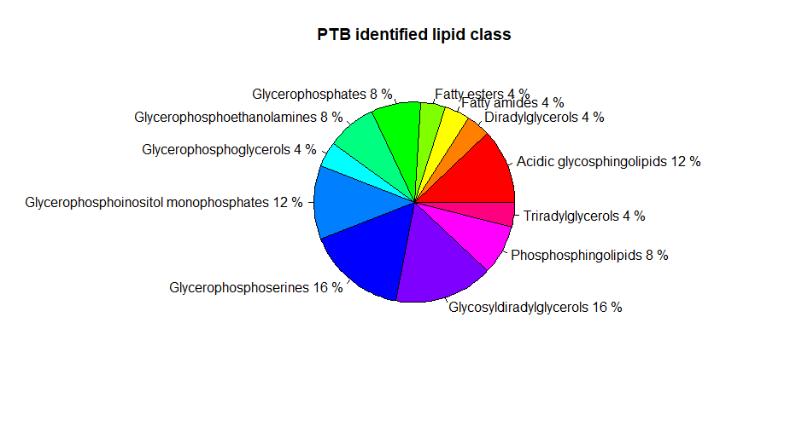

Slide 22
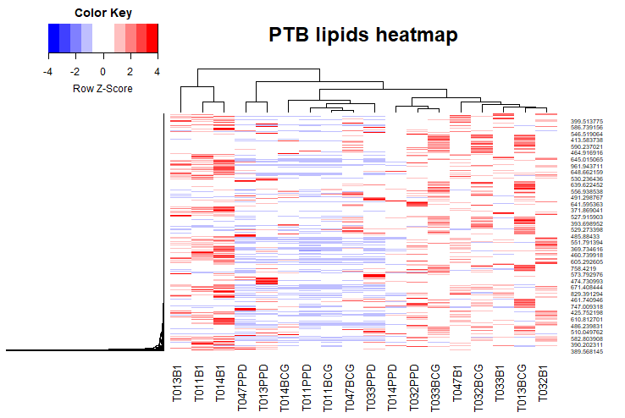

Slide 23
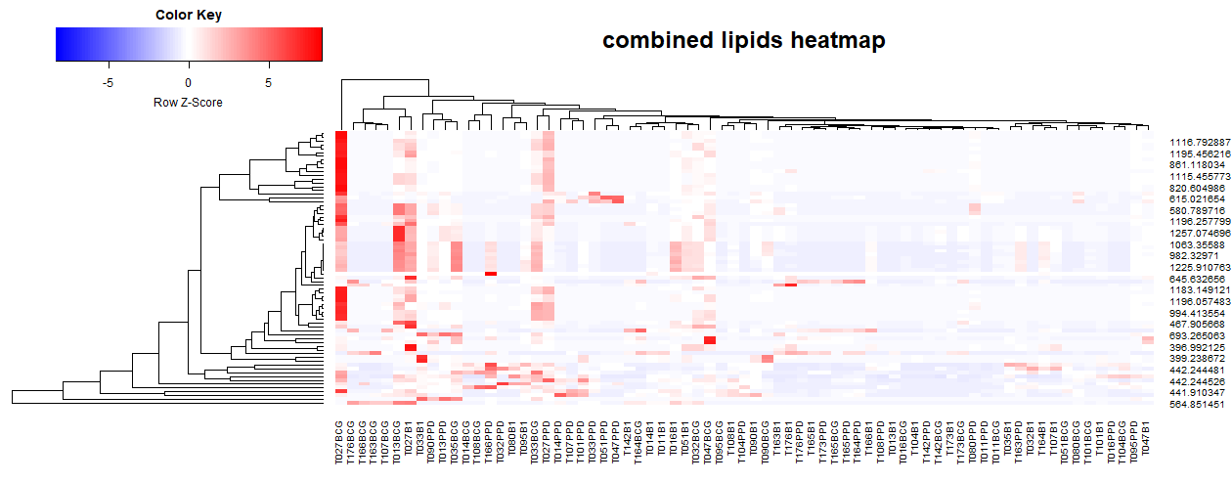

Slide 24
Thanks

Slide 25
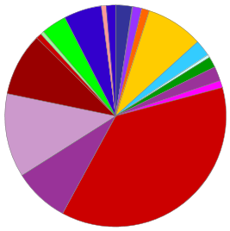
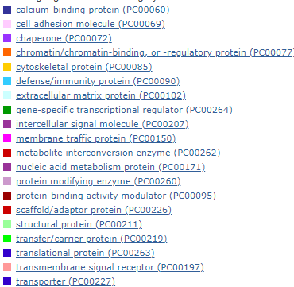

Slide 26
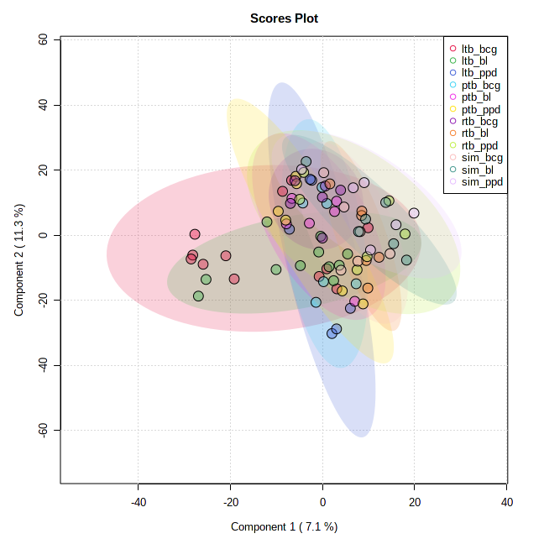
PLS-DA

Slide 27
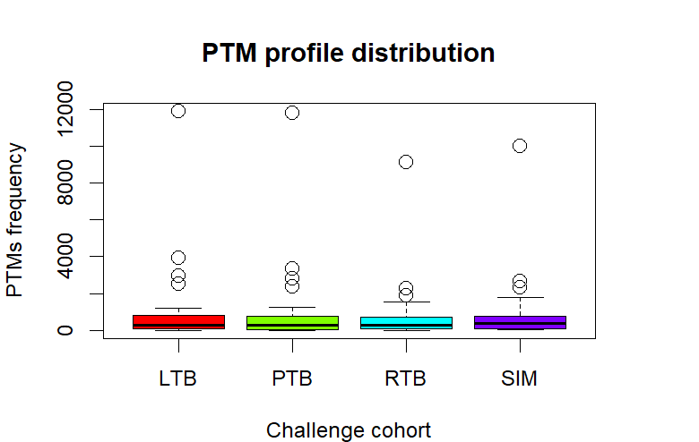
PTMs

Slide 28
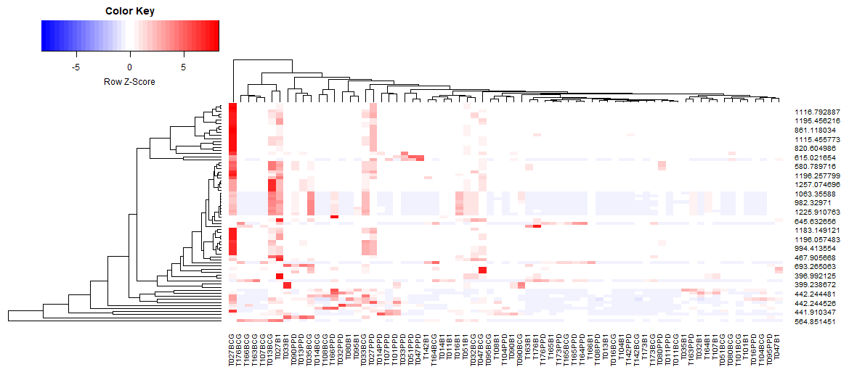

Slide 29
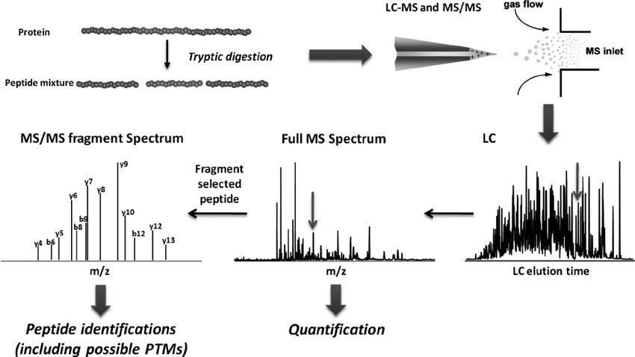
General workflow for LC-MS-based global proteomics
Xie et al 2011

