Slide 1
Identification of non-peptide Molecules and non-human peptides in Human BALF reveals potential TB biomarkers

Slide 2
Introduction
Shotgun proteomics widely used approach in the study of proteins
> 75% of acquired MS/MS spectra remain unidentified (Tabb et al 2007)
Unidentified spectra were of high quality and originated from the MS1 features (Griss et al 2016)
Non-tryptic peptides, single amino acid variants, PTMs, and low-quality spectra has been linked to the low peptide ID rate

Slide 3
Motivation
Omics: Consists of genomics, Tx, Px,metabolomics etc
They may contain hundreds or even thousands of variables
What are the other content of ~75% unidentified spectra? Lipids? , Metabolites?, non-human proteins?

Slide 4
Methodology
Remove non-informative spectra- pClean package
Filtering unidentified spectra – Spectra package
Identify human protein – MQ run Uniprot DB
Identify non-human Proteins- MetaNovo
Metabolite & lipid identification- XCMS-CAMERA & XCMS
MetaboSearch v 1.2 – putative metabolite ID
LipidFinder – putative lipid ID

Slide 5
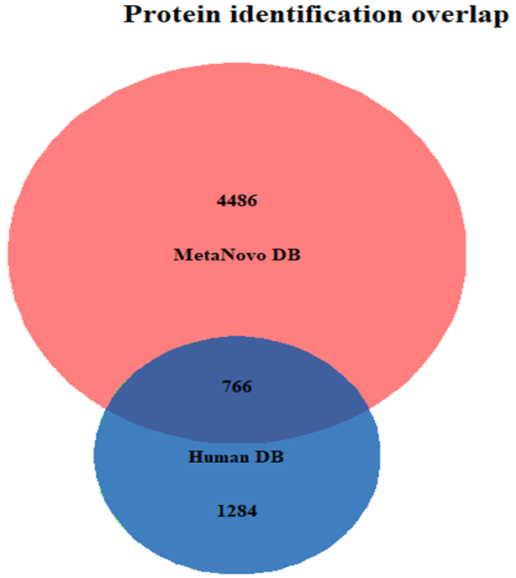
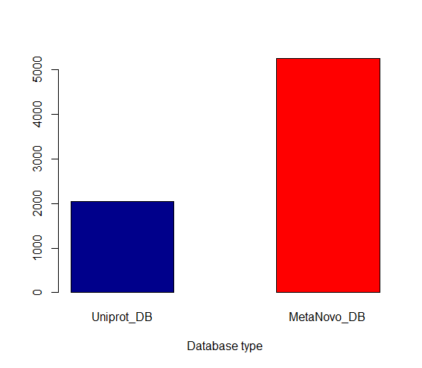
Human & non-human proteins
Figure 1 A: A Venn diagram showing the protein identification overlap between MetaNovo generated database and the Uniprot database. Unique proteins identified from the MetaNovo database were 4486 (68.46%) and 1284 (19.65%) from the Uniprot protein sequence database. There were 766 (11.72%) overlap proteins.
5253
Figure 1 B: # of protein IDs from Uniprot and MetaNovo constructed DB
2051

Slide 6
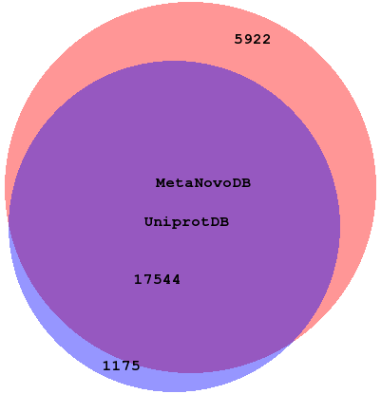
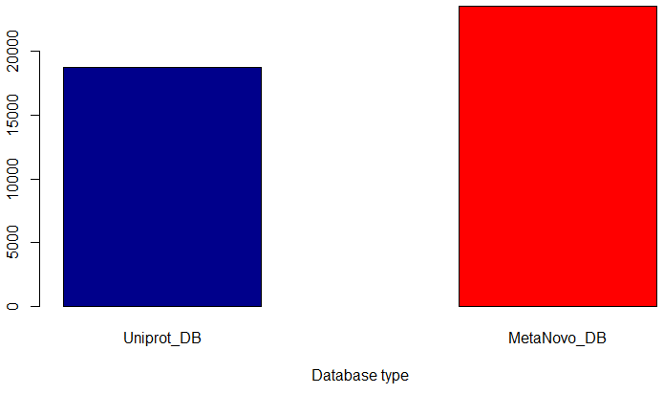
Human & non-human peptides
Figure 1 A: A Venn diagram showing the peptide identification overlap between MetaNovo generated database and the human Uniprot database. Unique peptides identified from the MetaNovo database were 5922 (24.03%) and 1175(4.77%) from the Uniprot protein sequence database. There were 17544 (71.2 %) overlap peptides.
23467
Figure 1 B: # of peptide IDs from Uniprot and MetaNovo constructed DB. There was no significant difference between human Uniprot IDs and MetaNovo protenot statistical significance p-value = 0.07133
18720

Slide 7
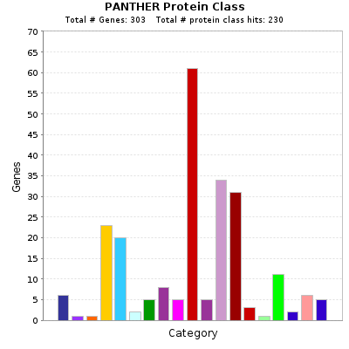
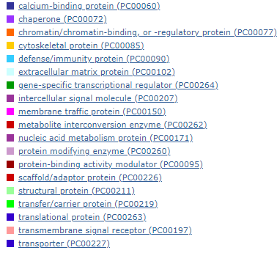
Non-human protein class
Figure 2: Bar graph showing the protein class of non-human proteins identified from the human BALF.

Slide 8
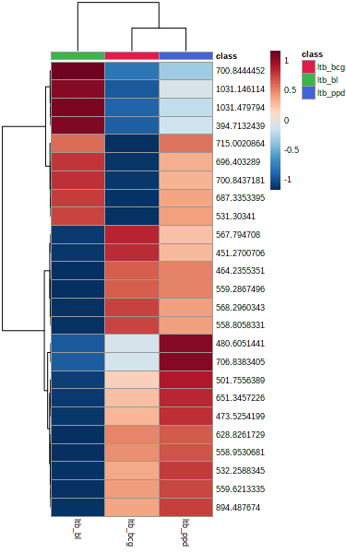
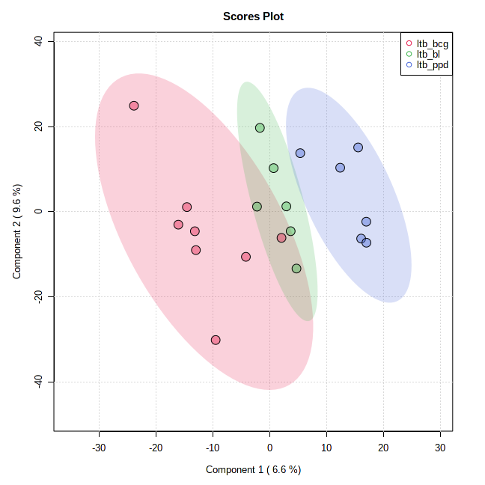
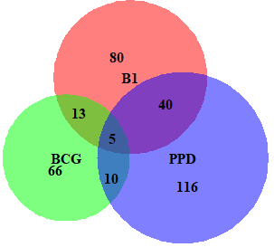
Sample clustering analysis: LTB
A
B
Figure 5: LTB patient cohorts cluster distinctly following BCG and PPD challenge
Biomarker:
Glycerol (B1 & PPD)
Cadaverine (BCG)
hexacosanoic acid (B1)
(5Z,8Z,11Z,13E,17Z)-icosapentaenoic acid (PPD)
C

Slide 9
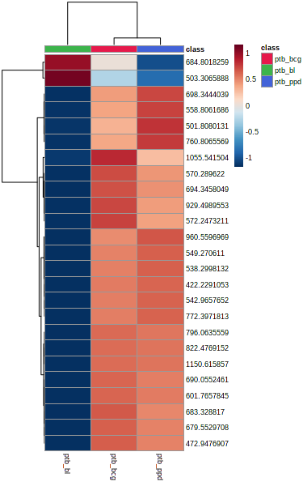
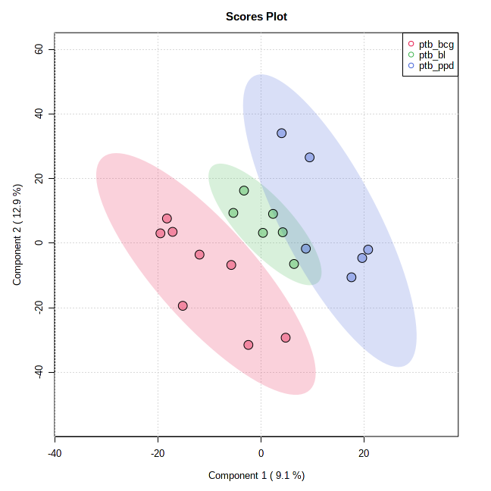
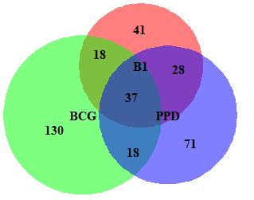
PTB
A
B
C
Figure 6: putative metabolic feature PPD & BCG cohort
BCG challenge have more unique putative metabolites

Slide 10
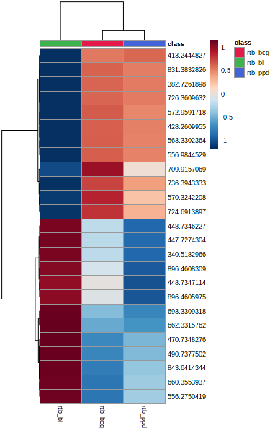
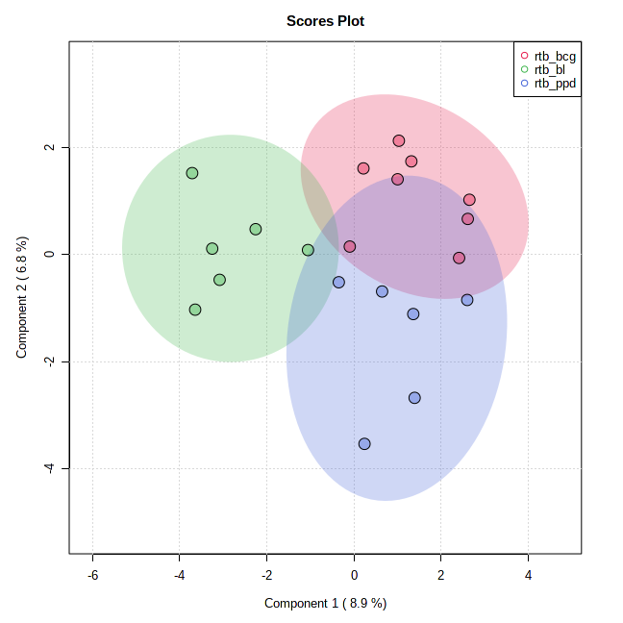
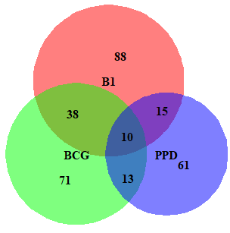
RTB
A
B
Figure 7: There was no clear separation samples. B1 has the majority putative metabolic features
Biomarkers:
3-methyl-butanal
9-octadecenoic
C

Slide 11
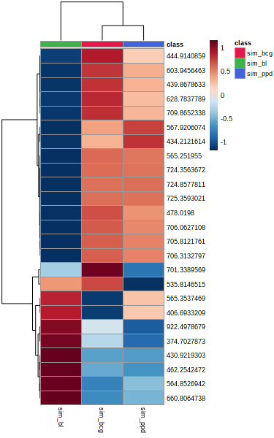
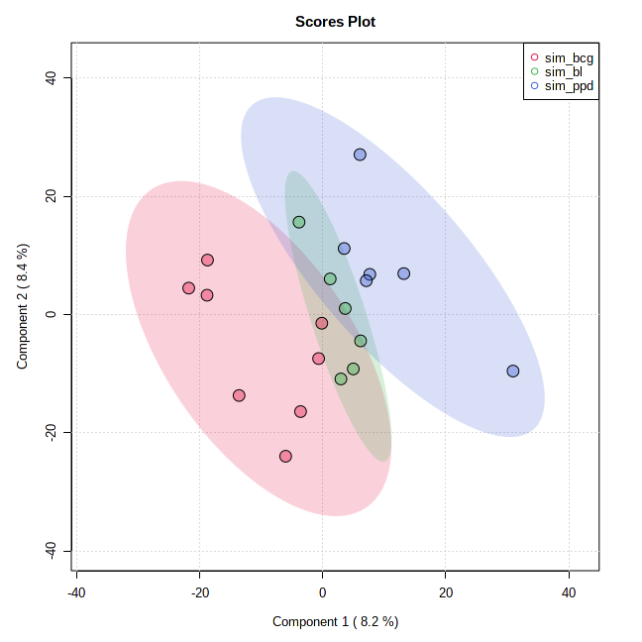
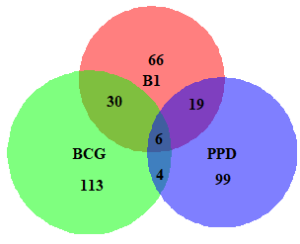
SIM
A
B
C

Slide 12
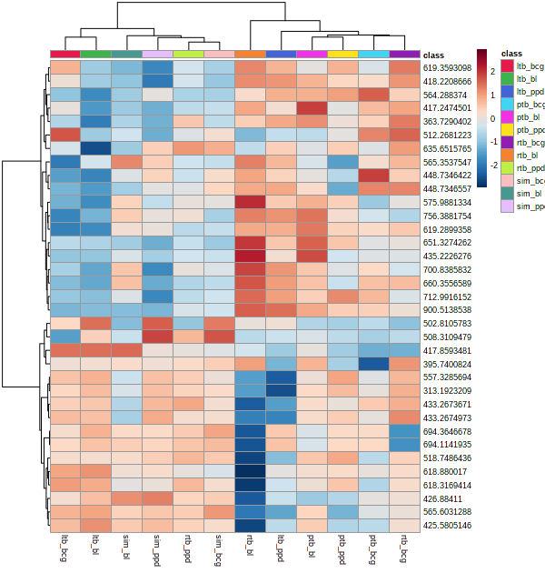
Metabolite features sample clustering
Figure 3: Heatmap showing putative metabolite m/z features clustering showing an overlap between protective and susceptible TB phenotypes

Slide 13
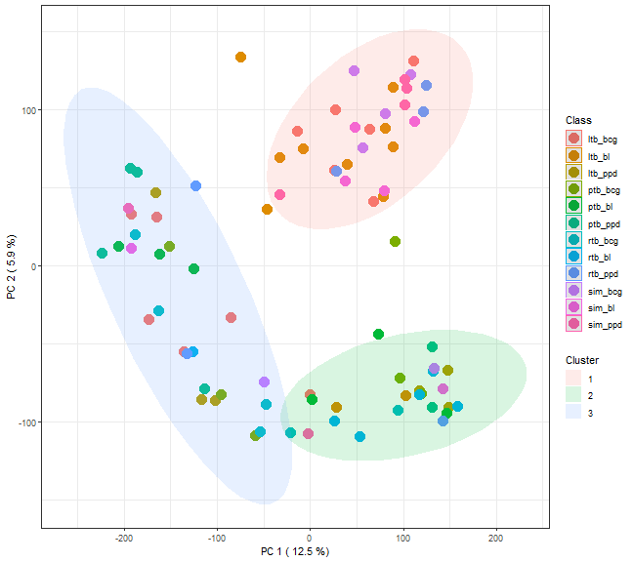
K-mean clustering
Figure 4: The putative metabolite features overlap. K-mean clustering built on entire dataset and color coded by patient challenge groups.

Slide 14
Lipids
Cell envelope lipids constitute ∼40% of the cell dry mass in M.tb (Jackson et al 2014)
Host-pathogen interaction-lipids
Lipids such as lipoarabinomannan, PI produced by mycobacterial species
The biosynthesis of some of these lipids is the site of action of anti-TB drugs such as isoniazid & ethionamide (ETH)
Pathogenesis: acyltrehaloses and long-chain diols

Slide 15
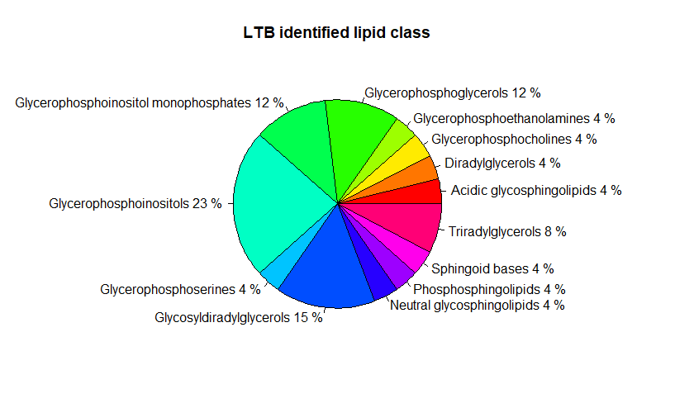
Lipids
XCMS: Bioconductor package used in processing of the MS1 raw files
Perform MS Search on the peak list filtered by Lipid Finder; This was done against computationally generated database composed of over 30,000 bulk (isobaric) species covering the major lipid classes
Glycerophospholipids: are the major lipid constituents of the plasma membrane of Mtb
Extractable lipids
Notes:
phosphatidylinositol [PI], phosphatidylglycerol, phosphatidylserine [PS], phosphatidylethanolamine [PE], cardiolipin [CL]), and mannosylated forms of PI are te major lipid constituents of the plasma membrane of Mtb

Slide 16

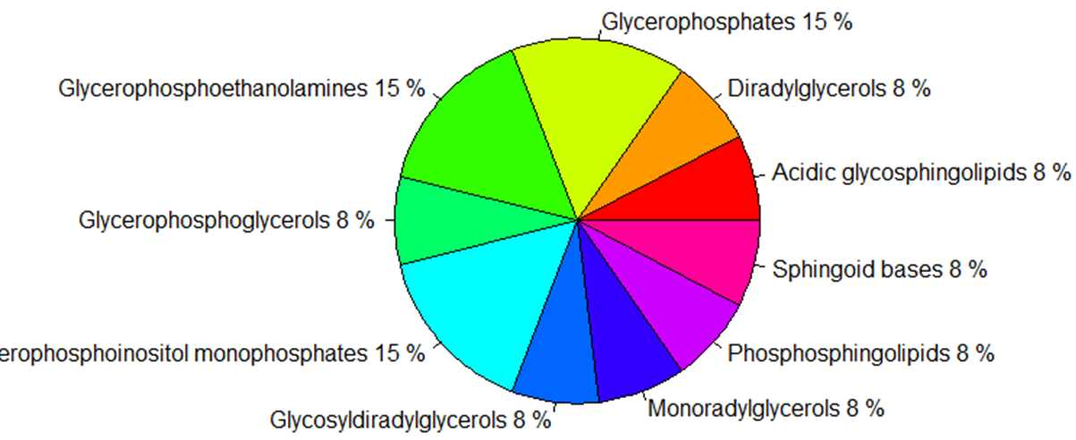
A
B

Slide 17
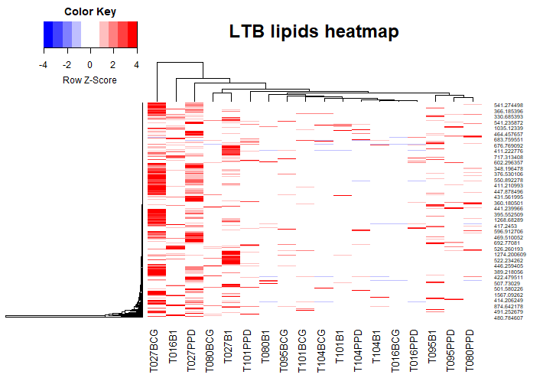

Slide 18

SIM

Slide 19
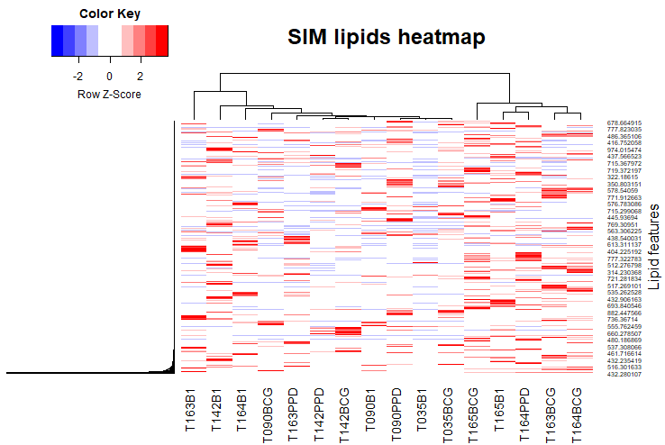

Slide 20
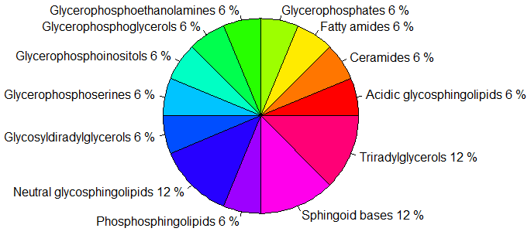
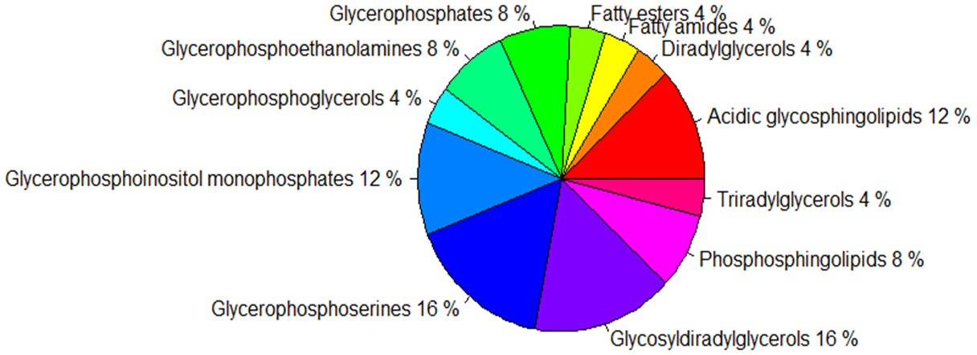
A
B

Slide 21
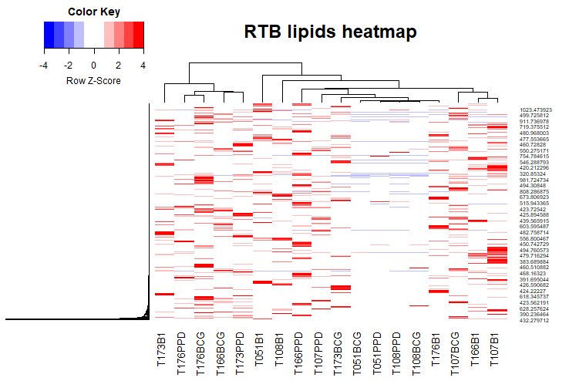

Slide 22


Slide 23
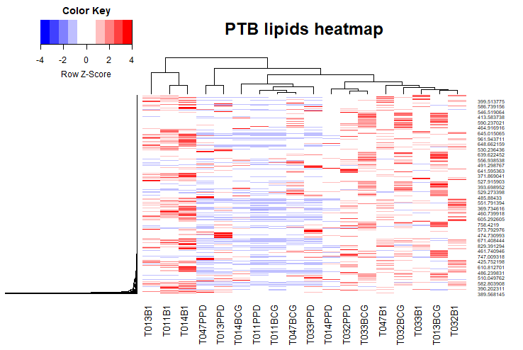

Slide 24
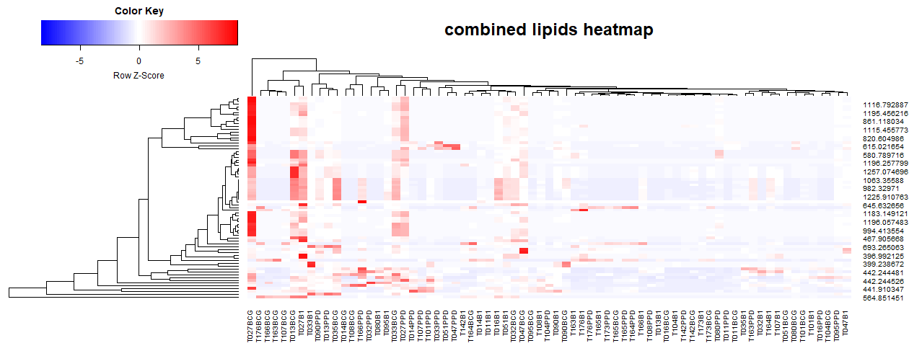

Slide 25
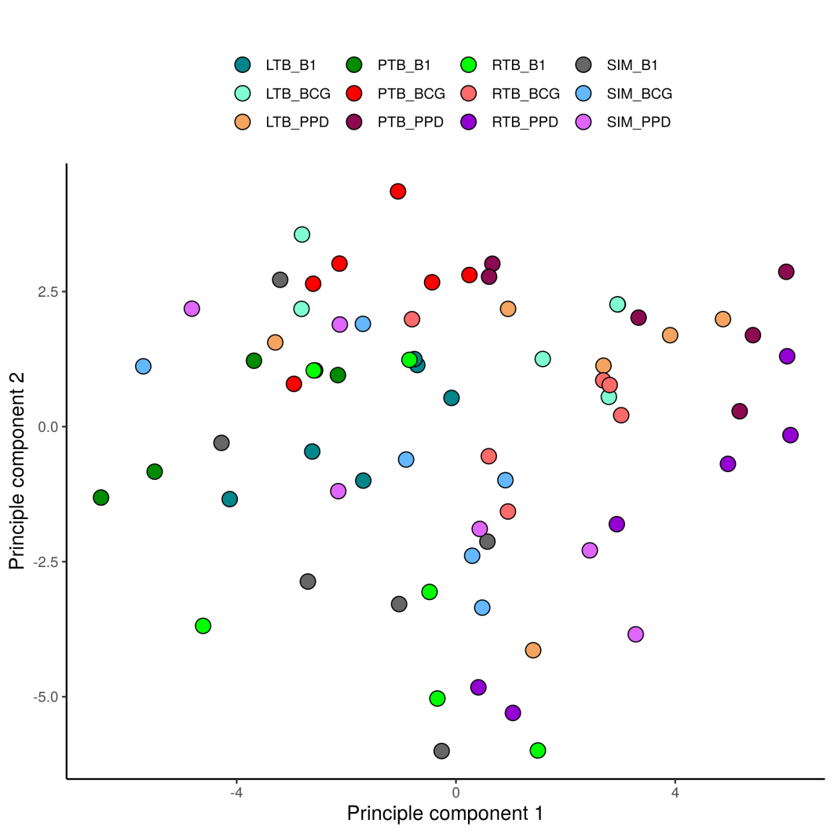
Non-human peptides PCA
Figure 12:Non-Human peptide clustering analysis.

Slide 26
Thanks

Slide 27
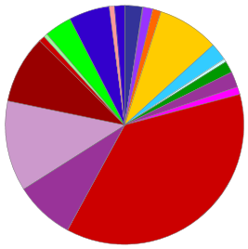
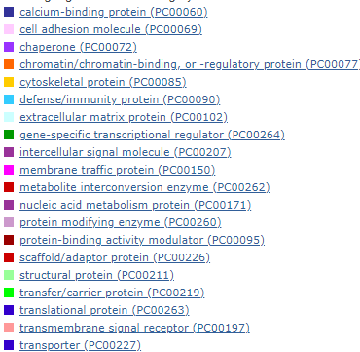

Slide 28
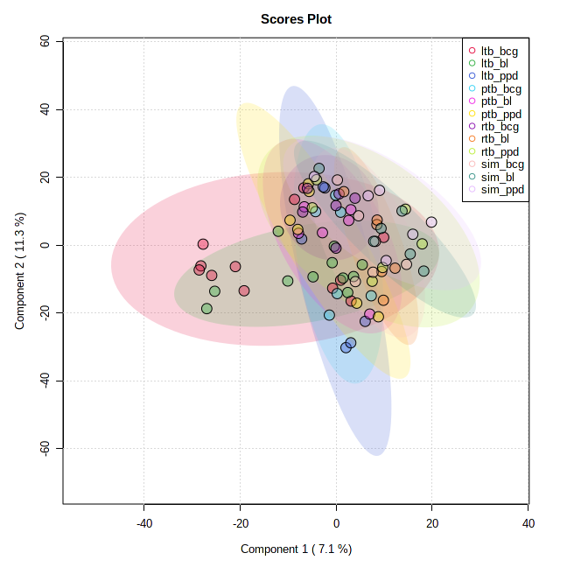
PLS-DA

Slide 29
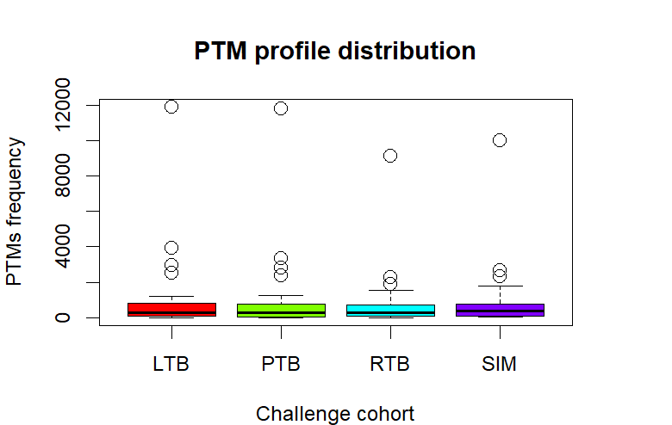
PTMs

Slide 30
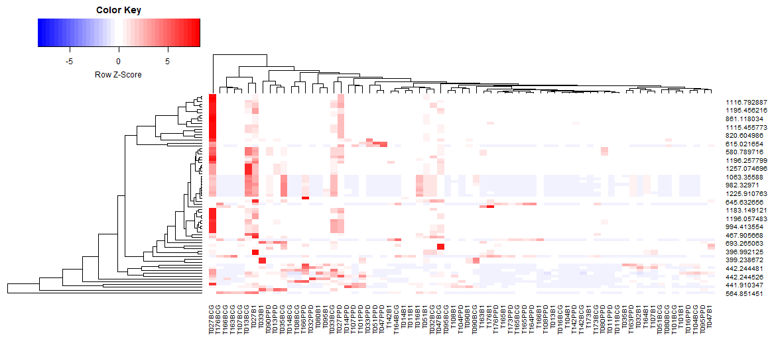

Slide 31
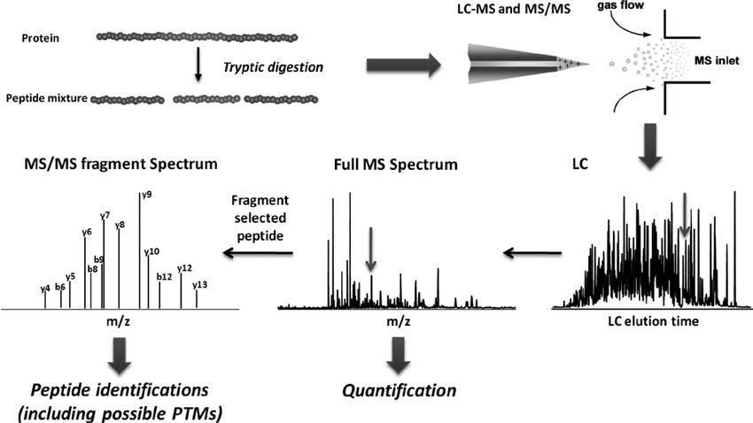
General workflow for LC-MS-based global proteomics
Xie et al 2011

