Slide 1
Python Introduction & Numpy Basic
Presenter: Yeh Ou
Original author: Howard Chang

Slide 2
Outline
Python Introduction
Linear Algebra and NumPy
Useful tools
Pandas
Sklearn

Slide 3
Outline
Python Introduction
Linear Algebra and NumPy
Useful tools
Pandas
Sklearn

Slide 4
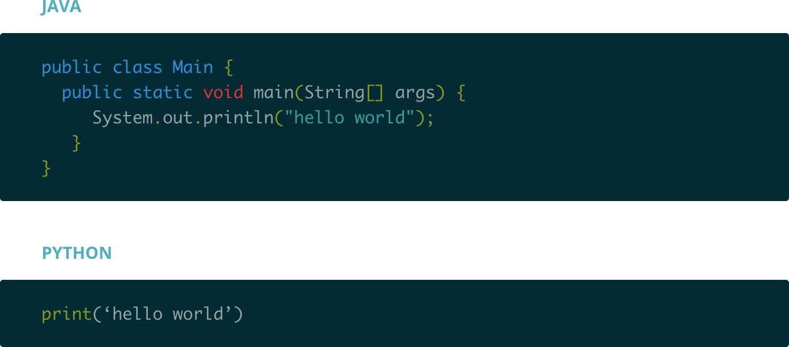
Why Python?
Python is high-level

Slide 5
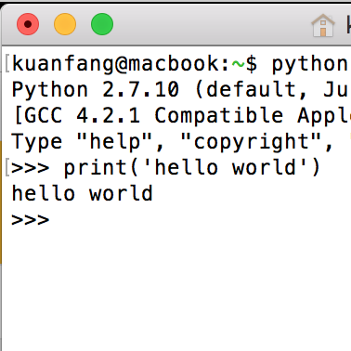
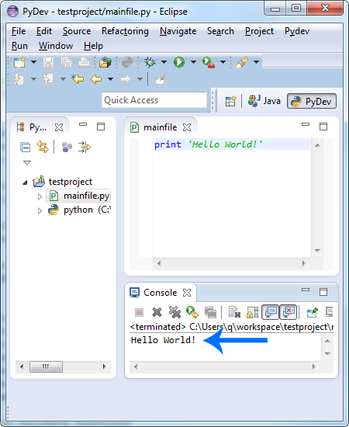
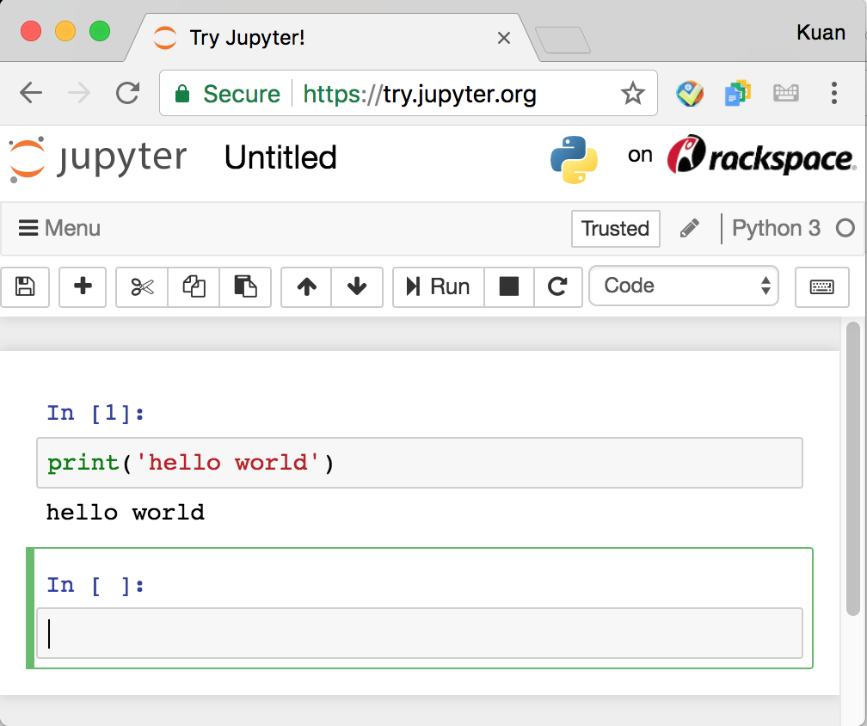
Why Python?
Python is accessible.
Interpreter/Terminal
IDE
Jupyter Notebook

Slide 6
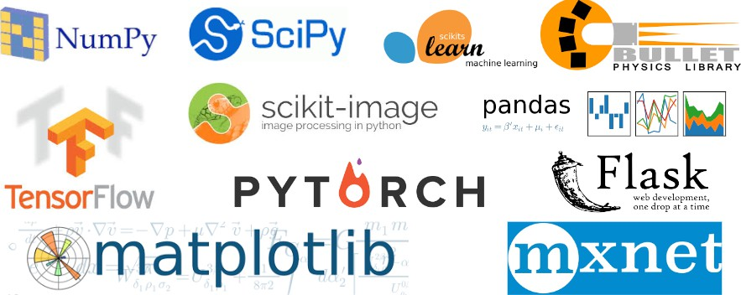
Why Python?
Python has many many awesome packages.

Slide 7
How to Set up Python?
Helpful to maintain the versions of packages
Install Anaconda (https://www.anaconda.com)
Create a Environment with Python 3.X (depends on your usage)
conda create --name myenvname python=3.8 (create environment)
conda env list
conda activate myenvname
conda deactivate
Install Packages (under an environment)
conda install numpy
pip install numpy
(check environments)
(enter an environment)
(leave an environment)
(try this first)
(if fail to install by “conda”)

Slide 8
Reference
https://www.anaconda.com/download https://ithelp.ithome.com.tw/articles/10192460?sc=hot https://me1237guy.pixnet.net/blog/post/70679227 https://stackoverflow.com/questions/64149680/how-can-i-activate-a-conda-environment-from-powershell

Slide 9
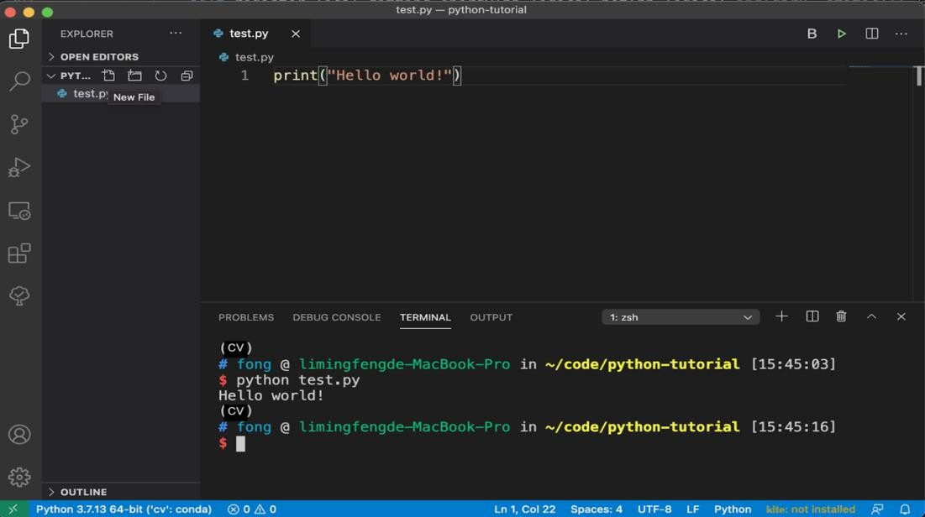
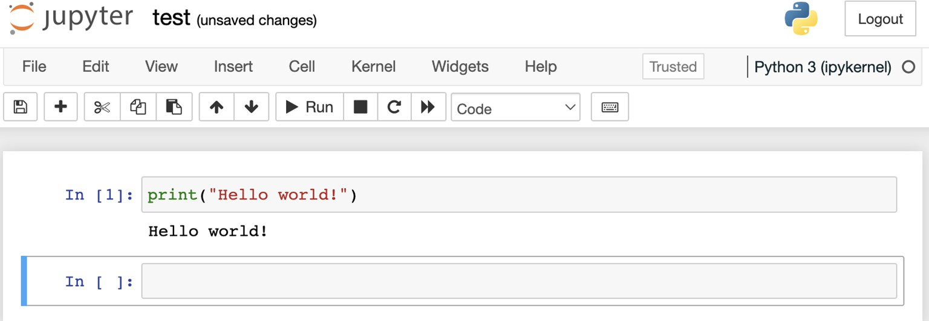
IDE and Editor
VS Code
Jupyter Notebook

Slide 10
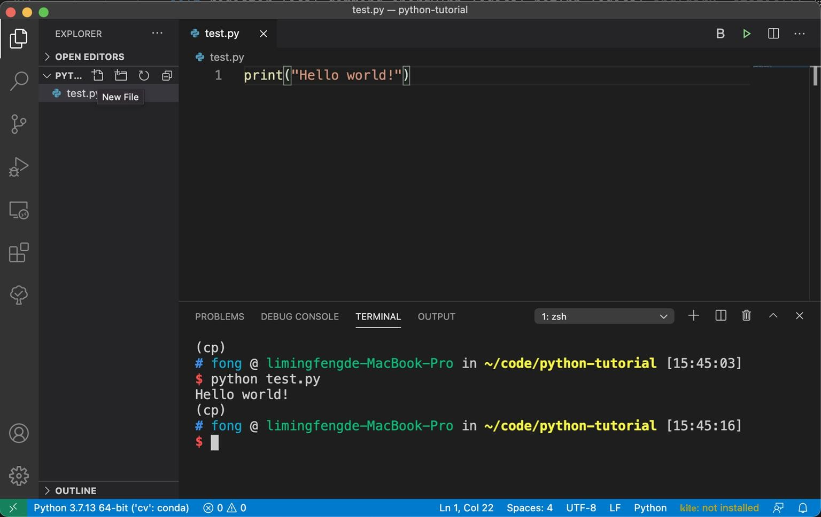
IDE and Editor (VS Code)
Download Link
2. Edit your code
1. Create a new *.py
(CV)
4. Run the *.py file
3. Under your environment
(CV)

Slide 11
IDE and Editor (Jupyter notebook)
Activate your environment
conda activate myenvname
Install Jupyter
conda install jupyter
Open Jupyter Notebook
jupyter notebook
(enter an environment)
(install jupyter)
(open jupyter notebook)

Slide 12
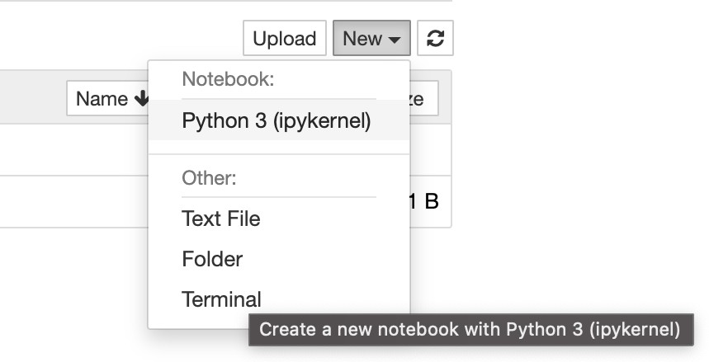
IDE and Editor (Jupyter notebook)
1. Create a new *.ipynb
2. Edit and run your code

Slide 13
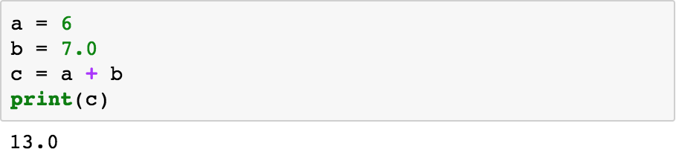
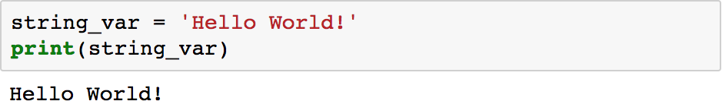
Variable

Slide 14
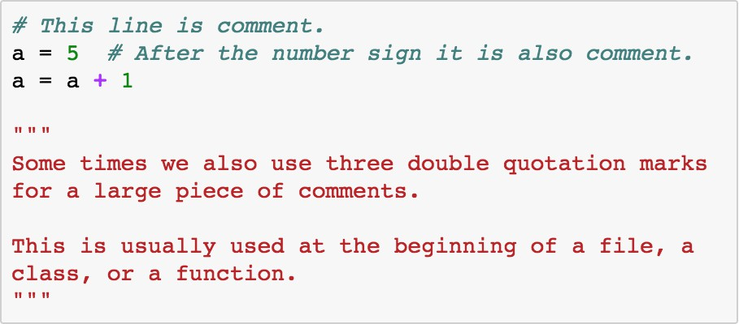
Comment
Hashtag
Quotation

Slide 15
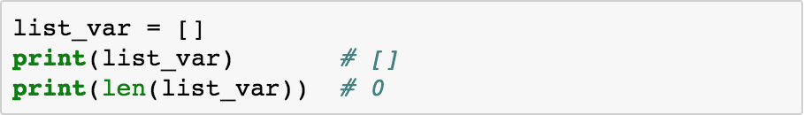
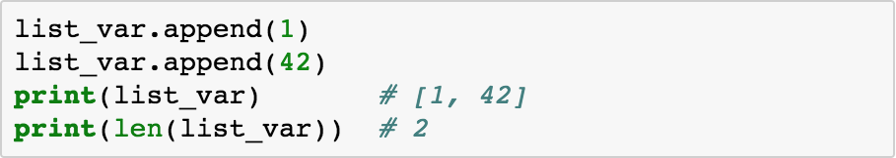
List

Slide 16


List
range

Slide 17
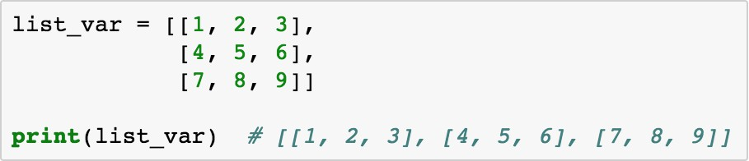
List

Slide 18
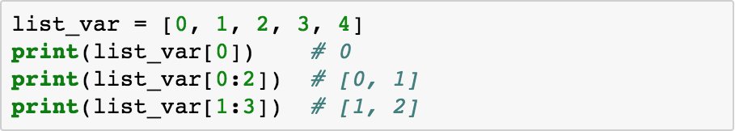
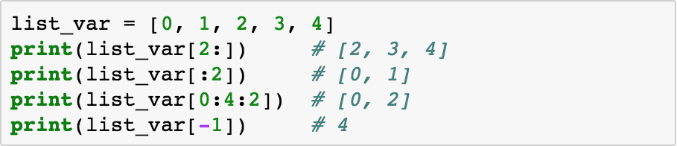
List Indexing

Slide 19
List Indexing

Slide 20
List Indexing

Slide 21
List Indexing

Slide 22
List Indexing

Slide 23
List Indexing

Slide 24
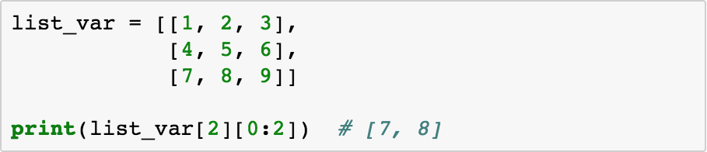
List Indexing

Slide 25

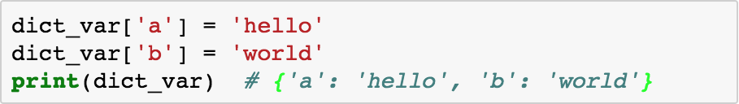
Dictionary (Similar to Map in Java/C++)

Slide 26

Dictionary

Slide 27
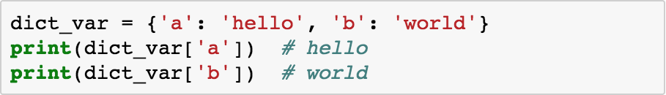
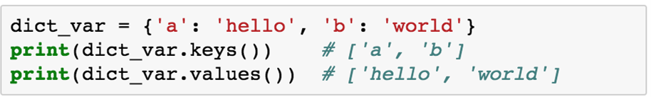
Dictionary Indexing

Slide 28
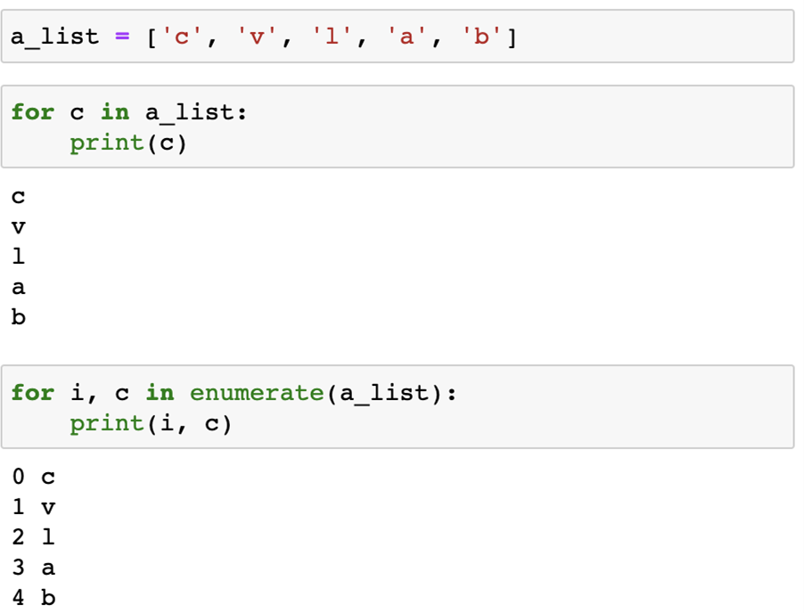
Traversing (List)

Slide 29
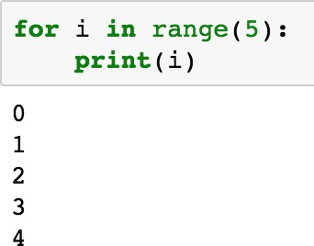
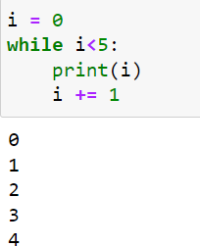
Control Flow

Slide 30
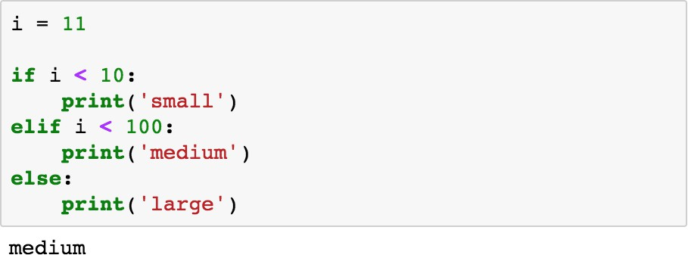
Control Flow

Slide 31
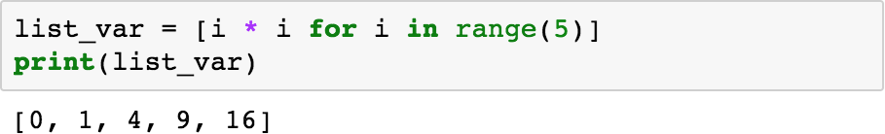
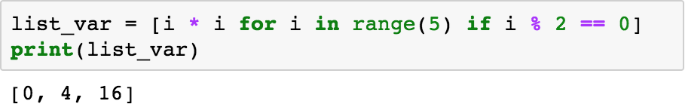
List Comprehension

Slide 32
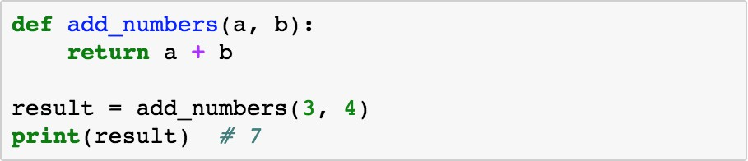
Function

Slide 33
Outline
Python Introduction
Linear Algebra and NumPy
Useful tools
Pandas
Sklearn

Slide 34

Why use Linear Algebra in ML?
As you’ve seen in lecture, it’s useful to represent many quantities, e.g. 2D points
on an image.
Images are literally matrices filled with numbers.
34 | 33 | 32 | 4 | 33
13 | 12 | 12 | 2 | 17
32 | 22 | 11 | 1 | 55
3
4 33
43 33
3
1
3 11
3
2 11
2
3
2 32
2
2 21
2

Slide 35
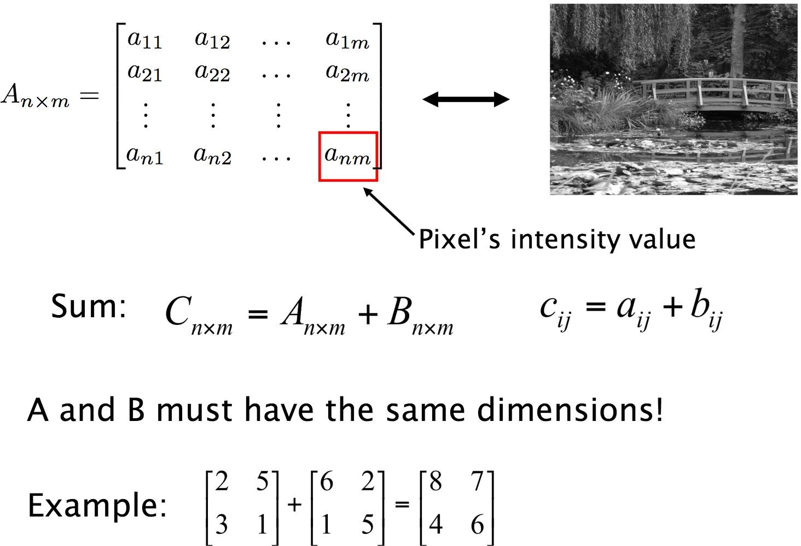
Matrix Review

Slide 36

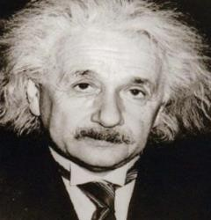
Matrix Review

Slide 37

Matrix Review

Slide 38

Matrices and Vectors in Python (NumPy
)
import numpy as np
An optimized, well-maintained scientific computing package for Python. As time goes on, you’ll learn to appreciate NumPy more and more.

Slide 39

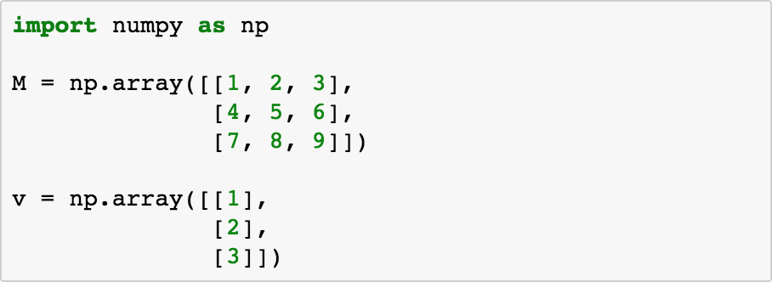
np.ndarray: Matrices and Vectors in Python

Slide 40

np.ndarray: Matrices and Vectors in Python

Slide 41
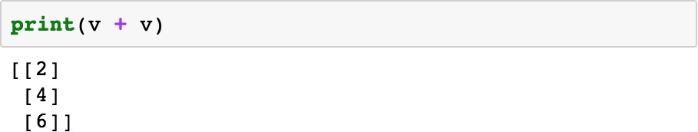
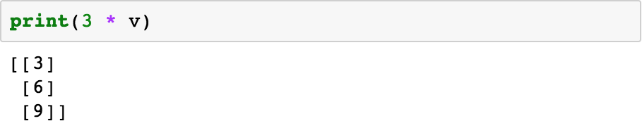
np.ndarray: Matrices and Vectors in Python

Slide 42
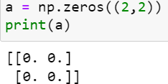
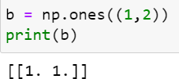
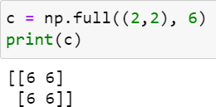
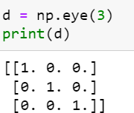
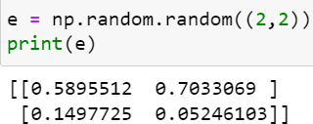
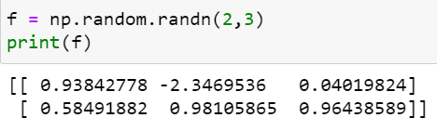
Other Ways to Create Matrices and Vectors
NumPy provides many convenience functions for creating matrices/vectors.
All zeros
All ones
Constant array
3x3 identity matrix
0~1 random values
Normal distribution

Slide 43
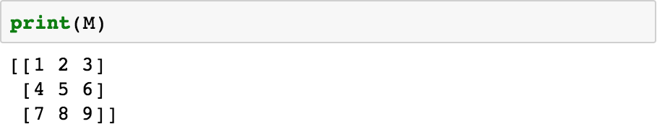
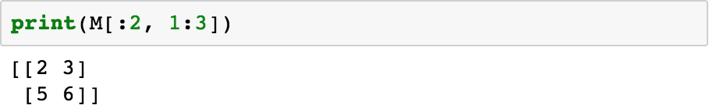
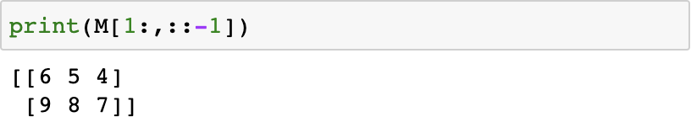
Matrix Indexing

Slide 44
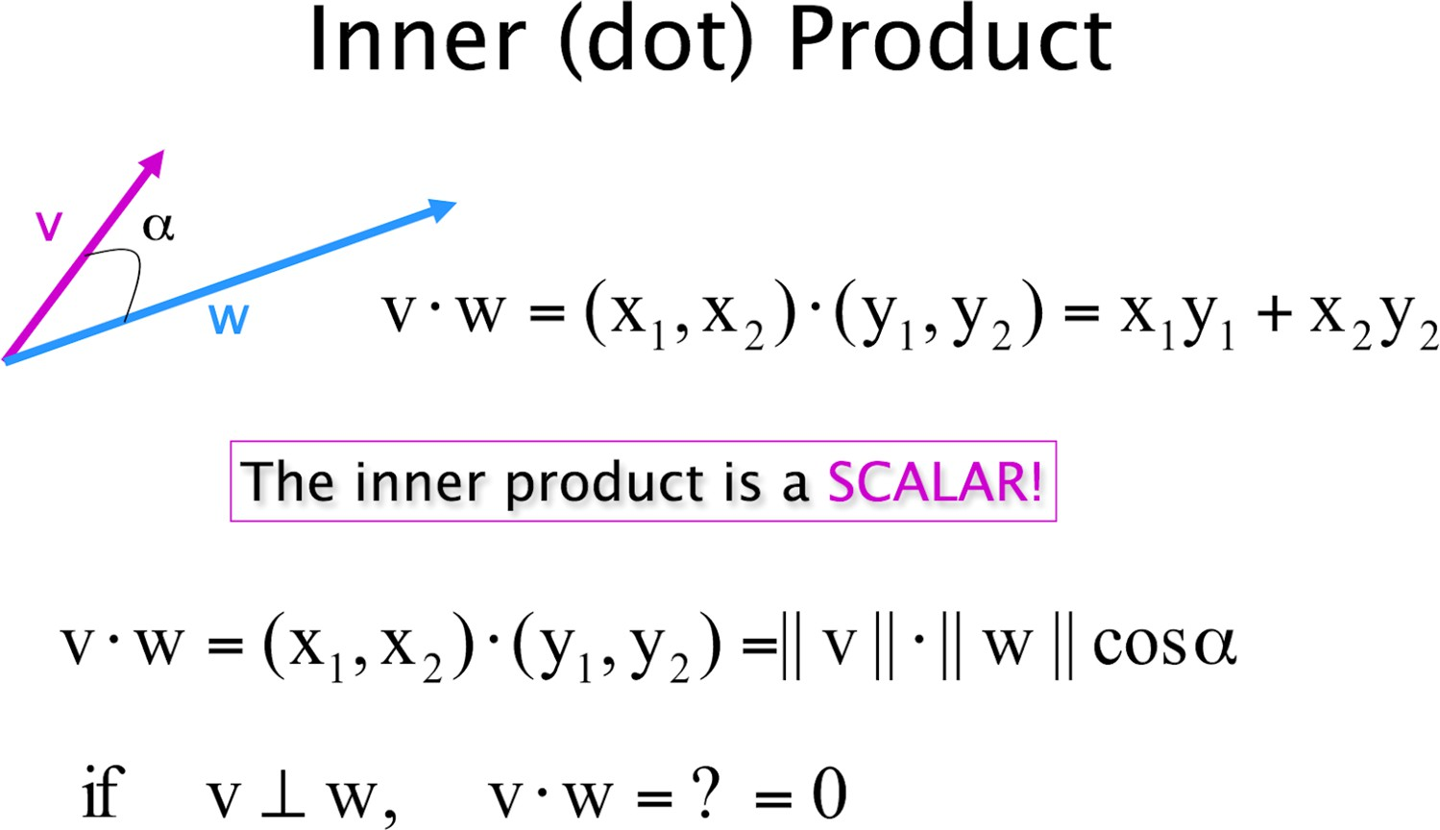
Dot Product

Slide 45
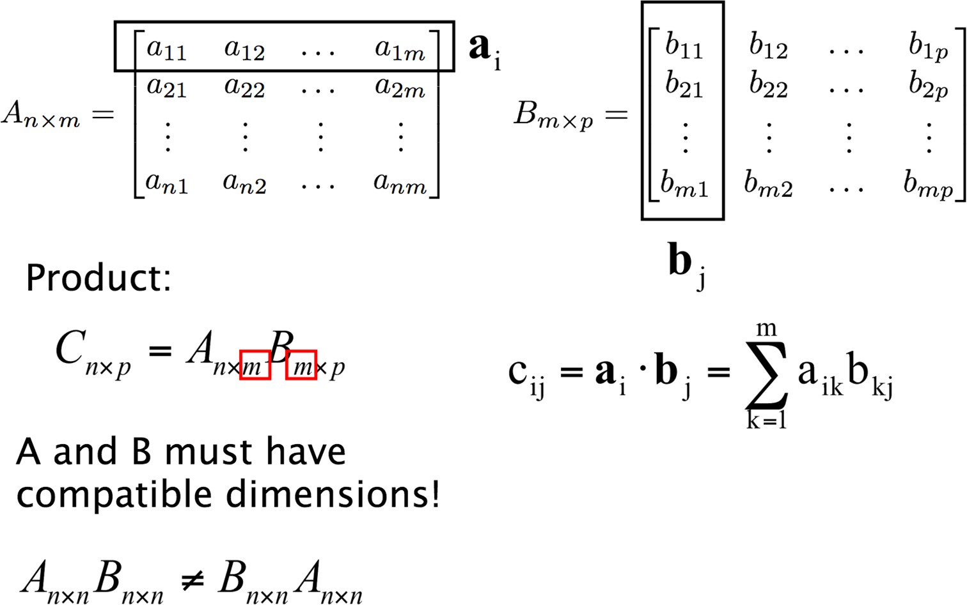
Matrix Multiplication

Slide 46
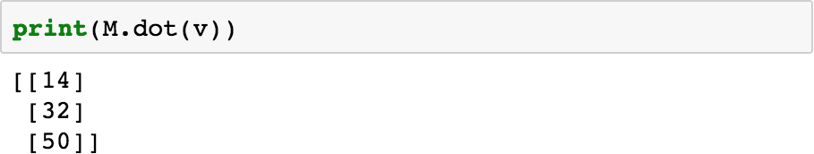
Basic Operations - Dot Multiplication
( M@v )
Matrix multiplication in NumPy can be defined as the dot product between a matrix and a matrix/vector.

Slide 47
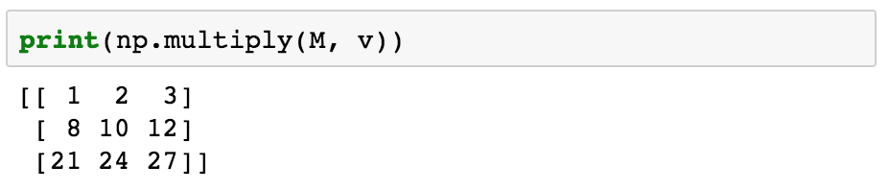

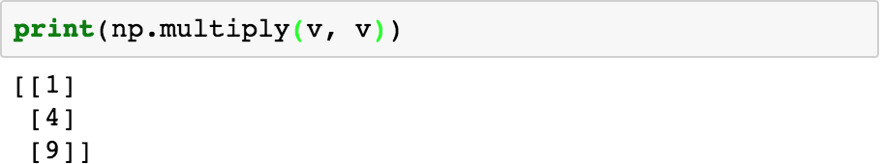
Basic Operations - Element-wise Multiplication
( M * v )

Slide 48
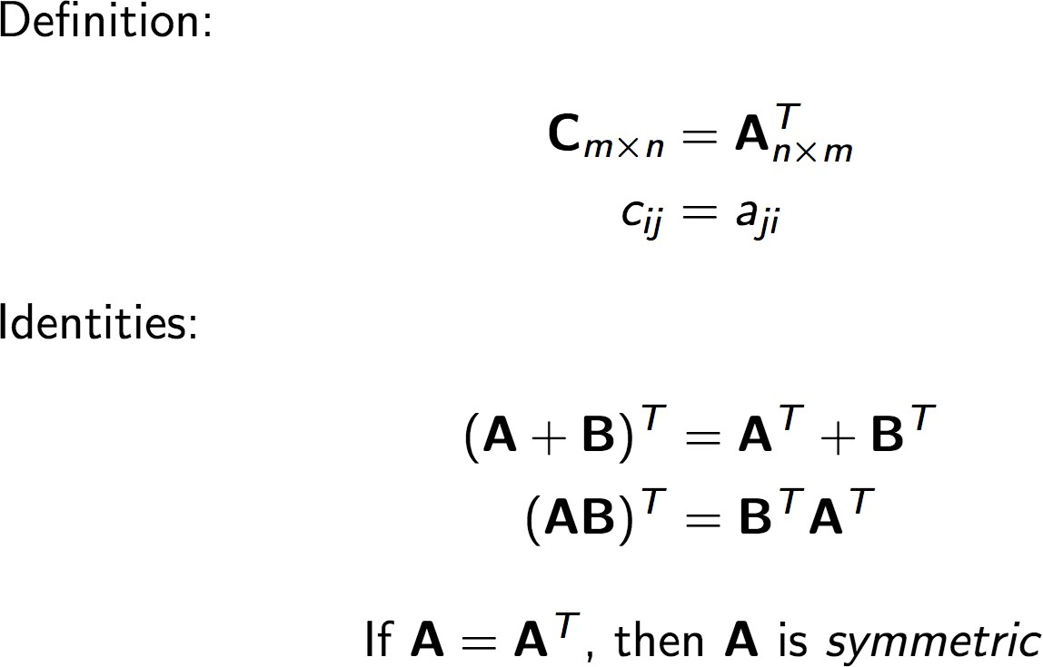
Transpose

Slide 49
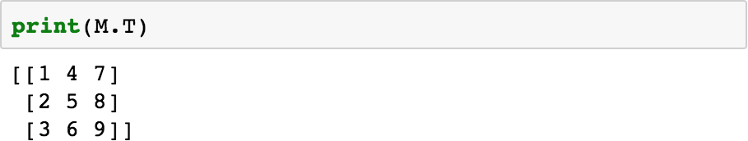
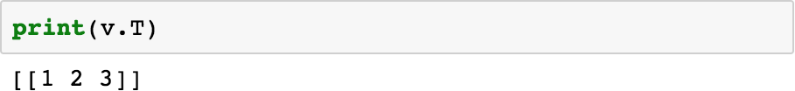

Basic Operations - Transpose

Slide 50

Matrix Determinant

Slide 51

Matrix Inverse

Slide 52



Basic Operations - Determinant and Inverse

Slide 53

Matrix Eigenvalues and Eigenvectors

Slide 54

Matrix Eigenvalues and Eigenvectors

Slide 55


Basic Operations - Eigenvalues, Eigenvectors
NOTE: Please read the NumPy docs on this function before using it, lots more information about multiplicity of eigenvalues and etc there.

Slide 56

Singular Value Decomposition
Image source: Wikipedia

Slide 57
Singular Value Decomposition
Image source: Wikipedia

Slide 58

Singular Value Decomposition
Recall SVD is the factorization of a matrix into the product of 3 matrices, and is formulated like so:
M = UΣV^{T}

Slide 59


Numpy Array Copy
1. “np_array” and “np_array_copy” share the same data address
2. “np_array” and “np_array_copy” have different data addresses

Slide 60
Outline
Python Introduction
Linear Algebra and NumPy
Useful tools
Pandas
Sklearn

Slide 61

Pandas
Pandas is a data analysis module for python.
Provide high-performance, easy-to-use data format for users to quickly operate and analyze data

Slide 62





Pandas
Insert the element to dataframe
Pick the element from dataframe
Fill the Nan rows with 0
Delete the NaN element from dataframe

Slide 63

Scikit-Learn (Sklearn)
One of the most famous python modules in the field of machine learning.
Simple and efficient tools for data mining and data analysis.
 | Discrete | Continuous
Supervised | Classification | Regression
Unsupervised | Clustering | Dimensionality Reduction

Slide 64

6 parts of Sklearn
Classification
SVM, Nearest neighbors, NN, etc.

Slide 65


6 parts of Sklearn
Regression
DecisionTreeRegression, AdaBoostRegressor, Nearest neighbors, etc.
Clustering
K-means, Spectral clustering, etc.

Slide 66



6 parts of Sklearn
Dimensionality Reduction
PCA, Feature selection, etc.
Preprocessing
Standardization, Normalization, Encoding, etc.

Slide 67


6 parts of Sklearn
Model selection
Grid search, Cross validation, etc.

Slide 68
Reference
Pandas
https://ithelp.ithome.com.tw/articles/10193421?sc=hot
Sklearn
https://scikit-learn.org/stable/

Slide 69
Thanks!
70

