Slide 1
Course Enrollment System
Dr. Tian
Hadi Alsaleh, Gregory Rice, Zakaria Alsahafi
Software Engineering- CIS474- CIS503

Slide 2
The University needs a new Course Enrollment system The new Course Enrollment system need the following:
Allow the user to add new courses to the system
Allow the user to remove old courses from the system
Allow the user to add/remove students from the courses
Use the Legacy Student table to identify students eligible to add.

Slide 3
Additional Note
The Admitting Department maintains the legacy Student table, so our application will only need to access it to add/remove students from Courses during Enrollment. No GUI is required for the Student Table.

Slide 4
How does our system work
The Add/Remove Course Screen will provide links to Enrollment of each course
The Enrollment Add/Remove Student Screen will provide a way to maintain the Enrollment of each course while using the Legacy Student table to populate the course with students

Slide 5
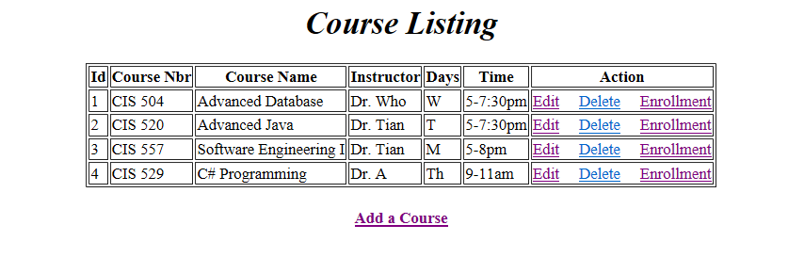

Slide 6
The technology used to build the system
Java
Spring MVC/Jdbc Template
JSP
JSTL
Mysql Database

