Slide 1
PortalPulse
Network progress and execution evidence
Portaldot Hacker House 2026
Node Operations & Tooling
Actual V3 deployment, record(1) and finalized state review
Builder JokerFuFu, with AI-assisted engineering
01 PortalPulse 4 Nov 2026
Notes:
11月4日本人签名部署并record(1)，核心产品采集器按真实事件/最终头/锚定状态生成完整报告。6059a1d为产品采集实现基线，本次更新实际证据、网页范围文案与相对静态路径。项目演示由真实截图和输出组成，离线报告保留三个false信任标志。签名始终由参赛者本人处理。
Sources:
https://github.com/JokerFuFu/portaldot-hacker-house-2026-portalpulse
https://github.com/JokerFuFu/portaldot-hacker-house-2026-portalpulse/blob/main/docs/live-chain-20261104.md
https://jokerfufu.github.io/portaldot-hacker-house-2026-portalpulse/

Slide 2
Operational questions
Node operators
DApp developers
Is this the expected network?
Are best and finalized blocks advancing?
How old is the latest observation?
Did this exact transaction execute?
Has it reached finality?
Does this caller’s stored state match?
PortalPulse keeps each stage and its evidence visible.
02 PortalPulse 4 Nov 2026
Notes:
批准设计目标用户为节点运营者和DApp开发者，未声称访谈、付费客户或收入。本页说明故障分层，具体真实闭环在后页。
Sources:
https://github.com/JokerFuFu/portaldot-hacker-house-2026-portalpulse/blob/main/docs/design.md
https://github.com/JokerFuFu/portaldot-hacker-house-2026-portalpulse/blob/main/docs/execution.md

Slide 3
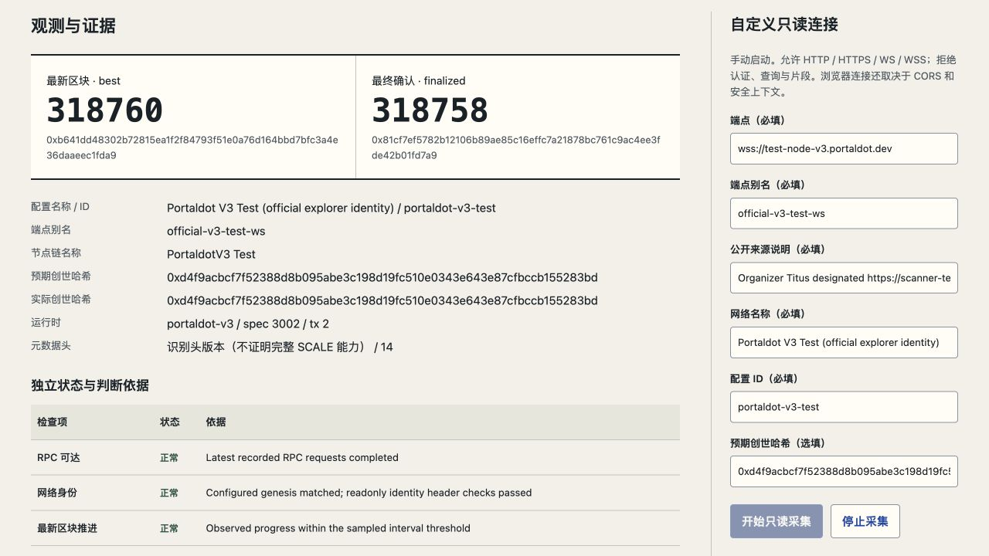
Official V3 browser monitoring
4 Nov, 09:50-09:54 UTC
11 samples / 99 successful reads
Best 318724 to 318760
Finalized 318722 to 318758
Configured genesis matched
Runtime 3002 / transaction 2
Actual public console capture, 4 Nov 2026
03 PortalPulse 4 Nov 2026
Notes:
真实公开Site6浏览器采样窗09:50:25.952至09:54:02.571UTC，11样本99只读RPC成功，best318724-318760/finalized318722-318758。截图当时仍采集中；停止后导出报告保持offline，随后freshness变stale。配置是custom-readonly，不能将其重标成event-testnet；官方来源genesis匹配不等于独立共识。
Sources:
https://github.com/JokerFuFu/portaldot-hacker-house-2026-portalpulse/blob/main/docs/evidence/portalpulse-browser-monitor-20261104.json
https://github.com/JokerFuFu/portaldot-hacker-house-2026-portalpulse/blob/main/docs/live-chain-20261104.md

Slide 4
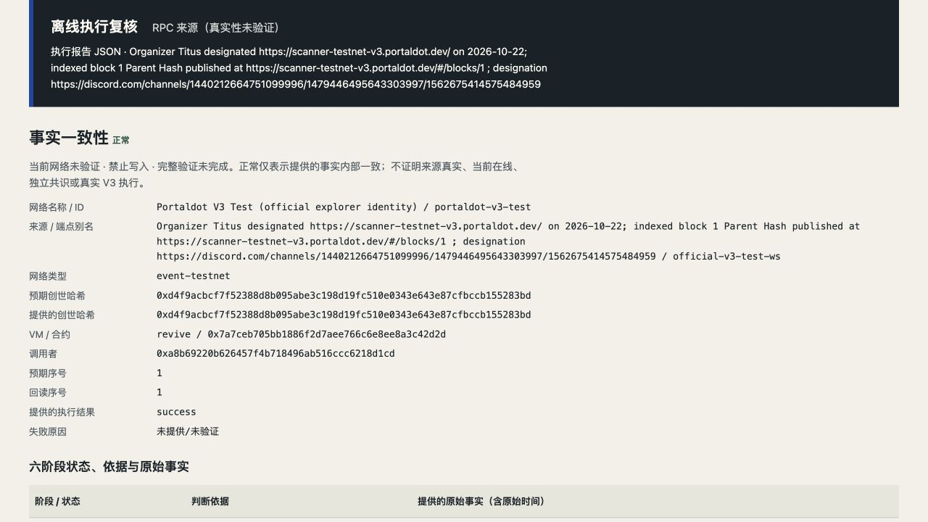
Actual V3 probe execution
Participant record(1), native block 318407
Exact transaction and event phase
Contract and caller matched
Finalized head 318410
Three checked parent links
Pinned EVM code and state
Expected 1
Readback 1
04 PortalPulse 4 Nov 2026
Notes:
实际合约0x7a7ceb705bb1886f2d7aee766c6e8ee8a3c42d2d。更新原生tx0xdbfe322c6fabf4f39f5f21ecfebc2f583a5511ba2e429cd7a38d7ef99785c7f3，native318407/index1。17真实读/exit0，目标phase SequenceRecorded/caller/uint64匹配，最终头318410/3父边，代码352B匹配及caller state1。截图显示原始RPC来源与offline、三个false边界。实际浏览器导出/文件重导入和CLI重放保持digest6dcdad84f91ac6ebd74ef333fb9371bea8839a9433ba2bc789edccd6dc12bf5b。
Sources:
https://github.com/JokerFuFu/portaldot-hacker-house-2026-portalpulse/blob/main/docs/evidence/portalpulse-v3-execution-report-20261104.json
https://github.com/JokerFuFu/portaldot-hacker-house-2026-portalpulse/blob/main/docs/evidence/portalpulse-v3-collection-20261104.json
https://github.com/JokerFuFu/portaldot-hacker-house-2026-portalpulse/blob/main/docs/live-chain-20261104.md

Slide 5
Shared evidence architecture
Implemented collection and review paths. Wallet signing stays with the participant.
Readonly
network adapter
Web console
and local CLI
Normalized records
and versioned reports
Offline execution
evidence evaluator
Native Revive
readback collector
V3 deployed probe
Caller-specific uint64 state
05 PortalPulse 4 Nov 2026
Notes:
原位复用八页模板的原生可编辑架构与连接器，全部实线表示这些路径已实现。参与者钱包独立执行部署/更新，采集器只读原生Revive事件和EVM状态；网页不接收私钥或执行签名。报告的normal为事实关联，独立共识/存储证明未实现。产品collector最大32父边/90秒，部署专用helper单独46边不扩大产品窗口。
Sources:
https://github.com/JokerFuFu/portaldot-hacker-house-2026-portalpulse/blob/main/docs/design.md
https://github.com/JokerFuFu/portaldot-hacker-house-2026-portalpulse/blob/main/docs/probe-readback.md
https://github.com/JokerFuFu/portaldot-hacker-house-2026-portalpulse/blob/main/contracts/PortalPulseProbe.sol

Slide 6
Real evidence and verification scope
Deployment and report loop
Trust and negative tests
New native deployment at 318063
Empty parent code, 352-byte runtime
Initial caller state 0, then update to 1
Browser JSON export and file reimport
Four actual A4 report pages
All six real-report stages normal
Six failure rehearsals use synthetic facts
Wrong genesis rejected in real browser
594 tests at the 3 Nov baseline
Saved report supports historical replay
Offline RPC reports retain verifiedNetwork=false, writeAllowed=false, fullVerification=false.
Independent consensus and trie/storage proofs remain outside scope.
06 PortalPulse 4 Nov 2026
Notes:
新部署tx0x2ea2e1a719b819f168807b6b3f97d618fc0bff2cbe2817f938803f5c6632e3b5，真实成功/Instantiated/父空代码/纳入最终352B匹配。实际下载JSON重导入与CLI重放通过，实际Chrome打印4A4页逐页看过。错误网络负例只故意换expectedgenesis，9真实样本identityabnormal。失败/revert/fork/错交易/读回不符负例仅人工测试，未诱导真实失败交易。594测试历史归11月3日，最新完整包记录另见development-evidence。
Sources:
https://github.com/JokerFuFu/portaldot-hacker-house-2026-portalpulse/blob/main/docs/evidence/portalpulse-v3-deployment-20261104.json
https://github.com/JokerFuFu/portaldot-hacker-house-2026-portalpulse/blob/main/docs/evidence/portalpulse-browser-identity-mismatch-20261104.json
https://github.com/JokerFuFu/portaldot-hacker-house-2026-portalpulse/blob/main/docs/acceptance.md
https://github.com/JokerFuFu/portaldot-hacker-house-2026-portalpulse/blob/main/docs/development-evidence.md

Slide 7
V3 integration and submission
Native Revive and EVM state
Submission and Demo Day
Official-source genesis crosschecked
Native/EVM account mapping checked
Finite storage bounds dry-run before signing
Participant signed deployment and record
Exact events and state readback retained
20 Oct Check-in submitted as Build 50050
4 Nov Real participant-probe flow complete
6 Nov, 12:00 Final deadline and code freeze
8-9 Nov UTC Demo Day dates
solc 0.8.24, Paris, optimizer 200
384-byte creation / 352-byte runtime
Final deadline in Asia/Shanghai
Organizer approval and Demo Day slot unconfirmed
07 PortalPulse 4 Nov 2026
Notes:
身份官方来源10月22日，实际签名者/映射/新鲜余额/有限cap/fee11月4日核对后由本人签名。部署实际费0.05110751235041tPOT、Code/Storagehold40.566tPOT，record预检cap7.683tPOT，值0；不是通用预算。原始Check-in10月20日submitted/UnderReview，不把原项目可编辑视为审核通过。截止11月6日04UTC/12北京时间、DemoDay11月8-9UTC为11月3日官方页实读排期，具体slot待官方。
Sources:
https://github.com/JokerFuFu/portaldot-hacker-house-2026-portalpulse/blob/main/docs/evidence/checkin-submission-20261020.json
https://github.com/JokerFuFu/portaldot-hacker-house-2026-portalpulse/blob/main/docs/live-chain-20261104.md
https://dorahacks.io/hackathon/portaldot-hacker-house-2026/detail

Slide 8
Portaldot ecosystem contribution
V3 integration and continued support
V3 combines native Revive events with EVM state.
PortalPulse keeps their transaction evidence linked.
Support would fund operator trials and broader runtime coverage.
Hosted monitoring and shared history remain product hypotheses.
Public console
jokerfufu.github.io/portaldot-hacker-house-2026-portalpulse/
Source
github.com/JokerFuFu/portaldot-hacker-house-2026-portalpulse
08 PortalPulse 4 Nov 2026
Notes:
单人builderJokerFuFu，AI辅助开发，保留比赛期有效提交。利用PortaldotV3原生Revive+EVM双域关联链上执行和caller状态。基础实链探针闭环已完成；继续支持具体用于运营者试用、故障复现反馈和更广runtime覆盖。托管监测/共享历史仍为产品假设，无虚构收入客户。正式平台材料与排期另跟踪。
Sources:
https://github.com/JokerFuFu/portaldot-hacker-house-2026-portalpulse
https://github.com/JokerFuFu/portaldot-hacker-house-2026-portalpulse/blob/main/docs/design.md
https://github.com/JokerFuFu/portaldot-hacker-house-2026-portalpulse/blob/main/docs/live-chain-20261104.md
https://jokerfufu.github.io/portaldot-hacker-house-2026-portalpulse/

