Slide 1
PortalPulse
Network progress and execution evidence
Portaldot Hacker House 2026
Node Operations & Tooling
V3 readonly integration and offline evidence review
Probe deployment and live update pending
01 PortalPulse | 04 Nov 2026
Notes:
PortalPulse 面向节点运营者与 DApp 开发者。当前快照以11月3日源码6059a1d为产品基线，11月4日材料刷新。官方V3只读监控、原生交易采集和报告已实现。真实新探针部署及更新仍待本人钱包确认和签名，本页不是最终提交回执。
Sources:
https://github.com/JokerFuFu/portaldot-hacker-house-2026-portalpulse/tree/6059a1dbde747501be826696573a06a35ae28178
https://portalpulse-jokerfufu-2026-readonly.jokerfu.chatgpt.site/
https://dorahacks.io/hackathon/portaldot-hacker-house-2026/detail

Slide 2
Operational questions
Node operators
DApp developers
Is this the expected network?
Are best and finalized blocks advancing?
How old is the latest observation?
Did this exact transaction execute?
Has it reached finality?
Does this caller’s stored state match?
PortalPulse keeps each stage and its evidence visible.
02 PortalPulse | 04 Nov 2026
Notes:
节点运营者和DApp开发者是批准设计的目标用户。本页描述设计问题，不代表已经外部访谈或商业验证。产品逐阶段展示具体证据，缺失与失败会保留。
Sources:
https://github.com/JokerFuFu/portaldot-hacker-house-2026-portalpulse/blob/6059a1dbde747501be826696573a06a35ae28178/docs/design.md
https://github.com/JokerFuFu/portaldot-hacker-house-2026-portalpulse/blob/6059a1dbde747501be826696573a06a35ae28178/docs/execution.md

Slide 3
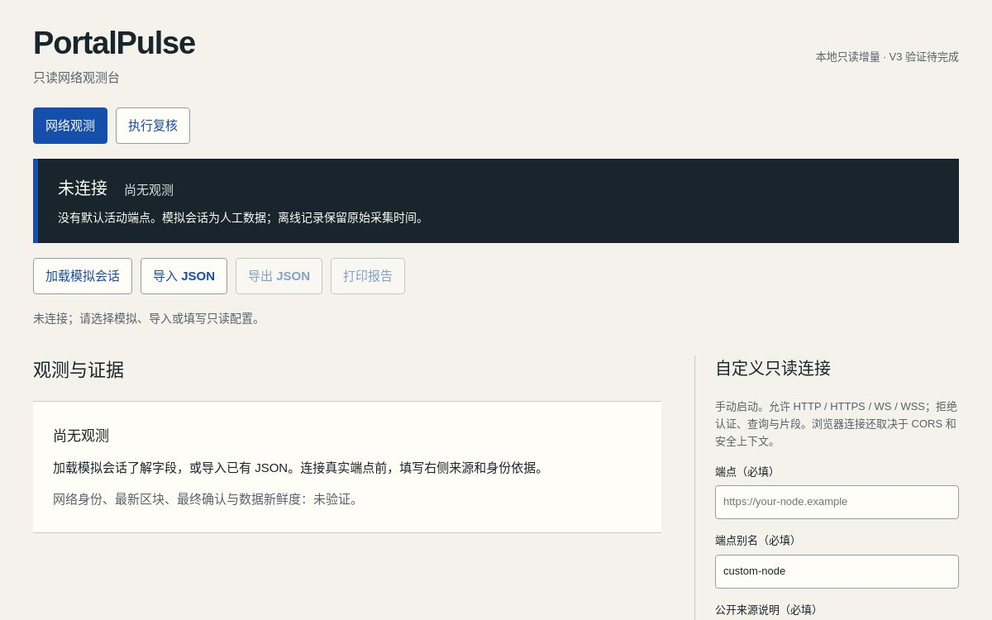
Official V3 observation
4 Nov 2026, 02:08-02:09 UTC
4 samples / 36 successful RPC reads
Best blocks 314148 to 314159
Finalized blocks 314146 to 314157
Configured genesis matched
Runtime 3002 / transaction 2
UI capture 16 Oct; CLI observations 4 Nov.
03 PortalPulse | 04 Nov 2026
Notes:
左列为11月4日实际CLI collect的四样本结果，共36个只读请求，02:08:16.520Z至02:09:21.268Z。所有采样检查normal，live verifiedNetwork=true仅表示与配置中的官方来源genesis匹配，不代表独立共识。右图保留10月16日真实公开UI未连接初始截图，不将旧图改称新监测截图。导入同一报告后mode=offline、verifiedNetwork=false，原始日期保留。
Sources:
https://github.com/JokerFuFu/portaldot-hacker-house-2026-portalpulse/blob/main/docs/materials/20261104/monitor-report.json
https://github.com/JokerFuFu/portaldot-hacker-house-2026-portalpulse/blob/6059a1dbde747501be826696573a06a35ae28178/examples/portaldot-v3-config-20261022.json
https://portalpulse-jokerfufu-2026-readonly.jokerfu.chatgpt.site/

Slide 4
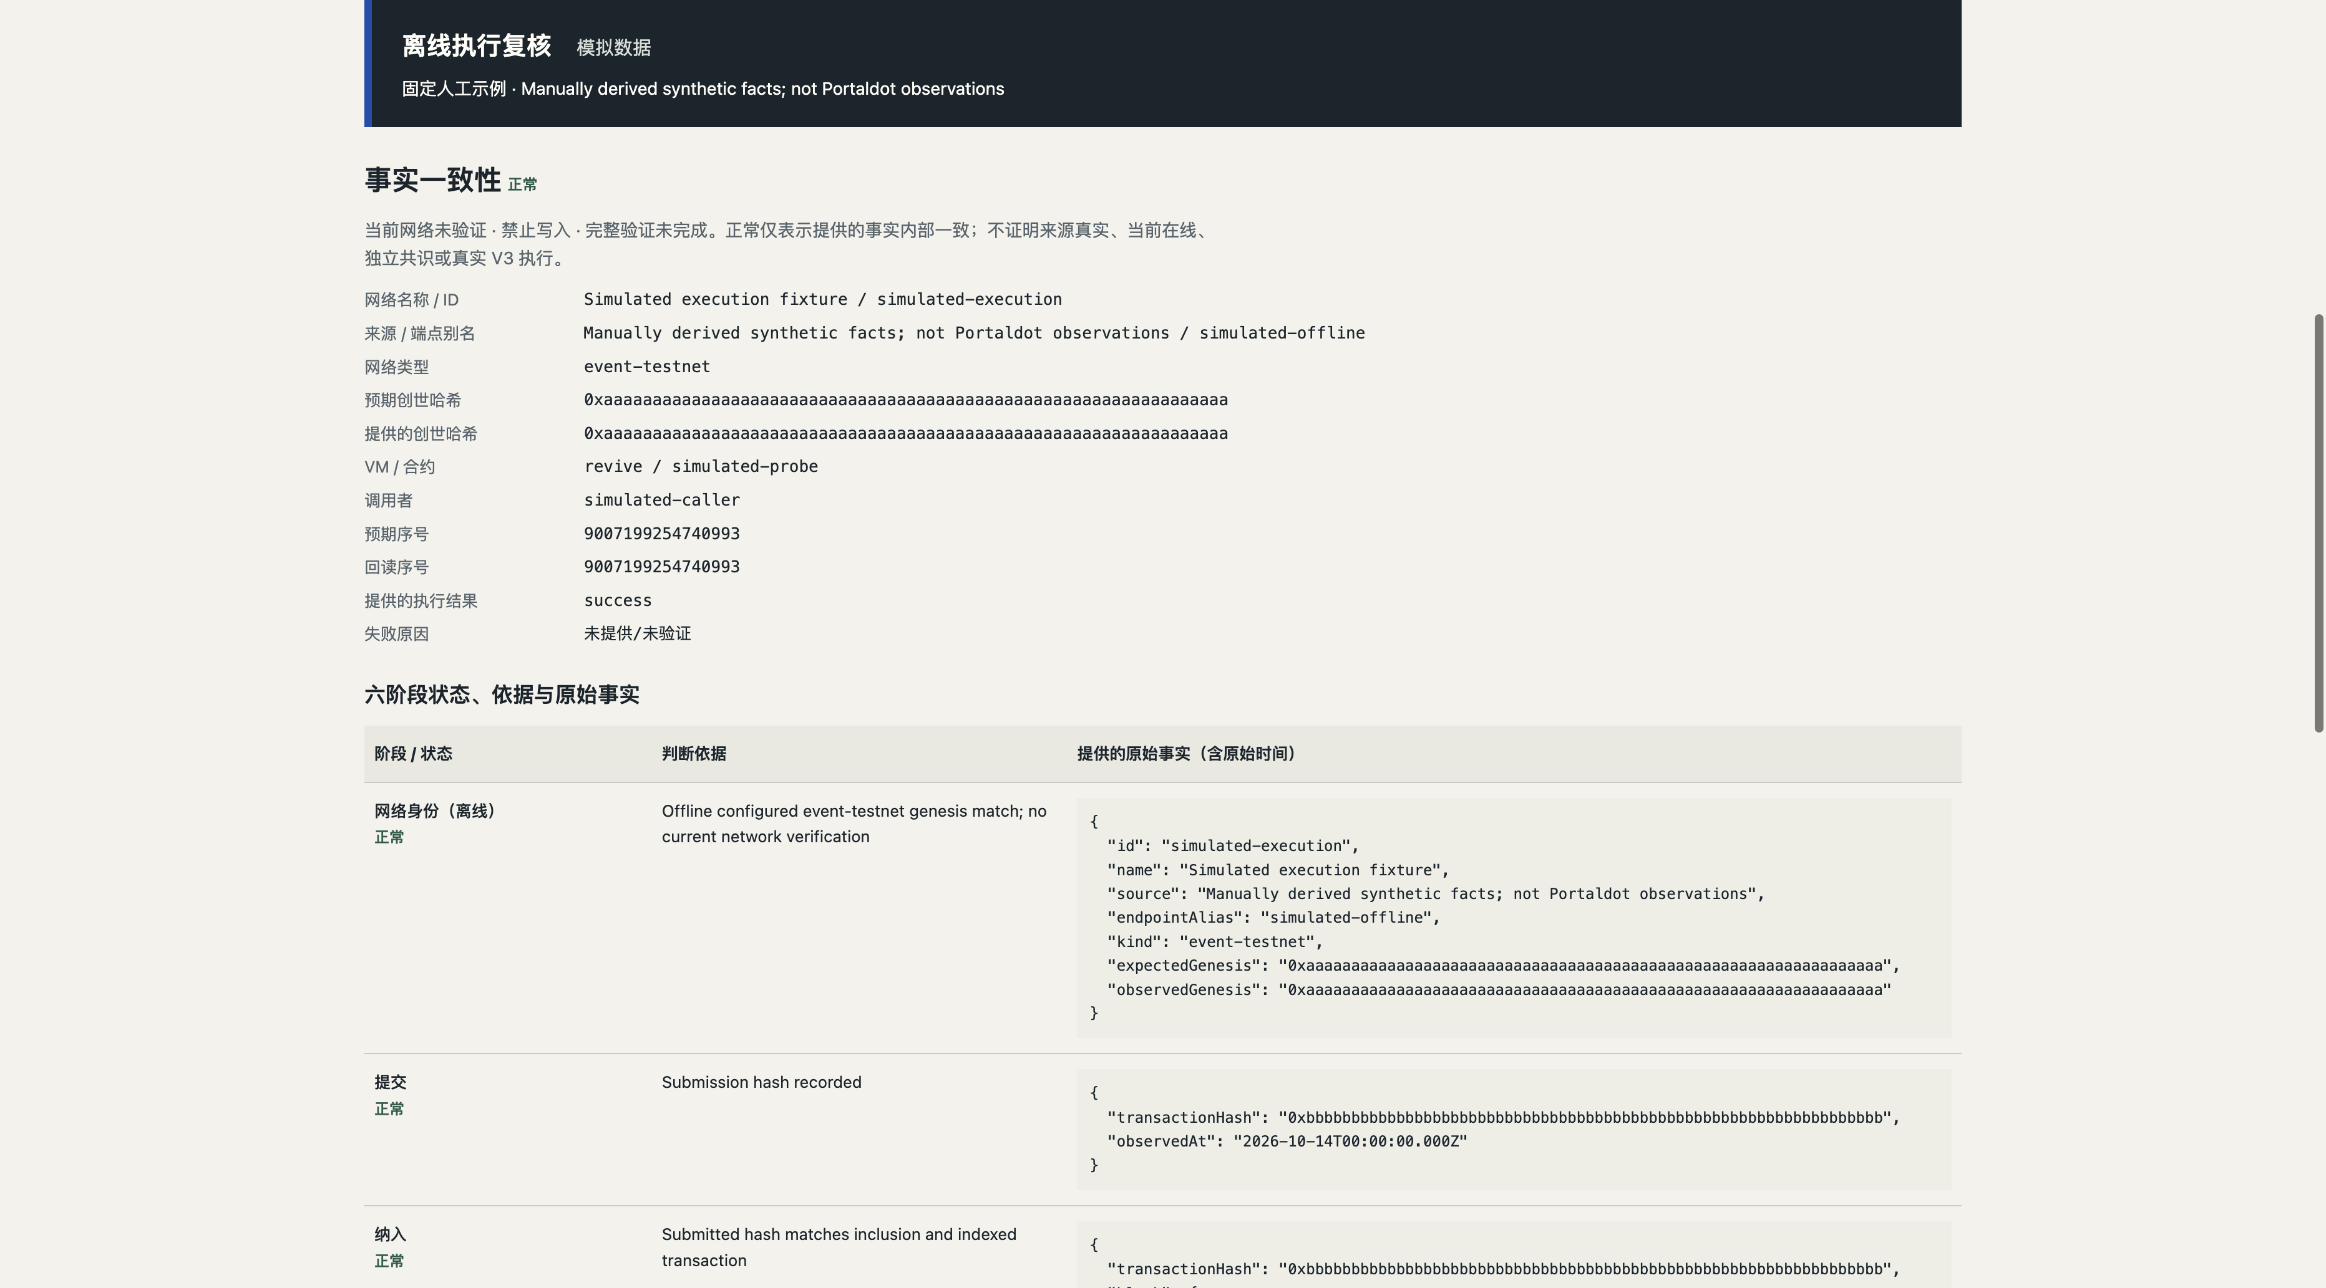
Native probe readback and offline review
Six-stage report UI | synthetic capture, 16 Oct
Native collector correlates
exact event and caller
Links native parent headers
Pins EVM code and uint64
state reads to block hashes
Full probe path tested
with artificial fixtures
04 PortalPulse | 04 Nov 2026
Notes:
截图为10月16日真实网页中的人工执行数据，依旧属于synthetic/offline。11月3日新增只读CLI按目标phase匹配Revive.ContractEmitted，核对contract/caller/uint64，检查原生父头路径和EVM锚定代码/状态，复用ExecutionReport v1供现有网页导入。最多32父边，支持的实际交易路线为原生Revive；使用EVM直接交易需额外关联原生extrinsic。完整探针正例由人工夹具和本地HTTP服务验证，尚无本项目实链部署及更新。
Sources:
https://github.com/JokerFuFu/portaldot-hacker-house-2026-portalpulse/blob/6059a1dbde747501be826696573a06a35ae28178/docs/probe-readback.md
https://github.com/JokerFuFu/portaldot-hacker-house-2026-portalpulse/blob/6059a1dbde747501be826696573a06a35ae28178/scripts/probe-observation.mjs
https://github.com/JokerFuFu/portaldot-hacker-house-2026-portalpulse/blob/6059a1dbde747501be826696573a06a35ae28178/tests/probe-observation.test.mjs
https://portalpulse-jokerfufu-2026-readonly.jokerfu.chatgpt.site/

Slide 5
Shared evidence architecture
Solid: implemented read paths Dashed: pending wallet deployment
Readonly
network adapter
Web console
and local CLI
Normalized records
and versioned reports
Offline execution
evidence evaluator
Native Revive
readback collector
Compiled probe
Wallet deployment pending
05 PortalPulse | 04 Nov 2026
Notes:
原始八页PPTX导入后原位修改，保留1280x720、Arial、颜色、布局、原生可编辑架构与两张原始UI截图。只读collector已经实现，故其边框及连接到核验器的路径改为实线。探针合约本地编译完成，钱包部署路径仍虚线。报告导入在本机执行，fullVerification/writeAllowed均false，不在网页中接收钱包密钥。
Sources:
https://github.com/JokerFuFu/portaldot-hacker-house-2026-portalpulse/blob/6059a1dbde747501be826696573a06a35ae28178/docs/probe-readback.md
https://github.com/JokerFuFu/portaldot-hacker-house-2026-portalpulse/blob/6059a1dbde747501be826696573a06a35ae28178/docs/probe-toolchain.md
https://github.com/JokerFuFu/portaldot-hacker-house-2026-portalpulse/blob/6059a1dbde747501be826696573a06a35ae28178/docs/design.md

Slide 6
Evidence available for review
Historical RPC evidence
Implementation and remaining proof
3 Nov, inclusion block 299780
Finalized head 299784
4 checked parent links
Zero-address code/call returned 0x
Missing block hashes were rejected
594 tests passed on 3 Nov
Local probe runtime reproduced
Actual signer and final budget pending
New deployment and update pending
Caller state on real probe pending
Historical report remains unverified; probe intent uses zero-address placeholders.
Offline review: verifiedNetwork=false, writeAllowed=false, fullVerification=false.
06 PortalPulse | 04 Nov 2026
Notes:
历史采集与完整探针夹具必须区分。11月3日真实RPC历史纳入299780，采集最终头299784，共4条父边，exit2/unverified，无匹配探针事件，caller/contract零地址、submission/execution/readback为空。EIP1898空地址返回0x，不存在哈希明确拒绝，未回退latest。594项测试/类型/构建属于11月3日最终6059源码，不把今天材料刷新写成重跑全套。11月4日本地probe重编译与22日产物字节相同。
Sources:
https://github.com/JokerFuFu/portaldot-hacker-house-2026-portalpulse/blob/6059a1dbde747501be826696573a06a35ae28178/docs/evidence/probe-readback-20261103.json
https://github.com/JokerFuFu/portaldot-hacker-house-2026-portalpulse/blob/6059a1dbde747501be826696573a06a35ae28178/docs/evidence/probe-readback-historical-report-20261103.json
https://github.com/JokerFuFu/portaldot-hacker-house-2026-portalpulse/blob/6059a1dbde747501be826696573a06a35ae28178/docs/probe-toolchain.md

Slide 7
Deployment and submission plan
Wallet preparation
Submission and Demo Day
Confirm selected account and mapping
Refresh funds and transaction fee
Review finite storage budget
User signs deployment and record
Collect exact finalized probe evidence
20 Oct Check-in submitted as Build 50050
4 Nov Core target, live writes pending
6 Nov, 12:00 Final submit and code freeze
8-9 Nov UTC Demo Day dates
solc 0.8.24, Paris, optimizer 200
384-byte creation / 352-byte runtime
Final deadline in Asia/Shanghai
Review result and Demo Day slot pending
07 PortalPulse | 04 Nov 2026
Notes:
网络身份已于10月22日核实，不再说genesis待确认。原生构造器预检10月27日估算40.566tPOT、候选cap81.132tPOT及零cap反例不是实际签名者预算。需要实际钱包账户/映射/当前可用余额/手续费/有限押金预算，随后本人签名部署和record。Check-in10月20日真实submitted/UnderReview，11月3日公开Build仍可读，但本人审核结论未核实。最终提交及冻结11月6日04:00UTC/12:00北京时间，DemoDay11月8-9UTC日期是11月3日官方页实读事实，本轮Web抓取405、GUI安全闸门未刷新。
Sources:
https://github.com/JokerFuFu/portaldot-hacker-house-2026-portalpulse/blob/6059a1dbde747501be826696573a06a35ae28178/docs/evidence/checkin-submission-20261020.json
https://github.com/JokerFuFu/portaldot-hacker-house-2026-portalpulse/blob/6059a1dbde747501be826696573a06a35ae28178/docs/probe-toolchain.md
https://dorahacks.io/hackathon/portaldot-hacker-house-2026/detail

Slide 8
Portaldot ecosystem contribution
V3 integration and continued support
V3 combines native Revive events with EVM state.
PortalPulse keeps their transaction evidence linked.
Support would fund real-probe validation and operator trials.
Hosted monitoring and shared history remain product hypotheses.
Public prototype
portalpulse-jokerfufu-2026-readonly.jokerfu.chatgpt.site
Source
github.com/JokerFuFu/portaldot-hacker-house-2026-portalpulse
08 PortalPulse | 04 Nov 2026
Notes:
单人团队JokerFuFu，负责项目设计、工程实现和演示，使用AI辅助开发并保留比赛期实际提交。项目利用Portaldot V3原生Revive与EVM双域，关联事件、链头和caller状态是当前具体集成点。请求长期支持的用途为完成真实探针、引导运营者试用、收集重复使用与错误复现反馈。托管监测/共享历史为未来商业假设，没有已验证收入或客户数据。
Sources:
https://github.com/JokerFuFu/portaldot-hacker-house-2026-portalpulse/tree/6059a1dbde747501be826696573a06a35ae28178
https://github.com/JokerFuFu/portaldot-hacker-house-2026-portalpulse/blob/6059a1dbde747501be826696573a06a35ae28178/docs/design.md
https://github.com/JokerFuFu/portaldot-hacker-house-2026-portalpulse/blob/6059a1dbde747501be826696573a06a35ae28178/docs/probe-readback.md
https://portalpulse-jokerfufu-2026-readonly.jokerfu.chatgpt.site/

