Slide 1
PortalPulse
Network progress and execution evidence
Portaldot Hacker House 2026
Node Operations & Tooling
Readonly and offline prototype
Synthetic demonstration. Recognized V3 deployment pending.
01 PortalPulse
Notes:
PortalPulse 面向节点运营者和 DApp 开发者。当前展示公开只读与离线原型，所有样例明确标为合成。尚无主办方认可的 V3 部署或真实状态回读。
Sources:
https://dorahacks.io/hackathon/portaldot-hacker-house-2026/detail
https://github.com/JokerFuFu/portaldot-hacker-house-2026-portalpulse/tree/33919c5472974a7d7709b0b116a7bd888f27203b
https://portalpulse-jokerfufu-2026-readonly.jokerfu.chatgpt.site

Slide 2
Operational questions
Node operators
DApp developers
Is this the expected network?
Are best and finalized blocks advancing?
How old is the latest observation?
Did this exact transaction execute?
Has it reached finality?
Does this caller’s stored state match?
PortalPulse keeps each stage and its evidence visible.
02 PortalPulse
Notes:
RPC 返回成功只回答部分问题。将网络身份、推进、精确交易执行、最终确认及同 caller/contract 状态回读分别呈现，避免一个总绿灯掩盖缺证。这些是项目设计中的目标用户问题，不代表经过外部用户访谈验证。
Sources:
https://github.com/JokerFuFu/portaldot-hacker-house-2026-portalpulse/tree/33919c5472974a7d7709b0b116a7bd888f27203b/docs/design.md

Slide 3
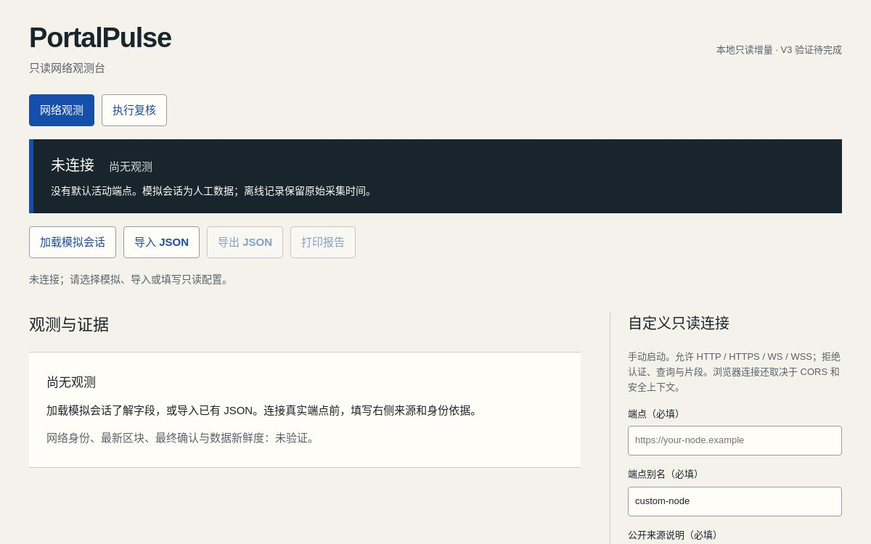
Network observation
1 Start with no default endpoint
2 Load the explicit simulated sample
3 Inspect identity, block progress and collection times
4 Export or import a bounded report
Actual initial view. No live connection or observations.
03 PortalPulse
Notes:
这是当前公开网页的真实初始截图，未连接且无观测。截图不是实链运行证明。演示中可主动加载模拟会话，或在核实可信配置后手动启动只读观测。原始时间与来源会保留。Image: PortalPulse public Site native screenshot, 2026-10-16, initial unconnected view.
Sources:
https://portalpulse-jokerfufu-2026-readonly.jokerfu.chatgpt.site
https://github.com/JokerFuFu/portaldot-hacker-house-2026-portalpulse/tree/33919c5472974a7d7709b0b116a7bd888f27203b

Slide 4
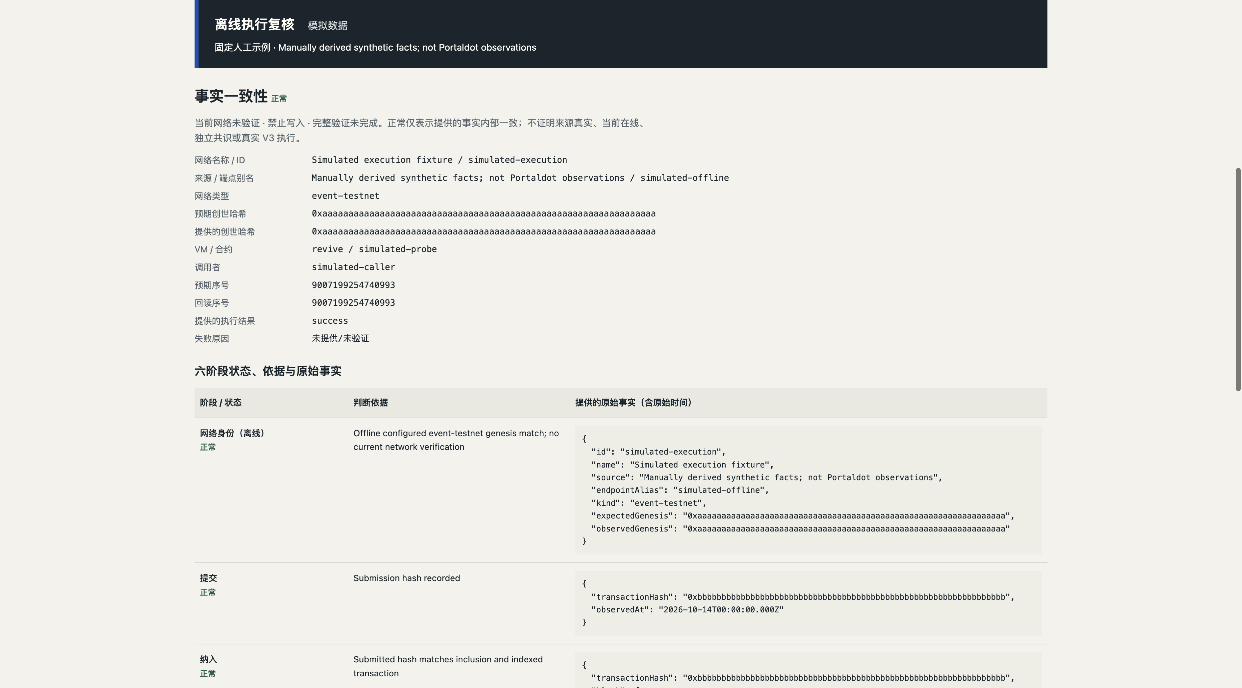
Offline execution review
Six stages of supplied evidence
Import raw facts or a report
Compare exact transaction, finality ancestry and state
Export and re-import with a SHA-256 check
Missing facts stay unverified.
Failures stay abnormal.
04 PortalPulse
Notes:
真实 UI 截图显示合成离线执行样例。六阶段为网络身份、提交、纳入、执行、最终确认祖先链及状态回读。所有事实一致仍只表示输入内部一致，三个验证/写入标志保持 false。SHA-256 只检查内容完整性，不证明来源真实性、当前在线、共识或 V3 执行。Image: actual public Site release 3 browser screenshot, 2026-10-16, synthetic complete evidence.
Sources:
https://portalpulse-jokerfufu-2026-readonly.jokerfu.chatgpt.site
https://github.com/JokerFuFu/portaldot-hacker-house-2026-portalpulse/tree/33919c5472974a7d7709b0b116a7bd888f27203b/docs/execution.md

Slide 5
Shared evidence architecture
Solid: current prototype Dashed: pending recognized V3 integration
Readonly
network adapter
Web console
and local CLI
Normalized records
and versioned reports
Offline execution
evidence evaluator
Recognized V3
and live collector
Probe contract
User wallet confirms writes
05 PortalPulse
Notes:
该技术架构图为原生可编辑对象。当前网页/CLI、只读网络适配器、离线执行核验器及统一版本化报告已经实现。虚线部分表示待完成的认可 V3 网络、真实执行采集及探针写入。用户钱包确认签名，应用不读取私钥。演示样例与导入事实不会被自动升级为可信实链记录。
Sources:
https://github.com/JokerFuFu/portaldot-hacker-house-2026-portalpulse/tree/33919c5472974a7d7709b0b116a7bd888f27203b/docs/design.md
https://github.com/JokerFuFu/portaldot-hacker-house-2026-portalpulse/tree/33919c5472974a7d7709b0b116a7bd888f27203b/docs/execution.md

Slide 6
Current delivery and evidence limits
Available now
V3 work still pending
Public console and source
Local CLI and portable JSON
Six-stage offline correlation
Strict report integrity checks
Print and pagination accepted
Recognized network and runtime
Mapped, funded deployer
Probe address and deployment transaction
Live finality and anchored state readback
Synthetic / offline verifiedNetwork = false writeAllowed = false
fullVerification = false. A digest checks content integrity only.
06 PortalPulse
Notes:
当前公开原型可使用，但不存在认可 V3 合约地址、部署交易或真实状态回读。界面所有执行复核保持 offline，verifiedNetwork/writeAllowed/fullVerification=false。当前版本已完成真实浏览器报告打印验收。
Sources:
https://portalpulse-jokerfufu-2026-readonly.jokerfu.chatgpt.site
https://github.com/JokerFuFu/portaldot-hacker-house-2026-portalpulse/tree/33919c5472974a7d7709b0b116a7bd888f27203b
https://discord.com/channels/1440212664751099996/1497976354157887680/1560475616669601833

Slide 7
Portaldot integration and delivery dates
Integration gate
Delivery plan
Current organizer configuration
Observed genesis and runtime
Caller mapping and test funds
Then wallet-confirmed probe deployment
Oct 23, 20:00 Internal Check-in target
Oct 24, 20:00 Official Check-in deadline
Nov 4 Core version target
Nov 6, 12:00 Final submission target
Solidity / Revive is a candidate.
Runtime compatibility requires verification.
All times: Asia/Shanghai
Submission requires platform readback.
07 PortalPulse
Notes:
部署前必须核实主办方认可的新配置、实际创世哈希/运行时、映射与余额，不能依赖失效的历史 RPC。Solidity/Revive 来源于固定历史指南，仅为候选路径。现有 PDK/FailLens 已覆盖基础诊断，本项目聚焦持续观察和执行至回读记录。Check-in 内部目标10月23日20:00，官方记录截止10月24日20:00；11月4日核心版本、11月6日12:00前最终提交回读为内部交付目标。所有时间北京时间。
Sources:
https://dorahacks.io/hackathon/portaldot-hacker-house-2026/detail
https://github.com/ItsCogumellum/portaldot-v3-testnet-guide/tree/d671a32758573f4d9ab00d891b2dd6a48f36bcbb
https://portaldot-pdk.vercel.app/

Slide 8
Product potential after testnet validation
Hypothesis
Teams may pay for hosted monitoring,
longer history and shared operating reports.
Validate repeat usage with node operators and DApp teams.
No customer, revenue or pricing claim at this stage.
Public prototype
portalpulse-jokerfufu-2026-readonly.jokerfu.chatgpt.site
Source
github.com/JokerFuFu/portaldot-hacker-house-2026-portalpulse
08 PortalPulse
Notes:
商业方向是待验证假设，包括托管监测、历史留存和团队运行报告。目前没有已验证的客户、收入或价格数据。下一步通过真实测试网使用记录与用户访谈决定是否产品化。项目还未完成 Check-in，不能保证获奖或未来资金支持。
Sources:
https://github.com/JokerFuFu/portaldot-hacker-house-2026-portalpulse/tree/33919c5472974a7d7709b0b116a7bd888f27203b/docs/design.md
https://portalpulse-jokerfufu-2026-readonly.jokerfu.chatgpt.site
https://github.com/JokerFuFu/portaldot-hacker-house-2026-portalpulse

