Slide 1
Optimizing On-Time Delivery through Process Mining
Team Mates Arshitha.R
Jokim Prathap A
Danish Baig

Slide 2
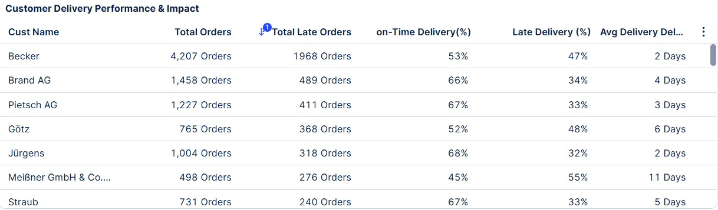
Wood Corp Operates 15% Below Industry OTD Benchmark
Current OTD: 64.46%
Target OTD: 80%
7,091 Late Orders
€5,318 Late Penalty Cost
Avg Delay: 5 Days
Wood Corp is significantly underperforming industry OTD standards, leading to recurring financial and operational inefficiencies.

Slide 3
Data Validation & Event Log Integrity Check
Data Validation & Event Log Integrity Check
Identified timestamp sequencing inconsistencies in activity log
Detected cases where production preceded order receipt
Corrected chronological order to ensure accurate process flow
Validated case-level event integrity before analysis

Slide 4
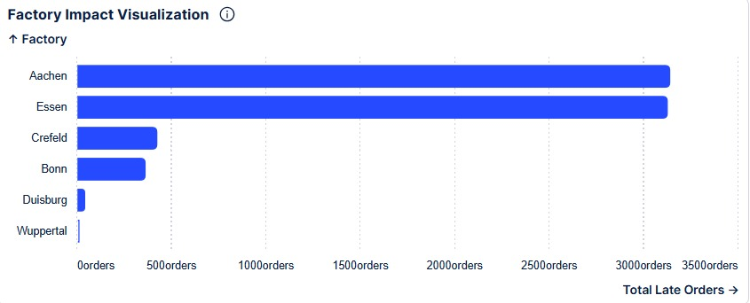
Why Are Delays Happening?
Factory Overload
– Aachen & Essen high volume concentration
Process Inefficiency
– Non-automated warehouses show lower OTD
Contractor Variability
– Certain delivery partners underperform
“Delays are structural, not random.”

Slide 5
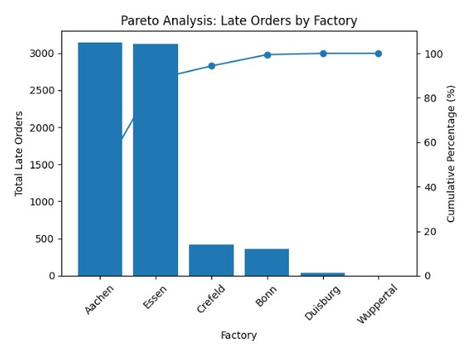
Late Orders Are Highly Concentrated in Few Operational Nodes
Aachen and Essen generate majority of total late orders
Non-automated warehouses consistently underperform
Pallet shipments and selected contractors show structural delay patterns

Slide 6
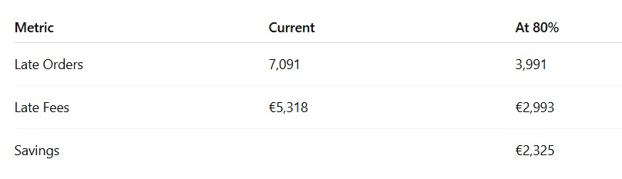
What Happens at 80% OTD?
Total Late Orders: Reduced from 7,091 to 3,991.
Operational Impact: Fewer backlogs and improved warehouse flow.
Penalty Costs: Dropped from €5,318 to €2,993.
Step 3
Bottom Line Results
Total Savings: €2,325 realized through improved performance.
Cost Efficiency: Direct correlation between On-Time Delivery (OTD) and bottom-line savings.
Efficiency Gain: Achieved a 44% reduction in total penalty costs.
Step 2
Financial Impact
Step 1
Volume Reduction
📈 Operational & Financial Impact
Total Orders: 19,954
Late Orders reduce from 7,091 → 3,991
Reduction of 3,100 orders (43.7%)
Penalty Cost reduces from €5,318 → €2,993
Direct Savings: €2,325

Slide 7
Enabling Sustainable Improvement
🔍 1. End-to-End Process Transparency
Real-time visibility into order-to-delivery flow
Identification of hidden bottlenecks across factories and warehouses
Root cause isolation at activity level
Impact: Moves from assumption-based decisions to data-driven clarity.
⚙ 2. Targeted Performance Optimization
Capacity imbalance detection across factories
Automation gap identification
SLA-based contractor performance tracking
Volume redistribution recommendations
Impact: Enables focused interventions instead of broad operational changes.
📊 3. Predictive & Proactive Control
Early delay risk detection
Real-time deviation alerts
Continuous OTD performance monitoring
Governance dashboards for management review
Impact: Shifts operations from reactive firefighting to predictive control.
Celonis transforms Wood Corp’s OTD challenge from a recurring operational issue into a controllable, measurable performance lever.

Slide 8
90-Day Action Plan to Achieve 80% OTD
Phase 1: diagnose & prioritize (days 0–30)
objective: identify high-impact delay driver
Deep-dive analysis on Aachen & Essen capacity utilization
Identify top 3 underperforming contractors
Analyze delay patterns in non-automated warehouses
Outcome :Clear prioritization of 3–5 critical intervention areas responsible for majority of delays.
Phase 2: Implement Quick Wins (Days 30–60)
Objective: Reduce delay volume immediately
Reallocate order load across factories to balance capacity
Introduce contractor performance-based allocation model
Set escalation triggers for orders exceeding delay threshold
Outcome :Immediate reduction in late orders from structural bottlenecks.
Phase 3: Stabilize & Monitor (Days 60–90)
Objective: Ensure sustainable performance improvement
Deploy real-time OTD monitoring dashboard (Celonis-driven)
Implement SLA tracking for logistics partners
Introduce weekly OTD performance review governance
Outcome : Shift from reactive issue handling to proactive performance control.

Slide 9
Strategic Recommendation
🎯 Target
Improve OTD from 64.46% → 80% within 90 days
⚙ Key actions
Rebalance capacity across aachen & essen
Introduce contractor sla-based allocation
Automate high-delay warehouse nodes
Deploy celonis real-time monitoring & predictive alerts
💰 Measurable outcome
3,100 fewer late orders
€2,325 direct penalty savings
Structural 43.7% reduction in delays
Sustainable performance governance model

Slide 10
Thank You!
Questions?

