Slide 1
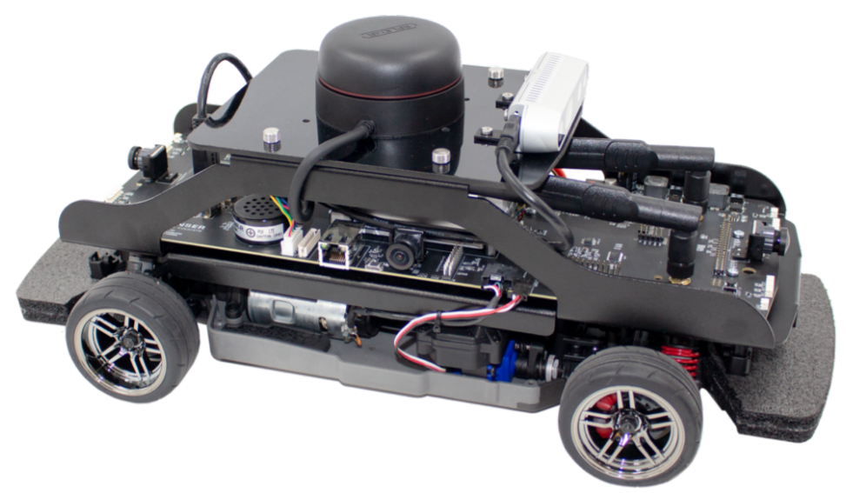
QCAR
Nathan MARTIN - Alexandre SPRICH -
Dmytro SAVCHUK

Slide 2
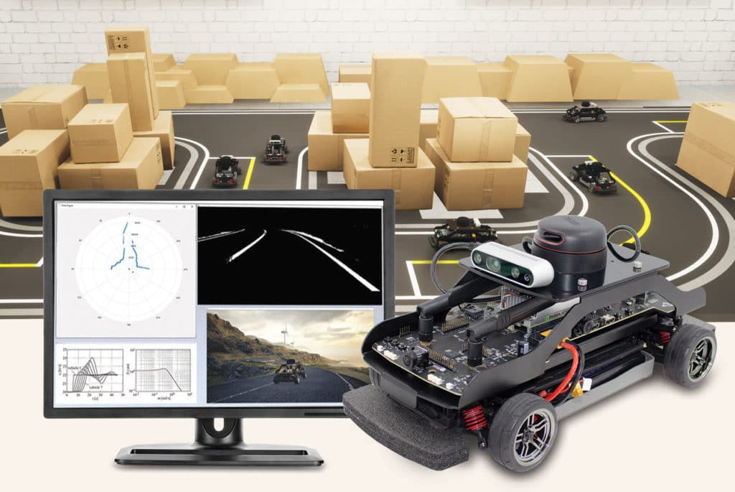
Summary
Introduction
Control of Qcar
Lane changing
Moving to a point
Conclusion

Slide 3
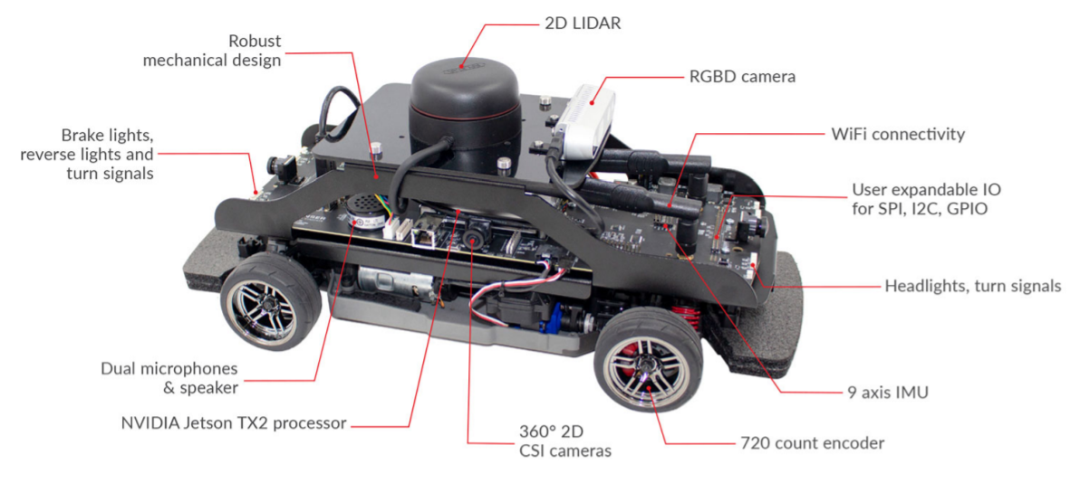
I. Introduction
QCAR → little model of autonomous vehicle, developed by Quanser

Slide 4
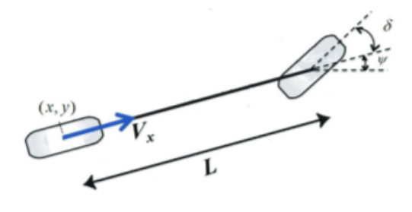

II. Control of Qcar
Follows the bicycle model :
cdfffff Velocity V
Steering angle δ

Slide 5
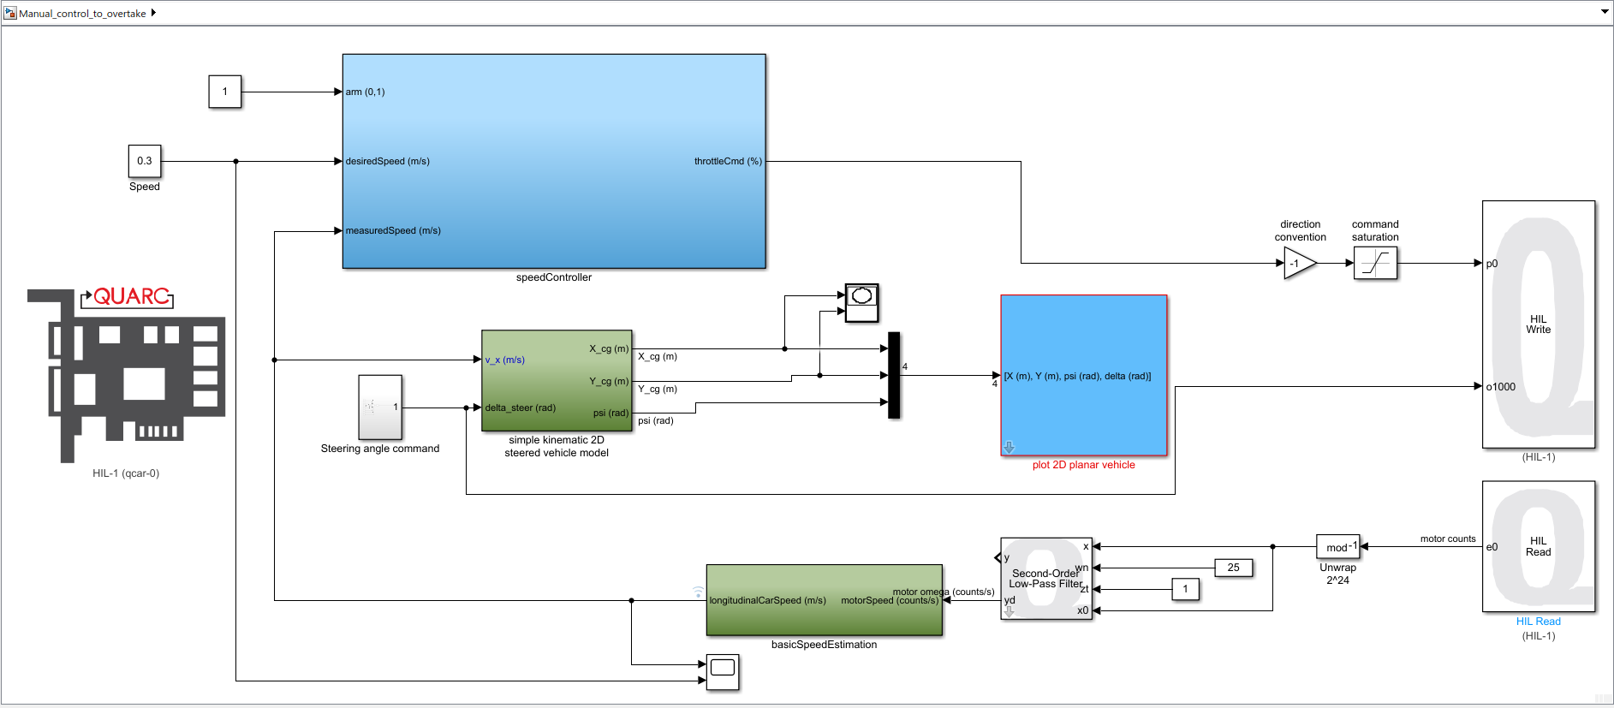
II. Control of Qcar
In Simulink : HIL Read & HIL Write blocks

Slide 6
III. Lane changing

Slide 7

III. Lane changing

Slide 8
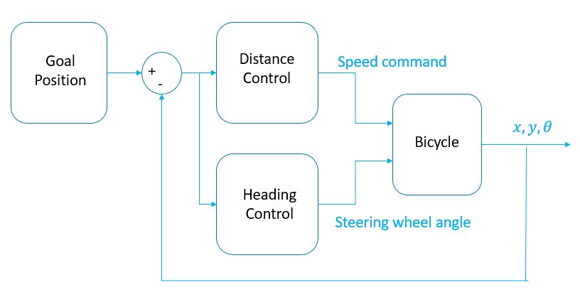
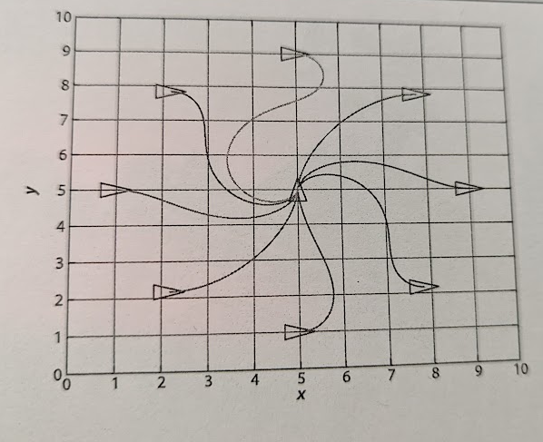
IV. Moving to a point
Goal : reach a given point

Slide 9
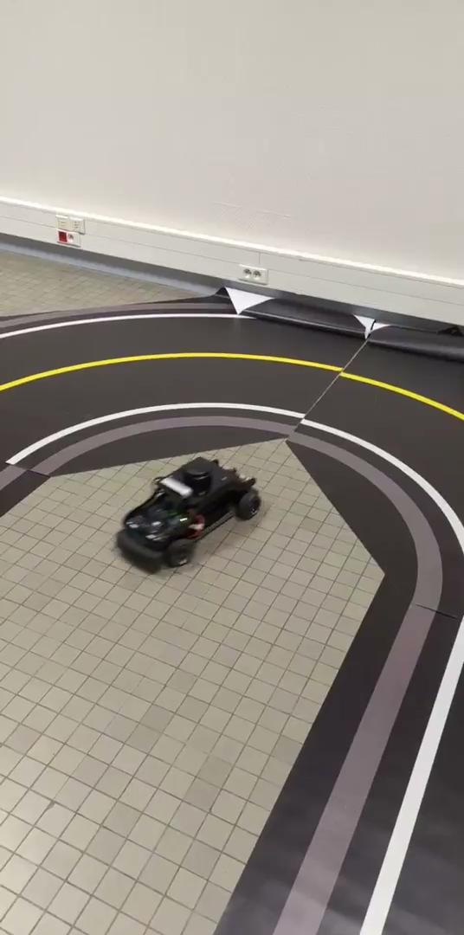
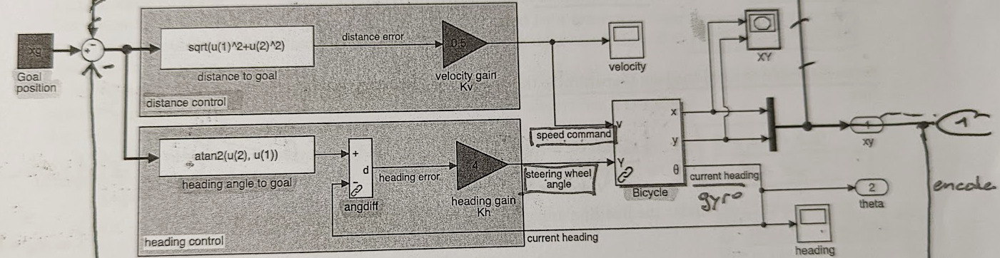
IV. Moving to a point

Slide 10
V. Conclusion
Manipulation of a model of autonomous vehicle
2 exercices :
- Lane changing To be developed
- Moving to a point
Still many possibilities of Qcar to be exploited (Line tracking, obstacle detection…)

Slide 11
Thank you for your attention

