Slide 1

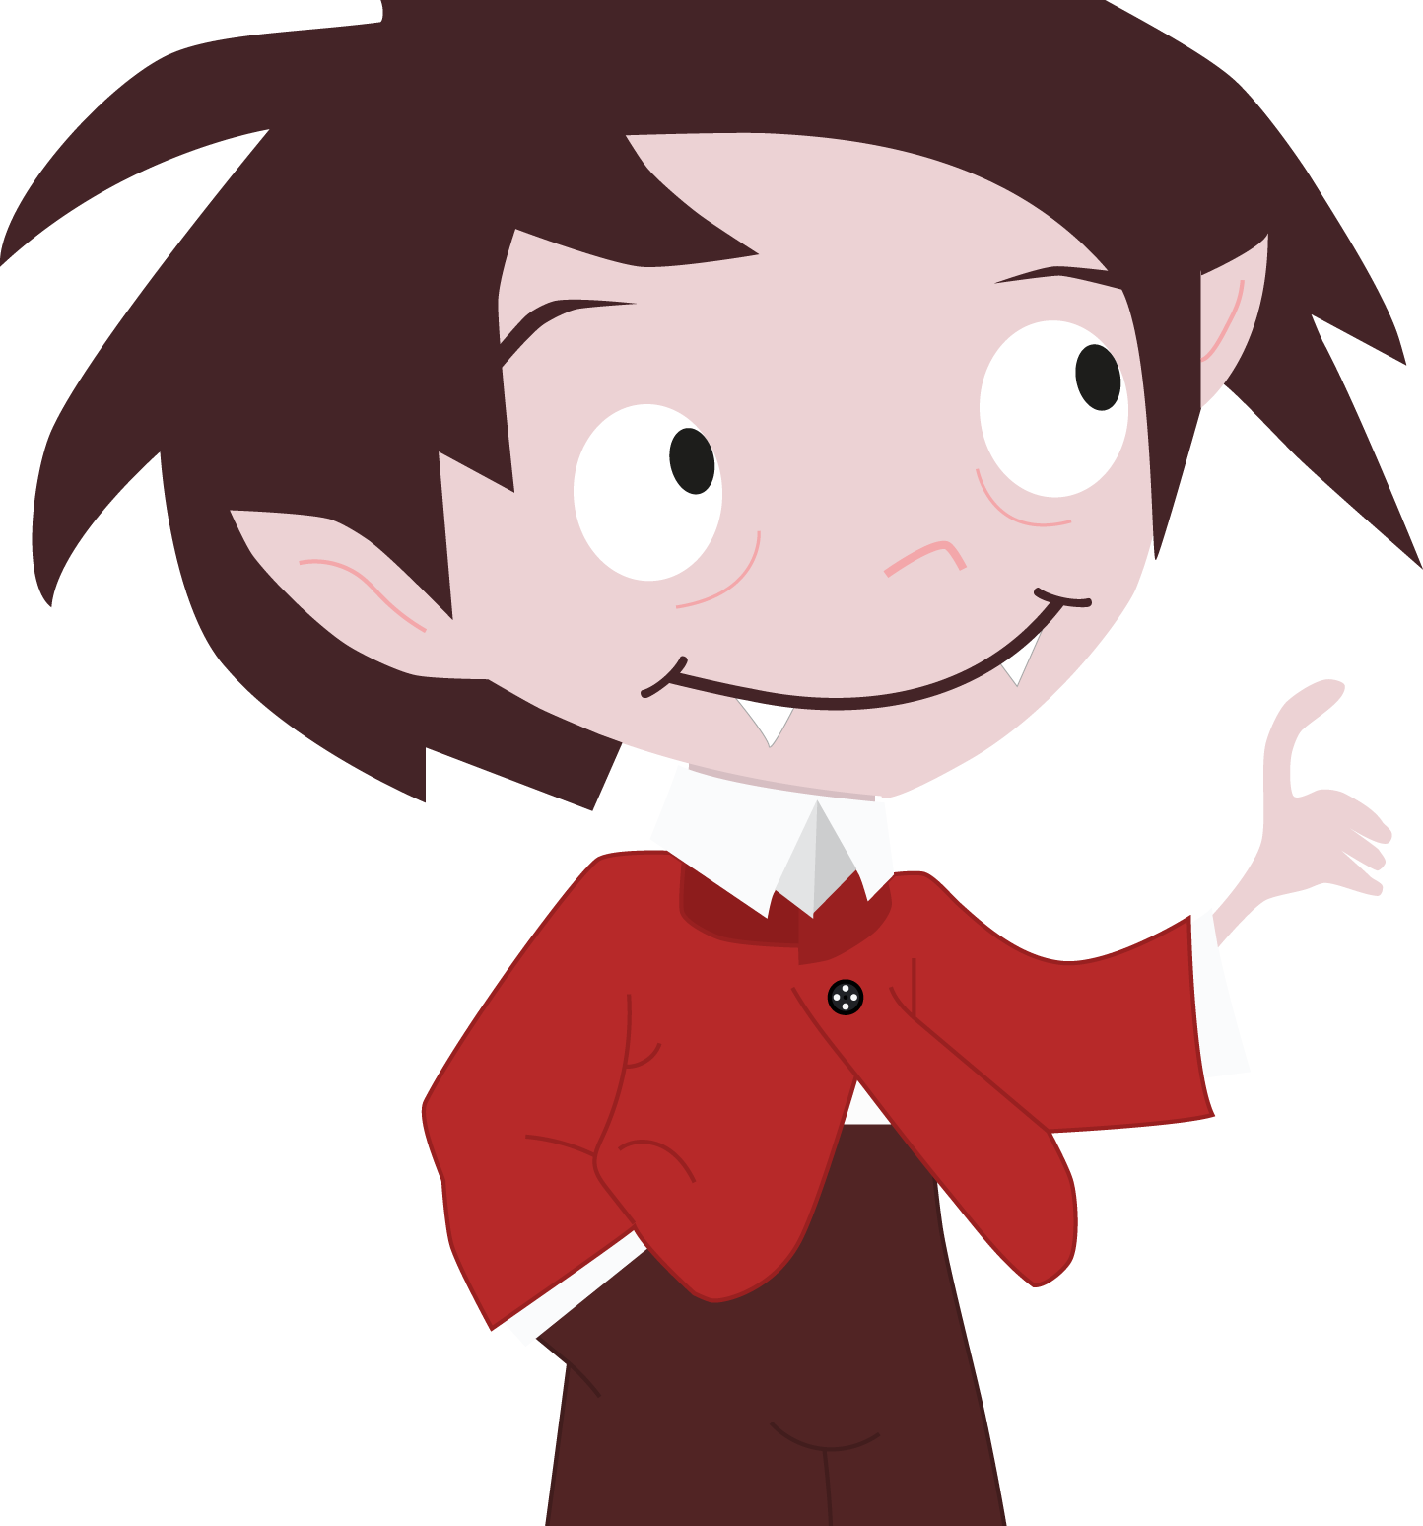
Sugar Vamp
User Interface Design SS 19
Jolanda Jerg, Magali Gröter, Athina Reißenweber, Rajan Serafi
Assignment 1: Domain Analysis

Slide 2

What makes our idea unique and amazing ?
Currently no competition
Everyday companion
Emotional
Child friendly usage
Gamification
Parental control
Notes:
! example story of child ! Storytelling – Imagine first week of school and your kid has to test its blood sugar level himself.
We want to develop an app designed to help children with diabetes control their sugar levels. The kids will be cared and guided by a little vampire.
Our app appeals emotionally to children with diabetes and helps them to have fun dealing with their illness. The child-friendly design allows children to feel in a familiar environment and enjoy using the app.

Slide 3
Technological know-how
Native App for IOS
Mobile device is required
Additional hardware to connect with glucometer required
Cloud-based access to data for parents and doctors

Slide 4
Functional know-how
Rich experience
Simple, self-explanatory functions
Direct manipulation
Child-friendly interface
Input via voice or text, depending on the age of the child

Slide 5
Context of use
Assistance in the kids everyday life
Reminder to test the blood sugar level
pictorial representation that shows the energy level of the child
Can be used everywhere and every time

Slide 6
Aesthetic research
Light and colorful
Child-friendly drawings
Light and colorful

Slide 7

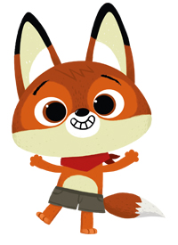


Aesthetic research
WoodieHoo toothbrushing app
Notes:
We really liked the design of the animals

Slide 8
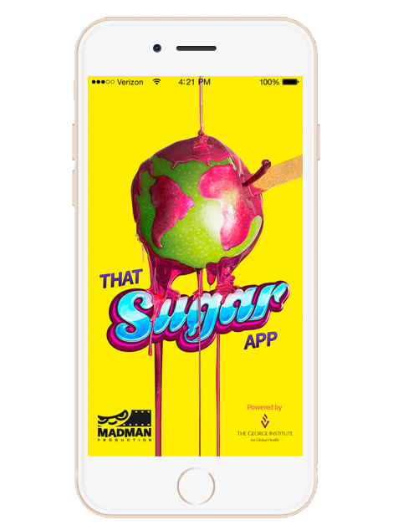
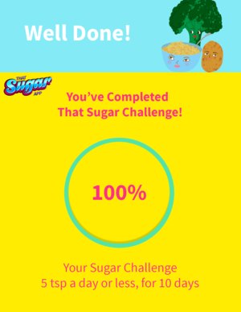
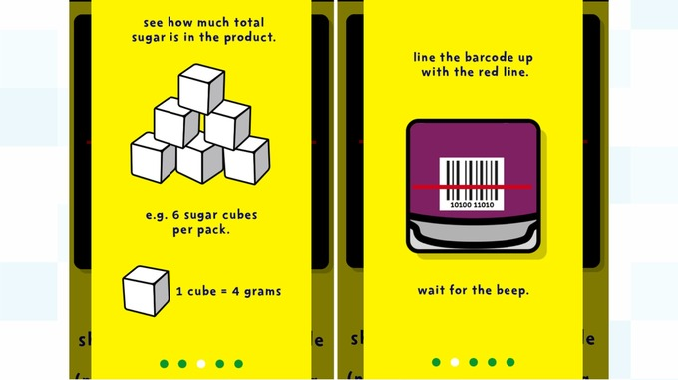
Competitive Analysis
That Sugar app
Tracks the amount of sugar the user is consuming

Slide 9
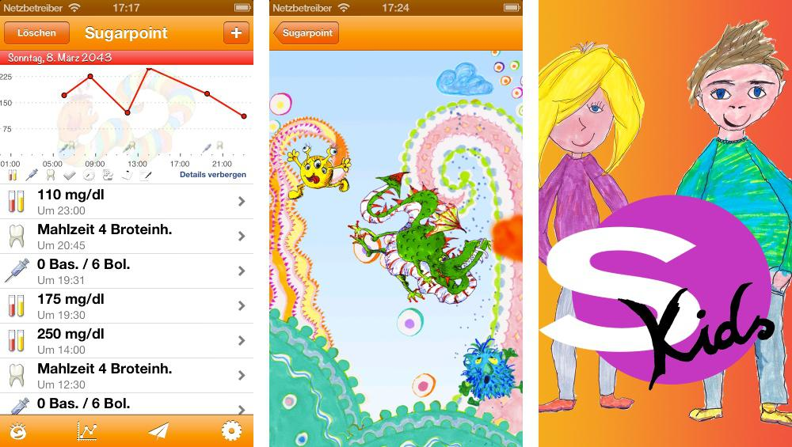
Competitive Analysis
Sugar point kids
Doesn’t exist anymore

Slide 10
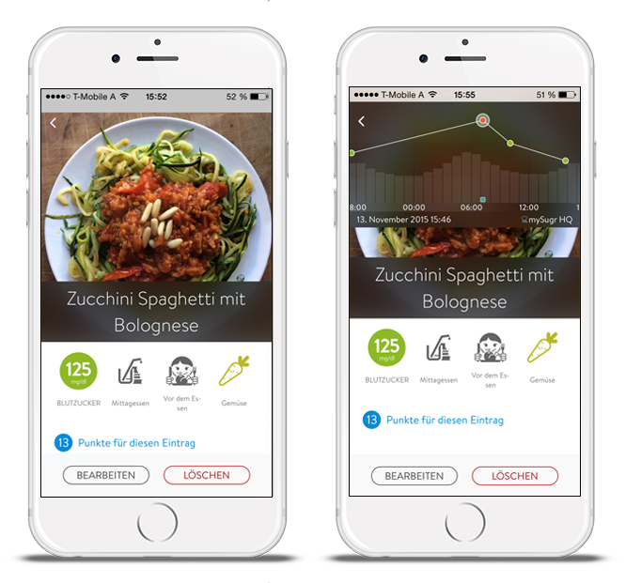

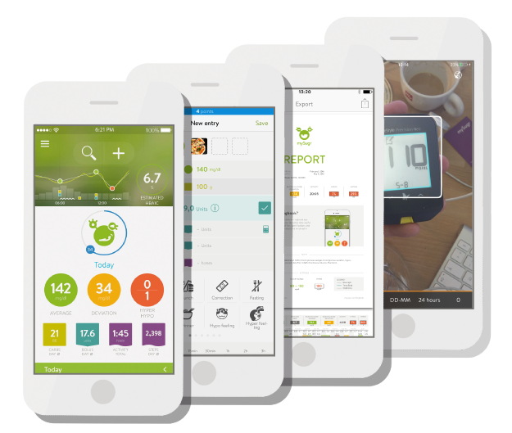
Competitive Analysis
mySugr
Diabetes Tracker for adults

