Slide 1
Hardware Software Platforms Project Presentation
G8-DE1-DC-Motor : Driver PWM-bidirectional-DC-Motor
Jolan DUBRULLE, Willy MOKOFTOM SIMIVOU and Eliot STRUELENS
Jolan.DUBRULLE@student.umons.ac.be
Willy.MOKOFTOMSIMIVOU@student.umons.ac.be
Eliot.STRUELENS@student.umons.ac.be

Slide 2
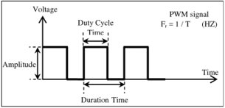
Introduction
Goals?
control bidirectional DC motor
What is a PWM signal?

Slide 3
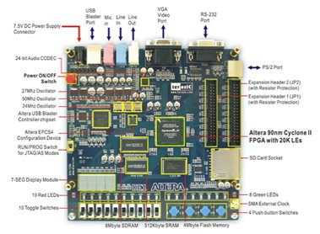
Introduction
DE1 Altera board:

Slide 4
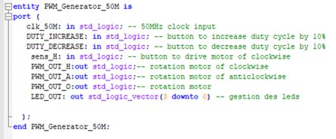
PWM Generator 50M.vhd
Definition of the entity's entry and exit ports

Slide 5
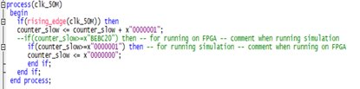
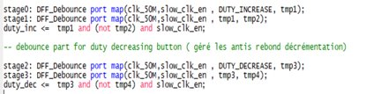
PWM Generator 50M.vhd
DFF_Debounce.vhd and debouncing process:

Slide 6
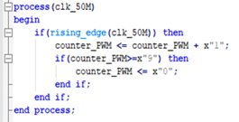
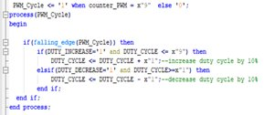
PWM Generator 50M.vhd
Counter_pwm, Duty_cylce and pwm_out:

Slide 7

PWM Generator 50M.vhd
PWM_OUT_H and PWM_OUT_A:

Slide 8
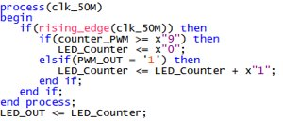
PWM Generator 50M.vhd
LED application:

Slide 9
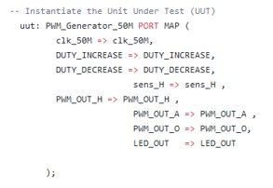
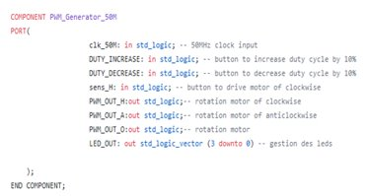
Test bench

Slide 10
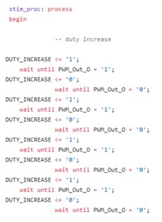
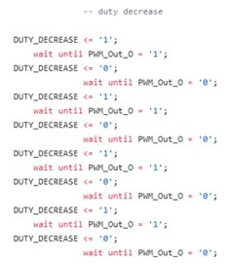

Test bench

Slide 11
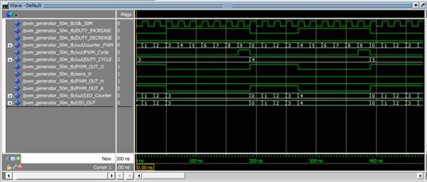
Simulation
Basic operations

Slide 12
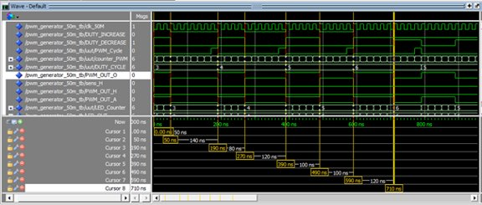
Simulation
DUTY_INCREASE

Slide 13
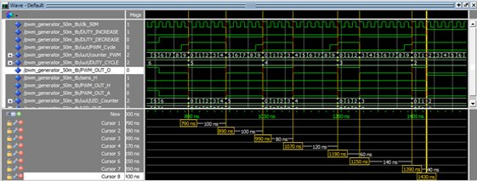
Simulation
DUTY_DECREASE

Slide 14
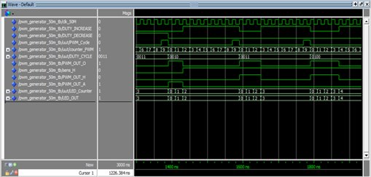
Simulation
Sens_H

Slide 15

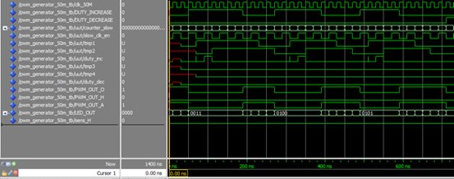
Simulation
Tmp1, tmp2, tmp3, tmp4 + slow_clk_en + counter_slow

Slide 16
Conclusion
What was done:
Clock
DC motor control
Application
Simulation

