Slide 1
Assignment 1 Writeup
Name: Yiwen Lu
GT Email: ylu647@gatech.edu
GT ID: 903620779

Slide 2
Two-Layer Neural Network

Slide 3
Learning Rates
Tune the learning rate of the model with all other default hyper-parameters fixed. Fill in the table below:
 | lr=1 | lr=1e-1 | lr=1e-2 | lr=5e-2
Training Accuracy | 0.9309 | 0.9222 | 0.7372 | 0.9094
Test Accuracy | 0.9387 | 0.9242 | 0.7648 | 0.9125

Slide 4
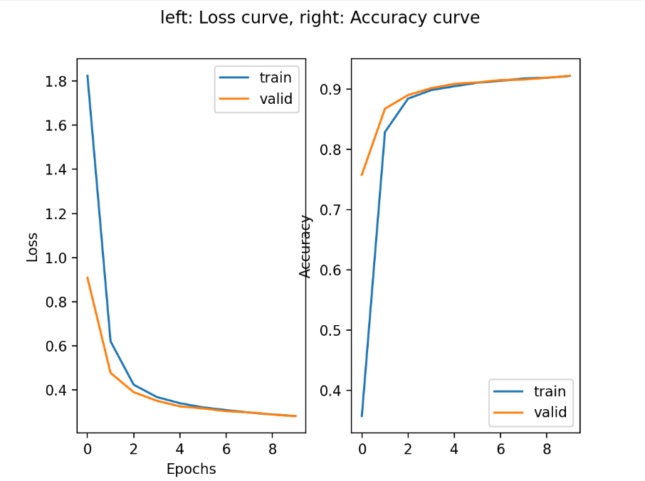
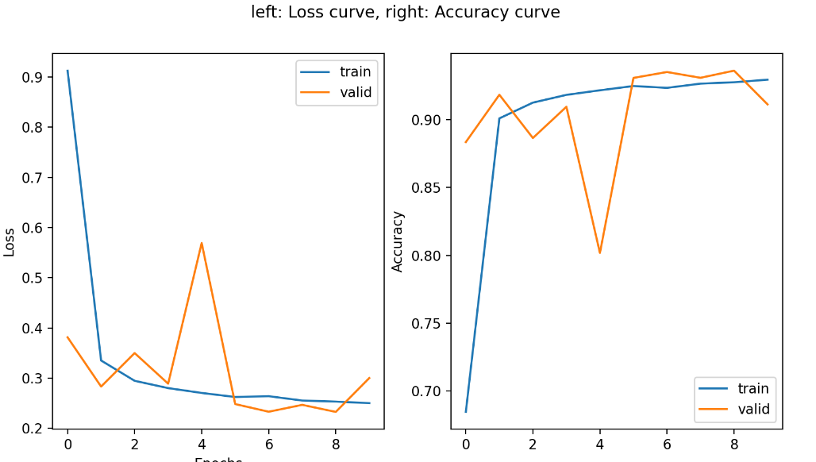
Learning Curve
Plot the learning curves and put it below:
Learning rate = 1
Learning rate = 1e-1

Slide 5
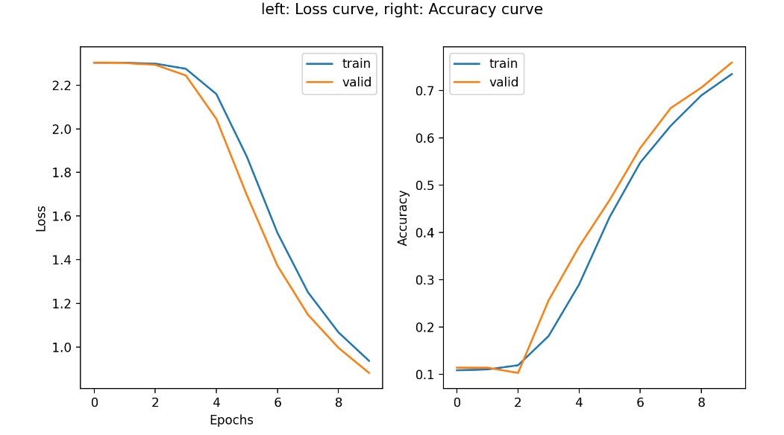
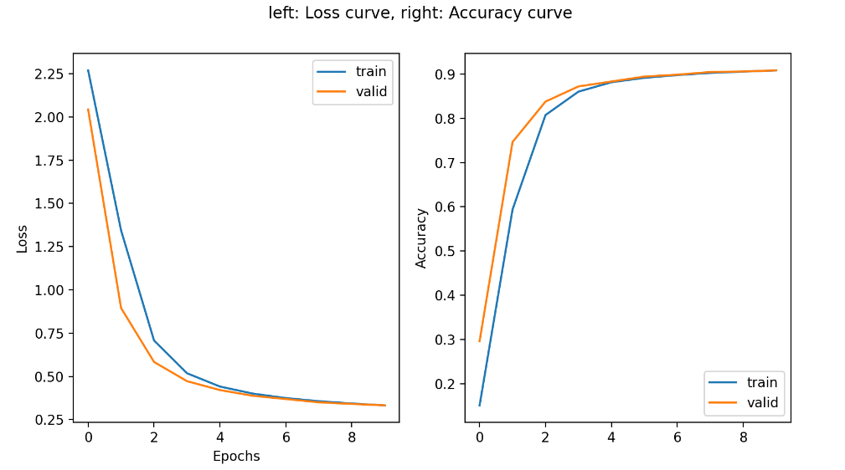
Learning Curve
Plot the learning curves and put it below:
Learning rate = 1e-2
Learning rate = 5e-2

Slide 6
Learning Rates
Describe and Explain your findings:
Description According to the learning rate table. We find that the accuracy of lr=1 or 0.1 is bigger than lr=0.01. Also, from the curve plot with lr=0.01, we see the loss is still decreasing, while the curve in lr=1 or 0.1 is flattened.
Explanation The larger the lr, the faster the learning speed.

Slide 7
2. Regularization
Tune the regularization coefficient of the model with all other default hyper-parameters fixed. Fill in the table below:
 | alpha=1e-1 | alpha=1e-2 | alpha=1e-3 | alpha=1e-4 | alpha=1e-0
Training Accuracy | 0.3296 | 0.8813 | 0.9226 | 0.9305 | 0.9319
Validation Accuracy | 0.3410 | 0.8767 | 0.9171 | 0.9300 | 0.9274
Test Accuracy | 0.3563 | 0.8872 | 0.9238 | 0.9334 | 0.9339

Slide 8

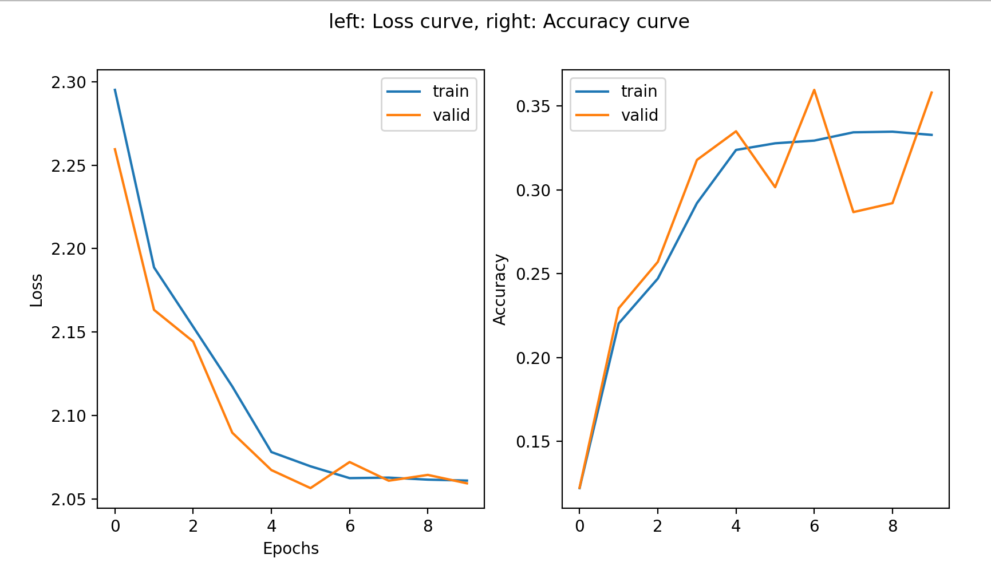
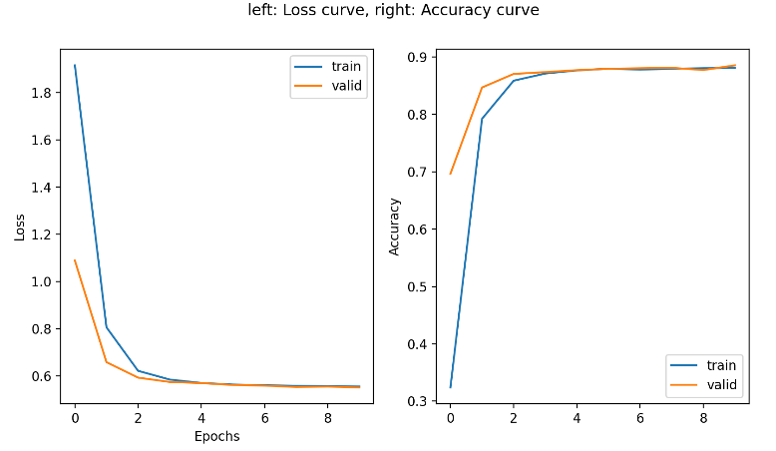
2. Regularization
Plot the learning curves and put it below:
Alpha=1e-3
Alpha=1e-1
Alpha=1e-2

Slide 9
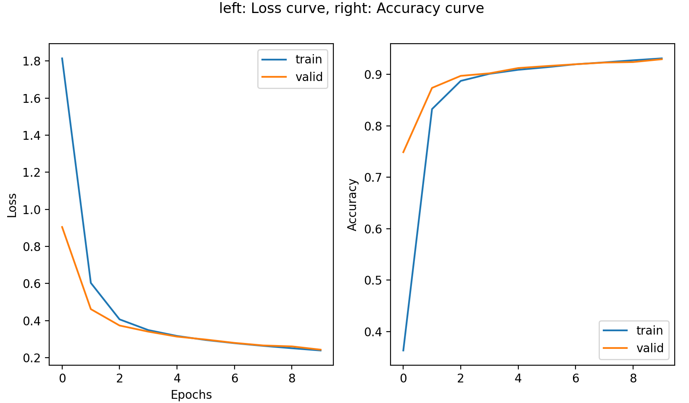
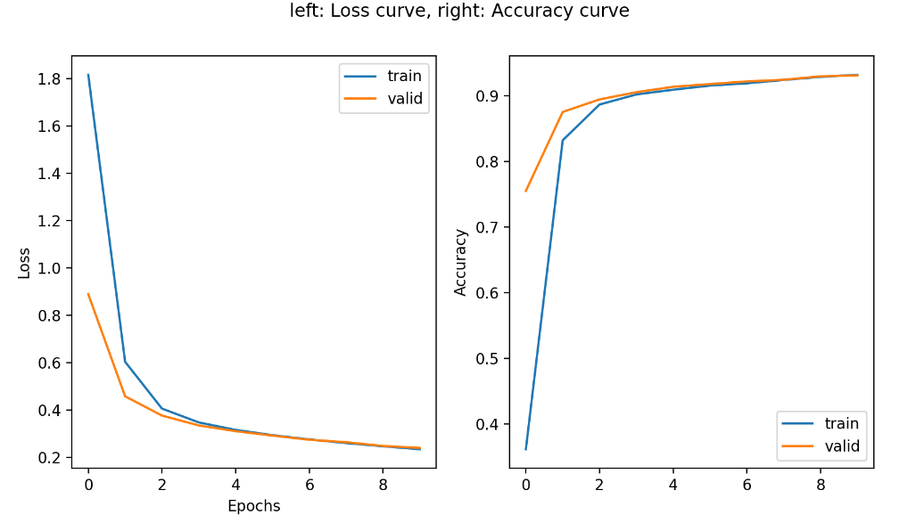
2. Regularization
Plot the learning curves and put it below:
Alpha=1e-4
Alpha=1e-5

Slide 10
2. Regularization
Describe and Explain your findings:
Description: The smaller the regularization coefficient, the better the modeling performance.
Explanation: Adding that small amount of bias, we get a significant drop in the variance. So the model can to some extent avoid overfitting and get a better performance.

Slide 11
3. Hyper-parameter Tuning
You are now free to tune any hyper-parameters for better accuracy. Create a table below and put the configuration of your best model and accuracy into the table:
Briefly explain why your choice works:
accuracy | Batch_size | Learning_rate | reg | epochs | momentum
0.9777 | 64 | 0.05 | 0.0001 | 500 | 0.9
Add up the epochs number, and lower down the learning rate. From the experiment we can see within 10 epochs the model haven’t find its local minimum point. So we should train more epochs. It will allow the model to search a better local minimum.

