Slide 1
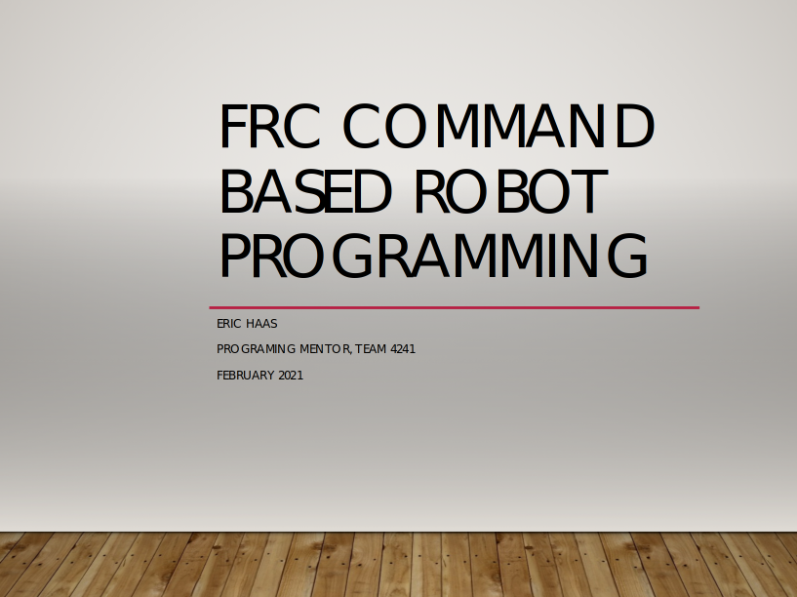
FRC Command Based Robot Programming
Eric Haas
Programing Mentor, team 4241
February 2021

Slide 2
Presentation Objective
Explain the general concepts of “Command”-based programming on an FRC robot.

Slide 3
Functional vs. Commands
There are a lot of ways to do something
We have a simple task: to fill a water bottle
We want to have the robot fill the bottle rather than do it ourselves
Depending on what we feel like, we might want to do something else while the bottle is filling but let’s focus on the water bottle for now

Slide 4
Let’s make program for it!
How about this?
  Remove the cap
  Put bottle under faucet
  Open faucet
  Watch until it’s full
  Close faucet
  Put the cap back on
Not bad – seems to get the job done

Slide 5
What would that program look like?
if (button(FILL_BOTTLE) == PRESSED) {
takeCapOffBottle();
putBottleUnderFaucet();
turnOnFaucet();
while (bottleFull() != True)
nothing; // all our attention is on the bottle
// now we’re full
turnOffFaucet();
moveBottleFromUnderFaucet();
putCapBackOnBottle();
}

Slide 6
What if we Want to do more?
That seems to get that job done
  If all we want to do is fill a water bottle
  But what if we want to do more?
Seems like we are spending most of our time watching the bottle
How can we do more?

Slide 7

What about the spinning plates?
We want to have spinning plates too so we could have a button to start the plates spinning
How does that effect our water bottle filling?

Slide 8
Modify the program
if (button(FILL_BOTTLE) == PRESSED) {
takeCapOffBottle();
putBottleUnderFaucet();
turnOnFaucet();
while (bottleFull() != True)
nothing; // all our attention is on the bottle
// now we’re full
turnOffFaucet();
moveBottleFromUnderFaucet();
putCapBackOnBottle();
}
if (button(SPIN_PLATES) == PRESSED) {
startPlatesSpinning();
while (button(SPIN_PLATES) == PRESSED) {
keepPlatesSpinning();
}
stopPlatesFromSpinning();
}

Slide 9
Will that work?
Kind of – sort of – for some situations
We can’t do both at once because we only pay attention to one task at a time
If we want to do both at a time, this is going to be harder than it seems…
  Buttons are being pressed and released all the time
  What if we want to start or stop spinning plates while the water is running?
  We could try to mix all this code together – but what if we want to do 3, 4, or even more things at once

Slide 10
Multitasking – FRC style
The FRC framework provides a way to do many things at once
Start, check, stop, etc. each thing independently
  We can fill the water bottle and spin plates at the same time
  We can start spinning plates while the water bottle is filling
  We can stop the water bottle filling early if we like
We can do both tasks at once – even add more tasks if we like

Slide 11
Command framework
Each of those tasks has some similar sets of things that need to be done
  Something to get it started
  Something to keep it going
  Something to figure out if it’s done
  Something to wrap things up at the end
The FRC framework provides this sort of grouping
  initialize, execute, isFinished, end

Slide 12
Turning our programs Commands
 | Water Bottle | Plate Spinner
Initialize | takeCapOffBottle(); putBottleUnderFaucet(); turnOnFaucet(); | startPlatesSpinning();
Execute | // nothing once the faucet is open | keepPlatesSpinning();
IsFinished | if (bottleFull() != True) finished = True; | if (button(SPIN_PLATES) != PRESSED) Finished = True;
End | turnOffFaucet(); moveBottleFromUnderFaucet(); putCapBackOnBottle(); | stopPlatesFromSpinning();

Slide 13
Who are you who is so wise in the ways of running things?
I am the “scheduler”
  I call your “Initialize” routine to start you up
  I call your “End” routine to shut you down
  In between, I call your “Execute” and “IsFinished” routines to keep things going
    50X per second or every 20 milliseconds (20ms)
  Something to wrap things up at the end
The FRC framework provides this sort of grouping
  initialize, execute, isFinished, end

Slide 14
Command Groups
What we’ve described so far as typically referred to as a single “command”
You can assemble more than one command into a larger command
  A command group
  How the commands in a group are run can be controlled:
    Sequential – one after the other
    Parallel – each command is started and they all essentially run at the same time
    Parallel Race – each command starts at the same time and they all run in paralle; as soon as one command finishes, the whole group is stopped (using the respective end routines)
    Parallel Deadline – each command starts at the same time but all the commands are stopped when a specific command finishes (the deadline command)
    The last two are not that common – sequential and parallel are what you’ll use most
  “The Cyborgs are awesome, even their command groups have command groups in them!”

Slide 15
Command Groups
Each command group can run at the same time as other command groups (so long as they don’t try to use the same things – you can’t have one group that says drive forward and another to drive backwards running at once)
You can pretty much use a command group anyplace where you can use a command in the code
This is useful when you want to do a set of steps to complete a goal: “sequentially drive to a spot, stop, aim, shoot, drive somewhere else” could all be one group; another group could be: “in parallel, stop the intake system, move the game piece to the scoring manipulator, and raise the manipulator arm into the scoring position.”

Slide 16
Command Groups
Each command or command group has “requirements”
A requirement is what that command groups needs to run – typically this is access or control of some robot resource
  Drivetrain
  Shooter
  Arm
  Etc.
This is how you stop one parallel command from “undoing” what some other parallel command is doing
In most cases the requirements are figured out by the code based on what robot resources are being used

Slide 17
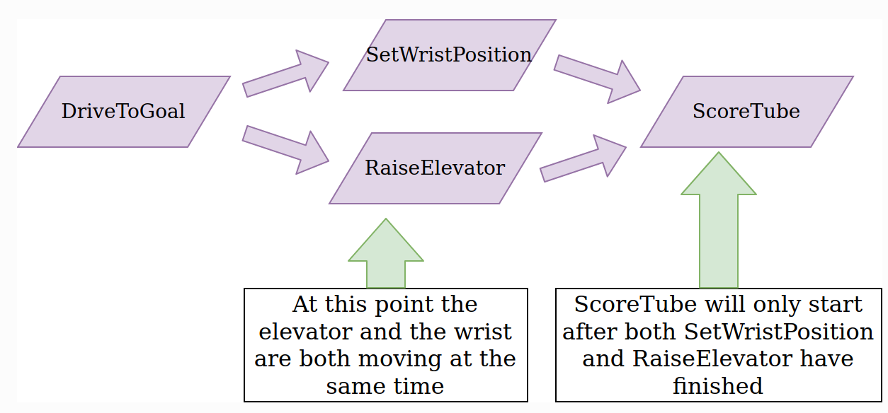
Running Commands
Commands are built and started in the code
Commands and command groups can be recursive – command groups can contain other command groups running in their on way (you could run groups with combinations of sequential and parallel execution)

Slide 18
Running Commands
Commands can be started right in the code
  They basically look sort of like functions
Commands can be tied to inputs
  Buttons
    Pressed
    Released
    While held
    Etc.
  Joysticks
  Sensors and switches on the robot
  Most anything the robot can detect or react to could be used to start a command group

Slide 19
How do I know what a command should be?
Think of thing you want the robot to do as a “task”
You wouldn’t have a command “Play this year’s game” but in each game there are many actions that are repetitive that are good candidates to make into a command group
Each set of related actions could be it’s own command group

Slide 20
How do I know what a command should be?
Suppose this year’s game involves opening a front hatch on the robot, driving around to get next to a game piece, using a scoop to pick up the game piece once the robot has sensed the game piece is in the scoop, move the game piece into the robot until a sensor says the game piece is secured, and then closing the front hatch to safely hold the game piece inside the robot for later scoring.
That’s a lot but there is definitely a command group in there
  Pretty much everything but the driving around part (since you want the drive team to control the actual driving of the robot most of the time)
  Command group could:
    Open hatch
    Lower scoop
    Watch scoop sensor for a game piece to be loaded
    Raise the scoop
    Run the internal mechanism to secure the game piece
    Close hatch
That’s a lot to expect a human driver to do flawlessly 10-20 times during a game plus you pretty much want to do that whole sequence most of the time in that specific sequence anyway (you don’t want to close the hatch while you’re trying to get the game piece inside for example!)
Make life easier and more reliable for the drive team – give them a command sequence that can start with one button press!

Slide 21
Getting more information
We’ll go more into the programming aspect of command groups in a later session but here are a few places to go further.
As with most FRC software things, the WPILib documentation is a great first step – for details on command-based programming see https://docs.wpilib.org/en/stable/docs/software/commandbased/index.html
Chief Delphi, at https://chiefdelphi.com, is great discussion board focusing on FIRST-related topics. Try a search for some FRC topic or create an account and post a question or a reply to join the fun.

