Slide 2
+
instruction
food picture
rating

Slide 3
LOOK

Slide 4
REGULATE

Slide 5
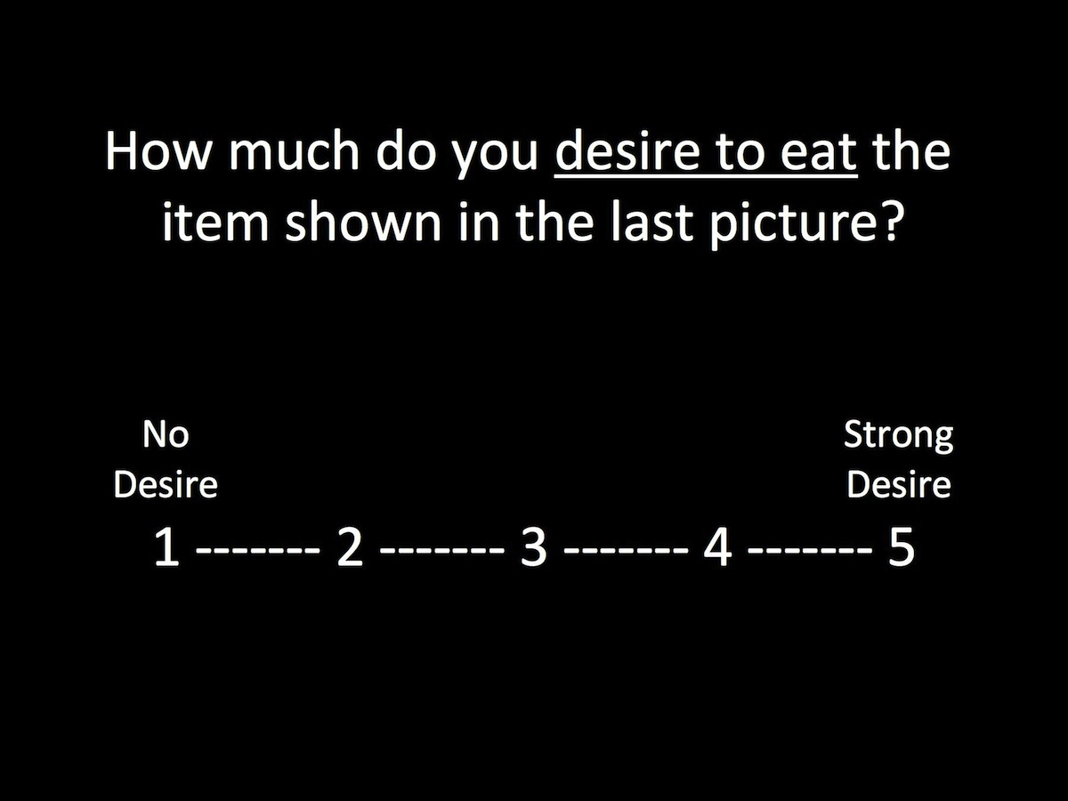

Slide 6
Calibrating scanner. Please hold VERY still.

Slide 7
+

Slide 8
LOOK

Slide 9
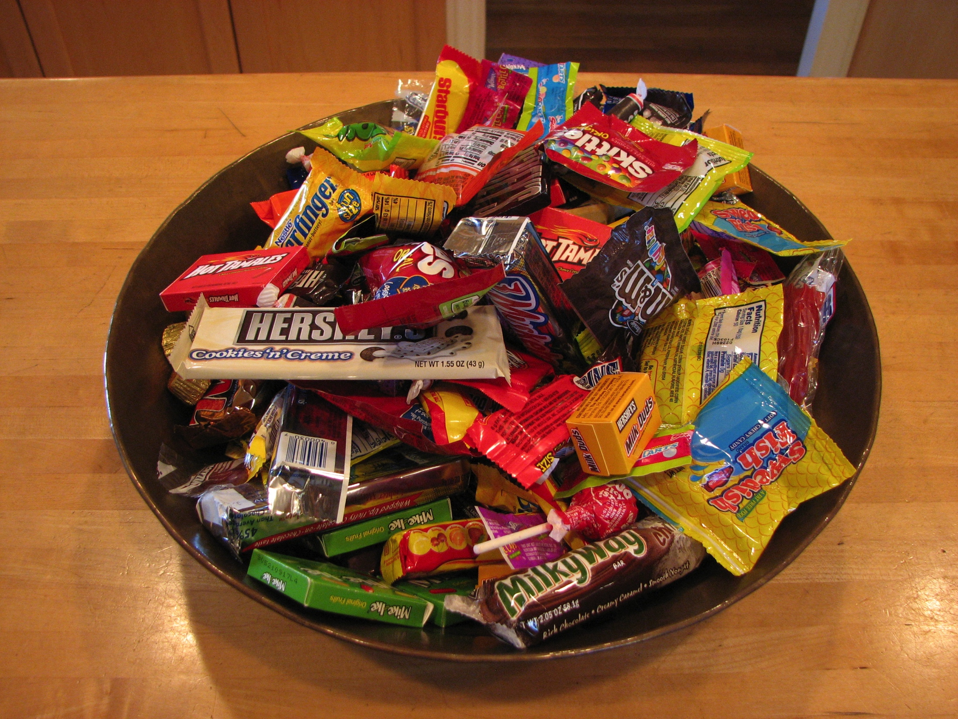

Slide 11
+

Slide 12
REGULATE

Slide 13
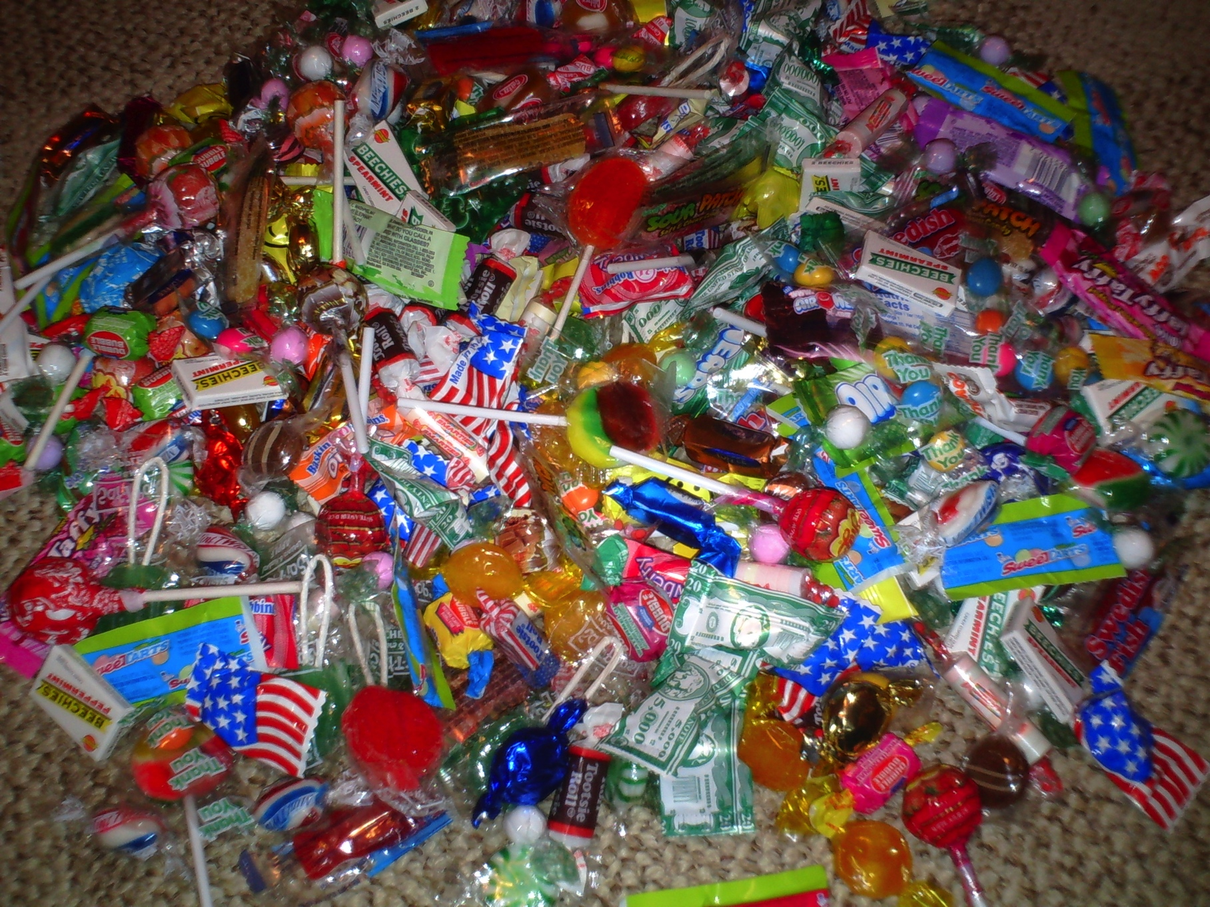

Slide 15
+

Slide 16
The task is now complete.

