Slide 2
Calibrating scanner. Please hold VERY still.

Slide 3
+

Slide 4
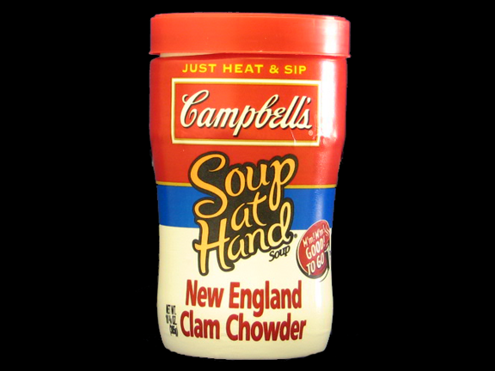

Slide 5
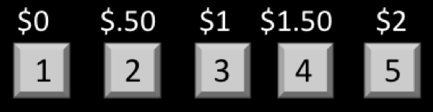
How much would you pay to eat this food?

Slide 6
+

Slide 7
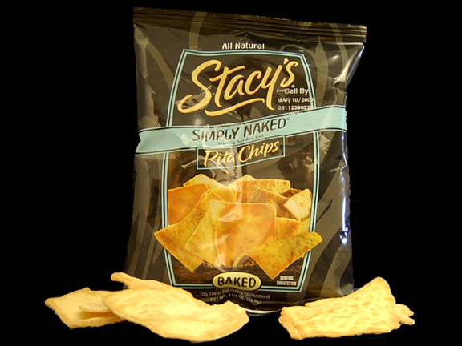

Slide 8
How much would you pay to eat this food?

