Slide 1
Multiple View Geometry
2020 Summer Seminar
Chapter 4: Estimation - 2D Projective Transformations
Sohee Lim

Slide 2
Contents
4. Estimation – 2D Projective Transformations
4.1 The Direct Linear Transformation (DLT) algorithm
4.2 Different cost functions
4.3 Statistical cost functions and Maximum Likelihood estimation
4.4 Transformation invariance and normalization
4.5 Iterative minimization methods
4.6 Experimental comparison of the algorithms
4.7 Robust estimation
4.8 Automatic computation of a homography
4.9 Closure

Slide 3
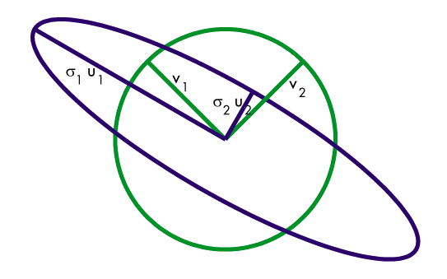
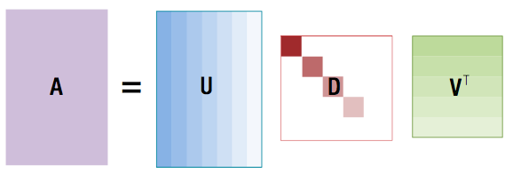
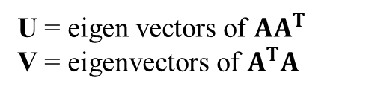
SVD (Singular value Decomposition)
U = eigen vectors of $AA^{T}$
V = eigenvectors of $A^{T}A$

Slide 4

SVD (Singular value Decomposition)
$Ax = UDV^{T}x=σ_{1}u_{1}v_{1}^{T}x$ + $σ_{2}u_{2}v_{2}^{T}x$+ $⋯$ + $σ_{n}u_{n}v_{n}^{T}x$
Which x makes $\left\|Ax\right\|$ to be minimum subject to $\left\|x\right\|=1$ ?
if $σ_{i}≠0, i=1,⋯,n$
$⇒$ $x=v_{n}$ (the last eigen vector)
$⇒$ the minimum is $σ_{n}$
if $σ_{i}=0, i=1,⋯,n$
$⇒$ $x=$ null space of A
$⇒$ $Ax=0$

Slide 5
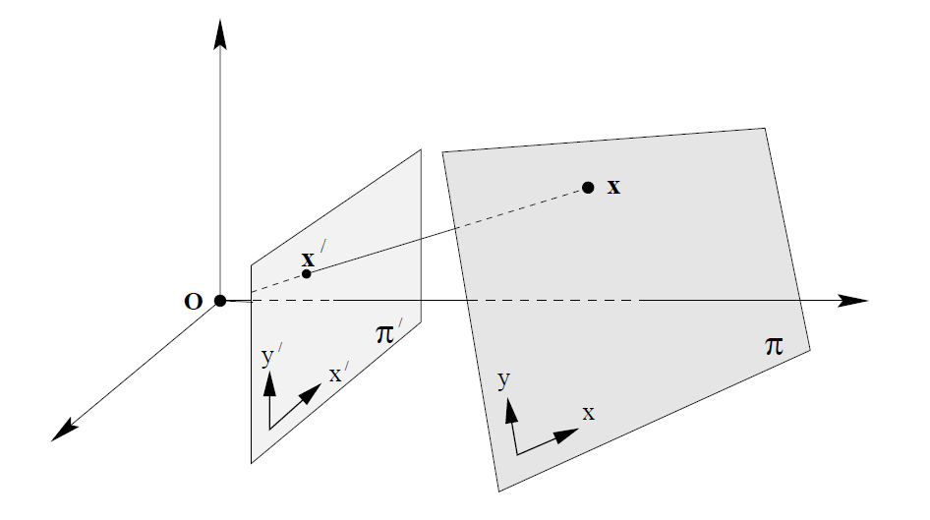
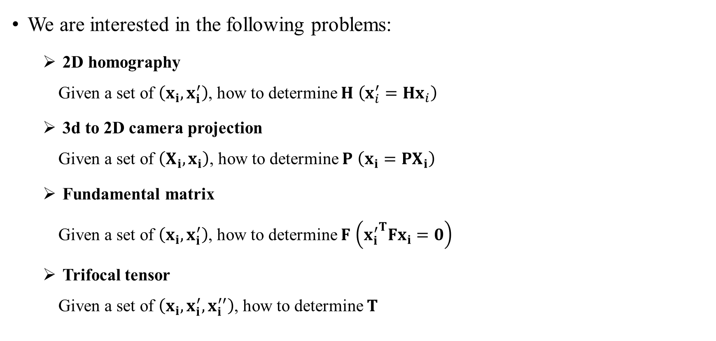

4. Estimation – 2D Projective Transformations
Parameter Estimation
We are interested in the following problems:
2D homography Given a set of $\left(x_{i}, x_{i}^{′}\right)$, how to determine $H$ $\left(x_{i}^{′}=Hx_{i}\right)$
3d to 2D camera projection Given a set of $\left(X_{i},x_{i}\right)$, how to determine $P$ $\left(x_{i}=PX_{i}\right)$
Fundamental matrix Given a set of $\left(x_{i}, x_{i}^{′}\right)$, how to determine $F$ $\left({x_{i}^{′}}^{T}Fx_{i}=0\right)$
Trifocal tensor Given a set of $\left(x_{i}, x_{i}^{′},x_{i}^{′′}\right)$, how to determine $T$
$$H$$
<Homography>

Slide 6
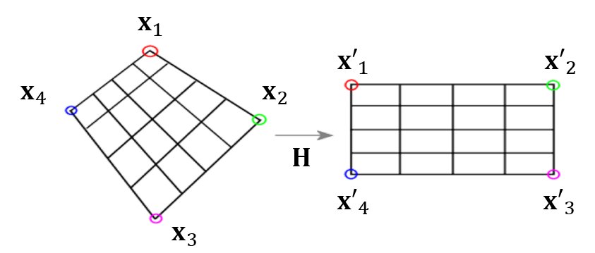


4. Estimation – 2D Projective Transformations
Number of measurements required
To estimate the parameters, we need # of independent equations $≥$ degrees of freedom
Example:
To estimate H: $x_{i}^{′}=Hx_{i} (x_{i}^{′}∼wx_{i}^{′}∼Hx_{i}$)
H has 8 DOF
$4×2≥8$
So, at least 4 points correspondences are required (where no 3 points are collinear)
a point correspondence $x_{i}↔x_{i}^{′}$
2 independent equations per a point

Slide 7
4. Estimation – 2D Projective Transformations
Approximate solutions
Minimal solution
4 points yield an exact solution for H
If more points…
No exact solution, because measurements are inexact (“noise”)
Find the optimal solution according to some cost function
Algebraic or geometric/statistical cost

Slide 8
4. Estimation – 2D Projective Transformations
Gold Standard algorithm
Cost function that is optimal for some assumptions
Computational algorithm that minimizes it is called “Gold Standard” algorithm
Other algorithms can then be compared to it

Slide 9







4. Estimation – 2D Projective Transformations
4.1 The Direct Linear Transformation (DLT) algorithm
$x_{i}^{′}=Hx_{i}$ may be expressed in terms of the vector cross product as $x_{i}^{′}×Hx_{i}=0$
Let $Hx_{i}= \left[\begin{matrix}h^{1^{T}}x_{i} \\ h^{2^{T}}x_{i} \\ h^{3^{T}}x_{i}\end{matrix}\right]$ and $x_{i}^{′}= {\left(x_{i}^{′},y_{i}^{′},w_{i}^{′}\right)}^{T}$ Then
"same directionality"
The j-th row of the matrix H is denoted by$h^{j T}$
$$⟹$$
3rd row is redundant,
only 2 are linearly independent
$$⟹$$
$$⟹$$
$$A_{i}h=0$$
Equations are linear in $h$
Holds for any homogeneous representation, $x_{i}^{′}= {\left(x_{i}^{′},y_{i}^{′},1\right)}^{T}$

Slide 10


4. Estimation – 2D Projective Transformations
4.1 The Direct Linear Transformation (DLT) algorithm
$x_{i}^{′}=Hx_{i}$
$$A_{i}h=0$$

Slide 11
4. Estimation – 2D Projective Transformations
4.1 The Direct Linear Transformation (DLT) algorithm
$x_{i}^{′}=Hx_{i}$
$$A_{i}h=0$$

Slide 12


4. Estimation – 2D Projective Transformations
4.1 The Direct Linear Transformation (DLT) algorithm
Solving for H
A has dimension 8$×$9 and rank 8
Trivial solution is $h=0_{9}^{T}$ is not interesting
1-D null space $h$ is the nontrivial solutions
Choose the one with $\left\|h\right\|=1$
$$⟹$$

Slide 13
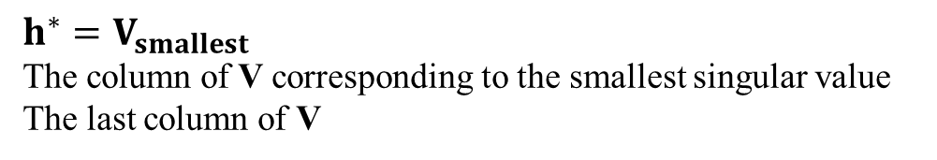

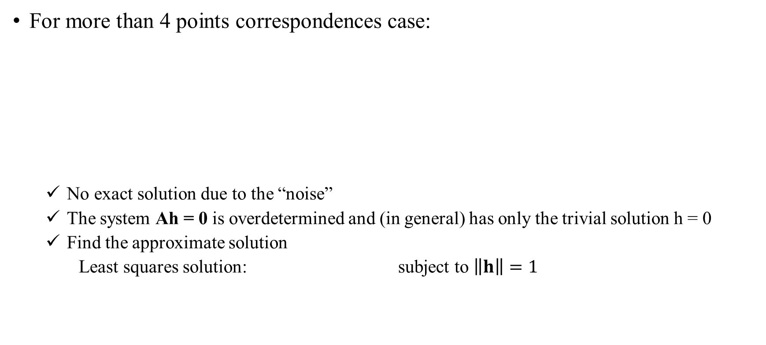
4. Estimation – 2D Projective Transformations
4.1 The Direct Linear Transformation (DLT) algorithm
4.1.1 Over-determined solution
For more than 4 points correspondences case:
No exact solution due to the “noise”
The system Ah = 0 is overdetermined and (in general) has only the trivial solution h = 0
Find the approximate solution
Least squares solution: subject to $\left\|h\right\|=1$
apply SVD: $A=UDV^{T}$
Matlab
[U, S, V] = svd(A);
h = V(:, end);
$$⟹$$
$h^{∗}=V_{smallest}$
The column of V corresponding to the smallest singular value
The last column of V
= (normed) eigenvector $A^{T}A$ with smallest eigenvalue

Slide 14
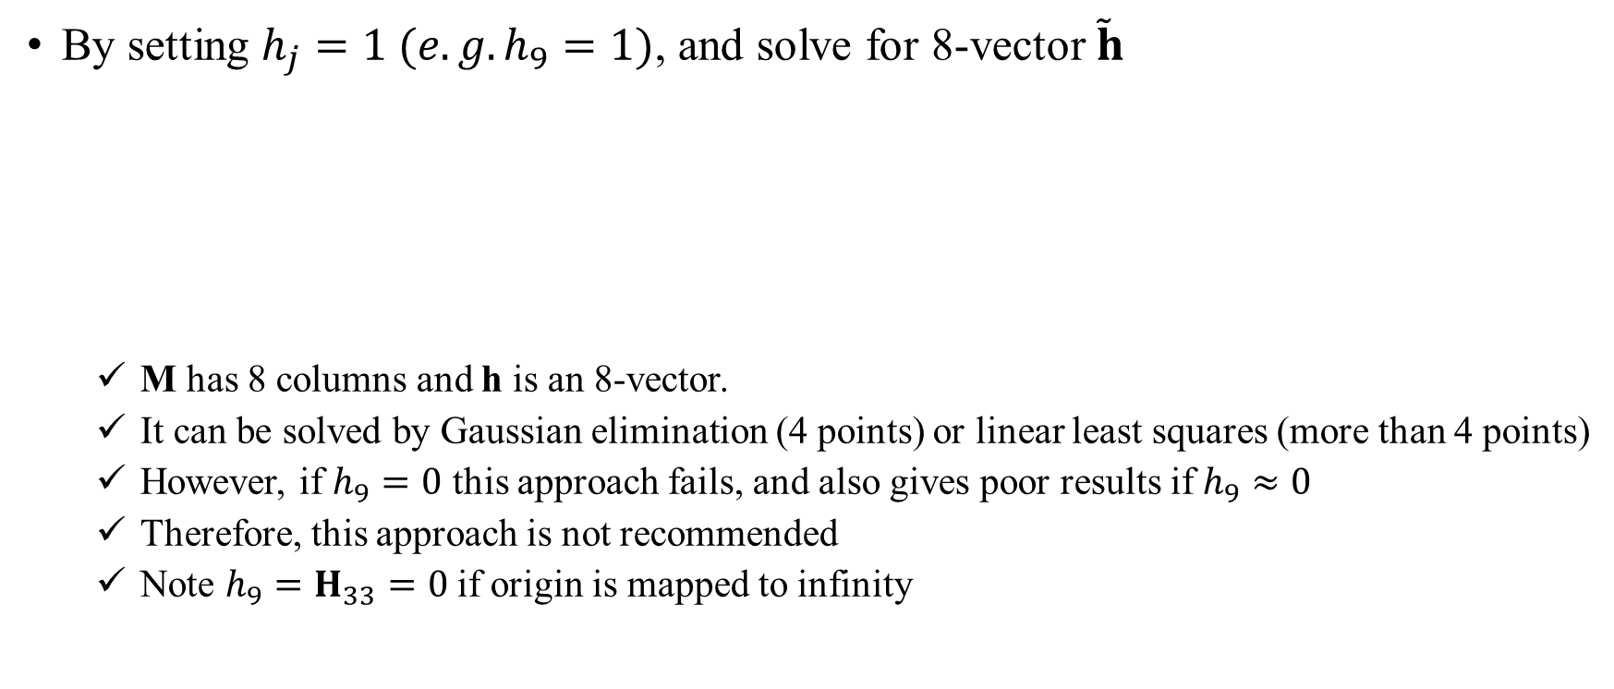
4. Estimation – 2D Projective Transformations
4.1 The Direct Linear Transformation (DLT) algorithm
4.1.2 Inhomogeneous solution
By setting $h_{j}=1 (e.g. h_{9}=1)$, and solve for 8-vector $\tilde{h}$
M has 8 columns and h is an 8-vector.
It can be solved by Gaussian elimination (4 points) or linear least squares (more than 4 points)
However, if $h_{9}=0$ this approach fails, and also gives poor results if $h_{9}≈0$
Therefore, this approach is not recommended
Note $h_{9}=H_{33}=0$ if origin is mapped to infinity

Slide 15
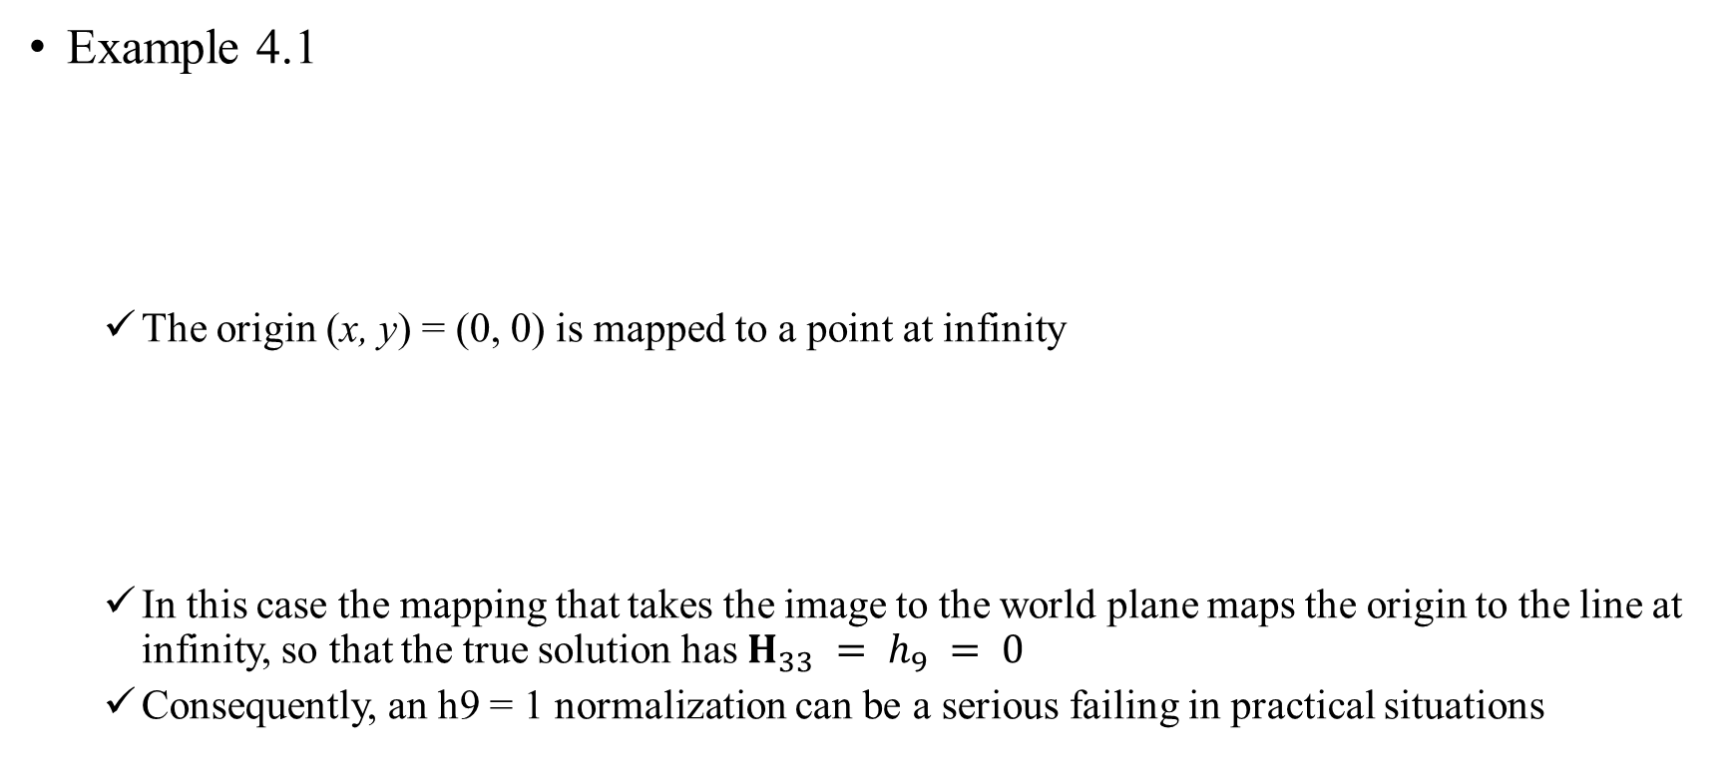
4. Estimation – 2D Projective Transformations
4.1 The Direct Linear Transformation (DLT) algorithm
4.1.2 Inhomogeneous solution
Example 4.1
The origin (x, y) = (0, 0) is mapped to a point at infinity
In this case the mapping that takes the image to the world plane maps the origin to the line at infinity, so that the true solution has $H_{33} = h_{9} = 0$
Consequently, an h9 = 1 normalization can be a serious failing in practical situations

Slide 16
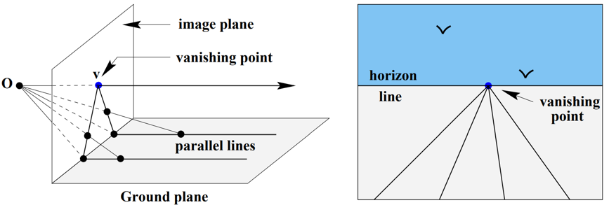
4. Estimation – 2D Projective Transformations
4.1 The Direct Linear Transformation (DLT) algorithm
4.1.2 Inhomogeneous solution
Example 4.1
O
(0, 0)

Slide 17


4. Estimation – 2D Projective Transformations
4.1 The Direct Linear Transformation (DLT) algorithm
4.1.3 Degenerate configurations
Case A
Case B
The homography is not sufficiently constrained
There will exist a family of homographies mapping $x_{i}$ to $x_{i}^{′}$
Projective transformation must preserve collinearity
There can be no transformation $H^{′}$ taking $x_{i}$ to $x_{i}^{′}$

Slide 18
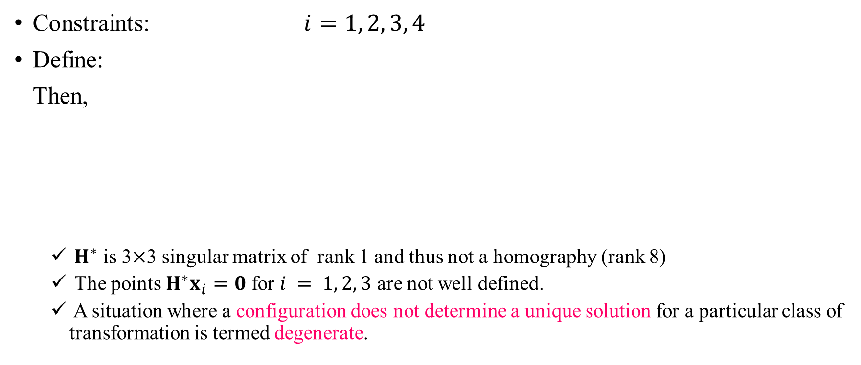
4. Estimation – 2D Projective Transformations
4.1 The Direct Linear Transformation (DLT) algorithm
4.1.3 Degenerate configurations
Constraints: $i=1, 2, 3, 4$
Define: Then,
$H^{∗}$ is 3$×$3 singular matrix of rank 1 and thus not a homography (rank 8)
The points $H^{∗}x_{i}=0$ for $i = 1, 2, 3$ are not well defined.
A situation where a configuration does not determine a unique solution for a particular class of transformation is termed degenerate.
case A
case B
8 equations are not independent

Slide 19
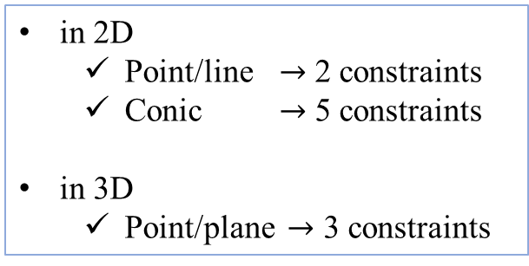
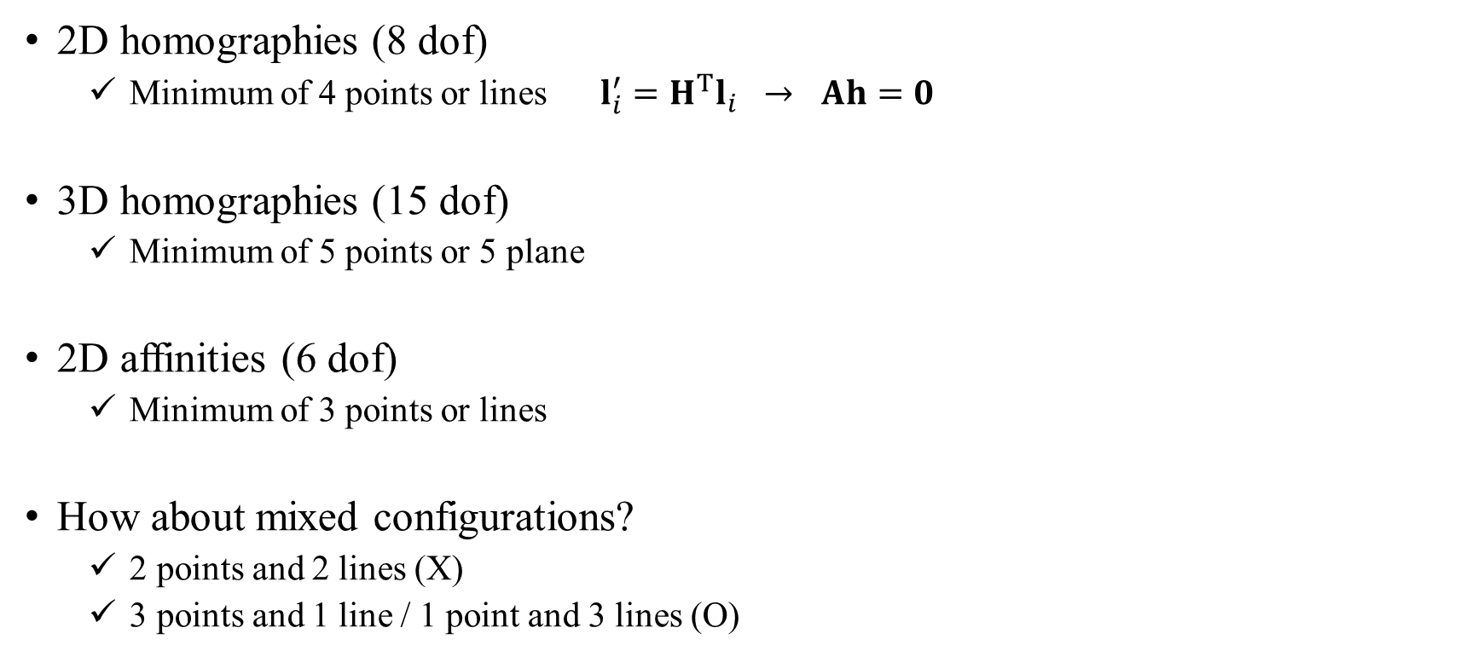
4. Estimation – 2D Projective Transformations
4.1 The Direct Linear Transformation (DLT) algorithm
4.1.4 Solutions from lines and other entities
2D homographies (8 dof)
Minimum of 4 points or lines $l_{i}^{′}=H^{T}l_{i}$ $→$ $Ah=0$
3D homographies (15 dof)
Minimum of 5 points or 5 plane
2D affinities (6 dof)
Minimum of 3 points or lines
How about mixed configurations?
2 points and 2 lines (X)
3 points and 1 line / 1 point and 3 lines (O)
in 2D
Point/line $→$ 2 constraints
Conic $→$ 5 constraints
in 3D
Point/plane $→$ 3 constraints

Slide 20
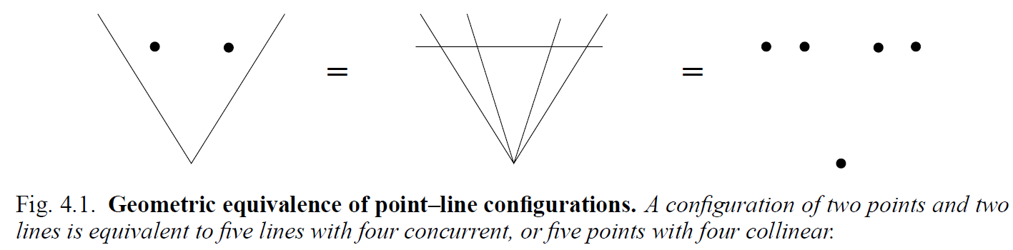
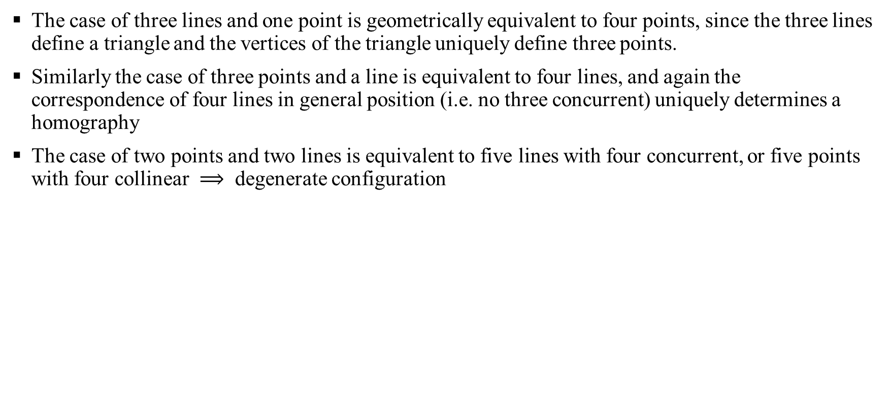
4. Estimation – 2D Projective Transformations
4.1 The Direct Linear Transformation (DLT) algorithm
4.1.4 Solutions from lines and other entities
The case of three lines and one point is geometrically equivalent to four points, since the three lines define a triangle and the vertices of the triangle uniquely define three points.
Similarly the case of three points and a line is equivalent to four lines, and again the correspondence of four lines in general position (i.e. no three concurrent) uniquely determines a homography
The case of two points and two lines is equivalent to five lines with four concurrent, or five points with four collinear $⟹$ degenerate configuration

Slide 21
4. Estimation – 2D Projective Transformations
4.2 Different cost functions
Cost functions which may be minimized in order to determine H for over-determined solutions
Algebraic distance
Geometric distance
Transfer error, Symmetric transfer error, Reprojection error
Sampson error

Slide 22
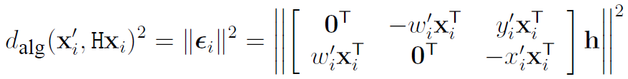

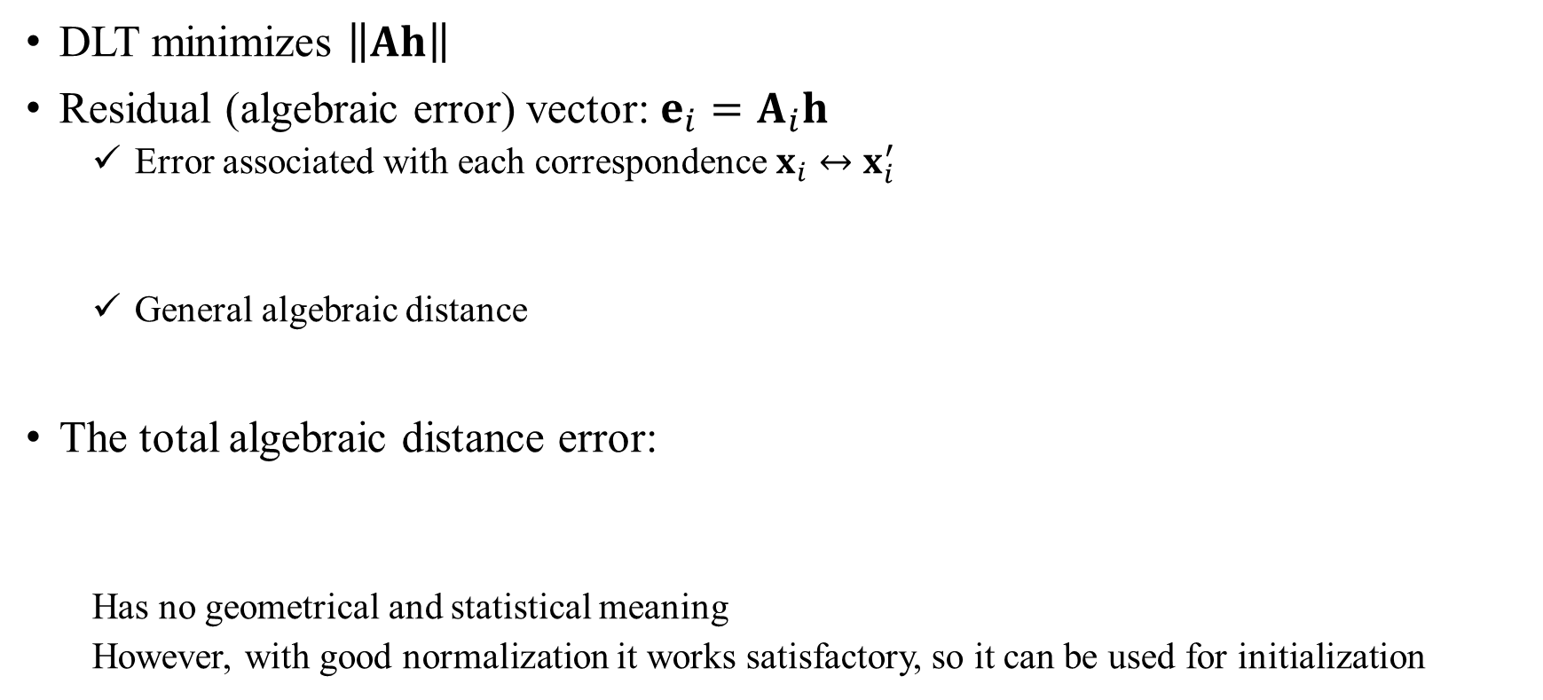
4. Estimation – 2D Projective Transformations
4.2 Different cost functions
4.2.1 Algebraic distance
DLT minimizes $\left\|Ah\right\|$
Residual (algebraic error) vector: $e_{i}=A_{i}h$
Error associated with each correspondence $x_{i}↔x_{i}^{′}$
General algebraic distance
The total algebraic distance error:
Has no geometrical and statistical meaning
However, with good normalization it works satisfactory, so it can be used for initialization
linear(unique) solution
computational cheapness

Slide 23

4. Estimation – 2D Projective Transformations
4.2 Different cost functions
4.2.2 Geometric distance
Transfer error (error in one image)
Symmetric transfer error (error in both images)
e.g. calibration pattern

Slide 24

4. Estimation – 2D Projective Transformations
4.2 Different cost functions
4.2.3 Reprojection error – both images
Reprojection error
Find $\hat{H}$ and pairs of perfectly matched points $\hat{x}$ and $\hat{x}′$ simultaneously
We wish to estimate a point on the world plane ${\hat{X}}_{i}$ from $x_{i} ↔x_{i}^{′}$ which is then reprojected to the estimated perfectly matched correspondence ${\hat{x}}_{i} ↔ {\hat{x}}_{i}^{′}$
estimatation
Reprojection

Slide 25
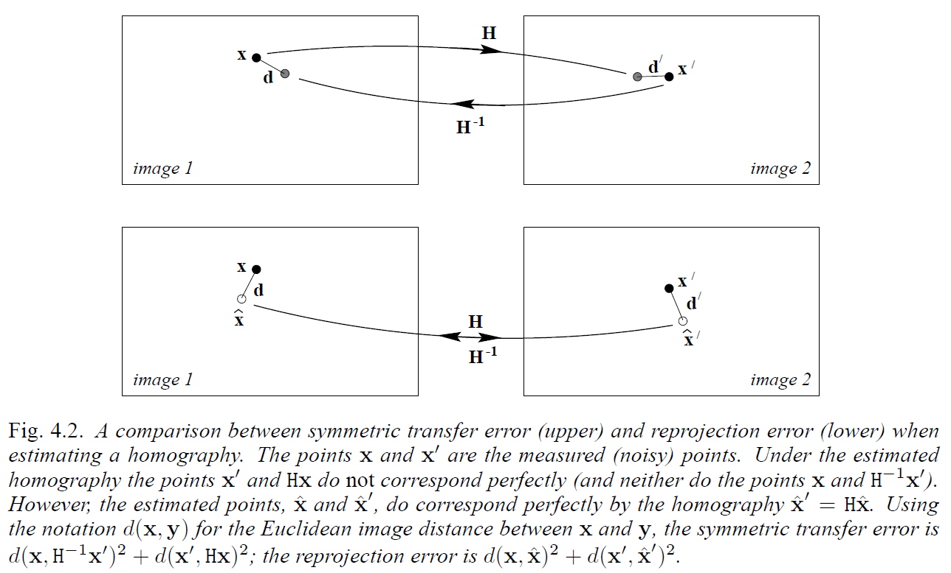


4. Estimation – 2D Projective Transformations
4.2 Different cost functions
4.2.3 Reprojection error – both images
Comparison of symmetric transfer error and reprojection error

Slide 26

4. Estimation – 2D Projective Transformations
4.2 Different cost functions
4.2.4 Comparison of geometric and algebraic distance
The algebraic error vector:
The geometric distance:
If $w_{i}=1$, then $w_{i}^{′}={\hat{w}}_{i}^{′}=1$,
Geometric distance is equal to algebraic distance
Example) 2D affine transform case

Slide 27
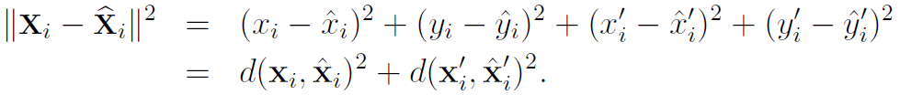


4. Estimation – 2D Projective Transformations
4.2 Different cost functions
4.2.5 Geometric interpretation of reprojection error
Estimating H is to fit surface $V_{H}$ to the measurement points, $X_{i}={\left(x_{i}, y_{i}, x_{i}^{′}, y_{i}^{′}\right)}^{T}$ in $ℝ^{4}$
Let ${\hat{X}}_{i}={\left({\hat{x}}_{i}, {\hat{y}}_{i}, {\hat{x}}_{i}^{′}, {\hat{y}}_{i}^{′}\right)}^{T}$ be the closest to $X_{i}$, then
= perpendicular distance
geometric distance in $ℝ^{4}$ is equivalent to reprojection error
∟

Slide 28

4. Estimation – 2D Projective Transformations
4.2 Different cost functions
4.2.6 Sampson error
The geometric error problem
Quite complex
Required the simultaneous estimation of both the homography matrix H and the point ${\hat{x}}_{i},{\hat{x}}_{i}^{′}$
Non-linear estmation

Slide 29
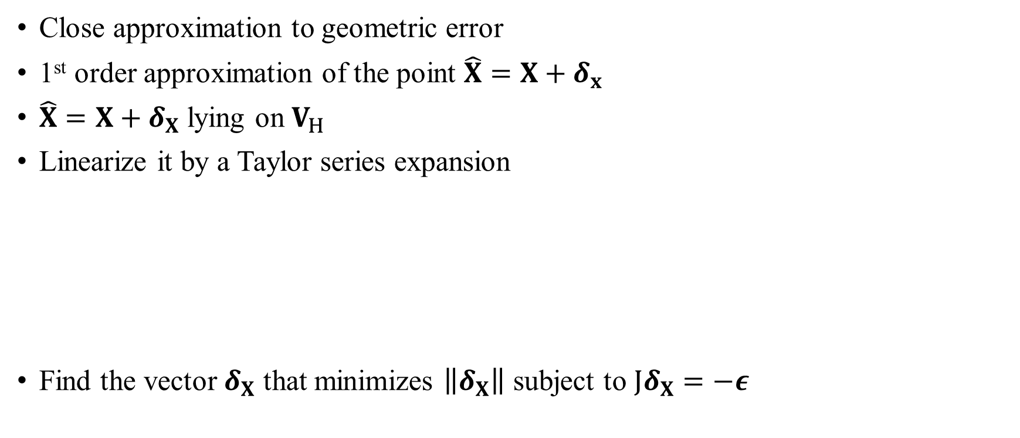

4. Estimation – 2D Projective Transformations
4.2 Different cost functions
4.2.6 Sampson error
$$X={\left(x,y,x^{′},y^{′}\right)}^{T}$$
Close approximation to geometric error
1st order approximation of the point $\hat{X}=X+δ_{x}$
$\hat{X}=X+δ_{X}$ lying on $V_{H}$
Linearize it by a Taylor series expansion
Find the vector $δ_{X}$ that minimizes $\left\|δ_{X}\right\|$ subject to $Jδ_{X}=−ε$

Slide 30

4. Estimation – 2D Projective Transformations
4.2 Different cost functions
4.2.6 Sampson error
Find the vector $δ_{X}$ that minimizes $\left\|δ_{X}\right\|$ subject to $Jδ_{X}=−ε$
Use of Lagrange method:
minimize

Slide 31
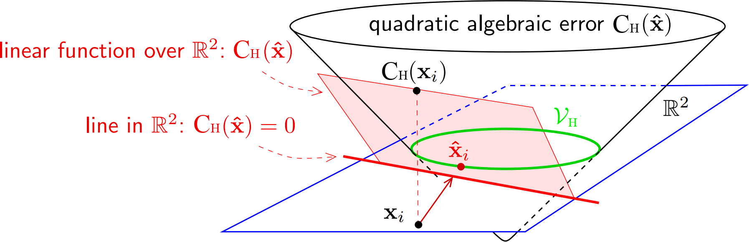
4. Estimation – 2D Projective Transformations
4.2 Different cost functions
4.2.6 Sampson error
not tangent to $V_{H}$ , outside!

Slide 32

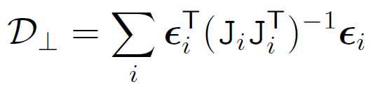

4. Estimation – 2D Projective Transformations
4.2 Different cost functions
4.2.6 Sampson error
Sampson error
Overall error
where $ε$ and $J$ both depend on H

Slide 33
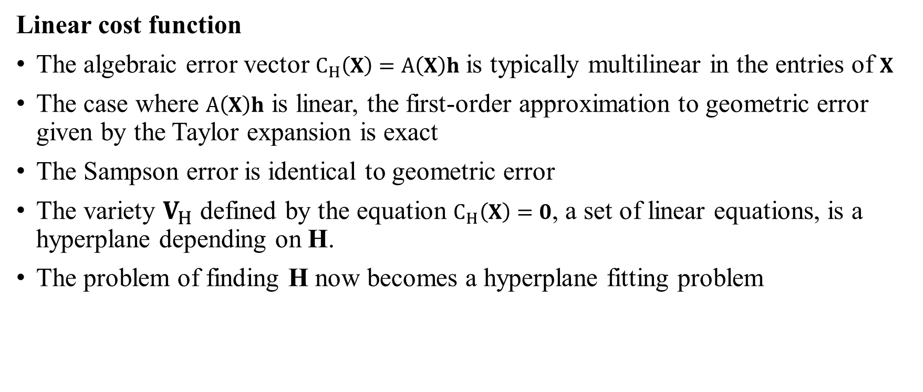
4. Estimation – 2D Projective Transformations
4.2 Different cost functions
4.2.6 Sampson error
Linear cost function
The algebraic error vector $C_{H}\left(X\right)=A\left(X\right)h$ is typically multilinear in the entries of $X$
The case where $A\left(X\right)h$ is linear, the first-order approximation to geometric error given by the Taylor expansion is exact
The Sampson error is identical to geometric error
The variety $V_{H}$ defined by the equation $C_{H}\left(X\right)=0$, a set of linear equations, is a hyperplane depending on H.
The problem of finding H now becomes a hyperplane fitting problem

Slide 34
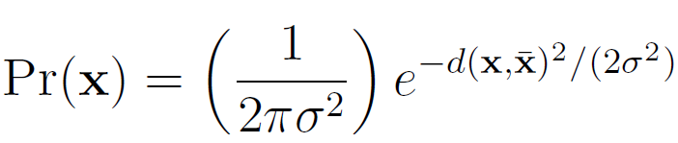
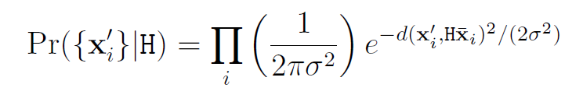





4. Estimation – 2D Projective Transformations
4.3 Statistical cost functions and Maximum Likelihood estimation
Assume that image measurement errors obey a zero-mean isotropic Gaussian distribution
The probability density function (PDF)
Error in one image
Log-likelihood
Maximum Likelihood Estimate (MLE) = maximize log-likelihood = minimize
Error in both images
Maximum Likelihood Estimate (MLE) = maximize log-likelihood = minimize
2

Slide 35


4. Estimation – 2D Projective Transformations
4.3 Statistical cost functions and Maximum Likelihood estimation
Mahalanobis distance
Consider non-isotropic Gaussian model
Density normalized distance
Maximizing the log-likelihood is then equivalent to minimizing the Mahalanobis distance
Error in one image
Error in both images
Varying covariance
cost function

Slide 36
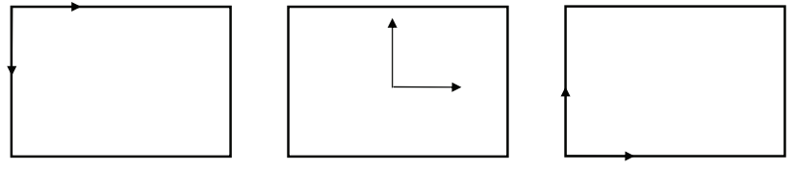
4. Estimation – 2D Projective Transformations
4.4 Transformation invariance and normalization
4.4.1 Invariance to image coordinate transformations
Let and , where and
e.g. Coordinate transformation

Slide 37
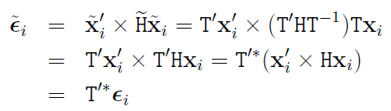
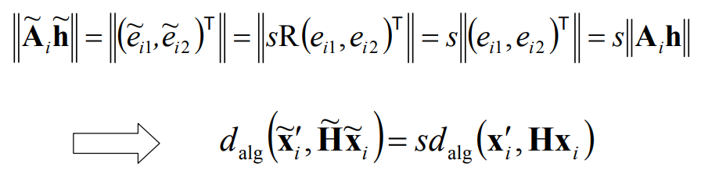
4. Estimation – 2D Projective Transformations
4.4 Transformation invariance and normalization
4.4.2 Non-invariance of the DLT algorithm
Let and , where and
Does the DLT algorithm applied to the correspondence set yield the transformation ?
special case
Effect of change of coordinates on algebraic error
similarity transform
projective transform

Slide 38
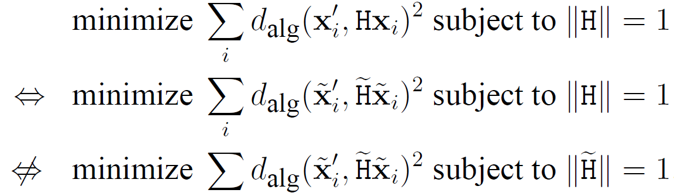
4. Estimation – 2D Projective Transformations
4.4 Transformation invariance and normalization
4.4.2 Non-invariance of the DLT algorithm

Slide 39

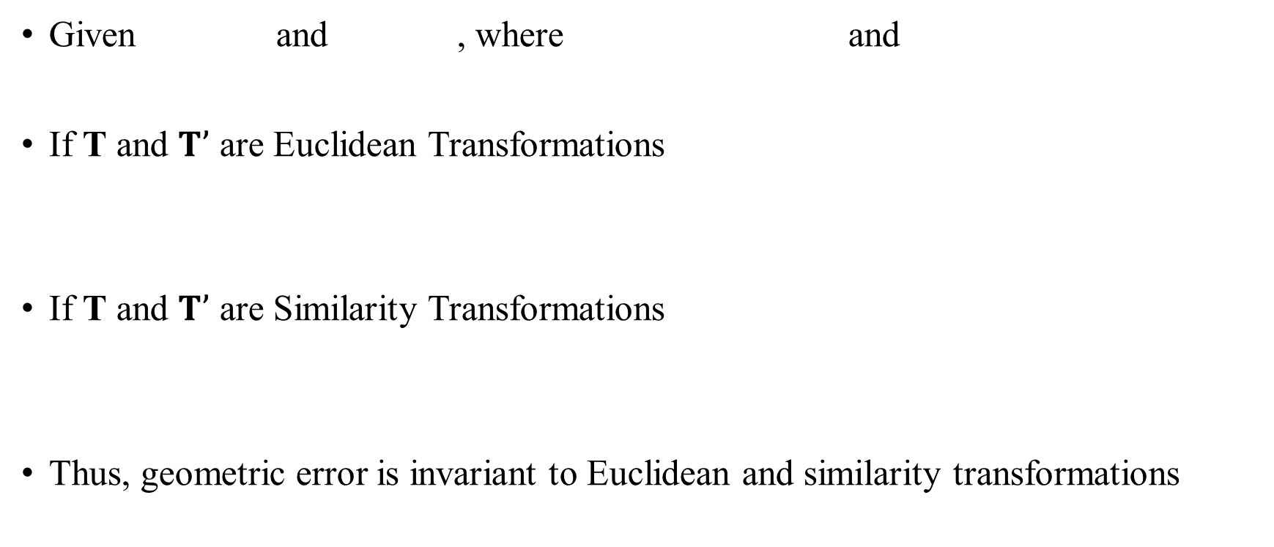
4. Estimation – 2D Projective Transformations
4.4 Transformation invariance and normalization
4.4.3 Invariance of geometric error
Given and , where and
If T and $T’$ are Euclidean Transformations
If T and $T’$ are Similarity Transformations
Thus, geometric error is invariant to Euclidean and similarity transformations

Slide 40
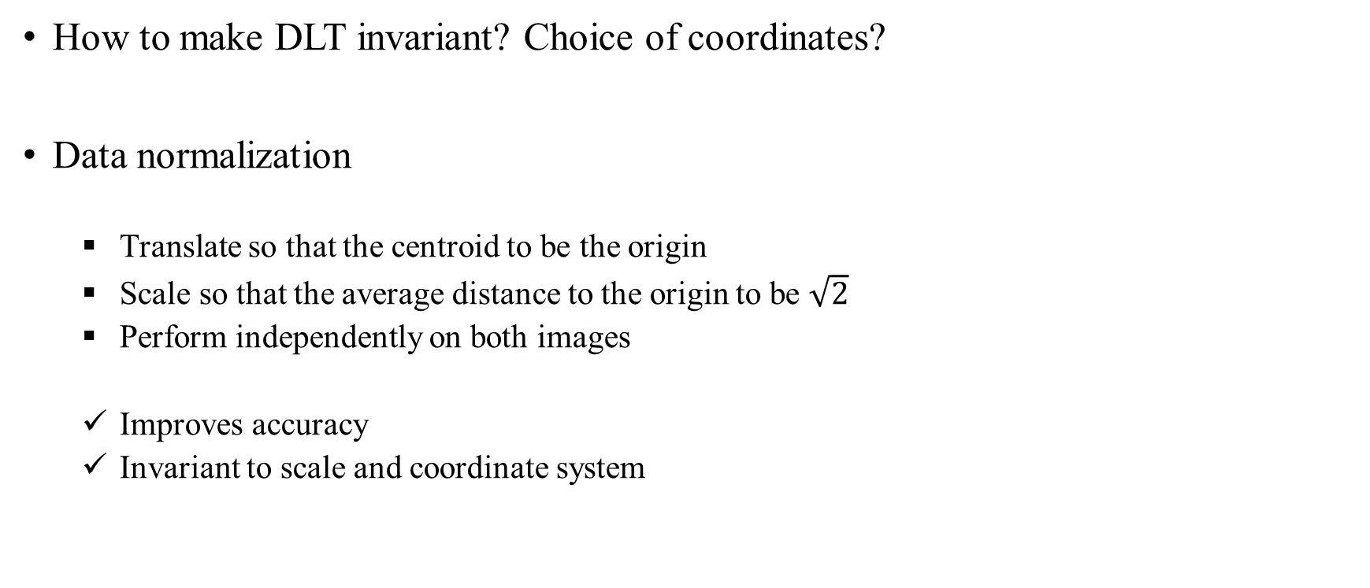
4. Estimation – 2D Projective Transformations
4.4 Transformation invariance and normalization
4.4.4 Normalizing transformations
How to make DLT invariant? Choice of coordinates?
Data normalization
Translate so that the centroid to be the origin
Scale so that the average distance to the origin to be $\sqrt{2}$
Perform independently on both images
Improves accuracy
Invariant to scale and coordinate system

Slide 41
4. Estimation – 2D Projective Transformations
4.5 Iterative minimization methods
minimizing the various geometric cost functions
iterative techniques
slower
initial estimate
local minimum
stopping criterion
Consequently, iterative techniques generally require more careful implementation
Step
Cost function: basis for minimization
Parametrization: finite number of parameters
Function specification: cost function expressed by parameters
Initialization: initial parameter estimate using DLT
Iteration: the parameters are iteratively refined with the goal of minimizing the cost function

Slide 42
4. Estimation – 2D Projective Transformations
4.5 Iterative minimization methods
Parametrization
Parameters should cover complete space and allow the estimation to be efficient
Minimal or over-parameterization e.g. 8 or 9
minimal parameterization gives often more complicate functions – local minima
good algorithms can deal with over-parameterization
So, it is not necessary to use minimal parameterization
Parameterization can also be sued to restrict transformation to particular class
e.g. homology

Slide 43
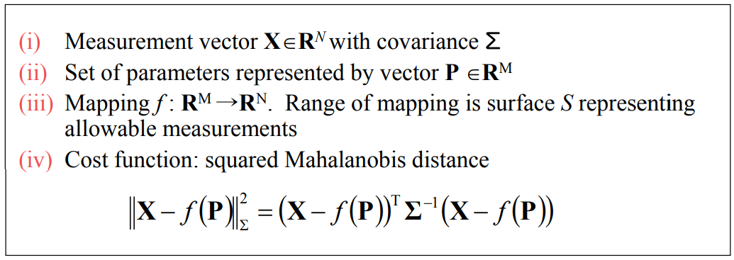
4. Estimation – 2D Projective Transformations
4.5 Iterative minimization methods
Function specification
The goal is to achieve P such that f (P) = X, or get as close as possible in terms of Mahalanobis distance

Slide 44
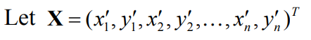


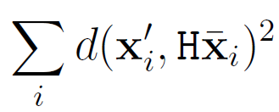
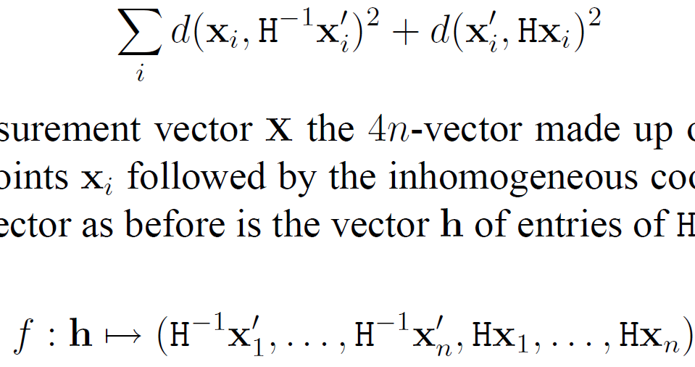


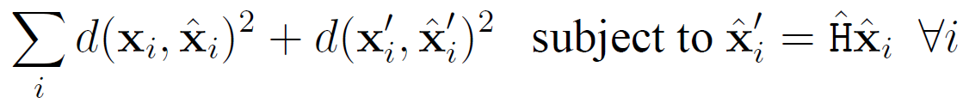
4. Estimation – 2D Projective Transformations
4.5 Iterative minimization methods
Error in one image
Symmetric transfer error
Reprojection error

Slide 45
4. Estimation – 2D Projective Transformations
4.5 Iterative minimization methods
Initialization
Good initialization is very important
Use linear solution (Normalized DLT) or random sampling (Robust algorithm), etc.
Dense sampling of parameter space
Fixed point in parameter space → often local minima

Slide 46
4. Estimation – 2D Projective Transformations
4.5 Iterative minimization methods
Iteration methods
For minimizing the chosen cost function
Newton iteration
Levenberg-Marquardt method
Powell’ method
Simplex method, etc.

Slide 47
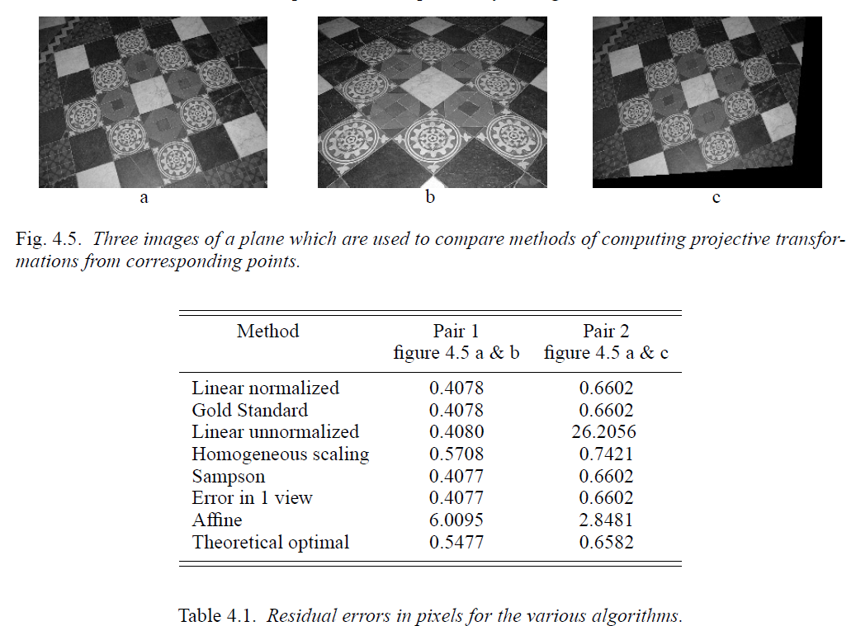
4. Estimation – 2D Projective Transformations
4.6 Experimental comparison of the algorithms

Slide 48
4. Estimation – 2D Projective Transformations
4.7 Robust estimation
4.7.1 RANSAC
How to determine inliers (discard outliers or mismatched correspondences) to estimate the homography robustly?
RANSAC (RAndom SAmple Consensus)
Consider a 2D line-fitting example
Select 2 points randomly – determine a line
Check the support points that lie within a distance threshold
The line with most support is the robust fit
$x^{′}=ax+b$ Estimation of 1D affine transform

Slide 49
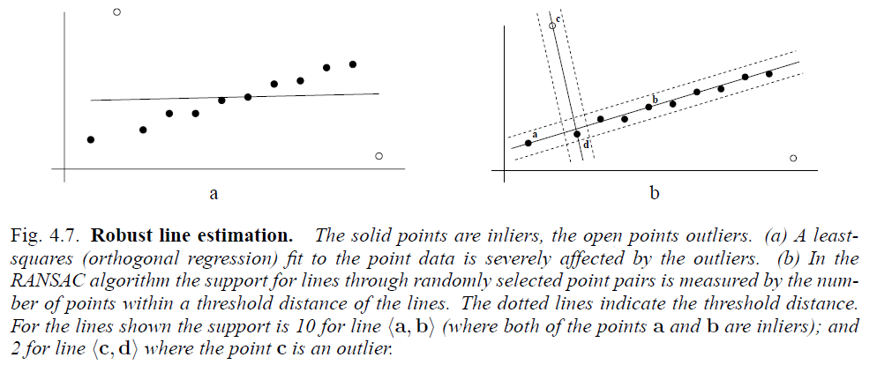
4. Estimation – 2D Projective Transformations
4.7 Robust estimation
4.7.1 RANSAC

Slide 50

4. Estimation – 2D Projective Transformations
4.7 Robust estimation
4.7.1 RANSAC

Slide 51







4. Estimation – 2D Projective Transformations
4.7 Robust estimation
chi-square distribution
$${\sum_{i=1}^{k}{\left(\frac{X_{i}−μ_{i}}{σ_{i}}\right)}}^{2}$$
4.7.1 RANSAC
What is the distance threshold?
Choose t so probability for inlier is α (e.g. 0.95)
If measurement error is Gaussian with zero mean and standard deviation $σ$
The squared of the point distance $d_{⊥}^{2}$ is sum of squared Gaussain variable
Follows a $χ_{m}^{2}$ distribution with m degrees of freedom (m = codimension)
Cumulative Distribution Probability
For Gaussian with $N(0, σ)$,

Slide 52




4. Estimation – 2D Projective Transformations
4.7 Robust estimation
4.7.1 RANSAC
How may samples?
Let p be the probability that at least one of the random samples of s points among N selection is free from outliers, and $ω$ be the probability that any selected point is an inlier
Ex 4.4) line fitting case $n=12, ε=\frac{2}{12}=\frac{1}{6}, s=2$ $⇒ N=5$

Slide 53

4. Estimation – 2D Projective Transformations
4.7 Robust estimation
4.7.1 RANSAC
How large is an acceptable consensus set?
Terminate when inlier ratio reaches expected ratio of inliers
For n data points, $T=\left(1−ε\right)n$
For the line fitting (fig 4.7) $ε=0.2$ → $T=\left(1−0.2\right)12=9.6⇒10$

Slide 54


4. Estimation – 2D Projective Transformations
4.7 Robust estimation
4.7.1 RANSAC
Determining the number of samples adaptively
$ε$ is often unknown, so pick the worst case, $ε$ = 0.5 and a consensus set with 80% of the data is found as inliers, then the updated estimate is $ε$ = 0.2

Slide 55



4. Estimation – 2D Projective Transformations
4.7 Robust estimation
4.7.2 Robust Maximum Likelihood estimation
The final step of the RANSAC algorithm is to re-estimate the model using all the inliers
minimizing a ML cost function
Iterative estimation
Optimal fit to inliers
Re-classify inliers
Iterate until no change
Robust cost function

Slide 56
4. Estimation – 2D Projective Transformations
4.7 Robust estimation
4.7.3 Other robust algorithm
RANSAC
Maximizes number of inliers
LMS (Least Median Squares) estimation
Minimizes the median error
Score the model by the median of the distances to all data
No threshold or prior knowledge of error variance
However, fails if more than half of the data is outlying
Use the proportion outliers to determine the distance
Not recommended
Case deletion
Iterative least-squares

Slide 57

4. Estimation – 2D Projective Transformations
4.8 Automatic computation of a homography

Slide 58
4. Estimation – 2D Projective Transformations
4.8 Automatic computation of a homography
Determining putative correspondences
Select corner points in each images
Match points using similarity measure (NCC, SSD, SAD, etc) symmetrically within a search region
RANSAC for homography
Distance measure
Symmetric transfer error
Reprojection error
Sampson error
Sample selection
Avoid degenerate samples (collinear ones)
Samples with good spatial distribution
Robust ML estimation (cycle approach)
Carry out ML estimation on inliers using Levenberg-Marquardt algorithm
Recompute the inliers using new H
Iterate cycle until converges

Slide 59

4. Estimation – 2D Projective Transformations
4.8 Automatic computation of a homography
(c, d) Interest points (500 / images)
(e) Putative correspondences (268)
(f) Outliers (117)
(g) Inliers (151)
(h) final set of correspondences (262)

