Slide 1
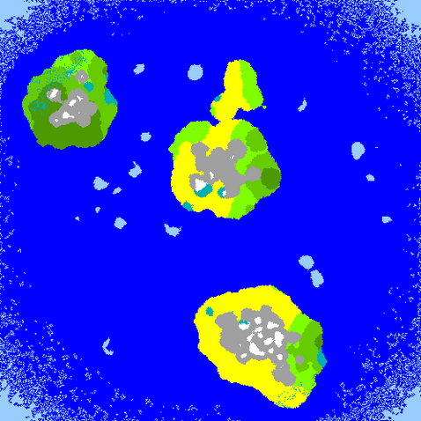
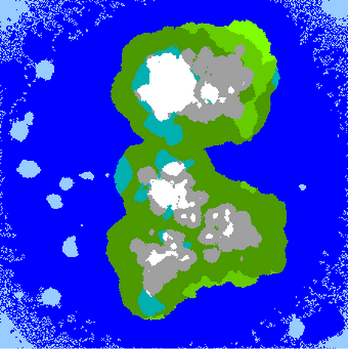
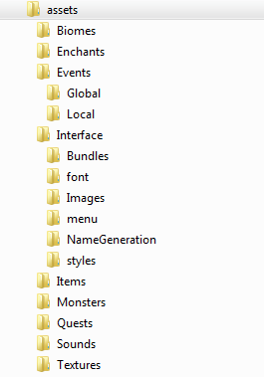
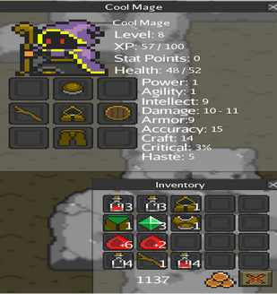
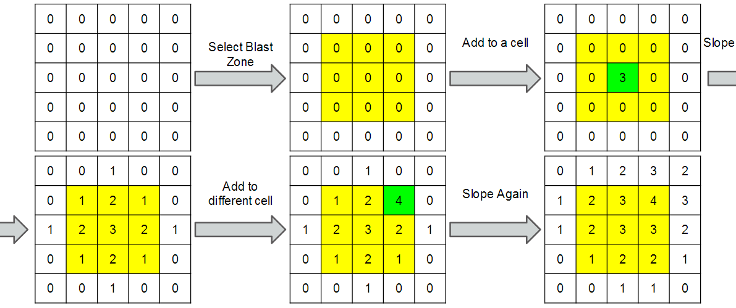
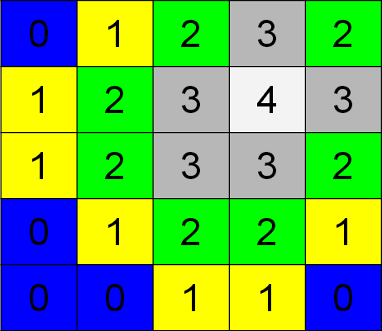
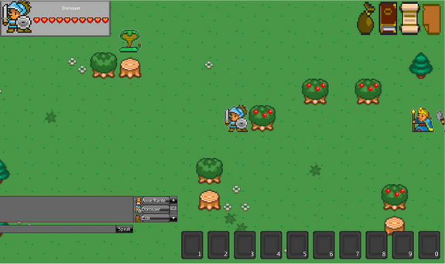
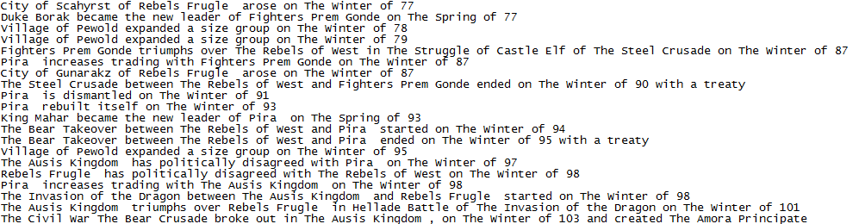
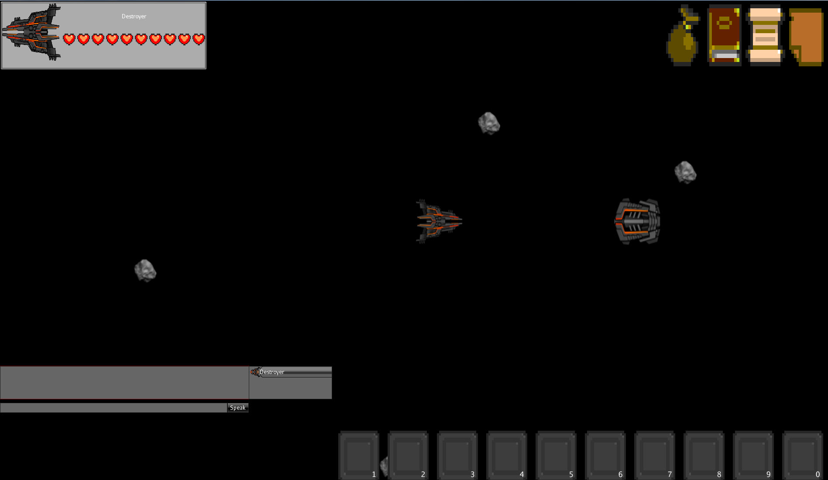

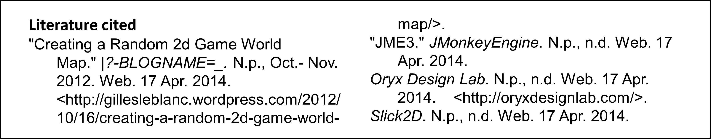
Christopher Hale
The Game
The Endless Expanse is a 2D Role Playing Game that focuses on increasing replay value through random generation of worlds.
The Endless Expanse creates random worlds, including history. Many aspects of the system can be customized by users.
Currently Developed in Java Monkey Engine 3, a shift towards Slick2D is in the works.
Random World Creation
Worlds are created in two steps: Macro and Micro. Macro is what applies to entire world, micro is a specific area.
Macro Terrain is created with Noise cannon. The steps to do this are blast a matrix with values, slope nearby values. Do this for height, precipitation, and temperature.
History is generated by having
events happen over periods of
time. These events are not
isolated, and can have
dependencies and can be
prevented from being a
dependency for other events.
Customizability
JSON, or JavaScript Object Notation, is how I save customizable data. JSON is stored in key/value pairs to save data is an easy to create and parse format.
Assets can be easily switched out in order to get an entirely new experience for the user.
Acknowledgments
XXXXXXXXXXX
XXXXXXXXXXX
Oryx Design Labs
jMonkey Engine 3
Further information
If you’d like to know more about the project, the best way to contact me is through my email:
XXXXXXXXXXXXXXXXXX
Notes:
Copyright Colin Purrington (http://colinpurrington.com/tips/academic/posterdesign).

