Slide 1
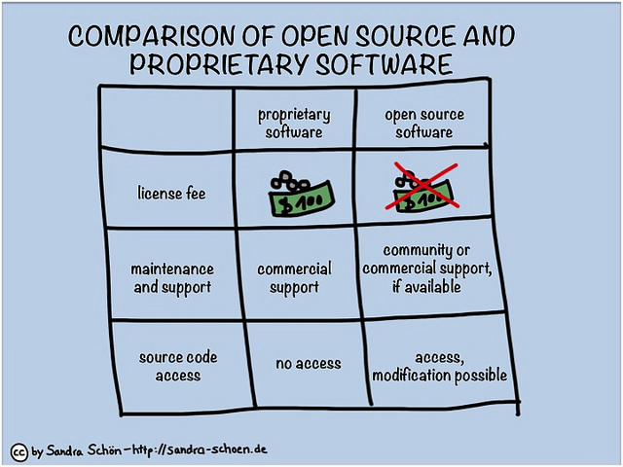
We went with the open-source openAI gym library for this project
an open-source toolkit for developing reinforcement learning task and agents
Large community support, great documentation, free
Other considered proprietary Alternative is Amazon Robomaker
a robotics simulation service that can also be used for training reinforcement learning agents using AWS cloud services
Main Drawbacks include cost, limited userbase and community creating lack of user generated content
Img source: http://www.differencebetween.net/technology/difference-between-open-source-and-proprietary-software/

