Slide 1
Group 3 Manual
Payroll Management System

Slide 2
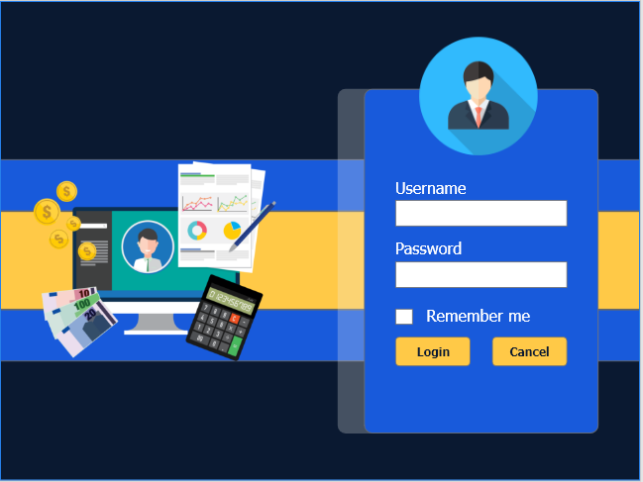
USER LOGIN FORM
Enter your provide Email
And provide Password

Slide 3
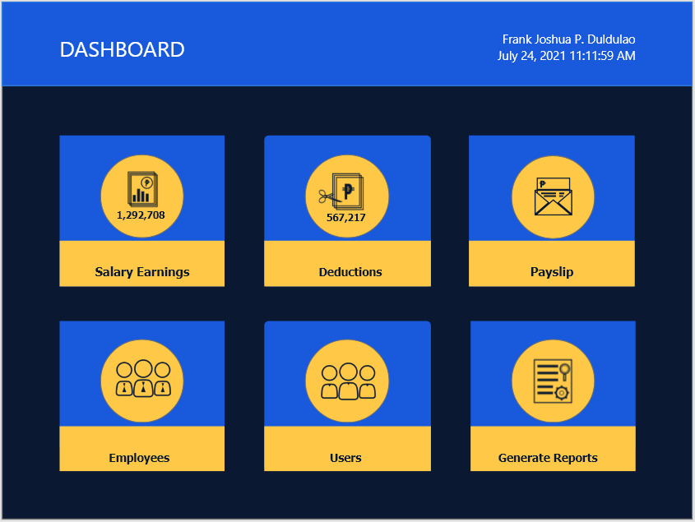
DASHBOARD
Offer a summarized view of the different
components of a system. They gather key
metrics from various components and present
them in a way that you can check at a glance.

Slide 4
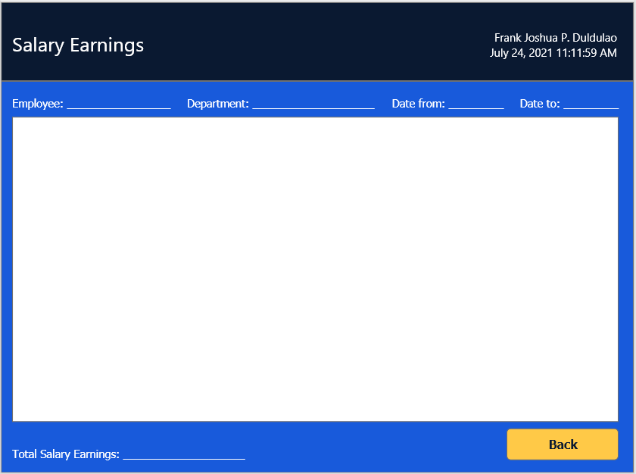
SALARY DATA INFORMATION
This area is viewing data
salary of the employee.

Slide 5
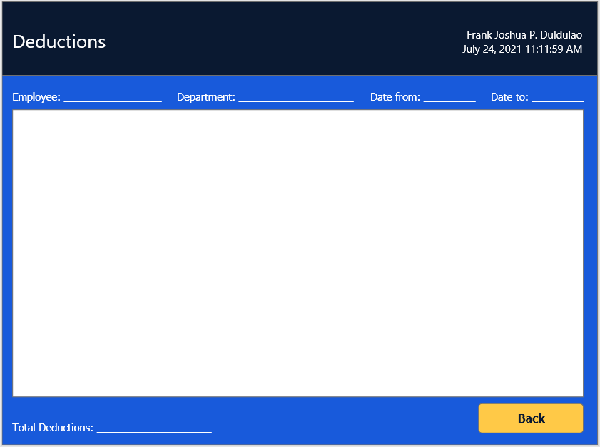
DEDUCTION DATA INFORMATION
This area is viewing the
deduction of the employee.
Ex.
Sss
Pag-Ibig fund
Philhealth

Slide 6
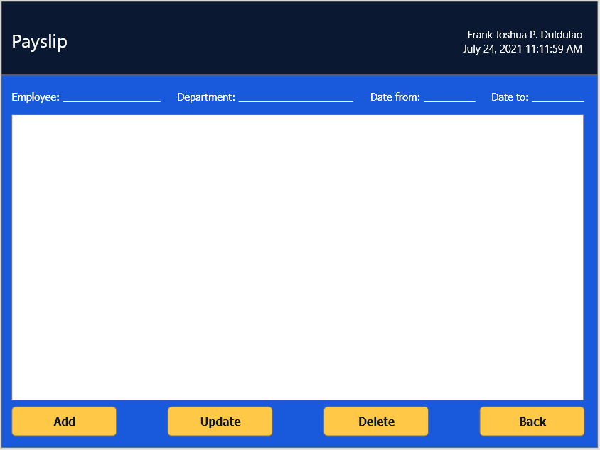
PAYSLIP DATA INFORMATION
This area is viewing and printing the monthly salary
of the employee.

Slide 7
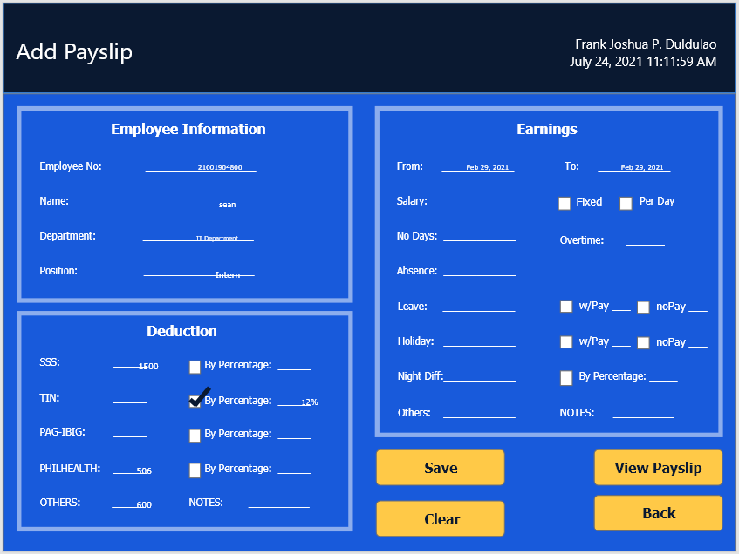
ADD PAYSLIP FORM
This tab is form table for adding data of employee for their monthly salary.

Slide 8
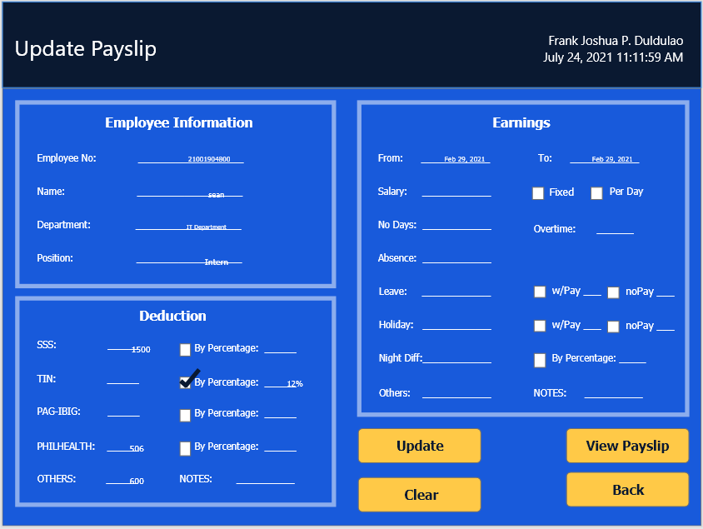
UPDATE PAYSLIP
This tab is form table Updating data of employee for their personal information.

Slide 9
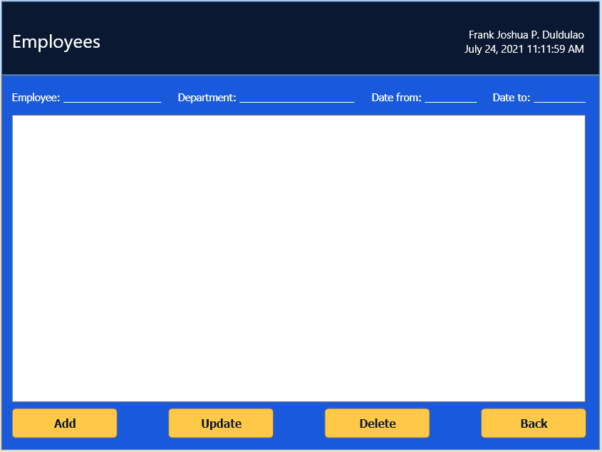
EMPLOYEE DATA
This area is viewing data information of the employee.

Slide 10
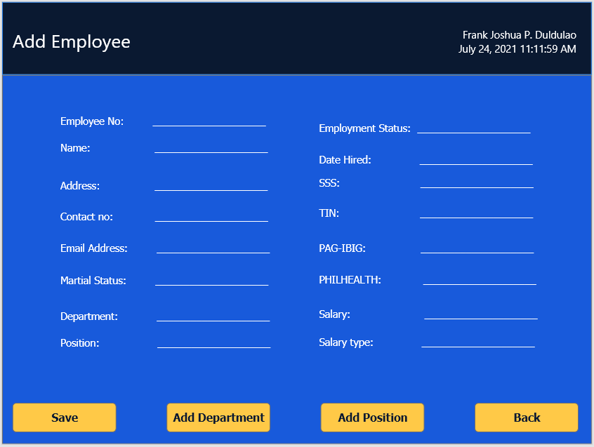
ADD EMPLOYEE
This tab is form table for adding data of of a new employee.

Slide 11
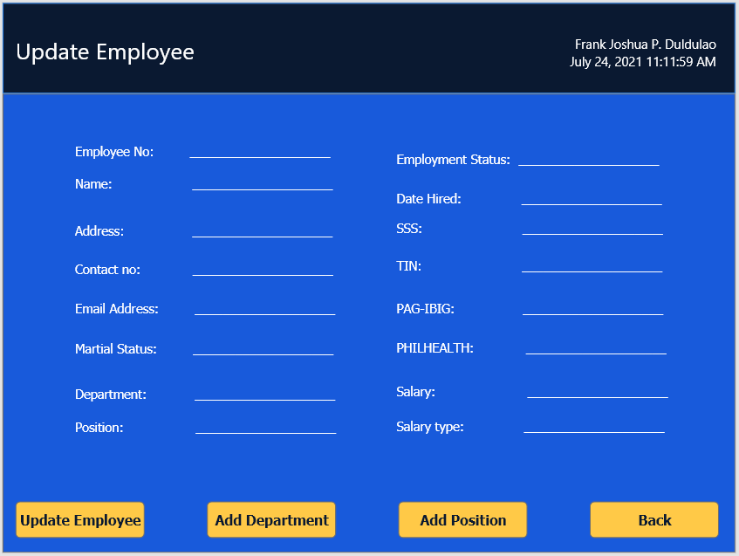
UPDATE EMPLOYEE
This tab is form table for updating data of
Of a employee.
Ex.
Promotion
Status
Address

Slide 12
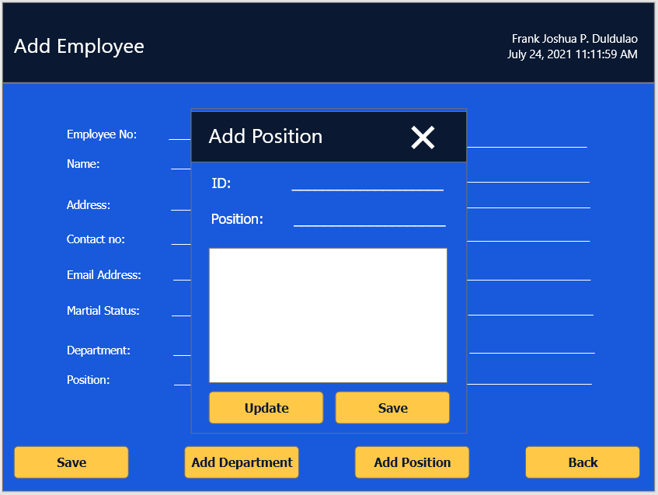
ADD POSITION
This tab is form table for adding new position or promotion of employee.

Slide 13
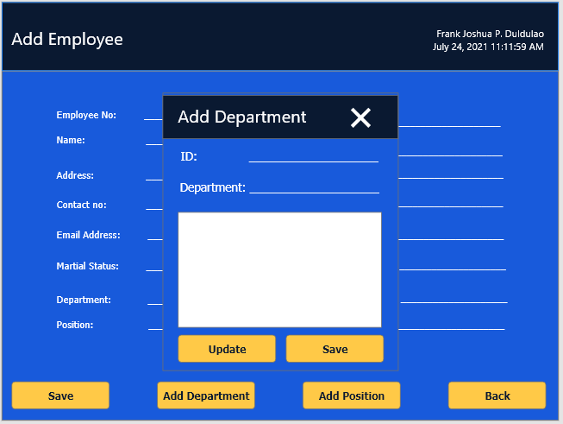
ADD DEPARTMENT
This tab is form table for adding new department for the new employee or transferred employee.

Slide 14
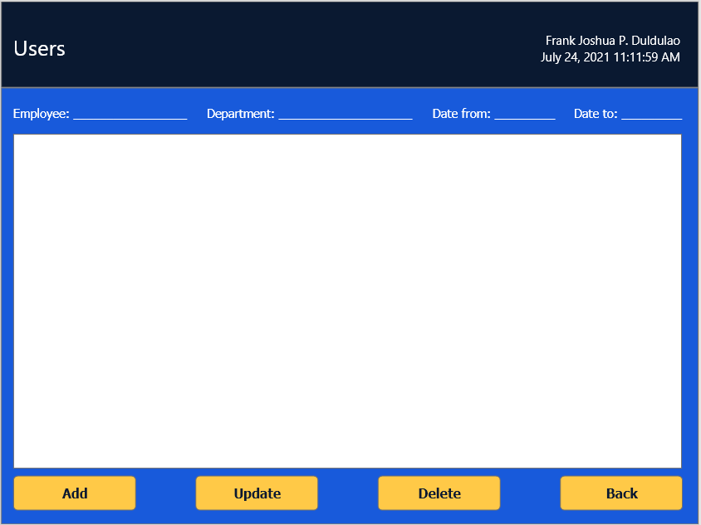
USERS
This area is viewing data information of the user of the payroll system.

Slide 15
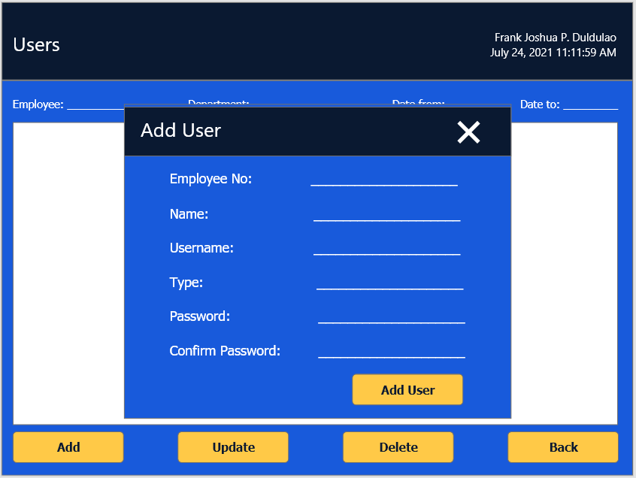
ADD USER
This tab is form table for adding data of
New user of the system.

Slide 16
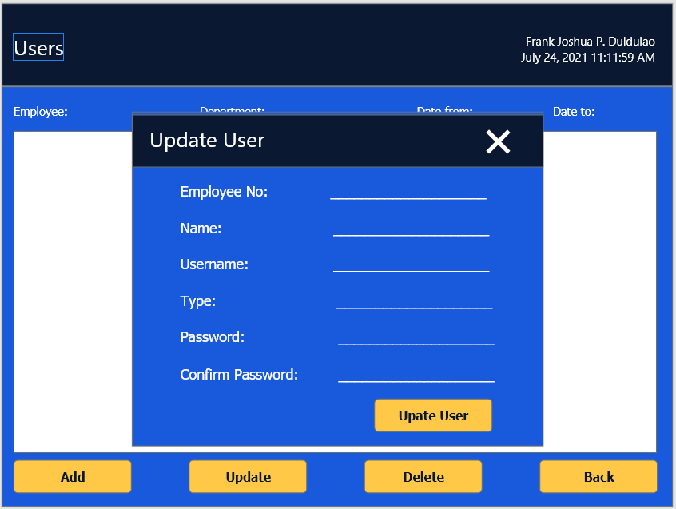
UPDATE USER
This tab is form table Updating data of user for their personal information.

Slide 17
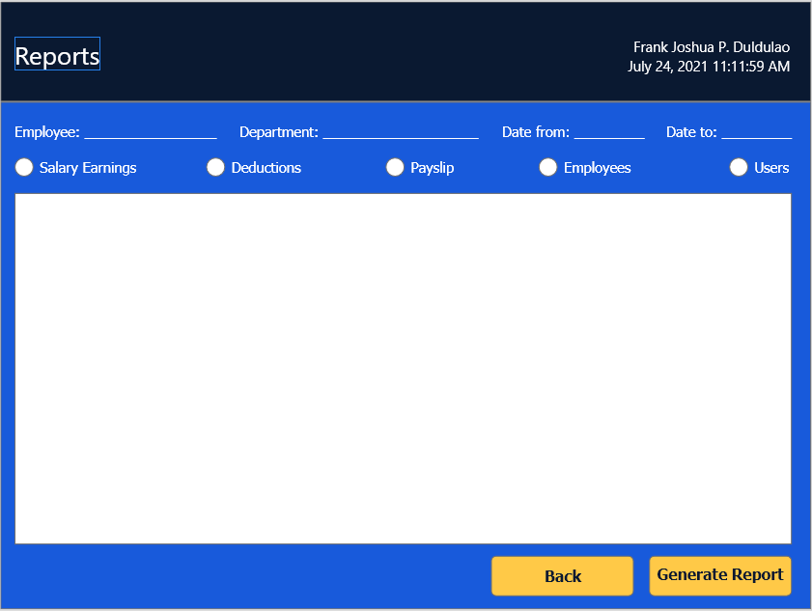
REPORTS
This area is viewing and printing the reports of the company.

Slide 18
Thank you

